Slide 1
Selected Topics in Designs and Methods
Ida Sim, MD, PhD
February 18, 2014
Division of General Internal Medicine, and
Graduate Group in Biological and Medical Informatics
UCSF
Copyright Ida Sim, 2014. All federal and state rights reserved for all original material presented in this course through any medium, including lecture or print.
Notes:
prospects for ehealth and ePCRN
if all data were “free” could ad hoc construct performance metrics as post-processing, not wired into data acquisition phase
http://content.nejm.org/cgi/content/full/NEJMsa0802005
OpenMRS
Medicine 2.0; n of 1? evidence farming
Health commons
20 percent of physician groups in Arizona are uninstalling HIT software, according to a June survey by HealthLeaders-InterStudy. In Britain, a $20 billion program to digitalize medicine across the National Health Service is five years behind schedule and heavily over budget.

Slide 2
Outline
Developing and evaluating technology
  agile participatory development
  evaluation designs
Using technology to ask new questions in new ways
Flipping the direction of research inference
Class summary

Slide 3
Mismatched "Metabolic Rate" of Technology and Evaluation
Riley et al. Clinical and Translational Medicine 2013, 2:10

Slide 4
Compare and Contrast
Develop idea and prototype on your own
Get it programmed
Pilot test on a small group of patients
Run an RCT
Years later, results are negative, technology is far advanced, and/or "everything's changed"
Participatory design
  develop idea and prototype with users and programmers
Mock up and test iteratively
Evaluate with increasing rigor
  qualitative
  observational
  interventional
Never stop developing, never stop testing, never stop evaluating

Slide 5
So you wanna build an app?
An app is not like a uni-dimensional therapeutic like a drug
  multi-modal (e.g., relaxation, education, information)
  reminders (e.g., text prompts, ringtones, calendar)
  rewards (e.g, leaderboard, badges, in-app purchases)
Different platforms yield different experiences
Many digital health interventions are behavioral (diet, exercise, stress, etc)
  life context (social network, work, physical environment) is very important and very variable

Slide 6
Challenges
Consumer expectations of software are high (the Apple effect)
  clunky, ugly software will not be used or be effective
Yet…scientific evaluation is needed to
  improve health, advance science
  secure financing
  secure sales and ongoing impact

Slide 7
Development Decisions
The “specs” (specifications)
  what is your system supposed to do? for whom? who will pay for/sustain it in the long run?
  what specific functions will it have?
  do use case scenarios (step-by-step, storyboards, etc)
Basic technical choices
  “form factor”: kiosk, desktop, laptop, notebook, tablet, phone…
  operating system (e.g., Mac vs PC, or Android vs iPhone vs mobile web)
    check browser and platform usage statistics
Find a developer
  external: contact Aenor Sawyer at Center for Digital Health Innovation for referrals and standard contracts
  internal: UCSF Mobile Services (being revamped) or Telemedicine
  see http://drupal.ucsf.edu/ for website development

Slide 8
User Interaction Design
The practice of designing interactive digital products
  more than user interface, is the whole user experience, i.e., how iPhone feels different than Android
User interaction design expertise
  e.g., http://www.coroflot.com/people - keyword=user interaction
  contact Beth Berrean BerreanB@MEDSCH.UCSF.EDU, UCSF Mobile Services
Participatory design
  involve your users in design right from the beginning
  e.g., test out different data visualizations at IBM's ManyEyes or Visualizing.org

Slide 9
Agile Rapid Cycle Field Testing
Qualitative tests
  surveys, interviews, video recordings, “talk-aloud protocols”
Quantitative tests
  user analytics
    track app launches, clicks, dwells, scrolls, links to web and back…e.g., Flurry.com
  A/B testing
    Google launched 450 search engine improvements in 2007, each one tested rigorously through real-time user analytics

Slide 10
A/B testing example
Identify part of the system for testing (e.g., video vs. pictures of proper inhaler use)
Randomly assign each person landing on the screen to video or pictures
Test for comprehension with a short survey
Compare % correct answers, set “stopping rule,” run study until answer clear or test is over
Can run multiple embedded user interaction RCTs to optimize design features in parallel, e.g.,
  different motivational wording
  different reward levels

Slide 11
Participatory Development and
Evaluation Cycle
Requirements & Specifications
Storyboards & Wireframes
Alpha Prototype
Beta Prototype
Released Version
Informaticist/Developer/Ethnographer
User Interaction Designer/Developer
Developer/UX Designer/Ethnographer
Usability Testing
A/B testing
Focus groups
Talk Aloud Protocols
Field pilot
Video observations
Interventional study

Slide 12
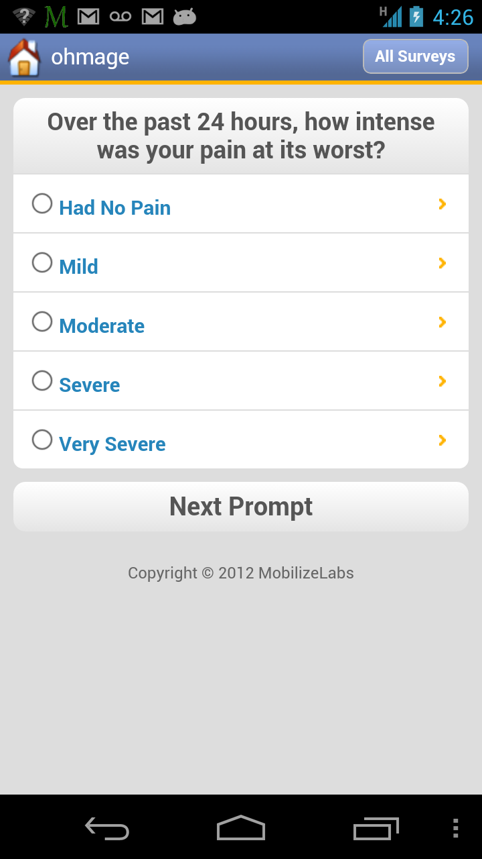
Example: Trialist App
PREEMPT Study: app for chronic pain monitoring and testing
Developed with clinicians, statistician, designer, programmer
Clinician and patient focus groups
  wording, navigation, functionality (e.g., reminders)
Redid over 3 cycles
Pilot to start 1 year in

Slide 13
Outline
Developing and evaluating technology
  agile participatory development
  evaluation designs
Using technology to ask new questions in new ways
Flipping the direction of research inference
Class summary

Slide 14
How Good is Dr. Watson?
at best, the correct answer appeared in the top 10 suggestions 77% of the time
evaluate like a diagnostic test, or like information retrieval
  FP, FN, TP, TN
  precision/recall
http://www.sciencedirect.com/science/article/pii/S0004370212000872

Slide 15
What do the results mean?
Watson tested only on diagnosis, e.g.,
  The syndrome characterized by joint pain, abdominal pain, palpable purpura, and a nephritic sediment. Answer: Henoch–Schonlein purpura.
  Familial adenomatous polyposis is caused by mutations of this gene. Answer: APC gene.
  The syndrome characterized by narrowing of the extra-hepatic bile duct from mechanical compression by a gallstone impacted in the cystic duct. Answer: Mirizzi’s syndrome.
How can Watson be evaluated/audited?
  "your request for surgery is denied based on 57,232 cases like yours" – but you have no access to training set, algorithm, or source code

Slide 16
‘Map’ of (Quasi)-Experimental Designs
RANDOMIZED DESIGNS* 1. Individual-patient randomized controlled trials 2. Cluster randomized trials
SEMI or NON-RANDOMIZED DESIGNS 1. Stepped Wedge Design (Wait-list design) 2. Time Series Design 3. Controlled/Uncontrolled Before and After Design 4. Other designs * Presented in order of methodological strength
From E Fan et al, How to use an article about quality improvement, JAMA 2010
Slide courtesy of Margaret Handley, UCSF
Notes:
16
QI research often focuses on getting doctors to change behavior to implement the intervention that was proven efficacious in RCT at patient level and to evaluate success using existing data- so often not called ‘research’.
While you can rank these for strength of design, context will also affect the choice- wrong design yet best ranked, may end up with wrong population or worse

Slide 17
Issues to Consider
Intervention can't be rolled out all at the same time
  e.g., EHR roll out, limited $ for online chat staffing, one team of anti-smoking counsellors
"More good than harm" interventions
  where unethical to randomize to no intervention, or to withdraw intervention in a crossover design
  e.g., EHR?
Temporal trends may confound
  e.g., change in reimbursement policies

Slide 18
Stepped Wedge Design
http://www.biomedcentral.com/1471-2288/6/54
Notes:
randomly assigned to row
- esp good for more good than harm (e.g., EHR) where everyone gets the intervention in the end (unethical not to let them use it)

Slide 19
More issues to Consider
Randomization is powerful but
  is expensive, logistically challenging to implement
  requires yielding treatment decision to chance
  assumes clinical equipoise
E.g., screening, enrolling, consenting, randomizing hundreds of patients to diabetes drug A vs. B may be too much hassle to do

Slide 20
Prompted Optional Randomized Trial
If enough docs switch when prompted, known and unknown confounders are washed out
  i.e., lower precision can be overcome with larger sample size
Prompt is an instrumental variable
  quite strongly associated with treatment assignment
  not directly associated with outcome of interest
  not associated with potential confounding variables
Flory, Karlawish. Am J Public Health.
2012;102:e8–e10. doi:10.
2105/AJPH.2012.301036

Slide 21
Outline
Developing and evaluating technology
  agile participatory development
  new study designs
Using technology to ask new questions in new ways
Flipping the direction of research inference
Class summary

Slide 22
New Questions/New Ways
What's the prevalence, natural hx, risk prediction etc. even of rare diseases?
Population-level efficacy and effectiveness
  for endpoints, not only intermediate outcomes
  for patient-centered outcomes (symptoms, side effects)
How to promote and sustain behavior change
Heterogeneity of treatment effect/Therapeutic precision
  best therapy for this patient
  learning from but not constrained by prior experience
Notes:
Generalizing beyond technology evaluation

Slide 23
Note on Sample Size
Since incremental cost of digital interventions are often negligible, less pressure to minimize sample size
  not unusual to get large samples (>10,000)
Large sample size can wash out random error
But high sample size ≠ high accuracy!
  may be precise (p < 0.05) but inaccurate if sample is non-representative

Slide 24
Non-interventional Study Designs
Cross-sectional: e.g., to assess prevalence, e.g.,
  city-wide text question for flu symptoms
  community-wide depression using Twitter data
Prospective cohort (like disease registries), e.g.,
  huge curated disease registries, e.g., 1 million Health eHeart
  crowdsourced, e.g., PatientsLikeMe, Health eHeart
Retrospective case control, e.g.,
  EHR data, e.g., anti-coagulation for pedi lupus, nephrosis and anti-phospholipid antibiodies
Simulation, multivariate modeling, causal modeling, data-driven machine learning
  e.g., Bayesian model of pressure ulcer risk using EHR data (Cho, 2013)

Slide 25
New Questions
What's the prevalence, natural hx, risk prediction, etc. even of rare diseases?
Population-level efficacy and effectiveness
  for endpoints, not only intermediate outcomes
  for patient-centered outcomes (symptoms, side effects)
How to promote and sustain behavior change
Therapeutic precision (best therapy for this patient)
    learning from but not constrained by prior experience

Slide 26
rephrasing ‘does it work?’
(Complexes of) Exposures
Outcome
strength of association?
anti-depressant
mood
individual
population
Notes:
Statistically, this is asking about the strength of association between being "exposed" to oxycodone or percocet, say, and some outcome we care about, like pain relief.
We can ask whether oxycodone works at the population level or whether it works for an individual (does it work for me).

Slide 27
which works better: Zoloft or Prozac?
Zoloft
Mood, social activity
100 people
50 people
Prozac
Mood, social activity
50 people
population
Notes:
27
The standard thing to do would be to run an RCT, and we will see on average if oxycodone works better than say Percocet.
The problem though is that none of us are average.

Slide 28
Interventional Designs
Recruited from within the health care system
  pragmatic studies with patient-centered outcomes, e.g., PCORI
  point-of-care trials: e.g., Fiore on insulin per SS vs. weight
  randomized registry trial: piggybacking the TASTE RCT on "an already existing high-quality observational registry"
Recruited from outside the health care system
  large-scale Internet-based interventions: e.g., StopSmoking.ucsf.edu 131,157 visits from 121 countries
  patient-driven: e.g., uncontrolled prospective cohort study on lithium for ALS, by PatientsLikeMe community
  through research platforms, e.g., Propeller Health for asthma

Slide 29
New Questions/New Ways
What's the prevalence, natural hx, risk prediction, etc. even of rare diseases?
Population-level efficacy and effectiveness
  for endpoints, not only intermediate outcomes
  for patient-centered outcomes (symptoms, side effects)
How to promote and sustain behavior change
Therapeutic precision (best therapy for this patient)
  learning from but not constrained by prior experience

Slide 30
Behavior change frameworks …
Allow one to
Identify and understand the target behaviour/s in context
Apply a theoretical framework to deepen understanding
Consider full range of possible intervention functions
Identify specific behaviour change techniques
Slides courtesy of Professor Susan Michie, University College London

Slide 31
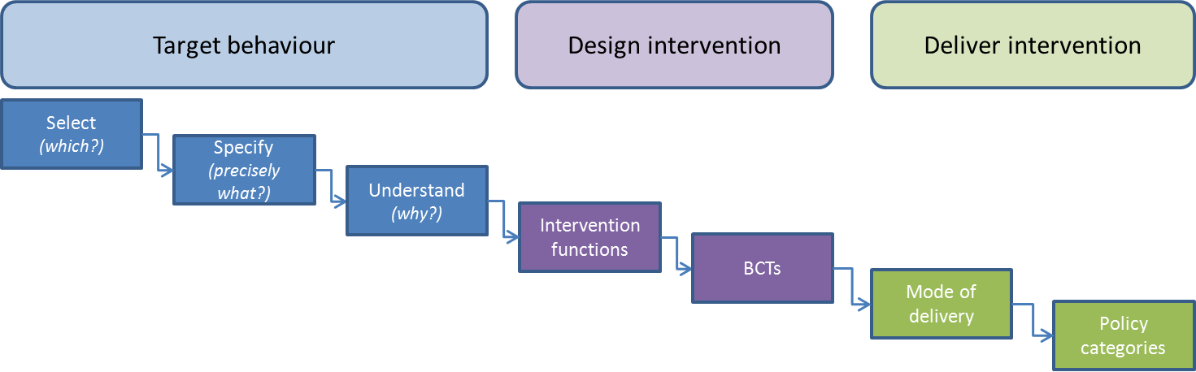
An approach to developing KT interventions

Slide 32




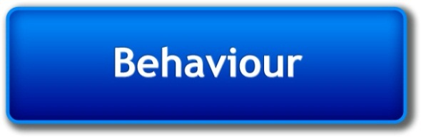




The COM-B system: Behaviour occurs as an interaction between three necessary conditions
Psychological or physical ability to enact the behaviour
Reflective and automatic mechanisms that activate or inhibit behaviour
Physical and social environment that enables the behaviour
Michie et al (2011) Implementation Science

Slide 33
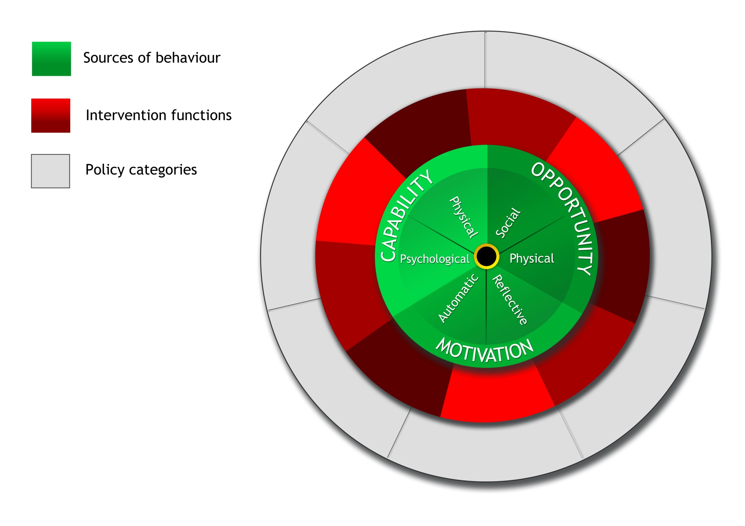
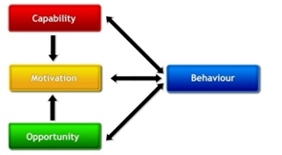
Behaviour at the hub …. COM-B
Behaviour at the hub …. COM-B
Notes:
33

Slide 34
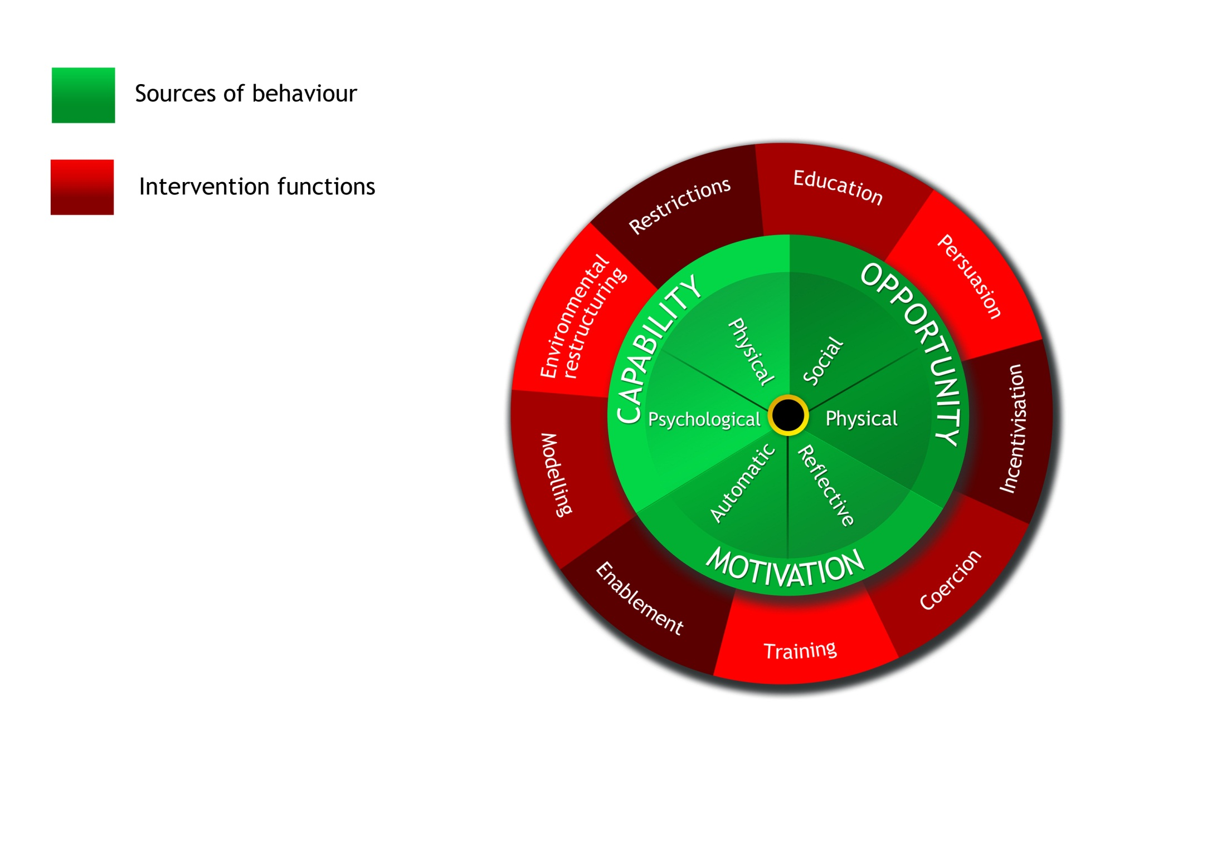
Interventions
Interventions: activities designed to change behaviours

Slide 35
Intervention functions
Intervention function | Definition | Example
Education | Increasing knowledge or understanding | Providing information to promote healthy eating
Persuasion | Using communication to induce positive or negative feelings or stimulate action | Using imagery to motivate increases in physical activity
Incentivisation | Creating expectation of reward | Using prize draws to induce attempts to stop smoking
Coercion | Creating expectation of punishment or cost | Raising the financial cost to reduce excessive alcohol consumption
Training | Imparting skills | Advanced driver training to increase safe driving
Restriction | Using rules that limit engagement in the target behaviour or competing or supporting behaviour | Prohibiting sales of solvents to people under 18 to reduce use for intoxication
Environmental restructuring | Changing the physical or social context | Providing on-screen prompts for GPs to ask about smoking behaviour
Modelling | Providing an example for people to aspire to or imitate | Using TV drama scenes involving safe-sex practices to increase condom use
Enablement | Increasing means/reducing barriers to increase capability or opportunity | Behavioural support for smoking cessation, medication for cognitive deficits, surgery to reduce obesity, prostheses to promote physical activity
Notes:
As talk through say these were the results of SR

Slide 36
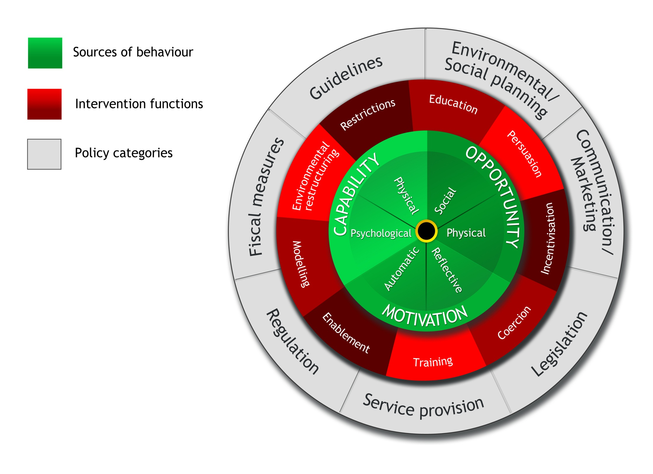
Intervention functions
Policies
Policies: decisions made by authorities concerning interventions
Michie et al (2011) The Behaviour Change Wheel: a new method for characterising and designing behaviour change interventions Implementation Science

Slide 37
Policy categories
Policy category | Example | Example
Communication/ marketing | Using print, electronic, telephonic or broadcast media | Conducting mass media campaigns
Guidelines | Creating documents that recommend or mandate practice. This includes all changes to service provision | Producing and disseminating treatment protocols
Fiscal | Using the tax system to reduce or increase the financial cost | Increasing duty or increasing anti-smuggling activities
Regulation | Establishing rules or principles of behaviour or practice | Establishing voluntary agreements on advertising
Legislation | Making or changing laws | Prohibiting sale or use
Environmental/ social planning | Designing and/or controlling the physical or social environment | Using town planning
Service provision | Delivering a service | Establishing support services in workplaces, communities etc.

Slide 38
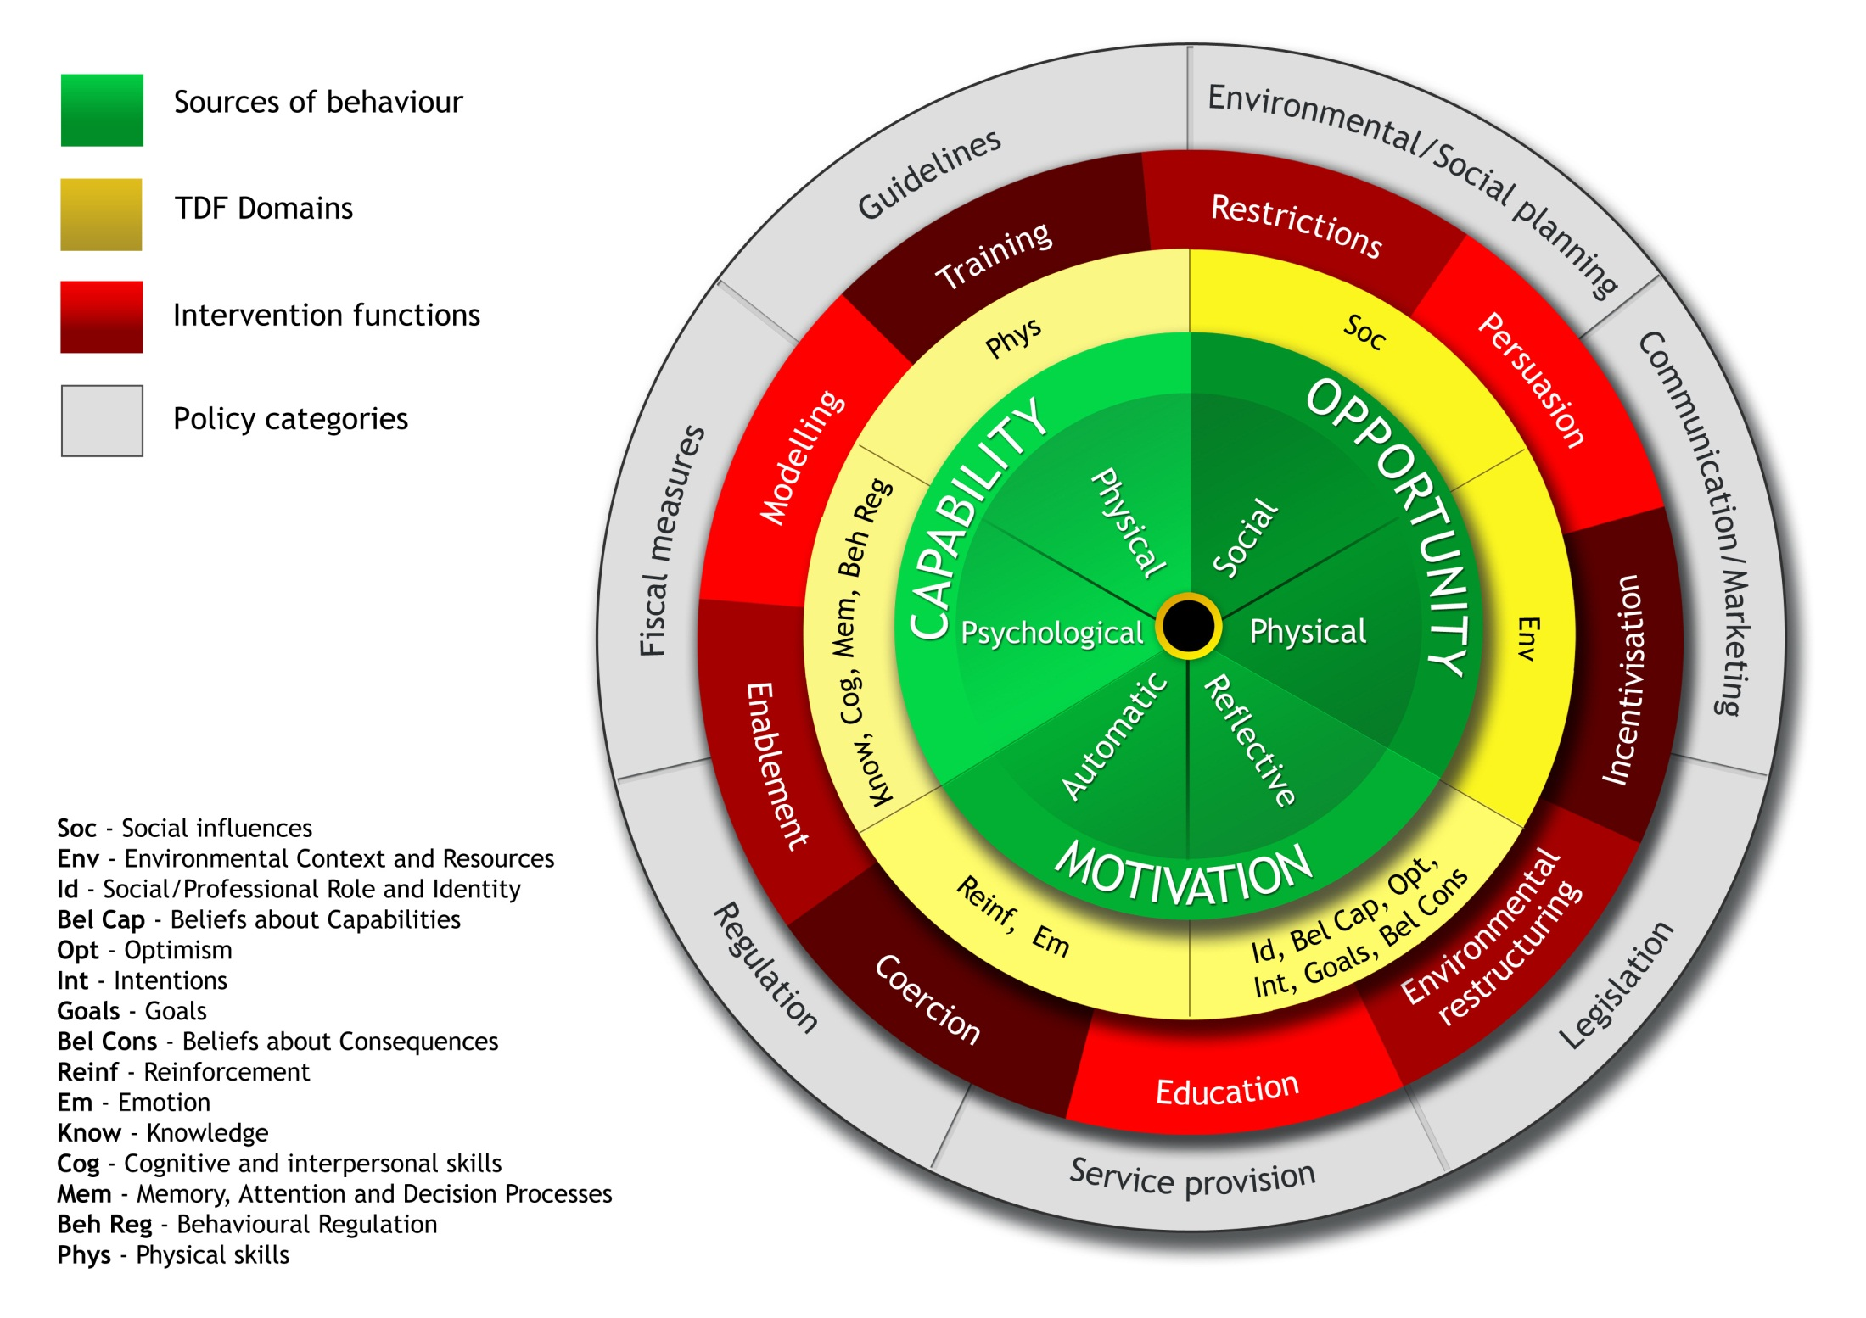
Notes:
Theoretical Domains Framework

Slide 39
An approach to developing KT interventions
Use Theory Domains Framework to understand current behaviour
Use Behaviour Change Wheel to select intervention functions
Use Taxonomy of Behaviour Change Techniques to select active ingredients aimed at bringing about behaviour change

Slide 40
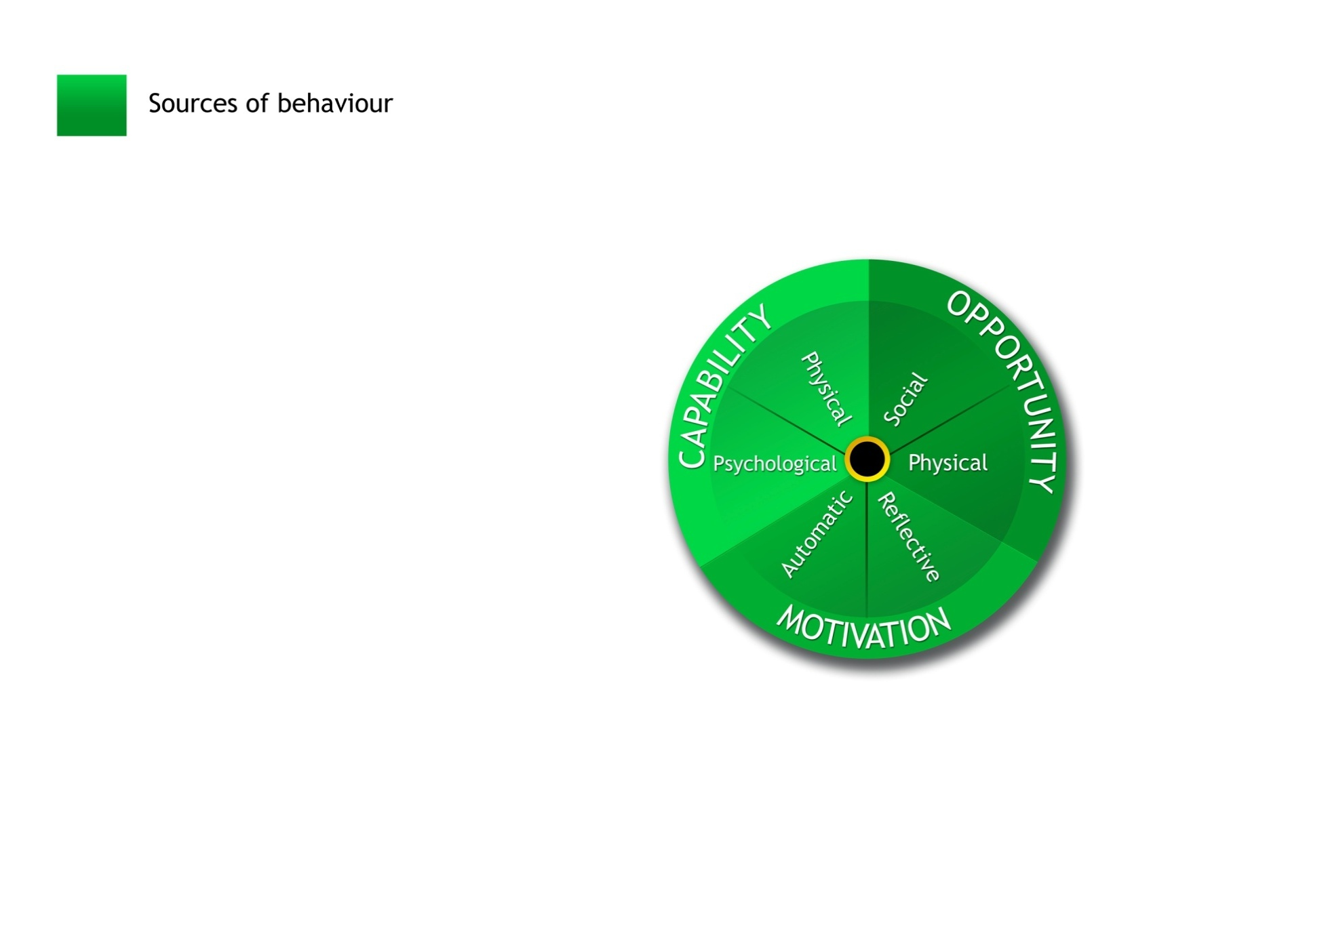
Smoking: evidence based techniques
and policies
Advise on stop-smoking medication
Smoking ban
Under the counter
Facilitate relapse prevention and coping
Seek commitment
Advise on changing routine

Slide 41
Interventions made up of Behaviour Change Techniques (BCTs)
“Active ingredients” within the intervention designed to change behaviour
They are
  observable,
  replicable and
  irreducible components of an intervention
Can be used alone or in combination with other BCTs

Slide 42
Upcoming NIH Lecture
Office of Behavioral and Social Sciences Lecture Series
February 21, 2014 1:00-2:00 pm
National Institutes of Health Natcher Conference Center, Room F1/F2
Videocast available at:
http://videocast.nih.gov/default.asp
New Technologies and Behavior Change Interventions: What Can They Do for Each Other?
Bonnie Spring, Ph.D., ABPP
Professor of Preventive Medicine, Psychology, and Psychiatry
Director, Center for Behavior and Health
Northwestern University

Slide 43
New Questions/New Ways
What's the prevalence, natural hx, etc. even of rare diseases?
Population-level efficacy and effectiveness
  for endpoints, not only intermediate outcomes
  for patient-centered outcomes (symptoms, side effects)
How to promote and sustain behavior change
Therapeutic precision (best therapy for this patient)
  learning from, but not constrained by, prior experience

Slide 44
rephrasing ‘does it work?’
(Complexes of) Exposures
Outcome
strength of association?
anti-depressant
mood
individual
population
Notes:
Statistically, this is asking about the strength of association between being "exposed" to oxycodone or percocet, say, and some outcome we care about, like pain relief.
We can ask whether oxycodone works at the population level or whether it works for an individual (does it work for me).

Slide 45
which works better: Zoloft or Prozac?
Zoloft
Mood, social activity
100 people
50 people
Effexor
Mood, social activity
50 people
population
tells us on average whether Zoloft or Effexor is better at improving mood, depression
Notes:
45
The standard thing to do would be to run an RCT, and we will see on average if oxycodone works better than say Percocet.
The problem though is that none of us are average.

Slide 46
none of us are average
Zoloft better
Effexor better
Notes:
46
The standard thing to do would be to run an RCT, and we will see on average if oxycodone works better than say Percocet.
The problem though is that none of us are average.

Slide 47
Consider…
8-week remission rate¹
For the last 200 patients "like you" in APEX
  60 Effexor patients, 30 remitted (50%)
  140 Zoloft patients, 100 remitted (63%)
Which one will work for you?
 | Effexor | Zoloft | p value
Mehtonen, et al. 2000 | 68 | 45 | 0.008
Sir, et al. 2005 | 54.4 | 59.5 | 0.47
¹http://www.effectivehealthcare.ahrq.gov/repFiles/Antidepressants_Final_Report.pdf

Slide 48

which works better for you?
N-of-1 study design: testing both in you for the outcomes that matter to you
Zoloft
Effexor
Zoloft
You
Effexor
Mood
Zoloft
Mood
Effexor
individual
¹Kravitz, et al. Contemp Clin Trials 2009; 30:436-445
Notes:
48
The only formal method for answering "does it work for me" is the N-of-1 study design.
In which there's only 1 person, 1 "n" in the study. So I would be randomized first to PTSD Coach, then usual care, and back and forth a few cycles, assessing my depression symptoms along the way.
This method is not widely known and is statistically complicated, but offers the kind of personal evidence we need to drive systematic but personalized learning across mHealth

Slide 49
there you are!
Zoloft better
Prozac better
Notes:
49
The standard thing to do would be to run an RCT, and we will see on average if oxycodone works better than say Percocet.
The problem though is that none of us are average.

Slide 50
Outline
Developing and evaluating technology
  agile participatory development
  new study designs
Using technology to ask new questions in new ways
Flipping the direction of research inference
Class summary

Slide 51
n = 1
Notes:
Ιν σελφ−εξπεριμεντατιον, ν, τηε νυμβερ οφ παρτιχιπαντσ, ισ 1. Τηε εξπεριμεντ μαψ βε θυιτε χασυαλ, ορ λιτ μαψ βε μορε σοπηιστιχατεδ ιν μετηοδολογψ λικε Ιαν ανδ Μιχηαελ ηαϖε δεσχριβεδ,

Slide 52
(n = 1).^{N}
Notes:
Scaling self-experimentation means having more people do it, to the power of a much much bigger n, still with strong methoology so we can learn more and advance health more broadly.

Slide 53
(n = 1).^{N}
Σ
Notes:
But even better, we should sum the experiences of all of those experiments to achieve real scale. The question of course, is how.

Slide 54
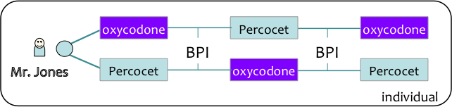
flip direction of research inference
population
Notes:
54
Once we get individual evidence, can aggregate to population level evidence – VA/DoD should help build the evidence base for better care.

Slide 55
a new science of digital health
(n ≥ 1).^{N}
Σ
Learning through big and small data
libraries of standard measures (e.g., Prescribable Data, PatientsLikeMe)
indexing of variables and results to standard vocabularies
  e.g., SNOMED, ICD-10, LOINC, etc.
indexing of evaluations to techniques and theories
  behavior change model, ontology of intervention types
capture context metadata
  technical, activity, social
data sharing and privacy/security architecture
Notes:
The real excitement is aggregating findings from many self-experiments. For that, we must first make the findings comparable. We are building libraries of standard measures, and working on way to index variables and results to standard vocabularies.

Slide 56
Digital Health Research Methods
International Society for Research on Internet Interventions
Health UnBound Evaluation Commons
k4health mHealth Toolkit
mHealth data worldwide
NIH Office of Behavioral and Social Science Research
Internet and communications technology for social and behavioral change communication
AHRQ n-of-1 monograph (release date 2/15/14)

Slide 57
Outline
Developing and evaluating technology
  agile participatory development
  new study designs
Using technology to ask new questions in new ways
Flipping the direction of research inference
Class summary

Slide 58
Summary
Informatics helps make sense of data into information and knowledge
  is necessary for better care and research
Today's health IT focus almost exclusively on supporting doctor-driven transactions
Need brand new technologies for other 3/4 of Big Picture
  semantic interoperation, better decision support, adaptive systems modeling
Disruptive change to care and research is coming (fast)
  as EHR adoption and data exchange take hold
  as mobile technologies break down time and space barriers
  as social computing takes off
  as open data becomes more common

Slide 59
New Picture of Health(care)
WELLNESS
PATIENT CARE
RESEARCH
. .
. .
Virtual Patient
Transactions
Raw data
Medical knowledge
Clinical research transactions
Raw research data
. .
. .
Doctor
. .
Decision support
. .
. .
Medical logic
. .
. .
. .
Patient Transactions
. .
. .
Citizen
Scientists
Patient
Big (Open) Data
Interaction design, workflow modeling and support, cognitive support, policies and mechanisms for sharing, privacy

Slide 60
Take Home Message
At the cusp of something transformative
  be open to partnering with computer scientists, patients, companies, etc.
To guard against hype and to maximize value
  stay grounded in what is clinically useful and important
  know as much as possible of the underlying informatics
  help develop new methods for evaluation, bring clinical research science to the Digital Age
Course evaluation
  https://courses.ucsf.edu/mod/questionnaire/preview.php?id=68451

