Slide 1
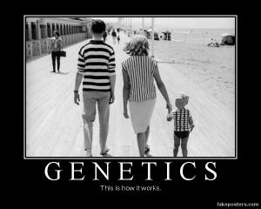
Epidemiology 217
Molecular and Genetic Epidemiology

Slide 2
Course Goals
Develop framework for incorporating genetics in your research.
Focus of course:
  Approaches to search for and interpret disease-causing genes.
  Primarily association studies.
Notes:
2

Slide 3



Course Details
Tuesdays: 1:30-3:00 pm
Zoom: https://tinyurl.com/ybec6nu4
Website: https://ticr.ucsf.edu/courses/mol_methodsi.html
Course Directors:
John Witte
Professor, UCSF
John.witte@ucsf.edu
Thomas Hoffmann
Assoc Professor, UCSF
HoffmannT@humgen.ucsf.edu
Teaching Assistant:
Yusuph Mavura
PhD Student
yusuph.mavura@ucsf.edu
Notes:
3

Slide 4
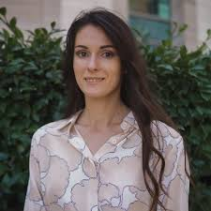
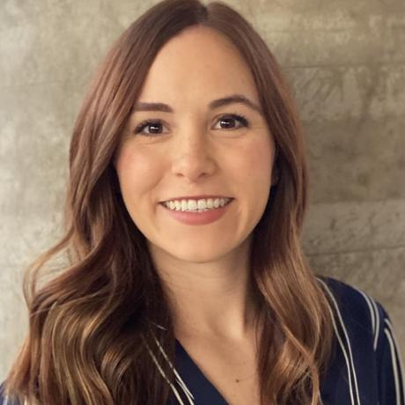
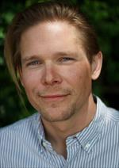
Lecturers
Linda Kachuri
Post-doc, UCSF
Taylor Cavazos
Pre-doc, UCSF
Iona Cheng
Assoc Professor, UCSF
Stephen Francis
Assist Professor, UCSF
Notes:
4

Slide 5
Assignments
In class work / problem sets
Due at noon on Mondays to course TA
Readings
Papers assigned for lectures
Student led discussion of papers during class
Final project
  Present to class
Course content
  Dropbox folder: https://tinyurl.com/y3953ax6
  CLE: https://courses.ucsf.edu/course/view.php?id=7774
Notes:
5

Slide 6
Molecular & Genetic Epidemiology
Define these terms…
How does this differ from conventional epi?

Slide 7
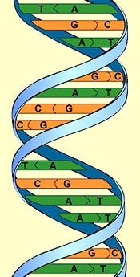
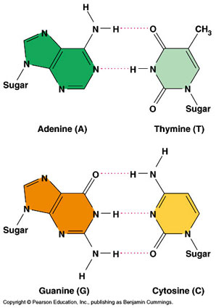
Genome: DNA
Notes:
7

Slide 8
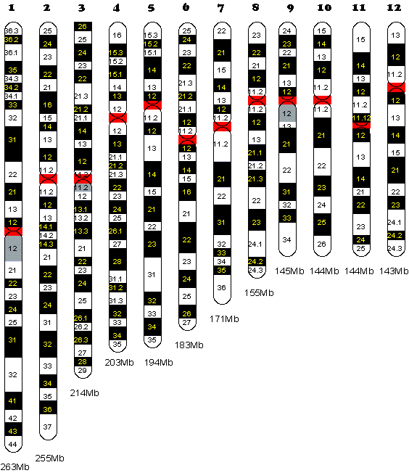
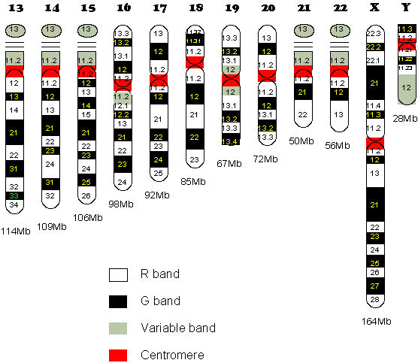
Genome: Human Chromosomes
G bands – AT rich / gene poor; R bands the reverse
Look for broad structural abnormalities from these stains
Notes:
Q and p arms of chromosomes. P = petite
8 q two four
8

Slide 9
Variation in Genome
Mutation
  When change first occurs in an individual
    Internal events (e.g., copy errors during cell division) or
    External agents (e.g., radiation, mutagens).
  Can end with one generation, or be passed on (germline mutations)
Polymorphism
  Means “many forms”
  Minor allele frequency (MAF) > 1%
  Generated by old mutations (random, or fitness benefit).

Slide 10
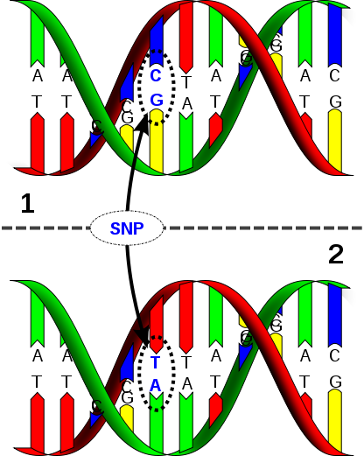
Single Nucleotide Polymorphism (SNPs)
Change a single DNA letter
Most frequent genetic variant
1 per 300 base pairs
  Common (MAF>5%)
  Less common (1-5%)
  Rare ‘variants’ (<1%)
David Hall
Notes:
10

Slide 11
Types of Variants in Genes
Noncoding
Coding
- Synonymous = no change in amino acid
- Nonsynonymous/nonsense = change to stop codon
- Nonsynonymous/missense = change amino acid
e.g., MTHFR C677T SNP
  Normal (‘wild-type’) allele
Gene sequence …..GCG GGA GCC GAT………………
Protein Sequence ……Ala Gly Ala Asp………………
Variant allele
Gene Sequence …..GCG GGA GTC GAT……………….
Protein Sequence ……Ala Gly Val Asp ..……………
Notes:
11

Slide 12
Genotypes
Locus 4
A
A
A
G
G
G
Alleles at locus 4
G
A
Locus: chromosomal location
that’s polymorphic.
Alleles: different variants @ locus
- Each cell is diploid (2 autosomes)
- Thus 3 genotypes at locus 4 (use only one strand, often forward): AA, AG, GG

Slide 13
Human Genome Statistics
Genome Reference Consortium Human Build 38
4.5B basepairs (bp)
~20K protein coding genes
Mutation rate ≈ 10⁻⁸ per bp per generation
In each person:
  ~ 65 new mutations expected
  ~ 1 variant per 1.3K bps
  > 2M variants
http://www.ensembl.org/Homo_sapiens
Notes:
13

Slide 14
Process of Genetic Epidemiology
Defining the Phenotype
Migrant Studies
Familial Aggregation
Segregation
Association Studies
Fine Mapping
Cloning
Characterization
Notes:
14

Slide 15
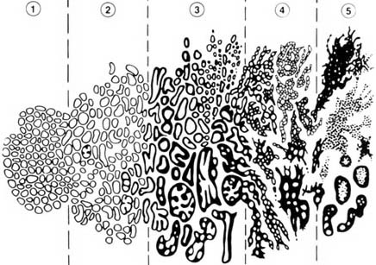
First: Define the Phenotype!
Gleason DF. In Urologic Pathology: The Prostate. 1977; 171-198.

Slide 16
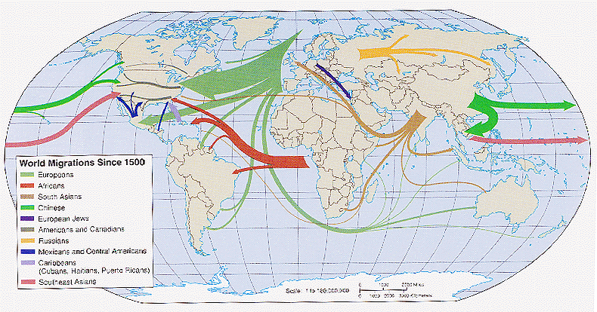
Migrant Studies
Weeks, Population. 1999
Studies based on the assumption that migrants carry a risk that reflects their country of origin, rather than the host country.
"Migrant Studies". Encycolpedia of Biostatistics, John Wiley and Sons 2005.
Notes:
16

Slide 17
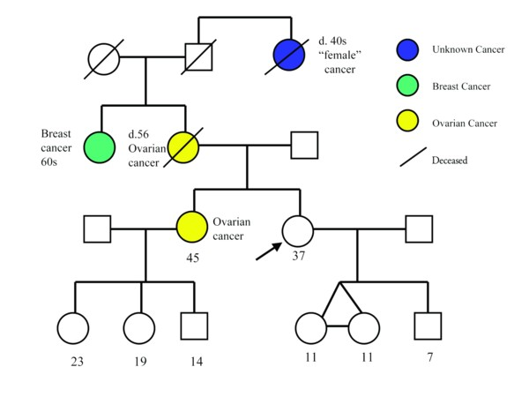
Familial Aggregation
Does the phenotype tend to run in families?
Notes:
17
For a common disease or one that manifests as a continuous trait, one might simply enroll a random series of families and look at the pattern of correlations in the disease between different types of relatives (e.g., sibling-sibling, parent-offspring, etc.).
For a rare dichotomous disease, one would generally begin with the identification of probands, preferably in some population-based fashion, together with a comparable control series from the same population.
For each subject, one can then obtain a structured family history (i.e., to generate a pedigree), collecting disease and other (e.g., age, time at risk, etc.) information.
One could then consider two approaches to the analysis of such data.

Slide 18
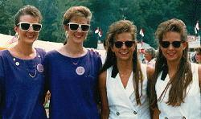
Analysis of Twin Studies
Compare the disease concordance rates of MZ (identical) and DZ (fraternal) twins.
Twin 1
Disease | Yes | No
Yes | A | B
No | C | D
Concordance =
2A/(2A+B+C)
Twin 2
Then one can estimate heritability of a phenotype.

Slide 19
Models of Genetic Susceptibility
Study families.
Estimate ‘mode of inheritance’ & what type of genetic variant might be causal.
Determine whether the disease appears to follow particular patterns across generations.
Estimate whether variants are rare or common, etc.

Slide 20
Segregation
Notes:
20

Slide 21
Segregation: Harry Potter’s Pedigree
Muggle
Wizard /
Witch
Vernon Dursley
Petunia Dursley
Lily Evans
James Potter
Dudley Dursley
Harry Potter
Notes:
21
Study families.
Estimate ‘mode of inheritance’ & what type of genetic variant might be causal.
I.e., determine whether the disease appears to follow particular patterns (recessive, dominant, co-dominant, log-additive).
Estimate whether variants are rare or common, etc.

Slide 22
Segregation: Harry Potter’s Pedigree
Measure co-segregation in pedigree
Based on detection of recombination events (meiosis)
Muggle
Wizard /
Witch
Vernon Dursley
Petunia Dursley
Lily Evans
James Potter
or
Dudley Dursley
Harry Potter
or
Notes:
22

Slide 23
Filch?
Squib
Argus Filch
Notes:
23

Slide 24
Segregation Analysis
Best model of inheritance for observed families?
    Dominant
    Recessive
    Additive
  Disease allele frequency?
  Magnitude of risk?
Fit models to data on disease of family members.
Estimate model of inheritance for linkage analysis.

Slide 25
Process of Genetic Epidemiology
Defining the Phenotype
Migrant Studies
Familial Aggregation
Segregation
Association Studies
Fine Mapping
Cloning
Characterization
Notes:
25

Slide 26

Linkage Disequilibrium (LD)
LD: non-random association of alleles at two or more loci that descend from a single, ancestral chromosomes.
Important fundamental concept will come up repeatedly.
Hirschhorn & Daly, Nat Rev Genet 2005
Notes:
26

Slide 27
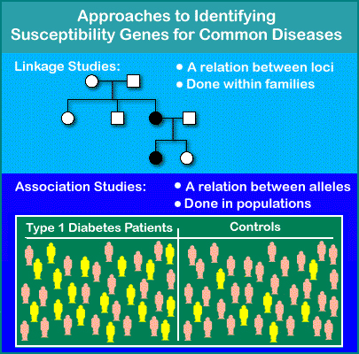
Association Studies
ROCHE Genetic Education (www)
Notes:
27
Compare alleles between individuals with extreme levels of a phenotype (i.e., cases and controls).
Association exists when cases are more (or less) likely than the controls to carry particular alleles (E.g., G).

Slide 28
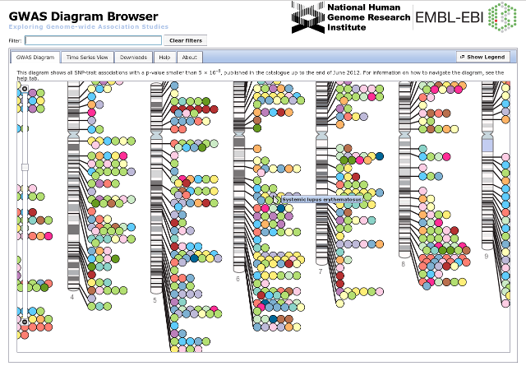
Many GWAS hits: Polygenic Model
http://www.ebi.ac.uk/fgpt/gwas.

Slide 29
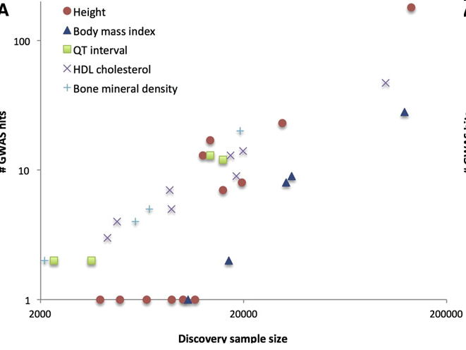
Sample Size and # of Associations
Why?
Consortiums
Visscher, AJHG 2012

Slide 30
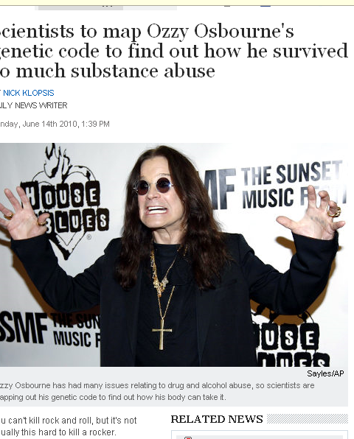
Next-Generation Sequencing
(Ozzy Osbourne?)
"Sequencing and analysing individuals with extreme medical histories provides the greatest potential scientific value.“
Nathan Pearson, Director of Research Knome
Notes:
30

Slide 31
Cloning and Characterizing a Gene
Show that it is clearly causal for disease
Basic science experiments.
Determine the structure of the gene, ID regulatory elements, etc.
Use epidemiologic studies to distinguish public health implications:
  Determine frequencies of causal alleles; and
  Characterize their effects—and interacting environmental factors—on disease rates.

Slide 32

Early Precision Medicine

Slide 33
Prediction Challenging (PRS)
Witte, Nat Rev Genet, 2009

Slide 34
DTC Genetic Testing
Multiple companies marketing direct to consumer genetic ‘test’ kits.
Send in spit or cheek swab.
Array technology (Illumina / Affymetrix).
Many results based on GWAS.

Slide 35


Slide 36


Slide 37
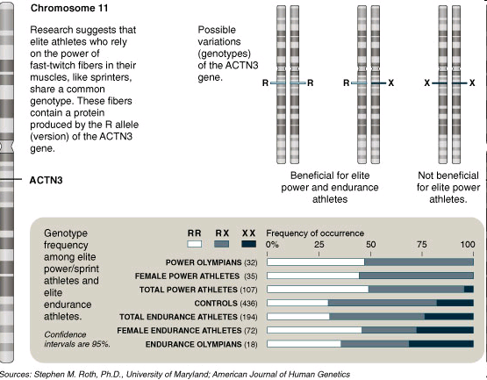
‘Test to Play’
NY Times, 11/30/08

Slide 38
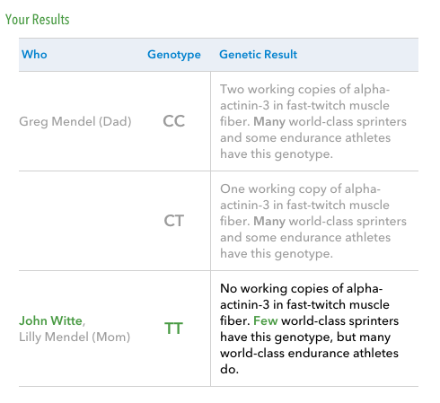
Notes:
JAMA Genetics Collections: http://jama.jamanetwork.com/collection.aspx?categoryid=5664
Nature Reviews Genetics Study Design Series: http://www.nature.com/nrg/series/studydesigns/index.html#d201601

Slide 39
Your background and what you would like to get out of class?

