Slide 1
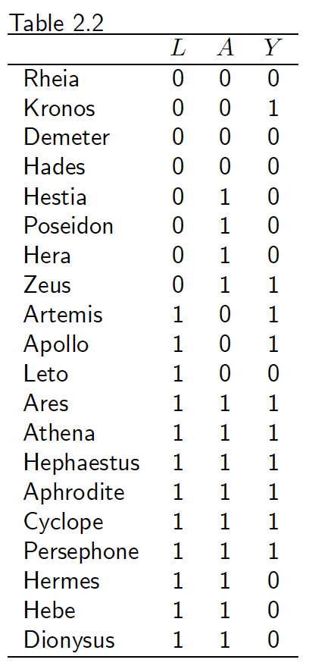
Exercise
Calculate the standardized risk in the unexposed
In this conditionally randomized experiment:
  Does exchangeability hold?
  Does conditional exchangeability given L hold?
  Is there a null average causal effect of A on Y?
  Is there a null association between A and Y?

Slide 2
Exercise Solution – Part I
Pr(L = 0) = 8/20
Pr(L = 1) = 12/20
Assuming consistency and conditional exchangeability hold:
Pr(Y^{a=0} = 1 | L = 0) = Pr(Y = 1 | A = 0, L = 0) = 1/4
Pr(Y^{a=0} = 1 | L = 1) = Pr(Y = 1 | A = 0, L = 1) = 2/3
Pr(Y^{a=0} = 1) = Pr(Y = 1 | A = 0, L = 0) * Pr(L = 0) +
Pr(Y = 1 | A = 0, L = 1) * Pr(L = 1)
= (1/4) * (8/20) + (2/3) * (12/20)
= 0.5

Slide 3
Exercise Solution – Part II
Does exchangeability hold?
  No, Pr(Y^{a=0}=1 | A = 1) ≠ Pr(Y^{a=0}=1 | A = 0) and, furthermore, Pr(Y^{a=1}=1 | A = 1) ≠ Pr(Y^{a=1}=1 | A = 0) (See Slide 51)
Does conditional exchangeability given L hold?
  Yes, Pr(Yª = 1 | A = 1, L = l) = Pr(Yª = 1 | A = 0, L = l) for all a and l
Is there a null average causal effect of A on Y?
  Yes, Pr(Y^{a=1} = 1) = Pr(Y^{a=0} = 1)
Is there a null association between A and Y?
  No, Pr(Y = 1 | A = 1) ≠ Pr(Y = 1 | A = 0)

