Slide 1
Social Determinants of Health and Health Disparities:
What Every Researcher Needs to Know
Kirsten Bibbins-Domingo, MD PhD

Slide 2
Course Logistics
Watch the introductory video!

Slide 3
Course Logistics
Watch the introductory video!
  Post responses to homework to the forum
  Homework due by 8:45am day of class
  OPTIONAL section on Mondays 3-4pm

Slide 4
Lecture 1: Health Inequities and a Socioecological Perspective
Kirsten Bibbins-Domingo, MD PhD
Safyer McKenzie-Sampson
January 5th, 2021

Slide 5
What type of research do you want to do?
High quality, inclusive research that is generalizable to diverse populations?
Research to advance health equity

Slide 6
Why do you need to consider race/ethnicity and SES (and other social determinants) to do high quality research?

Slide 7
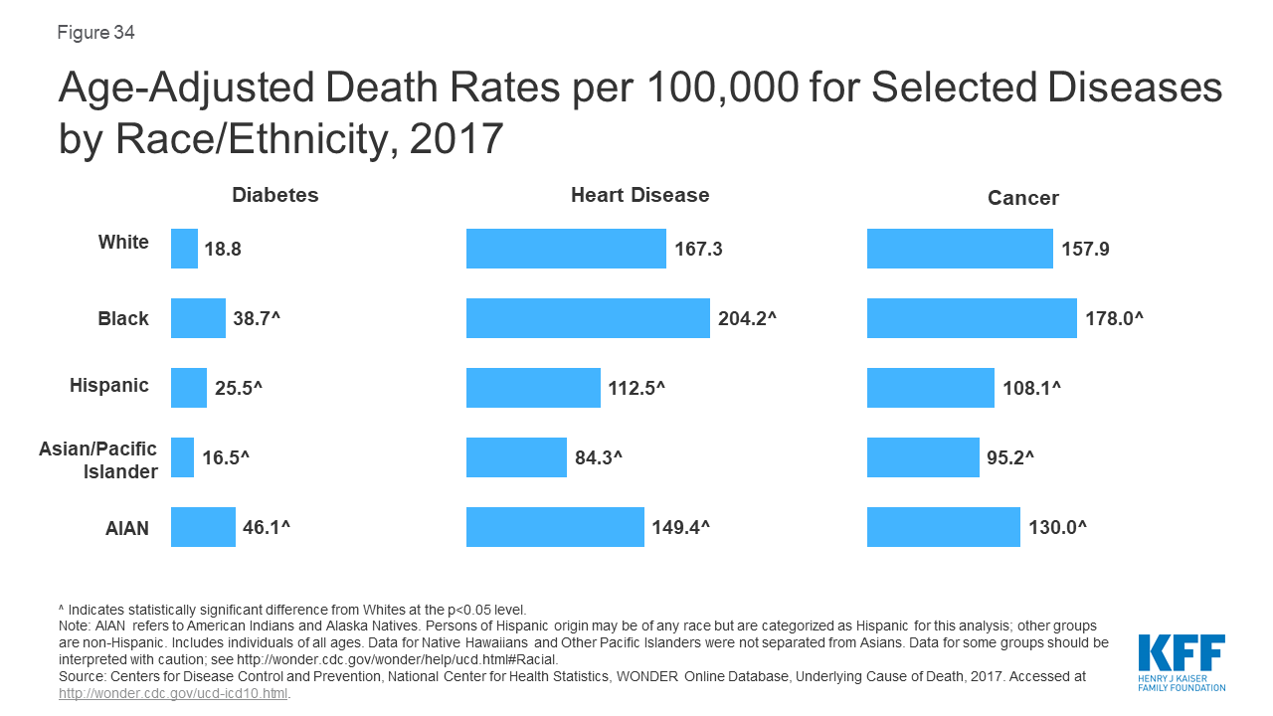

Slide 8
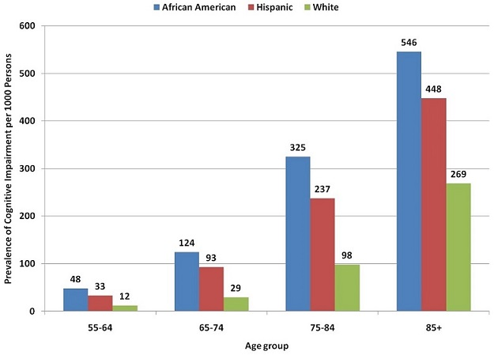
FIGURE 1. Prevalence of Cognitive Impairment among Americans Aged 55 and Older (rate per 1,000 population) by Age and Race/Ethnicity, 2006 Health and Retirement Study

Slide 9
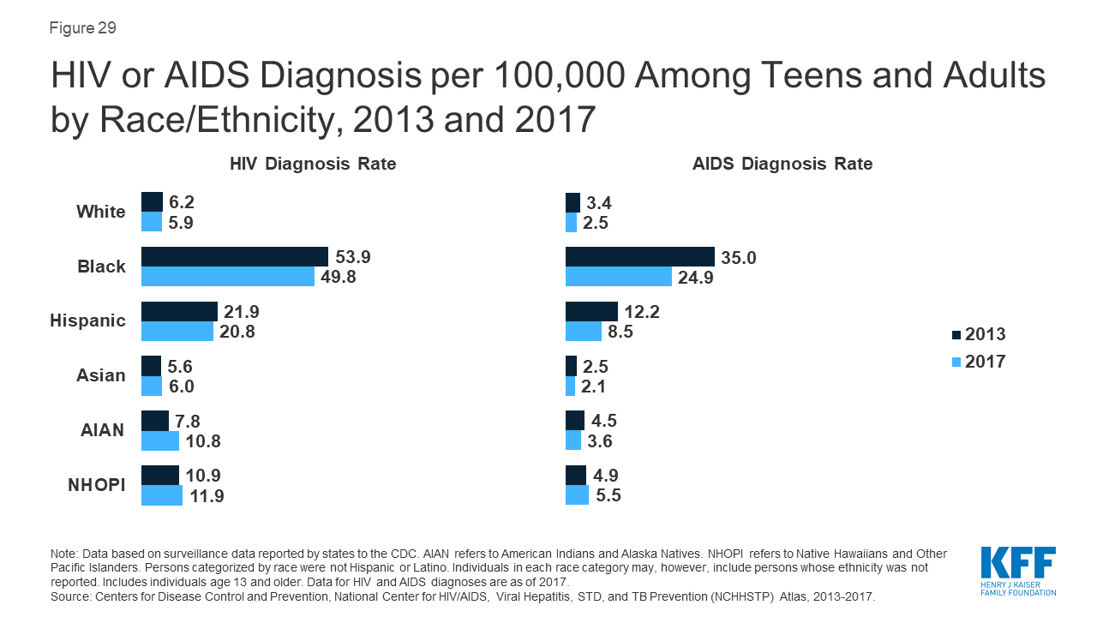

Slide 10
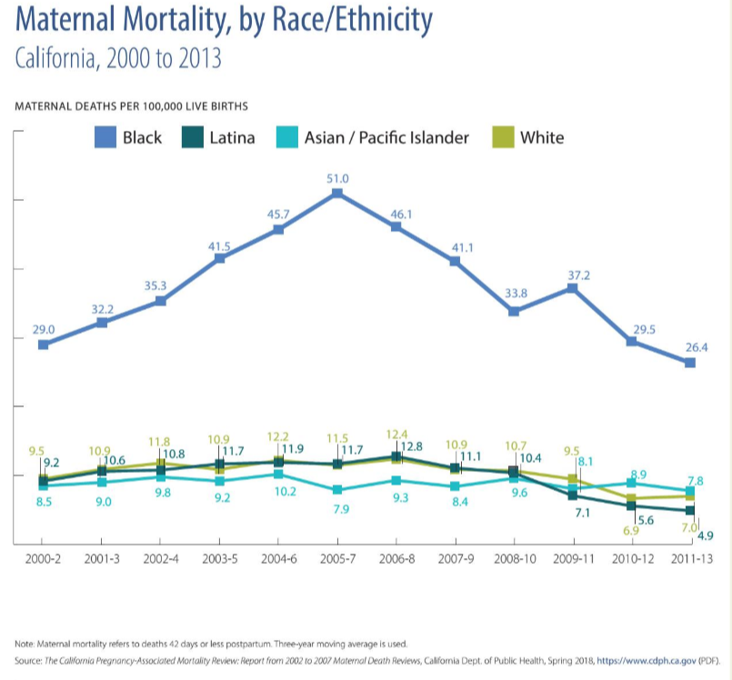

Slide 11
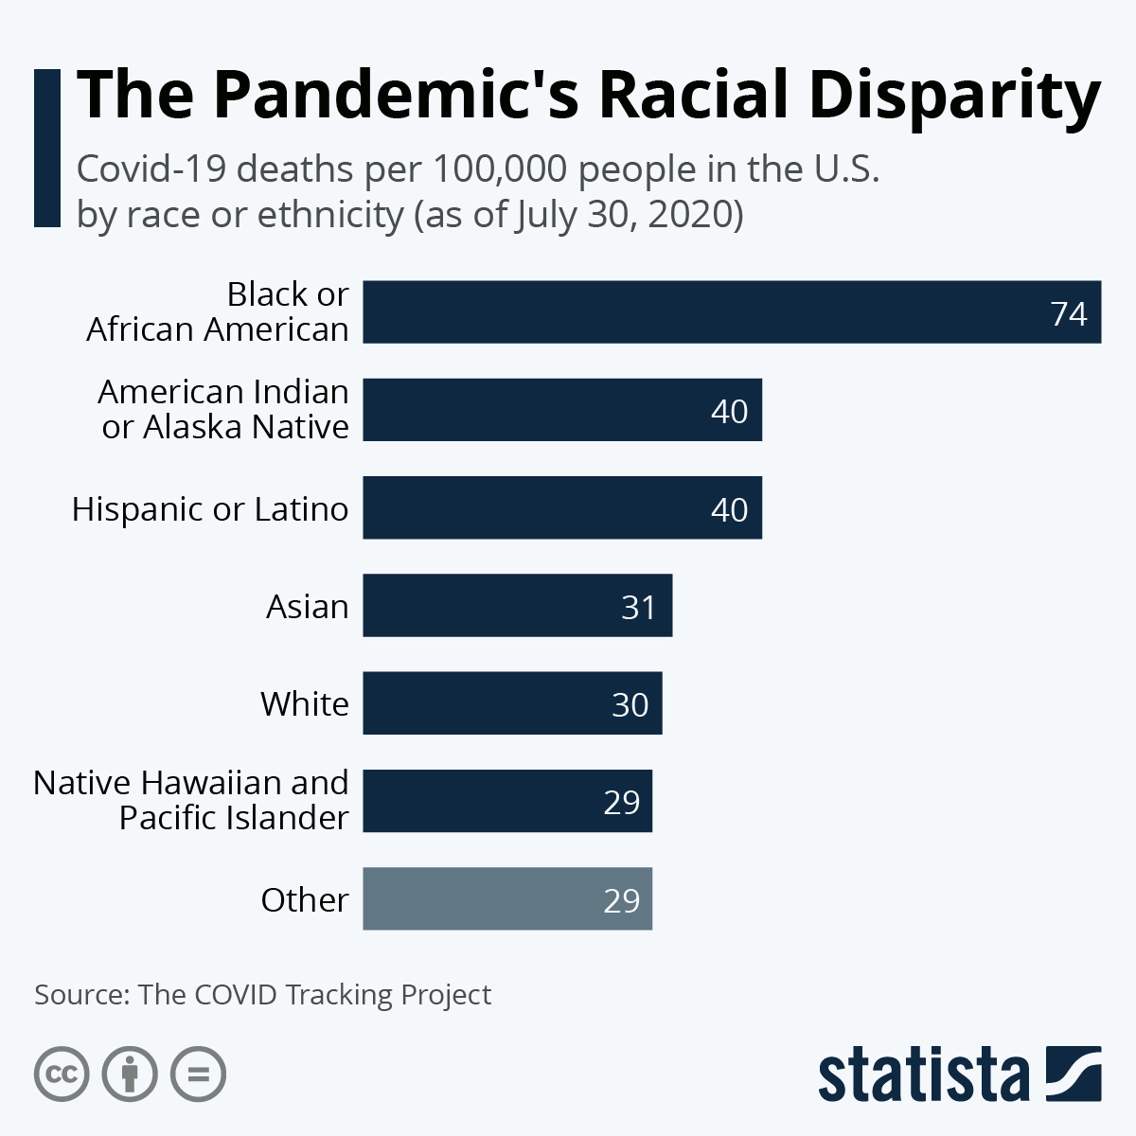

Slide 12
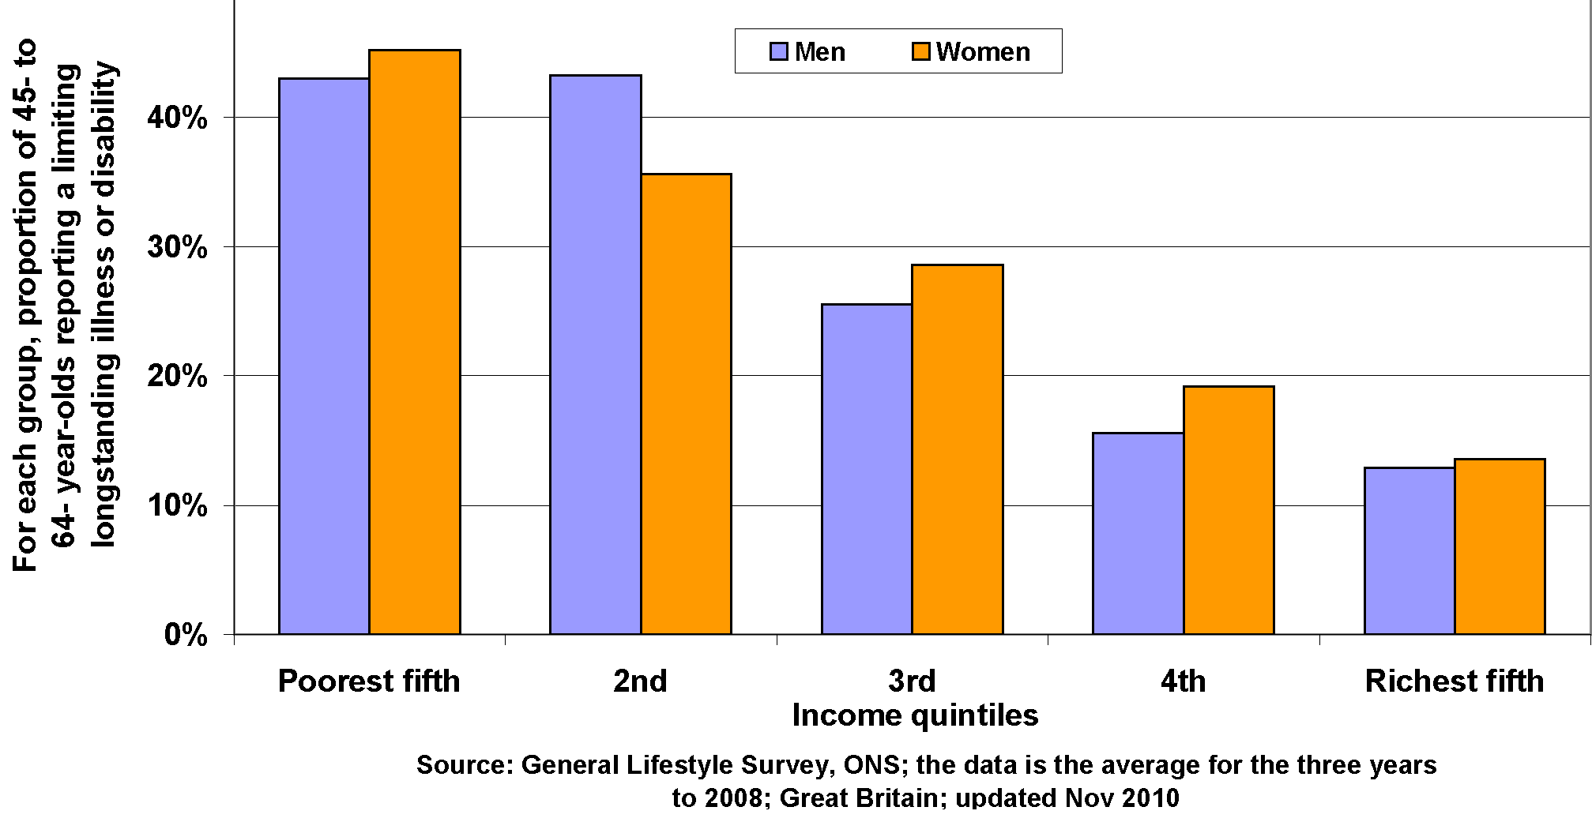
Illness or Disability by Income

Slide 13
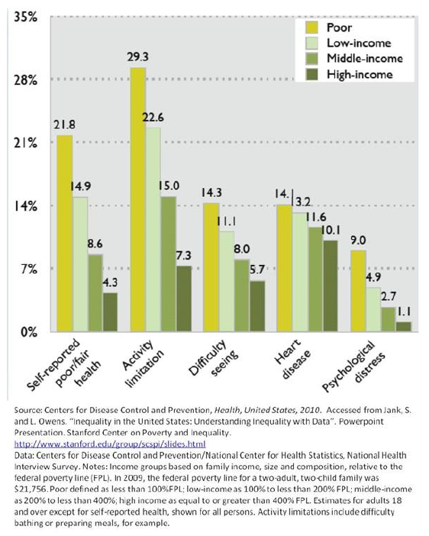

Slide 14
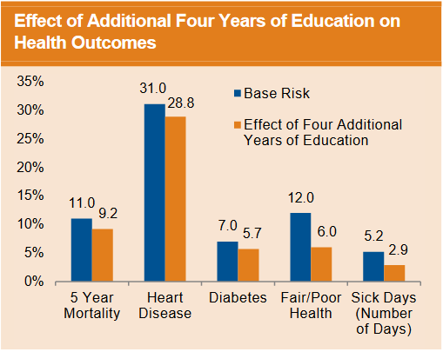
Source: National Poverty Center. Education and Health. Policy Brief. March 2007

Slide 15
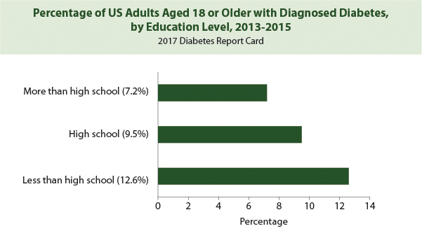

Slide 16
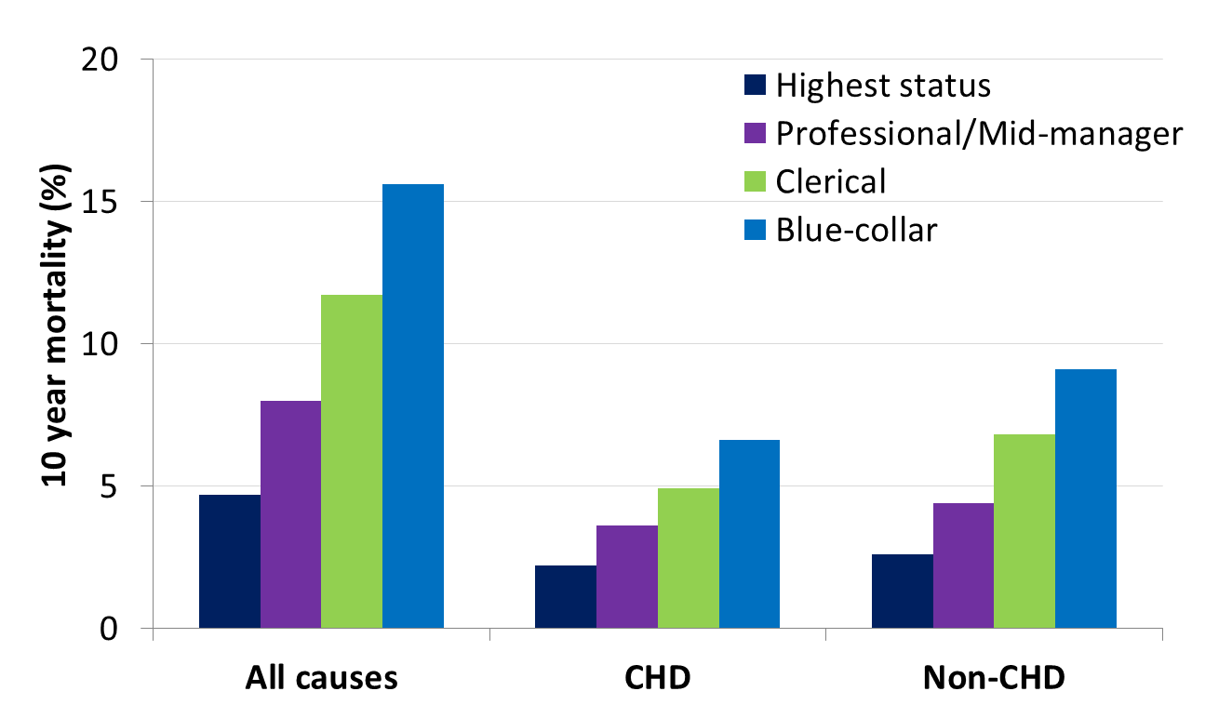
Higher-Status Job, Longer Life
UK Whitehall Study
Source: Marmot, M. G., et al (1984). "Inequalities in death--specific explanations of a general pattern?" Lancet 1(8384): 1003-1006.

Slide 17
Self-Reported Health
Braveman et al. analyses of NHIS 2001-2005.
Age-Adjusted.
Braveman et al. analyses of NHIS 2001-2005.
Age-Adjusted.

Slide 18
Diabetes-related mortality by Federal Poverty Level (FPL)
Age adjusted to the 2000 U.S. standard population
Rates per 100,000 person years
National Health Interview Survey

Slide 19
What are Health Disparities?
“A particular type of health difference that is closely linked with economic, social, or environmental disadvantage. Health disparities adversely affect groups of people who have systematically experienced greater social or economic obstacles to health based on their racial or ethnic group, religion, socioeconomic status, gender, age, or mental health; cognitive, sensory, or physical disability; sexual orientation or gender identity; geographic location; or other characteristics historically linked to discrimination or exclusion.”
Healthy People 2020 (HealthyPeople.gov)

Slide 20
Differences versus disparities
Health disparities have at times been defined as all differences in health and not clearly linked to social justice and oppression
  Healthy People definition is explicit on this point
However, many people prefer reference to health equity and inequities as a means to emphasize the unjust nature of the differences

Slide 21
Health and Healthcare Disparities
A “health disparity” refers to a higher burden of illness, injury, disability, or mortality experienced by one group relative to another. A “health care disparity” typically refers to differences between groups in health insurance coverage, access to and use of care, and quality of care. Health and health care disparities often refer to differences that are not explained by variation in health needs, patients preferences, or treatment recommendations and are closely linked with social, economic, and/or environmental disadvantage.
(Kaiser Family Foundation)

Slide 22
Health Equity
“attainment of the highest level of health for all people. Achieving health equity requires valuing everyone equally with focused and ongoing societal efforts to address avoidable inequalities, historical and contemporary injustices, and the elimination of health and health care disparities”
Healthy People 2020

Slide 23
Why is it important to think about race/ethnicity and SES in research?
Health inequities are omnipresent
Patterning of health along sociodemographic characteristics has implications for all research
  Implications for methods and interpretation
  Potential for research to exacerbate inequality
Research designed to describe, understand, and ameliorate differences in health outcomes can advance health equity

Slide 24
Research with Attention to
Health Inequities:
Applying a Socioecological Lens

Slide 26
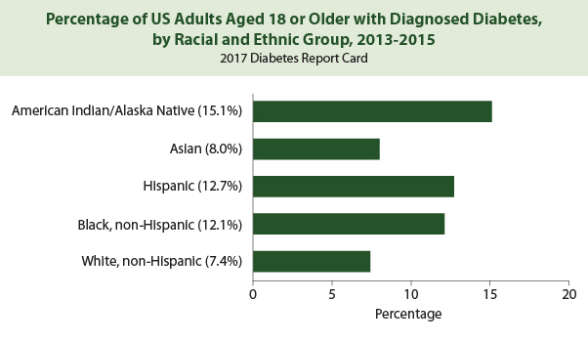

Slide 27
What causes diabetes?
What causes disparities in diabetes?
Behavioral factors?
  Diet
  Sedentary lifestyle
  Obesity
Genetics?

Slide 28
Chronic Disease Epidemiology
Diabetes
Behavioral/
Clinical Factors
Genetic Factors
Kurian, Ethn Dis, 2007

Slide 29
Chronic Disease Epidemiology
Diabetes
Behavioral/
Clinical Factors
Environmental Factors
Genetic Factors
Kurian, Ethn Dis, 2007

Slide 30
Paradigms of Epidemiology
Miasma: Sanitary statistics
Germ theory: Infectious disease epidemiology
  Shift to individually focused interventions
Chronic disease epidemiology
  Emphasis on individual levels risks
Susser and Susser, AJPH, 1996

Slide 31
Shortcomings of Current Paradigm
Focus only on proximate risk factors
Singular attention to individual-level variables
Limited in time horizon
No recognition of interconnections
Isn’t getting us very far

Slide 32
Black Box Epi Applied To HIV
We know HIV causes AIDs
“Simple” behavioral solution
Why does safe sex messaging not solve the problem?
  HIV/sexual risk occurs in a social and cultural context
  Need to understand and address context to move the needle

Slide 33
Applying theory to epidemiology
Chronic Disease Epidemiology has implicit theory that is not always evident
  Drives research and interpretation in non-transparent manner
Need to consider other theories that can point to different research approaches and interventions

Slide 34
Theory of Fundamental Causes
1995 Link and Phelan addressed persistence of SES disparities in health despite changes in context and conditions
  19th century: Infectious disease
  20th and 21^{rst} centuries: Cancer, cardiovascular disease

Slide 35
Theory of Fundamental Causes
SES is a fundamental cause of poor health:
  Regardless of disease or context, high SES individuals and groups can flexibly deploy resources to avoid risks and mitigate effects of poor health
Resources include:
  Money
  Power
  Knowledge
  Prestige
  Social connections

Slide 36
Theory of Fundamental Causes
Infectious diseases:
Avoid areas that carry risk of contamination
Limit entry of potential infectious individuals
Cardiovascular diseases:
Access healthy food
Live in communities that facilitate healthy choices
All contexts:
Access quality medical care

Slide 37
Evidence to Support Theory of Fundamental Causes
SES gradients in mortality are more pronounced with preventable conditions
Advances in knowledge increases disparities in outcomes
Specific examples:
  Statins: Use reversed income/cholesterol gradient
  Smoking: No SES gradient until evidence of cancer risk released in 1950s

Slide 38
Race as a Fundamental Cause
Initially, theory of fundamental causes focused only on SES
Racial/ethnic disparities considered as collinear with SES
Paper by Link and Phelan in 2015 argued for race/ethnicity as a fundamental cause:
  Predictive of SES
  Independently through racism

Slide 39
Implications of Theory of Fundamental Causes
Importance of intervening on “upstream” forces that produce and maintain inequities
Interventions done without attention to equity will invariably worsen inequity, as those with “flexible resources” will disproportionately benefit
  e.g. Statins, new cancer therapies, CRISPR

Slide 40
Upstream Theories:
Not the Whole Story
Important in encouraging a broader perspective
  Encourage structural approaches to disparities
BUT - Neglect the “downstream” mechanisms by which social conditions are mediated
  Both perspectives are needed
Example of decline in infectious mortality:
  Economic growth -> improved nutrition
  Public health efforts such as sanitation
  Medical care, including antibiotic provision

Slide 41
Thinking Ecologically
Move toward ecological approach rooted in work in social science disciplines in 20th century
The ecological model is "a model of health that emphasizes the linkages and relationships among multiple factors (or determinants) affecting health.” – Institute of Medicine
  Allows for intervention at multiple levels

Slide 42
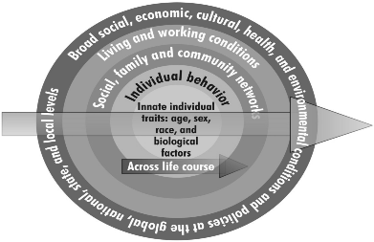
Institute of Medicine Ecological Model

Slide 43
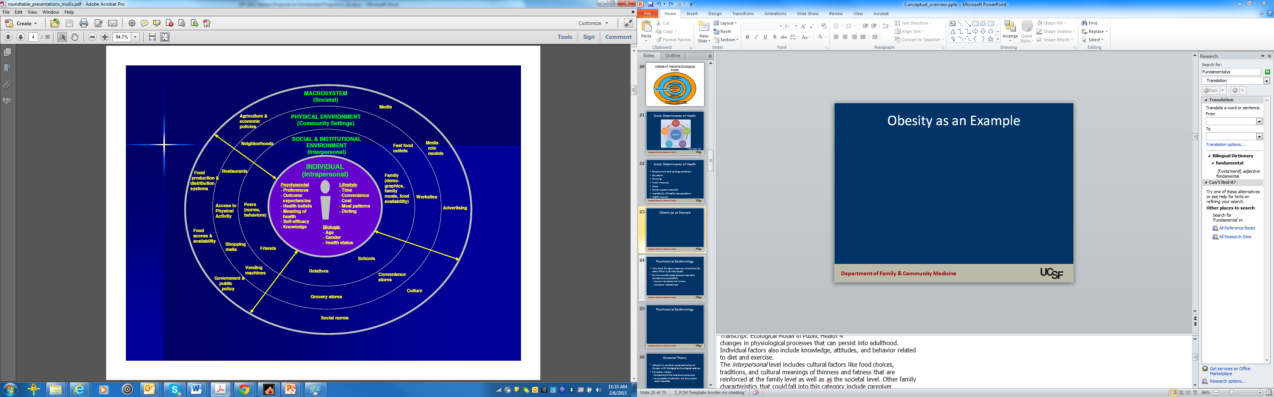
Obesity as an Example
Mullis, An ecological approach to childhood obesity. USDA, 2009

Slide 44
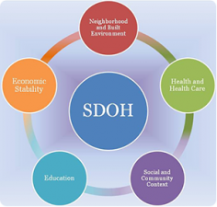
Social Determinants of Health
Healthy People 2020

Slide 45
The Socio-Ecological Model
Structural factors:
Racism
Economic inequality
shape this model of health & disease
Economic & Social
Opportunities and Resources
Living & Working Conditions
in Homes and Communities
Behaviors
Medical Care
Interaction with genetic/other biological factors
HEALTH
Adapted from Braveman et al., for RWJ Foundation
Commission to Build a Healthier America | www.commissiononhealth.org

Slide 46
Chronic Disease Epidemiology
Diabetes
Behavioral Factors
Genetic Factors
Kurian, Ethn Dis, 2007

Slide 47
Contextual Factors Affect Risk for Diabetes by SES
Neighborhoods influence likelihood of obesity:
  Poor quality retail food environments
  Lower perceived neighborhood safety
Neighborhoods with less physical activity resources have higher incidence of T2DM
Food insecurity is associated with incident diabetes and worse blood sugar control
Christine, JAMA Int Med, 2015
Steve, Curr Diab Rep, 2016

Slide 48
Contextual Factors Affect Risk for Diabetes by Race
Perceived discrimination associated with poor dietary habits
Insulin resistance found to be associated with:
  Experiences of racism
  Internalized racism
Incident diabetes associated with major experiences of discrimination, independent of obesity
Wagner, Enth Dis, 2013
Whitaker, Am J Epi, 2017

Slide 49
Chronic Disease Epidemiology
Diabetes
Behavioral Factors
Genetic Factors
Kurian, Ethn Dis, 2007

Slide 50
What about genetics?

Slide 51
Measurement of Race
Social construct?
Biological construct?

Slide 52
What is Race?
Societal constructed taxonomy that reflects intersection of particular historical conditions with economic, political, legal, social and cultural factors, as well as racism.
David Williams, PhD, 1994
Notes:
1

Slide 53
Race as a Social Category
Greater differences within groups than between groups
Racial definitions depend on cultural and social circumstances
  One-drop rule
  South Africa, Brazil
  American Indian Tribal membership
  Mixed race

Slide 54
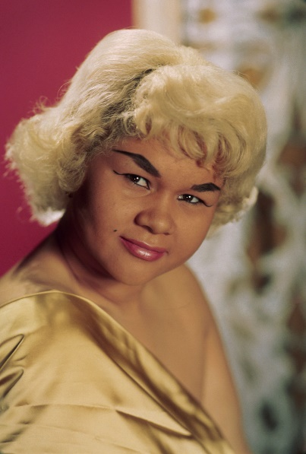
Race as a Social Category
“What you check on your census form in America is a product of social context. Social context is why someone who looks like me can be black (and proud, even!) in America and ‘colored’ somewhere else. Social context is why our concept of race doesn’t translate to, say, Brazil. This is a very present issue. Etta James didn’t call herself ‘biracial.’ Perhaps if she were living today, she would...”
Ta-Nehisi Coates, 2013

Slide 55
What about Ethnicity?
Ethnicity refers to self-identity with group defined by racial admixture, geographic origin, culture, religion and/or language
Characterized by sharing non-phenotypic characteristics (language, etc.)

Slide 56
But Aren’t There Genetic Differences?
On average two humans have 99.9% identical DNA
Genetic mapping studies have suggested that genetic variation, although minimal, can be used as marker of “ancestry”
However, ancestry does not consistently correlate with self-identified race/ethnicity

Slide 57
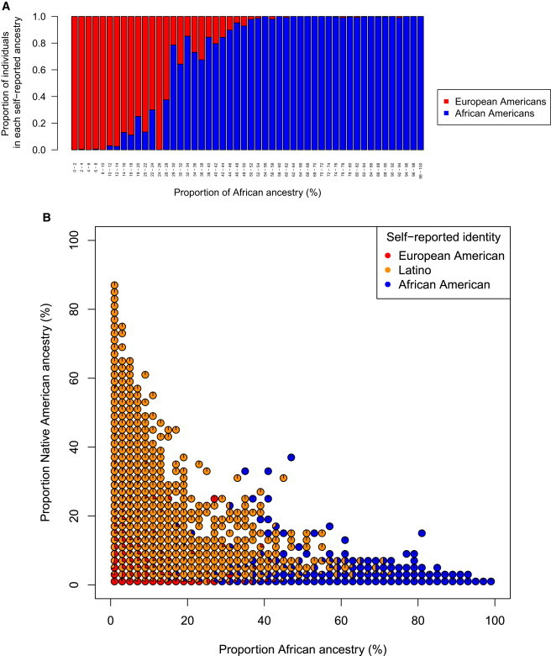
AIMs and Self-Identified Race
Byrc, Am J Hum Gen, 2015

Slide 58
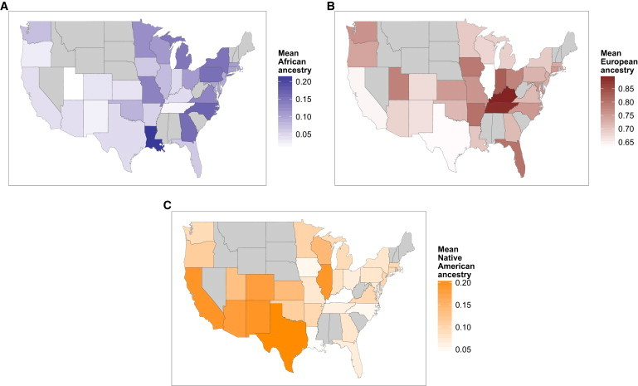
The Distribution of Ancestry of Self-Reported Latinos across the US
Byrc, Am J Hum Gen, 2015

Slide 59
Considerations in Use of Ancestry
Differences in ancestry is not the same as differences in biological outcomes
Differences in probabilities of alleles by ancestry or self-reported race ≠ individual level differences
Focus on genetic “racial” categories can reify genetic/biology conceptions of human differences

Slide 60
How is Ancestry Useful?
Variations in outcomes by ancestry can contribute to discovery science
Some polymorphisms related to ancestry may have relevance to health disparities (e.g. asthma)
Much work to be done to make use of ancestry more precise and informative
Need to recognize that study of ancestry is complicated by confounding by social factors

Slide 61
Investigating Genetics of Diabetes
Boston Area Community Study
  African and Native America ancestry (measured using ancestry informative markers) had unadjusted associations with diabetes
    This disappeared when controlled for self-identified race/ethnicity and socioeconomic factors
  Socioeconomic factors (income, education, occupation) explain > 50% of racial/ethnic disparities
Piccolo, Ann Epi, 2014

Slide 62
But what about the proportion not explained by SES?

Slide 63
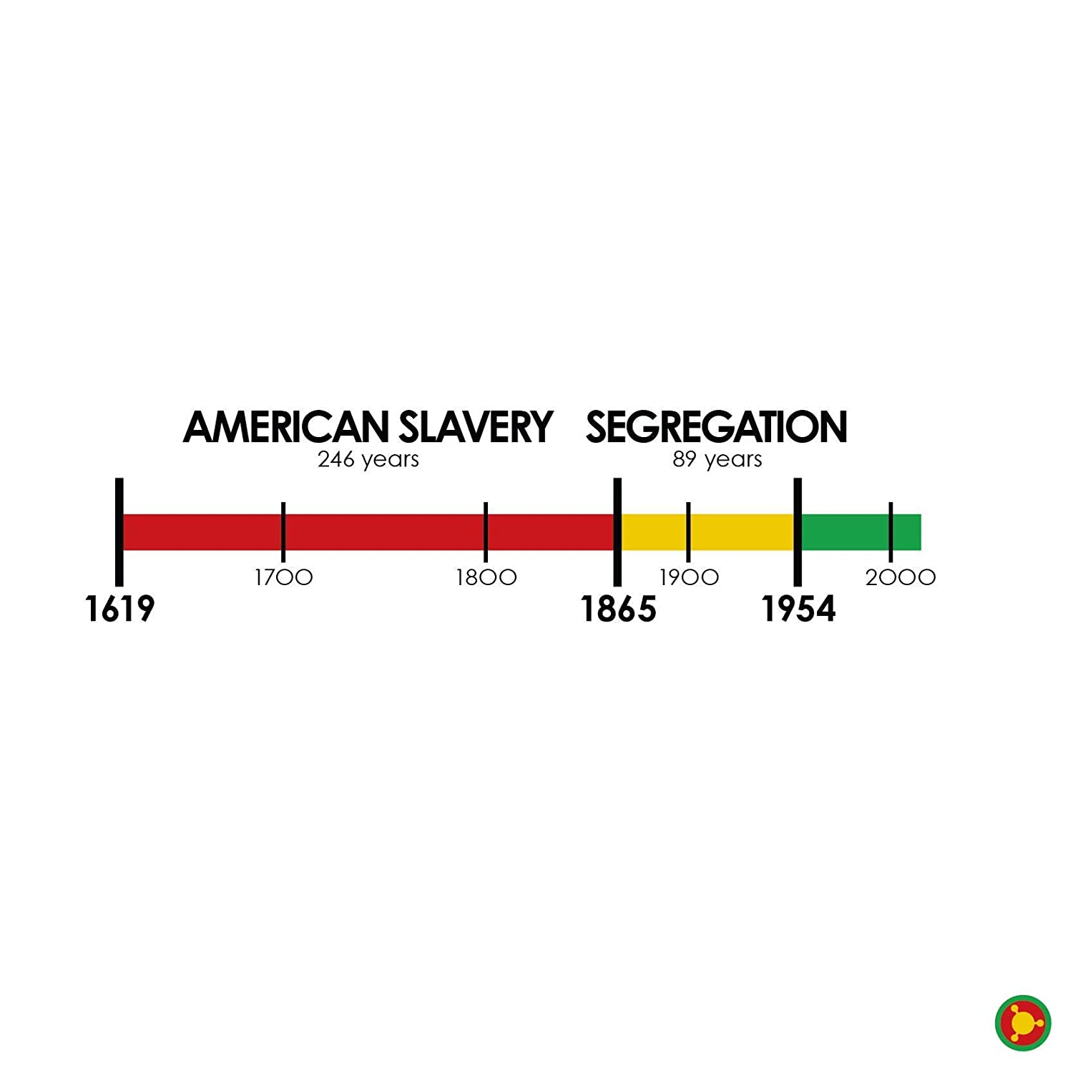
Racism in America:
A Historical Perspective

Slide 64
Racism in America:
A Historical Perspective
White Supremacist Racism is a system of power based on the supremacy & dominance of “white” people. “white” is a political concept created by the European & colonial ruling elite of the 17th & 18th centuries that is revealed in attitudes, behaviors & institutional systems in which white people maintain supremacy over peoples of color. Human beings create & maintain the systems which, in turn, reinforce white supremacist racism.”
-Shay-Akil McLean, PhD, 2014

Slide 65
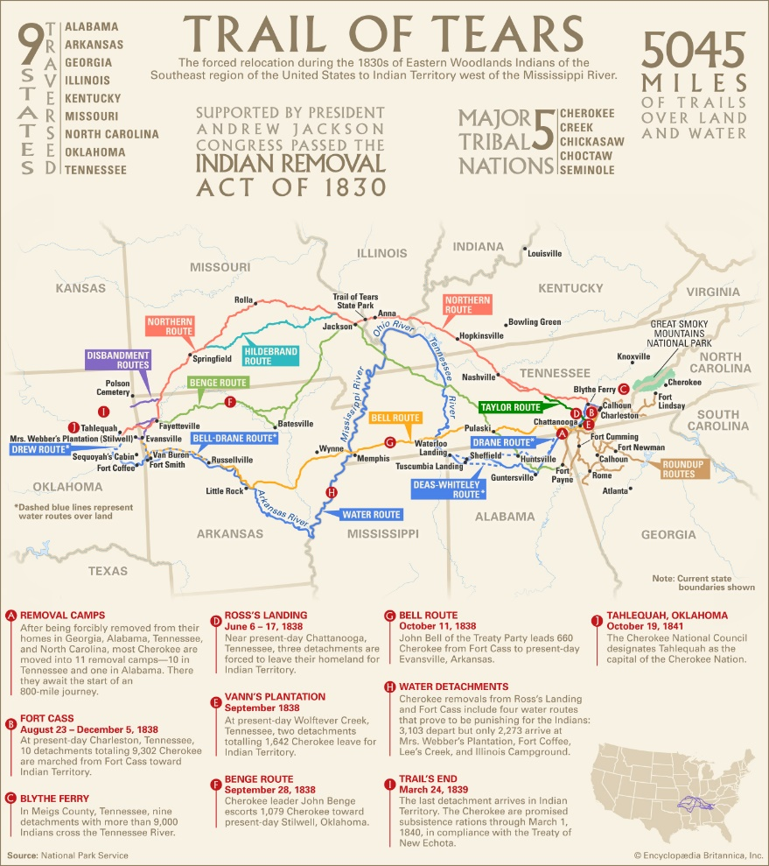
Racism in America:
Genocide of Indigenous People
Indigenous people were subjected to many different forms of violence, all with the intention of destroying their community.
Small pox blankets
Trail of Tears

Slide 66
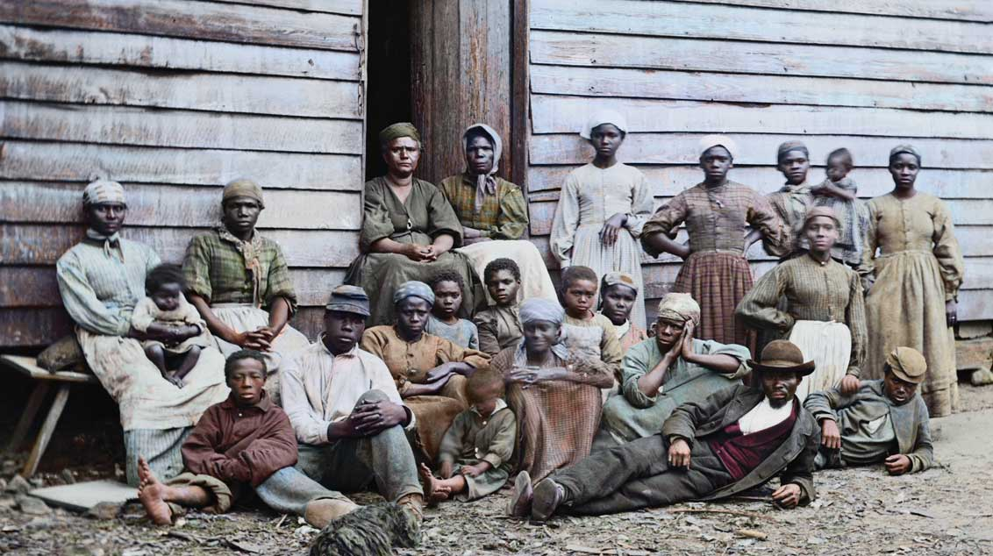
Racism in America:
Chattel Slavery
Millions of African people were kidnapped, enslaved, and shipped across the Atlantic to the Americas under horrific conditions.
As American slavery evolved, an elaborate and enduring mythology about the inferiority of Black people was created to legitimate, perpetuate, and defend slavery.

Slide 67
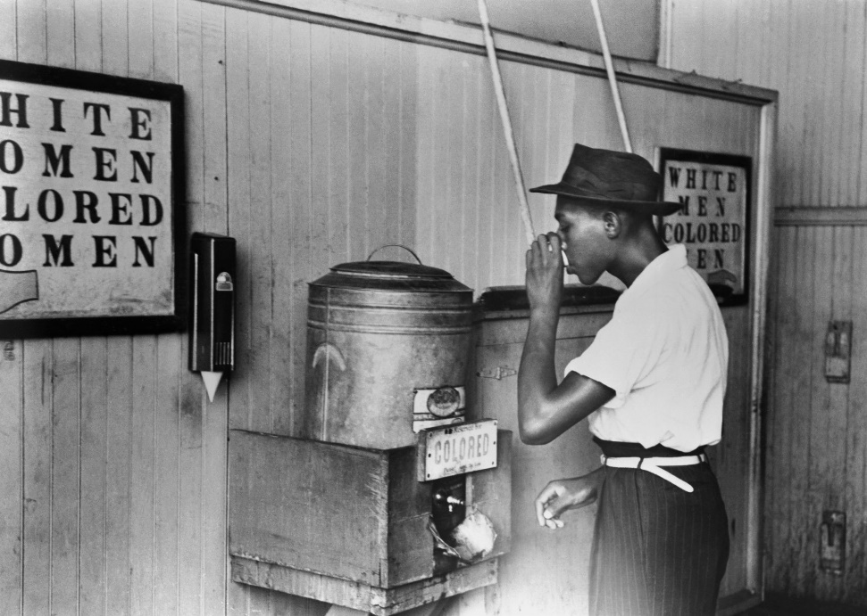
Racism in America:
Jim Crow Laws
Laws that enforced racial segregation in the South.
The segregation principle was extended to parks, cemeteries, theatres, and restaurants in an effort to prevent any contact between Blacks and whites as equals.

Slide 68
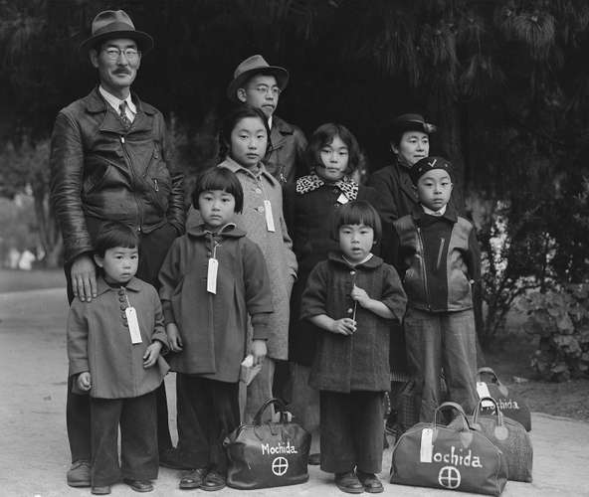
Racism in America:
Japanese-American Internment Camps
Forced relocation by the U.S. government of thousands of Japanese Americans to detention camps during World War II.
Culmination of the federal government’s long history of racist and discriminatory treatment of Asian immigrants and their descendants.

Slide 69
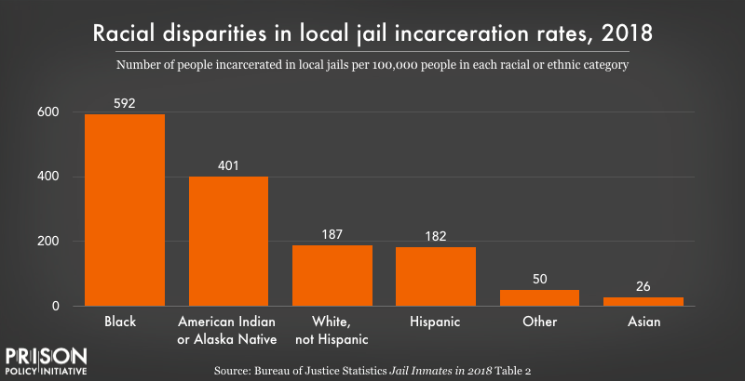
Racism in America:
Mass Incarceration
African Americans, the first victims of mass incarceration programs, are continually subjugated by way of racist policies and stereotypes that brand them as ‘problematic’ citizens.

Slide 70
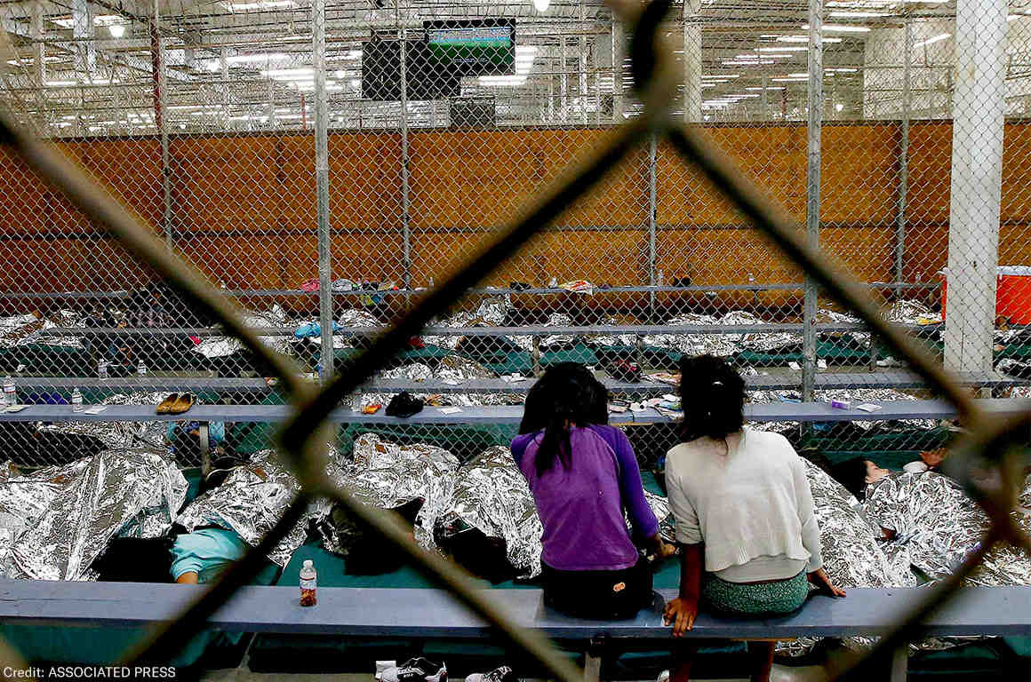
Racism in America:
ICE Detention Camps
Immigration detention is the unjust and inhumane practice of incarcerating immigrants while they await a determination of their immigration status or potential deportation.
ICE measures disproportionately affect Latinx and other racialized immigrant groups in U.S. society.

Slide 71
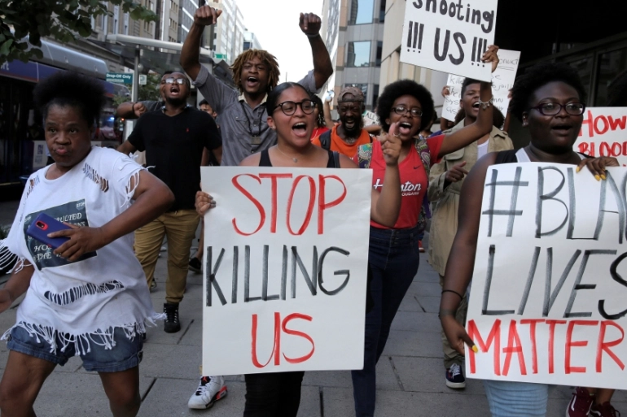
Racism ≠ Race
Racial disparities persist at every level of SES. According to social stress theory, racism is adversely related to a broad range of physical and mental health outcomes.
Racial disparities, and often the diseases themselves, stem in part from the stress of being silenced, ignored, oppressed, and targeted for violence.

Slide 72
Applying Socioecological Model to Diabetes
Understand behavior/lifestyle factors as embedded in social context
Inequities in these contextual factors lead to health inequities by race and SES
Racism (structural, interpersonal, intrapersonal) contributes to these contextual inequities and independently produce inequities

Slide 73
Map of Next Four Weeks
Week 2
Week 3
Economic & Social
Opportunities and Resources
Living & Working Conditions
in Homes and Communities
Week 4
Behaviors
Medical Care
Interaction with genetic/other biological factors
HEALTH
Adapted from Braveman et al., for RWJ Foundation
Commission to Build a Healthier America | www.commissiononhealth.org

Slide 74
What About Socioeconomic Status?

Slide 75
Questions?

