Slide 1
Social Determinants of Health
EPI 222
Salma Shariff-Marco, PhD, MPH
Scarlett Gomez, PhD, MPH
January 12, 2021

Slide 2
Part 1: Overview
SDOH
  definitions/domains/frameworks
  relevance of place
Racism
  Gardener’s Tale review
  structural racism
Socioeconomic Status

Slide 3
WHAT are the Social Determinants of Health?

Slide 4
Social Determinants of Health (SDOH)
Neighbor-hood and Built Environment
Social and Community Context
Education
Economic Stability
Health and Health Care
conditions in which people are born, grow, work, live, and age
broader set of forces and systems that shape the conditions of daily life
SDOH

Slide 5
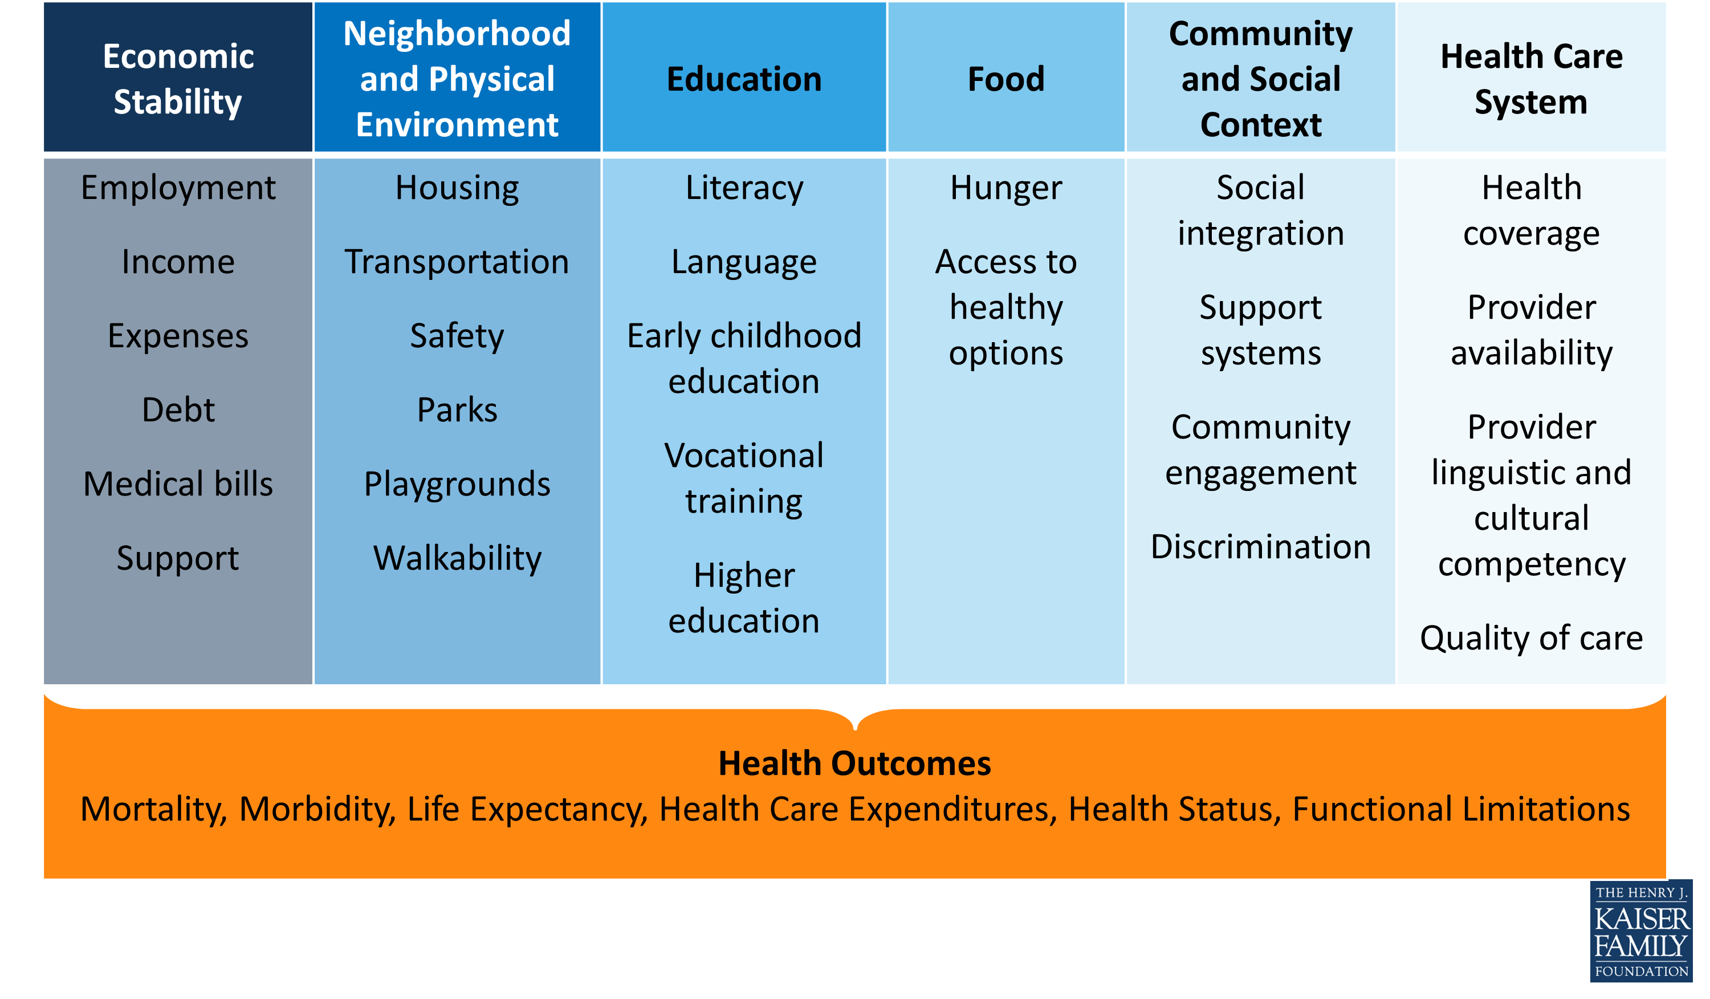
Social Determinants of Health
Beyond Health Care: The Role of Social Determinants in Promoting Health and Health Equity
http://www.kff.org/disparities-policy/issue-brief/beyond-health-care-the-role-of-social-determinants-in-promoting-health-and-health-equity/

Slide 6
Solar O, Irwin A. A conceptual framework for action on the social determinants of health. Social Determinants of Health Discussion Paper 2 (Policy and Practice). Geneva, World Health Organization, 2010.

Slide 7
Social Stratification/Social Status
“the relative rank that an individual holds, with attendant rights, duties, and lifestyle, in a social hierarchy based upon honor or prestige.”
www.brittannica.com
“relations of ownership or control over productive resources (i.e. physical, financial and organizational).”
WHO Social Determinants of Health
Notes:
Through social stratification or hierarchies are formed within societies to indicate
Relative rankings OR
They are often based on relations of ownership or control over productive resources

Slide 8
Dimensions of Social Status
Race/ethnicity
Socioeconomic status/position
Sex
Gender
Sexual orientation
Marital status
Religion
Immigration

Slide 9
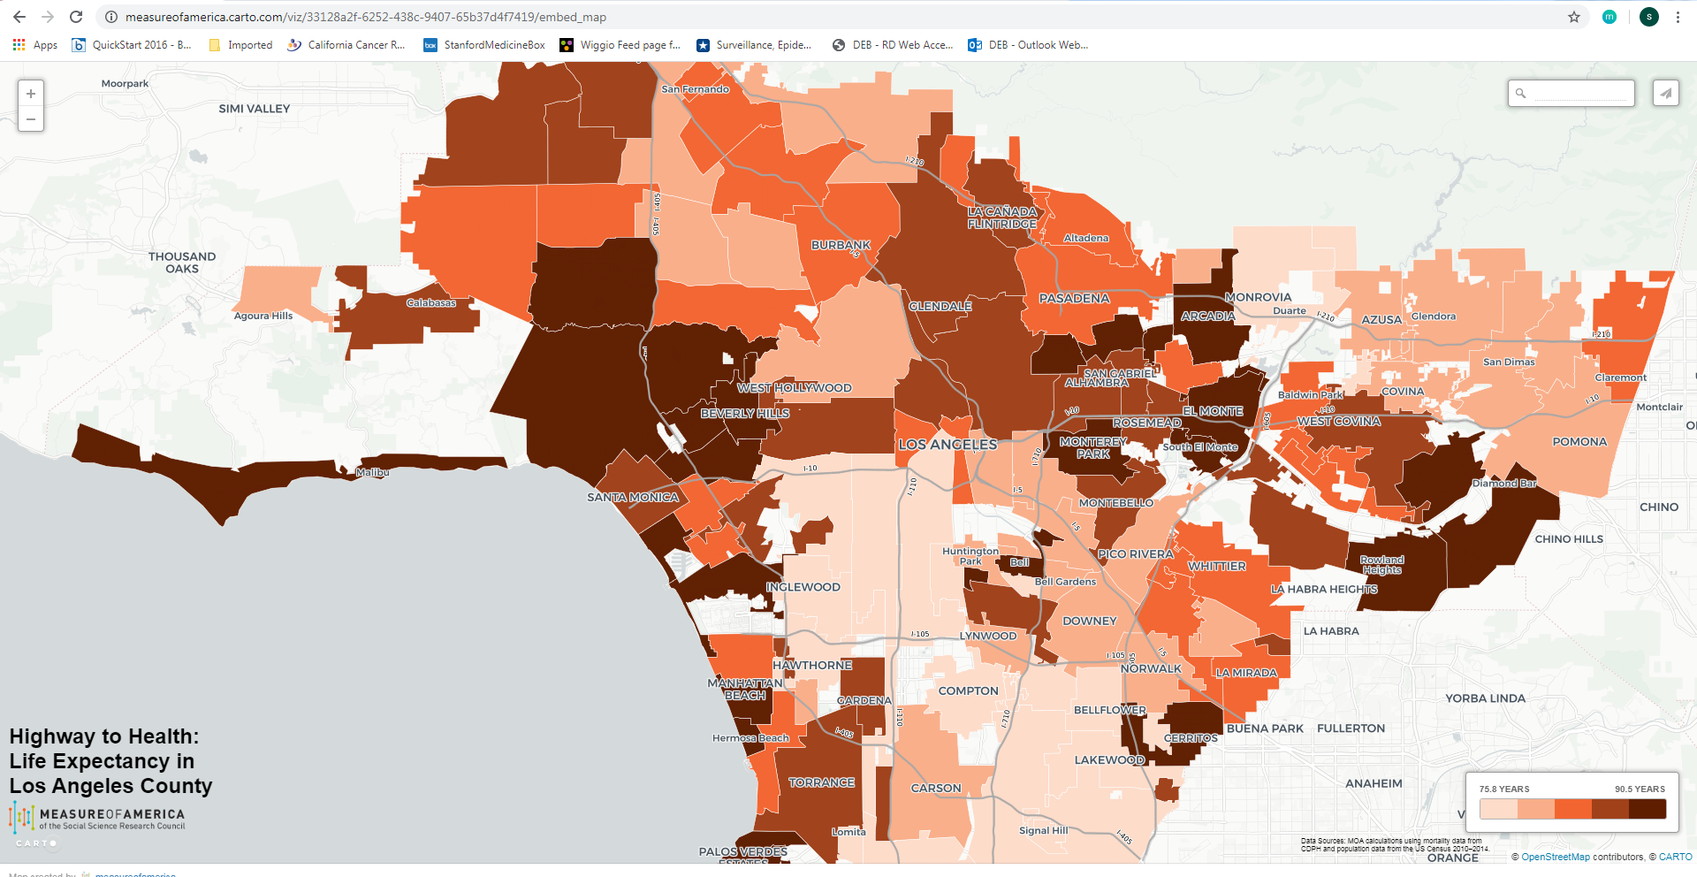
Social Status, Place and Health
Race/ethnicity and SES shape access to places
  Residential neighborhood
  Education
  Workplace
  Healthcare access
https://measureofamerica.carto.com/viz/33128a2f-6252-438c-9407-65b37d4f7419/embed_map

Slide 10
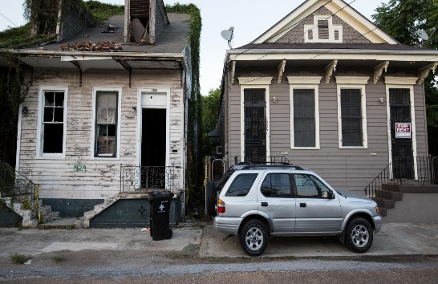

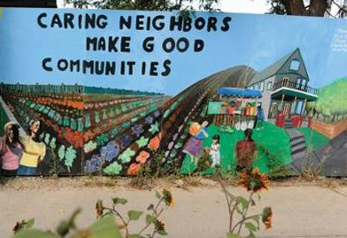
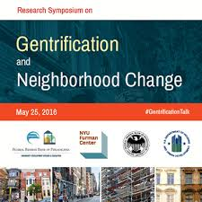
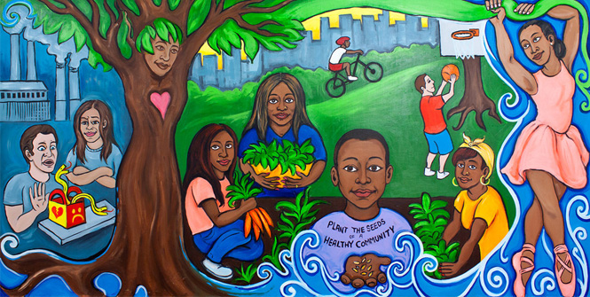
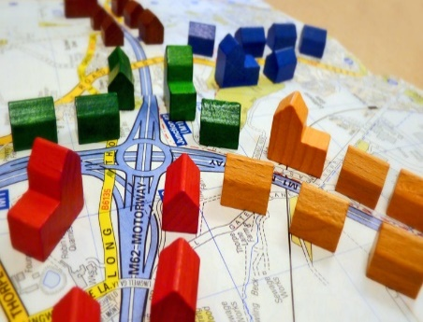
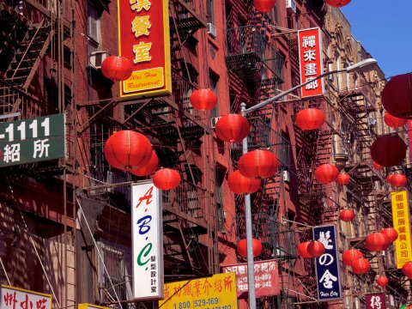
Social Environment Attributes
Social Environment
Socioeconomic status
Crime
Gentrification/ displacement
Ethnic enclave
Racial/ ethnic composition
Social cohesion
Segregation
Socioeconomic Status
Crime
Social Capital/
Social Cohesion
Racial/Ethnic Composition
Gentrification/
Displacement
Ethnic Enclave
Segregation

Slide 11
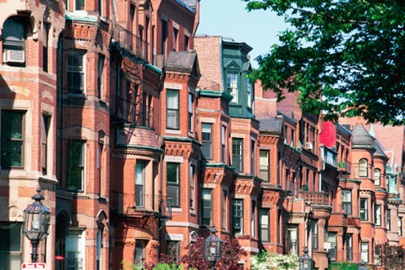
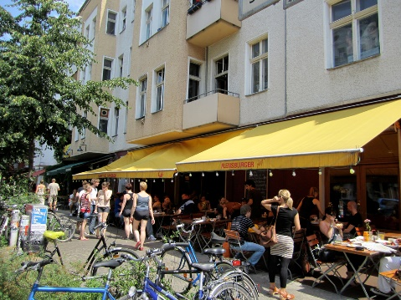
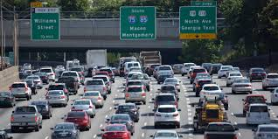
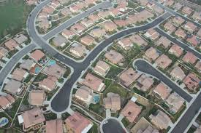
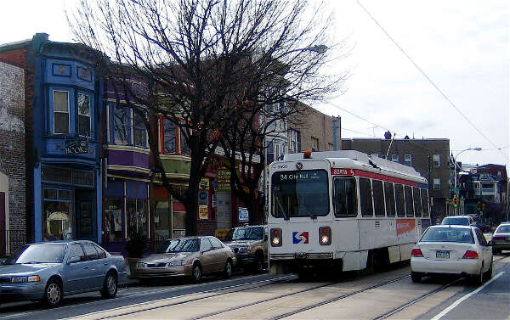

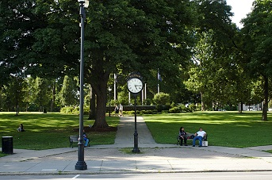

Built Environment Attributes
Population Density
Housing Characteristics
Built Environment
Population density
Housing characteristics
Commuting patterns
Parks/green space
Recreational facilities
Food environment (retail food outlets, restaurants)
Street connectivity
Traffic density
Traffic Density
Street Connectivity
Commuting Patterns
Food Environment
Parks/Green Space
Recreational Facilities

Slide 12
Additional Neighborhood Environments
Physical environment
  Air pollution
  Noise pollution
  Light pollution
  Toxic waste sites
Healthcare Context
  Resources: density of providers, facilities
  % insured/uninsured
  Distance to facilities

Slide 13
Fundamental causes
racism
socioeconomic status (SES)

Slide 14
Racism, United Nations
“any distinction, exclusion, restriction or preference based on race, color, descent, or national or ethnic origin which has the purpose or effect of nullifying or impairing the recognition, enjoyment or exercise, on an equal footing, of human rights and fundamental freedoms in the political, economic, social, cultural or any other field of public life.”

Slide 15
Racism
an organized system that categorizes population groups into ‘races’, and uses this ranking to preferentially allocate societal goods and resources to groups regarded as superior (Bonilla-Silva 1996)
ideology of inferiority that ranks some racial groups as inherently or culturally superior to others and supports the social norms and institutions that implement this ideology (Jones 1997)

Slide 16
Racism and Health
Multiple pathways (direct)
  economic deprivation, including poor housing and educational opportunities, exposure to dangerous neighborhoods, lack of access to healthy food, riskier work, and a lack of health insurance
  excess exposure to toxins, hazards, pathogens
  social trauma
  targeted marketing of harmful commodities
Muennig & Murphy, Journal of Health, Politics, & Law, 2011
Krieger, AJPH 2012

Slide 17
Racism and Health
Multiple pathways (indirect)
  effectively “stressing” the individual, leading to neuroendocrine disruptions that affect one’s physical and mental health (racism as a stressor)
  health-harming responses (coping via alcohol, smoking, poor diet)
Muennig & Murphy, Journal of Health, Politics, & Law, 2011
Krieger, AJPH 2012

Slide 18
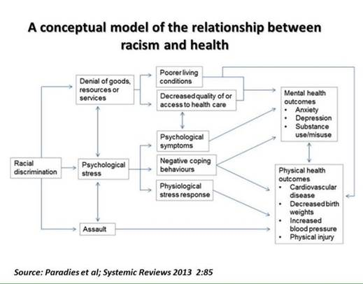

Slide 19
Multilevel, Multiple Dimensions of Racism
Jones, APJH 2000; Bailey et al, Lancet 2017; 389: 1453–63
Institutionalized racism (e.g., residential segregation)
  differential access to goods, services, opportunities and power
  structural, systemic (codified in customs, practices, laws)
Structural racism refers to the totality of ways in which societies foster racial discrimination through mutually reinforcing systems of housing, education, employment, earnings, benefits, credit, media, health care, and criminal justice.
  These patterns and practices in turn reinforce discriminatory beliefs, values, and distribution of resources.

Slide 20
Measures/Domains of Structural Racism
Beyers et al, Health & Place 2016; 40: 34–43; Bailey et al, NEJM 2020
Housing
  Redlining
  Bias in mortgage lending
  Racialized residential segregation
Education
Employment
Judicial System
  mass incarceration
  police violence
Unequal medical care

Slide 21
Multilevel, Multiple Dimensions of Racism
Jones, APJH 2000
Personally mediated racism (e.g., prejudice and discrimination)
  differential assumptions about abilities, motives, and intentions of others by race/ethnicity
  differential actions towards others by race/ethnicity
Internalized racism
  acceptance by members of stigmatized race/ethnicity of negative messages about their own abilities and intrinsic worth

Slide 22
Additional Dimensions of Racism
Intergenerational impacts
  Historical trauma
  Wealth and inheritance
Discrimination in health care (medical discrimination)
  Institutional policies, practices
  Interpersonal interactions (providers/staff)
Implicit (unconscious) racial bias
  https://implicit.harvard.edu/implicit/iatdetails.html
Notes:
Senate Bill 464offsite link, known as the California Dignity in Pregnancy and Childbirth Act, requires implicit bias training for all healthcare professionals working in perinatal services.
AB241—by January 1, 2022 requires all CME trainings to include content on implicit bias.

Slide 23
Lessons from the Gardener’s Tale
Jones, APJH 2000
Interventions at 3-levels of racism
  internalized: pink is beautiful
  personally mediated: change gardener’s attitudes/behavior towards pink flowers
  institutionalized: improve the conditions in which the pink flowers born, grow and live
Addressing the SDOH/fundamental causes will yield the biggest impact

Slide 24
Socioeconomic position/status
Socioeconomic position/status
“… the social and economic factors that influence what positions individuals or groups hold within the structure of a society”
“… the social and economic factors that influence what positions individuals or groups hold within the structure of a society”
Galobardes et al 2006
SES and health
Multidimensional, multilevel construct
Life course perspective
Multiple causal pathways
  Independent and joint associations across levels
  Interacts with other social status measures (race/ethnicity)

Slide 25
Measures of SES
Education
  years of formal education completed
  ordinal categories
Income
  annual household and factor number of dependents
Occupation
  laborer, technical, professional, business
  manual/non-manual
Neighborhood SES
  % poverty, composite indices

Slide 26
Additional SES Measures
Wealth
  Assets
  Debt
  Ownership (home, car)
Childhood SES
  Parental occupation and education
  Household income, wealth
Self-perceived ‘standing’ on a ladder ranging from 1 to 10

Slide 27
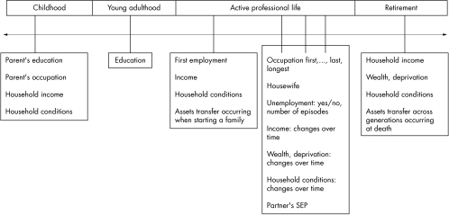
SES across the Life Course
Galobardes et al 2006
Notes:
Talk about research using cross-sectional measures, cumulative measures and then measures across the life course (more specific to research questions/outcomes)
Latency/critical period model: Exposure during sensitive window puts one at risk for development of disease later in life. Exposures encountered after the critical window closes do not influence risk. Focus on early life experiences that do not have a cumulative effect.
Example is cognitive and socioemotional development
Social trajectory model: Social disadvantage increases risk of future disadvantage later in life. The initial insult does not necessarily have a harmful effect on the outcome – but the first exposure leads to subsequent exposures that then directly cause the outcome.
Cumulative effects
Accumulation of risk model

Slide 28
SES-related Stressors
Job insecurity
Job strain (High demands / Low control)
Housing insecurity/homelessness
Food insecurity
Adequate health care coverage
Notes:
Can go even further and talk about food policy, corn syrup etc.
http://www.ncbi.nlm.nih.gov/pubmed/24392603
http://www.ncbi.nlm.nih.gov/pubmed/15622689
http://www.ncbi.nlm.nih.gov/pubmed/18366535/
Perceived discrimination/racism has been shown to play a role in unhealthy behaviors such cigarette smoking, alcohol/substance use, improper nutrition, and refusal to seek medical services (Lee, Ayers, & Kronenfeld, 2009; Peek et al, 2011).

Slide 29
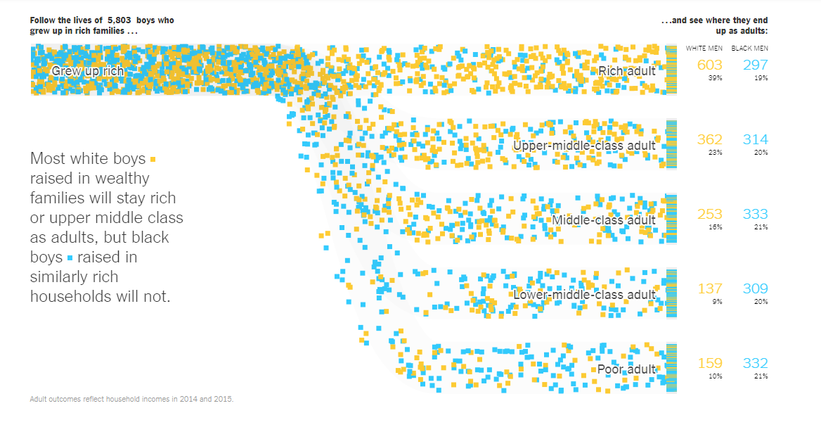
Adult SES | White Men | Black Men
Rich | 39% | 17%
Upper middle-class | 24% | 19%
Middle-class | 16% | 22%
Lower middle-class | 10% | 20%
Poor | 10% | 21%
https://www.nytimes.com/interactive/2018/03/19/upshot/race-class-white-and-black-men.html

Slide 30
Race/Ethnicity + SES as Fundamental Causes: Framework for social inequities in health
SDOH-Intermediate
Social Status
Diez Roux, Annual Review of Public Health 2012

Slide 31
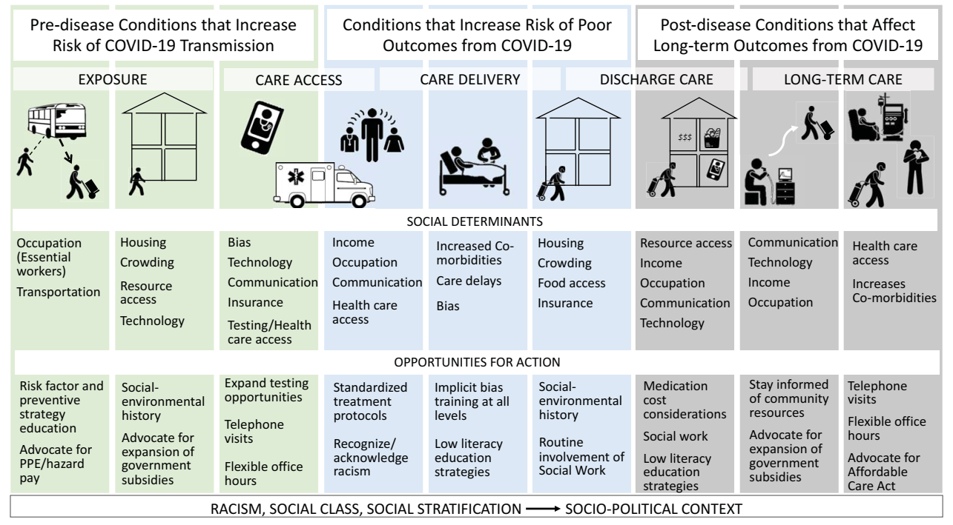
Figure 2 Thakur et al, 2020

Slide 32
Part 2: SDOH and Health Behaviors
Social patterning of behavioral factors
Conceptual models
Explanatory concepts & potential pathways
Small group work
Discussion

Slide 33

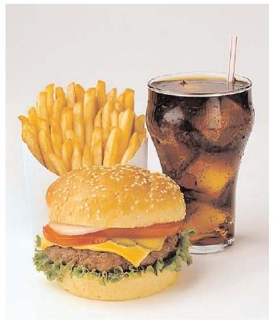
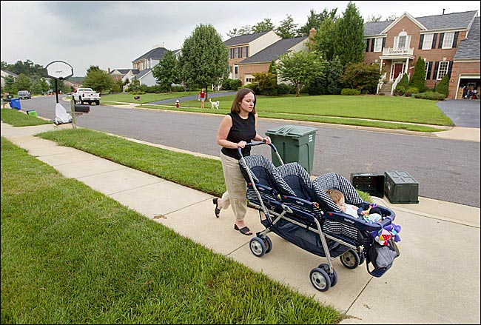
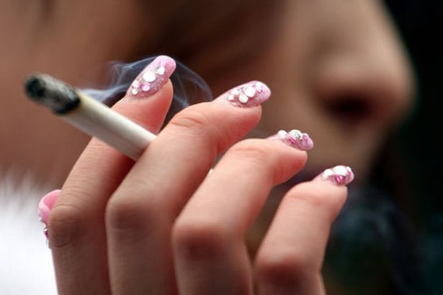
Social patterning of health behaviors

Slide 34
Health behaviors vary by SES
In representative US sample (Lantz, JAMA 1998)
Health Behavior | < High school education | College education
Smoking | 42% | 20%
Excessive alcohol intake | 4.4% | 3.7%
Physical inactivity | 37% | 14%
Obesity | 28% | 11%

Slide 35
Tobacco trends by education

Slide 36
Health behaviors by race/ethnicity,
California Health Interview Survey 2015-2016

Slide 37
Conceptual models of health behaviors

Slide 38
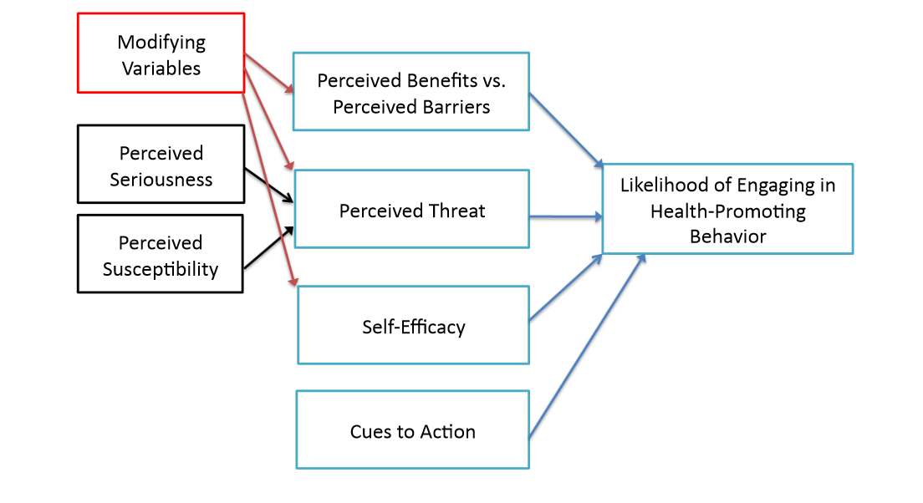
Psychological models of motivation and behavioral change
The Health Belief Model

Slide 39

Putting it in Context: World Health Organization’s Commission on Social Determinants of Health Framework
Socioeconomic & political context
Governance
Policy (Macroeconomic, Social, Health)
Cultural and societal norms and values
Social Position
Material circumstances
Social cohesion
Psychosocial factors
Behaviors
Biological factors
Distribution of health and
well-being
Education
Occupation
Income
Gender
Ethnicity/Race
Health-Care System
SOURCE: Amended from Solar & Irwin, 2007
SOCIAL DETERMINANTS OF HEALTH INEQUITIES
http://www.who.int/social_determinants/thecommission/finalreport/graphs/en/

Slide 40
“Unnatural Causes. Place Matters” (PBS 2008)
Why is your street address…such a good predictor of your health?
“When we think about health, we usually think about health care and access to health care and the quality of care. But what research clearly shows is that health is embedded in the larger conditions in which we live and work.…
Sometimes, we naively think of improving health by simply changing behaviors. But the choices of individuals are often limited by the environments in which they live.”
(David Williams)

Slide 41
Cells-to-Society model
A framework for multilevel research
Centers for Population Health and Health Disparities, NIH
Social conditions & policies
Poverty, norms, prejudice
Fundamental causes
Institutional context
Health care system, economic system, media, political system
Social context
Collective efficacy, social capital, racial/ethnic integration
Social relationships
Social networks, social support, religious participation, civic engagement
Social & physical context
Interactions
Disparate health outcomes
Physical context
Building quality, pollution, sidewalks, parks
Individual demographics
Age, race/ethnicity, SES, health insurance, education, acculturation
Individual factors
Individual risk behaviors
Smoking, alcohol, diet, sleep
Biological responses
Obesity, depression, stress, hypertension
Biologic/Genetic pathways
Allostatic load, biologic processes, genetic ancestry, genetic mechanisms
Biologic factors
Warnecke et al. AJPH 2008

Slide 42
Cells-to-Society model
Fundamental causes
They are considered fundamental causes because their influence is solely reflected at the population level in the variation in rates of disease or poor health... Their roots are embedded in policy, shared social norms about health and social practices, socioeconomic disadvantage, and policies that affect public availability of health services, including who receives them and the level and quality of service. They are the determinants of inequities rather than differences.
Social conditions & policies
Poverty, norms, prejudice
Fundamental causes
Institutional context
Health care system, economic system, media, political system
Social context
Collective efficacy, social capital, racial/ethnic integration
Social relationships
Social networks, social support, religious participation, civic engagement
Social & physical context
Interactions
Disparate health outcomes
Physical context
Building quality, pollution, sidewalks, parks
Individual demographics
Age, race/ethnicity, SES, health insurance, education, acculturation
Individual factors
Individual risk behaviors
Smoking, alcohol, diet, sleep
Biological responses
Obesity, depression, stress, hypertension
Biologic/Genetic pathways
Allostatic load, biologic processes, genetic ancestry, genetic mechanisms
Biologic factors
Warnecke et al. AJPH 2008
Notes:
The Cells-to-Society model of cancer disparities research, published in 2008, nicely illustrates
The model provides examples of fundamental causes of disparity,
the contexts in which people live and work,
individual-level factors—like race/ethnicity and education and behavioral factors like smoking and diet—
and the biologic responses and pathways that ultimately decide an individuals’ health state.
The arrow on the left indicates that one can expect interactions between these levels and between factors within

Slide 43

#RacismNotRace
Critical Race Theory
Selected tweets from academics
Race is NOT the risk factor, racism is.
M. McLemore
In fact, structural racism is THE risk factor…
J. Attilus
…we should be talking about the effects of structural, interpersonal, and cultural racism in not only the health care system but society in general
M. Agenor
#RacismNotRace is about pushing past the “control for race” mode of engaging structural racism & addressing the upstream factors that shape Black patients’ health.
A. Planey

Slide 44
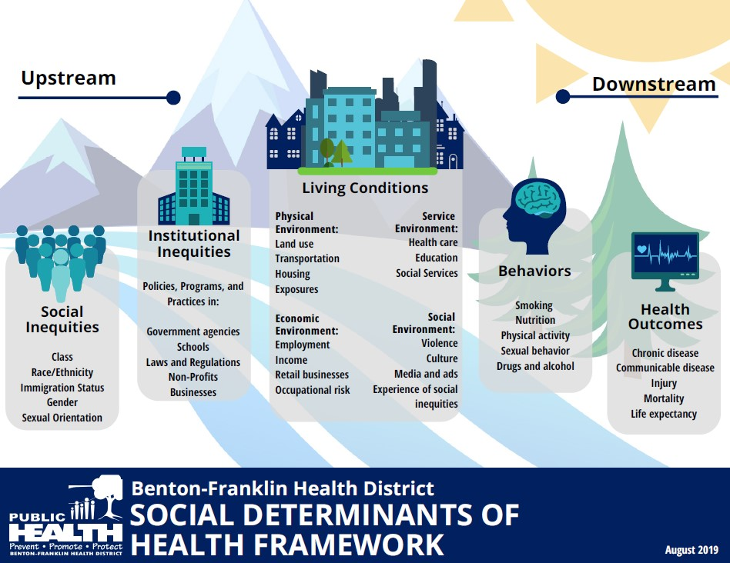
To achieve health equity…
To modify behaviors…we need to address the social determinants of health, especially the upstream factors.
Benton-Franklin Health District. Social determinants of health. Accessed 9/24/20 at: https://www.bfhd.wa.gov/health_topics/health_equity/social_determinants_of_health

Slide 45
Intersectionality: “intersecting inequalities” & “multiple vulnerabilities”
Intersectionality theory originated from Black feminist scholarship
Upstream social determinants (racism, sexism, classism) that shape life experiences and restrict opportunities for upward mobility for individuals as a consequence of their multi-dimensional social statuses
Social status/identity is a marker of institutional policies
In health inequalities research:
  “inter-categorical intersectionality” → interactions between dimensions of social statuses/identities
Application example: Freeman, Int J Equity Health 2017
  Structural racism and engagement in HIV care
Green, Evans, Subramanian. Social Sci Med 2017
Williams et al. Health Services Research 2012

Slide 46
Explanatory concepts/POTENTIAL PATHWAYS connecting social determinants with behaviors

Slide 47
Potential pathways
Sociological perspectives
Fewer benefits of health behaviors for longevity
Latent traits
Class distinctions
Knowledge and access to information
Efficacy and agency
(Pampel Annu Rev Sociol 2010)

Slide 48
Potential pathways
Contextual considerations
Access to resources: neighborhood/environmental context
Economic deprivation, financial constraints
Social and cultural norms, culturally-driven health beliefs
Stress & social support
Medical mistrust & healthcare utilization

Slide 49
Potential pathways
Sociological perspectives
Fewer benefits of health behaviors for longevity
Latent traits
Class distinctions
Knowledge and access to information
Efficacy and agency
(Pampel Annu Rev Sociol 2010)

Slide 50
Fewer benefits of health behaviors for longevity
Persons of low SES have less to gain from healthy behaviors
Less reason to invest in future longevity and more reason to focus on present when making decisions about health behaviors
Lower SES groups feel fatalistic about ability to act in ways that extend longevity, reduce disease risk
(Pampel Annu Rev Sociol 2010)

Slide 51
Potential pathways
Sociological perspectives
Fewer benefits of health behaviors for longevity
Latent traits
Class distinctions
Knowledge and access to information
Efficacy and agency
(Pampel Annu Rev Sociol 2010)

Slide 52
Latent traits
Personal characteristic with propensity to engage in risky and/or unhealthy behaviors
Crime literature – low self-control, attraction to risk, choose short-term gain in the face of long-term harm
(Pampel Annu Rev Sociol 2010)

Slide 53
Potential pathways
Sociological perspectives
Fewer benefits of health behaviors for longevity
Latent traits
Class distinctions
Knowledge and access to information
Efficacy and agency
(Pampel Annu Rev Sociol 2010)

Slide 54
Class distinctions
Engage in healthy behaviors and lifestyles to set themselves apart from lower SES groups
Classical theory: lifestyle as source of social differentiation, adoption of innovative fashion to reinforce differences
(Pampel Annu Rev Sociol 2010)

Slide 55
Potential pathways
Sociological perspectives
Fewer benefits of health behaviors for longevity
Latent traits
Class distinctions
Knowledge and access to information
Efficacy and agency
(Pampel Annu Rev Sociol 2010)

Slide 56
Knowledge and access to information
Lower SES groups have less access to and opportunities for learning about harms of unhealthy behaviors
Some groups may also be exposed to more advertising
Persons with college degree 3.6 x more likely to report that they pay attention to nutritional information from scientific experts, compared to those with less than high school degree
(Pampel Annu Rev Sociol 2010)

Slide 57
Potential pathways
Sociological perspectives
Fewer benefits of health behaviors for longevity
Latent traits
Class distinctions
Knowledge and access to information
Efficacy and agency
(Pampel Annu Rev Sociol 2010)

Slide 58
Efficacy and agency
Education provides human capital, effective agency, and sense of personal control
Education trains individuals to evaluate and use information
High SES groups are quickest to use new medical technologies
Education increases use of aids to quit smoking, and responsiveness to antismoking ads
(Pampel Annu Rev Sociol 2010)

Slide 59
Potential pathways
Contextual considerations
Access to resources: neighborhood/environmental context
Economic deprivation, financial constraints
Social and cultural norms, culturally-driven health beliefs
Stress & social support
Medical mistrust & healthcare utilization

Slide 60
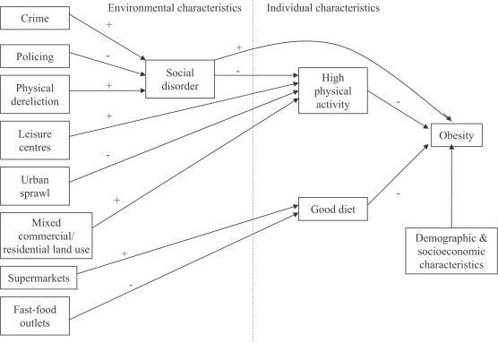
Model linking social and physical environmental characteristics to obesity
Stafford et al. Pathways to obesity: Identifying local, modifiable determinants of physical activity and diet. Social Science & Medicine 2007

Slide 61
Model linking social and physical environmental characteristics to obesity
… choices of individuals are often limited by the environments in which they live.
D. Williams
Stafford et al. Pathways to obesity: Identifying local, modifiable determinants of physical activity and diet. Social Science & Medicine 2007

Slide 62
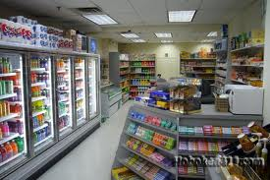
Food environment
Galvez et al 2009:
Children (ages 6-8) living on a block with 1 + convenience stores (range, 1–6) were more likely to have a BMI percentile in the top tertile (OR 1.90, 95% CI, 1.15–3.15) compared with children having no convenience stores
Oreskovic et al 2009:
Distance to nearest fast-food restaurant was inversely associated with BMI
Chen et al 2016:
Food environment incl. living in food desert associated with obesity after adjusting for home food environment factors

Slide 63
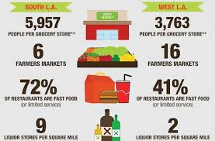
“Food Desert” - low-income census tract where a large number of residents are more than a mile from a grocery store.

Slide 64
Potential pathways
Contextual considerations
Access to resources: neighborhood/environmental context
Economic deprivation, financial constraints
Social and cultural norms, culturally-driven health beliefs
Stress & social support
Medical mistrust & healthcare utilization

Slide 65
Economic deprivation/
Financial constraints
Meta-analysis of 27 studies - healthy eating costs $1.48 more per day per adult than eating a low-quality diet ($550 more annually per person).
Aids for healthy behavior (Pampel 2010)
  Costs required for resources to quit smoking/reduce alcohol dependency, physical activities

Slide 66
Potential pathways
Contextual considerations
Access to resources: neighborhood/environmental context
Economic deprivation, financial constraints
Social and cultural norms, culturally-driven health beliefs
Stress & social support
Medical mistrust & healthcare utilization

Slide 67
Social and cultural norms, culturally-driven health beliefs
Some negative health behaviors are more common among certain social groups
  Culturally acceptable? E.g., alternative forms of smoking among South Asians, esp. women
  Less stigmatized? E.g., overweight/obesity among immigrant/2nd gen Latinos and Asians
  Targeted advertising? E.g., menthol cigarettes among African-American communities
  Greater availability? E.g., betel-nut chewing in East Asia
  Perceived necessity of preventive health in absence of symptoms

Slide 68
Potential pathways
Contextual considerations
Access to resources: neighborhood/environmental context
Economic deprivation, financial constraints
Social and cultural norms, culturally-driven health beliefs
Stress & social support
Medical mistrust & healthcare utilization

Slide 69
Stress & social support
Socioeconomic disadvantage → increased adversity, drain on capacity to cope (Pampel 2010)
Affordances model:
  Poor health behaviors → regulate mood → ability to cope
Environmental affordances:
  Relationships between people and their environments that can have an effect on human activity whether or not they are visible, known, or desirable.

Slide 70
Affordances Model
Over the life course, Black populations (and other underserved populations) are more likely to engage in coping strategies (i.e., adverse health behaviors) that “preserve” mental health
However, over time, in concert with social, economic, and environmental stressors, these coping strategies lead to poor physical health in middle age and older life
Jackson et al. AJPH 2010

Slide 71
Adverse Childhood Experiences (ACEs) - CDC
Before the age of 18:
Live with
  depressed or mentally ill person
  alcoholic
  drug user
  anyone sentenced to prison time
Parents separated or divorced
Exposed to domestic violence
Physical abuse
Sexual abuse

Slide 72
Adverse Childhood Experiences and adult health behaviors, UK
Bellis et al. AJPH 2013

Slide 73
Potential pathways
Contextual considerations
Access to resources: neighborhood/environmental context
Economic deprivation, financial constraints
Social and cultural norms, culturally-driven health beliefs
Stress & social support
Medical mistrust & healthcare utilization

Slide 74
Medical mistrust and healthcare utilization
Historical and personal experiences with adverse medical experiences may result in mistrust of the medical care system and providers, leading to avoidance of medical care
Medical mistrust index (of healthcare organizations) associated with measures of underutilization of health care (LaVeist et al. Health Serv Res 2009)
Review of 27 studies showed greater medical mistrust associated (in most studies) with lower use of colorectal cancer screening (Adams et al. J Comm Health 2017)

