Slide 1
Epi 207: Introduction to Directed Acyclic Graphs
Rebecca Graff
Assistant Professor, Department of Epidemiology & Biostatistics
Based on Slides from Maria Glymour and Miguel Hernán

Slide 2
Organization
Overview of DAGs
Research Design Interlude
DAGs for Common Problems in Epidemiology
  Confounding
  Selection Bias
  Measurement Bias
  Bias in RCTs
Limitations of DAGs
2

Slide 3
Overview of DAGs

Slide 4
Why Causal Diagrams?
Conceptualize problems
Show your assumptions about relationships among variables
Classify sources of bias
Identify issues in study design and analysis
4
Notes:
DAGs help to conceptualize problems. They offer a framework for summarizing your knowledge and assumptions about a research question.
Because causal inference generally requires expert knowledge and untestable assumptions about relationships among exposure, outcome, and other variables, DAGs are important for making choices explicit.
They also help to classify and identify sources of bias that could affect your ability to validly answer your research question.

Slide 5
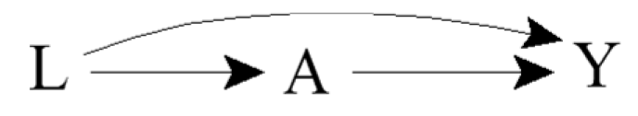
Terminology
Directed: Edges imply a direction
Acyclic: No cycles; a variable cannot cause itself
Edge: Arrow
Node: Random variable
Causal DAG: Common causes of any pair of variables in the graph are also in the graph
5
Notes:
Causal DAGs need not include variables that are not of interest for the analysis and that are not common causes of other variables in the DAG

Slide 6

Ideal Randomized Experiments
What does the DAG look like for a marginally randomized experiment?
What does the DAG look like for a conditionally randomized experiment?
6
Notes:
An ideal marginally randomized experiment is not affected by any sources of bias, so the only relevant variables are A and Y.
In a conditionally randomized ideal experiment, we know that L affects the probability of randomization as well as the probability of outcome, so now we see edges from L into A and Y.

Slide 7
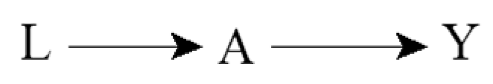
Incorporating Expert Knowledge
Complete DAGs do not exclude any possible causal effect
Incomplete DAGs encode expert knowledge in the form of missing arrows
7
Notes:
When incorporating expert knowledge into DAGs, the information is in the missing arrows.
A complete DAG does not exclude any possible causal effect
In contrast, incomplete DAGs, which is to say DAGs that don’t have all possible arrows, encode expert knowledge in the form of missing arrows.
This second DAG, for example, encodes the knowledge that the variable L does not affect the variable Y

Slide 8
Causal Effects and Association
For example:
  A: Cigarette smoking
  Y: Lung cancer
  Pr(Y^{a=1} = 1) ≠ Pr(Y^{a=0} = 1)
  Pr(Y = 1 | A = 1) ≠ Pr(Y = 1 | A = 0)
8
Notes:
Suppose you know that smoking has a harmful causal effect on the risk of lung cancer
Then what should the graph look like that represents an experiment in which cigarette smoking is randomly, and unconditionally, assigned?
We’re essentially back to our marginally randomized ideal experiment.
In general, when one knows that A has a causal effect on Y, then one should also generally expect A and Y to be associated
Consistent with the fact that in an ideal randomized experiment with unconditional exchangeability, causation implies association and vice versa

Slide 9
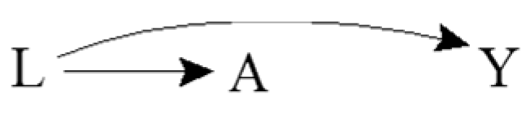
Common Causes and Association
For example:
  A: Yellow fingers
  Y: Lung cancer
  L: Cigarette smoking
  Pr(Y^{a=1} = 1) = Pr(Y^{a=0} = 1)
  Pr(Y = 1 | A = 1) ≠ Pr(Y = 1 | A = 0)
Confounding!
Results in lack of unconditional exchangeability
9
Notes:
Suppose you know that having yellow fingers has no causal effect on lung cancer, as reflected by the lacking arrow between A and Y
You also know that cigarette smoking, as represented by L, has a causal effect on both having yellow fingers and the risk of lung cancer. It is a common cause of A and Y.
So imagine that an investigator decides to study the effect of having yellow fingers on the risk of lung cancer in the observational setting.
He asks to see the fingers of a large number of people and records if they are diagnosed with lung cancer during the next five years.
Someone who has yellow fingers is more likely to be a smoker, and therefore is more likely to develop lung cancer.
A and Y are thus expected to be associated because the cancer risk in those with yellow fingers is different from the cancer risk in those without yellow fingers.
Having information about A improves our ability to predict Y, even though A does not cause Y
If we ask ourselves whether the individuals with A = 1 are exchangeable with the individuals for whom A = 0, the answer would be no. There is a lack of exchangeability, and thus confounding of relationship between A and Y by L
That’s reflected in the DAG by a pathway from A to L to Y

Slide 10
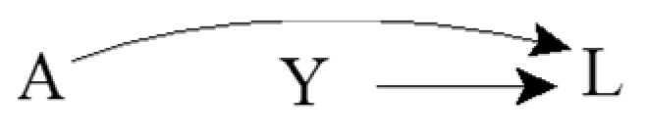
Common Effects
For example:
  A: Genetic factor
  Y: Environmental factor
  L: Lung cancer
  Pr(Y^{a=1} = 1) = Pr(Y^{a=0} = 1)
  Pr(Y = 1 | A = 1) = Pr(Y = 1 | A = 0)
Collider
10
Notes:
Assume that a genetic and environmental risk factor for lung cancer have no bearing on each other.
The common effect L is referred to as a collider on the path A → L ← Y because the two arrowheads collide on this node
No causal relationship between A and Y
And what about the associational relationship?
Imagine that another investigator decides to study the effect of the genetic risk factor on the risk of the environmental risk factor. She determine whether or not each individual has the genetic risk factor and records whether the same individual has the environmental risk factor. For a person without the genetic risk factor, is the environmental risk factor more or less likely to be present than for any other individual? Learning about the genetic risk factor not improve our ability to predict the outcome Y because the risk of the environmental factor in persons with or without the genetic risk factor is the same. In other words, we would intuitively conclude that A and Y are not associated. The knowledge that both A and Y cause lung cancer is irrelevant when considering the association between A and Y.
Causal graphs theory again confirms our intuition because it says that colliders, unlike other variables, block the flow of association along the path on which they lie.
Thus A and Y are independent because the only path between them is blocked by the L.

Slide 11
Conditioning on Mediators
For example:
  A: Cigarette smoking
  Y: Lung cancer
  B: DNA damage to lung cells
  Pr(Y^{a=1} = 1) ≠ Pr(Y^{a=0} = 1)
  Pr(Y = 1 | A = 1) ≠ Pr(Y = 1 | A = 0)
  Pr(Y = 1 | A = 1, B = b) = Pr(Y = 1 | A = 0, B = b)
A
B
Y
11
Notes:
Is there a causal effect of A on Y?
All of the arrows on the path from A to Y are pointing in the same direction, so A still causes Y.
Association, unlike causation, is a symmetric relationship between two variables; thus, when present, association flows between two variables regardless of the direction of the causal arrows. In this DAG, one could equivalently say that the association flows from A to Y or from Y to A. For causation, however, the arrows must all flow in the same direction. Both A and B cause Y according to this DAG, but Y does not cause either.
Are A and Y unconditionally associated?
We know that A has an effect on Y, so that should indicate to use that there is an association between A and Y
But what if we only look at individuals who do (or do not) have DNA damage?
Suppose we restrict the analysis to the subset of individuals with no DNA damage (B=0), as indicated by the box placed around B.
Individuals with no DNA damage (B = 0) have a lower than average risk of lung cancer. Regardless of whether an individual with no DNA damage was treated (A = 1) or untreated (A = 0), we already know that he has a lower than average risk because he doesn’t have DNA damage.
Because smoking affects lung cancer risk only through DNA damage, learning smoking status doesn’t contribute any additional information about lung cancer risk
In the subset of individuals with low DNA damage, smoking and lung cancer are not associated, and it’s the same argument for those DNA damage.
Graphically, we say that a box placed around variable B blocks the flow of association through the path A → B → Y .

Slide 12
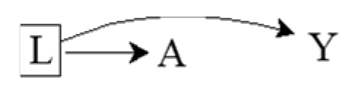
Conditioning on Common Causes
For example:
  A: Yellow fingers
  Y: Lung cancer
  L: Cigarette smoking
  Pr(Y^{a=1} = 1) = Pr(Y^{a=0} = 1)
  Pr(Y = 1 | A = 1) ≠ Pr(Y = 1 | A = 0)
  Pr(Y = 1 | A = 1, L = l) = Pr(Y = 1 | A = 0, L = l)
12
Notes:
We concluded in the previous section that yellow fingers A do not have a causal effect on the risk of lung cancer Y, but the two variables are associated because the path A ← L → Y was open for the flow of association from A to Y.
The question we ask now is whether A is associated with Y conditional on L.
Suppose the investigator restricts the study to nonsmokers (L = 0).
In that case, learning that an individual has yellow fingers (A = 1) does not help predict his risk of lung cancer (Y = 1) because the entire argument for better prediction relied on the fact that people with yellow fingers are more likely to be smokers.
This argument is irrelevant when the study is restricted to nonsmokers or, more generally, to people who smoke with a particular intensity.
Even though A and Y are marginally associated, A and Y are conditionally independent given L because the risk of lung cancer is the same in the treated and the untreated within levels of L
The flow between A and Y is interrupted because the path A ← L → Y is blocked by the box around L.

Slide 13
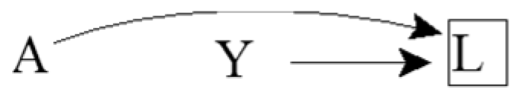
Conditioning on Common Effects
For example:
  A: Genetic risk factor
  Y: Environmental risk factor
  L: Lung cancer
  Pr(Y^{a=1} = 1) = Pr(Y^{a=0} = 1)
  Pr(Y = 1 | A = 1) = Pr(Y = 1 | A = 0)
  Pr(Y = 1 | A = 1, L = l) ≠ Pr(Y = 1 | A = 0, L = l)
Selection Bias!
Results in lack of conditional exchangeability
13
Notes:
What happens to the relationship between A and Y if we condition on their common effect L?
Suppose that the investigators, who are interested in estimating the effect of genetics on environment, restricted the study population to individuals with lung cancer (L = 1).
Knowing that an individual with lung cancer does not have the genetic risk factor provides some information about the environmental risk factor because, in the absence of the genetic risk factor, it is more likely that another cause of lung cancer is present.
That is, among individuals with lung cancer, the proportion of individuals with the environmental risk factor is increased among individuals without the genetic risk factor.
Therefore, A and Y are inversely associated conditional on L = 1.
The investigator will make a mistake if he concludes that A has a causal effect on Y just because A and Y are associated within levels of L.
In the extreme, if the genetic and environmental factors were the only causes of lung cancer, then among individuals with lung cancer, the absence of one risk factor would perfectly predict the presence of the other.
Causal graphs theory shows that indeed conditioning on a collider like L opens the path A → L ← Y, which was blocked when the collider was not conditioned on.
Intuitively, whether two variables (the causes) are associated cannot be influenced by an event in the future (their effect), but two causes of a given effect generally become associated once we stratify on the common effect.
That’s the premise of selection bias under the null.

Slide 14
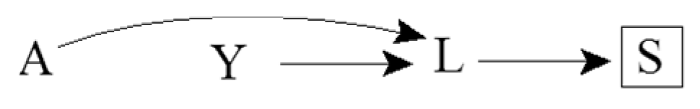
Consequences of Colliders
For example:
  A: Genetic risk factor
  Y: Environmental risk factor
  L: Lung cancer
  S: Death from lung cancer
  Pr(Y = 1 | A = 1, S = s) ≠ Pr(Y = 1 | A = 0, S = s)
14
Notes:
A and Y are associated within levels of S because S is a common effect of A and Y.
Causal graphs theory shows that conditioning on a variable S affected by a collider L also opens the path A → L ← Y
This path is blocked in the absence of conditioning on either the collider L or its consequence S.

Slide 15
Sources of Association
Statistical association between two variables A and Y may be due to:
Random fluctuation
A causing Y
Y causing A
A and Y sharing a common cause
Conditioning on a common effect of A and Y
15
Notes:
Two variables may be associated by chance, but that’s not a structural source of association
Increase the sample size and chance associations disappear, whereas structural associations will remain
We don’t address chance since we’re focusing our discussion on bias. We’re essentially assuming a very large population.

Slide 16
How we can use this
Eliminating four of these explanations is usually the goal of an analysis
Knowing these five sources of statistical association helps identify the (set of) causal structure(s) that could have generated the observed statistical associations
16

Slide 17
D-separation
Set of graphical rules to decide whether two variables are
  D-separated: independent
  D-connected: associated (in general)
If two variables are d-separated
  Without conditioning on any other variables in the DAG, then they are marginally independent
  After conditioning on a set of other variables, then they are conditionally independent
17

Slide 18
More Terminology
Ancestors / Descendants
  Parents / Children
Path: a route that connects two variables by following a sequence of edges such that the route visits no variable more than once
  A causal path consists entirely of edges with their arrows pointing in the same direction
Paths can be either blocked or open according to the following graphical rules
18
Notes:
V2 is a descendant of V1 (and V1 is an ancestor of V2) if there is a sequence of nodes connected by edges between V1 and V2 such that following the direction indicated by the arrows, one can reach V2 by starting at V1.
Parents: the set of nodes with direct arrow into the variable of interest

Slide 19
Rule 1
If there are no variables being conditioned on, a path is blocked if and only if two arrowheads on the path collide at some variable on the path
E.g., L → A → Y is open, but L → A ← Y is blocked
19

Slide 20
Rule 2
Any path that contains a noncollider that has been conditioned on is blocked
E.g., L → A → Y is blocked after conditioning on A
We use a box around a variable to indicate that we are conditioning on it
20

Slide 21
Rule 3
A collider that has been conditioned on does not block a path
E.g., L → A ← Y is open after conditioning on A
21

Slide 22
Rule 4
A collider that has a descendant that has been conditioned on does not block a path
E.g., L → A ← Y is open after conditioning on S, a descendent of the collider A
22

Slide 23
Exercises

Slide 24
Causation
What causal statement represents the relationship between A and Y?
L
A
B
Y
C

Slide 25
Association I
What marginal associational statement represents the relationship between A and Y?
L
A
B
Y
C

Slide 26
Association II
What marginal associational statement represents the relationship between L and C?
L
A
B
Y
C

Slide 27
Association III
What associational statement represents the relationship between L and Y, conditional on A?
L
A
B
Y
C

Slide 28
Association IV
What associational statement represents the relationship between L and B, conditional on A?
L
A
B
Y
C

Slide 29
Research Design Interlude

Slide 30
Research Design
You are interested in estimating the effect of A on Y
Imagine the most plausible the ways the world might work
If the world worked like this or like that, would your analysis plan successfully identify the effect of A on Y?
What assumptions do you have to make to interpret your statistical association as a causal effect?
30

Slide 31
Quizlet: Can you test which DAG is correct if you have data on these variables?
X₁
X₁
X₂
X₃
X₂
X₃
X₄
X₄
X₅
X₅
If you know that one of these two causal structures generated the data, and you have perfect measures of all 5 variables, can you tell which one is correct?
31

Slide 32
Quizlet: Can you test which DAG is correct if you have data on these variables?
X₁
X₁
X₁
X₁
X₂
X₃
X₂
X₃
X₂
X₃
X₄
X₄
U
X₄
X₅
X₅
X₅
If you know that one of these three causal structures generated the data, and you have perfect measures of all 5 variables, can you tell which one is correct?
32

Slide 33
DAGs for Common Problems in Epidemiology
Confounding

Slide 34
Confounding is When…
Exposure and outcome have common causes
The exposed are not exchangeable with the unexposed
Association is not causation
All equivalent characterizations!
34

Slide 35
Identifiability of Causal Effects
Two components of an unconditional association between exposure and outcome:
  Effect of exposure on outcome
  Result of common causes
Can we identify the former component?
35
Notes:
A causal effect can be identified when there are no common causes or there are common causes but we have enough information to block what all are called backdoor paths
Here, the path A ← L → Y is an example of a backdoor path
A backdoor path is a path between A and Y that includes an arrow into A
For that we need expert knowledge
Statistical criteria are insufficient

Slide 36
The Backdoor Criterion
A set of variables L satisfies the backdoor criterion relative to A and Y in a DAG if:
  No variable in L is a descendant of A
  All backdoor paths between A and Y are blocked by conditioning on L
If a set of variables L satisfies the backdoor criterion, then the causal effect of A on Y is identifiable
36
Notes:
Conditional exchangeability on L holds if and only if L satisfies the backdoor criterion

Slide 37
Healthy Worker Bias
For example:
  A: Working as a firefighter
  Y: Death
  L: Physical fitness
37
Notes:
The effect of working as a firefighter A on the risk of death Y will be confounded if “being physically fit” L is a cause of both being an active firefighter and having a lower mortality risk.
Does L satisfy the backdoor criterion?
Yes

Slide 38
Exercise
How might you draw a DAG representing confounding by indication?
  A: Aspirin
  Y: Stroke
  L: Heart disease
  (U: Atherosclerosis)
38

Slide 39
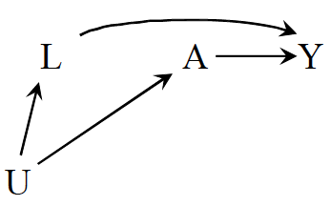
Confounding by Lifestyle
For example:
  A: Exercise
  Y: Death
  L: Cigarette smoking
  U: Personality or social factors
39
Notes:
The effect of exercise on the risk of death will be confounded if exercise is associated with another factor like cigarette smoking that has a causal effect on Y and tends to co-occur with exercise.
Does L satisfy the backdoor criterion?
Yes

Slide 40
Confounding by Early Life Factors
L₂
1
For example:
  A: Depression
  Y: Death
  L₁: Education
  L₂: Income
40
Notes:
Does education satisfy the backdoor criterion?
Yes
Does income satisfy the backdoor criterion?
Yes
One can adjust for either education or income to identify the effect of depression on mortality

Slide 41
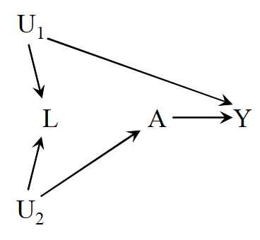
Be Careful with Adjustment!
For example:
  A: Physical activity
  Y: Cervical cancer
  L: Pap smear
  U₁: Pre-cancer lesion
  U₂: Health-conscious personality
41
Notes:
Do A and Y have any common causes in this scenario?
No!
L does not confound the effect of A on Y!
In fact, adjusting for it would open up a non-causal path between A and Y
Does L satisfy the backdoor criterion?
No!
This is our first example of a scenario in which unconditional exchangeability holds, but conditional exchangeability does not
Some people would call this selection bias since one is conditioning on a collider and others would still call it confounding since the bias results from an open backdoor path from A to Y
The definition is just a matter of preference
The conclusions are the same regarding identifiability of the causal effect

Slide 42
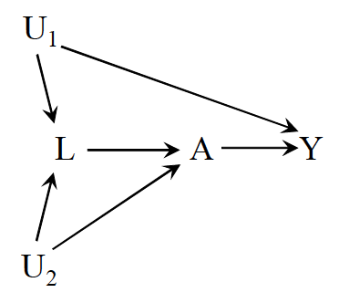
Intractable Confounding
Open backdoor path A ← L ← U₁ → Y
But what happens if we adjust for L?
  Open the path A ← U₂ → L ← U₁ → Y
42
Notes:
Does L satisfy the backdoor criterion?
No!
To deal with the bias, we’d have to find a way to measure a variable between U1 and A or Y or a variable between U2 and either A or L

Slide 43
DAGs for Common Problems in Epidemiology
Selection Bias
Notes:
For our purposes, the term selection bias encompasses biases that arise from the procedure by which individuals are selected into the analysis

Slide 44
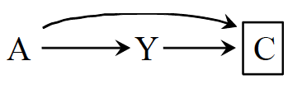
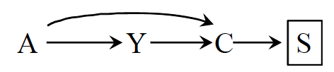
What is Selection Bias?
Bias due to the process used to select subjects into the study or into the analysis
Consequence of conditioning on a common effect of exposure and outcome
  Or on a common effect of a cause of the exposure and a cause of the outcome
44
Notes:
Two sources of association:
the causal effect of A on Y
The open path between A and Y resulting from conditioning on a common effect
Note that even within types of bias, there isn’t only one structure that represents the bias in all its forms
Depends on the causal questions, the nodes and relationships among them can change

Slide 45
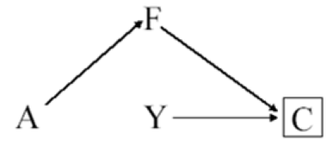
Inappropriate Selection of Controls
For example:
  A: Postmenopausal hormones
  Y: Coronary heart disease
  F: Hip fracture
  C: Selection into study
45
Notes:
The arrow from disease status Y to selection C indicates that cases in the population are more likely to be selected than noncases, which is the defining feature of a case-control study.
In this particular case-control study, the investigator decided to select controls (C = 0) preferentially among women with a hip fracture.
Because treatment A has a protective causal effect on hip fracture, the selection of controls with hip fracture implies that treatment A now has a causal effect on selection C.
In a case-control study, the odds ratio is by definition conditional on having been selected into the study (C = 0). If individuals with hip fracture are oversampled as controls, then the probability of control selection depends on a consequence of treatment A (as represented by the path from A to C) and “inappropriate control selection” bias will occur.
Again, this bias arises because we are conditioning on a common effect C of treatment and outcome.
A heuristic explanation of this bias follows:
Among individuals selected for the study (C = 0), controls are more likely than cases to have had a hip fracture.
Therefore, because estrogens lower the incidence of hip fractures, a control is less likely to be on estrogens than a case, and hence the A-Y odds ratio conditional on C = 0 would be greater than the causal odds ratio in the population.

Slide 46
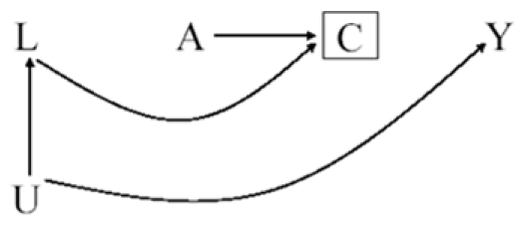
Differential Loss to Follow-up
For example:
  A: Antiretroviral therapy
  Y: AIDS
  C: Censoring
  L: Symptoms, CD4, viral load
  U: Immunologic status
46
Notes:
AKA informative censoring
The unmeasured variable U represents high level of immunosuppression (1: yes, 0: no).
Individuals with U = 1 have a greater risk of death.
Individuals who drop out from the study or are otherwise lost to follow-up are censored (C = 1).
Individuals with U = 1 are more likely to be censored because the severity of their disease prevents them from participating in the study.
The effect of U on censoring C is mediated by the presence of symptoms (fever, weight loss, diarrhea, and so on), CD4 count, and viral load in plasma, all included in L, which could or could not be measured.
Individuals receiving treatment are at a greater risk of experiencing side effects, which could lead them to dropout, as represented by the arrow from A to C.
The square around C indicates that the analysis is restricted to individuals who remained uncensored (C = 0) because those are the only ones in which Y can be assessed.
According to the rules of d-separation, conditioning on the collider C opens the path A → C ← L ← U → Y and thus association flows from treatment A to outcome Y
i.e., the associational risk ratio is not equal to 1 even though the causal risk ratio is equal to 1.
Some intuition for this bias: If a treated individual with treatment-induced side effects (and thereby at a greater risk of dropping out) did in fact not drop out (C = 0), then it is generally less likely that a second independent cause of dropping out (e.g., U = 1) was present
Therefore, an inverse association between A and U would be expected in those who did not drop out (C = 0).
Because U is positively associated with the outcome Y, restricting the analysis to individuals who did not drop out of this study induces an inverse association between A and Y
As I said before, differential loss to follow-up can take on many forms.
In addition, other types of bias can take on the same form.

Slide 47
Non-response / Missing Data Bias
For example:
  A: Antiretroviral therapy
  Y: AIDS
  C: Reluctance to answer questions
  L: Symptoms, CD4, viral load
  U: Immunologic status
47
Notes:
The variable C can represent missing data on the outcome for any reason, not just as a result of loss to follow up.
For example, individuals could have missing data because they are reluctant to provide information or because they miss study visits.
Regardless of the reasons why data on Y are missing, restricting the analysis to individuals with complete data (C = 0) may result in bias.

Slide 48
Exercise
How might you draw a DAG representing volunteer (self-selection) bias?
  A: Smoking
  Y: Coronary heart disease
  C: Volunteered to participate
  L: Heart disease awareness
  U: Family history of heart disease
48

Slide 49
Another Healthy Worker Bias
For example:
  A: Chemical exposure
  Y: Death
  C: Being at work
  L: Physical exam
  U: Health status
49
Notes:
The study is restricted to individuals who are at work (C = 0) at the time of outcome ascertainment.
Being exposed to the chemical reduces the probability of being at work in the near future (e.g., exposure can cause disabling asthma)

Slide 50
Prevalent User Bias
A
Y₋₁
C
Y₁
L
For example:
  A: Aspirin use
  Y₋₁: Death before time 0
  Y₁: Death after time 0
  C: Selection into study
  L: Exercise
50
Notes:
This creates a potential collider bias because exposed individuals who do not have the event prior to T₀ may have other characteristics (L) that protected them from an early event and also bias associations with later event rates.

Slide 51
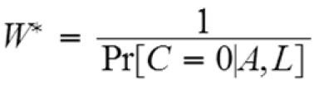
Adjusting for Selection Bias
Design
  E.g., sampling controls that represent the exposure distribution in the population
Analysis
  Stratification
  Inverse Probability Censoring Weighting
    Same concept as IPW
    But treat censoring as the “exposure”
    Everyone in the pseudo-population is uncensored
51
Notes:
Stratification boxes nodes, whereas IPW removes arrows

Slide 52
DAGs for Common Problems in Epidemiology
Measurement Bias
Notes:
Also called information bias

Slide 53
What is Measurement Bias?
Bias due measurement of study variables with error, such that the observed associational measure does not equal the causal measure
No single structure describing measurement bias
53

Slide 54
Relevant Variables
For example:
  A: Exposure
  A*: Exposure measurement
  U_{A}: Factors other than A that determine the value of A* (i.e., measurement error)
  Y: Outcome
  Y*: Outcome measurement
  U_{Y}: Factors other than Y that determine the value of Y* (i.e., measurement error)
54

Slide 55
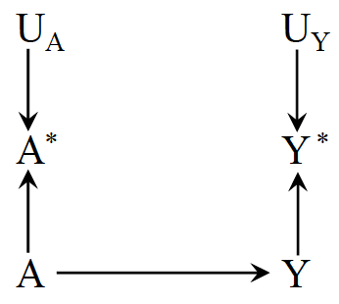
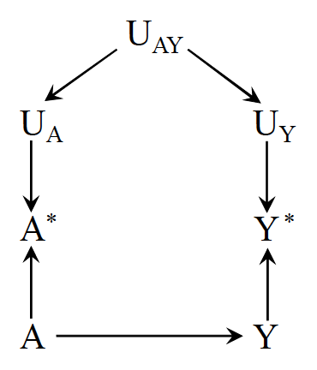
Nondifferential Measurement Error
Independent nondifferential measurement error
Dependent nondifferential measurement error
55
Notes:
E.g., A = cholesterol-lowering drugs, Y = liver disease
According to the rules of d-separation, the measurement errors Ua and Uy are independent because the path between them is blocked by colliders (either A* or Y*)
E.g., haphazard data entry errors
In other settings, however, the measurement errors for exposure and outcome may be dependent, as depicted in the second figure
For example, dependent measurement errors will occur if the information were obtained retrospectively by phone interview and an individual’s ability to recall her medical history (Uay) affected the measurement of both A and Y.
Both Figures represent settings in which the error for treatment Ua is independent of the true value of the outcome Y, and the error for the outcome Uy is independent of the true value of treatment A.
We then say that the measurement error for treatment is nondifferential with respect to the outcome and that the measurement error for the outcome is nondifferential with respect to the treatment.

Slide 56
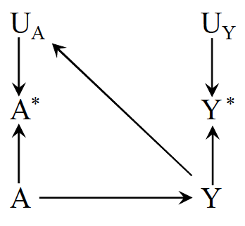
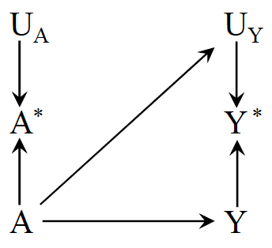
Independent Differential Measurement Error
Independent differential measurement error of exposure
Independent differential measurement error of outcome
56
Notes:
In the first figure, measurement errors of treatment and outcome are independent but differential, such that the true value of the outcome affects the measurement of the treatment
E.g., A = drug use, Y = dementia
A ascertained by interviewing demented study participants
The second figure, shows an example of independent but differential measurement error in which the true value of the treatment affects the measurement of the outcome (i.e., an arrow from A to Uy).
E.g., A differential measurement error of the outcome will occur if physicians, suspecting that drug use A causes liver toxicity Y, monitored patients receiving drug more closely than other patients.

Slide 57
Exercise
How might you draw a DAG representing recall bias?
  A: Alcohol use
  A*: Recalled alcohol use
  U_{A}: Factors other than A that determine the value of A* (i.e., measurement error)
  Y: Birth defects
  U_{Y}: Factors other than Y that determine the value of Y* (i.e., measurement error)
57

Slide 58
Reverse Causation Bias
For example:
  A: Drug A
  A*: Blood levels of drug A
  Y: Liver toxicity
58
Notes:
A bias with the same structure might arise if blood levels of drug A* are used in place of actual drug use A, and blood levels are measured after liver toxicity Y is present–because liver toxicity affects the measured blood levels of the drug.
The resulting measurement bias is often referred to as reverse causation bias

Slide 59
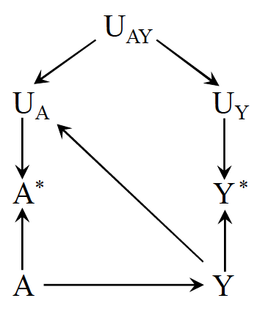
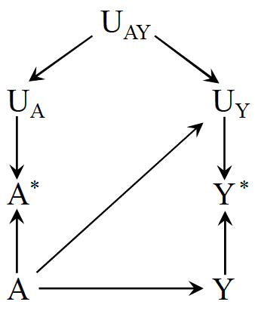
Dependent Differential Measurement Error
Dependent differential measurement error of exposure
Dependent differential measurement error of outcome
59
Notes:
These figures depict measurement errors that are both dependent and differential, which may result from a combination of the settings described above.

Slide 60
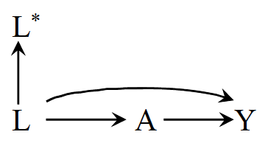
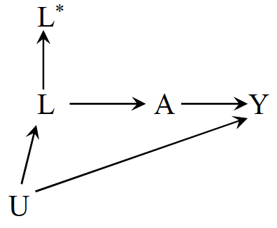
Mismeasured Confounders
Conditioning on L* does not block the backdoor path between A and Y in either scenario
60

Slide 61
DAGs for Common Problems in Epidemiology
Bias in RCTs

Slide 62
Confounding & Selection Bias
Can confounding occur in a marginally randomized RCT?
Can selection bias occur in a marginally randomized RCT?
62
Notes:
This DAG that we looked at before can represent an experiment in which treatment A is randomly assigned, because there are no common causes of A and any other variable.
Individuals in both randomized experiments and observational studies may be lost to follow-up or drop out of the study before their outcome is ascertained.
When this happens, the risk Pr[Y = 1|A = a] cannot be computed because the value of the outcome Y is unknown for the censored individuals (C = 1).
Only the risk among the uncensored Pr[Y= 1|A = a, C = 0] can be computed.
This restriction of the analysis to the uncensored individuals may induce selection bias because uncensored individuals who remained through the end of the study (C = 0) may not be exchangeable with individuals that were lost (C = 1).
Hence a key difference between confounding and selection bias: randomization protects against confounding, but not against selection bias when the selection occurs after the randomization.
On the other hand, no bias arises in randomized experiments from selection into the study before treatment is assigned.
For example, only volunteers who agree to participate are enrolled in randomized clinical trials, but such trials are not affected by volunteer bias because participants are randomly assigned to treatment only after agreeing to participate (C = 0).

Slide 63
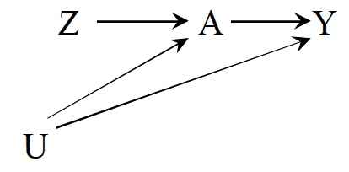
Noncompliance
For example:
  Z: Exposure assignment
  A: Exposure
  Y: Outcome
  U: Factors affecting adherence and the outcome
What kind of analysis is looking at the effect of A on Y?
What kind of analysis is looking at the effect of Z on Y?
63
Notes:
- per protocol vs. intention to treat

Slide 64
Exercise
How might you draw a DAG representing unblinding?
  Z: Exposure assignment
  A: Exposure
  Y: Outcome
  U: Blinded status
64

Slide 65
Limitations of DAGs

Slide 66
Some Objections to DAGs
DAGs do not display effect modification
  If Z modifies the effect of X on Y, then Z must itself affect Y.
  Effect modification is scale dependent, so showing an effect modifier implies a scale and DAGs do not represent any scale
  Some progress on this: e.g., VanderWeele’s sufficient cause framework
  If Z and X both affect Y, then there is some scale on which Z modifies the effect of X and vice versa
66

Slide 67
Some Objections to DAGs
DAGs do not represent the magnitude of bias
  Major limitation
  Lots of work now on (a) signing the bias and (b) estimating the magnitude
  Simulations and bias bounding formulas
67

Slide 68
Some Objections to DAGs
DAGs do not match the complex, dynamic feedback loops in the real world
  DAGs can represent feedback between two variables
  DAGs can represent complex interventions (e.g., deliver this set of 4 treatments vs only 2 of these)
  DAGs match (one of the) things you want to know: will intervening in a specific way elicit a change in health?
  To say “it’s all very complicated and impossible to specify which variables come first” is to abdicate any hope of guiding clinical or policy decisions
  DAGs do not tell you everything, and complex systems simulations are often useful as a next step to predict spillovers and interactions with variables you do not have in your DAG; the simulation will presumably rely on causal parameter inputs.
68

Slide 69
Some Objections to DAGs
I’m not sure about which causal structure is right
  Do you know enough to rule some DAGs out?
  What are the commonalities across all plausible DAGs?
  Useful to state: under these assumptions, we can draw these inferences; need evidence on the assumptions from other sources
I don’t know anything about the causal structure
  This is not an objection to DAGs, this is an objection to ever drawing causal inferences
69

Slide 70





Acknowledgements
June Chan
Shelley DeVost
Maria Glymour
Miguel Hernán
Francois Rerolle
70

Slide 71
Questions?

