Slide 1
Lecture 3:
Health CARE Disparities
Cassondra Marshall, DrPH, MPH
UC Berkeley
Christine Dehlendorf, MD MAS
UCSF

Slide 2
Objectives
Differentiate disparities in health care from inequities in health
Recognize common explanations of disparities
Discuss approaches to decreasing health care disparities

Slide 3
Economic & Social
Opportunities and Resources
Living & Working Conditions
in Homes and Communities
Behaviors
Medical Care
Interaction with genetic/other biological factors
HEALTH
Adapted from Braveman et al., for Robert Wood Johnson Foundation Commission to Build a Healthier America | www.commissiononhealth.org

Slide 4
What are Health Disparities?
“A particular type of health difference that is closely linked with economic, social, or environmental disadvantage. Health disparities adversely affect groups of people who have systematically experienced greater social or economic obstacles to health based on their racial or ethnic group, religion, socioeconomic status, gender, age, or mental health; cognitive, sensory, or physical disability; sexual orientation or gender identity; geographic location; or other characteristics historically linked to discrimination or exclusion.”
Healthy People 2020 (HealthyPeople.gov)

Slide 5
What are Health Disparities?
“A particular type of health difference that is closely linked with economic, social, or environmental disadvantage. Health disparities adversely affect groups of people who have systematically experienced greater social or economic obstacles to health based on their racial or ethnic group, religion, socioeconomic status, gender, age, or mental health; cognitive, sensory, or physical disability; sexual orientation or gender identity; geographic location; or other characteristics historically linked to discrimination or exclusion.”
Healthy People 2020 (HealthyPeople.gov)

Slide 6
Health CARE Disparities
Differences in quality of health care that are not due to access-related factors or clinical needs, preferences and appropriateness of intervention.
Financial access, a known problem in US health care, is often not included in disparities studies.
IOM, Unequal Treatment, 2003

Slide 7
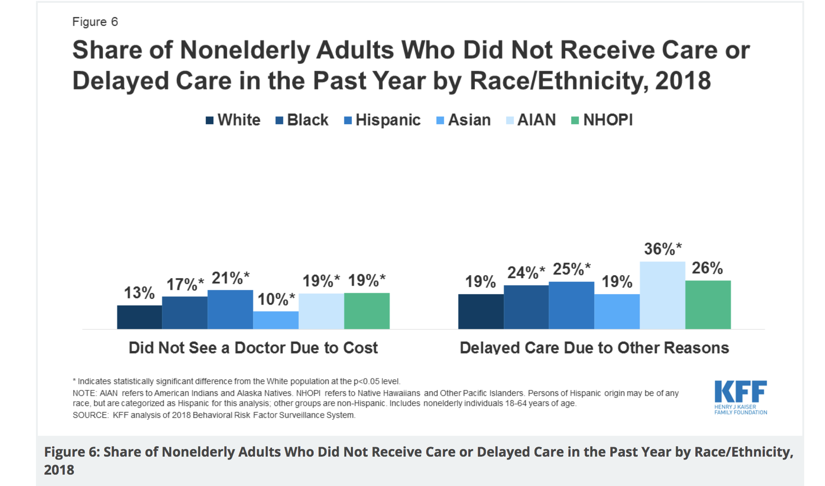

Slide 8

Health Care Quality
6 domains
  Safe
  Effective
  Patient-centered
  Timely
  Efficient
  Equitable

Slide 9
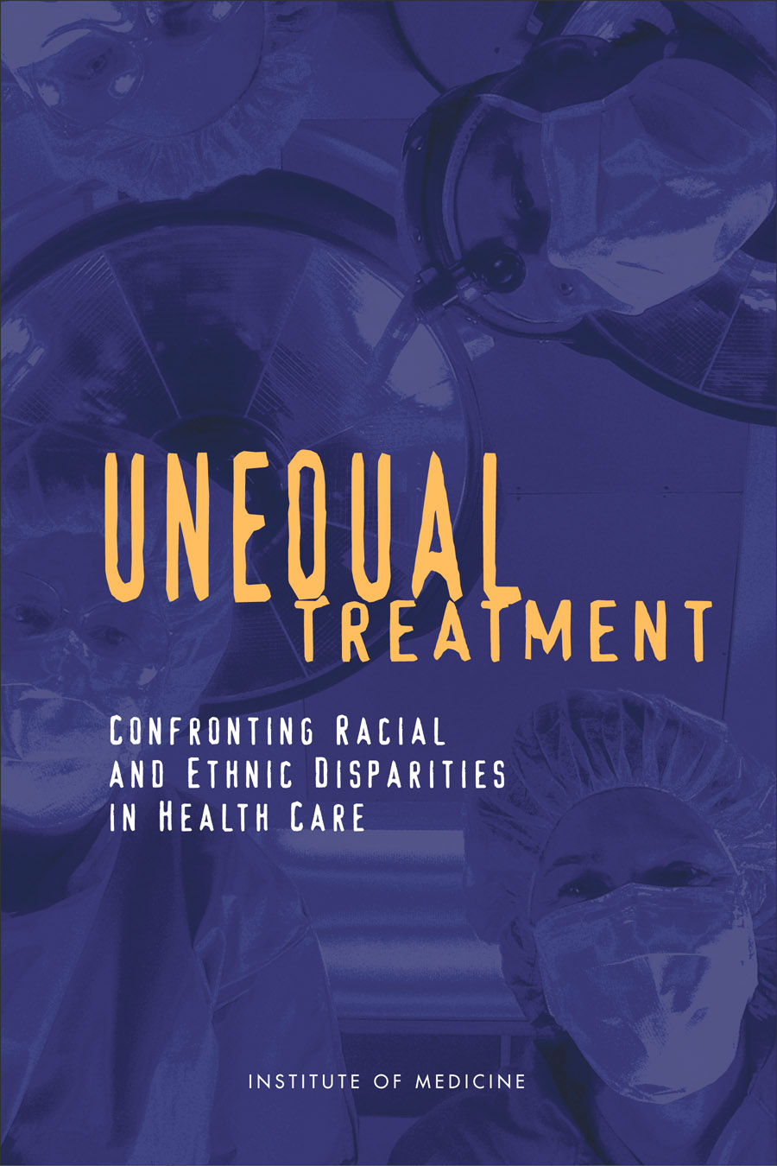

Slide 10
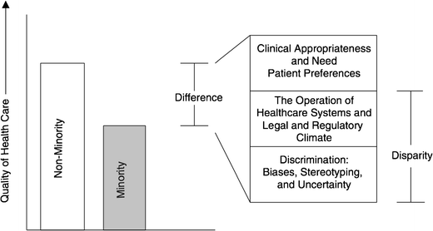
Differences, Disparities, and Discrimination: Populations with Equal Access to Health Care

Slide 11
Evidence Shows Disparities Exist
  The evidence is “remarkably consistent across a range of illnesses and healthcare services”
    Best studied in cardiology
    Also well documented in oncology, HIV care, etc.
  Lead to worse outcomes among disadvantaged populations
  Source: Unequal Treatment: Confronting Racial and Ethnic Disparities in Healthcare, March 2003.

Slide 12
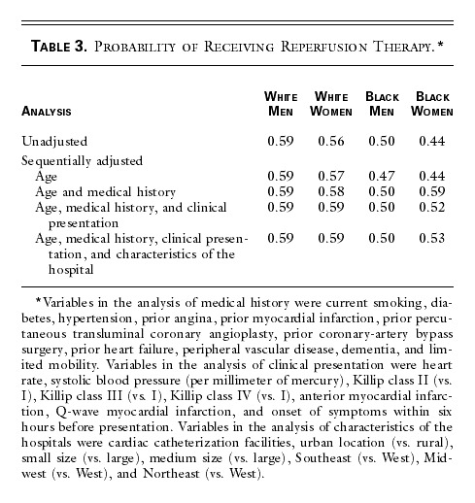
Disparities in Cardiac Treatment
Canto, NEJM, 2000

Slide 13
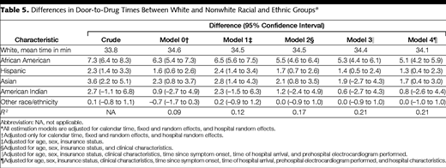
Door to Drug Time in AMI
Bradley, JAMA, 2004

Slide 14
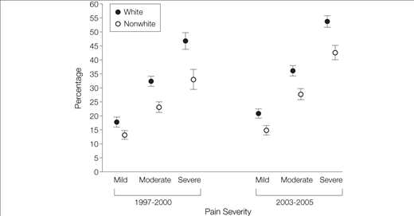
Percentage of Emergency Department Visits at Which an Opioid Was Prescribed, by Pain Severity and Period, NHAMCS 1997-2000 and 2003-2005
Pletcher, JAMA, 2008

Slide 15
Racial/ethnic health care disparities
Historically, most studies focused on Black-white disparities
Fewer studies documenting other racial/ethnic disparities
Language and ethnicity appear to be independent risk factors

Slide 16
What about SES?
Less research/focus in the US
Does appear to be independently predictive of treatment
  Guideline concordant treatment after AMI
  Valve replacement in aortic stenosis
  Cardiac procedures
Both race/ethnicity and SES matter
Hanley, JGIM, 2011
Sleder, JERHD, 2017

Slide 17

How big an effect do health care disparities have?

Slide 18
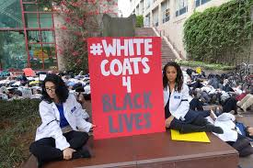
How big an effect do health care disparities have?
Focusing on relative impact misses an important ethical component
Health care should be a tool for social justice/equity, not the opposite

Slide 19
Summary
Health care disparities are about differences in quality of health care
  Quality: safe, effective, patient-centered, timely, efficient, and equitable
Typically conceptualized as differences not due to access-related factors or clinical needs, preferences, and appropriateness

Slide 20
Summary (cont.)
Evidence of health care disparities is ‘remarkably consistent across a range of illnesses and health care services’
  IOM report Unequal Treatment’
  Largest body of evidence on Black-white disparities
  Race and SES are independent risk factors

Slide 21
Economic & Social
Opportunities and Resources
Living & Working Conditions
in Homes and Communities
Behaviors
Medical Care
Interaction with genetic/other biological factors
HEALTH
Adapted from Braveman et al., for Robert Wood Johnson Foundation Commission to Build a Healthier America | www.commissiononhealth.org

Slide 22
Social factors
Health Outcomes
Race

Slide 23
Social factors
Health Outcomes
Racism

Slide 24
Social factors
Health Care
Health Outcomes
Racism
Health Care

Slide 25
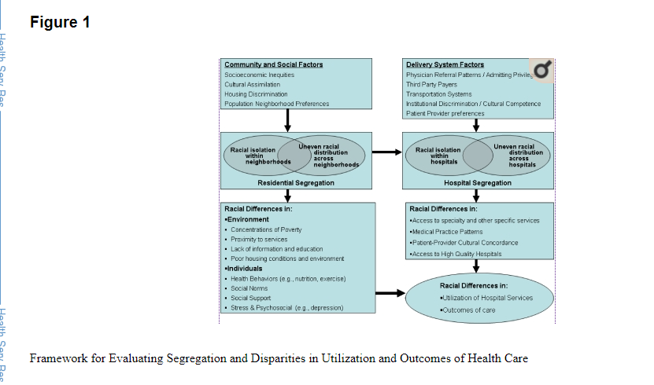
Notes:
Hidden slide offering an alternative complex framework for how this all fits together

Slide 26
Do Differences in Insurance Explain Racial/Ethnic Differences?
Insurance access mediates differences in health care utilization in analyses of national datasets
However, does not explain all differences when assessed within an insurance/care system, such as Medicare, VA studies or Kaiser studies

Slide 27
Racial Differences Not Completely Explained by Insurance
Cardiac Procedure Use in Chronic Renal Disease Patients, by Race and Gender, 1986-1992
Equally likely as white men
*Difference is statistically significant after adjustment.
NOTE: Odds ratios are adjusted for age, health insurance, sociodemographic characteristics, and clinical factors.
DATA: Daumit and Powe, 2001.
SOURCE: Kaiser Family Foundation, Key Facts: Race, Ethnicity and Medical Care, June 2003.
Notes:
Talk about patient preferences
Though insurance coverage diminishes disparities in cardiac care, it does not eliminate them. For example, a nationwide study examined patients with chronic renal failure who, when they progress to end-stage renal disease (ESRD), acquire Medicare coverage.
Before qualifying for Medicare, male and female African American patients with chronic renal failure were 32% and 30% as likely to receive catheterization, angioplasty and bypass surgery as white men (the study reference group).
After enrolling in Medicare and entering into a comprehensive system of care, there was no difference in the cardiac procedure use between African American women and white men.
However for African American men, the disparity persisted even after enrolling in Medicare.

Slide 28
Do Patient Factors Explain Differences?
“The studies that the IOM reviewed suggest that racial differences in patients’ attitudes, such as their preferences for treatment, do not vary greatly and cannot fully explain racial and ethnic disparities in healthcare.”
          IOM, Unequal Treatment, 2003

Slide 29
What Else Explains Differences?
- System Related Issues?
  Non-insurance related access
  Hospital and provider characteristics
  Literacy, numeracy and language issues
Doctor/Health Care System Issues?
  Bias
  Statistical discrimination
Patient Issues?

Slide 30
Other Possible Explanations…
Overuse in whites? or Underuse in black people?
Some overuse in white people, particularly in cases when procedure indication has larger subjective component
Substantive underuse in Black individuals
Notes:
Consider deleting

Slide 31
What Causes Health Care Disparities?

Slide 32
48% of Physicians Treat 82% of All “Minority” Patients
Source HSC Community Tracking Study Physician Survey, 2004-05.

Slide 33
The Importance of Language
Why is “minority” problematic?
  It is not about numbers, but is about power
  Centers whiteness
What language should we use?
  Pay attention to how groups define themselves
  “People of color” increasingly shifting to “BIPOC”
  Also important to be responsive to terms preferred by specific groups
  Person-first language

Slide 34
Primary Care Provided to Medicare Patients
% of MDs
Bach, NEJM; 2004
Notes:
https://www.ncbi.nlm.nih.gov/pmc/articles/PMC6912985/
This study also found to be clustered

Slide 35
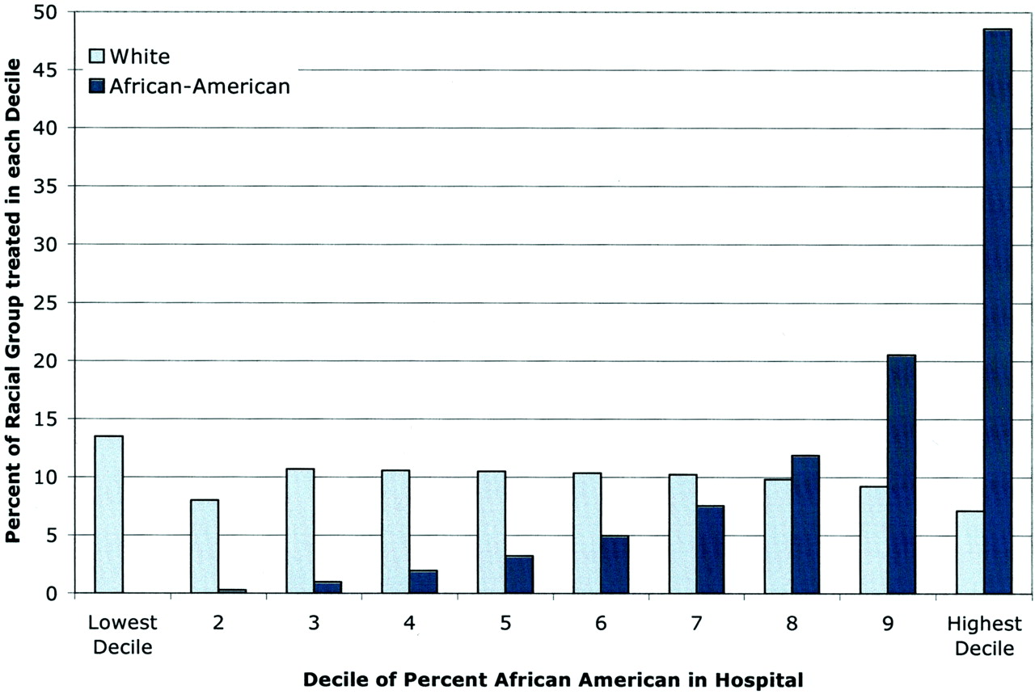

Blacks with MI Disproportionately Treated in a Subset of Hospitals Nationally
Skinner, J. et al. Circulation 2005;112:2634-2641
Copyright ©2005 American Heart Association
Notes:
33.6% of AMI seen in the highest decile hospital were among Black patients
Risk-adjusted mortality after AMI is significantly higher in US hospitals that disproportionately serve blacks. A reduction in overall mortality at these hospitals could dramatically reduce black-white disparities in healthcare outcomes

Slide 36
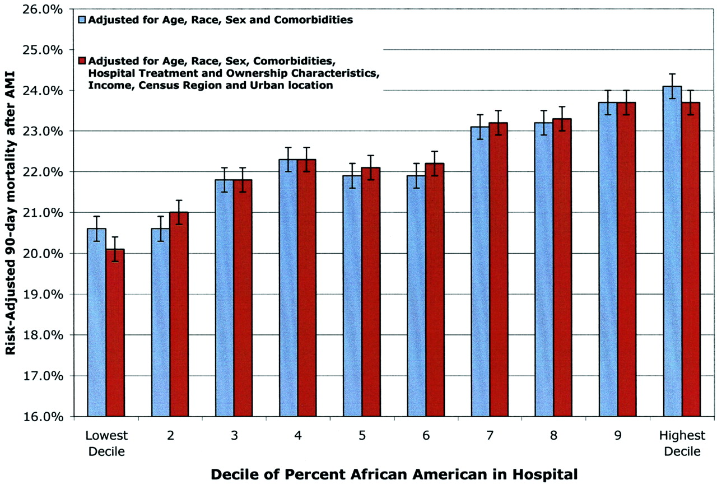
Hospitals that Disproportionately Treat Blacks with AMI Have Higher Mortality Rates
Skinner, J. et al. Circulation 2005;112:2634-2641
Dimick, Health Affairs, 2013
Copyright ©2005 American Heart Association
Notes:
https://www.ncbi.nlm.nih.gov/pmc/articles/PMC4789147/
More recent study such as this above have found that this is independent of geographic proximity and related to racial segregation

Slide 37
How do Fragmented Systems of Care Contribute to Disparities?
System deficits affect all segments of society, but especially those with least flexible resources
Disadvantaged patients “fall through the cracks” in complex system of care
Small disparities in multi-step processes create moderate to large disparities overall
Disparities arise even when providers well intentioned
Ayanian, 2009
Notes:
Flexible resources or with less power in the system

Slide 38
What About Health Literacy and Numeracy?
Low health literacy and numeracy associated with worse health outcomes
Have been found to be a mediating factor for health disparities
Is this a social determinant or an indication of health care disparities? Or both?
Berkman, Ann Int Med, 2011
Mantwill, PLOS One, 2015

Slide 39
Health Literacy and Numeracy
While clearly is this a social issue, also reflects failures of the health care system
Health care system should be responsive to patient’s needs for information and access

Slide 40
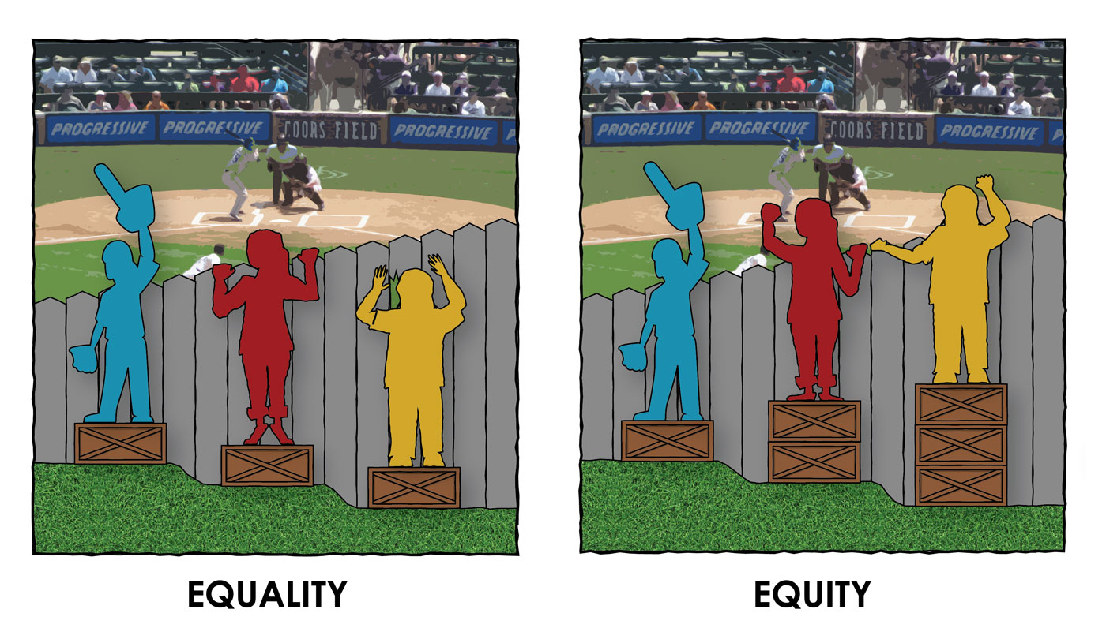

Slide 41


Slide 42
Language Barriers
Even among insured, language barriers associated with:
  Decreased patient satisfaction with care
  Increased problems with medication comprehension
  Decreased receipt of health services

Slide 43
Language Barriers
LEP among Latinx patients associated with worse glycemic control
  Mediated by patient-provider language concordance
Disparities in colon cancer screening between whites and Asians
  Explained by LEP and LHL in Asian patients
Disparities related to language services are a systems-issue that leads to racial/ethnic disparities in health
Fernandez, JGIM, 2010 Diamond, JGIM, 2019
Sentell, J Health Comm, 2013
Notes:
https://pubmed.ncbi.nlm.nih.gov/31147980/ - systematic review that shows this leads to worse health outcomes

Slide 44
Lack of Provider Diversity
White individuals overrepresented, and BIPOC individuals underrepresented, among health professionals
Provider-Patient concordance in race/ethnicity associated with improved use of health services
Recent report of decreased infant mortality among Black patients with concordance
However, the relationship is complex and not universal
Laveist, J Pub Health Pol, 2003
Greenwood, PNAS, 2020
Notes:
https://bhw.hrsa.gov/sites/default/files/bureau-health-workforce/data-research/diversity-us-health-occupations.pdf
https://pubmed.ncbi.nlm.nih.gov/30586847/

Slide 45
Differences, Disparities, and Discrimination: Populations with Equal Access to Health Care

Slide 46
Do Within-Institution Factors Explain Differences?
Differences persist even when controlling for system level-factors, including:
  Hospital
  Provider specialty
  Region
Notes:
Edit it to make health care system
Think about add Li
Think about a quote from the Dovidio paper about whites being unaware

Slide 47
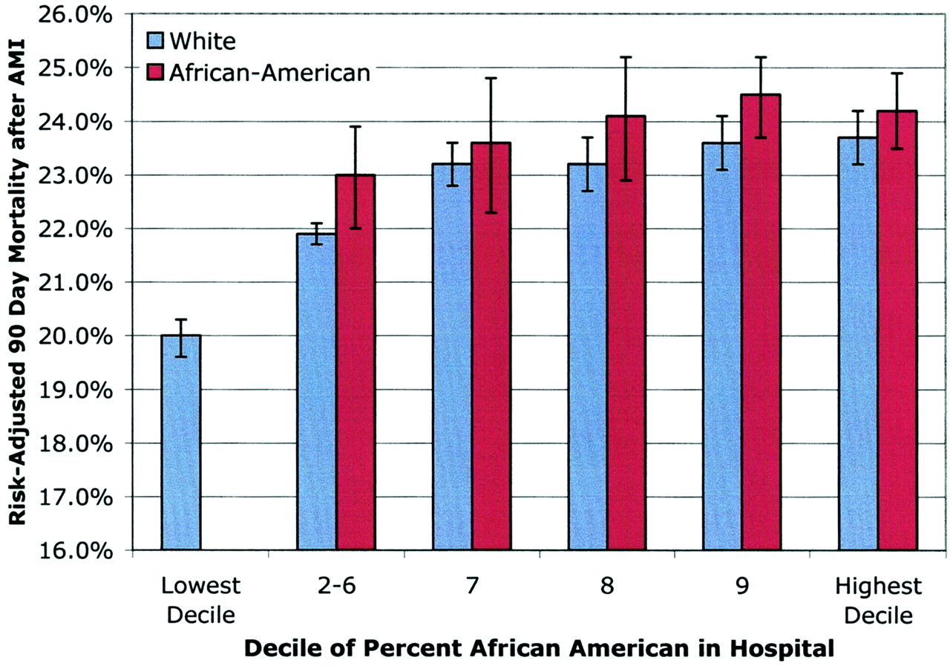

Slide 48
Door to Drug Time in AMI
Bradley, JAMA, 2004
Notes:
Controlling for difference within the hospital

Slide 49
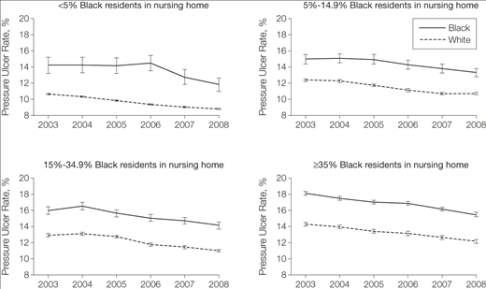
Intra- and inter-site contributions to disparities in pressure ulcers
Li, JAMA, 2005

Slide 50
What about differences within physicians?
Within-physician differences in treatment by socioeconomic indicators and racial/ethnic group found across clinical context, including:
  Cancer treatment
  Diabetes care
  Post-partum pain control
  Referral to cardiac surgery
Popescu, Med Care, 2016 Badreldin, Obstet Gynecol, 2019
Simonetti, Diabetes Care, 2014 Mukamel, Health Serv Res, 2006
Notes:
Make point that the fragmented systems of care can contribute to some of these differences – need to drill down on the effect of bias specifically
Post-partum pain was in one center with random effects by physician
Often hard to study

Slide 51
Schulman Summary
Videotaped vignettes with 8 actors representing men/women, AA/white patients, 55y/70y
Convenience sample of physicians at ACP and ACC meetings
All “patients” had identical script describing chest pain – outcome was decision to refer for angiography
Schulman, et al. NEJM 1999

Slide 52
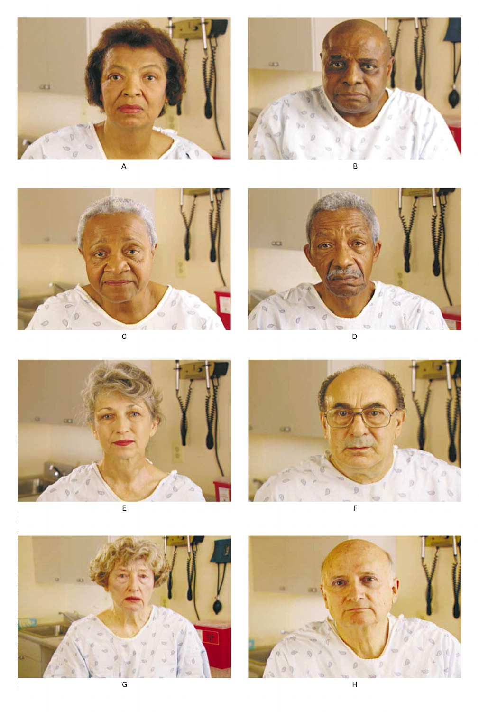

Slide 53
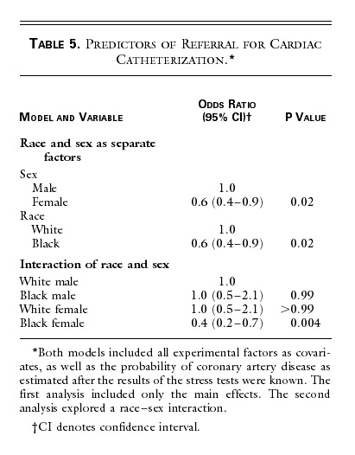
Notes:
Reference intersectionality – to scarletts lecture – but also say it is more complicated than just a statistical interaction

Slide 54

Provider-Level Disparities in Reproductive Health
History of reproductive abuses by family planning providers towards women of color and poor women
Are there disparities in counseling about the IUD?
  RCT using videos of standardized patients presenting for contraceptive advice
  Shown to participants at national meetings of ACOG and AAFP
Dehlendorf: Am J Obstet Gynecol, 2010
Notes:
Check about income in Harrison study.
Just do low SES

Slide 55



The “Patients”
Notes:
Just to give a sense of the videos, here are snapshots of the standardized patients. This slide is of the high SES patients…
As you can imagine, planning an directing these videos, including the hiring of models was a challenge for someone with no background in this area.

Slide 56
P<0.05
Dehlendorf, et al. AJOG, 2010
Notes:
Need to understand sociohistorical context

Slide 57
Differences in Health Communication
Patient experience is a critical part of health care quality, and is associated with outcomes
  Providers have less positive affect and are more dominant with BIPOC patients
  African American patients report less participation in clinical decision making
  Hispanics experience less patient-centered communication
  In general, racially-discordant care results in less information and less patient participation
Beach, AIDS Behav, 2011 Gordon, Cancer, 2016
Beach, JGIM, 2010 Rodriguez, JGIM, 2008

Slide 58
Audiotaped Conversations After Angiography
Less information given to AA patients
Fewer questions asked by AA patients
Less social or bonding type statements
→Cycle: less information, fewer questions, less social comfort
Less Information
Fewer Questions
Less Social Comfort
Gordon, Soc Sci Med, 2005
Notes:
Cooper, L. A., Roter, D. L., Johnson, R. L., Ford, D. E., Steinwachs, D. M., &
Powe, N. R. (2003). Patient-centered communication, ratings of
care, and concordance of patient and physician race. Annals of Internal
Medicine, 139, 907–915.
Cooper-Patrick, L., Gallo, J. J., Gonzales, J. J., Vu, H. T., Powe, N. R., &
Nelson, C., et al. (1999). Race, gender, and partnership in the
patient–physician relationship. Journal of the American Medical Association,
282, 583–589.

Slide 59
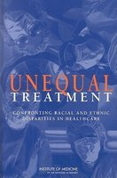
Can well-intentioned providers be biased?
“…biases may exist…often unconsciously, among people who strongly endorse egalitarian principles and truly believe that they are not prejudiced. There is considerable empirical evidence that even well-intentioned whites…who do not believe that they are prejudiced demonstrate unconscious implicit negative racial attitudes and stereotypes [which] significantly shape interpersonal interactions….Evidence suggests that bias, prejudice, and stereotyping on the part of healthcare providers may contribute to differences in care.”

Slide 60
Can well-intentioned providers be biased?
“…biases may exist…often unconsciously, among people who strongly endorse egalitarian principles and truly believe that they are not prejudiced. There is considerable empirical evidence that even well-intentioned whites…who do not believe that they are prejudiced demonstrate unconscious implicit negative racial attitudes and stereotypes [which] significantly shape interpersonal interactions….Evidence suggests that bias, prejudice, and stereotyping on the part of healthcare providers may contribute to differences in care.”
Notes:
Dovidio points the ways that white providers are less able to see it

Slide 61
Stereotyping is necessary and unavoidable
Stereotyping
  Fixed and oversimplified image or idea of a particular type of person or thing
  Not necessarily negative
  Cognitive psychology demonstrate it is used to organize our complex world

Slide 62
How is stereotyping used in medicine?
Two learning and memory systems
Slow learning
  Information is extracted and applied rapidly, automatically and unconsciously→ implicit beliefs
Fast binding
  Information is extracted and applied consciously and deliberate
  When there is ample time to determine the answer for a complex question →explicit beliefs
Which type of memory system do you think clinicians most often use? And why?
Burgess, JGIM, 2004

Slide 63
How we naturally process information -> unequal care
When we are tired, distracted, stressed or under time pressure → automatic, slow-learning process are used to make decisions
These conditions are typical of many clinical settings
Regardless of intention or motivation we all fall prey to using automatic cognitions (stereotypes)
Burgess, D. J Gen Intern Med 2004

Slide 64
Sterotyping and Bias in Medicine
United States has a long history of racism that creates negative racial and ethnic stereotyping
  The system and practice of medical education reinforce narratives about racial differences
Structures of clinical systems exacerbate the impact of these stereotypes
AND explicit bias is still present and powerful
Notes:
Note how systems and individual levels are interacting

Slide 65
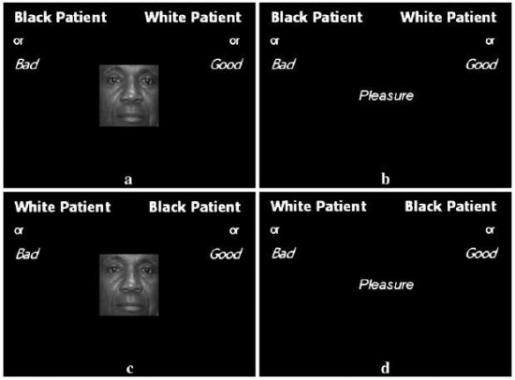
Implicit associations can be measured
    Implicit association test (IAT): https://implicit.harvard.edu/
  Assesses speed and accuracy of responses to linking concepts together, varying values across two dimensions
  Done rapidly so that your slow-
  learning (unconscious) decision
  making is in play
  Various areas
    Race, substance abuse,
    sexual orientation
Notes:
HOW IS THIS RELATED TO HEART DISEASE
DOCUMENTATION THAT THIS IS AN ISSUE – LOTS OF LITERATURE

Slide 66
Health Care Disparities
Systematic review of 15 studies found that all but one found that providers have pro-white bias
  Similar to general population
Physicians judge Black patients to be:
    Less intelligent
    Less likely to comply
    More likely to abuse drugs
Hall, AJPH, 2015
Van Ryn, 2000
Notes:
Both about how we interact with patients and the bias we bring in

Slide 67

The Effect of Patient Race/Ethnicity on Physicians' Ratings of Patients
63
All p ≤ 0.01
%
Adjusted for broad range of variables, including self-reported social support
Van Ryn and Burke. Soc. Sci. Med. 2000
Notes:
Also less educated, intelligent, less feelings of affiliation
Soc Sci Med. 2000 Mar;50(6):813-28.
The effect of patient race and socio-economic status on physicians' perceptions of patients.
van Ryn M¹, Burke J.
Author information
Abstract
Despite its potential influence on quality of care, there has been little research on the way physicians perceptions of and beliefs about patients are affected by patient race or socio-economic status. The lack of research in this area creates a critical gap in our understanding of how patients' demographic characteristics influence encounter characteristics, diagnoses, treatment recommendations, and outcomes. This study uses survey data to examine the degree to which patient race and socio-economic status affected physicians' perceptions of patients during a post-angiogram encounter. A total of 842 patient encounters were sampled, out of which 193 physicians provided data on 618 (73%) of the encounters sampled. The results of analyses of the effect of patient race and SES on physician perceptions of and attitude towards patients, controlling for patient age, sex, race, frailty/sickness, depression, mastery, social assertiveness and physician characteristics, are presented. These results supported the hypothesis that physicians' perceptions of patients were influenced by patients' socio-demographic characteristics. Physicians tended to perceive African-Americans and members of low and middle SES groups more negatively on a number of dimensions than they did Whites and upper SES patients. Patient race was associated with physicians' assessment of patient intelligence, feelings of affiliation toward the patient, and beliefs about patient's likelihood of risk behavior and adherence with medical advice; patient SES was associated with physicians' perceptions of patients' personality, abilities, behavioral tendencies and role demands. Implications are discussed in terms of further studies and potential interventions.

Slide 68
Trust in Family Planning Patients
Table 3. Multivariate analysis for Providers’ Trust in Patient Scale (PTPS) Scores *
 | Difference in Provider trust in patient score | ^{ǂ}p-value
Patient race/ethnicity
White | ref | ref
African-American | -2.3 | 0.05
Latina | -1.2 | 0.3
Asian Pacific Islander | 1.1 | 0.5
Native American | -14.9 | 0.016
Multi-racial/Other | -.6 | 0.8
Provider age | -0.06 | 0.6
Provider type
Nurse Practitioner | -2.1 | 0.5
Physician | ref | ref
*Includes all patient and provider demographics with p-value <0.05 in bivariate analysis
Jackson, unpublished data

Slide 69
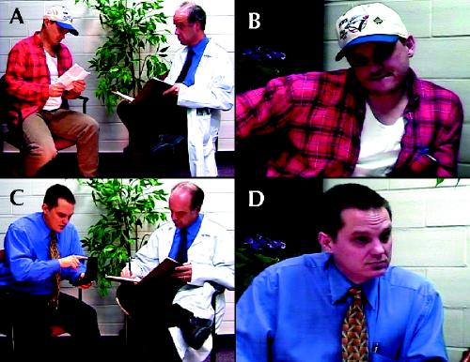
Unconscious Bias by SES
Woo, CMAJ, 2004
Notes:
Of medical students specifically

Slide 70
Unconscious Bias by SES
Low SES patients perceived as less likely to:
  Adhere to medications
  Follow up as recommended
  Second year students were less likely to report wanting the low SES patients in their practice
    But less true among low SES medical students
In context of cardiovascular disease, low SES patients less likely to be perceived as independent, responsible, and likely to participate in rehab
Woo, CMAJ, 2004
Van Ryn, Soc Sci Med, 2000
Notes:
Also in van ryn study with post angiogram encounter - patient SES was associated with physicians' perceptions of patients' personality, abilities, behavioral tendencies and role demands

Slide 71
Implicit bias results in unequal care
Implicit attitudes affect verbal communication and non-verbal behavior (eye contact, friendliness)
Physicians who implicitly favored whites have:
    Less patient-centered communication
    More negative tone during the visit
    Poorer ratings of care by black patients
    Black patients with worse treatment adherence and worse health outcomes
Biases about black patients mediate differences in recommendations in heart disease
Burgess, D. J Gen Intern Med 2004 Hall, AJPH, 2015
Van Ryn, M. JAMA 2011 Van Ryn, AJPH, 2006 Green, JGIM, 2007
Notes:
Reference back to research – this has an impact when we do clinical research
The Chapman paper reviews this
https://pubmed.ncbi.nlm.nih.gov/17594129/ - another study about heart disease and thrombolysis

Slide 72
Statistical Discrimination
Making assumptions about individuals based on the probabilistic application of data about their demographic group
For example:
  Differences in recommendations for IUD could be related to considering population rates of unintended pregnancy
  Differences in diagnosis of PID vs. appendicitis related to STI demographics
Fails to consider individual differentiating information
Balsa, HSR, 2005
Notes:
But at the end of the day it’s the same and is just a rationalization
How can you really separate these things out? Need to recognize that motivation is the relevant thing.

Slide 73
Patient Factors
Black patients known to have less trust in the medical system
  But shouldn’t the medical system be addressing this?
Notes:
Reference the paper on mistrust
Add back slides from Safyer’s lecture on history
- Example of reproductive health
Include something about the pain paper – the problem with biological narratives
Vaccination for COVID
Implications for research at the end

Slide 74
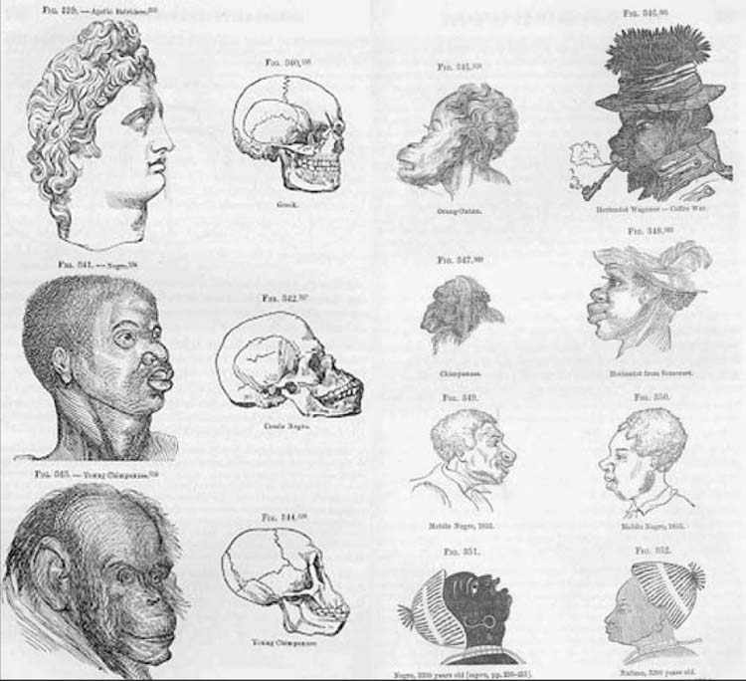
The legacy of racism in medicine
Modern American medicine has historical roots in scientific racism and eugenics movements.
Scientific racism reinforced the concept of race as an innate biologic, and later genetic, attribute using culturally influenced scientific theory and inquiry.
Notes:
Quotes from Bailey et al 2020, using the Samuel Morton skull size experiments which aimed to prove white superiority over other races. Bailey (2020) also notes that :” The modern eugenics movement swept through the United States in the early 20th century, leading to laws prohibiting “miscegenation” and the forced sterilization of undesirable “races” in an effort to create a better, more intelligent, Whiter nation.”

Slide 75
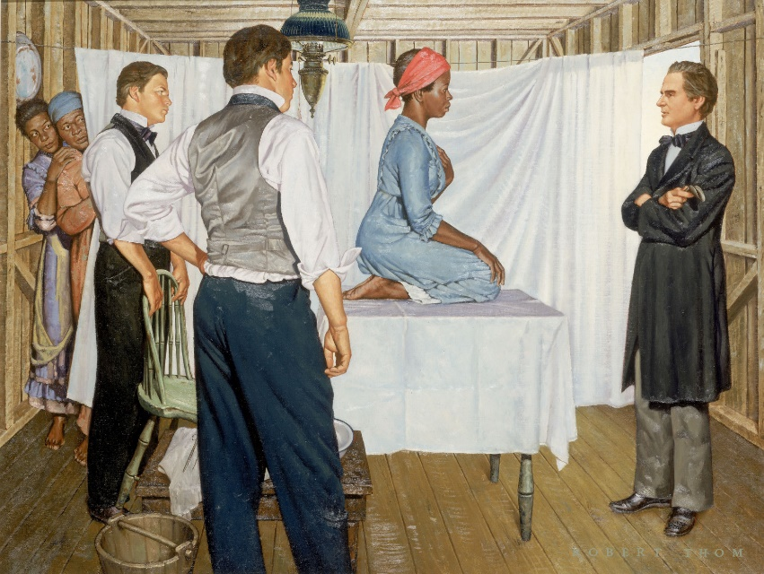
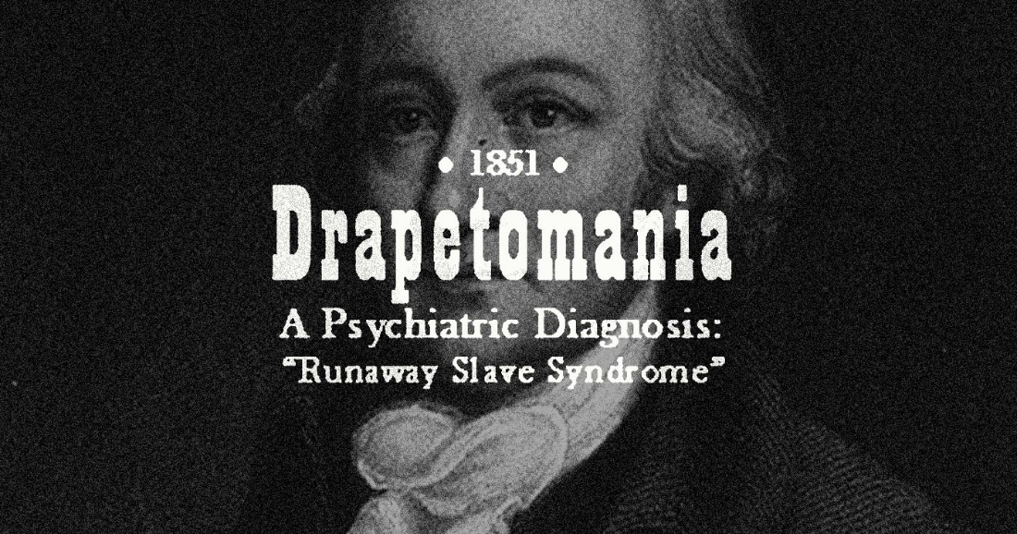
The legacy of racism in medicine
Well-respected medical doctors cast Black people as innately diseased and dehumanized their suffering, using scientific arguments to provide the illusion of neutrality and objectivity.
Notes:
Another quote from Bailey (2020), with a couple examples of how the legacy of scientific racism is inextricably linked with modern day disparities and inequality.
First is Samuel Cartwright’s definition of the “drapetomania” aka runaway slave syndrome. Published in the The New Orleans Medical And Surgical Journal in 1851.Second is J. Marion Sims (father of gynecology), image depicts the vesicovaginal fistula repair which was perfected through repeated operations without anesthesia, on enslaved Black women.

Slide 76
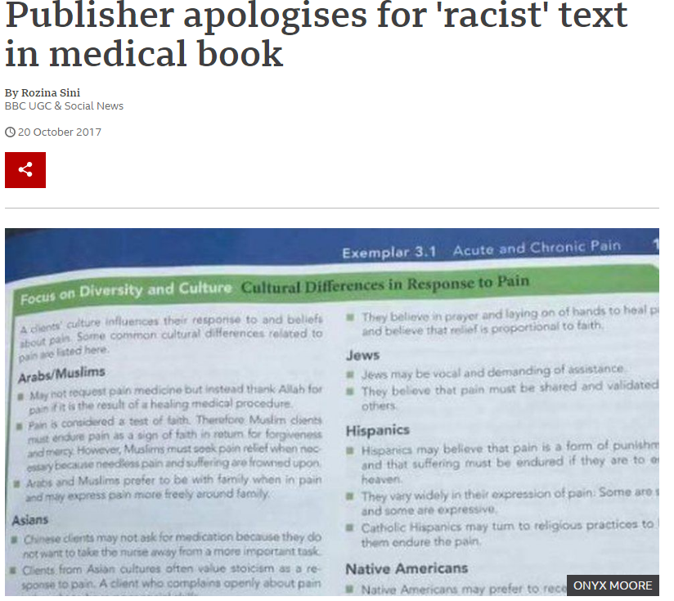
The (sometimes) hidden curriculum
Both implicitly and explicitly, the structure and culture of medicine continues to foster bias and disparities in care
Notes:
For instance, in a 2016 study to assess racial attitudes, half of White medical students and residents held unfounded beliefs about intrinsic biologic differences between Black people and White people. These false beliefs were associated with assessments of Black patients’ pain as being less severe than that of White patients and with less appropriate treatment decisions for Black patients. In addition, as recent as 2017, nursing textbook had to be recalled due to racist stereotypes (https://www.bbc.com/news/blogs-trending-41692593)

Slide 77
Patient Factors
Black patients known to have less trust in the medical system
  But shouldn’t the medical system be addressing this?
Real question is how can the system, and individuals within it, can earn trust within this context
Providing individualized care is the goal
  Recognizing the lived experience of racism and other oppressions, without stereotyping
Notes:
Reference the paper on mistrust
Add back slides from Safyer’s lecture on history
- Example of reproductive health
Include something about the pain paper – the problem with biological narratives
Vaccination for COVID
Implications for research at the end

Slide 78
Summary of Causes of HCD
Health Care system:
  Segregated and inferior
  Fragmented and challenging for all
  Language barriers
  “Literacy” and “Numeracy”
Provider:
  Unconscious bias
  Statistical discrimination
Patients?
So what can we do about it?

Slide 79
Interventions to Eliminate Disparities in Healthcare
Systems:
  Better systems
  Tailored support
Providers:
  Address unconscious bias
  Change the provider workforce
Bring together clinical care and public health

Slide 80
System approaches to reduce disparities: Best practices
Healthcare organizations must commit to reducing disparities and promoting equity.
Public health and the healthcare system must collaborate to address disparities at each level of prevention and each level of the system.
Data that allow for the detection of disparities must be collected, and quality improvement frameworks must incorporate interventions to reduce disparities.
National Quality Forum. Effective Interventions in Reducing Disparities in Healthcare and Health Outcomes in Selected Conditions. 2017.

Slide 81
System approaches to reduce disparities: Best practices (cont.)
Healthcare organizations should partner with their communities and ensure buy-in from patients when implementing interventions.
Cultural competency, person and family engagement, and multidisciplinary teams focusing on care coordination can all help to reduce disparities.
Reducing disparities in health and healthcare will require both general and condition-specific approaches.
National Quality Forum. Effective Interventions in Reducing Disparities in Healthcare and Health Outcomes in Selected Conditions. 2017.

Slide 82
Quality Improvement and Health Disparities

Slide 83
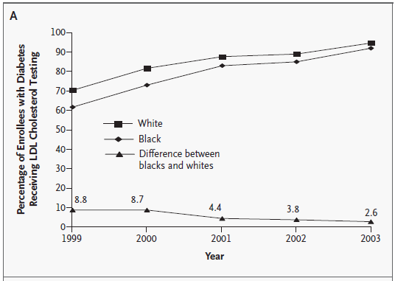
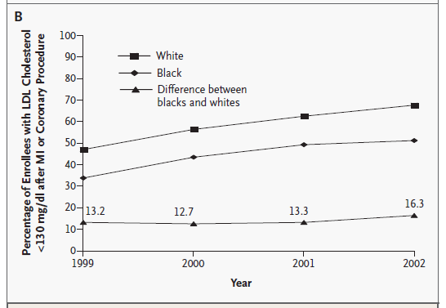
Trends in Receipt of Two HEDIS Measures for Enrollees in Medicare Managed-Care Plans, by Race
LDL TESTING
LDL CONTROL
Trivedi, A. N.; NEJM, 2005
Notes:
Figure 1. Trends in Receipt of Two HEDIS Measures for Enrollees in Medicare Managed-Care Plans, by Race. Panel A shows large overall improvements in the quality of care by year and a significant narrowing of the disparity between blacks and whites in testing for levels of low-density lipoprotein (LDL) cholesterol among patients with diabetes (P

Slide 84
Quality Improvement and Disparities
QI works
Variable effect on disparities
Generic programs probably less useful for addressing disparities
Weak correlation between overall quality of care and size of disparities for a given system of care
Shakir, JGIM, 2018

Slide 85
Patient Portals
May increase care coordination and access to information
  Safety net patients indicate interest in electronic communication
However, internet access and computer literacy can lead to exacerbation of disparities
Schickendaz, JGIM, 2013
Lyles, PLoS Med, 2015

Slide 86
Other Interventions
Address barriers to care related to numeracy/literacy
  Decision support tools
Promote ease of access to services and information
  Reducing co-payments (Lewey et al.,2015)
Adequate interpreter services used by trained providers

Slide 87
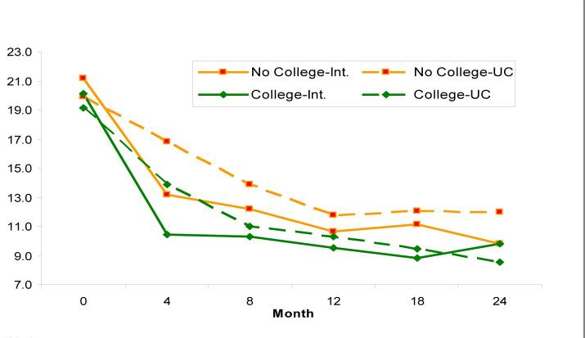
Addressing Disparities Through Collaborative Care Management - Depression
Bao, Arch Gen Psychiatry, 2011
Angstman, Medical Care, 2015
2
Notes:
Maybe both about social determinants and health care did not have an effect on race

Slide 88
Provider Interventions
Make provider population more representative of patients served
  Race and language concordant interactions associated with more patient-centered care
Change the philosophy of care
  Patient-centered attitudes associated with fewer disparities in communication among medical students
What about implicit bias itself?
Beach: Acad Med, 2007
Shen, J Racial Ethn Health Disparities, 2017

Slide 89
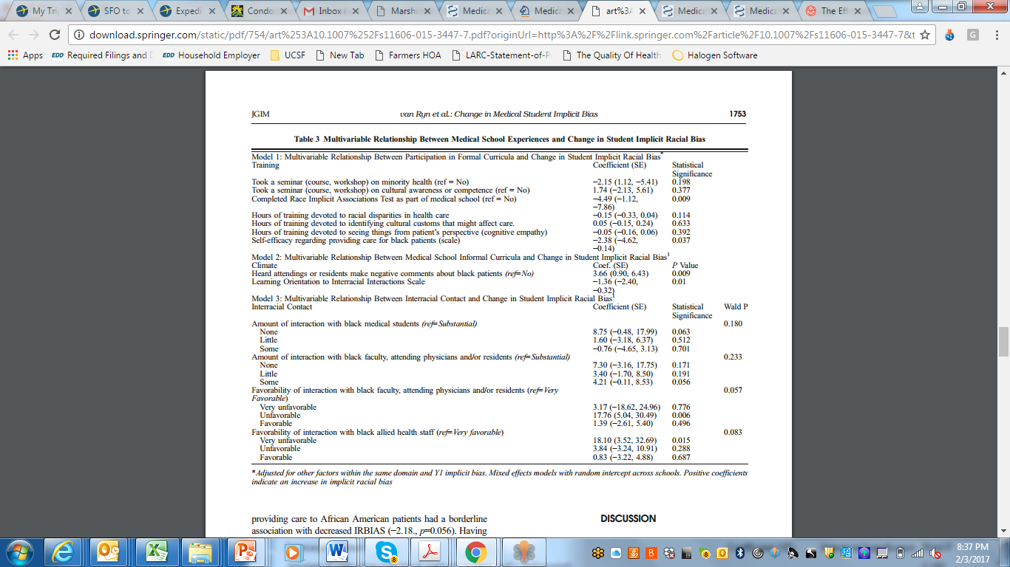
Implicit Association Test?
Van Ryn, JGIM, 2015

Slide 90
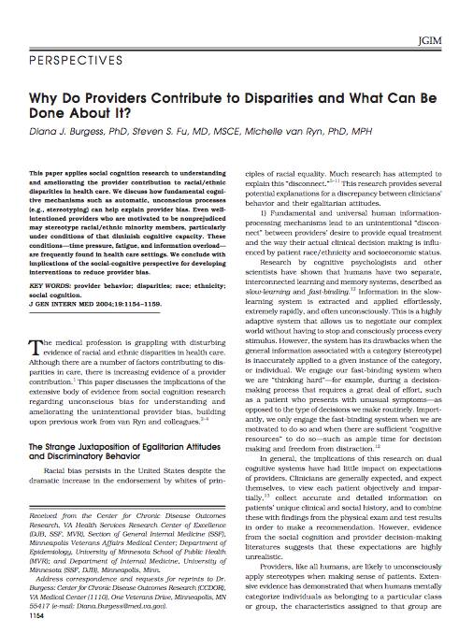
Addressing Implicit Racial Bias
Focus on individual qualities
  Individuation v. categorization
Enhance individual motivation
  IAT/ what would/should I do?
Open discussion of stereotypes
Improve confidence in interacting with dissimilar group
Empathy – perspective-taking
Partnership building with patients
Burgess, JGIM, 2004
Notes:
Perspectives from Psych Literature

Slide 91
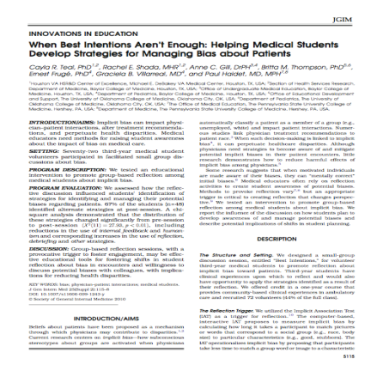
Effects of Implicit Bias Workshop
    Workshop using Implicit Attitude Test
    Facilitated small group discussion
      Discussion
        Reactions, clinical experiences, and strategies
      Noted differences after sessions in strategies
        Focus on recognition of bias
        Shift from self-reliance to talking with others
        Consider possible bias before seeing patient
Teal, JGIM, 2010

Slide 92
Facing Outward
Social screening is gaining prominence – e.g. collecting social variables in EHR
Benefit for linkages to social resources
Can also help inform treatment and care by addressing barriers to treatment
HOWEVER, important to prevent stereotyping
  Some health care disparities arise from assumptions about preferences or abilities based on social variables

