Slide 1
Study Design – RCT to Cohort – and Target Trials
Epidemiology 207 - Epidemiology Methods II
June M. Chan, ScD
Professor & Vice Chair, Epidemiology & Biostatistics
Steven & Christine Burd-Safeway Distinguished Professor & Assoc. Chair, Clinical Research, Urology

Slide 2
RCT – Brief Summary
Acknowledgement: Deb Grady, MD MPH
Notes:
This next set of slides is NOT RECORDED and is considered a review of some aspects of RCT design. Please review on your own, as needed.
We thank Dr. Deb Grady for developing and sharing these slides.

Slide 3
Concept of clinical trials or experimental studies guide other study designs
⚐ “Trial” → there is an intervention, distinct from “Observational” studies
Randomized experiments → paradigm for causal inference
Randomized trials provide helpful idealized framework in which to think about other types of study designs
Notes:
EPI 205 focuses on clinical trial design/conduct
Be deliberate when you use the word “trial”; this means a study with an intervention… and often “trial” refers to a ”randomized trial”

Slide 4
Basic Trial Design
Population
Intervention
Outcome
Sample
Randomization
+ Blinding
Placebo
Control
Outcome
Notes:
For example, select persons with memory loss, treat with daily mathematics and memory exercises and see if this improves score on MMSE and reduces risk of developing dementia.
Note can have an uncontrolled trial or time series design. These have no concurrent control group and can produce the wrong answer due to learning, regression to the mean, secular trends and the placebo effect. Note, for example, that it is common to have a 30-50% improvement in depression scores, pain scores, hot flash scores.
Can have a controlled trial without randomization. This addresses problems noted above, but may make the treatment look good simply because the groups are different to begin with. For example, if you put all the older people in the control group because it’s too hard to teach them mathematics, the rate of developing dementia may be higher in this group simply because they are older. This design is really no different from a double cohort study. Randomization fixes this - for both known (measured) and unknown (unmeasured) potential confounders - I.e., age will be balanced in both groups, as will education, etc. And potential confounders we don’t know about.
Can have a randomized controlled trial without placebo (blinding). This allows (as will be discussed later) for co-intervention and biases outcome ascertainment.
Also note that these three elements - treatment, randomization and blinding result in the major ethical concerns regarding randomized trials.

Slide 5
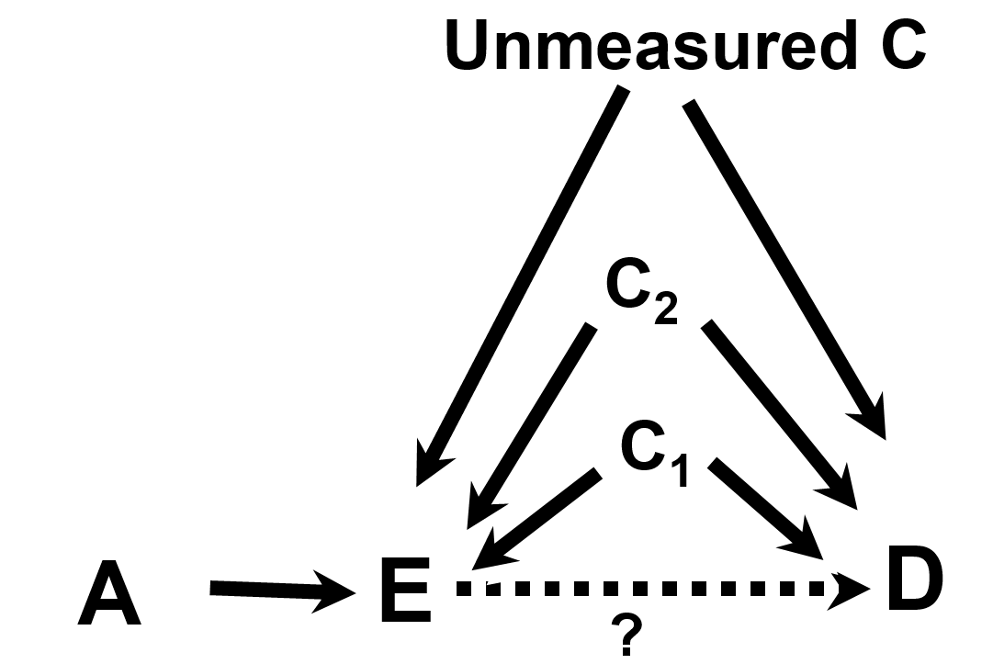
EPI203, Confounding & Interaction
Variable A is referred to as an instrumental variable (IV) or “instrument”.
Notes:
Variable A is referred to as an instrumental variable or “instrument”. An instrument is defined to as a factor related to exposure but to nothing else.

Slide 6
EPI203, Confounding & Interaction
Randomization
Variable A is referred to as an instrumental variable (IV) or “instrument”. Here, let A be randomization in a RCT.
Randomization is an Instrumental Variable, that is related to the Exposure and nothing else. In a RCT, we focus on the IV-D relationship (randomized assignment and disease outcomes) in Intent-to-Treat analyses
Notes:
Variable A is referred to as an instrumental variable or “instrument”. An instrument is defined to as a factor related to exposure but to nothing else.

Slide 7
Randomized Clinical Trial attributes:
  Randomization to Exposure (e.g., drug) or a Control (e.g., placebo) addresses known & unknown confounding factors
  Intention to Treat (ITT): “once randomized, always analyzed”, maintains randomization
  Blinding minimizes bias in assessments/self-report

Slide 8
RCT Rationale
Why do a randomized blinded trial?
  minimize confounding
  minimize co-interventions
  minimize biased outcome ascertainment
Why not do a randomized trial?
  major ethical issues
  narrow research question
  expensive
  long time from idea to publication
Generally reserved for mature questions
Notes:
Will talk more about why to do a trial…want to emphasize that there are some good reasons NOT to do a trial.
Randomized Clinical Trial attributes:
Randomization to Exposure (e.g., drug) or a Control (e.g., placebo) addresses known/unknown confounding factors
Intention to Treat (ITT): “once randomized, always analyzed”, maintains randomization
Blinding minimizes bias in assessments
Co-Intervention – additional diagnostic or therapeutic tests or procedures applied to either the intervention or control group in a RCT. Such additions that are not pre-specified by the protocol could introduce confounding and threaten validity of the trial.

Slide 9
Randomization
Participants are assigned to treatment groups by chance with a known probability
Random number sequence, generated by computer
Tamper-proof system
  ordered, sealed envelopes
  centralized system (phone, computer, web)

Slide 10
Value of Randomization
Balances baseline characteristics of the treatment groups
  eliminates confounding due to measured and unmeasured factors
  provides an unbiased comparison between groups
Does NOT maintain balance after randomization
  What does that mean?
  Consider an intervention that is not blinded….
Notes:
If your intervention is not blinded to the dr. or participant, self-awareness of the intervention after randomization can lead to the introduction of differences bt groups.

Slide 11
Choice of Intervention
Maximize
  effectiveness (highest tolerable dose)
  safety (lowest effective dose)
  generalizability
  trial design/conduct
    recruitment
    compliance
    blinding

Slide 12
Choice of Control
Inert placebo usually best
Active therapy or “standard of care”
  Active Comparator Trial - new therapy more effective than standard
    Ho: two treatments equally effective
    Ha: one treatment more effective
  Equivalence Trial - new therapy equivalent
    Ho: two treatments differ by at least X
    Ha: two treatments differ by less than X
Notes:
Best control is inactive placebo
easy to determine benefit or harm
Usually (not always) easy to blind
Some trials use an active treatment of “standard of care” as the comparator. Here, the goal might be to show that the new intervention is better than the standard. The design and statistical analysis here is exactly the same as if the standard of care were a placebo.
But often, the goal is to determine if the new treatment is AS GOOD as the standard of care. Sometimes, we do just want a second line therapy, but generally don’t really care if a new treatment is as good as the standard of care unless it has some advantages, for example better side effect profile, more convenient, or less expensive.
Decision about what is considered “good enough” for non-inferiority trial is based on lit. example: https://jamanetwork.com/journals/jama/fullarticle/2320315?utm_source=silverchair&utm_campaign=marketing&utm_content=article-decade&cmp=1&utm_medium=email
In this example, X was set at 24% for power calculations.
Consider, for example, the problem of conducting a clinical trial with a new drug for prevention of osteoporotic fractures. There are already proven effective drugs for this, namely estrogens, bisphosphonates and PTH. Is it ethical and/or clinically useful to study this new drug compared to placebo? There are many such examples - HTN, depression, lipid lowering, etc.

Slide 13
Adherence
Intervention cannot work if it is not used
Adherence measures
  intervention
    pill count, diaries, biologic measure, measuring device in dispenser
  visits
  study measurements

Slide 14
Maximizing Adherence and Follow-up
Choose subjects likely to adhere
  exclude if likely nonadherent
  complete several visits before randomization
  complete a run-in
Intervention easy and safe
Visits easy and enjoyable
  frequent enough to be engaging
  evening visits, travel and parking reimbursement
  personal relationships with participants
Measurements easy, safe and painless
Never discontinue participants

Slide 15
High Quality Randomized Trials
Tamper-proof randomization
Blinding of participants, study staff, lab staff, outcome ascertainment and adjudication
Adherence to study intervention
Complete follow-up
Adequate sample size

Slide 16
Clinical Trial Limitations
While RCT’s are often considered ”gold standard” & helpful for guiding other study designs, there are also limitations.
  Time
  Cost
  Generalizability
  Ethical Issues & need for Equipoise
  Issues related to Dose, Duration, & Timing of Intervention
Notes:
Equipoise – the group or tx allocations in the trial must be equally acceptable based on current state of knowledge
There are certain questions that will NEVER be addressed in a trial

