Slide 1
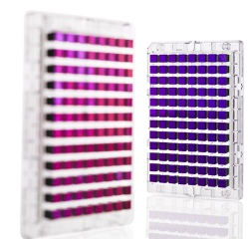

Genome-wide association studies (GWAS)

Slide 2
Outline for GWAS
Review / Overview
Design
Analysis
  QC
  Prostate cancer example
  Imputation
  Replication & Meta-analysis
(Likely next time)

Slide 3
Outline for GWAS
Review / Overview
Design
Analysis
  QC
  Prostate cancer example
  Imputation
  Replication & Meta-analysis

Slide 4
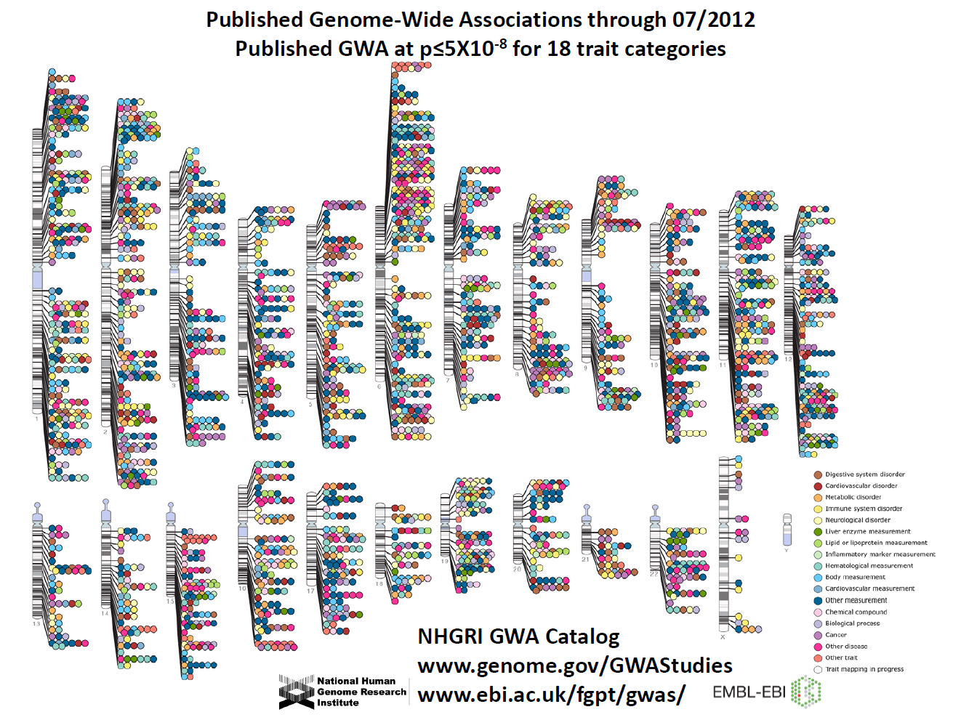
Manolio et al., Clin Invest 2008
Notes:
4

Slide 5
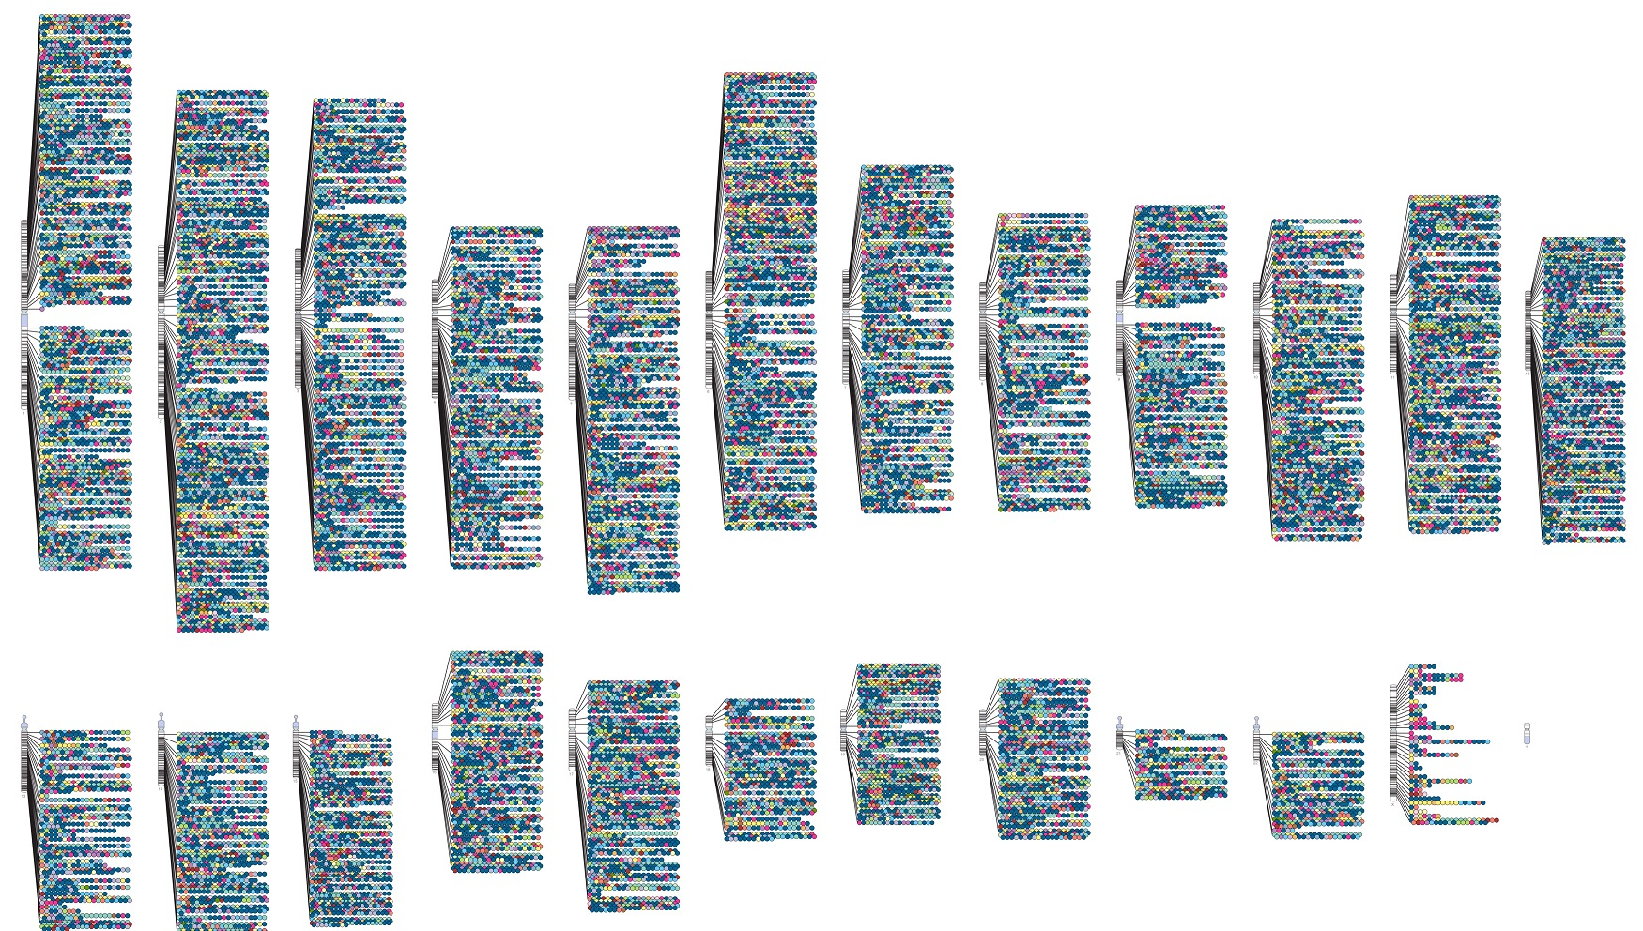
01/25/2021

Slide 6
Outline for GWAS
Review / Overview
Design
Analysis
  QC
  Prostate cancer example
  Imputation
  Replication & Meta-analysis

Slide 7

Design 1: Microarray – Genotype a subset of markers available
(guilt by association)
Disease locus directly typed
Marker correlated with typed disease locus
Previously we talked about using this to “tag” candidate genes (only Genotype a subset of the SNPs).
Same principal applies to tagging the whole genome.
Hirschhorn & Daly, Nat Rev Genet 2005
Notes:
7

Slide 8
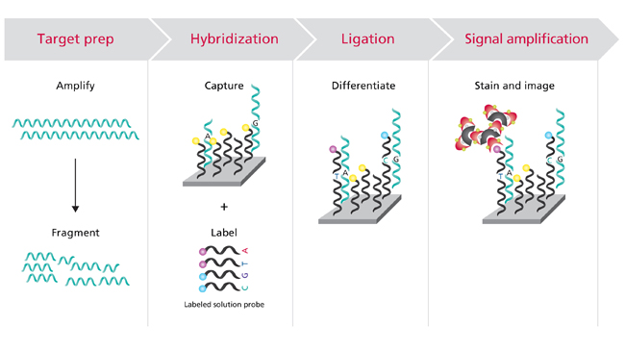
Technology behind a GWAS Microarray
Labeled probes bind to sample, differentiating between the two alleles
Make it bright enough then measure intensity of array
Sample binds to array
Assay ~ 0.7 - 5M SNPs (keeps increasing)
Affymetrix, http://www.affymetrix.com

Slide 9
Raw microarray data: Genotype calls
Good calls!
Bad calls!

Slide 10
Class Exercise (groups of 3-4)!:
How would you design a general GWAS microarray?
It will be linked to an EHR, all diseases of interest
Do you have to genotype everything?
Regions/SNPs to prioritize?
Hoffmann et al., Next generation genome-wide association tool. Design and coverage of a high-throughput European-optimized SNP array. Genomics, 2012.
Hoffmann et al., Design and coverage of high throughput genotyping arrays optimized for individuals of East Asian, African American, and Latino race/ethnicity using imputation and a novel hybrid SNP selection algorithm. Genomics, 2012.

Slide 11
Class Exercise (groups of 3 ideal)!:
How would you design a general GWAS microarray?
It will be linked to an EHR, all diseases of interest
Do you have to genotype everything/everyone? [tag SNPs (population?), minor allele frequency limit, old multistage design]
Regions/SNPs to prioritize? [genes?, prev hits, functional significance?; some SNPs cost more; some SNPs work better]
[Similar to candidate genes before, but grander scale]
Hoffmann et al., Next generation genome-wide association tool. Design and coverage of a high-throughput European-optimized SNP array. Genomics, 2012.
Hoffmann et al., Design and coverage of high throughput genotyping arrays optimized for individuals of East Asian, African American, and Latino race/ethnicity using imputation and a novel hybrid SNP selection algorithm. Genomics, 2012.

Slide 12
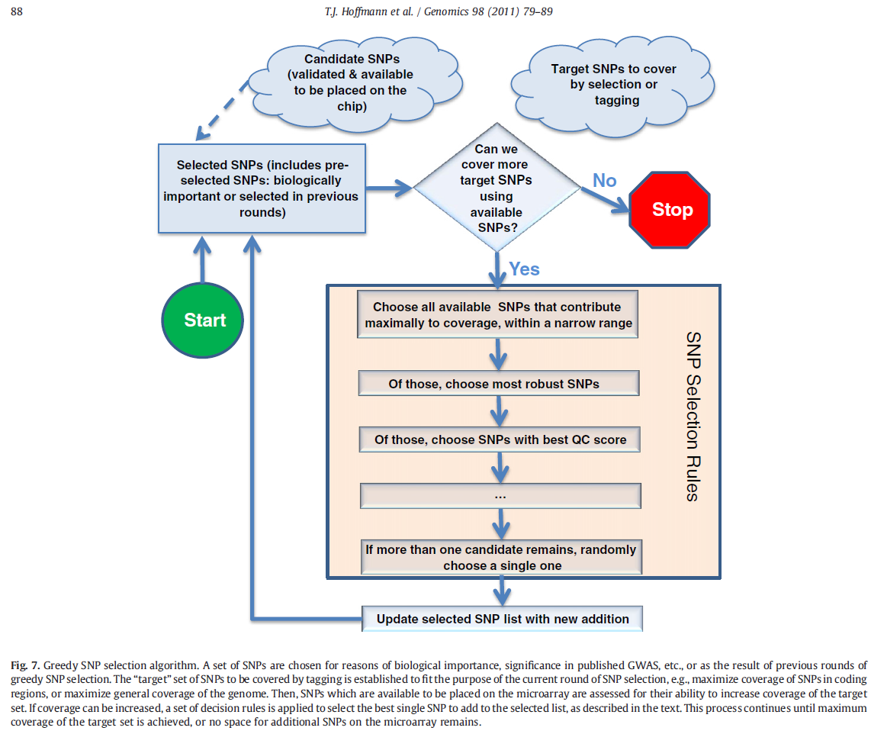
Class Exercise!: How would you design a general GWAS microarray?
Hoffmann et al., Next generation genome-wide association tool. Design and coverage of a high-throughput European-optimized SNP array. Genomics, 2012.
Hoffmann et al., Design and coverage of high throughput genotyping arrays optimized for individuals of East Asian, African American, and Latino race/ethnicity using imputation and a novel hybrid SNP selection algorithm. Genomics, 2012.

Slide 13
Genome-wide Assocation Studies (GWAS)

Slide 14
Genome-wide Assocation Studies (GWAS)
entire
Just this first step is done these days.
Cost previously

Slide 15
Class Exercise!: How would you sequence a genome?
Capture every base (or at least try to)…

Slide 16
Class Exercise!: How would you sequence a genome?
Capture every base (or at least try to)…
Can only sequence fragments of a certain size… (you can chop the genome into pieces…)

Slide 17
Class Exercise!: How would you sequence a genome?
Capture every base (or at least try to)…
Can only sequence fragments of a certain size… (you can chop the genome into pieces…)
  How many times should you sequence it?
  Are some regions harder than others?

Slide 18
Class Exercise!: How would you sequence a genome?
Capture every base (or at least try to)…
Can only sequence fragments of a certain size… (you can chop the genome into pieces…)
  How many times should you sequence it?
  Are some regions harder than others?
De novo, or from a reference?

Slide 19
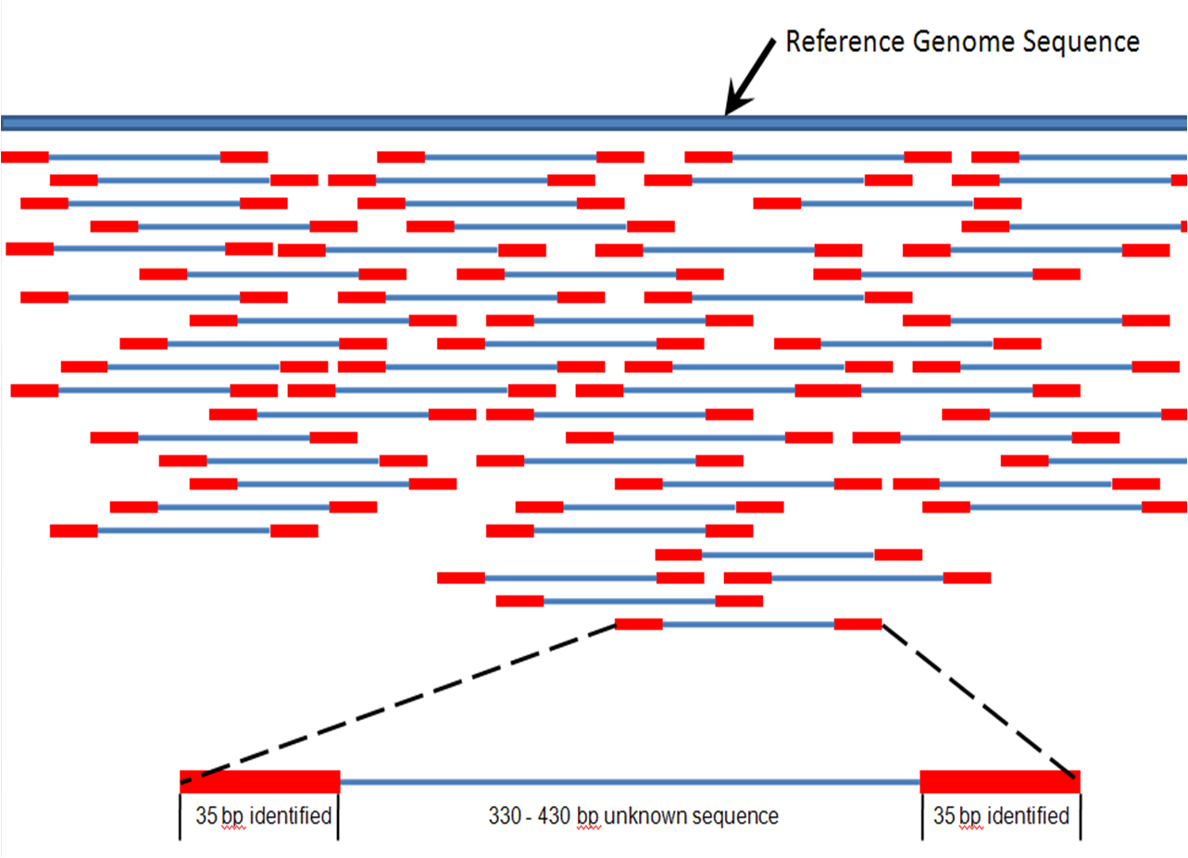
Design 2: Next generation sequencing
Genotype essentially entire genome
A bunch of ~random reads all over the genome are assembled (not trivial) to produce the genome

Slide 20
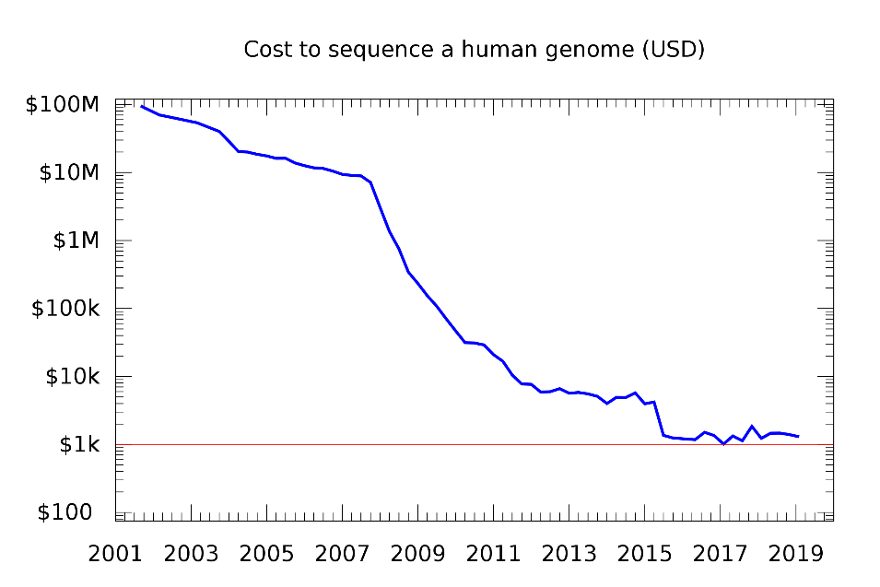
Design 2: Next generation sequencing
Genotype essentially entire genome
A bunch of ~random reads all over the genome are assembled (not trivial) to produce the genome
Some regions of the genome have more reads than others; can choose how much you want to sequence (5x coverage 1000 Genomes, e.g.)
More expensive
  Old thought: Extreme phenotypes,
    since can't do everyone?
  New thought: Just sequence everyone.

Slide 21
Design choices
GWAS Microarray
  Only assay SNPs designed into array (0.7-5 million)
  Cheaper (so more subjects tradeoff)
GWAS Sequencing
  “De novo” discovery (particularly good for rare variants)
  More expensive (but costs are falling) (many less subjects)
  Need much more expansive IT support
  Lots of interesting interpretation problems (field rapidly evolving)
Can also do a hybrid design (use sequencing on some to inform
array design on rest; complicates analysis)

Slide 22
Design choices
Exome Microarray
  Only assay SNPs designed into array (~300K+custom); in exons only and that could affect protein coding function
  Cheapest (so many more subjects)
Exome Sequencing
  “De novo” discovery (particularly good for rare variants); %age of exons only (first step is a pull down that does not capture all exons)
  More expensive than microarrays, less expensive than gwas sequencing
  Need more expansive IT support, but not as much as whole genome

Slide 23
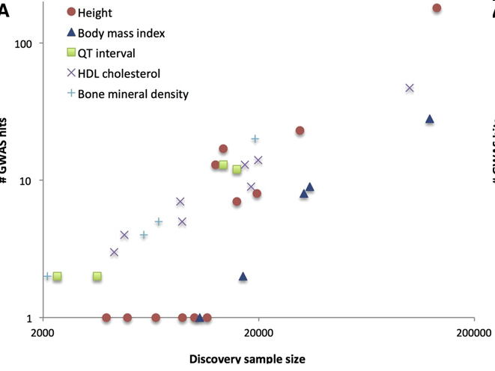
Size of study matters
Large # SNPs tested – multiple comparisons
Very small effect sizes
Tag SNP, rather than actual SNP
Consortiums
(This is an old figure, but has certainly held up)
Visscher, AJHG 2012

Slide 24
Biggest studies...
GWAS Microarray:
  US:
    Million Veteran’s Program (1M in process, >300K now)
    100K people in the Kaiser RPGEH (Hoffmann et al., Genomics, 2011a&b)
    23&me, crude self report, but sample size can win for discovery!
  UK Biobank: nearly 500K people
  Other big groups:
Whole Genome Sequencing: 1000 Genomes Project (2.5K), UK10K (~4K), TopMed (150K)
Exome Sequencing: GO ESP (12,031 subjects, for exome microarray design), Geisinger, all of UKB planned (200K so far)

Slide 25
Outline for GWAS
Review / Overview
Design
Analysis
  QC
  Prostate cancer example
  Imputation
  Replication & Meta-analysis

Slide 26
Why QC data?
HIV resistance

Slide 27
QC Steps: Class exercise!
Can you think about potential QC steps you might take at an individual and SNP level basis? Which one first?
What tests have we talked about in this course?
Special chromosomes?
(Could families be problematic? useful?)

Slide 28
QC Steps
“garbage rises to the top”
Filter SNPs and Individuals
  MAF (e.g., 1%, but very sample size dependent!)
  Low call rates (means genotype probably didn't work correctly)
Test for HWE among controls & within ethnic groups. Use conservative alpha-level (10⁻⁶, e.g., but opinions vary) (again, to remove artifacts)
Check for relatedness.
  MZ twins, or accidentally genotyped same sample twice?
  Remove first degree, or account for.
Check genotype gender (mislabeled samples)
Filter Mendelian inhertance (family-based, or potentially cryptics, if large enough sample)
plink sofware: pngu.mgh.harvard.edu/~purcell/plink/reference.shtml

Slide 29
Filter for Mendelian inheritance
A|A-----A|A
|
A|T

Slide 30
Filter for Mendelian inheritance
A|A-----A|A
|
A|T ← Offspring Genotype not
Possible!
(De novo mutation, but
more likely genotyping
error.)

Slide 31
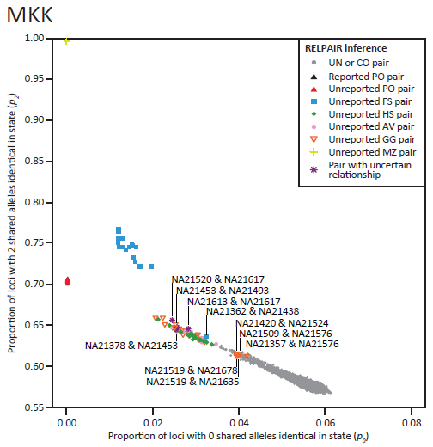
Check for relatedness, e.g., HapMap
Take overall average of all SNPs of how many alleles are shared.
E.g., parent-offspring never shares zero alleles.
HapMap was supposed to be unrelateds (this was a bit of a surprise!)
Pemberton et al., AJHG 2010

Slide 32
GWAS analysis
Most common approach: Model each SNP separately
Additive coding of SNP most common, just a covariate in a regression framework
Dichotomous phenotype: logistic regression
Continuous phenotype: linear regression
Correct for multiple comparisons
  e.g., Bonferroni, 1 million gives α=5x10⁻⁸
  [Often use 5x10⁻⁸ for larger GWAS arrays (or imputed SNPs, more later) also, SNPs are correlated, so Bonferroni is a little too conservative…]
Adjust for potential population stratification (details next slides…)
  principal components (PC’s), on best performing SNPs
  software usually does LD filter (e.g., Eigensoft)

Slide 33
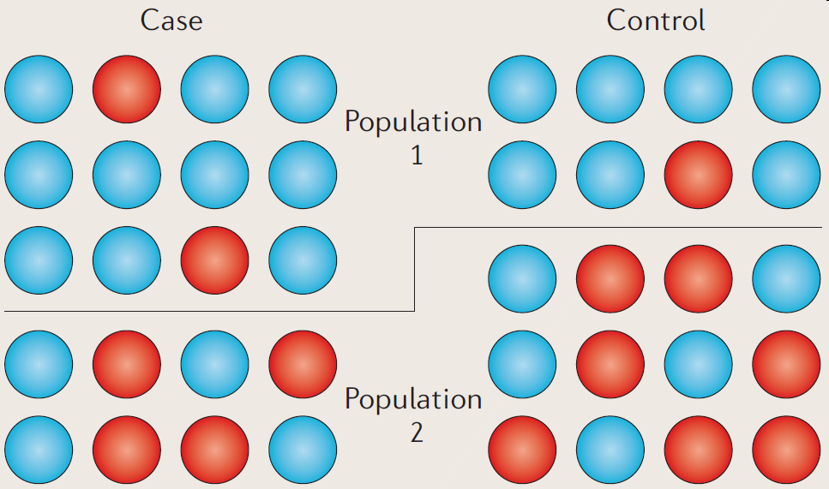
Recap of population substructure
Two populations have different disease frequency, and different allele frequency (Recall Pima & Papago example).
Association picks up they are different populations!
Balding, Nature Reviews Genetics 2010

Slide 34
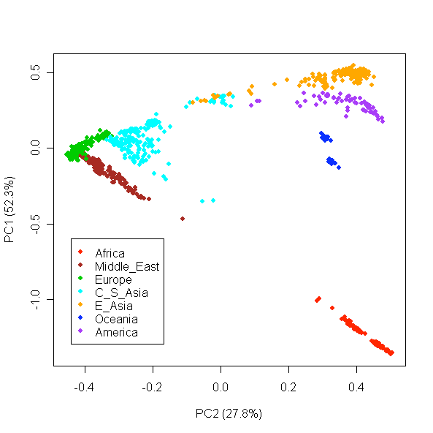
Control for race/ethnicity/ancestry: Principal Components (PCs) as covariates in regression model
Li et al., Science 2008

Slide 35
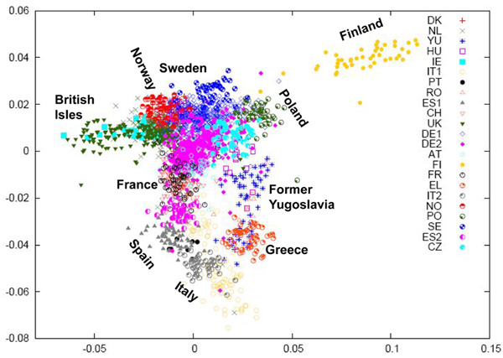
PCs pick up fine population structure
Razib, Current Biology 2008

Slide 36
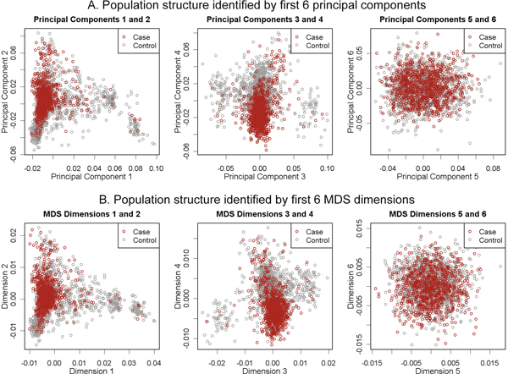
Adjusting for PC's
Do not want separate cluster for cases as controls! – Why want individuals from similar population for controls (and randomization). [These look reasonable, but if see a separation…]
Wang, BMC Proc 2009

Slide 37
Instead of adjusting for PCs, adjust for the rest of the genome (mixed models)
(1) Increase power by jointly modelling all variants, and (2) adjust for population structure
Adjust for genetic relatedness between all pairs of individuals (kinship matrix)
  This is huge, need approximations to handle this in modern cohorts.
  In practice -- leave one chromosome out analysis
    E.g., chromosome 1, adjust for kinship based on chromosome 2-22
    Don’t really want to adjust for variants immediately nearby (LD, proximal contamination)
Software: Emmax, GEMMA, BOLT-LMM (fast)

Slide 38
After run analysis
Assess the fit with Q-Q plot (saw last lecture)
Look at results in Manhattan plots
Replication of hits in a separate cohort

Slide 39
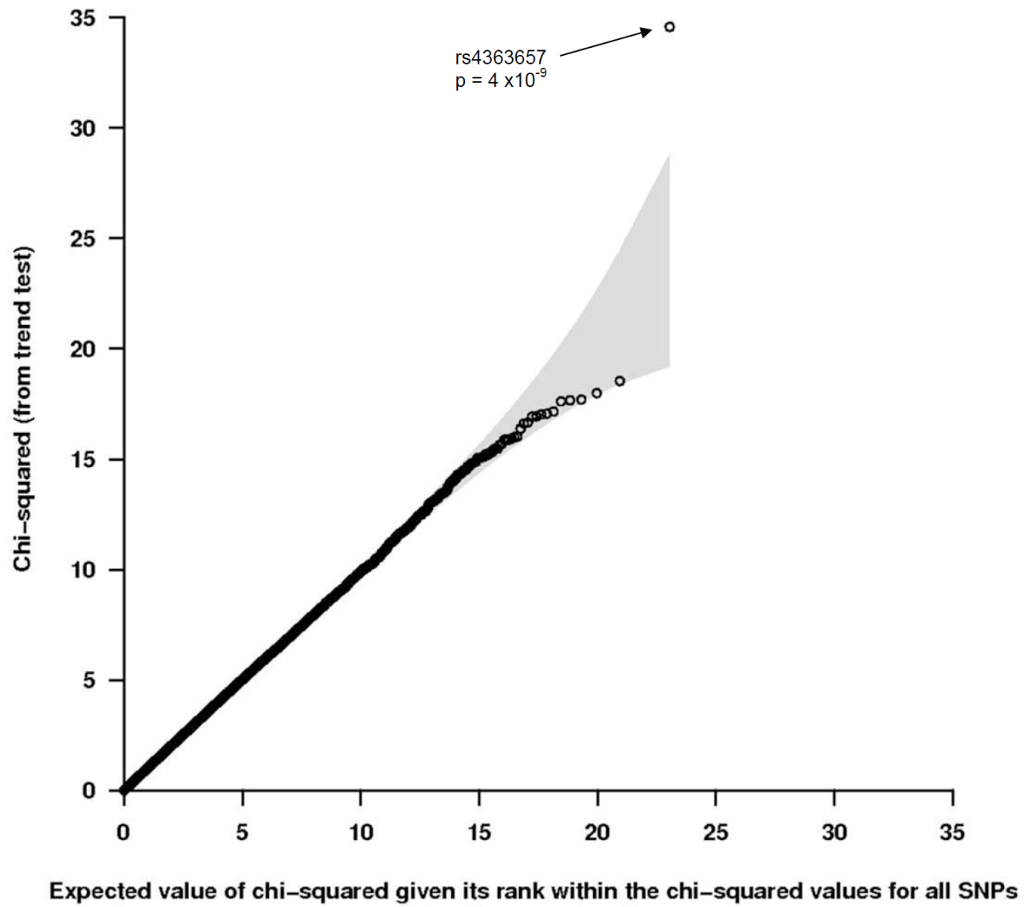
Quantile-quantile (Q-Q) plot review
Most SNPs are on the line, but want a few hits off the line (true significant associations!)

Slide 40
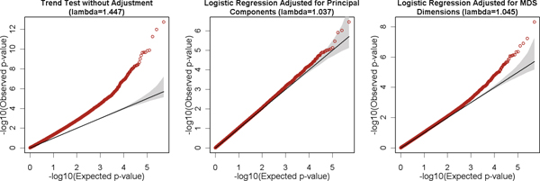
Q-Q plots and PC adjustment recap
Exactly on line if no signal at all.
If don't adjust for PC's, then p-values are all inflated artificially.
Adjusting for PC's fixes the problem.
Wang, BMC Proc 2009

Slide 41
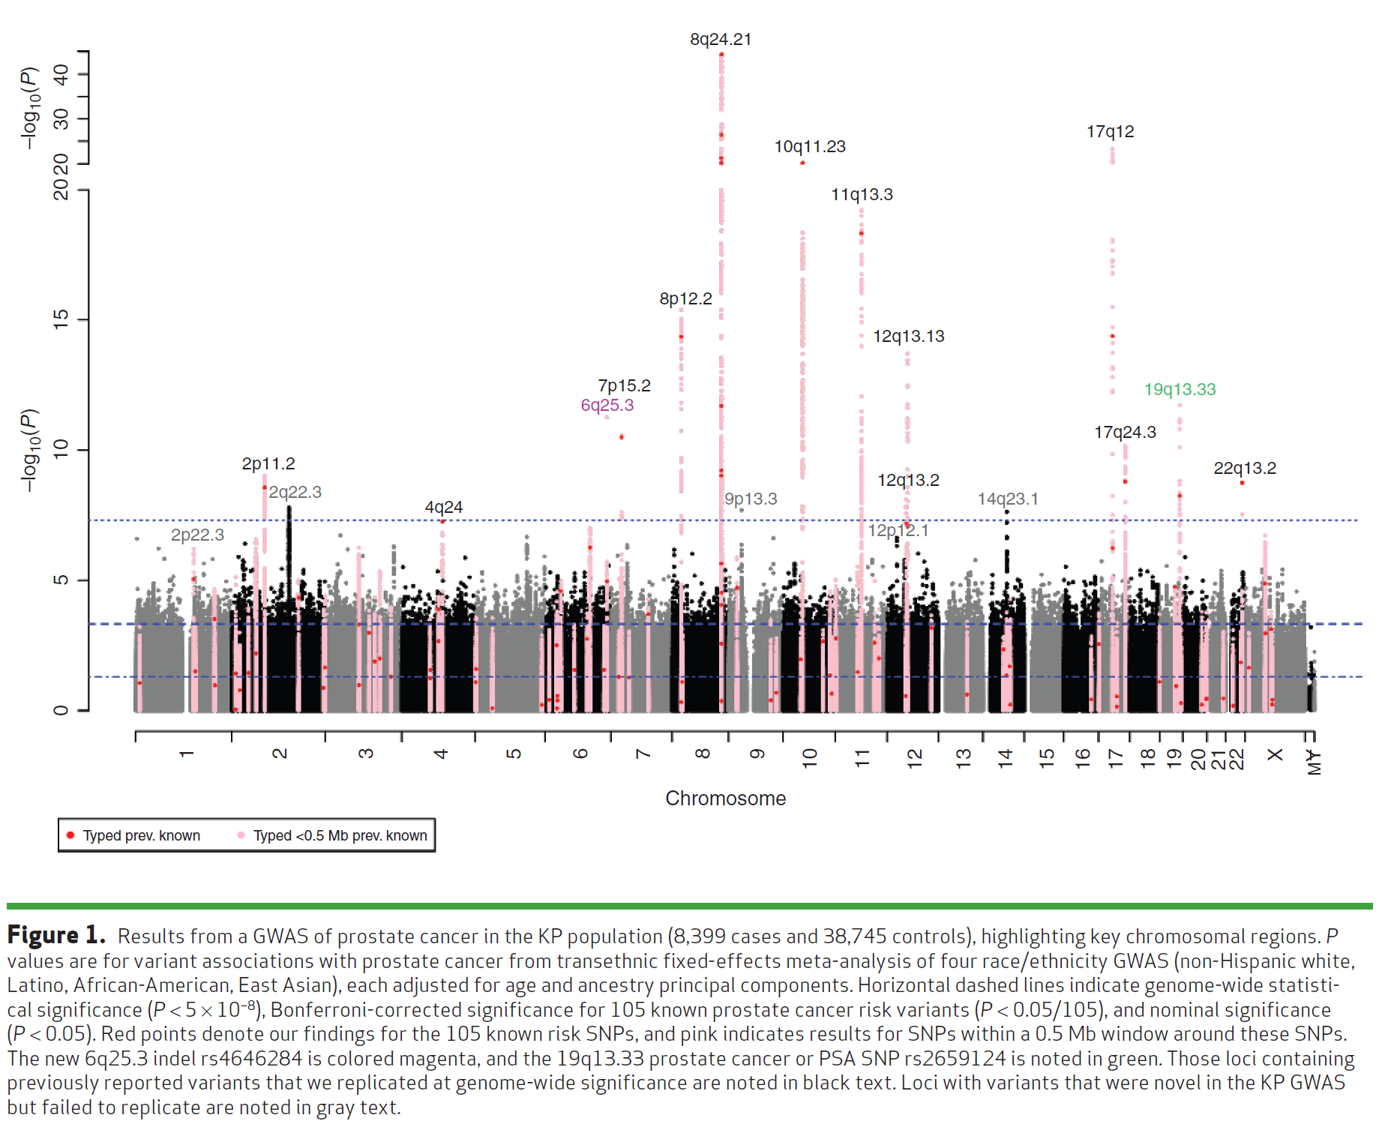
Manhattan plot example:
Kaiser GWAS of Prostate Cancer
Hoffmann et. Al, Cancer Discovery 2015

Slide 42
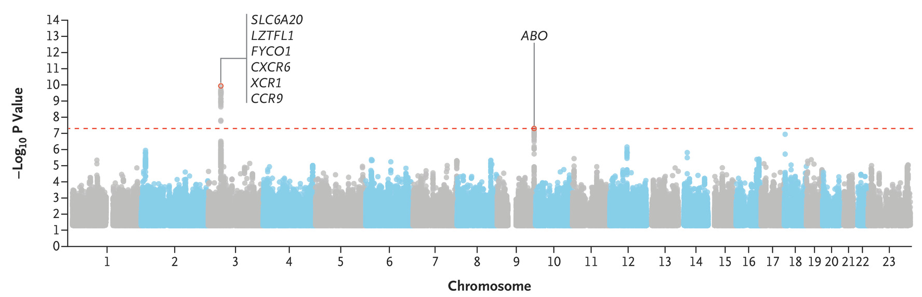
Manhattan plot example: Covid-19
The severe covid-19 GWAS group. Genomewide association study of severe covid-19 with respiratory failure. NEJM, 2020; 383:1522-1534.

Slide 43
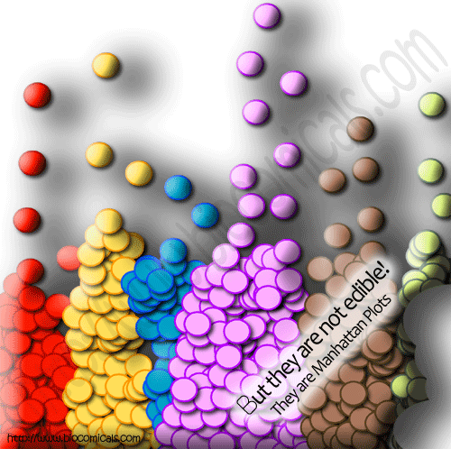

Slide 44
Replication, Replication, Replication
To replicate:
  Association test for replication sample significant at 0.05/{Number of SNPs replicating} alpha level
  Same genetic model (e.g. additive, dominant)
  Same direction
  Sufficient sample size for replication!
    [e.g., do a power calculation]
Non-replications not necessarily a false positive
  LD structures, different populations (e.g., flip-flop)
  covariates, phenotype definition, underpowered
  Winner’s curse

Slide 45
Meta-analysis
Combine multiple studies to increase power
Either combine p-values (Fisher’s test),
or coefficient estimates + standard error (better)

Slide 46
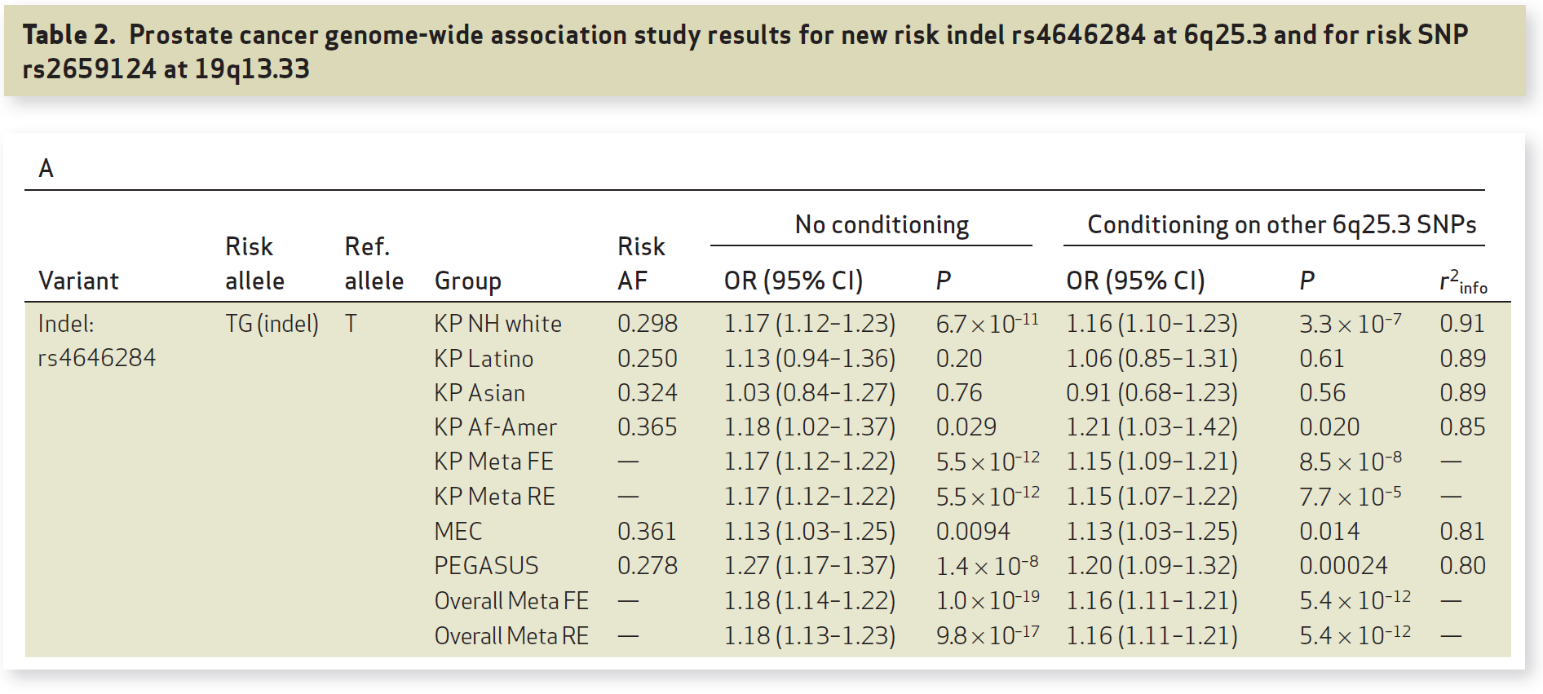
Replication & Meta-analysis
Hoffmann et. Al, Cancer Discovery 2015`

Slide 47
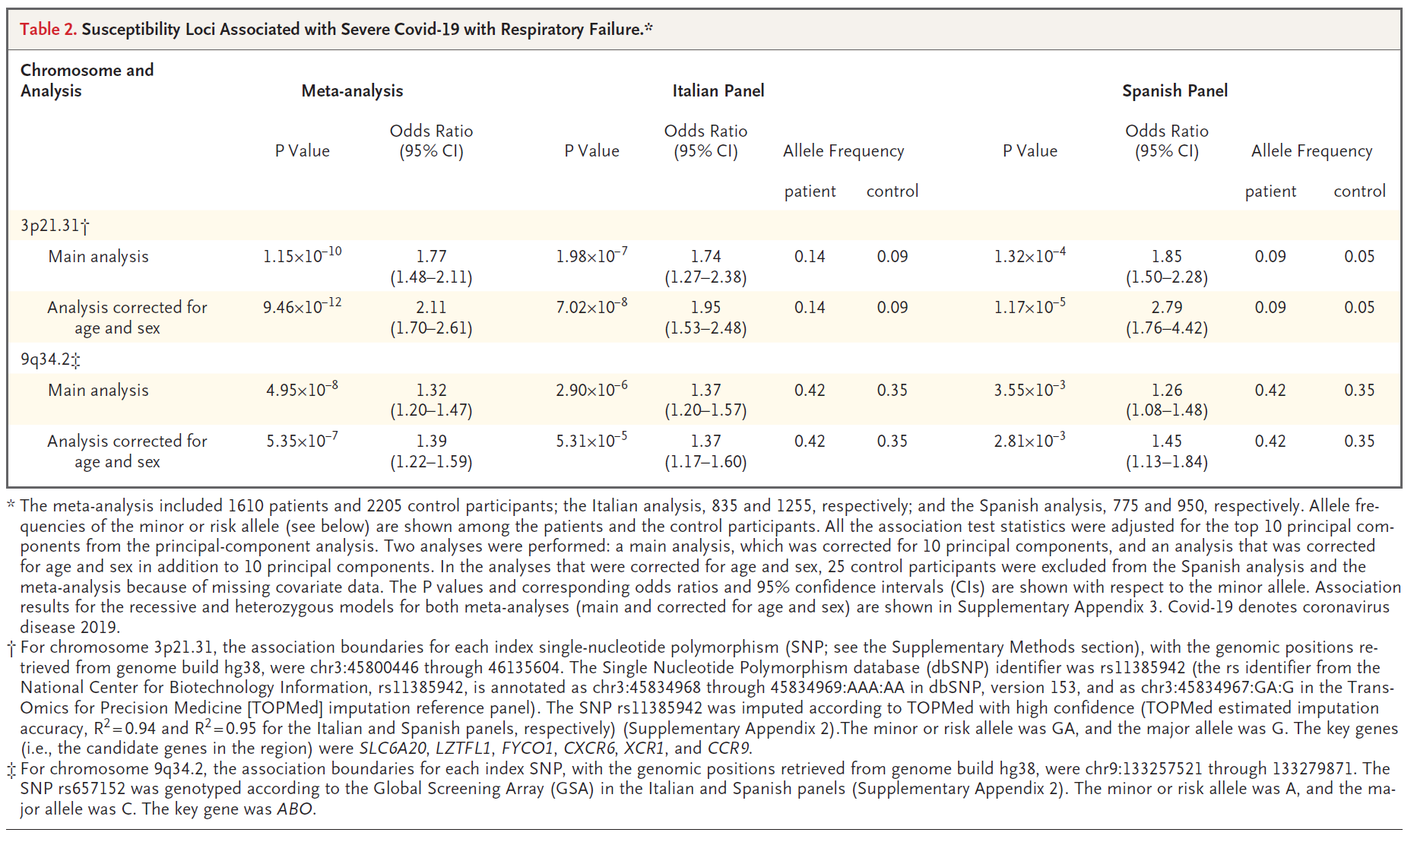
Replication and Meta-analysis
The severe covid-19 GWAS group. Genomewide association study of severe covid-19 with respiratory failure. NEJM, 2020; 383:1522-1534.

Slide 48
Beyond Genotyped SNPs:
Imputation of SNP Genotypes
Combine data from different platforms (e.g., Affy & Illumina) (for replication / meta-analysis).
Estimate unmeasured or missing genotypes.
Based on measured SNPs and external info (e.g., haplotype structure of HapMap).
Increase GWAS power (impute and analyze all), e.g. Sick sinus syndrome, most significant was 1000 Genomes imputed SNP (Holm et al., Nature Genetics, 2011)
HapMap as reference, now 1000 Genomes Project; UK10K, Haplotype reference consortium?
Hybrid sequencing/genotyping approaches

Slide 49
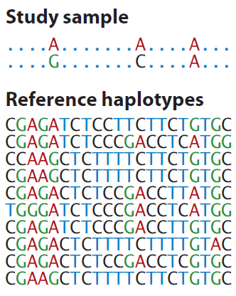
Generalization of Tag SNPs: Imputed SNPs using a Reference Panel
Generalization of pairwise r² of tagSNPs to multi-marker correlation
Class Exercise!
How would you fill in the remaining genotypes of this study sample individual, given the reference haplotypes?
http://www.shapeit.fr/, http://mathgen.stats.ox.ac.uk/impute/impute_v2.html
http://faculty.washington.edu/browning/beagle/beagle.html
http://www.sph.umich.edu/csg/abecasis/MACH/download/
Li et al., Ann Rev Human Genet, 2009

Slide 50

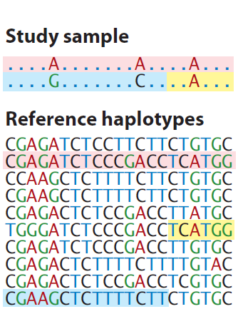
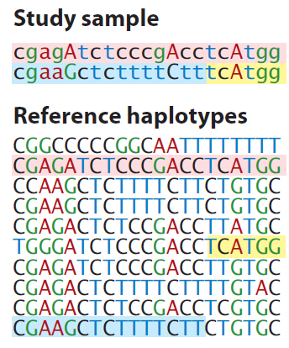
Generalization of Tag SNPs: Imputed SNPs using a Reference Panel
Generalization of pairwise r² of tagSNPs to multi-marker correlation
http://www.shapeit.fr/, http://mathgen.stats.ox.ac.uk/impute/impute_v2.html
http://faculty.washington.edu/browning/beagle/beagle.html
http://www.sph.umich.edu/csg/abecasis/MACH/download/
Li et al., Ann Rev Human Genet, 2009

Slide 51
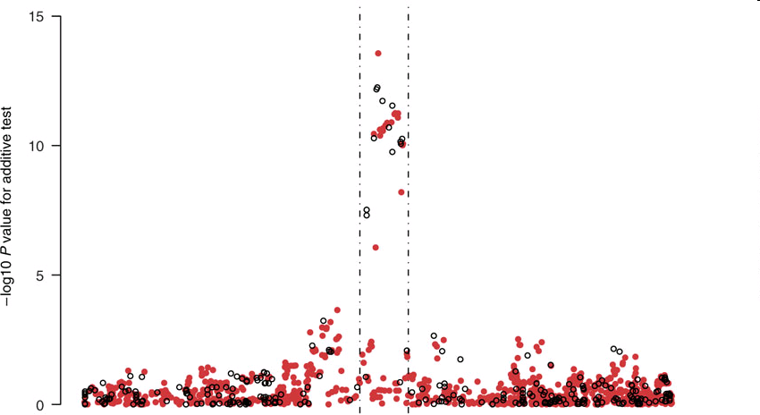
Imputation Application
TCF7L2 gene region & T2D from the WTCCC data
Observed genotypes black
Imputed genotypes red.
Imputed SNP more significant than typed SNP!
Chromosomal Position
Marchini Nature Genetics2007
http://www.stats.ox.ac.uk/~marchini/#software
Notes:
51

Slide 52
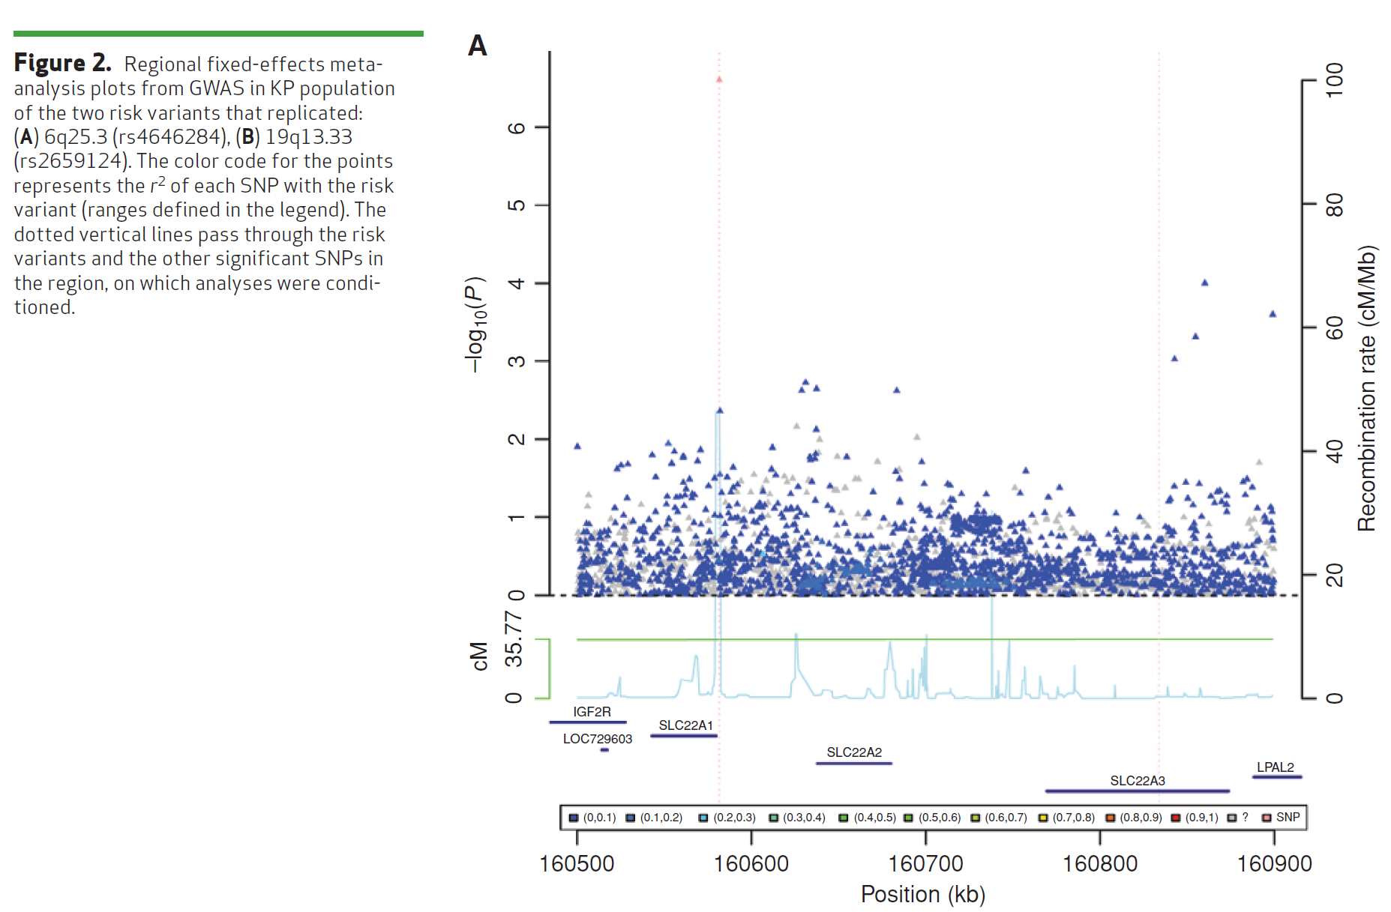
Imputation Application #2 – Do not always see a jet of points, even for common SNP…
(Same SNP as 4 slides ago)
Hoffmann et. Al, Cancer Discovery 2015`

Slide 53
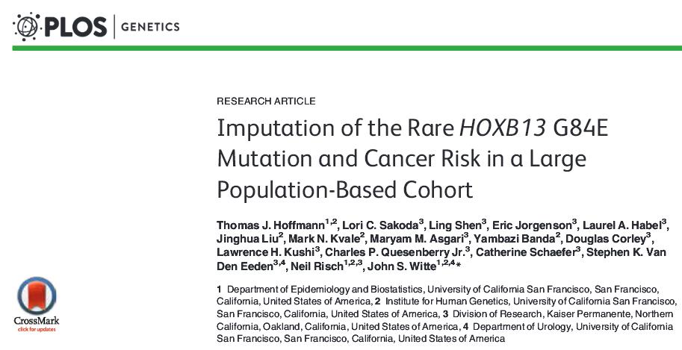
Imputation example: How rare can you go?
G84E example talked about in Austin pg. 62
MAF 0.0034 in European ancestry. r²=0.57.
In general, a moving target, still unknown how rare is possible

Slide 54
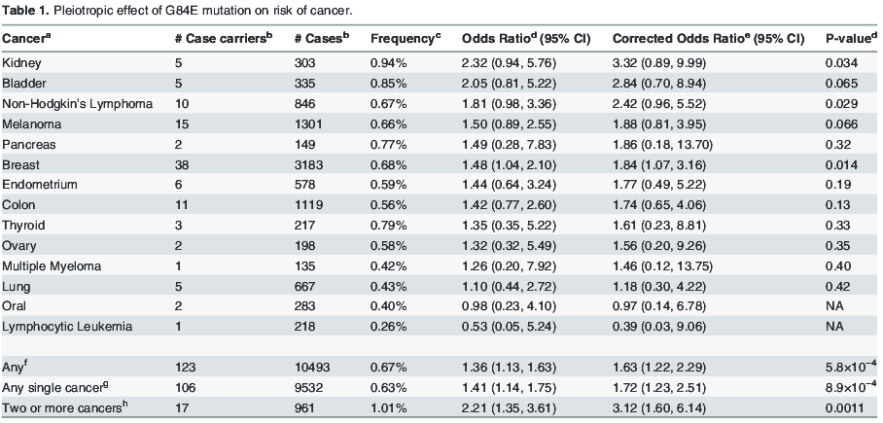
HOXB13 G84E (continued)

