Slide 1
Non-Mendelian Genetics
Eric Jorgenson
Epidemiology 217
2/25/14

Slide 2
Outline
Mitochondrial DNA
De Novo Variation
Parent-of-origin Effects
Epigenetics: DNA Methylation and Histone Modification

Slide 3
Outline
Mitochondrial DNA
De Novo Variation
Parent-of-origin Effects
Epigenetics: DNA Methylation and Histone Modification

Slide 4
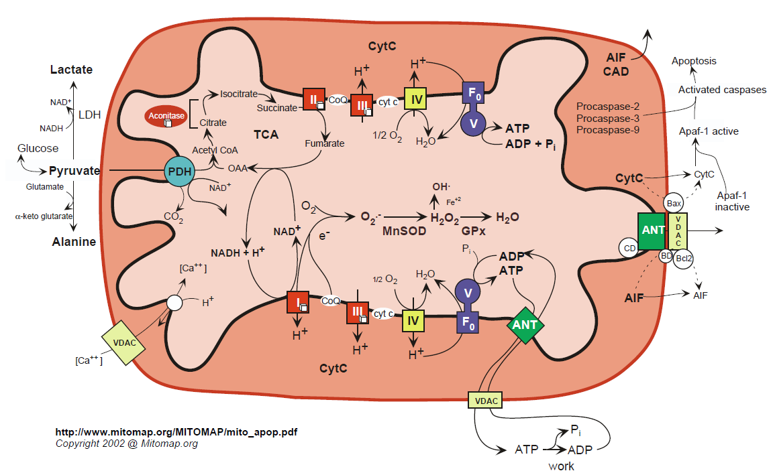
Mitochondrial Energetics
Notes:
Single mitochondrion in one celled organisms
1-2,000 in human liver cells

Slide 5
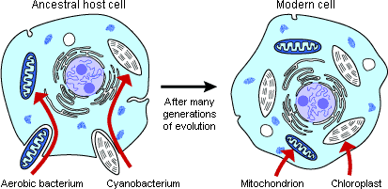
Origin of Mitochondria
Notes:
Mitochondria appear to have entered the eukaryote lineage as a singular event .

Slide 6
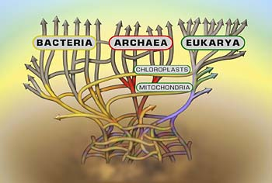
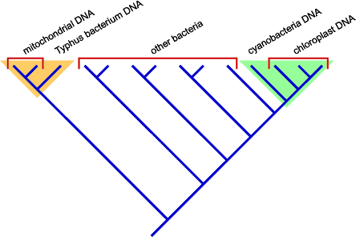
Origin of Mitochondria
Notes:
DNA sequence analysis suggests that the proto-mitochondrion was related to a aerobic alpha-proteobacterium like Typhus.

Slide 7
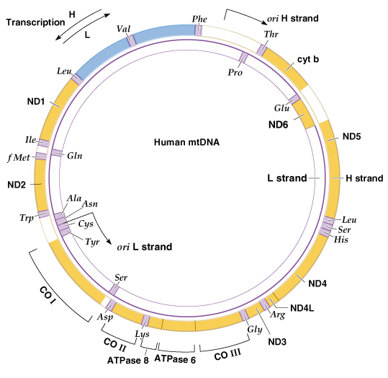
Human mtDNA (16,569 bp)
Notes:
Mitochondrial genomes are generally circular, double stranded, supercoiled, and small (less than 20 Kb in length in animals)
linear mitochondrial genomes are also found in some protozoa and fungi
In most animals the two strands of mtDNA have different densities, so they are called the H (heavy) and L (light) strands
Length varies, but in humans mtDNA is 16,569 bp long

Slide 8
Mitochondrial Genes
  tRNAs
  rRNAs
  Protein subunits:
    cytochrome oxidase
    NADH dehydrogenase
    ATPase
Notes:
mtDNA encodes a number of RNAs and proteins

Slide 9
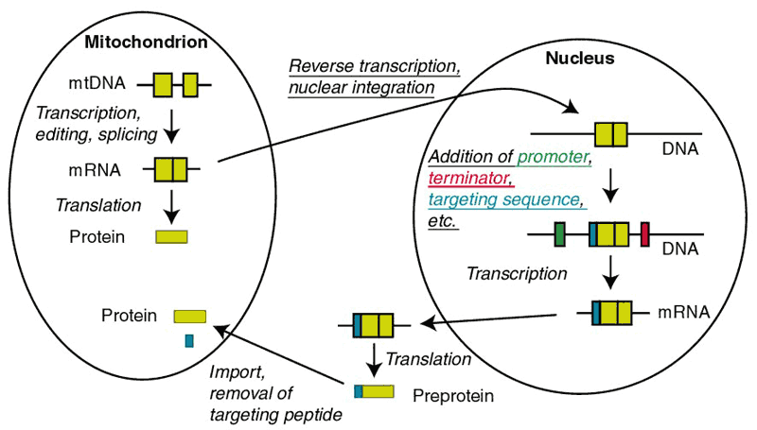
mtDNA Products Act Inside and Outside the Mitochondrion
Notes:
mtDNA does not provide all the proteins that act in mitochondrion
Nuclear genes produce proteins that are transported into the mt

Slide 10
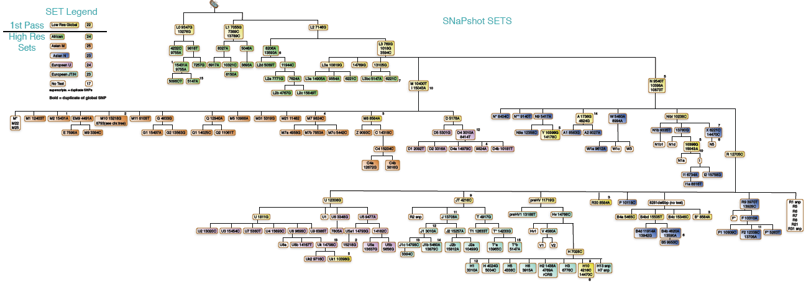
Human mtDNA Lineages
Notes:
Here is a tree of human mtDNA lineages
As you can see, individual or multiple mutations defined different branches

Slide 11
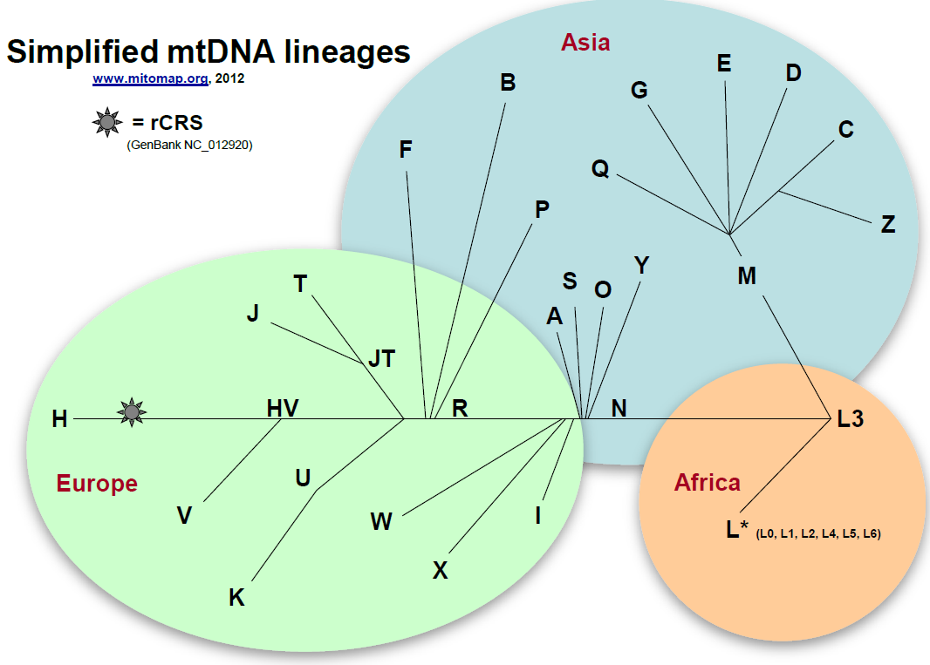
mtDNA Lineages (Simplified)
Notes:
Here you can see a simplified diagram of the main mtDNA lineages in humans
The origin is in Africa, with several branches to the other continents.

Slide 12
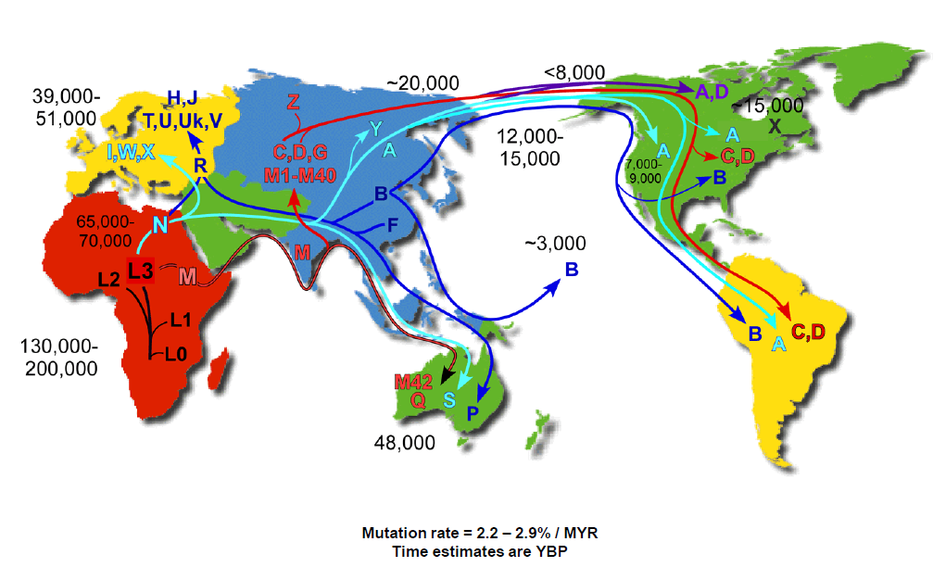
Human mtDNA Migrations
Notes:
Migration patterns have also been inferred based on the distribution of these lineages throughout the world.
Note the multiple migrations out of Africa.

Slide 13
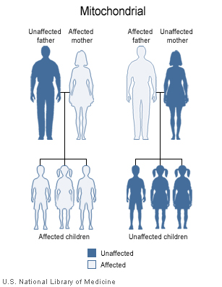
Mitochondrial Inheritance
Notes:
An important feature of mitochondria is the maternal inheritance pattern

Slide 14
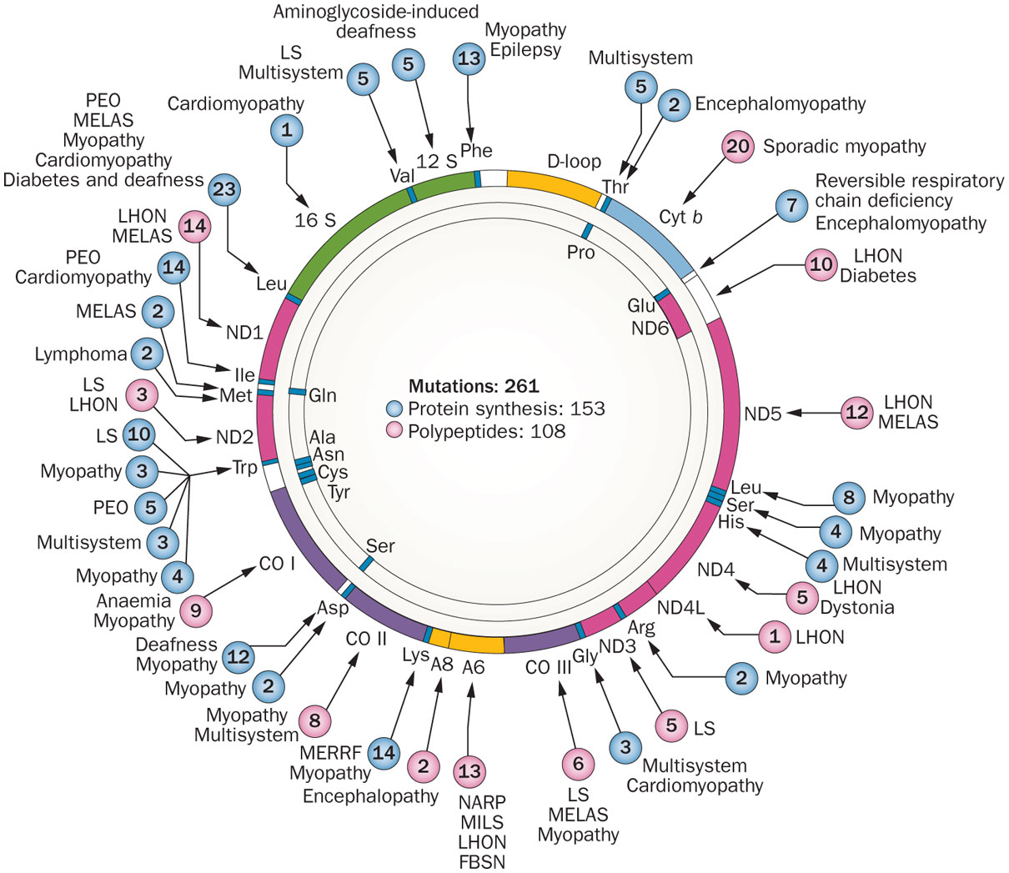
Morbidity Map of mtDNA
DiMauro, S. et al. (2013) The clinical maze of mitochondrial neurology
Nat. Rev. Neurol. doi:10.1038/nrneurol.2013.126
Notes:
Affects mid-life adults resulting in complete or partial blindness from optic nerve degeneration
Several mutations in mitochondrial electron transport chain enzyme complexes have been identified
LHON results from defects in the enzymes of oxidative phosphorylation: without ATP production, the optic nerve dies

Slide 15
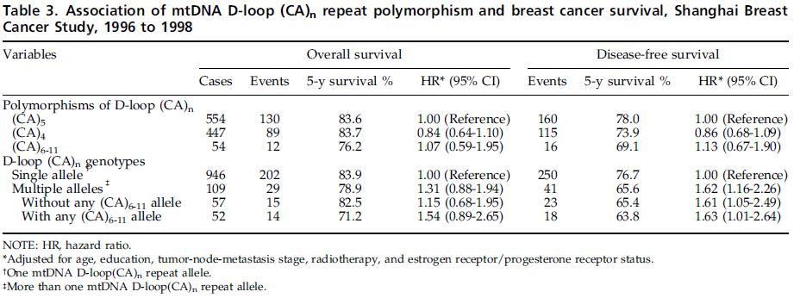
Breast Cancer Survival and mtDNA (Ye et al. 2008)
Notes:
Example from the text book

Slide 16
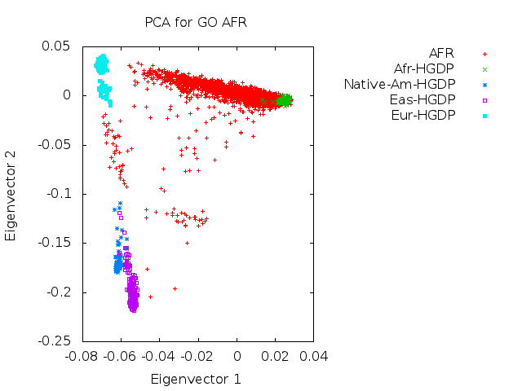
Genetic Epidemiology Research in Adult Health and Aging (GERA) Cohort:
African American (AFR) Population Structure
Notes:
GERA cohort
3,765 African American samples
PC1 separates African from European, Asian, and Native American populations

Slide 17
Population Structure and mtDNA Haplogroups (AFR)
Notes:
Population structure in autosomal DNA exists across subjects carrying different mtDNA haplogroups
Ls are African mtDNA

Slide 18
Outline
Mitochondrial DNA
De Novo Variation
Parent-of-origin Effects
Epigenetics: DNA Methylation and Histone Modification

Slide 19
Your De Novo Mutations
74 new SNPs
2 new Indels
Rarely a CNV

Slide 20
De Novo Mutation Methods
Family Design
  Trios
Exome Sequencing
  Coding Variants
Array CGH
  CNVs
Bioinformatics
  Filter artifacts
Sanger Sequencing
  Confirmatory

Slide 21
Sporadic Autism Exome Study and De Novo Mutations
209 Families, 677 Individuals
  Trios
  Unaffected Siblings
Exome Sequencing
248 De Novo Events
  225 SNVs (single nucleotide variants)
  17 Indels
  6 CNVs
181 nonsynonymous changes
  120 severe

Slide 22
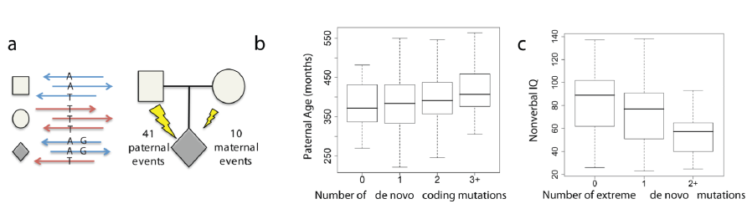
De Novo Mutations and Autism Spectrum Disorder
Notes:
a Haplotype phasing using informative markers shows a strong parent-of-origin bias with
41/51 de novo events occurring on the paternally inherited haplotype.
b and c, Box and whisker plots for 189 SSC probands.
b, The paternal estimated age at conception versus the
number of observed de novo point mutations (0, n = 53; 1, n = 65; 2, n = 44; 3+, n = 27).
c, Decreased nonverbal IQ is significantly associated with an increasing number of “extreme”
mutation events (0, n = 138; 1, n = 41; 2+, n = 10), both with and without CNVs

Slide 23
Outline
Mitochondrial DNA
De Novo Variation
Parent-of-origin Effects
Epigenetics: DNA Methylation and Histone Modification

Slide 24
Parent-of-origin Effects
In utero effects
  Mother’s genotype can affect environment
Imprinting
  Genes expressed only from one parent
  DNA Methylation
  <1% of genes

Slide 25
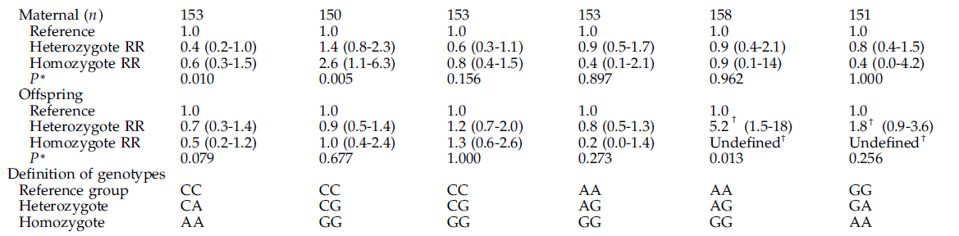
Testicular Germ Cell Tumors and Maternal Genotype

Slide 26
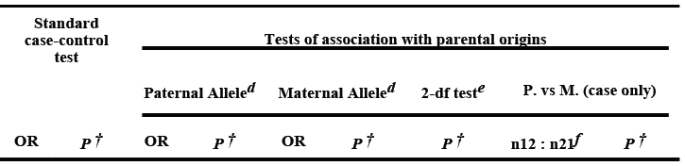


Parent-of-origin Effects in GWAS Findings

Slide 27
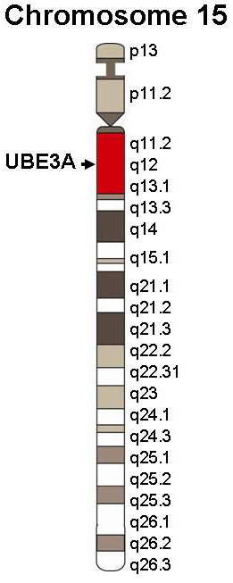
Diseases of Imprinting: Prader-Willi and Angelman
Paternal loss = Prader-Willi (gene SNRPN, Necdin gene, clusters of snoRNAs)
PWS/AS region
Maternal loss = Angelman (gene UBE3A)
Paternal allele silenced in hippocampus and cerebellum
Notes:
Prader-Willi: hypotonia, short stature, hyperphagia, obesity, behavioral issues (specifically OCD-like behaviors), small hands and feet, hypogonadism, and mild mental retardation
Mother’s copy is imprinted (off)
Angelman: Developmental delay, speech impairment, ataxia, behavioral uniqueness (happy demeanor, frequent laughter/smiling)
Father’s copy is imprinted (off)

Slide 28
Outline
Mitochondrial DNA
De Novo Variation
Parent-of-origin Effects
Epigenetics: DNA Methylation and Histone Modification

Slide 29
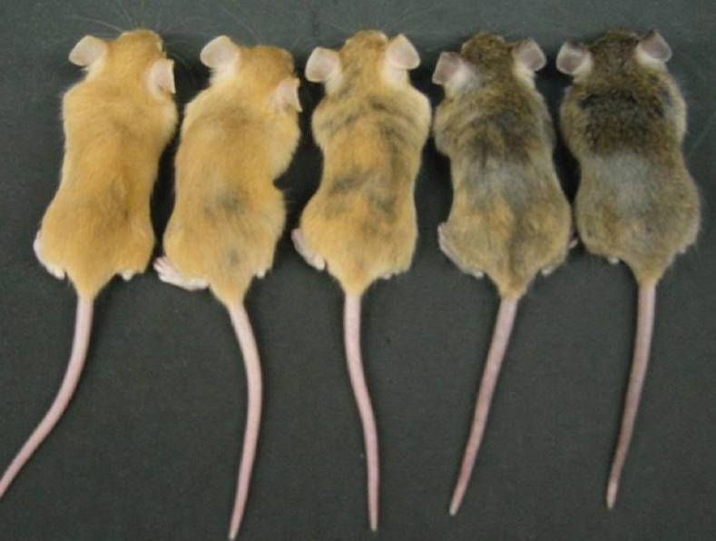
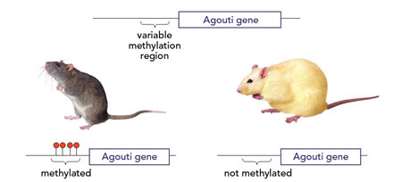
‘Over’
Epi-genetics
Epigenetic gene regulation comprises
the heritable changes in gene expression that occur
in the absence of changes to the DNA sequence itself
Genetically identical adult yellow agouti (A^{vy}) mice displaying five different coat color phenotypes

Slide 30
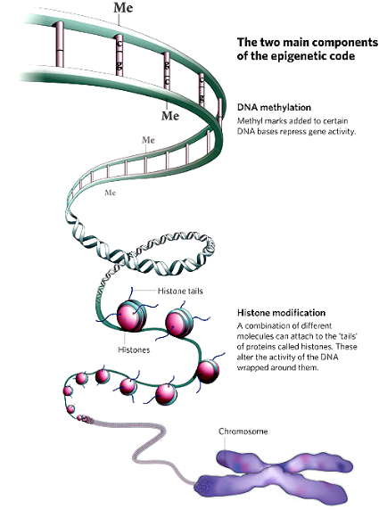
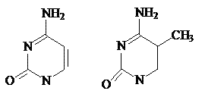
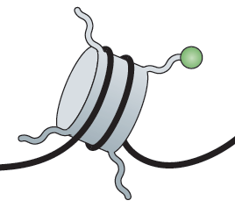
The two main components of the epigenetic code
DNA methylation
DNA Methylation occurs predominantly at CpG dinucleotides in mammals
Histone modification
Different molecules can attach to the tails of proteins called “histones”

Slide 31
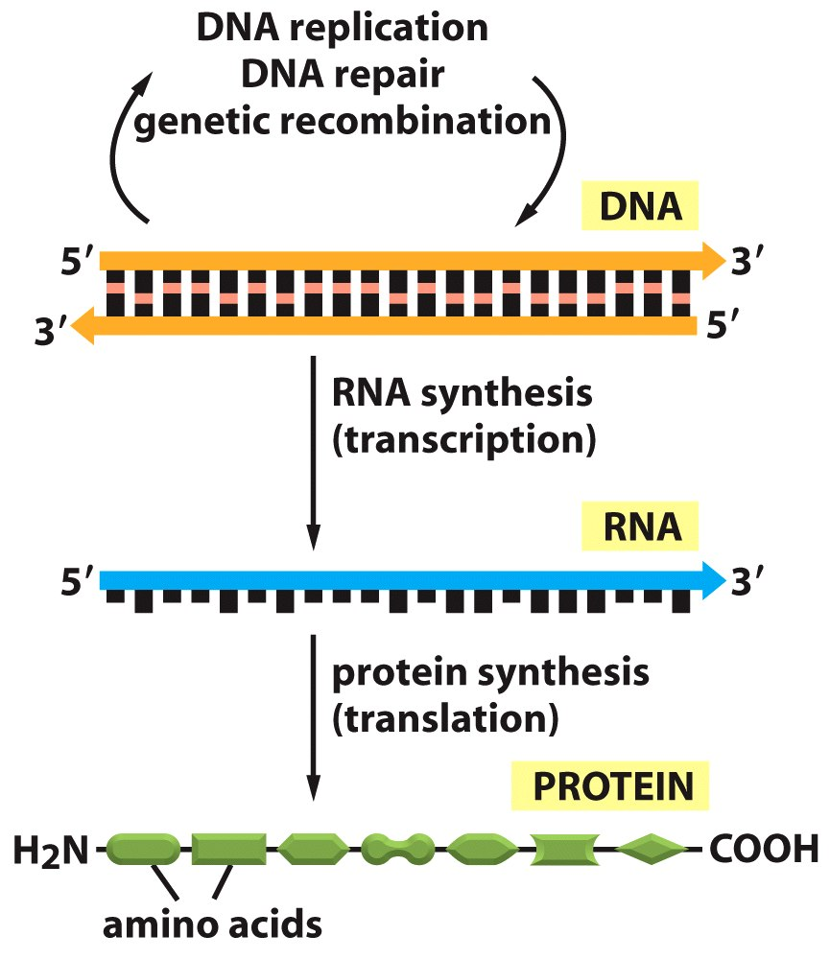
Central Dogma: DNA→RNA→Protein

Slide 32
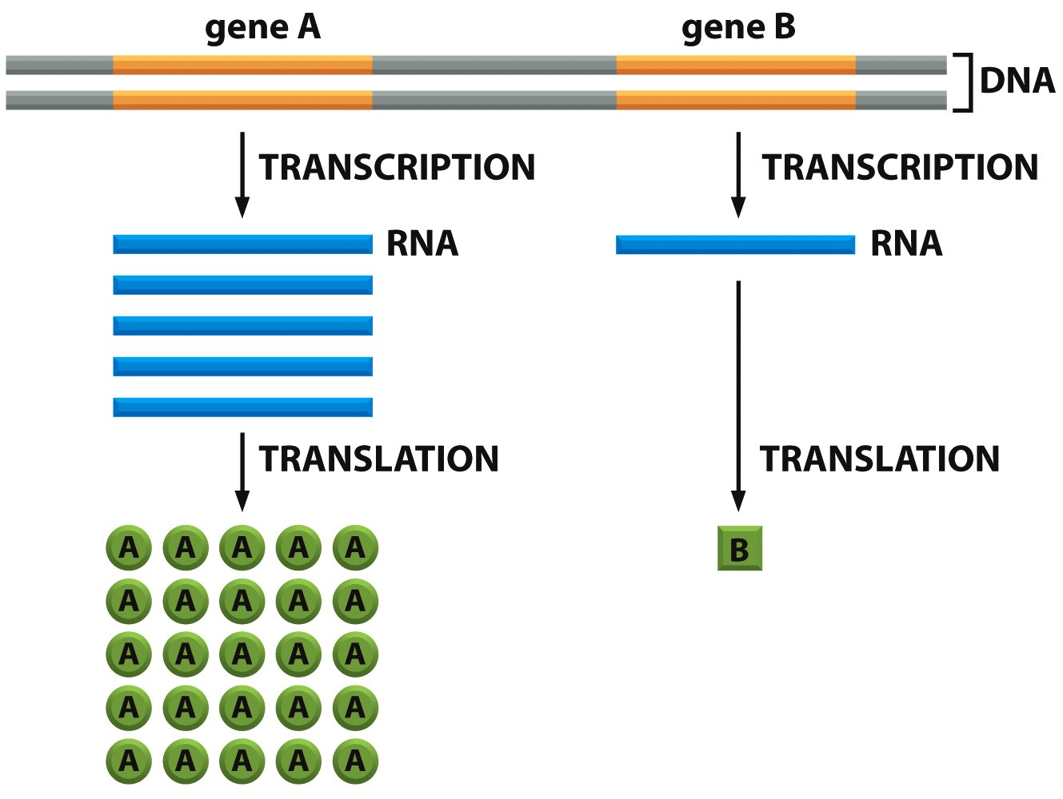
Does Not Address Amount of Genetic Information

Slide 33
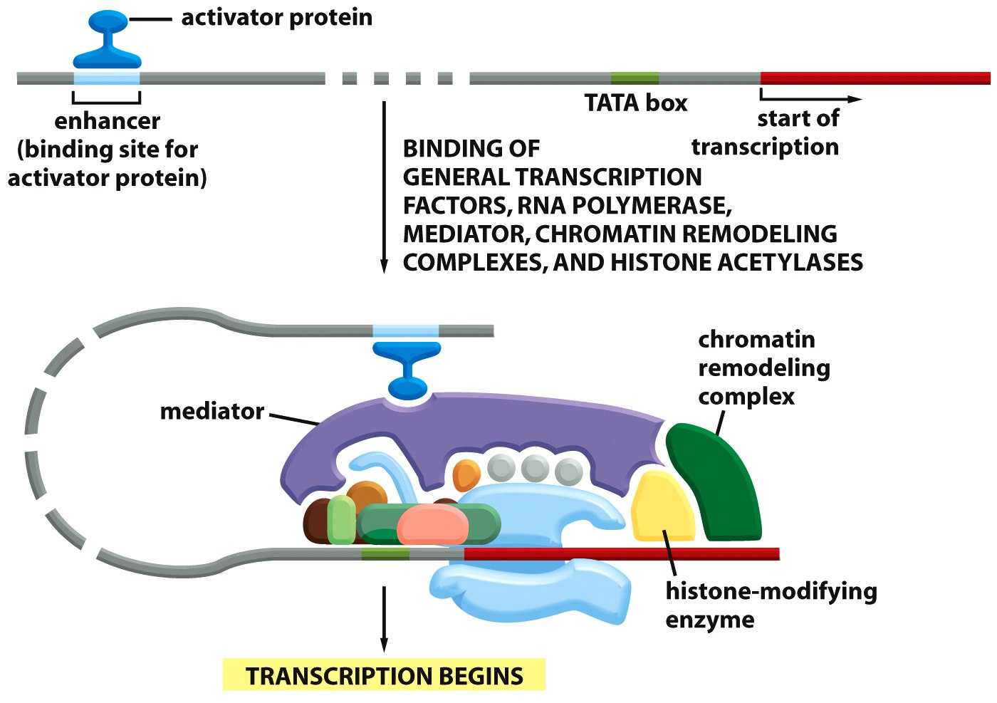
Activator Protein is Required to Turn on Genes
Notes:
The binding of activator proteins depends on chromatin structure

Slide 34
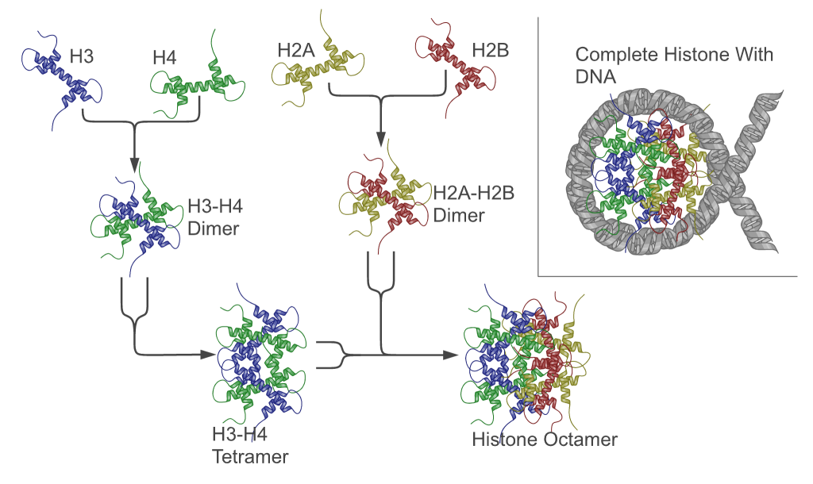
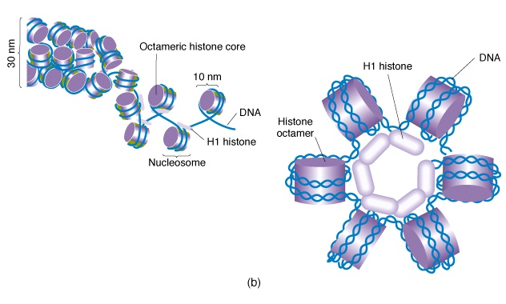
Chromatin: Histones Provide Structure to DNA
Chromatin
Notes:
Histones are proteins; they combine to form an octamer (8 subunits)
DNA wraps around the histone octamer twice to form a nucleosome
The resulting structured DNA and protein complex is called chromatin
Changes in chromatin lead to changes in gene regulation
in eukaryotes
80bp DNA = 1 turn
DNA wraps two times and 145bp DNA associates with each core
Linker DNA = 55bp
Human nucleus = 15-30 x 10⁶ nucleosomes

Slide 35
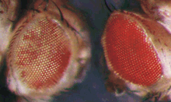
Euchromatin and Heterochromatin
Euchromatin
  Active, less condensed, gene rich
Heterochromatin
  Inactive, highly condensed, gene poor
Position effect variegation
White⁺
Euchromatin
Heterochromatin
White⁺
Heterochromatin spreads
Notes:
Chromosome inversion in drosophila

Slide 36
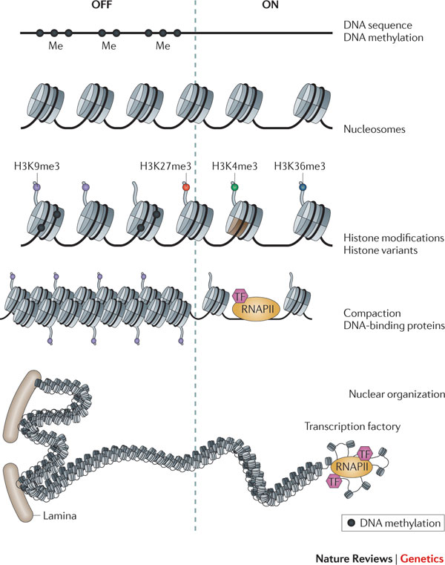
Chromatin Structure is determined by
Histone Modifications

Slide 37
Histone Modifications Influence Gene Expression
Chromatin structure altered directly
Inhibit binding of repressive factors
Recruit activating factors

Slide 38
Histone Modifications
Nucleosome
Histone tails
Chemical modification
DNA (147 bp)
Modification | Role in transcription | Histone-modified sites
Acetylation | Activation | H3 (K9,K14,K18,K56)
 |  | H4 (K5,K8,K12,K16)
 |  | H2B (K6,K7,K16,K17)
Phosphorylation | Activation | H3 (S10)
Methylation | Activation | H3 (K4,K36,K79)
 | Repression | H3 (K9,K27)
 |  | H4 (K20)
Notes:
Residues of histone tails can be covalently modified. There are at least 150 different modifications that define the histone code

Slide 39
Histone Acetylation and Deacetylation
AC
ON
HAT
activator
Upstream activator sequence
HAT= Histone acetyltransferase
AC
HDAC
OFF
repressor
Upstream repressive sequence
HDAC= Histone deacetylase

Slide 40
Acetylation Reduces Histone Binding to DNA
AC
Transcription factor
Transcription ON
Closed
Open
Notes:
Neutralization of positively charged lysines by acetylation reduces the strength of binding of the histones to the negatively charged DNA and thus opens DNA binding sites.

Slide 41
Histone Methylation
Occur at either lysines or arginines
Activate or repress gene transcription depending on the position within the histone tail
Multiple possible methylation states on each residue (-mono, -di or –tri methylated).

Slide 42
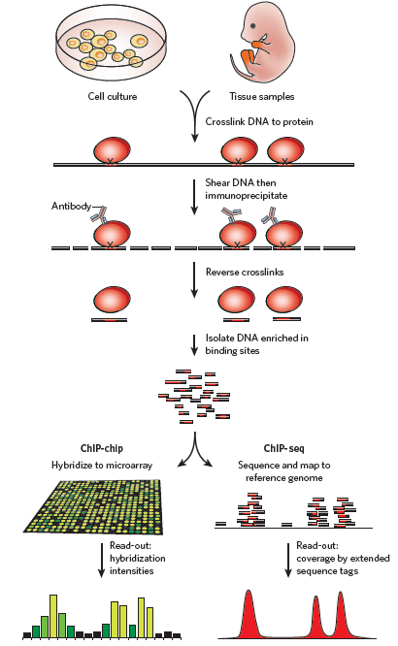
How Can We Measure Chromatin Structure?
Proteins are cross-linked to the DNA
Chromatin is isolated and fragmented
Antibodies against activating proteins are used to precipitate DNA : protein complexes
Binding between DNA and protein is released
DNA is sequenced
Sequences are mapped back on the genome to identify the binding sites.

Slide 43
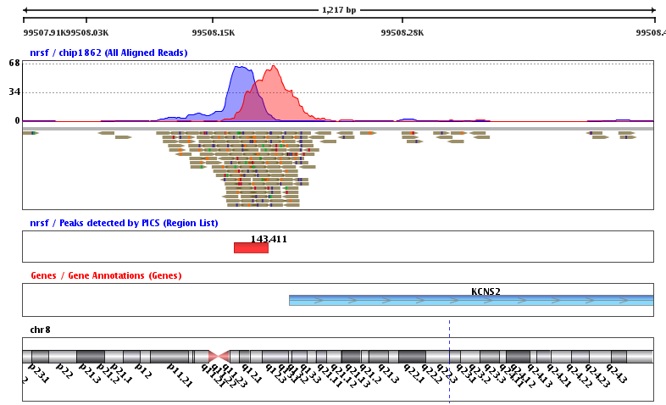
Chromatin Immunoprecipitation
Notes:
Sequences are mapped on the human genome in order to look at the position with respect to genes and other functional sequences.

Slide 44
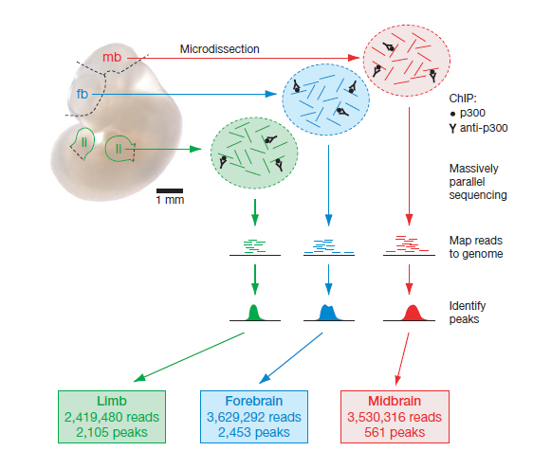
Identification of Enhancers using ChIP
HAT
activator
P300
Enhancer
Prediction of enhancer position using ChIP against activator protein p300
Chromatin isolated from midbrain, forebrain, and limb
Immunoprecipitation performed with antibodies against p300
DNA binding p300 sequenced and mapped on the human genome

Slide 45
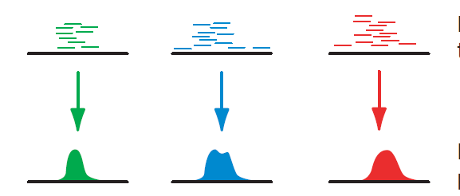
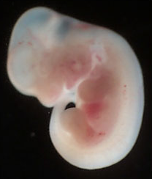
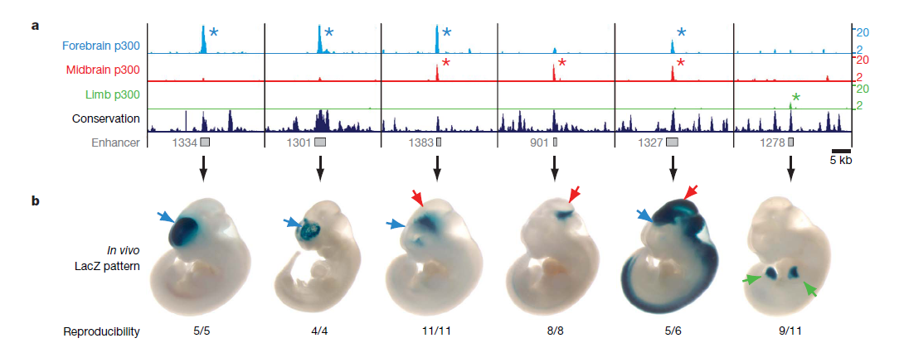
Validation of Enhancers
Midbrain
LacZ
weak
promoter
Enhancer
Notes:
The putative enhancer is cloned in a vector and its ability to drive expression of LacZ is tested in transgenic mice.

Slide 46
DNA Methylation
Unmethylated
de novo
methylation
Dnmt3a
Dnmt3b
Methyl CpG
Methylated
DNA
replication
maintenance
methylation
Dnmt1
Hemimethylated
Notes:
Cytosine methylation occurs predominantly in CpG dinucleotides in mammalian cells.
DNA methylation is established and maintained by DNA methyltransferases.
So far Dnmt1 and Dnmt3a and Dnmt3b have been shown to have methylase activity on CpG DNA.

Slide 47
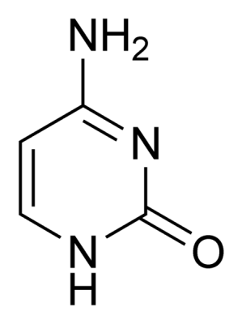
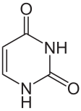
DNA Methylation and
Gene Expression
ON
CpG island
SILENCED
ACTIVE
Repair
Cytosine
Uracil
Cytosine
Notes:
DNA from mammalian somatic tissues is methylated at 70% of all CpG sites
CpG islands located nearby active genes are hypomethylated
Cytosine tend to deamminate to Uracil which is
recognized as a mutation by the DNA repair and reconverted in Cytosine

Slide 48
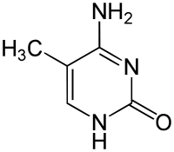
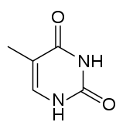
DNA Methylation and
Gene Expression
ON
CpG island
SILENCED
ACTIVE
5-Methylcytosine
Thymine
Notes:
When 5-Methylcytosines deamminate they become Thymine which are normally present in DNA and therefore are not repaired

Slide 49
DNA Methylation affects Gene Expression in Two Ways
Model 1
The presence of the methyl groups interferes with the binding of transcription factors that activate transcription from a specific gene.
Transcription factor
Model 2
Repressing proteins are attracted by methylated DNA.
Repressive factor

Slide 50
How Can We Study DNA Methylation?
Bisulfite sequencing
Treatment with sodium bisufite converts all cytosines (C) in uracils (U)
unless they are methylated (C^{m}).
m
CTGTCGAGTCGT
GACAGCTCAGCA
m
m
UTGTCGAGTUGT
GAUAGCTUAGUA
m
m
TTATCGAATTGTAT
AATAGCTTAACATA
Bisulfite
treatment
PCR
Sequencing
Notes:
After PCR the uracils are substitute with thymines (T). Sequencing allows to determine is a sequence is mainly methylated (>CG) or hypomethylated (>TG).

Slide 51
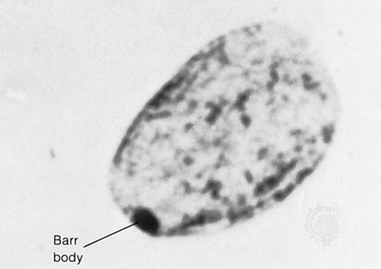
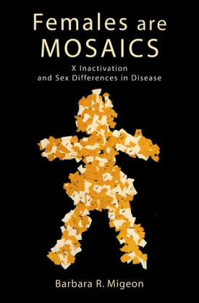
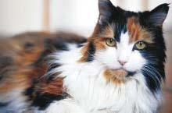
X Chromosome Inactivation
Dosage Compensation
  Males XY, Females XX
Barr Body
  One copy effectively off
  heterochromatin
Random inactivation

Slide 52
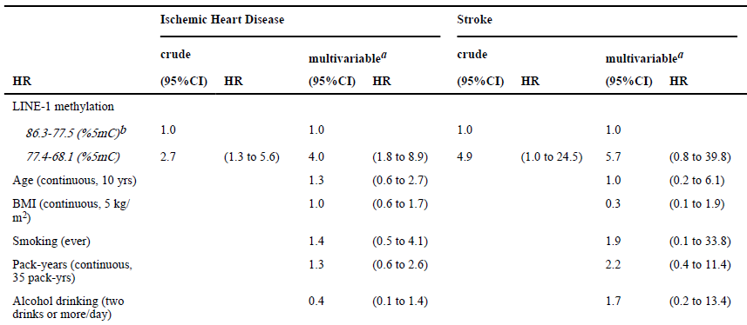
DNA Methylation and Heart Disease and Stroke
Notes:
Long Interspersed Nucleotide Elements
Repetitive, highly methylated sequences
Demethylation of LINE-1 increases their activity as transposable elements
That leads to genomic alteration and deregulates gene transcription

