Slide 1
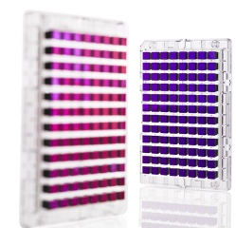

Genome-wide association studies (GWAS) – continued!

Slide 2
Outline for GWAS
Analysis
  QC
  Analysis approach
  Prostate cancer example
  Imputation
  Replication & Meta-analysis
GWAS Limitations

Slide 3
Why QC data?
HIV resistance

Slide 4
QC Steps: Class exercise!
Can you think about potential QC steps you might take at an individual and SNP level basis? Which one first?
What tests have we talked about in this course?
Special chromosomes?
(Could families be problematic? useful?)

Slide 5
QC Steps
“garbage rises to the top”
Filter SNPs and Individuals
  MAF (e.g., 1%, but very sample size dependent!)
  Low call rates (means genotype probably didn't work correctly)
Test for HWE among controls & within ethnic groups. Use conservative alpha-level (10⁻⁶, e.g., but opinions vary) (again, to remove artifacts)
Check for relatedness.
  MZ twins, or accidentally genotyped same sample twice?
  Remove first degree, or account for.
Check genotype gender (mislabeled samples)
Filter Mendelian inhertance (family-based, or potentially cryptics, if large enough sample)
plink sofware: pngu.mgh.harvard.edu/~purcell/plink/reference.shtml

Slide 6
Filter for Mendelian inheritance
A|A-----A|A
|
A|T

Slide 7
Filter for Mendelian inheritance
A|A-----A|A
|
A|T ← Offspring Genotype not
Possible!
(De novo mutation, but
more likely genotyping
error.)

Slide 8
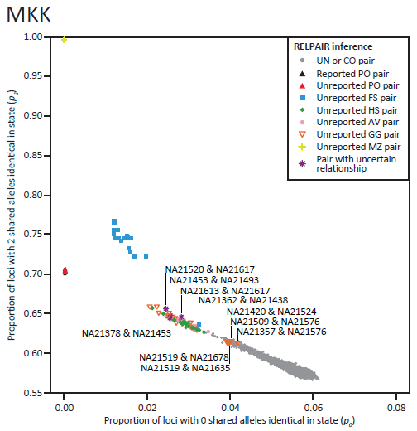
Check for relatedness, e.g., HapMap
Take overall average of all SNPs of how many alleles are shared.
E.g., parent-offspring never shares zero alleles.
HapMap was supposed to be unrelateds (this was a bit of a surprise!)
Pemberton et al., AJHG 2010

Slide 9
GWAS analysis
Most common approach: Model each SNP separately
Additive coding of SNP most common, just a covariate in a regression framework
Dichotomous phenotype: logistic regression
Continuous phenotype: linear regression
Correct for multiple comparisons
  e.g., Bonferroni, 1 million gives α=5x10⁻⁸
  [Often use 5x10⁻⁸ for larger GWAS arrays (or imputed SNPs, more later) also, SNPs are correlated, so Bonferroni is a little too conservative…]
Adjust for potential population stratification (details next slides…)
  principal components (PC’s), on best performing SNPs
  software usually does LD filter (e.g., Eigensoft)

Slide 10
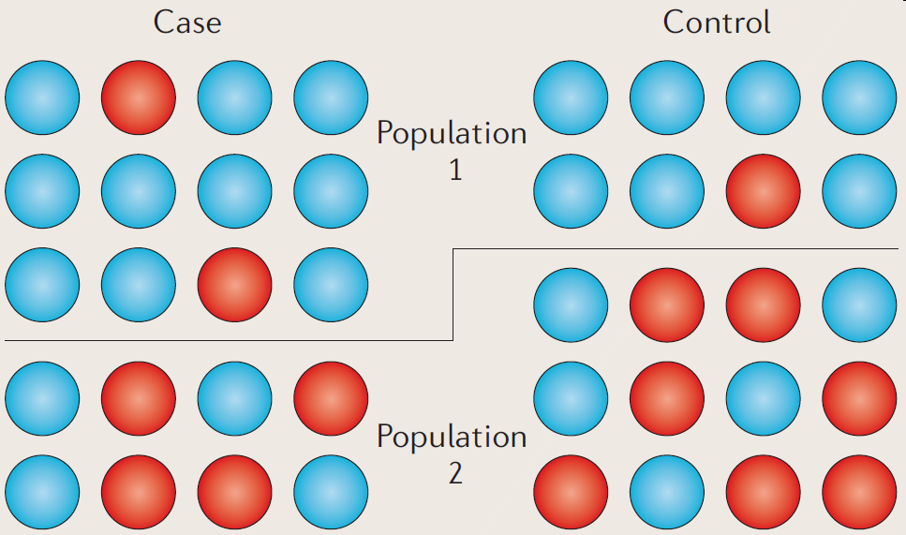
Recap of population substructure
Two populations have different disease frequency, and different allele frequency (Recall Pima & Papago example).
Association picks up they are different populations!
Balding, Nature Reviews Genetics 2010

Slide 11
How to handle population substructure?
Any ideas?

Slide 12
How to handle population substructure?
Hint:
    Majority of allele frequency differences are due to ancestry…?

Slide 13
How to handle population substructure?
Homogeneous group?
  But what if we don’t want to?
Indicator variable for each group?
  Is that really practical?
  Majority of allele frequency differences are due to ancestry…?
  Data reduction techniques…?
    Some sort of continuous adjustment for how much ancestry…?

Slide 14
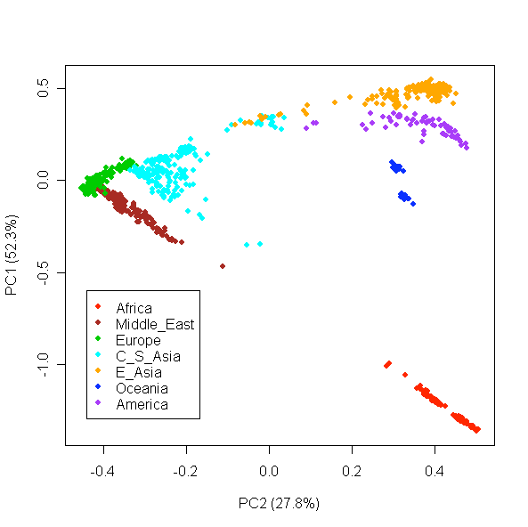
Control for race/ethnicity/ancestry: Principal Components (PCs) as covariates in regression model
Principal component analysis is, in general, a data reduction technique
Each PC is a linear combination of all SNPs
First PC accounts for as much of the variability in the data as possible
Subsequent PCs are orthogonal (uncorrelated) with previous
In GWAS, it captures ancestry clines
Li et al., Science 2008

Slide 15
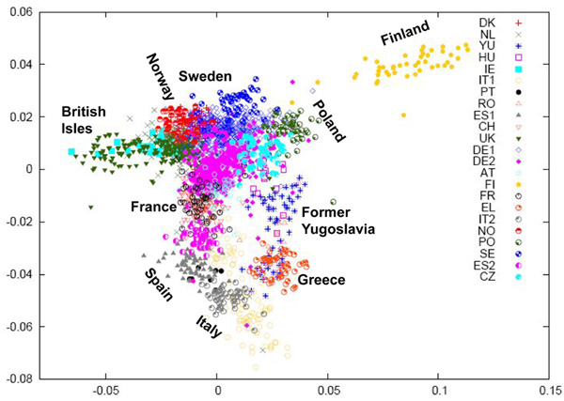
PCs pick up fine population structure
Razib, Current Biology 2008

Slide 16
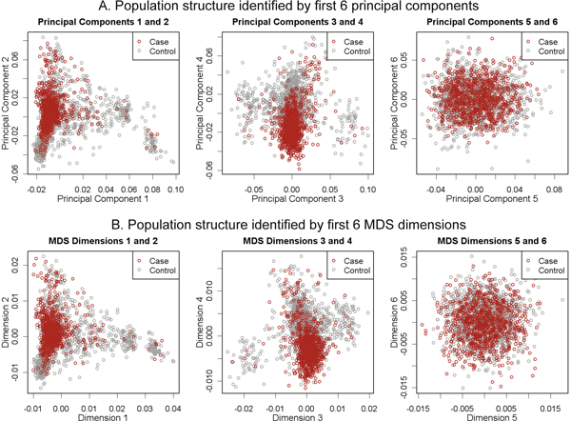
Adjusting for PC's
Do not want separate cluster for cases as controls! – Why want individuals from similar population for controls (and randomization). [These look reasonable, but if see a separation…]
Wang, BMC Proc 2009

Slide 17
Instead of adjusting for PCs, adjust for the rest of the genome (mixed models)
(1) Increase power by jointly modelling all variants, and (2) adjust for population structure
Adjust for genetic relatedness between all pairs of individuals (kinship matrix)
  This is huge, need approximations to handle this in modern cohorts.
  In practice -- leave one chromosome out analysis
    E.g., chromosome 1, adjust for kinship based on chromosome 2-22
    Don’t really want to adjust for variants immediately nearby (LD, proximal contamination)
Software: Emmax, GEMMA, BOLT-LMM (fast)

Slide 18
After run analysis
Assess the fit with Q-Q plot
Look at results in Manhattan plots
Replication of hits in a separate cohort

Slide 19
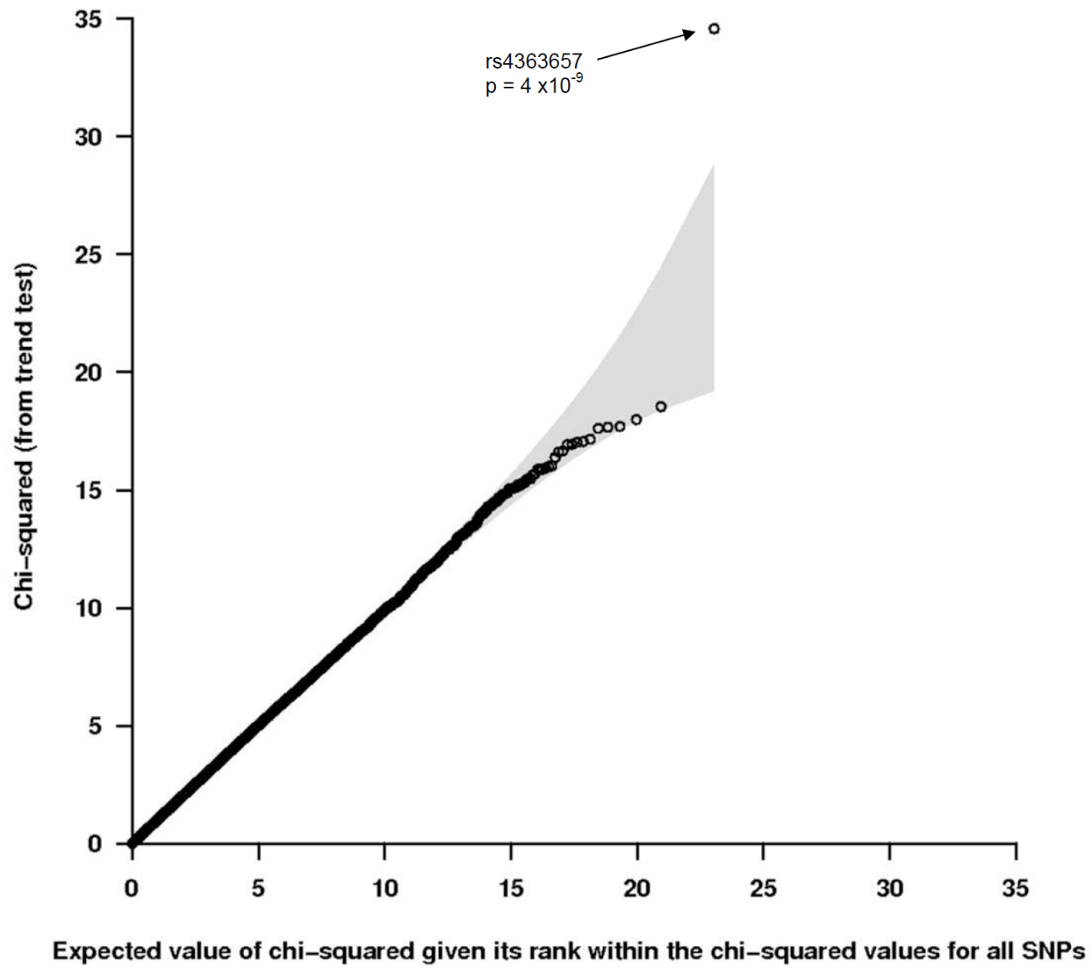
Quantile-quantile (Q-Q) plot review
Most SNPs are on the line (i.e., null), but want a few hits off the line (true significant associations!)
This isn’t really true any more with polygenic traits and large populations – so much of the genome is associated…

Slide 20
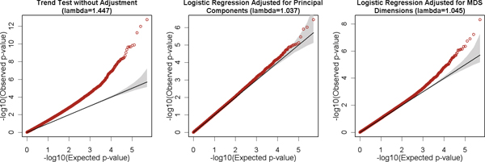
Q-Q plots and PC adjustment recap
Exactly on line if no signal at all.
If don't adjust for PC's, then p-values are all inflated artificially.
Adjusting for PC's fixes the problem.
Wang, BMC Proc 2009

Slide 21
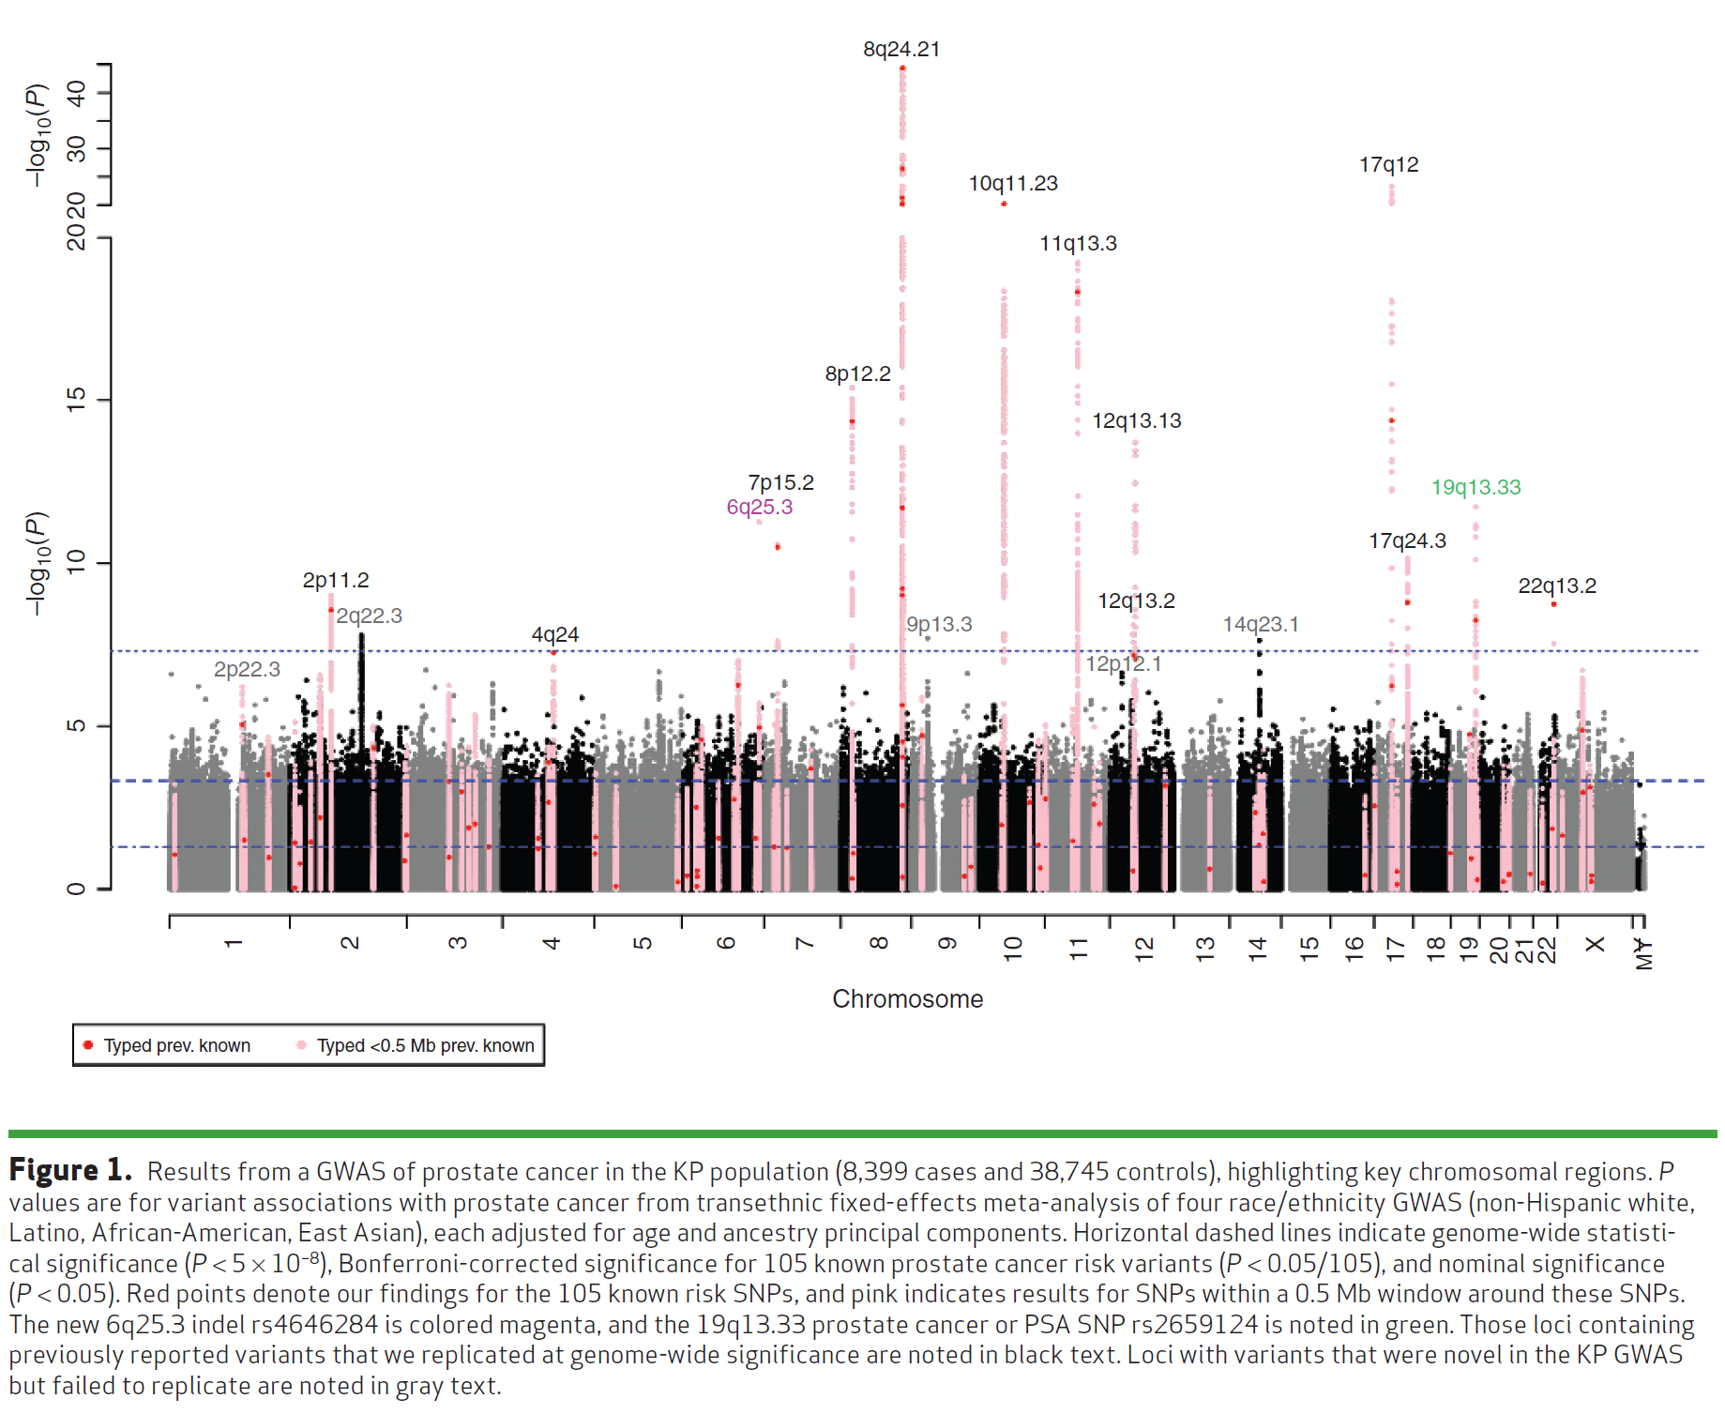
Manhattan plot example:
Kaiser GWAS of Prostate Cancer
Hoffmann et. Al, Cancer Discovery 2015

Slide 22
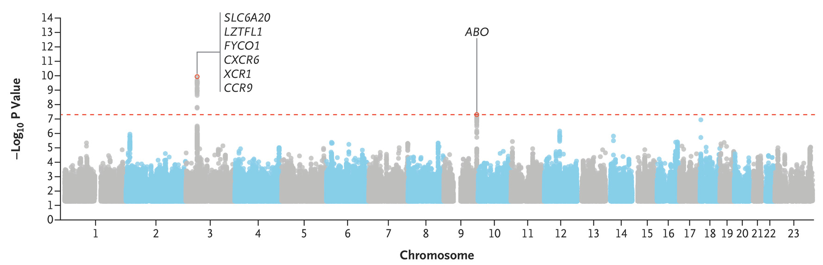
Manhattan plot example: Covid-19
The severe covid-19 GWAS group. Genomewide association study of severe covid-19 with respiratory failure. NEJM, 2020; 383:1522-1534.

Slide 23
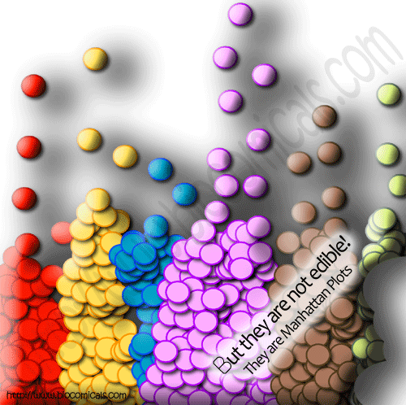

Slide 24
Replication, Replication, Replication
To replicate in a separate cohort:
  Association test for replication sample significant at 0.05/{Number of SNPs replicating} alpha level
  Same genetic model (e.g. additive, dominant)
  Same direction
  Sufficient sample size for replication!
    [e.g., do a power calculation]
Non-replications not necessarily a false positive
  LD structures, different populations (e.g., flip-flop)
  covariates, phenotype definition, underpowered
  Winner’s curse

Slide 25
Meta-analysis
Combine multiple studies to increase power
Either combine p-values (Fisher’s test),
or coefficient estimates + standard error (much better)

Slide 26
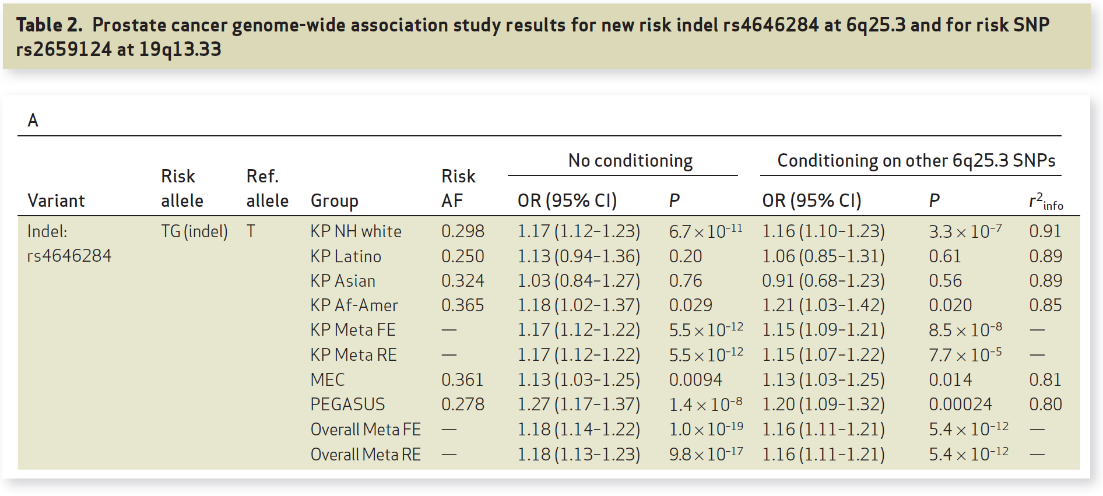
Replication & Meta-analysis
Hoffmann et. Al, Cancer Discovery 2015`

Slide 27
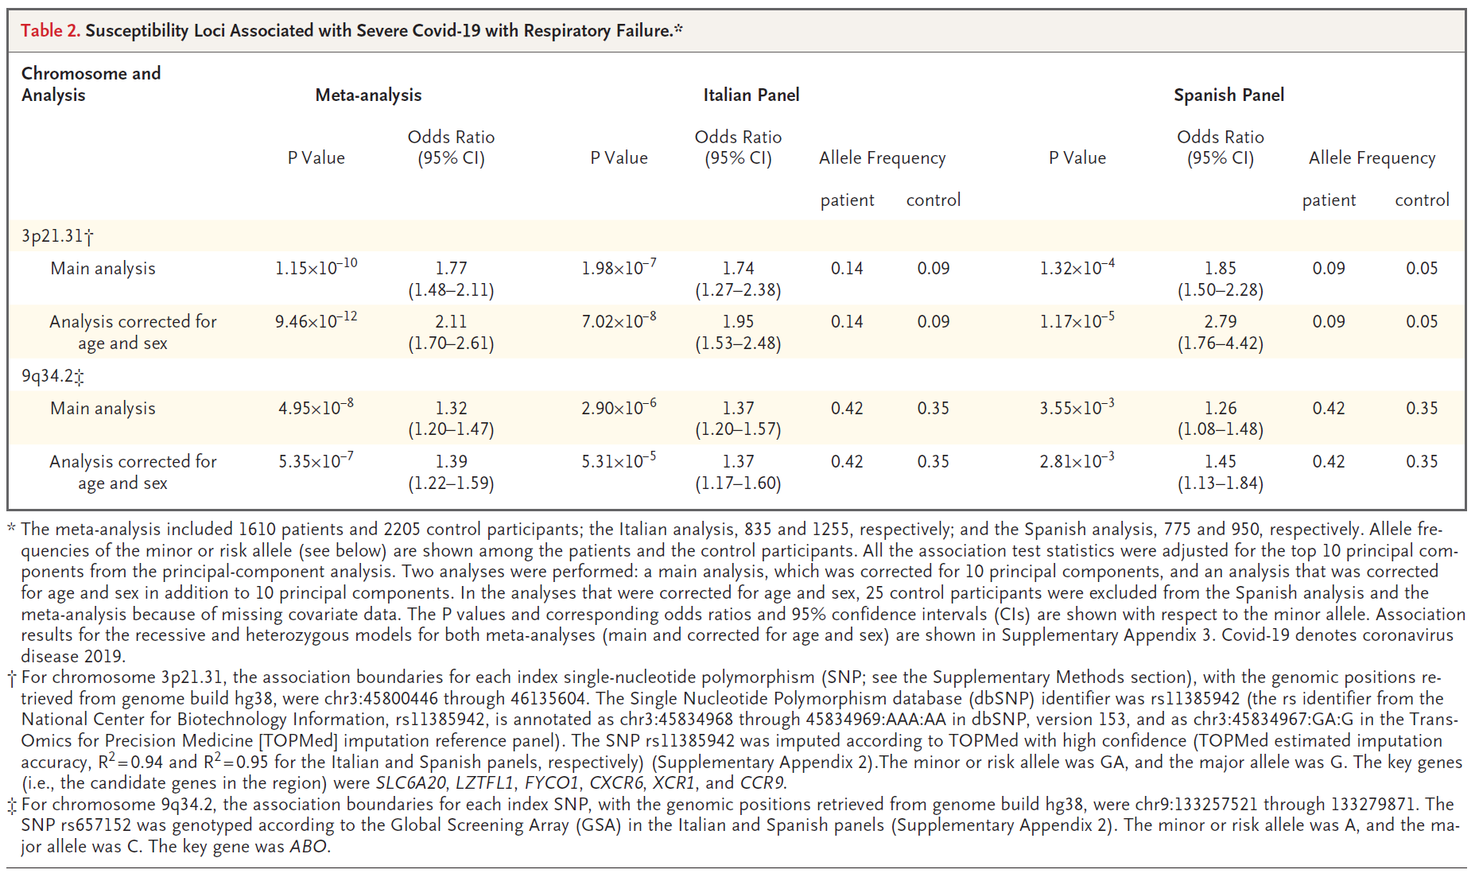
Replication and Meta-analysis
The severe covid-19 GWAS group. Genomewide association study of severe covid-19 with respiratory failure. NEJM, 2020; 383:1522-1534.

Slide 28
Beyond Genotyped SNPs:
Imputation of SNP Genotypes
Combine data from different platforms (e.g., Affy & Illumina) (for replication / meta-analysis).
Estimate unmeasured or missing genotypes.
Based on measured SNPs and external info (e.g., haplotype structure of HapMap).
Increase GWAS power (impute and analyze all), e.g. Sick sinus syndrome, most significant was 1000 Genomes imputed SNP (Holm et al., Nature Genetics, 2011)
HapMap as reference, now 1000 Genomes Project; UK10K, Haplotype reference consortium?
Hybrid sequencing/genotyping approaches

Slide 29
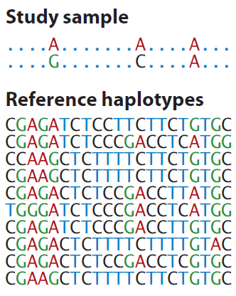
Generalization of Tag SNPs: Imputed SNPs using a Reference Panel
Generalization of pairwise r² of tagSNPs to multi-marker correlation
Class Exercise! (Groups ~3)
How would you fill in the remaining genotypes of this study sample individual, given the reference haplotypes?
http://www.shapeit.fr/, http://mathgen.stats.ox.ac.uk/impute/impute_v2.html
http://faculty.washington.edu/browning/beagle/beagle.html
http://www.sph.umich.edu/csg/abecasis/MACH/download/
Li et al., Ann Rev Human Genet, 2009

Slide 30

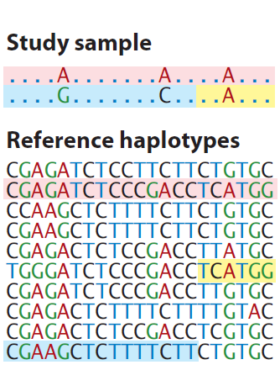
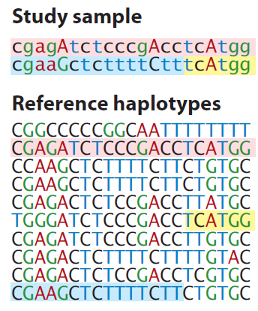
Generalization of Tag SNPs: Imputed SNPs using a Reference Panel
Generalization of pairwise r² of tagSNPs to multi-marker correlation
http://www.shapeit.fr/, http://mathgen.stats.ox.ac.uk/impute/impute_v2.html
http://faculty.washington.edu/browning/beagle/beagle.html
http://www.sph.umich.edu/csg/abecasis/MACH/download/
Li et al., Ann Rev Human Genet, 2009

Slide 31
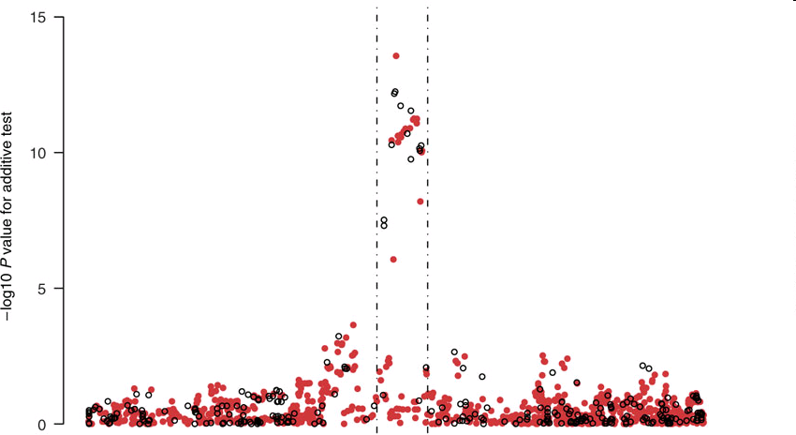
Imputation Application
TCF7L2 gene region & T2D from the WTCCC data
Observed genotypes black
Imputed genotypes red.
Imputed SNP more significant than typed SNP!
Chromosomal Position
Marchini Nature Genetics2007
http://www.stats.ox.ac.uk/~marchini/#software
Notes:
31

Slide 32
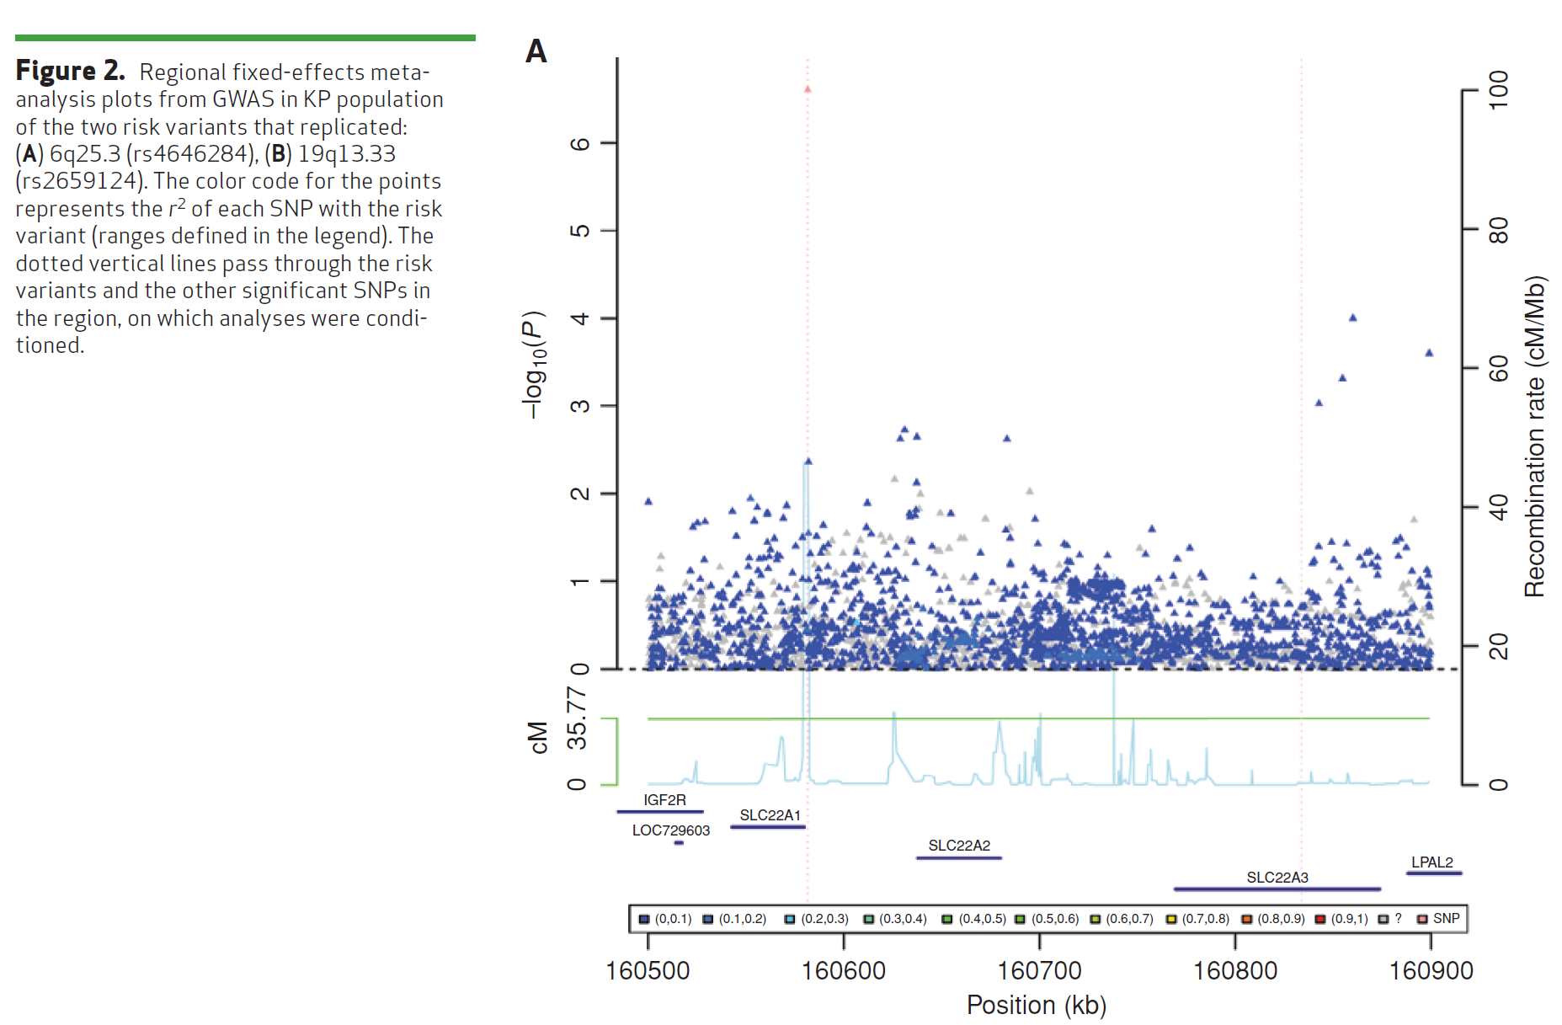
Imputation Application #2 – Do not always see a jet of points, even for common SNP…
(Same SNP as 4 slides ago)
Hoffmann et. Al, Cancer Discovery 2015`

Slide 33
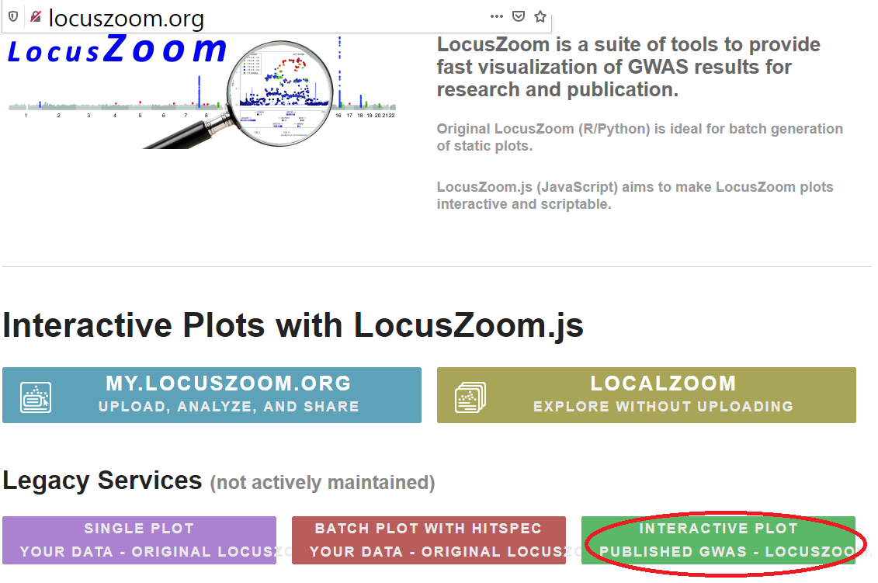
LocusZoom plot: LDL, rs6544713

Slide 34
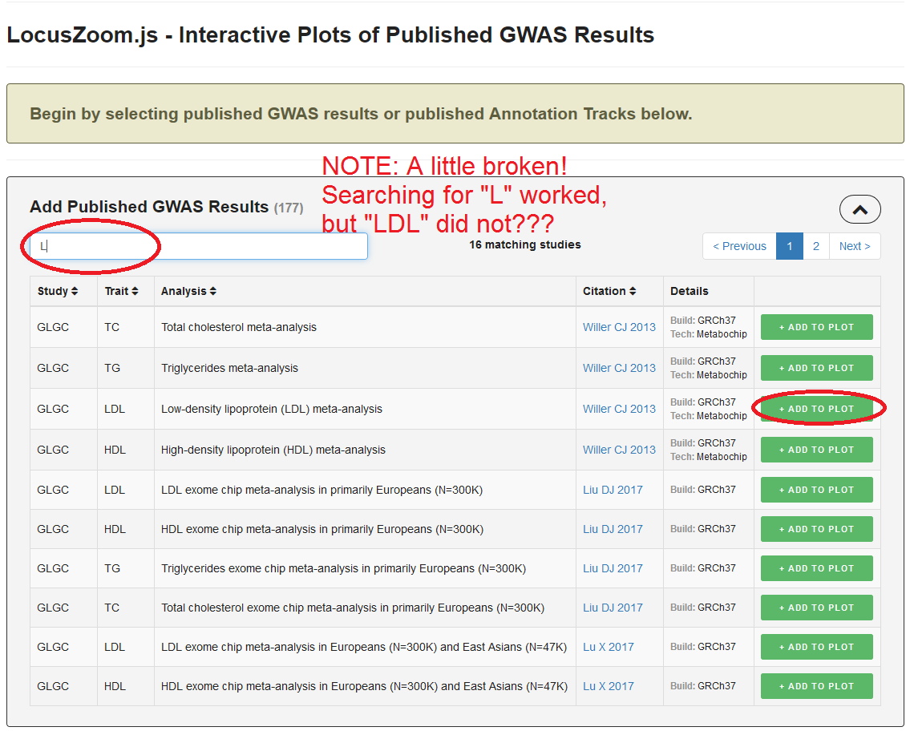
LocusZoom plot: LDL, rs6544713

Slide 35
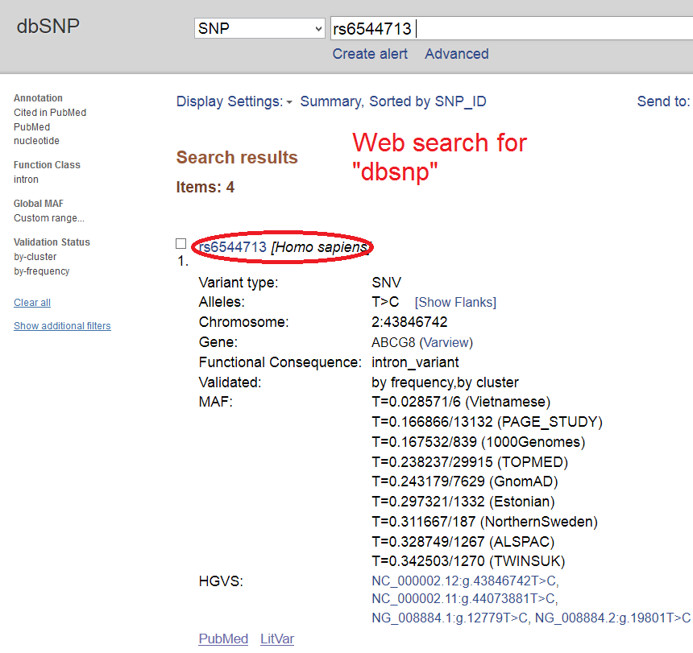
Very broken, need to get coordinates by hand!

Slide 36
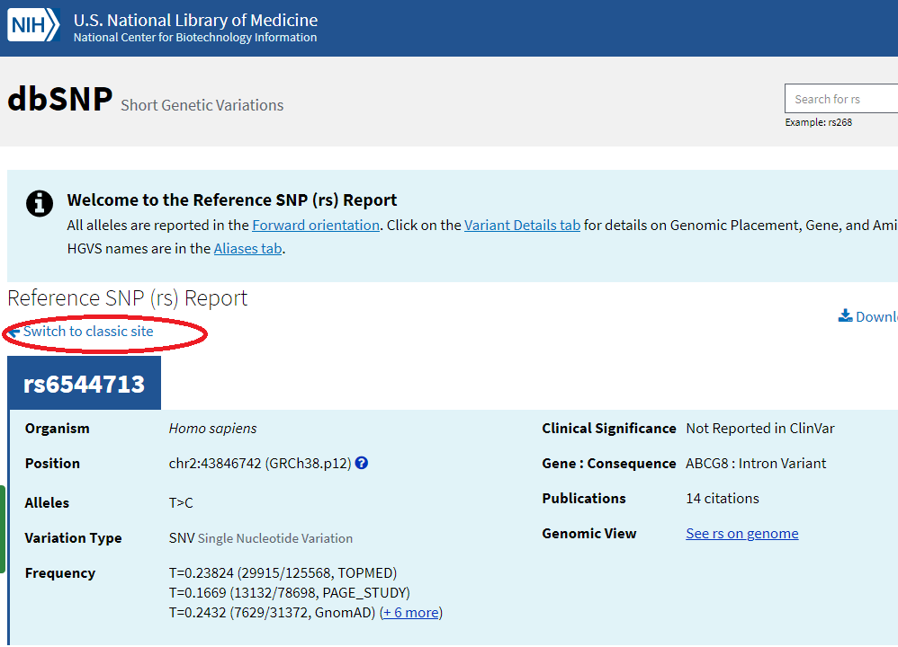
Very broken, need to get coordinates by hand!

Slide 37
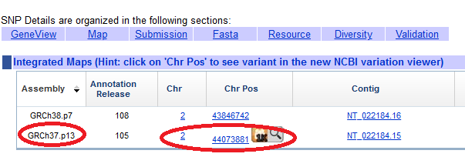
Very broken, need to get coordinates by hand!

Slide 38
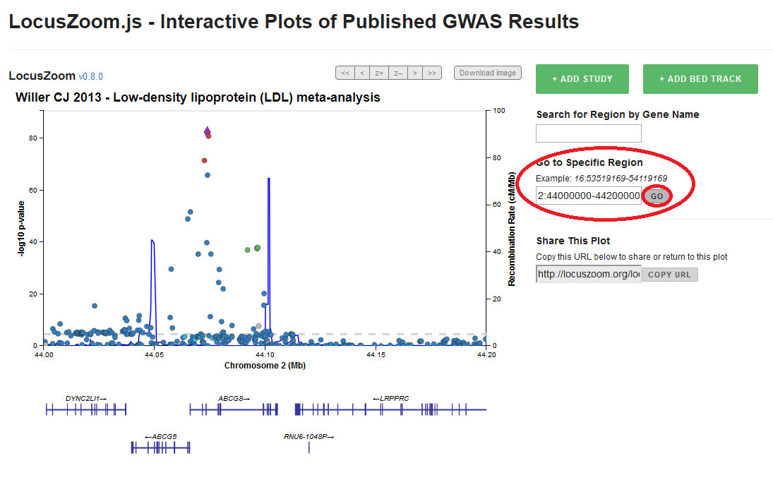
Very broken, need to get coordinates by hand!

Slide 39
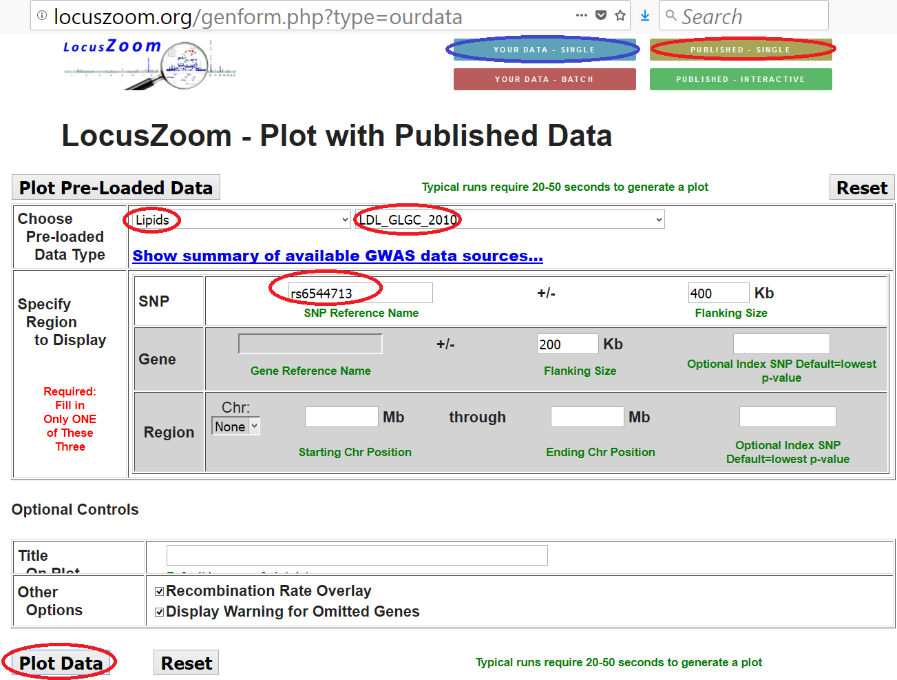
LocusZoom plot: LDL, rs6544713

Slide 40
Imputation QC – r_{info}² value
Similar to pairwise tagging r² value, but multi-marker r² value
  More than pairwise r², why it can beat pairwise tagging r² value
Rules of thumb
  r²>0.8: very good
  0.5<r²<0.8: not as good, maybe include
  0.3<r²<0.5: not great, maybe include
  r²<0.3: probably exclude from analysis

Slide 41
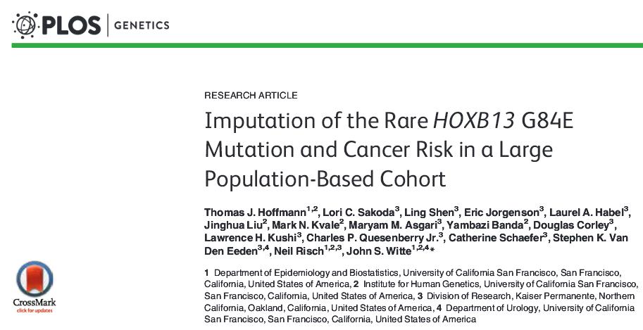
Imputation example: How rare can you go?
G84E example talked about in Austin pg. 62
MAF 0.0034 in European ancestry. r²=0.57.
In general, a moving target, still unknown how rare is possible

Slide 42
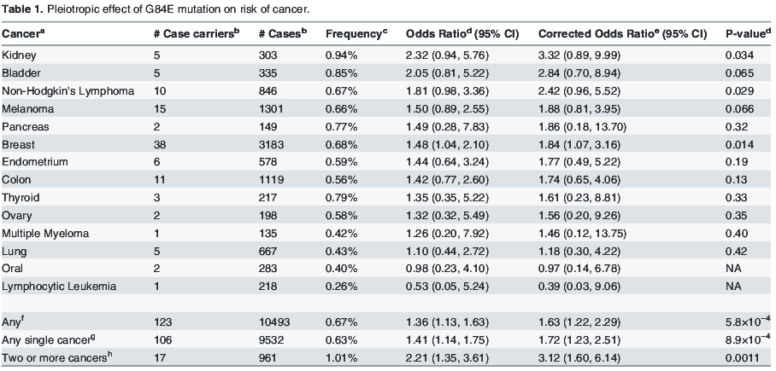
HOXB13 G84E (continued)

Slide 43
GWAS catalog (revisit)
https://www.ebi.ac.uk/gwas/home

Slide 44
Outline for GWAS
Analysis
  QC
  Analysis approach
  Prostate cancer example
  Imputation
  Replication & Meta-analysis
GWAS Limitations

Slide 45

Limitations of GWAS
Not very predictive
Explain little heritability, generally, but improving
Focus on common variation, but getting rarer
Many associated variants are not causal

Slide 46
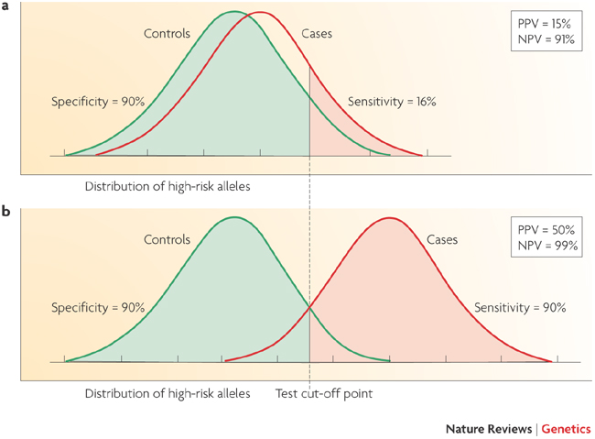
Limitations of GWAS
Example:
AUC for Breast Cancer Risk
58%: Gail model (# first degree relatives w bc, age menarche, age first live birth, number of previous biopsies) + age, study, entry year
58.9%: SNPs
61.8%: Combined
Wacholder et al., NEJM 2010
Not very predictive
Witte, Nat Rev Genet 2009
Notes:
46

Slide 47
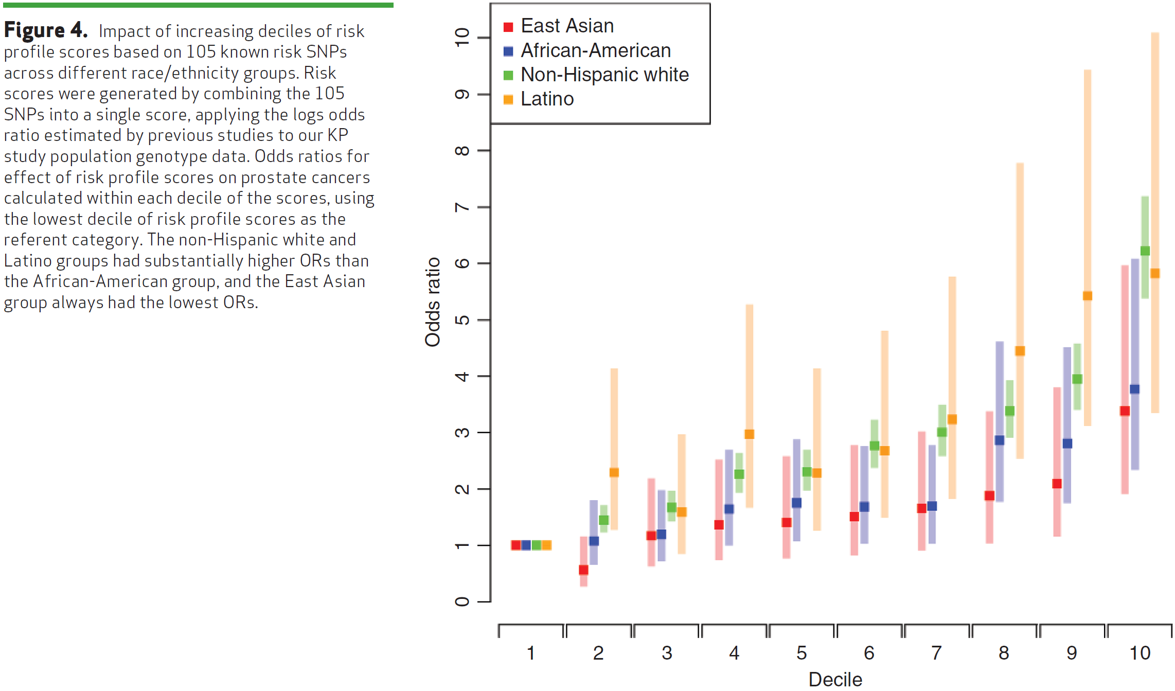
Genetic Risk Score (GRS) – Overall genetic risk; tails show more sep.?
i.e., β_{j}
GRS_{j}
Be careful of SNPs in LD… e.g., don’t want to include same SNP effectively twice if reported in two studies.
Hoffmann et. Al, Cancer Discovery 2015

Slide 48
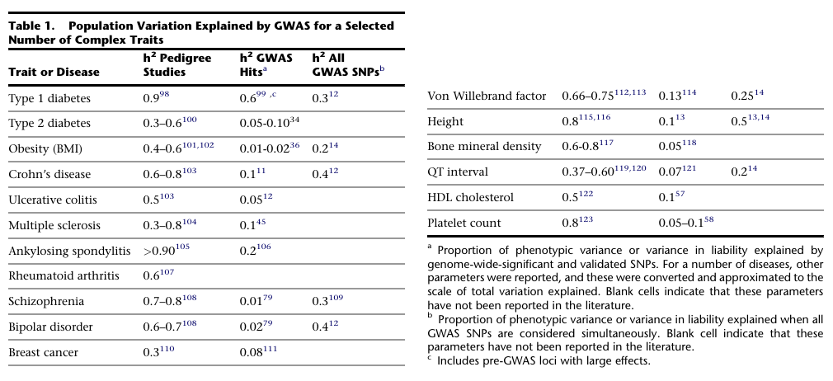
What does it mean to explain little of the heritability, and where is it?
Visccher, AJHG 2011

Slide 49
Class exercise: Where is it?
Can GWAS find more?
Are our analysis methods not creative enough?
Are we missing genetic things?

Slide 50
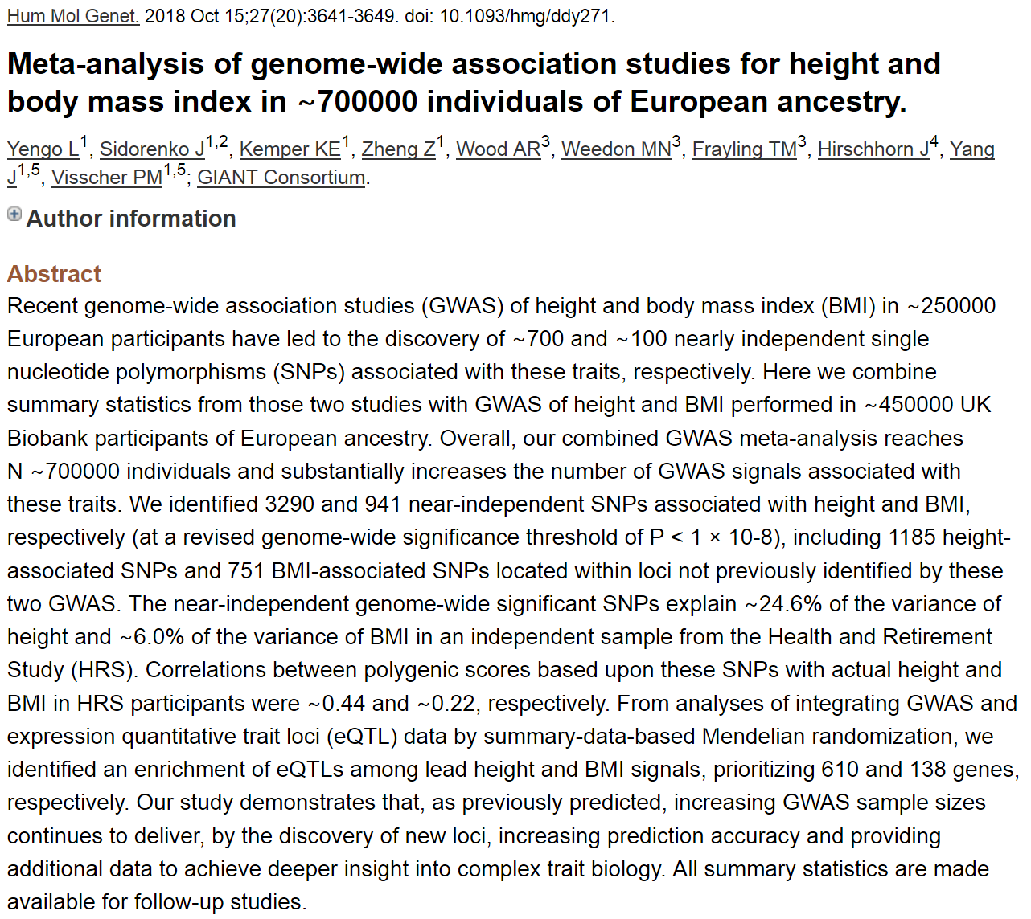
Revised height variance explained
(really not very predictive, or?)

Slide 51
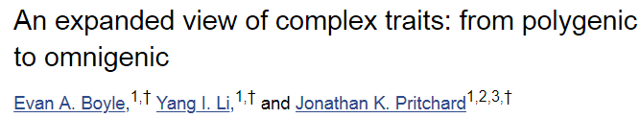
… or is it omnigenic? …
Predict 100,000 variants with some effect on height…
PRS variant that builds model based on all SNPS

Slide 52
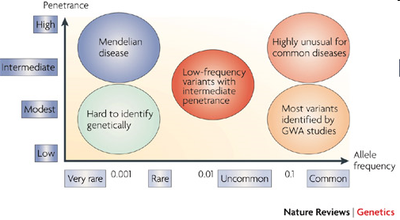
Where’s the heritability?
Common disease rare variant (CDRV) hypothesis: diseases due to
multiple rare variants with intermediate penetrances (allelic heterogeneity)
Many more
of these?
See: NEJM, April 30, 2009
McCarthy et al., 2008

Slide 53
Will GWAS results explain
more heritability?
Possibly, if…
Causal SNPs not yet detected due to power issues – weak effects
  Previous GWAS designed/powered for MAF>0.05/0.10; lower MAFs for newer arrays and larger reference panels
More complicated modeling necessary, e.g. gene-gene interaction (epistasis), gene-environment interaction, etc.
Notes:
53

Slide 54
How much is left to discover?
“Array” heritability
Compute heritability using all SNPs
  Be careful with QC, esp. case-control
If you adjust for the known hits, how much remains yet to be found?
Restricted to narrow sense heritability
E.g.,
Lecture 2:
“Broad sense”: H²=σ²_{G}/σ²_{P}=(σ²_{A} + σ²_{D})/σ²_{P}
“Narrow sense”: h² = σ²_{A} /σ²_{P}
http://www.complextraitgenomics.com/software/gcta/

Slide 55
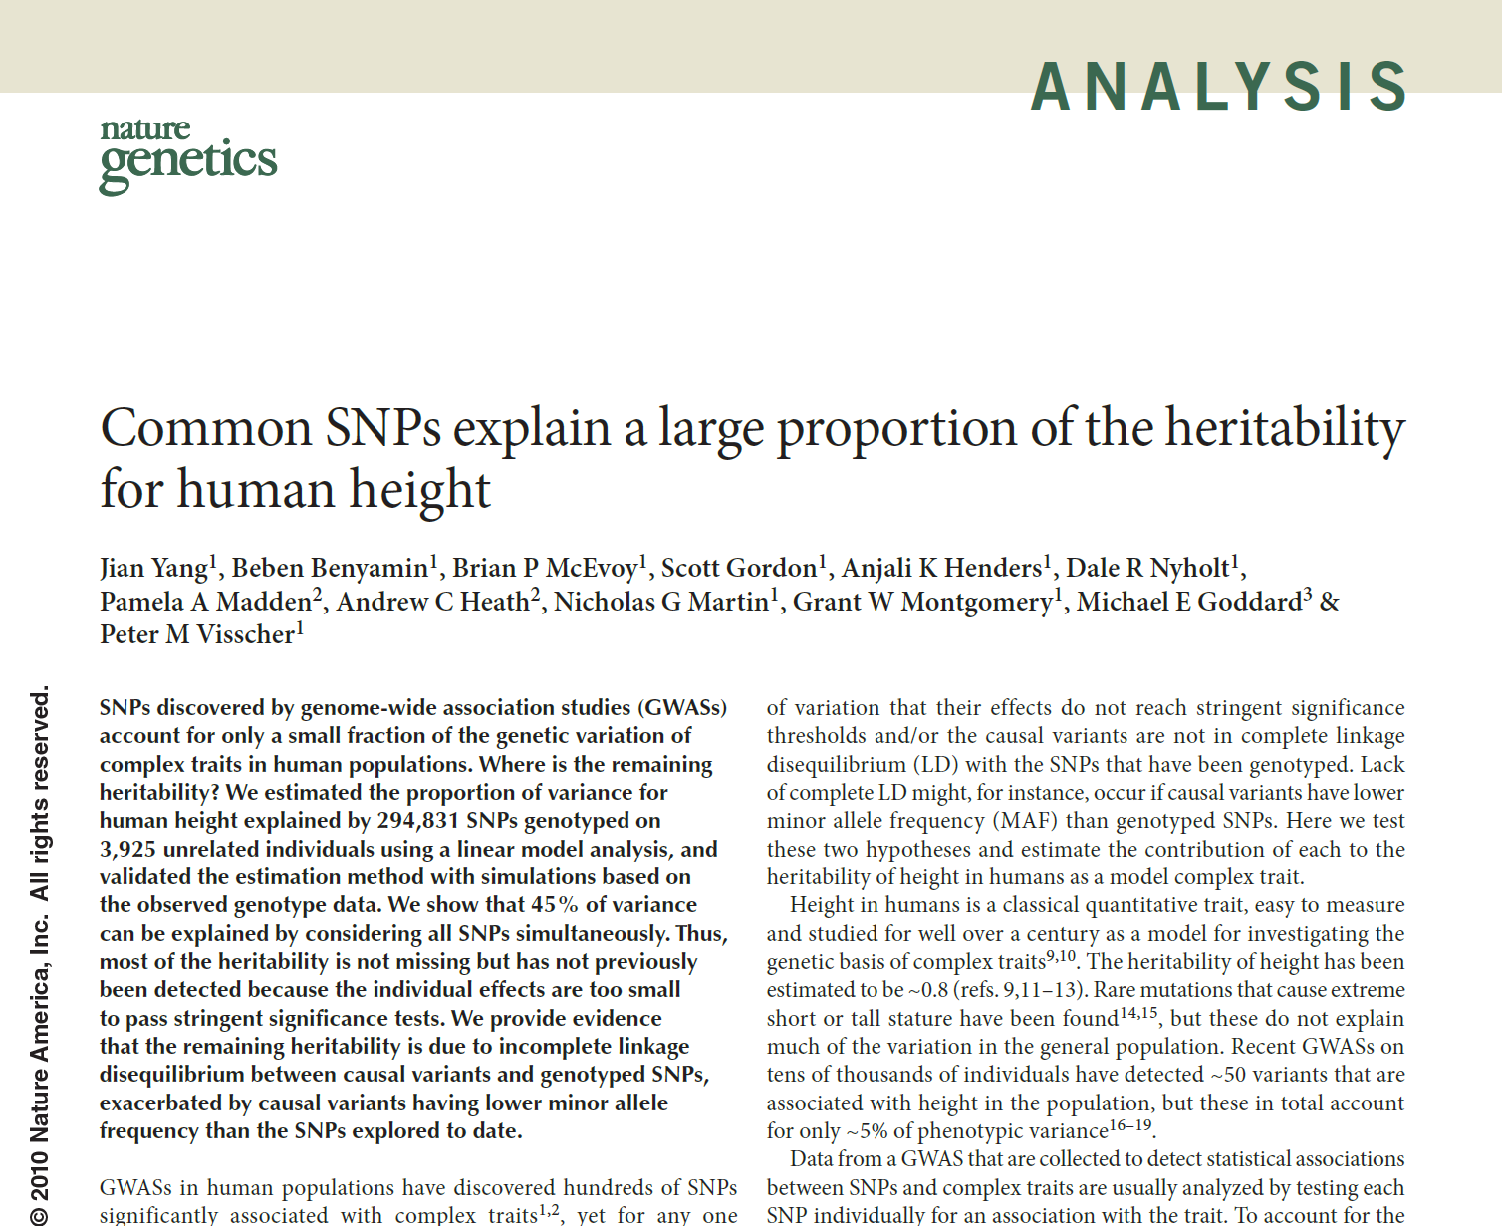

Slide 56
Other things than SNPs
Copy number variants (CNVs)
Epigenetics, e.g., methylation, histone modification
Gene expression (RNA levels) [eQTLs! we covered these]
Proteomics (measures of proteins in cells)
...

Slide 57
But, what about more complicated modeling? Epistasis
Epistasis – snp x snp, or gene x gene interactions
Very difficult to do genome-wide
  Much less power to detect an interaction than a main effect in general
  Multiple testing burden: Correct for 10⁶ tests before? Now 10¹² tests!!!
Some argue not worth testing for an interaction unless a main effect…
Notes:
. The SNP in ABO is *not* blood type.

Slide 58
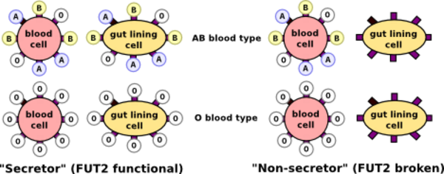
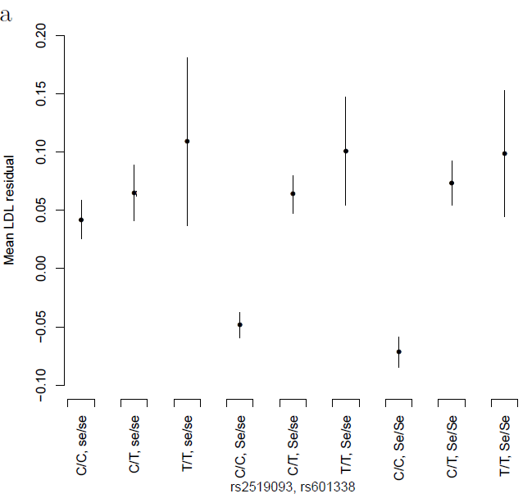
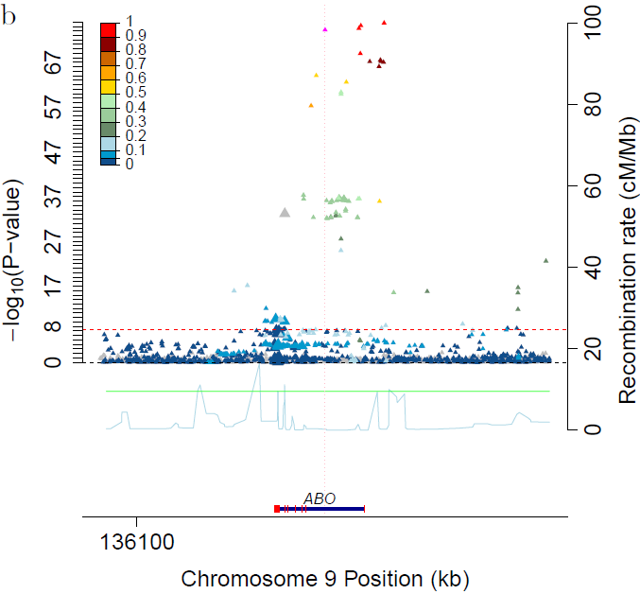
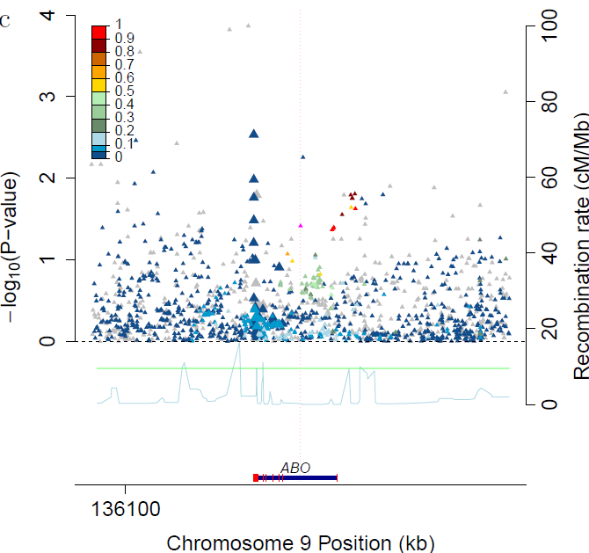
Epistasis in serum lipids
Serum lipids example
  Tested all pairs of known GWAS hit variants
  Rs2519093 (ABO) x rs492602 (FUT2): Interaction P_{LDL}=8.1x10⁻¹⁰
    Rs492602 has r²=0.992 with rs601338, a nonsense dominant variant determining FUT2 non-secretor status
http://genos.hr/en/laboratories/analytical-dna-laboratory-1/human-dna-analysis-1/secretor-status-dna-test-1/
Residual LDL by genotype ABO locus for secretors (Se/Se or Se/se) ABO locus plot for non-secretors
Notes:
. The SNP in ABO is *not* blood type.

