Slide 1
Bringing it together:
Applying the socioecological model in clinical and translational research
Christine Dehlendorf, MD MAS
Safyer McKenzie-Sampson, MSc

Slide 2
Objectives
To apply the socioecological model and understanding of the fundamental causes of racism and SES to:
  Identification of research questions
  Methods selection
  Analysis
  Interpretation
  Dissemination

Slide 3
Objectives
To apply the socioecological model and understanding of the fundamental causes of racism and SES to:
  Identification of research questions
  Methods selection
  Analysis
  Interpretation
  Dissemination

Slide 4
Identification of a Research Question
Considering the socioecological context of health conditions provides broader and more accurate insight into possible approaches to understand and improve health (and address health disparities)
  Relevant even when targeting proximal risk factors

Slide 5
Examples in Descriptive/Exploratory Studies
Qualitative research to understand contextual factors influencing diabetic control
Inclusion of questions related to experience of racism in cohort studies of medication adherence
Assessing lifecourse SES when investigating predictors of CVD
Notes:
Note some of these may be primary questions or can be secondary questions – e.g. think about including them

Slide 6
Examples in Intervention Studies
Health coaches that help with diet and medication adherence in the context of social situation (including food insecurity)
PrEP promotion efforts that acknowledge issues of gender-based power and relationship dynamics (e.g. not just stopping at offering PrEP)
Barbershop/church interventions to address risk for chronic diseases
Studying policies with impacts on determinants of health, such as soda taxes and improved housing
Notes:
Examples of incorporating a multilevel socioecological perspective even while investigating/intervening on more proximal mechanisms include

Slide 7
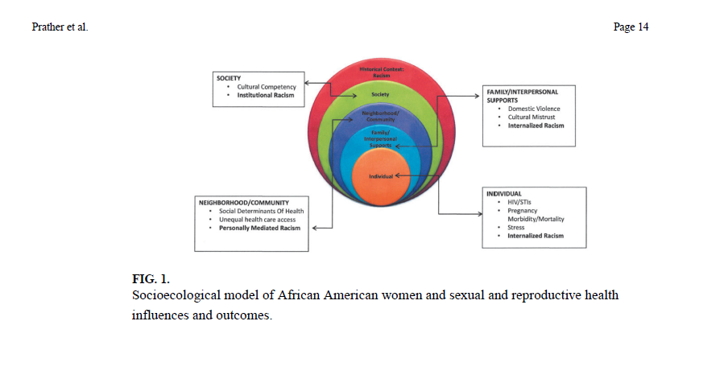


Slide 8
Community Engaged Research
“The process of working collaboratively with and through groups of people affiliated by geographic proximity, special interest, or similar situations to address issues affecting the well-being of those people” – CDC
Occurs across continuum, from consultation to CBPR
Helps to ensure ask relevant questions, get relevant answers, and disseminate in appropriate manner

Slide 9
Resources
http://ctsi.ucsf.edu/about-us/programs/community-engagement-health-policy

Slide 10
Incorporating the SEM Model
Specify contextual relationships:
  Ensures that ecologic thinking is incorporated into research question and design
  Provides clarity into pathways being investigated and how they relate to other influences

Slide 11
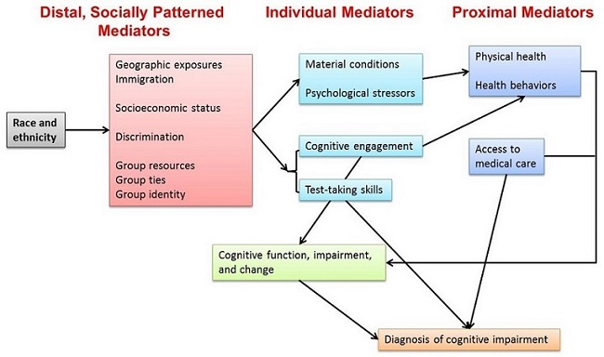

Slide 12

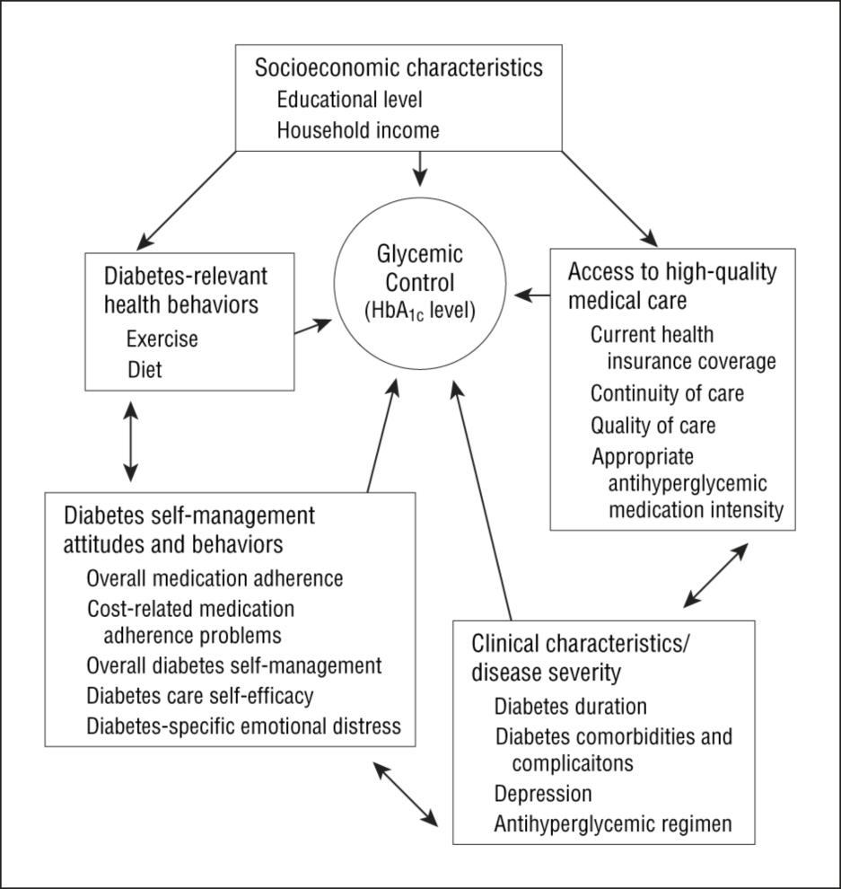
From: Mechanisms for Racial and Ethnic Disparities in Glycemic Control in Middle-aged and Older Americans in the Health and Retirement Study
Arch Intern Med. 2007;167(17):1853-1860. doi:10.1001/archinte.167.17.1853
Figure Legend:
Hypothesized mechanisms for racial/ethnic disparities in glycemic control. HbA_{1c} indicates hemoglobin A_{1c}.
Date of download: 2/9/2015
Copyright © 2015 American Medical Association. All rights reserved.
Notes:
The next few weeks will help you do this

Slide 13
Avoid the Pitfalls of Decontextualized Research Questions
Focusing in on behavior change or health care delivery without consideration of contextual factors
Overestimating the conclusions you can draw from a narrow research question
Exacerbating inequalities by not considering how flexible resources will contribute to who benefits from your work

Slide 14
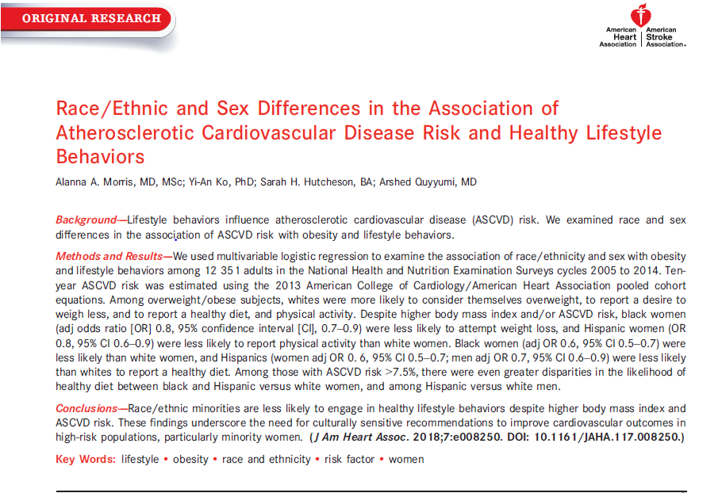
Notes:
Underscores interconnections between question you ask and how you interpret it

Slide 15
BiDil: A cautionary tale
Trial in only African Americans found a benefit with hydralazine/isosorbide dinitrate
FDA approved combination ONLY for African Americans
Lead to outcry about presumption of genetic differences
  Potential for this type of approach to increase health disparities
  (Consider how relates to other examples of using race in clinical decision making)

Slide 16
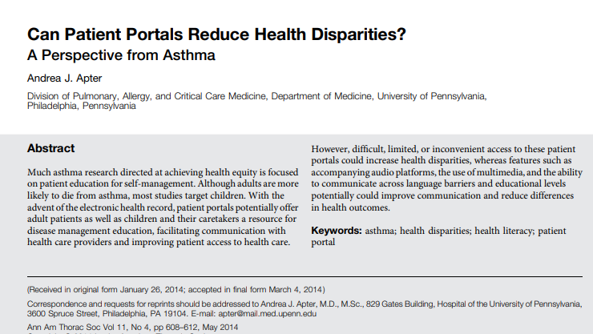

Slide 17
Objectives
To apply the socioecological model and understanding of the fundamental causes of racism and SES to:
  Identification of research questions
  Methods selection
  Analysis
  Interpretation
  Dissemination

Slide 18
Methodologic Considerations
Recruitment and retention of diverse populations
Development and training of research teams
Appropriate measurement of sociodemographic and contextual characteristics

Slide 19
Methods: Recruitment and Retention
1993 NIH Revitalization Act: Women and minorities must be included in clinical research supported by NIH
Sufficient numbers to allow valid evaluation of differences for major groups
Notes:
The Revitalization Act of 1993 mandated, for the first time, the inclusion of women and minorities in research funded by The National Institutes of Health. Before then, medical researchers – working on every scientific stage from early discovery to clinical trials – were encouraged to include women but, as it was never enforced, they rarely did. Male mice were almost exclusively used in laboratory experiments. In fact, before 1990, the term “women’s health” was limited primarily to reproductive health. To the extent there was any interest at all in the field, it was in terms of family planning, maternal and child health, and abortion. While these are important aspects of women’s health, they are not the drivers of the women’s health field, which, thanks to the Revitalization Act now connotes the overall health of women, including an acknowledgement of sex differences in the physiology of men and women down to the molecular level.

Slide 20
Why is this important?
Participation of diverse participants ensures that:
  Research findings are generalizable and can be translated into diverse communities
  The benefits of clinical research are broadly distributed
  Disparities can be investigated and understood

Slide 21
Dismal Representation
Jan 2013 review of NCI-sponsored trials
  < 100/10,000 cancer trials focused on racial/ethnic marginalized populations
Of participants in cancer research, only 10% are racialized, while they make up almost 40% of U.S. population
Overall, Black and Hispanic people make up 5% and 1% of clinical trial participants
Chen M. Cancer 2014; 120(7 supple):109-6
www2.mdanderson.org/cancerwise/2010/03/minority-participation-in-clinical-trials.html

Slide 22
Barriers to Participation in Research
Inconvenience
Lack of transportation
Caregiver obligations
Distrust of doctors, researchers, institutions
Lack of information
Lack of outreach

Slide 23
Differences in Willingness to Participate in Research
Braunstein, Medicine (Baltimore), 2008

Slide 24
Perceived Risk with Research
Braunstein, Medicine (Baltimore), 2008
Notes:
African American participants possessed lower WTP than white participants (27% vs. 39%, p = 0.001) and had higher mean distrust scores than whites (p < 0.0001). African American participants more frequently reported that doctors would less fully explain research participation to them (24% vs. 13%, p < 0.001), use them as guinea pigs without their consent (72% vs. 49%, p < 0.001), prescribe medication as a way of experimenting on people without their knowledge (35% vs. 16%, p < 0.001), and ask them to participate in research even if it could harm them (24% vs. 15%, p = 0.002). African American participants also more often believed they could less freely ask their doctor questions (8% vs. 2%, p < 0.001) and that doctors had previously experimented on them without their consent (58% vs. 25%, p < 0.001).

Slide 25
Lack of Access to and Information about Research
Clinical trials often not available at safety net institutions or publicized in low income/communities of color
Differential recruitment by study staff
Overly rigid exclusion criteria

Slide 26
How Do We Address Barriers?
Need to budget time and effort
Engage with the community
  Enhance relevance of research
  Develop trust
  Disseminate information
Make research accessible

Slide 27
How Do We Address Barriers?
Provide adequate financial incentives
Multiple methods of recruitment are higher yield
Use personal contacts
Employ culturally sensitive (and pretested) recruitment methods
Monitor recruitment and adjust as necessary
Feed results back to the community
Notes:
Be careful around what is considered “culturally sensitive” – community engagement can help with this

Slide 28
Considerations for Retention
Is the respondent burden reasonable (transportation, poor health)?
Are there tangible benefits to participating?
Are setting, approach, personnel welcoming?
Is research relevant and interesting?
How can I feed back interim and final results to participants and the communities involved?

Slide 29
Summary of Recruitment and Retention
Recruitment and retention of diverse groups is an equity and scientific issue
Planning and awareness of potential barriers can help ensure adequate representation among research participants

Slide 30
Methods: Development and Training of Research Teams
Prioritize representation/diversity in research teams
Proactively address the potential for bias and structural factors to impact the conduct and outcomes of research
  Consider implicit bias/structural competency training
  Assess the policies and practices of sites and environments where research is conducted

Slide 31
Methods: Collect appropriate race/ethnicity and SES data
Assess representativeness/generalizability
Control for confounding/assess effect modification
Investigate disparities
Notes:
Should include to think about what measures to collect and also collecting mechanisms rather than just these constructs

Slide 32
Should we measure race/ethnicity?
Health does vary by race/ethnicity – so can’t ignore it
Social constructions of race/ethnicity are most important for understanding health disparities
Need to be thoughtful and conceptually motivated when measuring, analyzing and reporting results related to racial/ethnic differences
Notes:
To answer the question about why we can’t be “race blind”

Slide 33
What are you measuring when you measure race?
Historical discrimination
Socioeconomic status
Structural racism
Interpersonal racism

Slide 34
Most important recommendations from Caulfield
Define why you are measuring/analyzing race, and consider potential for misinterpretation
Use appropriate terms
  Do not use Caucasian
  Consider what groups themselves prefer to be called
Collect data about mechanisms by which race/ethnicity can have an impact
Carefully report results
Notes:
https://www.sjsu.edu/people/carol.mukhopadhyay/race/Mukhopadhyay-Caucasian-article.pdf

Slide 35
Measuring race/ethnicity
Self-identification is the gold standard
  Preferred NIH approach, as administrative data has limitations with up to 30% misclassification
  May depend on research question and whether external assessment is relevant
Specify reason for measuring/including race/ethnicity
Kaplan and Bennett, JAMA, 2003
Krieger, AJPH, 2005
Notes:
http://www.ncbi.nlm.nih.gov/pubmed/8840198
When researchers
use race/ethnicity as a variable
without explanation, they imply that
race/ethnicity is “a primary, natural, and
neutral means of grouping humans.”25
Using race/ethnicity without specifying
a reason for doing so can also reinforce
perceptions that the categories used
are mutually exclusive and exhaustive
and that individuals can be validly and
reliably assigned to categories. As noted
by Hahn and Stroup, “scientific use of
a social category may be interpreted as
endorsement of its validity.”59
Neither the validity nor the reliability of racial/ethnic assignment can be assumed.^{43,67- 79} Individuals are frequently assigned to racial/ethnic categories by researchers, interviewers, hospital admitting clerks, clinicians, undertakers, and medical examiners.^{43,76,79} These assignments are made according to the assumptions and biases of the observer, based on factors such as appearance, surname, language spoken, and neighborhood of residence. Boehmer et al⁷⁷ found high rates of discordance between race/ethnicity as self-perceived and as recorded in clinical records for a large sample of Veterans Administration dental outpatients. Among 12 444 survey respondents who selected a single race/ethnicity, 70.5% of those who selected American Indian or Alaska Native were inconsistently classified in the clinical database, as were 14.1% of those who chose Spanish, Hispanic, or Latino, 13.8% of those who chose Asian, 5.0% of those who chose black or African American, and 1.5% of those who chose white.⁷⁸

Slide 36
Measurement of Race/Ethnicity in Clinical Research
Office of Management and Budget (OMB) Directive 15 sets guidelines for the collection of racial and ethnic categories to “provide for the collection and use of compatible, non-duplicated, exchangeable racial and ethnic data by Federal agencies.”
Separate race and ethnicity question

Slide 37
OMB Standards set in 1997
Allow for reporting 2 or more race categories––multi-racial
Separate Asian/Pacific Islander into 2 categories: Asian and Native Hawaiian or Other Pacific Islander
Change to Hispanic or Latino
Change to Black or African American
Strongly endorse self-identification

Slide 38
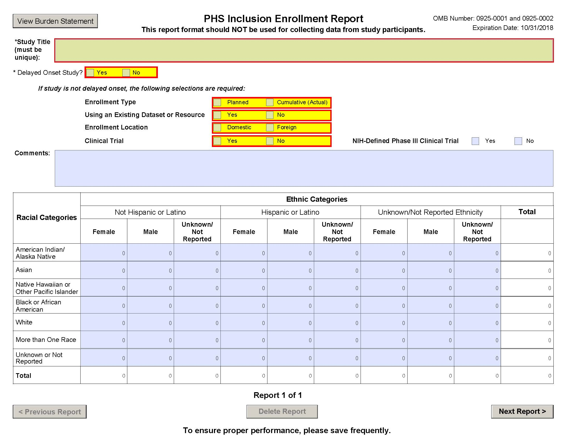
NIH Required Categories

Slide 39
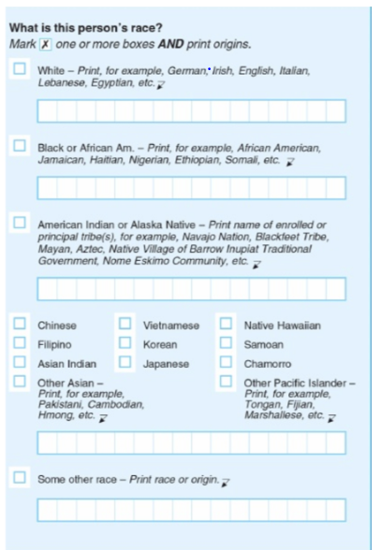
2020 U.S. Census Questions Racial Groups
Notes:
One challenge we currently face is how Americans view “race” and “ethnicity” differently than in decades past. In our diverse society, a growing number of people find the current race and ethnic categories confusing, or they wish to see their own specific group reflected on the census questionnaire. Our research has found that over time, there have been a growing number of people who do not identify with any of the official OMB race categories, and this means that an increasing number of respondents have been racially classified as “Some Other Race.” In fact, in 2000 and in 2010, the Some Other Race (SOR) population, which was intended to be a small residual category, was the third largest race group. This was primarily due to reporting by Hispanics, who make up the overwhelming majority of those classified as SOR, not identifying with any of the OMB race categories. In addition, segments of other populations, such as Afro-Caribbean and Middle Eastern or North African populations, did not identify with any of the OMB race categories and identified as SOR.
Census bureau recommended collapsing to race and including Hispanic as a race and creating MENA (middle eastern and north Africa race – omb did not respond

Slide 40
2020 U.S. Census Questions
Ethnicity question:
Is this person or Hispanic, Latino, or Spanish origin?
Ethnicity response options:
No, not Hispanic/Latino/Spanish
Yes, Mexican, Mexican-Am, Chicano
Yes, Puerto Rican
Yes, Cuban
Yes, other Spanish/Hispanic/Latino
Notes:
One challenge we currently face is how Americans view “race” and “ethnicity” differently than in decades past. In our diverse society, a growing number of people find the current race and ethnic categories confusing, or they wish to see their own specific group reflected on the census questionnaire. Our research has found that over time, there have been a growing number of people who do not identify with any of the official OMB race categories, and this means that an increasing number of respondents have been racially classified as “Some Other Race.” In fact, in 2000 and in 2010, the Some Other Race (SOR) population, which was intended to be a small residual category, was the third largest race group. This was primarily due to reporting by Hispanics, who make up the overwhelming majority of those classified as SOR, not identifying with any of the OMB race categories. In addition, segments of other populations, such as Afro-Caribbean and Middle Eastern or North African populations, did not identify with any of the OMB race categories and identified as SOR.

Slide 41
2010 US Census Latinos by Race
Race Category | Percent
White | 53
Black | 2.5
American Indian | 1.4
Asian | 0.4
Pacific Islander | 0.1
Some Other Race | 36.7
Mixed Race | 6
Notes:
http://www.pewresearch.org/fact-tank/2017/04/20/seeking-better-data-on-hispanics-census-bureau-may-change-how-it-asks-about-race/
https://www.census.gov/content/dam/Census/library/publications/2011/dec/c2010br-04.pdf

Slide 42
Measurement of SES
Think about measures that have most relevance to your research question
  May need multiple measures
  Results may depend on what measures you use
Use validated question
Consider life course perspective
Don’t say you “controlled for SES”
Always think about both race/ethnicity and SES

Slide 43
Measures of SES
Education – years of formal or establish ordinal categories
Income defined in terms of annual household and factor number of dependents. Frequently decline to report or inaccurate
Occupation– laborer, technical, professional, business

Slide 44
Additional SES Measures
Wealth
Class measure over the life course––childhood exposure
Parental occupation and education
Self-perceived ‘standing’ on a ladder ranging from 1 to 10

Slide 45
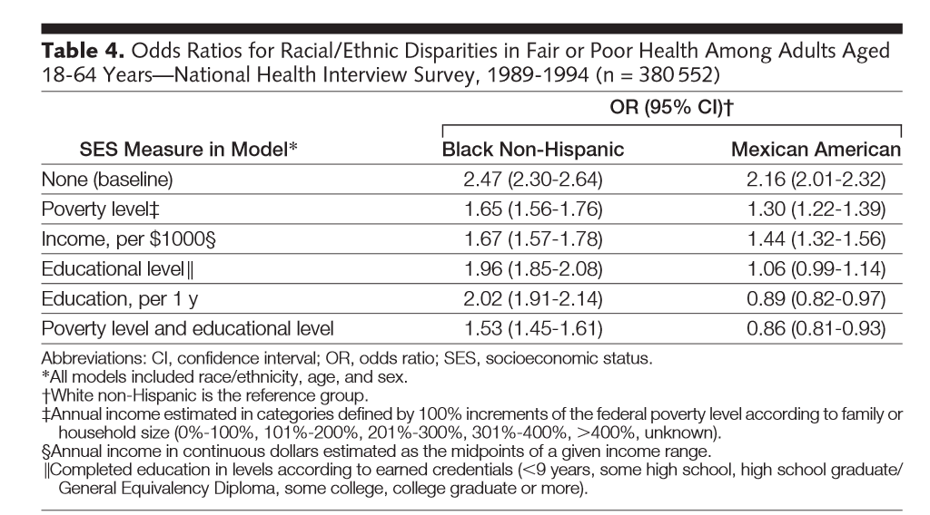

Slide 46
Methods: Considerations with Other Measurements
Ensure measurements of “latent variables” have been developed or assessed in diverse populations
Consider collection of contextual variables – e.g. neighborhood or zip code

Slide 47
What about secondary data analyses?
Sometimes you don’t have control over the data you have access to
Carefully consider what you CAN say with the available data and whether it adds value
Carefully plan analysis and interpretation so as to not overstate your findings and acknowledge their limitations
Notes:
Also with EHR data

Slide 48
Objectives
To apply the socioecological model and understanding of the fundamental causes of racism and SES to:
  Identification of research questions
  Methods selection
  Analysis
  Interpretation
  Dissemination

Slide 49
Analytic Considerations
Incorporate a socioecological perspective in choices about statistical models
  Consider confounding and effect modification by both race/ethnicity and markers of SES
  Include contextual variables and multilevel analyses as appropriate
  Investigate disparities, including with interactions between race and SES

Slide 50
Confounding
Cancer
Exposure
Race
SES
Notes:
When are doing it to identify confounding can be important, but still need to recognize are identifying social risks – if actually care about what causes the cancer are probably missing something big

Slide 51
Effect Modification
Race A
Behavior
Intervention
Race B

Slide 52
Effect Modification
“High SES”
Behavior
Intervention
“Low SES”

Slide 53
Multilevel/Contextual Analyses
“Living in a low SES neighborhood confers additional mortality risk beyond individual SES.”
“The odds of violence for African Americans was 2.7 times greater than the odds of violence for Whites… when neighborhood disadvantage was added to the logistic regression equation, the significant effect of race was eliminated.”
Winkleby, J Epi Comm Health, 2003
Silver, Law Hum Behav, 2000
Notes:
Good example of this is with respect to infectious disease – vaccines and stis
http://www.ncbi.nlm.nih.gov/pubmed/10974802
With respect to discharged psychiatric patients
http://aje.oxfordjournals.org/content/151/4/409.full.pdf+html
Examples – air pollution etc
Some variables are not measurable on the individual level
http://www.ncbi.nlm.nih.gov/pmc/articles/PMC1615039/pdf/amjph00456-0117.pdf
Individualistic fallacy is the erroneous presumption
that differences in population outcomes can be entirely
explained by differences in individual-level characteristics.
In the present study, the census-based variables
are intended to capture neighborhood or "contextual"
effects of SES, and not to stand as proxies for personlevel
SES variables.
The use of the ecological fallacy in
epidemiology also fosters a dismissal of
social variables as causal factors in disease.
First, as seen above, it leads to a
consignment of sociological and anthropological
studies to examining impacts on
whole societies,2 and it denies that ecological
variables can affect individual processes.
28 Second, it reinforces an assumption
that aggregated variables are
substitutes for individual-level variables.
Under such an assumption, the potential
etiological influence of aggregate-level
variables, distinct from the effects of the
same measures on an individual level,
would not be considered.
http://www.ete-online.com/content/11/1/18

Slide 54
Investigating Disparities
Consider interactions between race/ethnicity and measures of SES:
    “Both neighborhood and individual SES are associated with survival after breast cancer diagnosis, but these relationships vary by race/ethnicity.” - Shariff-Marco S, 2014
Be thoughtful about what variables to include in models as confounders vs. mediators
  Depends on the research question
Notes:
Consider neighborhood too!
https://www.ncbi.nlm.nih.gov/pmc/articles/PMC6734101/ - can also vary by contextual factors
Recognize the limitations of the methods and analytic tools we have
- People are not just combined 0s and 1s in different cells

Slide 55
Maternal Mortality
Race
SES?
Marital status?
Exposure to police violence?
Experience of interpersonal racism?
Notes:
Think about parental education….etc. what are you controlling for?
Think about whether to flesh this out

Slide 56
Objectives
To apply the socioecological model and understanding of the fundamental causes of racism and SES to:
  Identification of research questions
  Methods selection
  Analysis
  Interpretation
  Dissemination

Slide 57
Considerations with Interpretation
Risk of misinterpreting data from multivariate models
  Genetic fallacy
  Individualistic fallacy
Implications of results may depend on context

Slide 58
Genetic Fallacy
The presumption that differences that cannot be explained by identified non-biologic factors must be due to biologic differences.
  “High rates of ESRD among blacks is not fully explained by racial differences in age, socioeconomic status, or access to health care…. suggest[ing] an inheritable genetic predisposition.“ – Controlled for percent of individuals with college education in zip code
Notes:
You have all learned about ecologic fallacy – but the other side is an issue as well.
Only controlled for education, was looking at individual level factors – intepreted this as “independent of SES”. Studies that have controlled for multiple factors have found a much bigger effect of controlling.
So did not collect right data, and provided overly broad interpretation – even if was not SES controlled, then needs to say why lifestyle factors might be diferrent.
http://www.ncbi.nlm.nih.gov/books/NBK25517/#a2000af96rrr00690
Kaufman, cooper and mcgee
May even be a factor in genetic studies
1996
Such a conclusion is unwarranted
because of our limited knowledge of non-biologic factors,
combined with our inability to measure and
adjust for known non-biologic factors.

Slide 59
Individualistic Fallacy
The fallacy of assuming that individual-level outcomes can be explained exclusively in terms of individual-level characteristics
  “Living in a low SES neighborhood confers additional mortality risk beyond individual SES.”
  “The odds of violence for African Americans was 2.7 times greater than the odds of violence for Whites… when neighborhood disadvantage was added to the logistic regression equation, the significant effect of race was eliminated.”
Winkleby, J Epi Comm Health, 2003
Silver, Law Hum Behav, 2000
Notes:
Good example of this is with respect to infectious disease – vaccines and stis
http://www.ncbi.nlm.nih.gov/pubmed/10974802
With respect to discharged psychiatric patients
http://aje.oxfordjournals.org/content/151/4/409.full.pdf+html
Examples – air pollution etc
Some variables are not measurable on the individual level
http://www.ncbi.nlm.nih.gov/pmc/articles/PMC1615039/pdf/amjph00456-0117.pdf
Individualistic fallacy is the erroneous presumption
that differences in population outcomes can be entirely
explained by differences in individual-level characteristics.
In the present study, the census-based variables
are intended to capture neighborhood or "contextual"
effects of SES, and not to stand as proxies for personlevel
SES variables.
The use of the ecological fallacy in
epidemiology also fosters a dismissal of
social variables as causal factors in disease.
First, as seen above, it leads to a
consignment of sociological and anthropological
studies to examining impacts on
whole societies,2 and it denies that ecological
variables can affect individual processes.
28 Second, it reinforces an assumption
that aggregated variables are
substitutes for individual-level variables.
Under such an assumption, the potential
etiological influence of aggregate-level
variables, distinct from the effects of the
same measures on an individual level,
would not be considered.
http://www.ete-online.com/content/11/1/18
ecological study design may also be utilised when the underlying question regards individuals, such as when one is interested in the effects of air quality on health. In this context, ecological studies are potentially susceptible to the “ecological fallacy”; biases that may occur when an observed relationship between aggregated variables differs from the true, i.e. causal, association at an individual level [2]. Indeed, since Robinson in 1950 showed that correlations on an individual level can differ markedly from those on an aggregate, ecological level, epidemiological textbooks, papers and courses have warned us about the dangers of this ecological fallacy [3,4].

Slide 60
Remember to acknowledge limitations
Limitation sections provide an important way to avoid misinterpretation of your findings
  Can set up rationale for future studies
Can provide an opportunity to shape narrative around what research questions are needed and what methodological issues need to be considered

Slide 61
Considerations with Interpretation
Risk of misinterpreting data from multivariate models
  Genetic fallacy
  Individualistic fallacy
Implications of results may depend on context

Slide 62
Interpretation of Results:
PrEP Studies in Women
Seidman, Ob Gyn, 2016
Notes:
However, product
diversity alone is not enough: preexposure prophylaxis
implementation requires careful attention to
both women’s preferences and powerful social forces
at play. Without developing implementation strategies
that incorporate an individual’s sexual health goals
and the context of her community and greater structural
environment (Fig. 1), the full potential of preexposure
prophylaxis’ effect is unlikely to be realized.
The implications of negative preexposure prophylaxis

Slide 63
Notes:
Underscores interconnections between question you ask and how you interpret it

Slide 64
P<0.05
Dehlendorf, et al. AJOG, 2010
Notes:
Need to understand sociohistorical context

Slide 65
Objectives
To apply the socioecological model and understanding of the fundamental causes of racism and SES to:
  Identification of research questions
  Methods selection
  Analysis
  Interpretation
  Dissemination

Slide 66
Dissemination
Consider non-academic routes of communication and Open Access publishing
Work to ensure that communities who contribute to research have the findings reported to them, and benefit from the impacts of the work
Consider and act on policy implications, including by collaborating with relevant advocates/non-profits

Slide 67
A few random points
Recognize that sometimes new measures are needed to answer questions that matter
Consider qualitative research (or collaborating with qualitative researchers) to deepen insights
Build in money for recruitment, community engagement, and dissemination into grants

Slide 68
Summary
Incorporate contextual considerations into research questions and methods
Consider the role of inequities in access and justified mistrust of health systems in the development of research questions and methods
Conduct analysis and interpretation with consideration of socioecologic perspectives

Slide 69
Breakout Groups
What are the most interesting or relevant things you have learned in this class?
What will you change in your research from this class?

