Slide 1
Social Determinants of Health and Health Disparities:
What Every Researcher Needs to Know
Intro to Session 5
Christine Dehlendorf, MD MAS

Slide 2
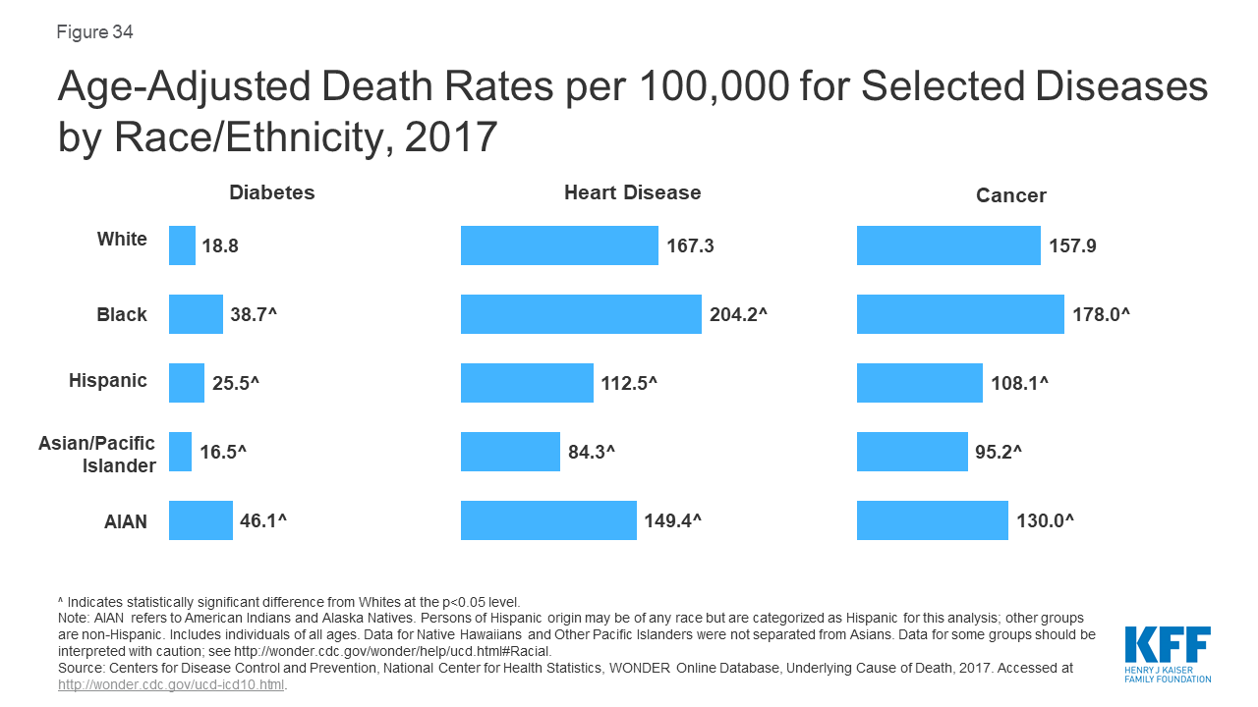

Slide 3
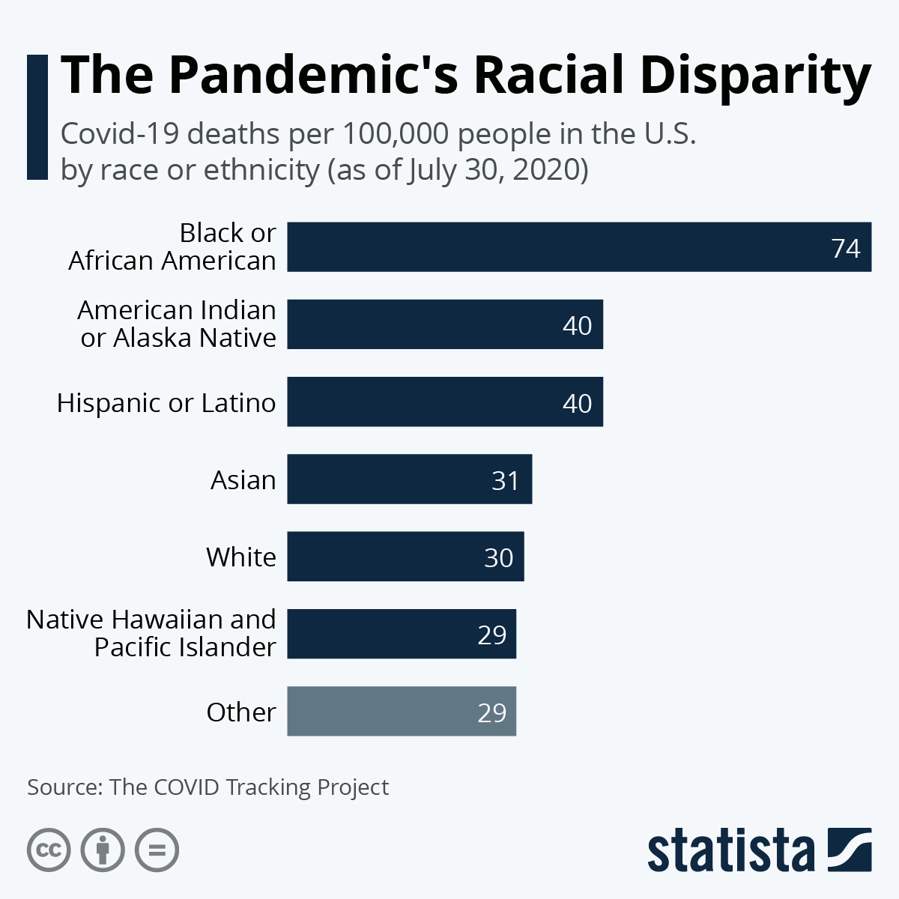

Slide 4
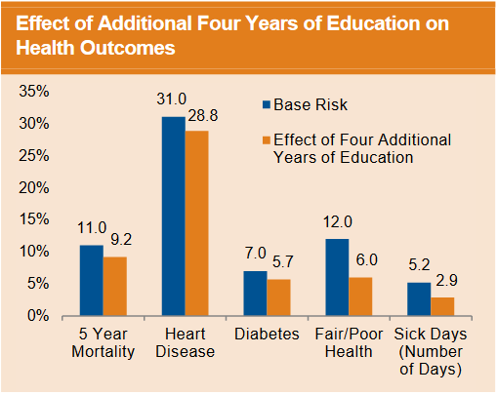
Source: National Poverty Center. Education and Health. Policy Brief. March 2007

Slide 5
Why is it important to think about race/ethnicity and SES in research?
Health inequities are omnipresent
Patterning of health along sociodemographic characteristics has implications for all research
  Implications for methods and interpretation
  Potential for research to exacerbate inequality
Research designed to describe, understand, and ameliorate differences in health outcomes can advance health equity

Slide 6
Chronic Disease Epidemiology
Diabetes
Behavioral/
Clinical Factors
Environmental Factors
Genetic Factors
Kurian, Ethn Dis, 2007

Slide 7
Black Box Epi Applied To HIV
We know HIV causes AIDs
“Simple” behavioral solution
Why does safe sex messaging not solve the problem?
  HIV/sexual risk occurs in a social and cultural context
  Need to understand and address context to move the needle

Slide 8
Theory of Fundamental Causes
SES is a fundamental cause of poor health:
  Regardless of disease or context, high SES individuals and groups can flexibly deploy resources to avoid risks and mitigate effects of poor health
Resources include:
  Money
  Power
  Knowledge
  Prestige
  Social connections

Slide 9
Race as a Fundamental Cause
Initially, theory of fundamental causes focused only on SES
Racial/ethnic disparities considered as collinear with SES
Paper by Link and Phelan in 2015 argued for race/ethnicity as a fundamental cause:
  Predictive of SES
  Independently through racism

Slide 10
Implications of Theory of Fundamental Causes
Importance of intervening on “upstream” forces that produce and maintain inequities
Interventions done without attention to equity will invariably worsen inequity, as those with “flexible resources” will disproportionately benefit
  e.g. Statins, new cancer therapies, CRISPR

Slide 11
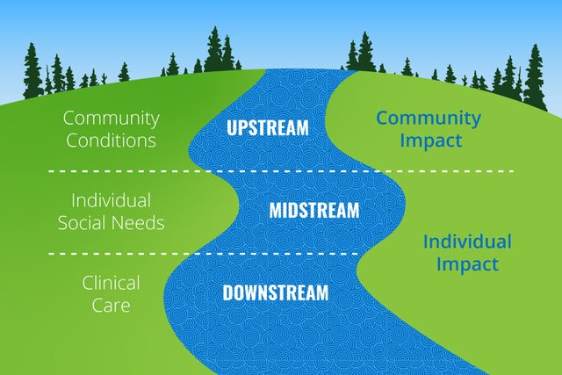

Slide 12
The Socio-Ecological Model
Structural factors:
Racism
Economic inequality
shape this model of health & disease
Economic & Social
Opportunities and Resources
Living & Working Conditions
in Homes and Communities
Behaviors
Medical Care
Interaction with genetic/other biological factors
HEALTH
Adapted from Braveman et al., for RWJ Foundation
Commission to Build a Healthier America | www.commissiononhealth.org

Slide 13
Race in Clinical and Translational Research
Social construct?
Biological construct?

Slide 14
Measurement of Race
Social construct
Biological construct

Slide 15
But Aren’t There Genetic Differences?
Genetic mapping studies have suggested that genetic variation, although minimal, can be used as marker of “ancestry”
However, ancestry does not consistently correlate with self-identified race/ethnicity

Slide 16
How is Ancestry Useful?
Variations in outcomes by ancestry can contribute to discovery science
Some polymorphisms related to ancestry may have relevance to health disparities (e.g. asthma)
Much work to be done to make use of ancestry more precise and informative
Need to recognize that study of ancestry is complicated by confounding by social factors

Slide 17
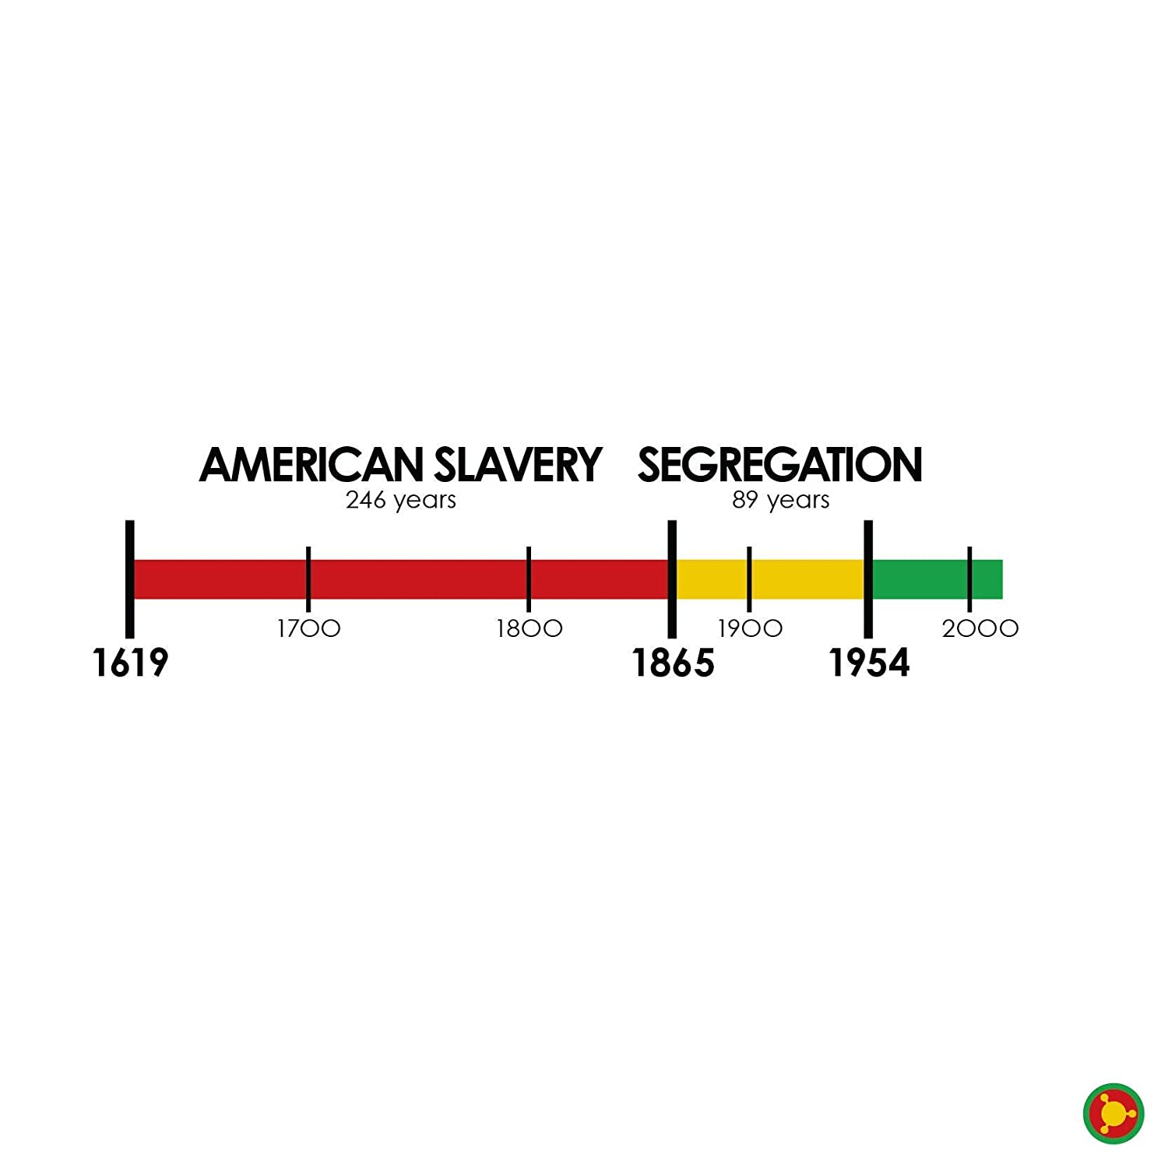
Racism in America:
A Historical Perspective

Slide 18
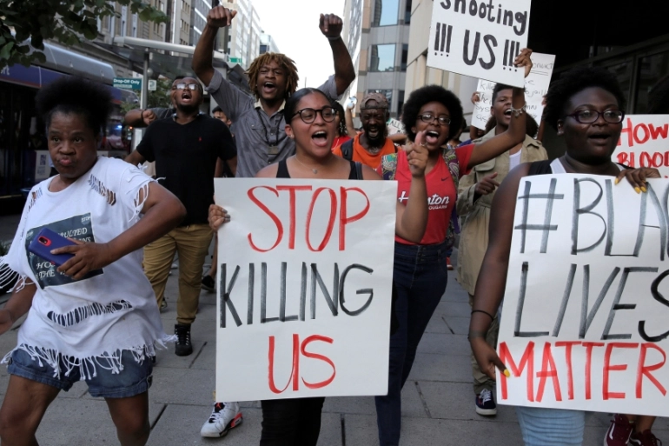
Racism ≠ Race
Racial disparities persist at every level of SES. According to social stress theory, racism is adversely related to a broad range of physical and mental health outcomes.
Racial disparities, and often the diseases themselves, stem in part from the stress of being silenced, ignored, oppressed, and targeted for violence.

Slide 19
WHAT are the Social Determinants of Health?

Slide 20
Fundamental causes
racism
socioeconomic status (SES)

Slide 21
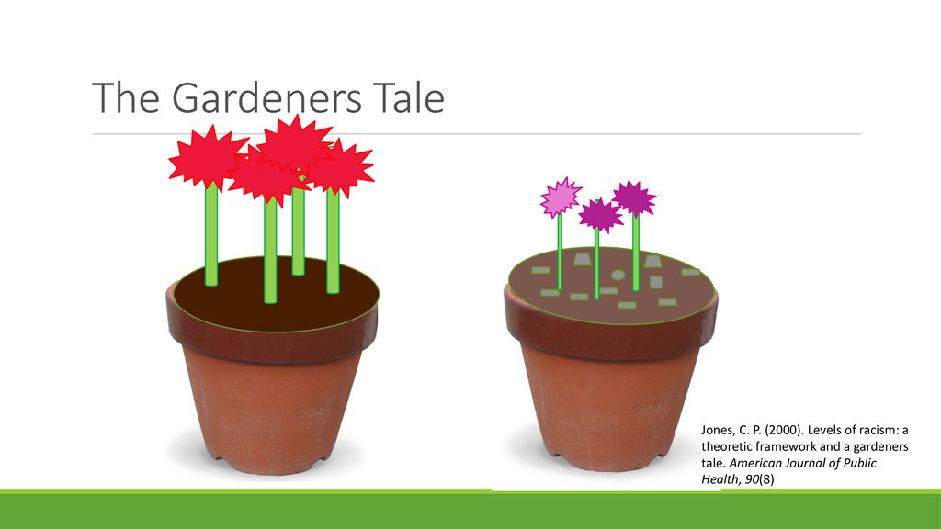

Slide 22
Racism as a Fundamental Cause
Dimensions of Racism
  Structural/institutional
    E.g. redlining, segregation, mass incarceration, police violence
  Personally mediated
  Internalized
Dimensions are interrelated and reinforcing
Operate intergenerationally

Slide 23
Socioeconomic position/status
Socioeconomic position/status
“… the social and economic factors that influence what positions individuals or groups hold within the structure of a society”
“… the social and economic factors that influence what positions individuals or groups hold within the structure of a society”
Galobardes et al 2006
SES and health
Multidimensional, multilevel construct
Life course perspective
Multiple causal pathways
  Independent and joint associations across levels
  Interacts with other social status measures (race/ethnicity)

Slide 24
Measures of SES
Education
  years of formal education completed
  ordinal categories
Income
  annual household and factor number of dependents
Occupation
  laborer, technical, professional, business
  manual/non-manual
Neighborhood SES
  % poverty, composite indices

Slide 25
Additional SES Measures
Wealth
  Assets
  Debt
  Ownership (home, car)
Childhood SES
  Parental occupation and education
  Household income, wealth
Self-perceived ‘standing’ on a ladder ranging from 1 to 10

Slide 26
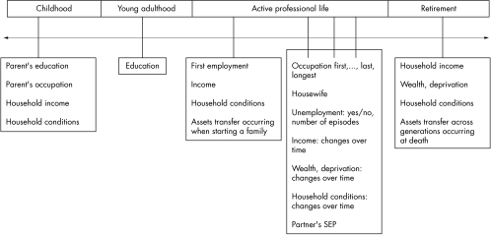
SES across the Life Course
Galobardes et al 2006
Notes:
Talk about research using cross-sectional measures, cumulative measures and then measures across the life course (more specific to research questions/outcomes)
Latency/critical period model: Exposure during sensitive window puts one at risk for development of disease later in life. Exposures encountered after the critical window closes do not influence risk. Focus on early life experiences that do not have a cumulative effect.
Example is cognitive and socioemotional development
Social trajectory model: Social disadvantage increases risk of future disadvantage later in life. The initial insult does not necessarily have a harmful effect on the outcome – but the first exposure leads to subsequent exposures that then directly cause the outcome.
Cumulative effects
Accumulation of risk model

Slide 27
Race/Ethnicity + SES as Fundamental Causes: Framework for social inequities in health
SDOH-Intermediate
Social Status
Diez Roux, Annual Review of Public Health 2012

Slide 28
The Socio-Ecological Model
Structural factors:
Racism
Economic inequality
shape this model of health & disease
Economic & Social
Opportunities and Resources
Living & Working Conditions
in Homes and Communities
Behaviors
Medical Care
Interaction with genetic/other biological factors
HEALTH
Adapted from Braveman et al., for RWJ Foundation
Commission to Build a Healthier America | www.commissiononhealth.org
Notes:
Go back and forth between these

Slide 29
Health behaviors vary by SES
In representative US sample (Lantz, JAMA 1998)
Health Behavior | < High school education | College education
Smoking | 42% | 20%
Excessive alcohol intake | 4.4% | 3.7%
Physical inactivity | 37% | 14%
Obesity | 28% | 11%

Slide 30
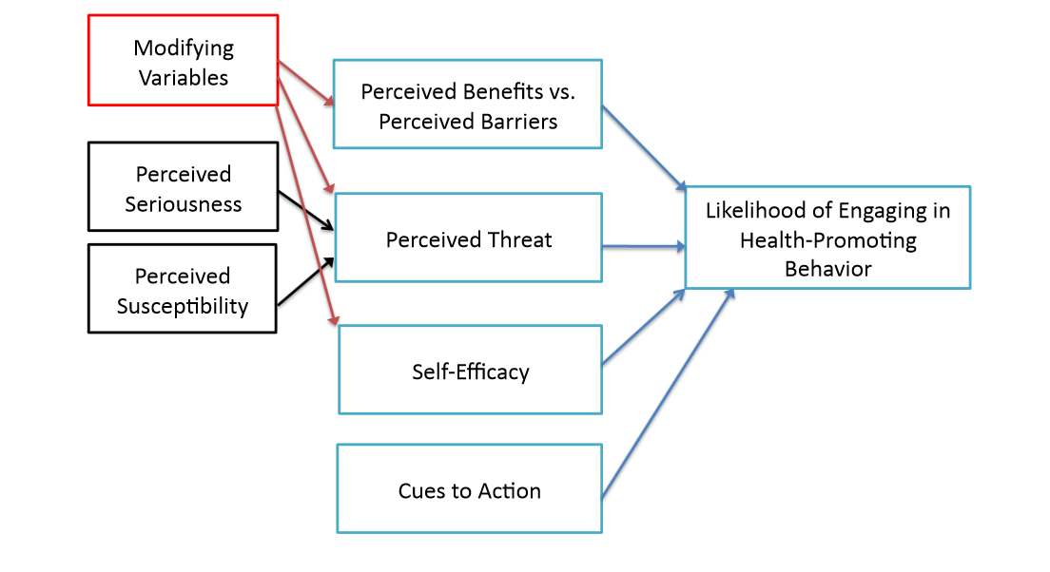
Psychological models of motivation and behavioral change
The Health Belief Model

Slide 31
Potential pathways
Sociological perspectives
Fewer benefits of health behaviors for longevity
Class distinctions
Knowledge and access to information
Efficacy and agency
(Pampel Annu Rev Sociol 2010)

Slide 32
Knowledge and access to information
Lower SES groups have less access to and opportunities for learning about harms of unhealthy behaviors
Some groups may also be exposed to more advertising
Persons with college degree 3.6 x more likely to report that they pay attention to nutritional information from scientific experts, compared to those with less than high school degree
(Pampel Annu Rev Sociol 2010)

Slide 33
Potential pathways
Contextual considerations
Access to resources: neighborhood/environmental context
Economic deprivation, financial constraints
Social and cultural norms, culturally-driven health beliefs
Stress & social support
Medical mistrust & healthcare utilization

Slide 34
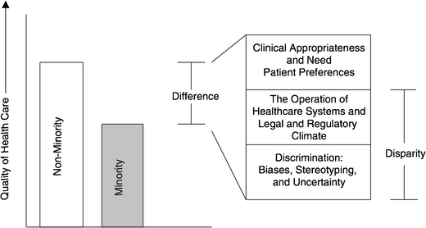
Differences, Disparities, and Discrimination: Populations with Equal Access to Health Care

Slide 35
Social factors
Health Care
Health Outcomes
Racism
Health Care

Slide 36
Summary of Causes of HCD
Health Care system:
  Segregated and inferior
  Fragmented and challenging for all
  Language barriers
  “Literacy” and “Numeracy”
Provider:
  Unconscious bias
  Statistical discrimination
So what can we do about it?

Slide 37
Interventions to Eliminate Disparities in Healthcare
Systems:
  Better systems
  Tailored support
Providers:
  Address unconscious bias
  Change the provider workforce
Bring together clinical care and public health

Slide 38
Toxic exposures, developmental, stress, etc.
Epigenetic modification/
neurocognitive, etc.
Economic & Social
Opportunities and Resources
Living & Working Conditions
in Homes and Communities
Behaviors
Medical Care
Interaction with genetic/other biological factors
HEALTH
Adapted from Braveman et al., for Robert Wood Johnson Foundation Commission to Build a Healthier America | www.commissiononhealth.org

Slide 39
Takeaway Points about Embodiment
Different mechanisms, including:
  Epigenetics
  Allostatic load
  Cognitive development
  Toxic exposures
Existence of critical periods
Can be multigenerational
  Need to avoid assumptions about immutability
Even in cases where genetic differences are identified, social factors still underlie most disparities

