Slide 1
Is MDMA-assisted therapy for severe, chronic, treatment-resistant PTSD, cost-effective?
DCEA (EPI 213) - UCSF
February 11, 2021
Elliot Marseille, DrPH, MPP
Health Strategies International

Slide 3
What’s the difference between
‘Cost-effective’ and ‘Cost-saving’?
Cost-saving = For society as a whole or for relevant payers such as health insurers, reduced future medical costs exceed intervention cost.
Cost-effective = Good value for $$ relative to other feasible options.
If it’s cost-saving, it’s cost-effective.
Not everything that’s cost-effective is cost-saving.

Slide 4
With that as background, the answer is . . .
“YES”
MDMA-assisted therapy (MAT) as provided to the types of patients served in the P2 trials appears to be cost-saving – thus, highly cost-effective.
Third-party payers are likely to save $ by including MAT as a benefit.
These conclusions hold true across a wide range of plausible assumptions.

Slide 6
Cost-effective, compared to what?
For most clinical trials, it is best to compare costs and health outcomes for the intervention arm with those of the control arm.

Slide 7
Why not use this comparison?
~22 point drop in mean CAPS score = Benefit due to MDMA alone.
(Mithoefer, 2019)

Slide 8
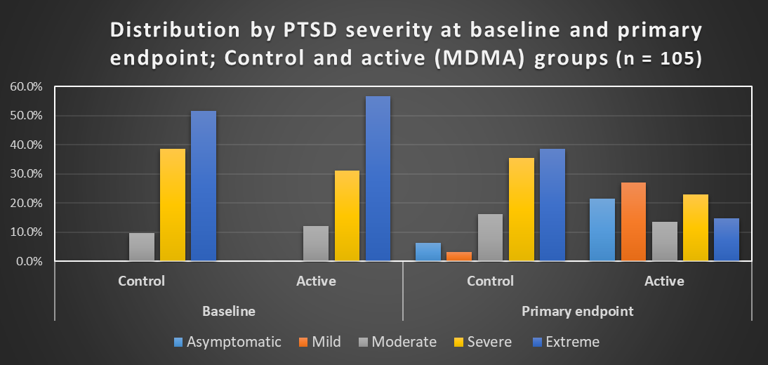
These patients have had a PTSD diagnosis for an average of 18 years, failed 2+ attempts at conventional therapy, and are severely or extremely affected by PTSD.
Notes:
DROP?

Slide 9
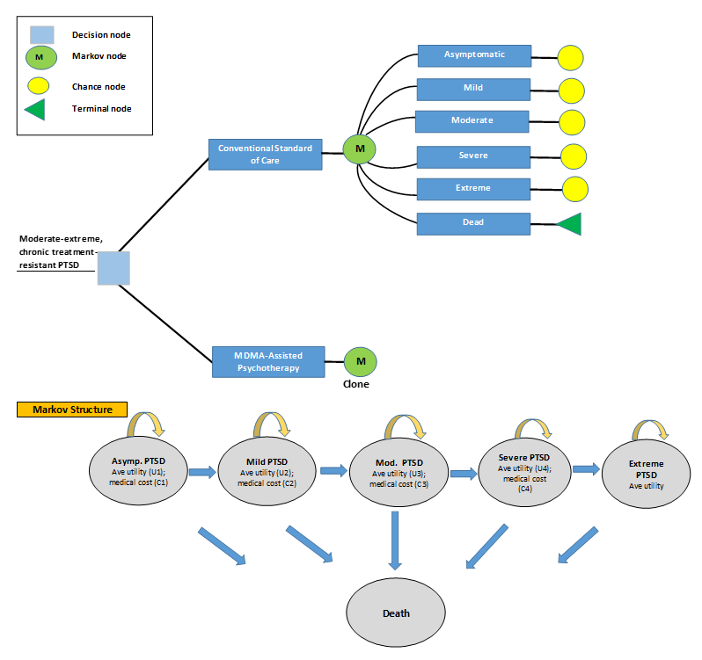

Slide 10
Major features of cost-effectiveness model
Markov disease-state transition model.
  Patients partitioned into 5 standard severity categories by CAPS score.
  Costs and health states accounted for as pts progress to more severe disease states.
  No further remission after trial
  Cohort of 1000 patients
Mortality = Background age-specific mortality x RR of death associated with each PTSD severity level.
Assumes no disease progression for first 4 years following MAT.
Can adjust for rate of reduction in medical care costs as patients move to lower levels of severity following MAT.
Allows for variation in analytic horizon.
Implemented in Excel and @RISK software for sensitivity analysis.

Slide 11
Key Inputs: Base-case values, ranges and data sources

Slide 13
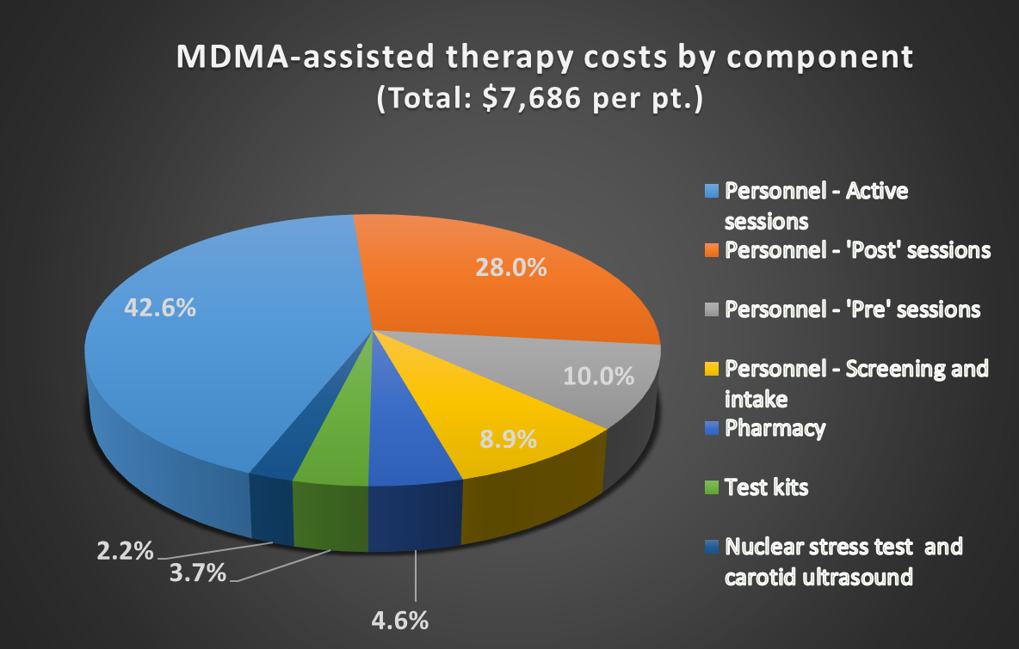
Personnel accounts for ~90% of the total
MDMA is ~5% of total cost at $1.41 / mg. and 125 mg / session)

Slide 14
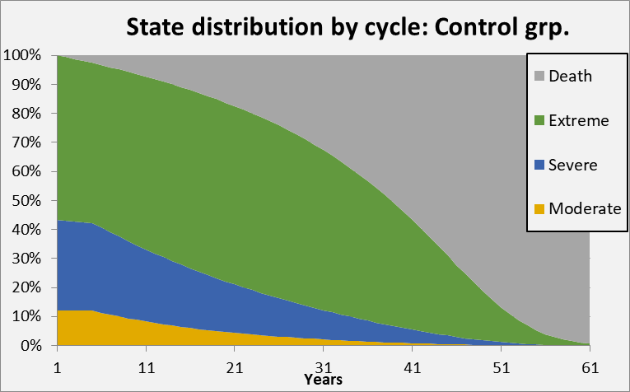
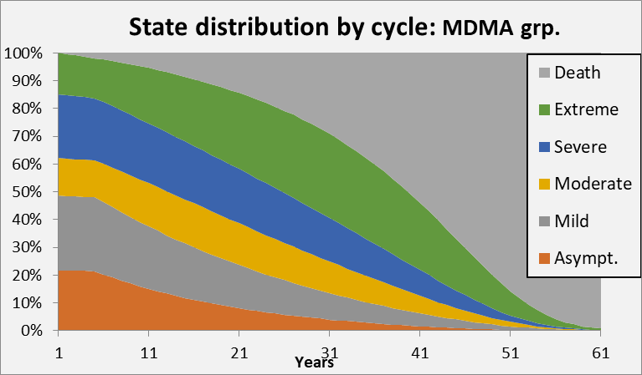
Life-time health-state trajectory from end of trial: MDMA group versus Control.

Slide 15
Summary of cost and cost-effectiveness outcomes
‘Break-even’ is ~ 3.5 years
after MAT.
At that point the net discounted cost is zero while still delivering about 1,000 QALYs.

Slide 16
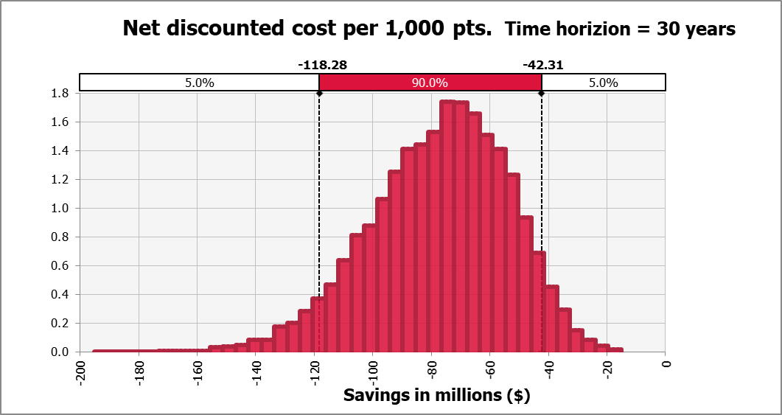

Slide 17
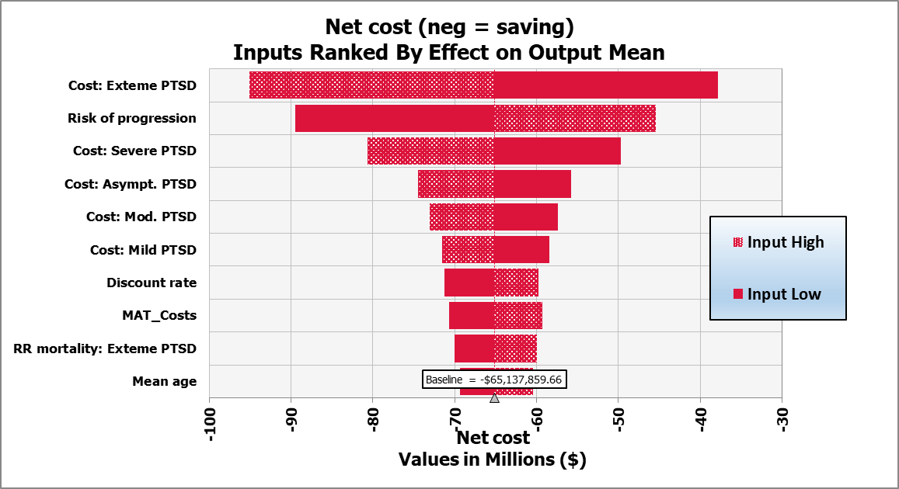

Slide 18
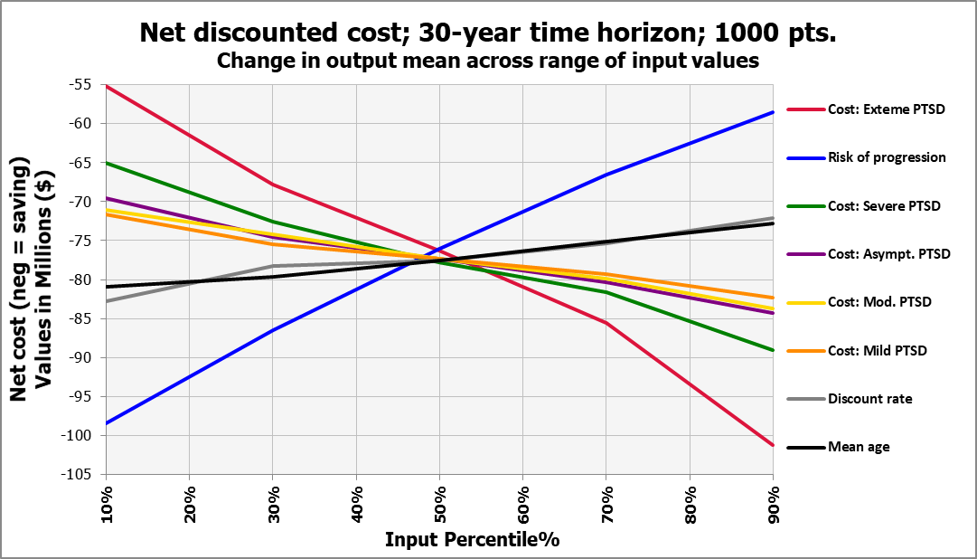

Slide 19
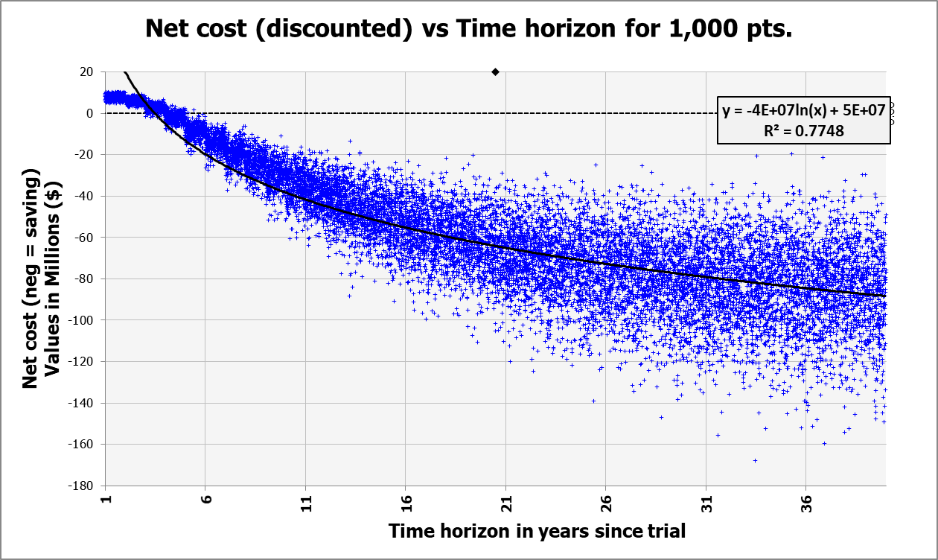
Notes:
Do this for QALYs too?

Slide 20
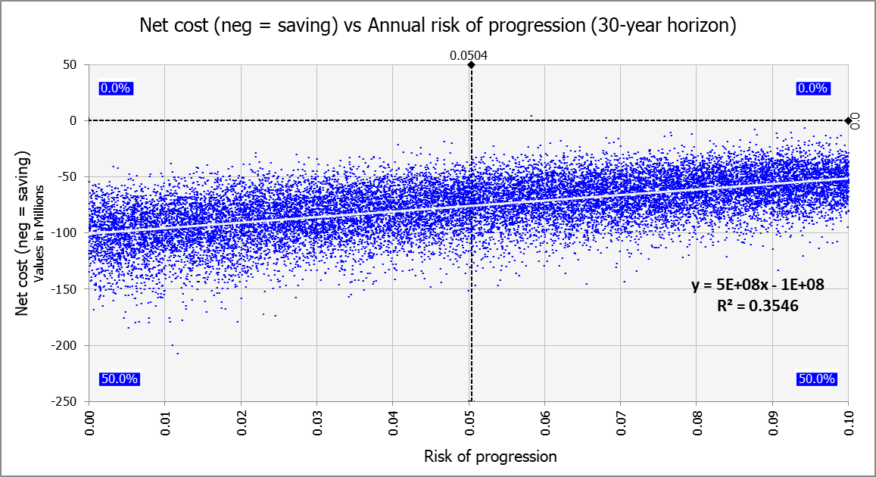

Slide 21
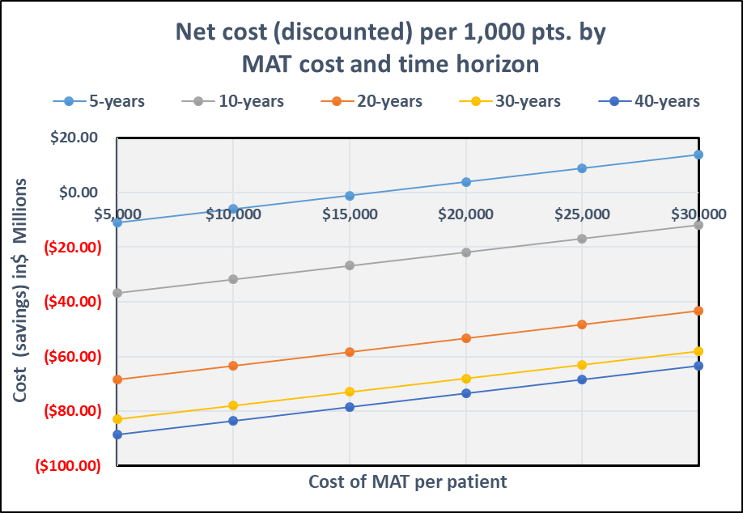
Base - case $7,686
Break - even $16,125
$10,265 per QALY gained;
$150,000 per QALY = rough rule of thumb for acceptable CE in USA

Slide 22
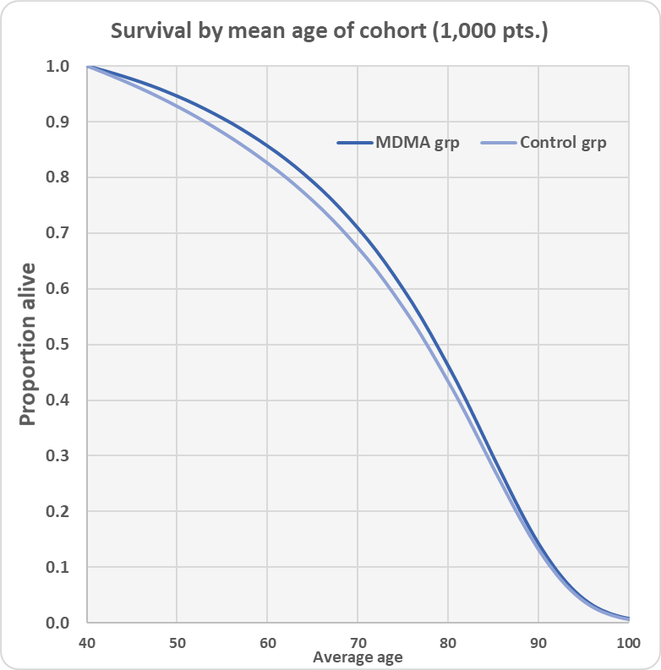
34.8 premature deaths averted

Slide 23
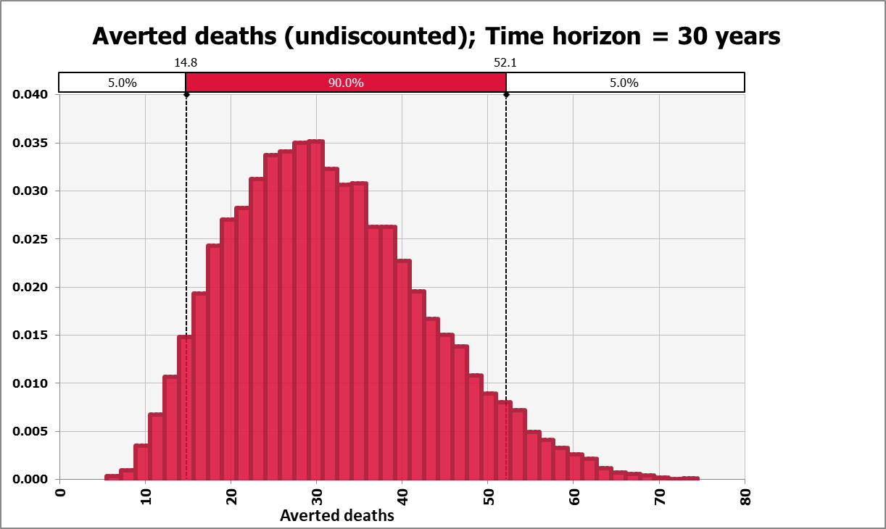

Slide 24
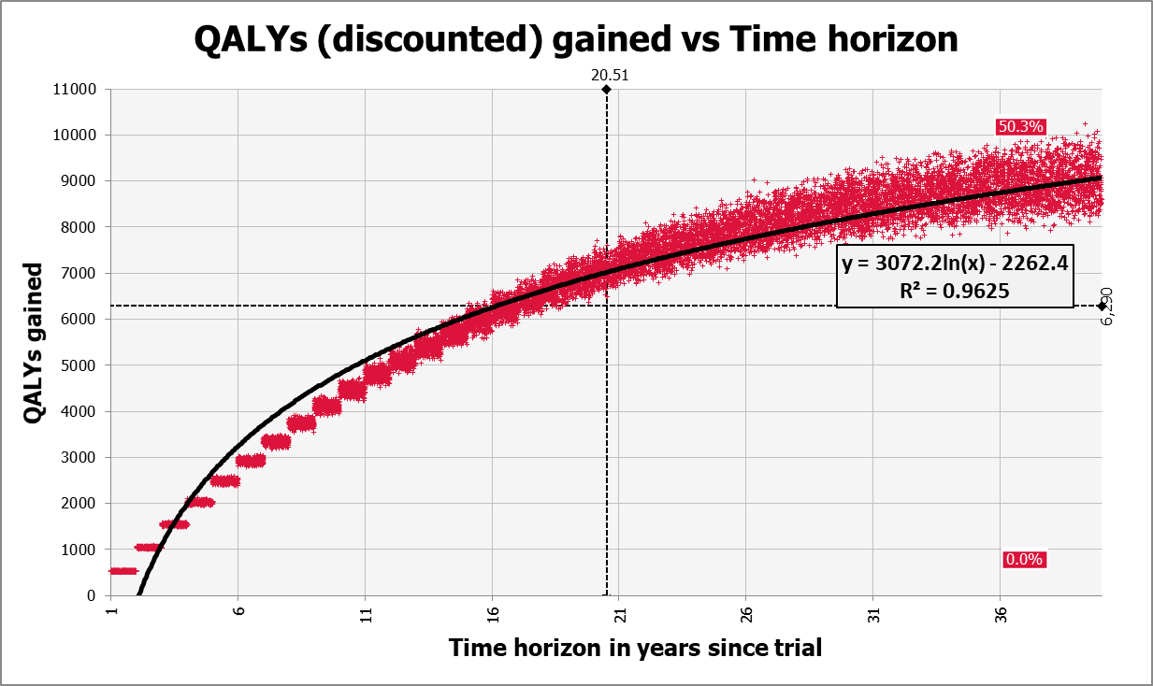

Slide 25
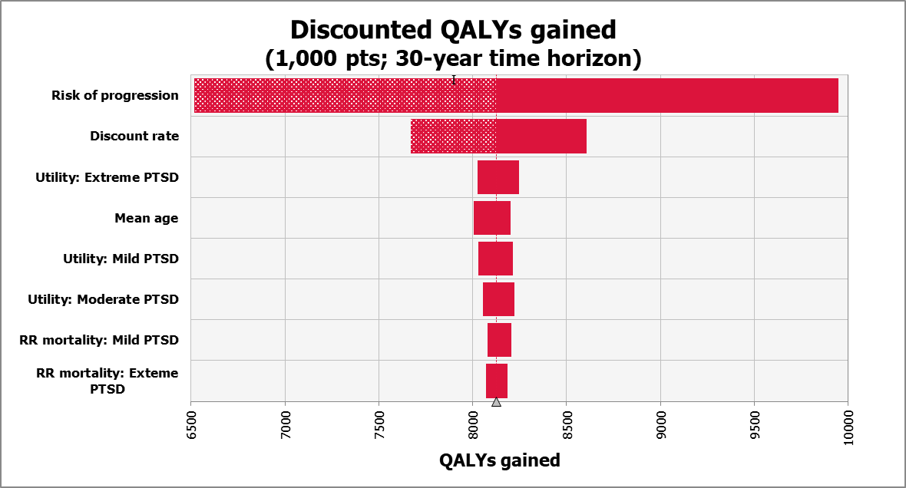

Slide 26
Putting these findings in context
MAT is cost- saving from a payer’s perspective, for patients with clinical profiles like those in the P2 trials.
This holds for a wide range of plausible input values even after building conservative assumptions into the model.
From a societal perspective it is even more favorable, since many benefits are excluded from this analysis:
  QALYs accruing to family members
  Lower disability payments
  Increased productivity
  Reduced substance abuse
  Less involvement with criminal justice system.
These results can help MAPS and others make the case that accelerated access to MDMA-Assisted Therapy makes sense – in both human and economic terms.

Slide 27
Next steps
Apply model to Phase 3 results
Working on similar analysis pf psilocybin for major depressive disorder – Usona Institute.
Model can be adapted for other medications, populations and psychiatric indications.

