Slide 1
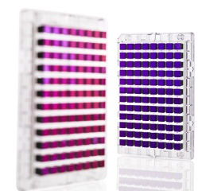

Genome-wide association studies (GWAS) – still continued!

Slide 2
Outline for GWAS
Imputation
Following up on hits
eQTLs & Transcriptome-wide association studies (TWAS)
Limitations, heritability, and “missing heritability”, Polygenic risk scores

Slide 3
Beyond Genotyped SNPs:
Imputation of SNP Genotypes
Combine data from different platforms (e.g., Affy & Illumina) (for replication / meta-analysis).
Estimate unmeasured or missing genotypes.
Based on measured SNPs and external info (e.g., haplotype structure of HapMap).
Increase GWAS power (impute and analyze all), e.g. Sick sinus syndrome, most significant was 1000 Genomes imputed SNP (Holm et al., Nature Genetics, 2011)
HapMap as reference, now 1000 Genomes Project; UK10K, Haplotype reference consortium?
Hybrid sequencing/genotyping approaches

Slide 4
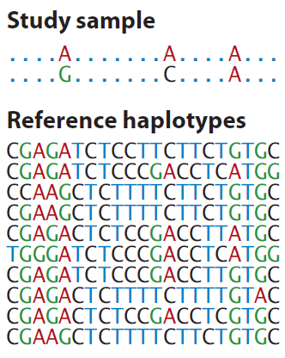
Generalization of Tag SNPs: Imputed SNPs using a Reference Panel
Generalization of pairwise r² of tagSNPs to multi-marker correlation
Class Exercise! (Groups ~3)
How would you fill in the remaining genotypes of this study sample individual, given the reference haplotypes?
http://www.shapeit.fr/, http://mathgen.stats.ox.ac.uk/impute/impute_v2.html
http://faculty.washington.edu/browning/beagle/beagle.html
http://www.sph.umich.edu/csg/abecasis/MACH/download/
Li et al., Ann Rev Human Genet, 2009

Slide 5

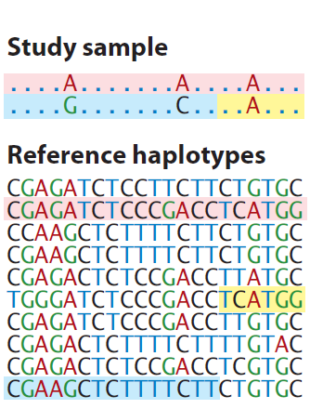
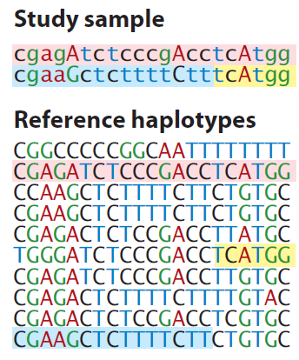
Generalization of Tag SNPs: Imputed SNPs using a Reference Panel
Generalization of pairwise r² of tagSNPs to multi-marker correlation
http://www.shapeit.fr/, http://mathgen.stats.ox.ac.uk/impute/impute_v2.html
http://faculty.washington.edu/browning/beagle/beagle.html
http://www.sph.umich.edu/csg/abecasis/MACH/download/
Li et al., Ann Rev Human Genet, 2009

Slide 6
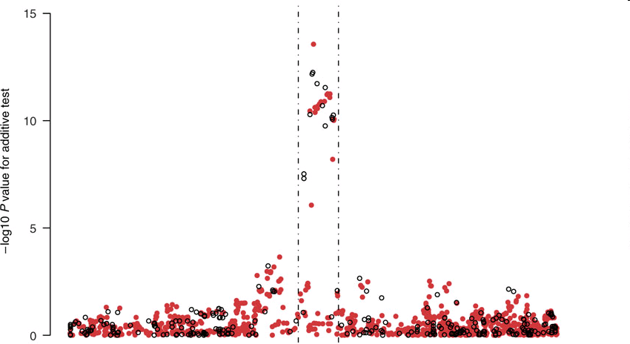
Imputation Application
TCF7L2 gene region & T2D from the WTCCC data
Observed genotypes black
Imputed genotypes red.
Imputed SNP more significant than typed SNP!
Chromosomal Position
Marchini Nature Genetics2007
http://www.stats.ox.ac.uk/~marchini/#software
Notes:
6

Slide 7
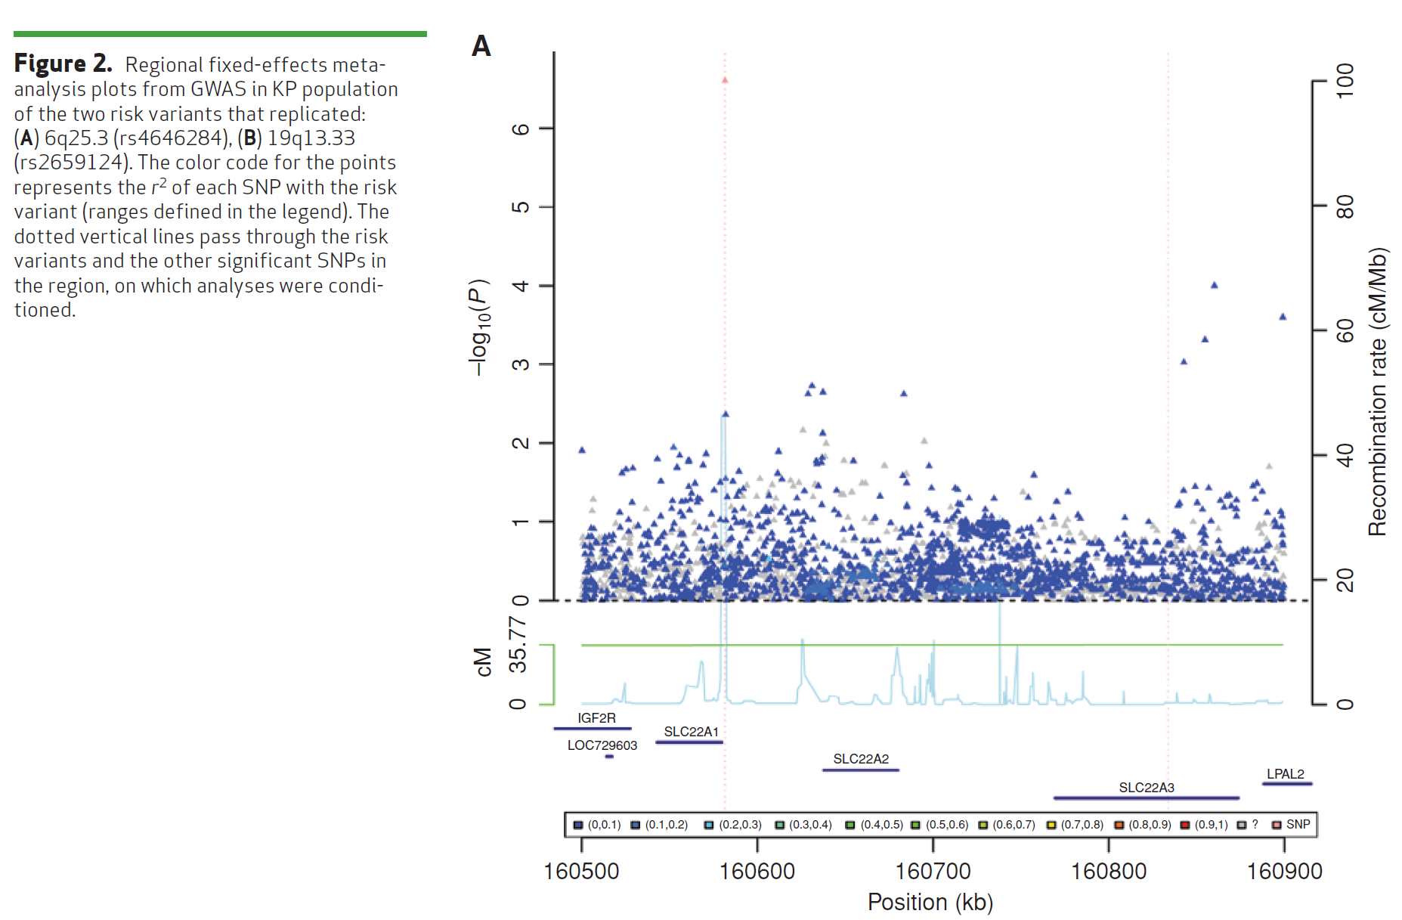
Imputation Application #2 – Do not always see a jet of points, even for common SNP…
(Same SNP as 4 slides ago)
Hoffmann et. Al, Cancer Discovery 2015`

Slide 8
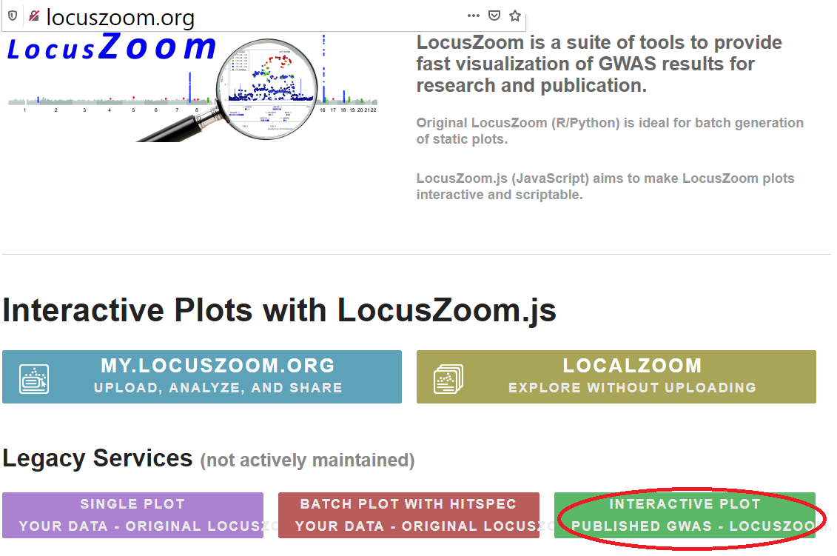
LocusZoom plot: LDL, rs6544713
You did this in your homework, some instructions are in previous slides…

Slide 9
Outline for GWAS
Imputation
Following up on hits
eQTLs & Transcriptome-wide association studies (TWAS)
Limitations, heritability, and “missing heritability”, Polygenic risk scores

Slide 10

What after we’ve discovered (and replicated) a novel variant?
Recall that we may not have the true causal locus
Fine mapping vs. imputed genotypes…
Tie-in to biology
A lot of work has been done to characterize SNPs and prioritize what should be followed up on
Functional studies

Slide 11
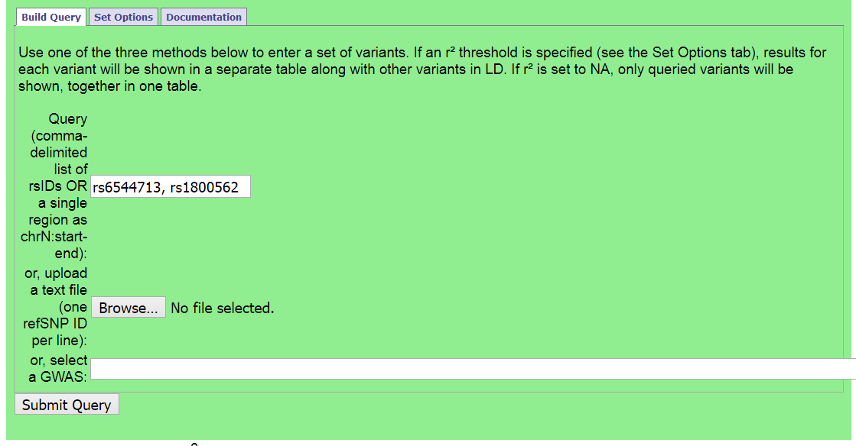
Refining GWAS SNPs: Haploreg
http://archive.broadinstitute.org/mammals/haploreg/haploreg.php

Slide 12
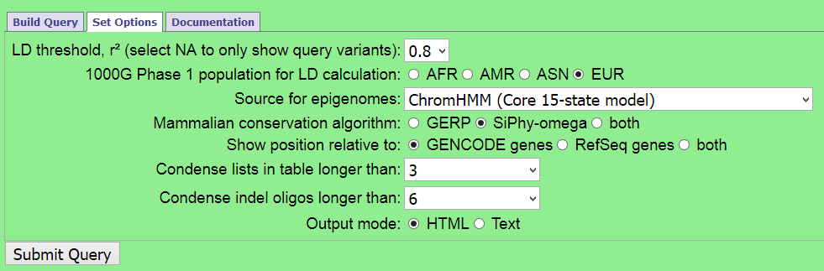
Haploreg further options
(r², 1000 Genomes population)

Slide 13
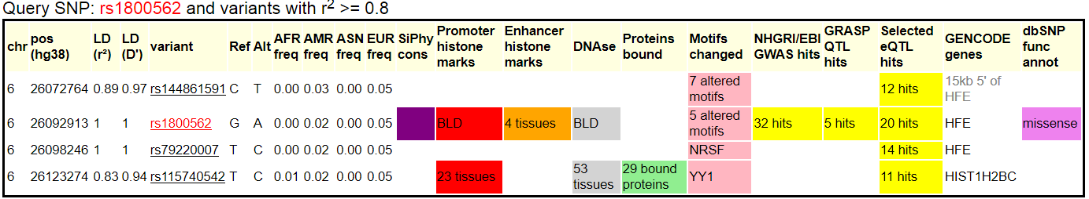
Which one is causal / biological mechanism?
(Talk about eQTLs later today)
Don’t know for certain, can do some exploration:
Likely will not know for certain, may prioritize for functional work

Slide 14
Which one is causal / biological mechanism?
(Talk about eQTLs later today)
Don’t know for certain, can do some exploration:
Likely will not know for certain, may prioritize for functional work
Maybe?

Slide 15
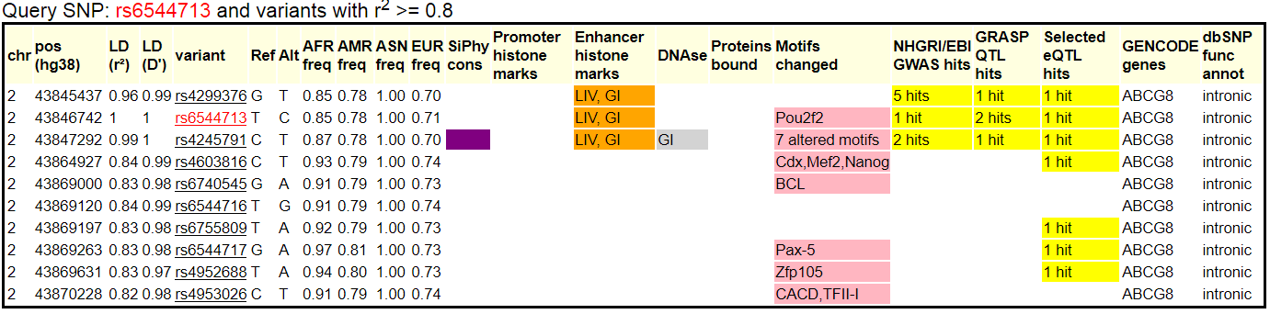
Which one is causal / biological mechanism?
?
For later… note that multiple variants are an eQTL…

Slide 16
Outline for GWAS
Imputation
Following up on hits
eQTLs & Transcriptome-wide association studies (TWAS)
Limitations, heritability, and “missing heritability”, Polygenic risk scores

Slide 17
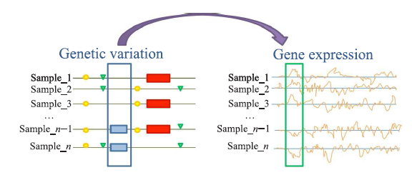
What is an eQTL?
Tian Lu et al., Tsinghua Science and Technology, 2014, 19(6): 624-634.

Slide 18
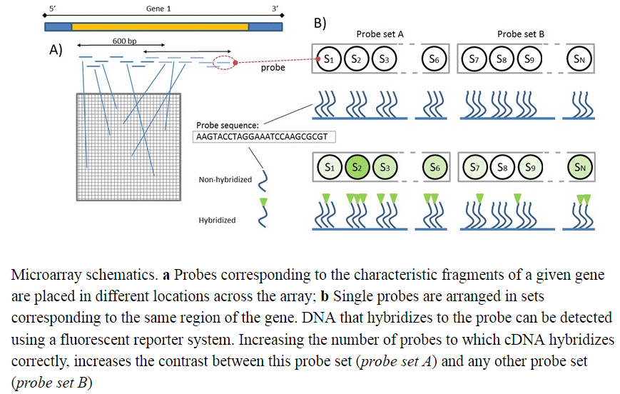
Measuring the expression of a gene
Note: by tissue
  Reverse-transcribe RNA (cDNA, complementary DNA), then
  Microarray
    Multiple fixed probesets
  RNA Seq
    More expensive but…
    Better dynamic range
    Better at picking up low expression
A lot of QC, not enough time to cover
Jaksik et al. Microarray experiments and factors wihich affect their reliability.

Slide 19
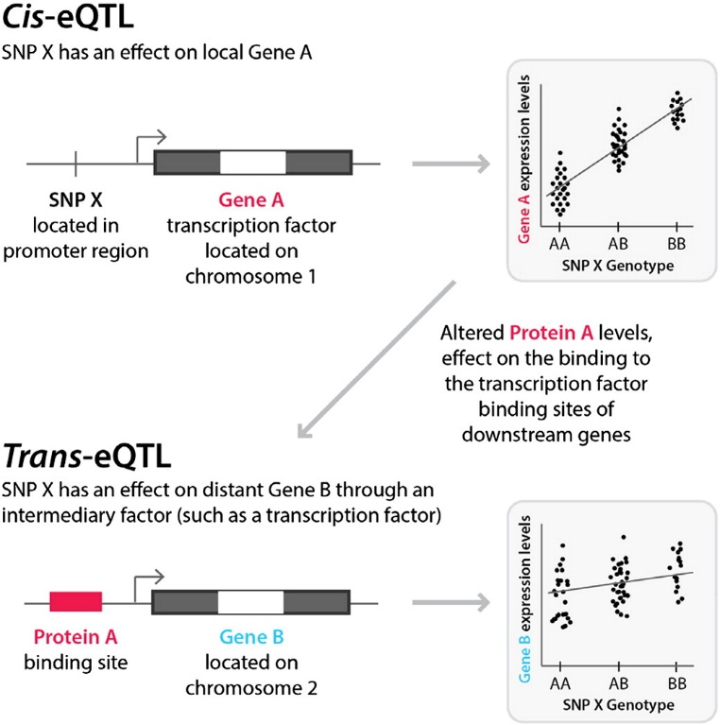
What is an eQTL?
Harm-Jan Westra & Lude Franke, Bichimica et Biophysica Acta – Molecular Basis of Disease 1842(10):1892-1902

Slide 20
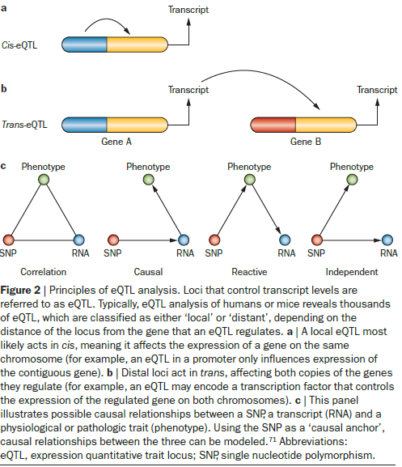
What is an eQTL?
E.g. of cis-eQTL – transcription factor
W. Robb MacLellan et al, Nature Reviews Cardiology, 9:172-184

Slide 21
What is an eQTL?
CLASS EXERCISE
Design an eQTL study!
(Assume that the expression of each gene has been quantified. Or sort of. This is expensive.)
Harm-Jan Westra & Lude Franke, Bichimica et Biophysica Acta – Molecular Basis of Disease 1842(10):1892-1902

Slide 22
What is an eQTL?
CLASS EXERCISE
Design an eQTL study!
(Assume that the expression of each gene has been quantified. Or sort of. This is expensive.)
What kind of genotyping method? LD?
Advantages / Disadvantages to testing only cis, only trans, both? How many tests?
How far up/downstream of each gene?
Harm-Jan Westra & Lude Franke, Bichimica et Biophysica Acta – Molecular Basis of Disease 1842(10):1892-1902

Slide 23
What is an eQTL?
The expression of a gene can be viewed as a quantitative trait.
Test the SNPs around the gene for association with the expression of the gene.
Does the SNP affect expression?
The same problem still applies, don’t know causal locus!
Might differentiate between which gene is being expressed, if between or amongst more than one.

Slide 24
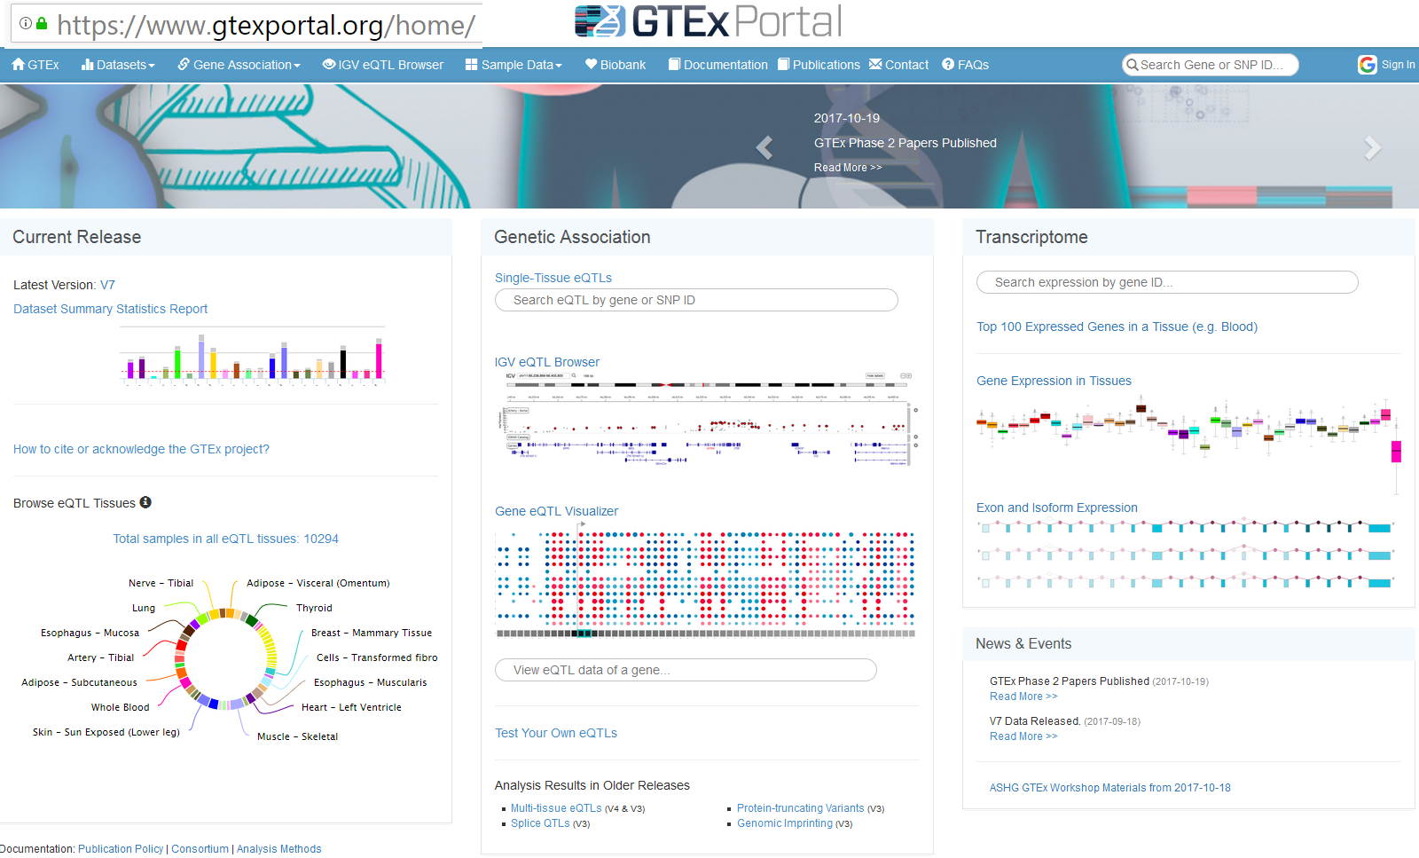
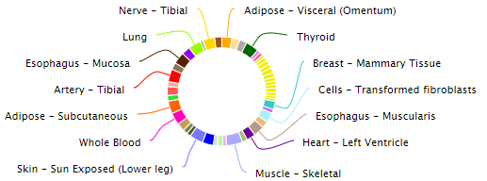
cis eQTLs: GTeX
Database of SNP associations with gene expression in humans

Slide 25
Transcriptome-Wide Association Studies (TWAS)
We have used reference panel sequence data to fill in missing genotypes.
We have talked about eQTLs, testing for correlation between SNPs and the genotype expression
  But what about predicting/imputing what the expression data was based on the genotypes?
    And then test that for correlation with the trait instead?
    Guided gene-based test, if you will

Slide 26
Class Exercise!: Express yourself (or at least someone else)!
SNP 1
SNP 2
SNP 3
SNP 4
SNP 5
Expression
Reference population
How is this similar/different to genotype imputation?
Person
Ref-001
Ref-002
Ref-003
Ref-004
Ref-005
AA AA TT TT TT 0.98
AA AA TC TG TG 0.90
GG GG TC TG TG 0.10
GG GG CC TT TG 0.12
GG GG CC TT GG 0.05
SNP 1
SNP 2
SNP 3
SNP 4
SNP 5
Expression
Target population
Person
Target-001
Target-002
AA AA TT TT TT ?
GG GC CC CC GG ?

Slide 27
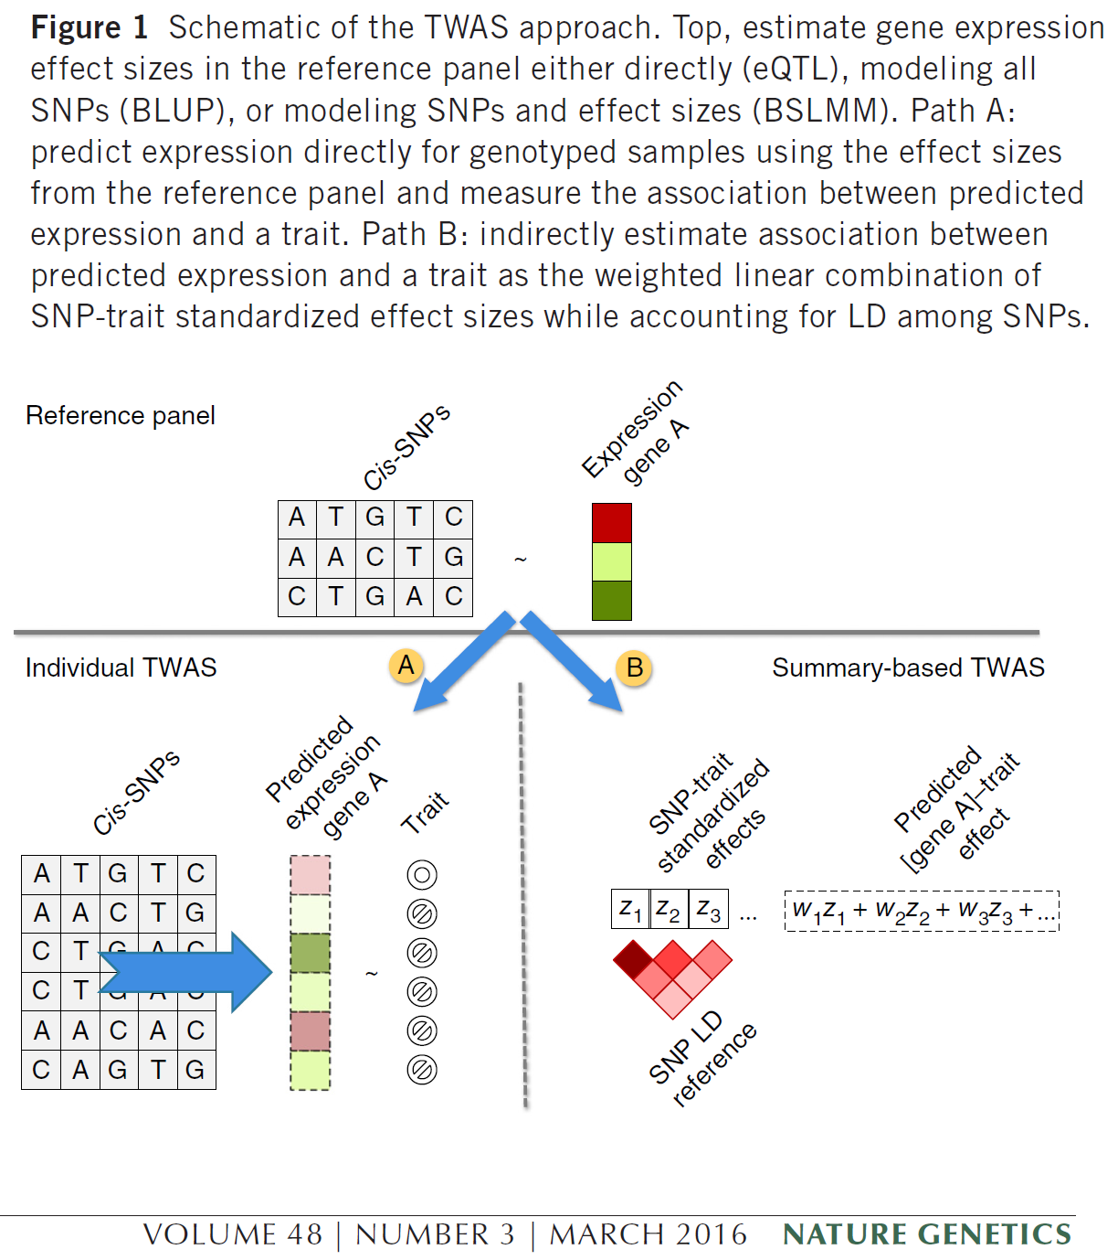
TWAS – cis expression
GTEx eQTL data
Model that predicts expression data using the GWAS SNPs (instead of testing for association between those SNPs and expression)
Test that expression for association with trait
Repeat for each of the 44 GTEx tissues
Software Predixcan

Slide 28
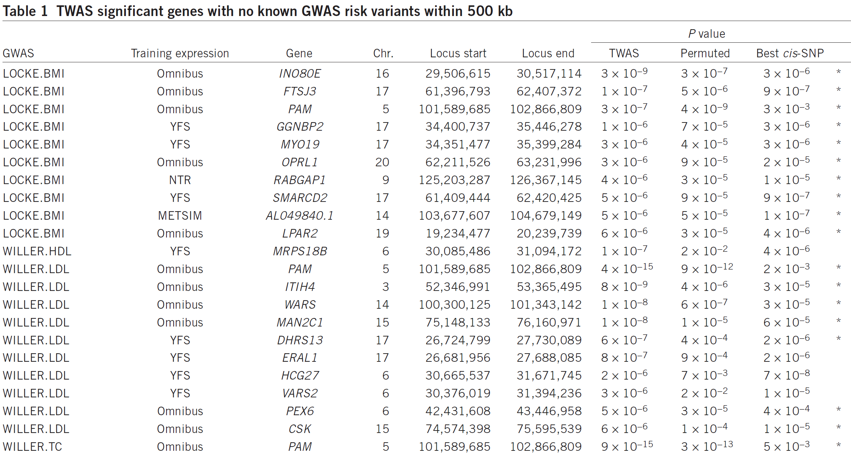
TWAS results

Slide 29
Outline for GWAS
Imputation
Following up on hits
eQTLs & Transcriptome-wide association studies (TWAS)
Limitations, heritability, and “missing heritability”, Polygenic risk scores

Slide 30
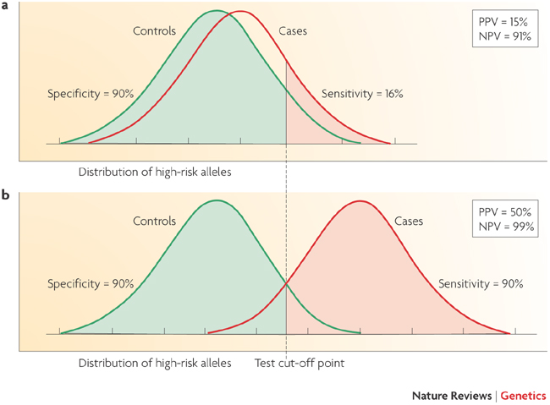
Limitations of GWAS
Example:
AUC for Breast Cancer Risk
58%: Gail model (# first degree relatives w bc, age menarche, age first live birth, number of previous biopsies) + age, study, entry year
58.9%: SNPs
61.8%: Combined
Wacholder et al., NEJM 2010
Not very predictive
Witte, Nat Rev Genet 2009
Notes:
30

Slide 31
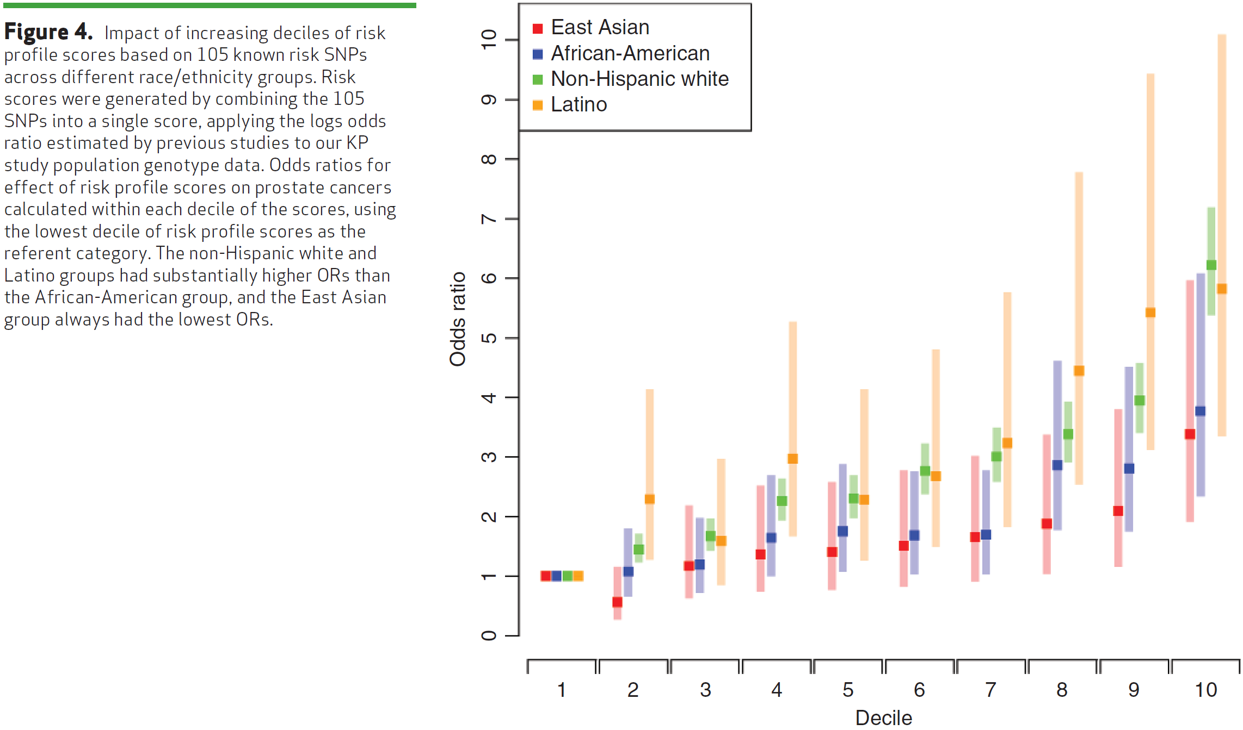
Genetic Risk Score (GRS) – Overall genetic risk; tails show more sep.?
i.e., β_{j}
GRS_{j}
Be careful of SNPs in LD… e.g., don’t want to include same SNP effectively twice if reported in two studies.
Hoffmann et. Al, Cancer Discovery 2015

Slide 32
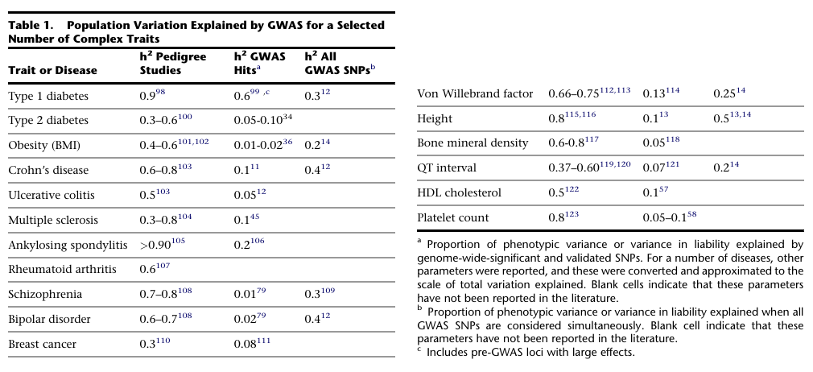
What does it mean to explain little of the heritability, and where is it?
Visccher, AJHG 2011

Slide 33
Class exercise: Where is it?
Can GWAS find more?
Are our analysis methods not creative enough?
Are we missing genetic things?

Slide 34
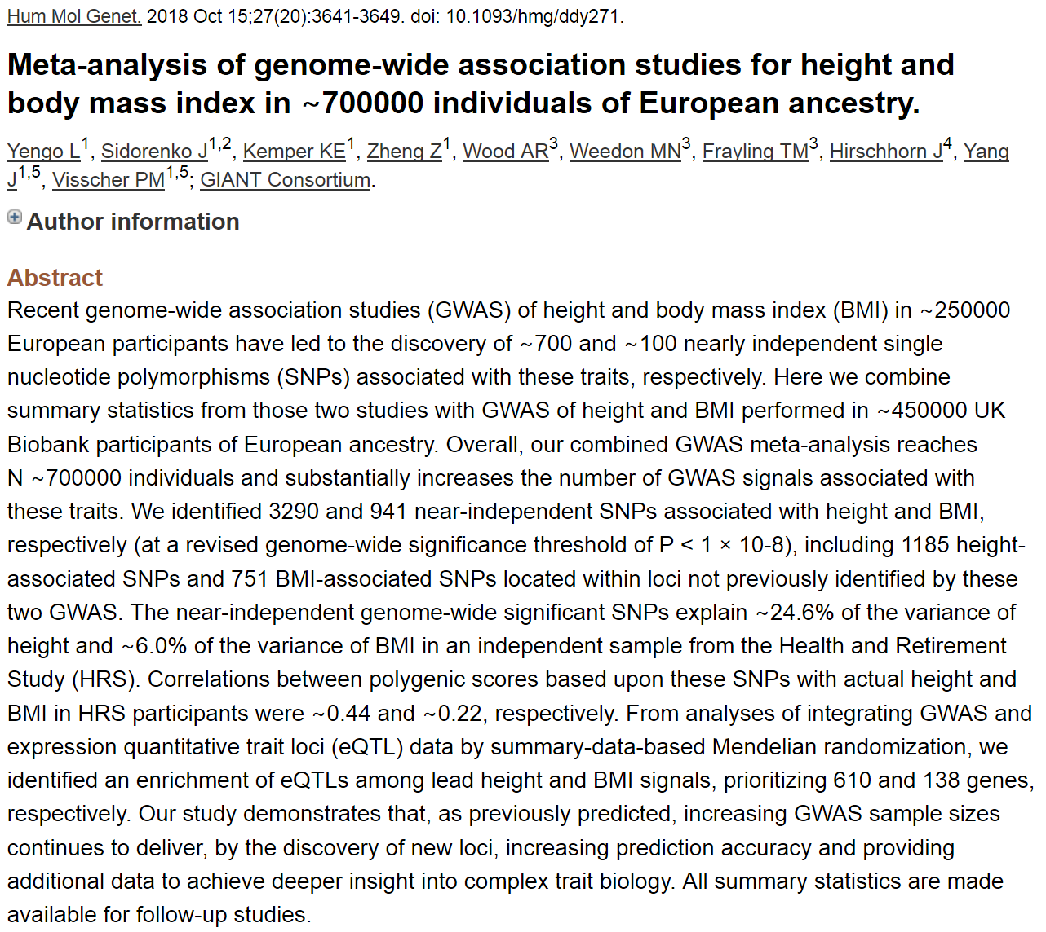
Revised height variance explained
(really not very predictive, or?)

Slide 35
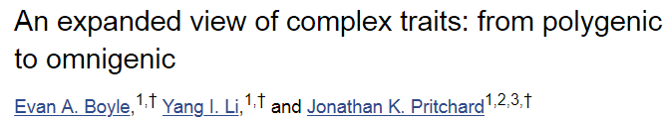
… or is it omnigenic? …
Predict 100,000 variants with some effect on height…
PRS variant that builds model based on all SNPS

Slide 36
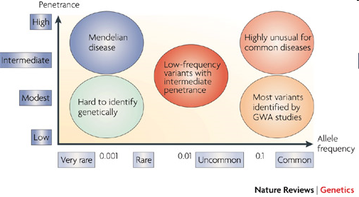
Where’s the heritability?
Common disease rare variant (CDRV) hypothesis: diseases due to
multiple rare variants with intermediate penetrances (allelic heterogeneity)
Many more
of these?
See: NEJM, April 30, 2009
McCarthy et al., 2008

Slide 37
Will GWAS results explain
more heritability?
Possibly, if…
Causal SNPs not yet detected due to power issues – weak effects
  Early GWAS designed/powered for MAF>0.05/0.10; lower MAFs for newer arrays and larger reference panels
More complicated modeling necessary, e.g. gene-gene interaction (epistasis), gene-environment interaction, etc. – later lectures
Notes:
37

Slide 38
How much is left to discover?
“Array” heritability
Compute heritability using all SNPs
  Be careful with QC, esp. case-control
If you adjust for the known hits, how much remains yet to be found?
Restricted to narrow sense heritability
E.g.,
Lecture 2:
“Broad sense”: H²=σ²_{G}/σ²_{P}=(σ²_{A} + σ²_{D})/σ²_{P}
“Narrow sense”: h² = σ²_{A} /σ²_{P}
GCTA: http://www.complextraitgenomics.com/software/gcta/
LD Score (can use summary statistics!): https://github.com/bulik/ldsc

Slide 39
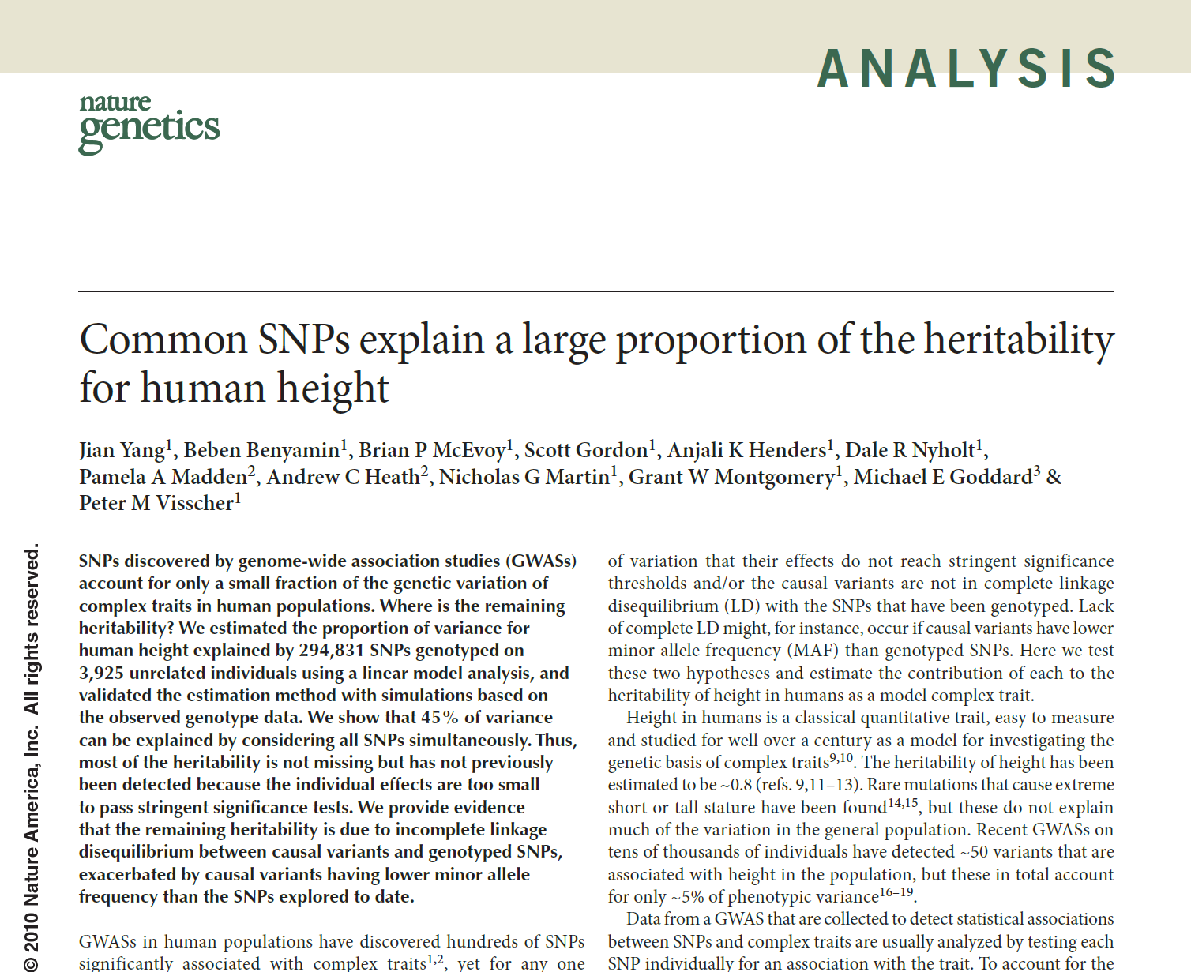

Slide 40
Other things than SNPs
Copy number variants (CNVs)
Epigenetics, e.g., methylation, histone modification
Gene expression (RNA levels) [eQTLs! we covered these]
Proteomics (measures of proteins in cells)
...

Slide 41
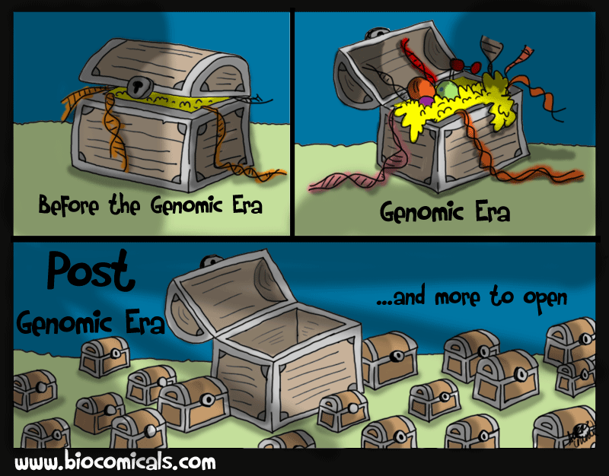
Thanks!

