Slide 1
The Effects of Social Policies on Health Disparities
Epi 222
Rita Hamad, MD, PhD
Acknowledgement: Maria Glymour

Slide 2
Big Picture:
The Socioecological Framework
Economic & social
opportunities and resources
Policies to reduce poverty, promote employment,
and reduce segregation
Policies to promote child
development, education
Conditions in
homes and communities
Policies to promote healthier homes, neighborhoods,
schools, workplaces
Behaviors
Medical care
Biology and its interaction with experiences
Health
Notes:
Determinants of health, from the proximal to the distal, and where policies can have an effect

Slide 3
Policies and Health Disparities
Reasons to research policies
Types of policies that may affect disparities
Examples of evaluating health effects of policies
  Moving to Opportunity: a randomized trial
  Regression discontinuity and related methods: hospital desegregation, educational policies
  Pseudo-randomization: juvenile judges
Distinguishing effects on average outcomes versus disparities: GI Bill
Major controversies and uncertainties
Notes:
Overview of today’s lecture

Slide 4
Policies and Health Disparities
Reasons to research policies
Types of policies that may affect disparities
Examples of evaluating health effects of policies
  Moving to Opportunity: a randomized trial
  Regression discontinuity and related methods: hospital desegregation, educational policies
  Pseudo-randomization: juvenile judges
Distinguishing effects on average outcomes versus disparities: GI Bill
Major controversies and uncertainties

Slide 5
Why Study Social Policies & Health?
Practical Reasons
Policies may be the most powerful health interventions.
Evaluating health impact of policies can inform the design and implementation of such policies.
Methodological Reasons
Policies may provide “natural experiments” to understand the origins of health disparities.
Evaluating policies as natural experiments can clarify whether social factors are causal.

Slide 6
Social Factors and Health:
Hypothesized Pathways
Employment/
Occupation
Income
Wealth
Social Networks
Knowledge
Cognitive Skills
Self-efficacy
Toxic/Dangerous
Environments
(housing, work,
Infections, lead)
Behaviors
(diet, medical care,
sex, violence)
Psychological
Experiences
(stress, shame)
Education
Disease
Onset, Progression, Consequences
Race
(& racism)

Slide 7
Pathways Affected by Healthcare
Employment/
Occupation
Income
Wealth
Social Networks
Knowledge
Cognitive Skills
Self-efficacy
Toxic/Dangerous
Environments
(housing, work,
Infections, lead)
Behaviors
(diet, medical care,
sex, violence)
Psychological
Experiences
(stress, shame)
Education
Disease
Onset, Progression, Consequences
Race
(& racism)
Notes:
Medical care is only one of very many potential pathways linking social factors with health.

Slide 8
Pathways Affected by Policies
Employment/
Occupation
Income
Wealth
Social Networks
Knowledge
Cognitive Skills
Self-efficacy
Toxic/Dangerous
Environments
(housing, work,
Infections, lead)
Behaviors
(diet, medical care,
sex, violence)
Psychological
Experiences
(stress, shame)
Education
Disease
Onset, Progression, Consequences
Race
(& racism)
Notes:
I’ve highlighted here the pathways that are most obviously affected by policies. But what about these remaining pathways? Are those outside the realm of policy impacts?

Slide 9
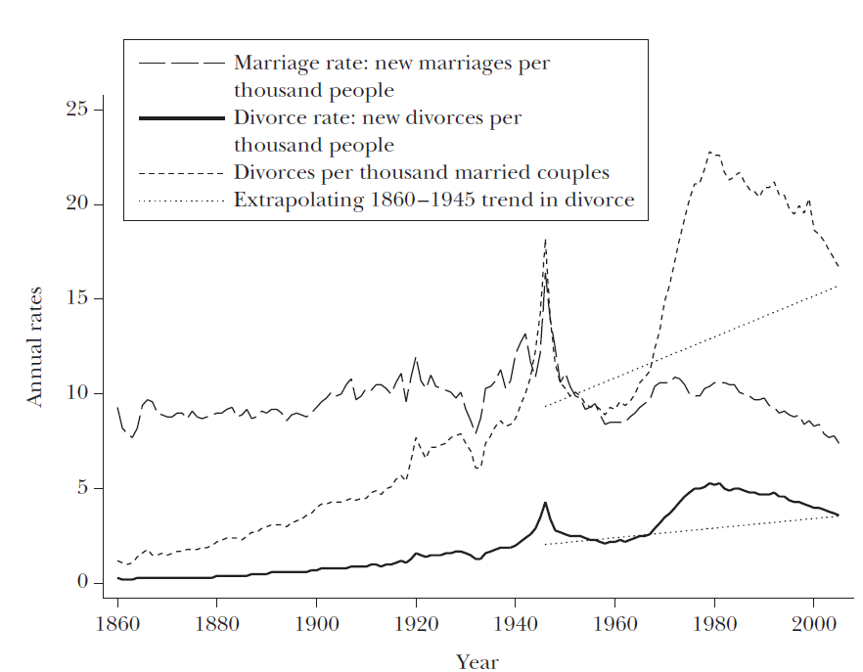
Even Very Personal Exposures are Shaped by Policies
U.S. Marriage and Divorce Rates, 1860-2005
Stevenson and Wolfers, JEP 2007
Notes:
Let’s look at one policy example. This one has to do with policy around divorce. In particular, elimination of requirement that there had to be a specific reason like adultery for divorce by states beginning in the late 1960s

Slide 10
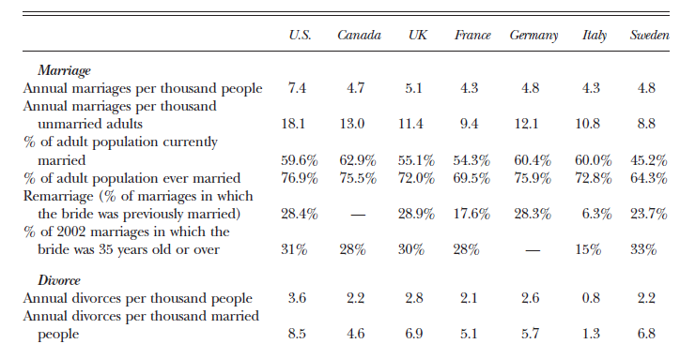
Even Very Personal Exposures are Shaped by Policies
International Marriage and Divorce Rates, 2003
Marriage/divorce rates differ by time and across countries
Interaction between social policies and social norms
Stevenson and Wolfers, JEP 2007
Notes:
Compare marriage and divorce rates across international settings, you can imagine that culture or social norms may play some role, but policies may contribute to these differences. CAN ANYONE THINK OF ANOTHER POLICY THAT MAY DRIVE MARRIAGE/DIVORCE RATES?
CT at one point had law that made contraception illegal, which resulted in a Supreme Court case brought by Griswold (head of Planned Parenthood) that defined a “right to marital privacy,” which was later extended to unmarried couples.
Another Supreme Court case overturned state laws that exempted men from paying child support for children they had out of wedlock.
Loving v Virginia allowing interracial marriage in 1967.
Tax policies that provide bigger tax breaks to married couples.

Slide 11
Even Very Personal Exposures are Shaped by Policies
Policies shape marriage, divorce, and children, which:
  Affect core social networks
  Affect marriage → household resources
  Affect fertility → labor market participation, resources
  Affect stigma → mental health
Notes:
Point here is simply that something that seems fundamentally personal and individual level – who you love, have sex with, and marry – is deeply shaped by social policies. These factors in turn shape a whole host of downstream health risk factors – health behaviors, medical access, exposures.

Slide 12
Pathways Affected by Policies
Employment/
Occupation
Income
Wealth
Social Networks
Knowledge
Cognitive Skills
Self-efficacy
Toxic/Dangerous
Environments
(housing, work,
Infections, lead)
Behaviors
(diet, medical care,
sex, violence)
Psychological
Experiences
(stress, shame)
Education
Disease
Onset, Progression, Consequences
Race
(& racism)
Notes:
So going back to this figure, I’m going to go ahead and highlight pretty much all of these pathways.

Slide 13
Policies and Health Disparities
Reasons to research policies
Types of policies that may affect disparities
Examples of evaluating health effects of policies
  Moving to Opportunity: a randomized trial
  Regression discontinuity and related methods: hospital desegregation, educational policies
  Pseudo-randomization: juvenile judges
Distinguishing effects on average outcomes versus disparities: GI Bill
Major controversies and uncertainties
Notes:
Next let’s think about the types of policies

Slide 14

Policies affecting fundamental social causes
Social inequalities in health risk factors
Social inequalities in morbidity and mortality
Schooling
Availability
Quality
Quantity
Content
Behaviors
Healthcare access
Toxic environment
Housing
Occupational health
Neighborhood safety
Stress
Social networks/ integration
Social norms
Mental and physical health
Financial Resources
Taxation
Safety net programs
Retirement pensions
Work anti-discrimination
Minimum wages
Employment security
Notes:
One way to organize thinking about categories of policies relevant to health. Policy mechanisms influencing social determinants of health and socially patterned risk factors. Some social policies directly influence “fundamental social determinants of health”, such as education and income, but many social policies also target inequalities in health risk factors. Policies that eliminate social inequalities in health risk factors, for example by guaranteeing healthy housing in safe neighborhoods, can also reduce social inequalities in health.

Slide 15
Types of Policies
Helpful to classify by “proximity” to health outcome:
  Social determinants of health
  Recognized health risk factors
  Receipt of high-quality medical care
Alternatively, classify by stage of disease process:
  Primordial prevention: prevent development of risk factors
  Primary prevention: prevent disease incidence
  Secondary prevention: reduce the impact of existing disease
  Tertiary prevention: reduce long-term impact of ongoing illness

Slide 16
Social Epidemiology Translation Model
Interventions within the Medical Care System
Identify populations likely to be underdiagnosed to improve screening and preventive treatment
Identify vulnerable people and vulnerable periods to improve quality of care delivery systems
Identify modifiers of treatment effects, personalize treatment
Risk Factors
Disease Incidence
Disease Diagnosis
Disease Management
Morbidity, Mortality
Prevent development of risk factors (e.g., unhealthy behaviors); modify risk factors for disease incidence,
e.g., smoking, lead exposure
Modifiable risk factors for non-adherence to treatment, e.g., low literacy, lack of transportation
Modifiable risk factors for poor outcomes even with good treatment adherence, e.g., psychological stressors
Interventions for Individual or Community
Patton & Glymour, 2014
Notes:
Figure: Conceptual model for strategies to use social epidemiology research to reduce morbidity and mortality: the social epidemiology translation framework. So you have the disease progression here down the middle. And you can intervene early or late through the medical system. Analogously, you can intervene early or late on social and environmental risk factors.

Slide 17
Stages of Policy Evaluation
What are the causes of health and illness?
Theoretical understanding, including biology and social theory
How important are the various causes?
Heterogeneity/subgroup analyses
Population attributable fractions
How do we alter these health determinants?
Collaborations with experts in the “determinants of social determinants” to define interventions
Policy analyses
Simulation studies
Quasi- or natural-experiments
Implementation expertise
Observational epidemiology
Randomized trials
Feedback: intervention results inform theoretical understanding of causal determinants of health.
Notes:
And this figure illustrates the stages of policy evaluation, and all the different kinds of questions that can be asked. For example, in investigating the causes of health and illness…

Slide 18
Policies and Health Disparities
Reasons to research policies
Types of policies that may affect disparities
Examples of evaluating health effects of policies
  Moving to Opportunity: a randomized trial
  Regression discontinuity and related methods: hospital desegregation, educational policies
  Pseudo-randomization: juvenile judges
Distinguishing effects on average outcomes versus disparities: GI Bill
Major controversies and uncertainties
Notes:
Next I’m going to go through a few examples of studies that examine the health effects of policies.

Slide 19
How Do You Study the Health Effects of Policies?
Randomize: generally preferable, but rare.
Other possible sources of exogenous variation:
  Geographic variation
  Temporal variation
  Institutional variation (bank policies, loan guarantees)
  Evidence on the effects of the target of the policy
    Hypothesis: Policy → “Resource” → Health
    Prove “resource” affects health
Notes:
19
So how is such research conducted?

Slide 20
Policies and Health Disparities
Reasons to research policies
Types of policies that may affect disparities
Examples of evaluating health effects of policies
  Moving to Opportunity: a randomized trial
  Regression discontinuity and related methods: hospital desegregation, educational policies
  Pseudo-randomization: juvenile judges
Distinguishing effects on average outcomes versus disparities: GI Bill
Major controversies and uncertainties

Slide 21
Study Design
Families with public housing randomized to:
  No intervention
  Section 8
  “Low poverty” section 8
Once randomized:
  63% of section 8 group moved
  48% of low poverty group moved
Compare to Women’s Health Initiative:
  “At the time the trial was stopped, 54.0% of study participants assigned to receive estrogens and 53.5% of those assigned to receive placebo had discontinued study medication.” (Hsia 2006)
Ludwig 2013

Slide 22
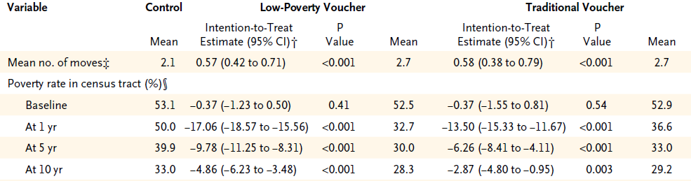
Effects on Neighborhood Poverty
Ludwig 2011
Notes:
Voucher groups more likely to move [CLICK], as expected by the intervention, and ended up in lower-poverty neighborhoods [CLICK].

Slide 23
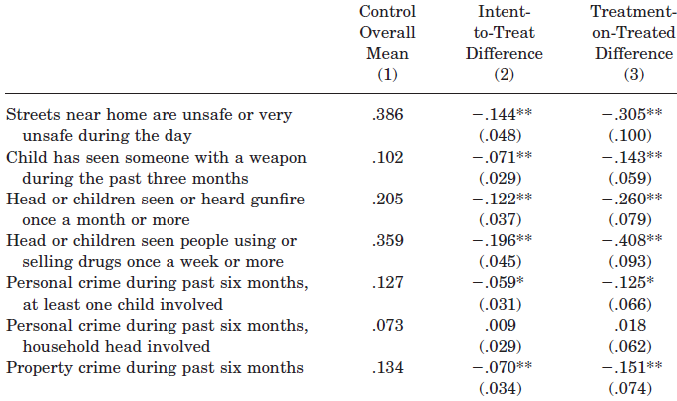
Effects on Neighborhood
Boston, 2-year Follow-up
Katz 2001
Notes:
Led to residence in “safer better” neighborhoods

Slide 24
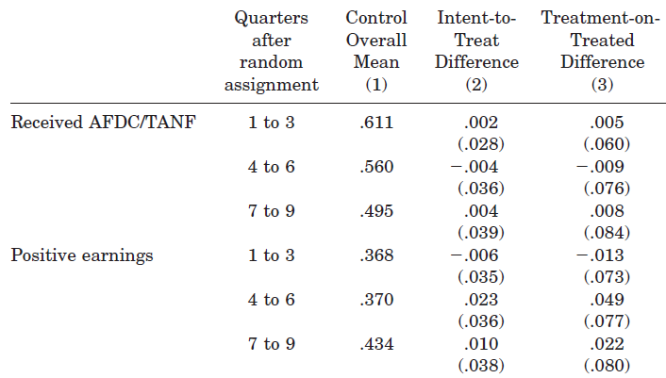
Effects on Labor Outcomes
Boston, 2-year Follow-up
Katz 2001
Notes:
No association with receiving welfare or employment earnings at 2 year follow-up

Slide 25
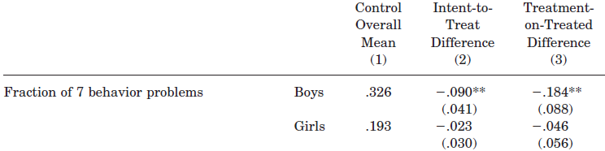
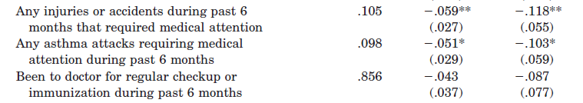
Low Poverty Effects on Health
Boston, 2-year Follow-up
Katz 2001
Notes:
Also at two years: fewer behavioral problems for boys, fewer injuries and asthma attacks.

Slide 26
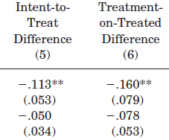
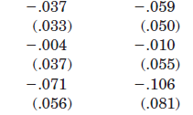
Section 8 Effects on Health
Boston, 2-year Follow-up
Katz 2001
Notes:
Children whose families received traditional section 8 vouchers had fewer behavioral problems too, but no association with injuries or asthma attacks.

Slide 27
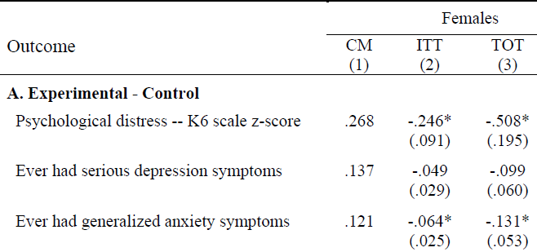
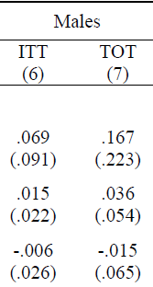

Effects on Children’s Mental Health
5- to 7-year Follow-up
Notes:
For children’s mental health in the medium term at 5-7 years follow up: while there was improved mental health among girls, there was no effect among boys.

Slide 28
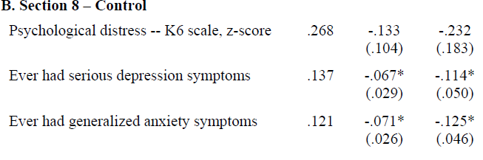
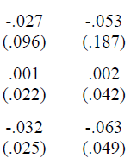
Effects on Children’s Mental Health
5- to 7-year Follow-up
Girls ITT
Girls TOT
Boys ITT
Boys TOT
Notes:
Less depression among girls, no effect among boys.

Slide 29
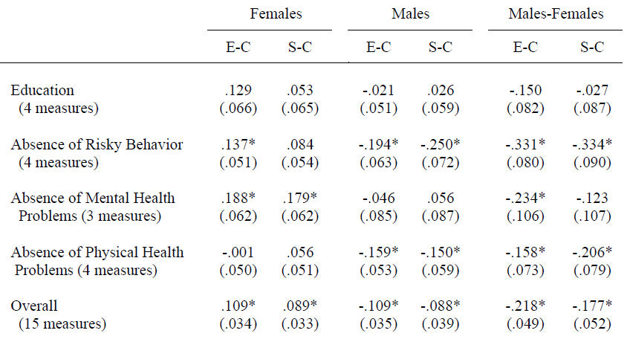
Effects on Children’s Mental Health
5- to 7-year Follow-up
Notes:
Girls in general did better than boys for both physical and mental health problems.

Slide 30
Effects at 5- to 7-year Follow-up
No effects on economic self-sufficiency
Reduction in adult obesity
Improvements in adult mental health

Slide 31
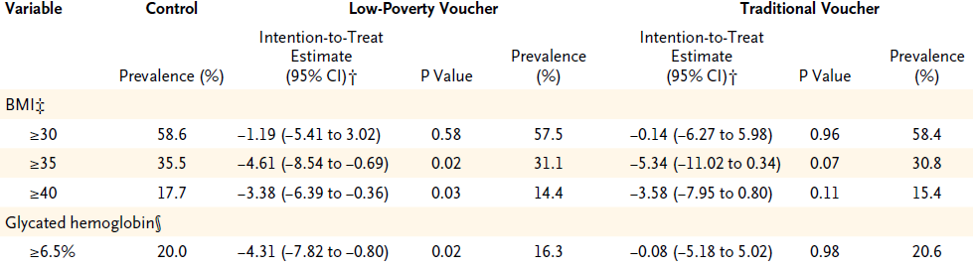
Effects on Adult Health
10-year Follow-up
Ludwig 2011
Notes:
Reductions in morbid obesity and diabetes in intervention group.

Slide 32
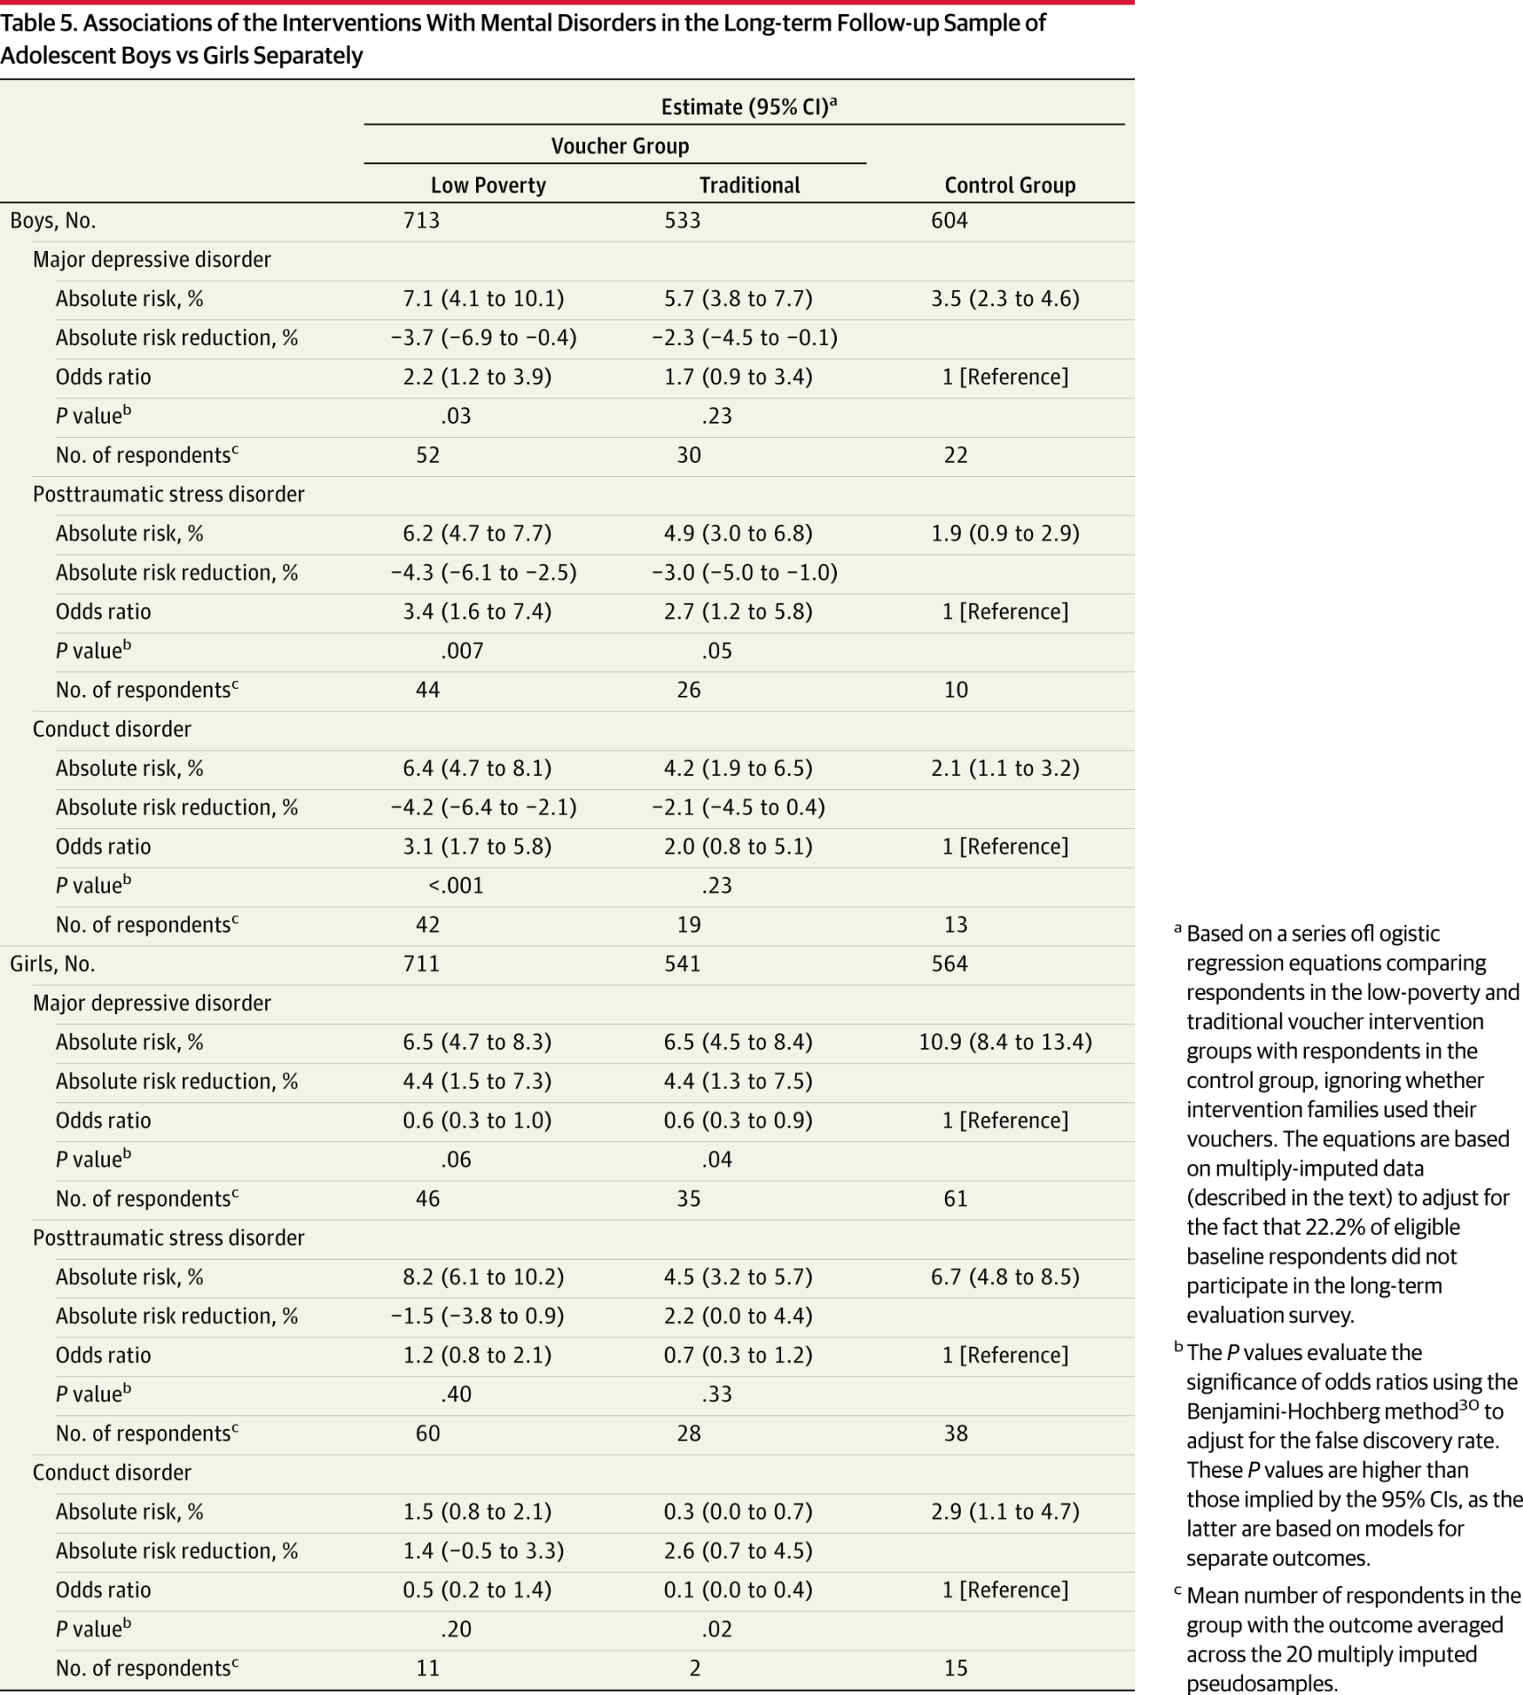
Effects on Children’s Mental Health
10-year Follow-up
Kessler 2014
Notes:
More depression among boys in intervention group (but not Section 8). Less depression among girls in both groups.

Slide 33
Earlier Exposure→ Benefits
Children who moved before 13 years old had average annual income $3,477 (31%) higher in their mid-twenties relative to mean of $11,270 in the control group.
In contrast, the same moves have negative long-term impacts on children who moved after 13 years old, perhaps because of disruption effects.
Chetty 2015

Slide 34
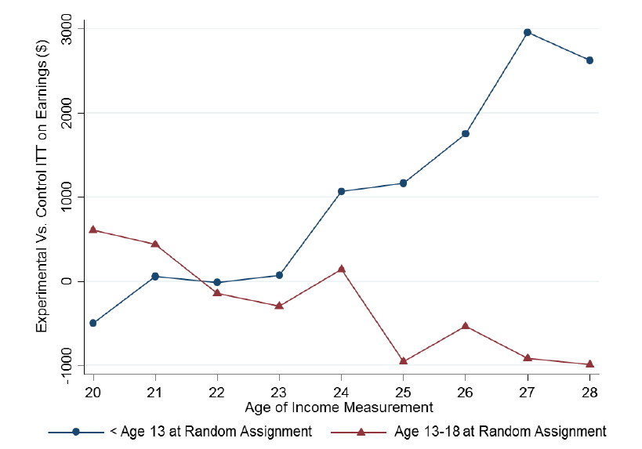
Effects on Earnings, by Age of Randomization
Chetty 2015
Notes:
Figure illustrating this point.

Slide 35
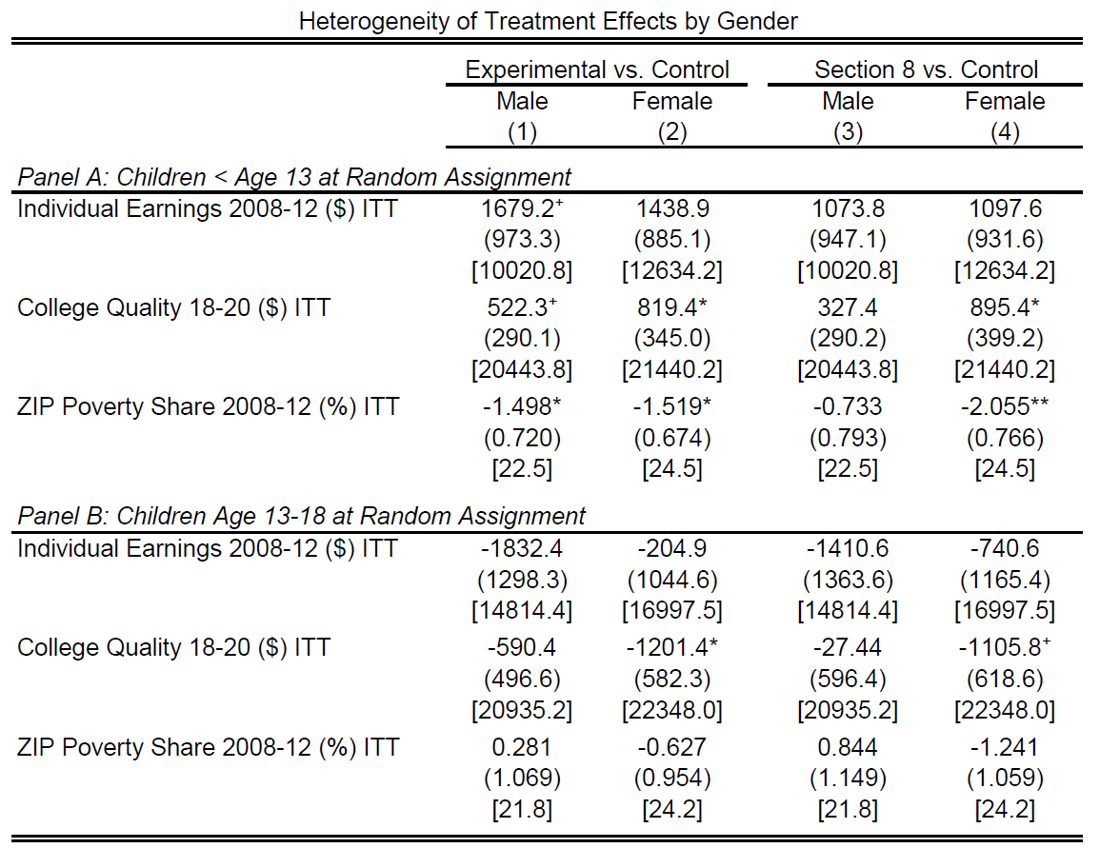
Effects on Earnings, by Age and Gender
Chetty 2015
Notes:
Effect on earnings stronger among boys (both positive and negative effects)

Slide 36
Effects on Educational and Social Outcomes
Outcomes of children who move converge to outcomes of permanent residents of destination at a rate of 3-4% per year.
Similar effects for college attendance, teenage employment, teenage birth, and marriage.
Chetty 2015

Slide 37
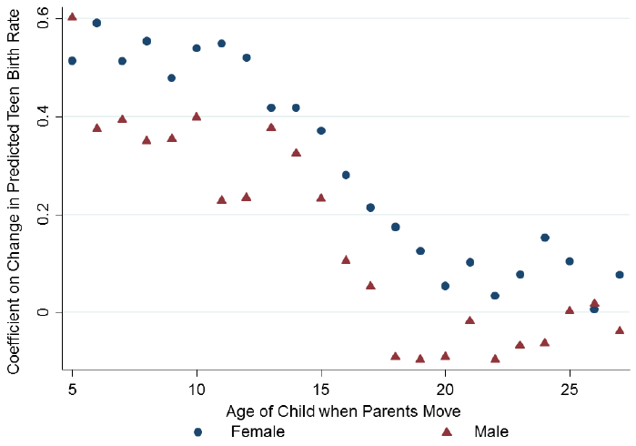
Different Study: Change in Teen Births When a Family Moves
N = over 16 million
Born 1980-1991
Chetty 2015
Notes:
Younger children experience greater effects on fertility after a move

Slide 38
MTO Trial Challenges
Small samples?
Heterogeneous effects?
What was the salient component of the treatment?
Notes:
N = 4500 underwent randomization

Slide 39
Policies and Health Disparities
Reasons to research policies
Types of policies that may affect disparities
Examples of evaluating health effects of policies
  Moving to Opportunity: a randomized trial
  Regression discontinuity and related methods: hospital desegregation, educational policies
  Pseudo-randomization: juvenile judges
Distinguishing effects on average outcomes versus disparities: GI Bill
Major controversies and uncertainties

Slide 40
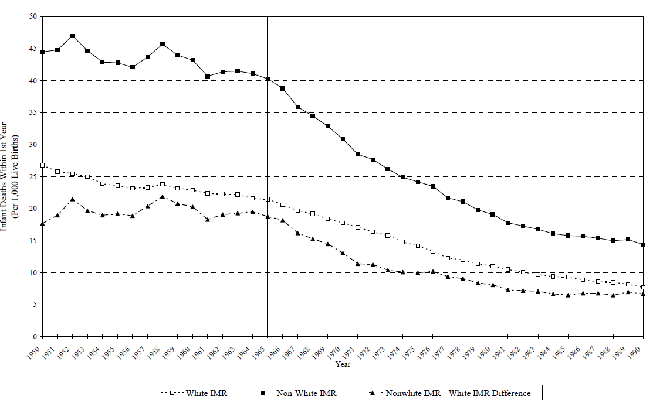
Trends in US Infant Mortality, by Race: 1950-1990
Non-White
White
Disparity
1965
Notes:
Note dramatic declines over time, with fairly persistent *relative* disparity but markedly narrowing absolute disparity.
Note sharpness of black IMR decline in 1965

Slide 41
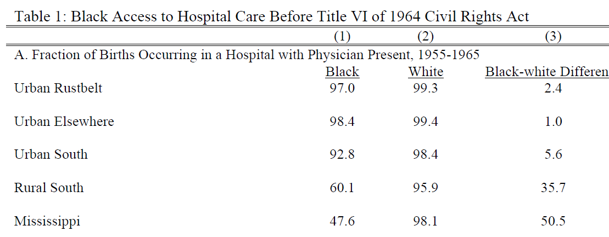
Pre-Civil Rights: Limited Access in Southern States
Notes:
This table illustrates racial disparities in hospital care before the 1964 civil rights act. 1% difference in physician-attended hospital birth in many urban locations. But in rural south, 36% difference, and over 50% in Mississippi in particular.

Slide 42
Did Hospital Desegregation Reduce Black Infant Mortality?
Hypotheses:
  Racial gap will decrease after 1965
  Gap will decrease more in areas where segregation and inadequate supply were more pervasive pre-1965
  Gap will decrease more among causes of death responsive to hospital access
  Among causes of death preventable with hospital access, gap will fall promptly and persistently upon integration
Supported by the evidence?
Almond 2006
Notes:
Obviously there’s no RCT feasible or ethical here, but we can examine this question rigorously.

Slide 43
Did Hospital Desegregation Reduce Black Infant Mortality?
Data
  Individual mortality data for 1960-1975
  Birth data for each state by race and urban/rural
  Examine trends in mortality rates due to pneumonia and gasteroenteritis
  Separate analysis for Mississippi counties
Trend break in 1965
  Black infants in the rural south: -0.705
  White infants in the rural south: -0.076
  Black infants in the urban rustbelt: -0.205
  White infants in the urban rustbelt: -0.048
Notes:
Reduction in infant mortality ten times higher among black infants in rural south compared with white infants in rural south. Also reductions in urban rustbelt, more modest since infant mortality wasn’t as high in these places at baseline.

Slide 44
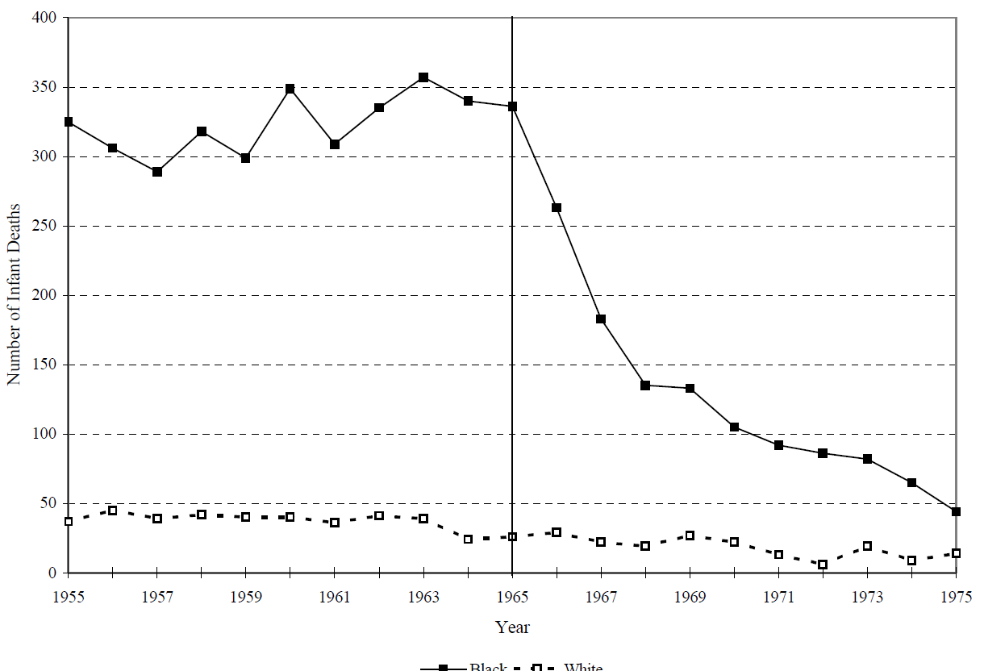
Post-Neonatal Infant Deaths Due to Diarrhea and Pneumonia, Mississippi 1955-1975
Black Infants
White Infants
1965

Slide 45
What Makes the Evidence Convincing?
This is basically a time trend… is the result credible?
A priori plausible
Specificity of population affected
  Black infants, not White infants
Specificity of the outcome
  amenable to the exposure targeted by the policy
Specificity of the place
  segregated states in the South
Notes:
Usually we don’t like time trend analyses, since there may have been all kinds of other co-occurring policies…

Slide 46
Policies and Health Disparities
Reasons to research policies
Types of policies that may affect disparities
Examples of evaluating health effects of policies
  Moving to Opportunity: a randomized trial
  Regression discontinuity and related methods: hospital desegregation, educational policies
  Pseudo-randomization: juvenile judges
Distinguishing effects on average outcomes versus disparities: GI Bill
Major controversies and uncertainties

Slide 47
Research Question
Does increased years of education reduce dementia risk?
Why education?
  Education modifiable via individual or policy actions (unlike ApoE gene)
  Likely few harmful side effects, possibly other benefits
  Generally politically feasible
  Revolutionary changes in years of education in 20th century U.S.
  Plausible mechanism: “use it or lose it” hypothesis
Challenge: Many confounders of education → dementia
  How to show that it was education itself that benefited kids?
Notes:
47

Slide 48
Example: Compulsory Schools Laws in South Carolina

Slide 49
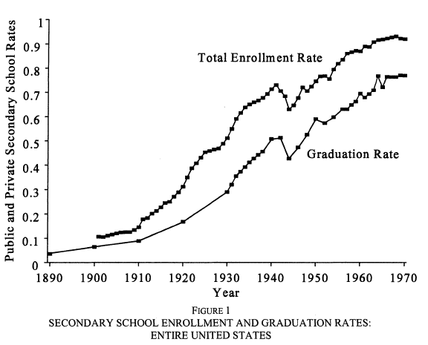
National Trends in High School Enrollment and Graduation
Goldin 1998

Slide 50
Natural Experiment: School Policy as an Instrumental Variable
Sample: U.S.-born Whites with ≤12yrs of school
Compulsory schooling laws
  Minimum age to drop out or receive a work permit
  Based on policy in state-of-birth when 14 yrs old
Exposure variable:
  Years of education (self-reported, confounded)
Outcome: Memory score in later adulthood
Two-sample instrumental variables analysis
Glymour 2008

Slide 51
Models with Different Covariates
1
Unadjusted
Sex
Birth year
State-of-birth indicators
State characteristics:
  age 6: % Black, % urban, % foreign-born
  age 14: manufacturing jobs per capita, wages per manufacturing job
2
3
4

Slide 52
Sample:
Health & Retirement Survey

Slide 53
IV Results: Effect of Education on Memory Scores
Effect of 1 year of Education on Cognitive Test Scores
5. OLS estimates 0.09 (0.08, 0.10)

Slide 54
Schooling and Racial Disparities
Analyses restricted to Whites because CSLs were not enforced for Black children
Major historical differences in school quality for Black and White children
De jure desegregation fairly recent and de facto segregation persists… do we know if it affects health?
Surprisingly limited evidence

Slide 55
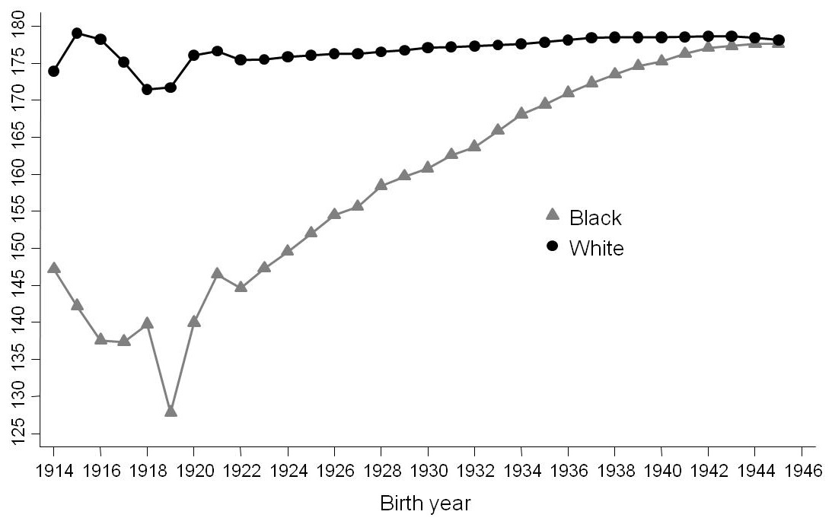
Variation in School Quality by Race
State-mandated school term length, by race
Liu 2015

Slide 56
Does This Affect Health Disparities?
Effect of state-level school term length on blood pressure
 | Change per 10% difference in school term length
 | Black |  | White
 | Female | Male | Female | Male
Systolic blood pressure (mm/Hg) | -5.9 (-8.7, -3.0) | -2.4 (-6.1, 1.3) | -0.3 (-2.3, 3.0) | 1.6 (-0.8, 4.0)
Liu 2015

Slide 57
Desegregating Schools and Reductions in Teen Pregnancy
1970-1980 Change in Teen Fertility by Race and Period of Desegregation
Liu 2012
Notes:
Some school desegregated in 60s, 70s, 80s… dark bars illustrate teen fertility as measured in 1970, and light bars in 1980. Black vs white. Look at the middle first.

Slide 58
Desegregating Schools and Reductions in Teen Pregnancy
Difference-in-difference-in-difference:
change in teen fertility during 1970-1980
among Black versus White adolescents
in cities that desegregated in the 1970s vs in the 60s or 80s
Y = β₀ + β₁Census1980 + β₂Desegregated1970s + β₃Black + β₄Census1980*Desegregated1970s + β₅Census1980*Black + β₆Desegregated1970s*Black + β₇Desegregated1970s*Census1980*Black + ε_{istr}
→ U.S. school desegregation policy in the 1970s was associated with a 3.2 percentage points reduction in the prevalence of births among Black teenage girls.
Liu 2012
Notes:
Important to frame this in reproductive justice framework. This is not to stigmatize teenage births, especially among women of color. Rather, the key point here is that equalizing opportunity and giving children hope leads to differences in reproductive decision-making that likely affect long-term outcomes later in life.

Slide 59
Conclusions:
School Policy and Health
Compulsory schooling laws predict years of education.
Effect of CSL-driven education on memory scores was statistically and clinically significant.
Other state characteristics may be confounders, but must change in tandem with CSLs and affect only those with <13 years of education.
School quality differences → persistent racial disparities in blood pressure, but effects may differ by sex
Desegregation → reduced adolescent births

Slide 60
Policies and Health Disparities
Reasons to research policies
Types of policies that may affect disparities
Examples of evaluating health effects of policies
  Moving to Opportunity: a randomized trial
  Regression discontinuity and related methods: hospital desegregation, educational policies
  Pseudo-randomization: juvenile judges
Distinguishing effects on average outcomes versus disparities: GI Bill
Major controversies and uncertainties

Slide 61
What are Effects of Juvenile Incarceration?
35,000 children in Chicago juvenile court
Linked to public school and adult incarceration data
Assigned to 1 of 62 judges essentially randomly
Judge decides whether the juvenile is:
  Placed on probation
  Incarcerated in detention center then placed on probation
Aizer 2015
Notes:
Placed on judge’s schedule based on order entered into system. Average age 14yrs. Average detention 42 days.

Slide 62
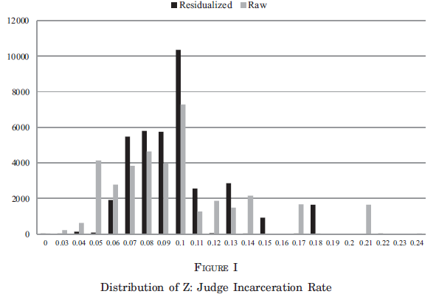
Chance of Incarceration Dependent on Judge
Number of cases assigned
Probability Judge Chooses to Incarcerate
(black bars adjusted for covariates such as child’s age)
Notes:
Range 6-18%, based on proclivities of that particular judge

Slide 63
Effects of Juvenile Incarceration
Results:
  Decreased high school graduation (13% points)
  Increased chance of imprisonment by age 25 (23% points)
  Increased chance of imprisonment as adult by age 25 for violent crime (15% points)
Effects largest for older children, ages 15-16 years
Estimates often different than those from conventional regression
Note: not for all kids, this is among kids on the margin who some judges incarcerated but others may not have.
Health effects unknown
Notes:
Effects for older children maybe because it leads them to drop out of school?

Slide 64
Policies and Health Disparities
Reasons to research policies
Types of policies that may affect disparities
Examples of evaluating health effects of policies
  Moving to Opportunity: a randomized trial
  Regression discontinuity and related methods: hospital desegregation, educational policies
  Pseudo-randomization: juvenile judges
Distinguishing effects on average outcomes versus disparities: GI Bill
Major controversies and uncertainties

Slide 65
GI Bill
  GI Bill implemented in 1944 under Roosevelt
  Components:
    Educational subsidy to cover college tuition
    Guarantees for loans for housing/business
    Job placement assistance
    Unemployment compensation
  Eligibility: 90+ days service, no dishonorable discharge
  Policy was de jure race neutral
  Were effects actually race neutral?

Slide 66
GI Bill: Job Placement
Assistance administered by local offices, mostly staffed by White staff:
“In trying to find a job, the [Black] veteran would visit the local U.S. Employment Service Office. If he’ll accept some laborer’s job, they’ll readily place him. If he knows some of the old-timey trades, they can get him placed…
But if he’s qualified in some of the new skills that Negros haven’t traditionally been doing, or has some kind of professional training, they just can’t find a place for him and he’ll be offered a job as a porter in the local hotel or the like.’”
Onkst 2001

Slide 67
GI Bill: Job Placement
In Mississippi in Oct 1945, job counselors filled 6,583 non-agricultural jobs
86% of professional, skilled, and semi-skilled positions went to White veterans
92% of the unskilled and service-oriented jobs went to Black veterans
Men who did not take a job deemed “suitable” by counselor were denied unemployment compensation

Slide 68
GI Bill: Loan Guarantees
Administered by local banks
  Loans require collateral
Survey of 13 Mississippi cities in 1947
  3,229 loans guaranteed by the VA
  2 were for Black veterans
Unclear how widespread, limited evidence, but likely that loan guarantees were essentially unavailable to Black veterans

Slide 69
GI Bill: Education
At the end of WWII, there were only ~100 small, under-resourced colleges in the South accepting Black students
Southern Black colleges turned away ~55% of veterans
High school graduation rates lower among Black kids, further reducing potential value of college tuition subsidy
How to estimate the effect of GI bill?
  Compare veterans to non-veterans?
Biased differentially for Black and White men because of selection criteria for entry into the military (literacy, disability, discrimination)

Slide 70
Birth Cohort as a Natural Experiment
Don’t compare veterans to non-veterans
Equate birth cohort with chance of being a veteran
Compare outcomes by birth cohorts
Bound 2002

Slide 71
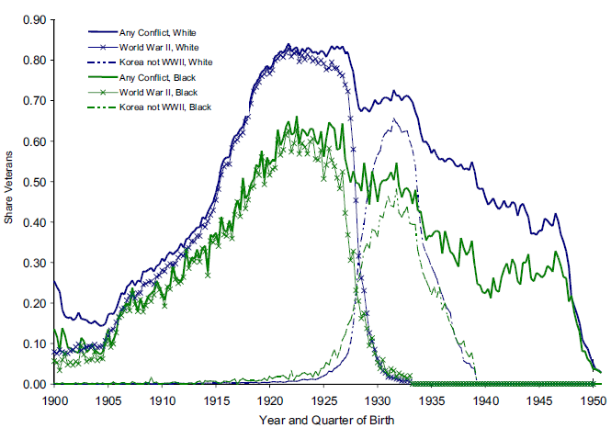
Birth Year → Chance of Military Service
Notes:
X axis: year of birth; Y axis: proportion of cohort that were veterans. Of course this is for men. White men represented by blue line, Black men by green line. Those born in the 1920s had very high rates of military service.

Slide 72
How to Estimate Disparities in
GI Bill Benefits?
Assume that military participation differed by birth cohort not because of men’s characteristics.
I.e., men in service cohorts were not smarter, richer, more educated, less likely to have kids...
Not quite credible, because there are secular trends in college enrollment and fertility.
Notes:
We assume that men in these cohorts with high military service rates were otherwise comparable to men born just before/after

Slide 73
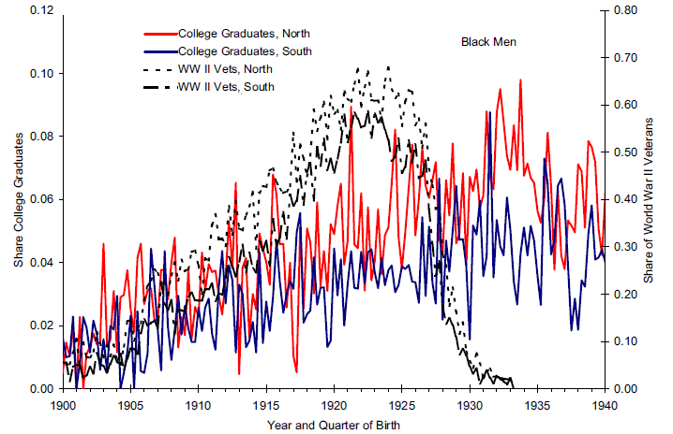
Temporal Trend in College Attendance: Black Men
Notes:
This figure is Black men only. Dashed black lines are the share of that cohort that were WWII veterans. Peaked in 1920s. Colored lines are college graduation rates, red being those in the north and blue those in the south. Cohorts of Black men with lots of veterans graduated from college more often in the north, but not as much in the south.

Slide 74
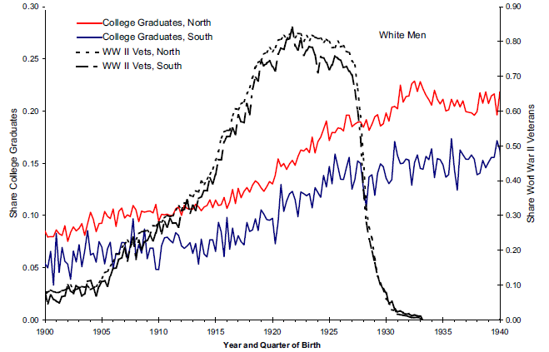
Temporal Trend in College Attendance: White Men
Notes:
This figure is the same setup, but for White men. Positive effects on college education for White men in both north and south. Suggests that for Black men, the lack of opportunities in the south meant that the GI bill had differential effects.

Slide 75
Estimated Effect of GI Bill
4% point increase in college completion
Large and positive benefits for White men
Negligible benefits for Black men born in South
Positive benefits for Black men outside South
Health effects?

Slide 76
Untargeted Resources Can Exacerbate Inequalities
Key lessons from GI Bill:
  Making a resource generally available without special consideration for least advantaged can exacerbate disparities even while helping the “average”
  Advantaged are best able to use the new resource
  This is one prediction of “fundamental cause theory”: new information, technological advances, and similar general progress can exacerbate inequalities
May depend on how inequality is measured
Notes:
Theory: SES embodies an array of resources, such as money, knowledge, prestige, power, and beneficial social connections that protect health no matter what mechanisms are relevant at any given time (Link and Phelan, 1995).
Can you think of how this has operated in the context of COVID? Testing, treatment, vaccines…

Slide 77
Policies and Health Disparities
Reasons to research policies
Types of policies that may affect disparities
Examples of evaluating health effects of policies
  Moving to Opportunity: a randomized trial
  Regression discontinuity and related methods: hospital desegregation, educational policies
  Pseudo-randomization: juvenile judges
Distinguishing effects on average outcomes versus disparities: GI Bill
Major controversies and uncertainties

Slide 78
Uncertainties and Controversies
Little rigorous research: Major social policies rarely evaluated for health impact: Social Security, home ownership subsidies, school quality, transportation, etc.
Results are often not what we expect.
What are details of intervention implementation?
  Additional education at age 4 versus age 17?
  Additional high- vs low-quality education?
  Education in the future similar to education in the past?
Results are often sensitive to model specification.
Data challenges: Difficulty linking data across life course, studies not powered adequately.

Slide 79
Homework
Identify a social or economic policy you think may have important health implications.
Describe why an evaluation of that policy is informative (e.g., primarily about the policy, or primarily a test of hypothesized mediators).
Specify the outcomes and populations you think most or least affected by the policy.
Propose a study design to evaluate the policy.
Describe biggest challenge to implementing and drawing inferences.
Notes:
Small groups?

