Slide 1
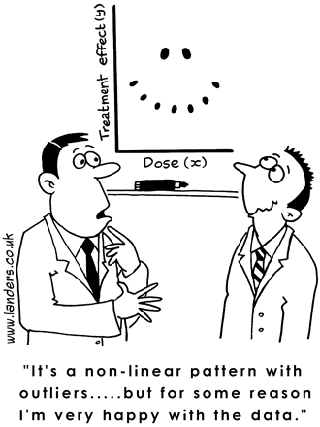
Regression models and modeling
Cindy Leung, ScD, MPH
Center for Health and Community

Slide 2
Agenda
Basics of modeling
Nonparametric vs. parametric models
Frequently used epidemiologic models
Dose-response relationships
Standardization
IPW

Slide 3
Why use regression models?
Control for confounding
Assess effect modification
Summarize the exposure-outcome association

Slide 4
Estimator, estimand, estimate
An ESTIMATOR is some function of the data that is used to estimate an unknown population parameter
  The sample average of SBP among men
The ESTIMAND is the unknown population parameter
  The mean SBP among men in the study population
An ESTIMATE is the result of applying the estimator of the data set
  120 mmHg
As the sample size increases towards infinity, the ESTIMATOR provides a consistent estimate of the ESTIMAND
  The sample average is a consistent estimator of the population mean
  Choosing the value of the first observation is not a consistent estimator of the population mean
Notes:
We require that estimators be consistent.

Slide 5
More terminology
The REGRESSAND is the outcome variable or the dependent variable
The REGRESSOR is the exposure variable or the independent variable
The concept of regression does not imply any causal or temporal relation between the regressor and regressand.

Slide 6
Nonparametric models
Also known as saturated models
Use only the data
Do not impose any restrictions on the value of the estimate
Example for a dichotomous A:
E[Y|A] = β₀ + β₁A
Imposes no a priori restrictions because they have as many parameters as quantities the model can estimate
  E[Y|A=0] = β₀
  E[Y|A=1] = β₀+β₁
  2 parameters (β₀, β₁), 2 quantities (E[Y|A=1], E[Y|A=0])
Therefore, not really a model…

Slide 7
An example
Consider the saturated logistic model:
logit Pr[Y|A] = β₀ + β₁A
 | A=1 (smokers) | A=0 (non-smokers)
Y=1 (death) | 168 | 62
Y=0 | 44 | 136
What are the odds of death among smokers?

Slide 8
An example
Consider the saturated logistic model:
logit Pr[Y|A] = β₀ + β₁A
 | A=1 (smokers) | A=0 (non-smokers)
Y=1 (death) | 168 | 62
Y=0 | 44 | 136
What are the odds of death among non-smokers?

Slide 9
An example
Consider the saturated logistic model:
logit Pr[Y|A] = β₀ + β₁A
 | A=1 (smokers) | A=0 (non-smokers)
Y=1 (death) | 168 | 62
Y=0 | 44 | 136
What is the odds ratio of death for smokers versus non-smokers?

Slide 10
Your turn
Consider the saturated logistic model:
logit Pr[Y|A] = β₀ + β₁A
What is your interpretation and numerical value of the quantitites:
β₀
β₁
e^{β0+β1}
e^{β0+β1/} e^{β0}
 | A=1 (smokers) | A=0 (non-smokers)
Y=1 (death) | 168 | 62
Y=0 | 44 | 136

Slide 11
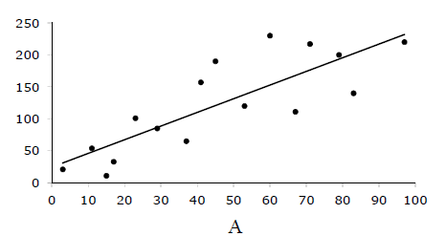
Consider a linear model
E[Y|A] = β₀ + β₁A
The parameters β₀, β₁ are consistently estimated by ordinary least squares estimation
β₀ = estimated as the point at which the line intercepts the vertical axis
β₁ = estimated as the slope of the line
Notes:
Find the line that results in the minimum sum of squared differences between each point and the line.
Once b0 and b1 are estimated, you can use them to predict the mean of Y of any possible value of A=a, including those values not present in the data by borrowing information from subjects in the study population
For example, the mean of Y for A=95 cannot take on any value – it is restricted to be between the mean of Y when A=90 and A=100. The restriction is encoded by the parameters b0 and b1.

Slide 12
Parametric models
Use the data plus external information
Impose a priori restrictions on the value of the estimate
  Hence, reduces the number of strata and parameters to estimate
  Parameter for exposure will have narrower confidence interval
Example for a dichotomous A and B:
E[Y|A] = β₀ + β₁A + β₂B
Has more quantities the model can estimate than parameters
  3 parameters (β₀, β₁ , β₂)
  4 quantities (E[Y|A=1, B=1], E[Y|A=1, B=0], E[Y|A=0, B=1], E[Y|A=0, B=0])
What does this model assume?
  β₃AB = 0
  No effect modification by A on the effect of B on Y
  The contributions of A and B to the mean of Y are additive.
  All of these are the same!
Notes:
Which parameter is missing that would make this model nonparametric?

Slide 13
Why model?
Let’s estimate the mean E[Y] in the presence of 3 dichotomous variables L, M and N.
  E[Y|L, M, N] = β₀ + β₁L + β₂M + β₃N + β₄LM + β₅LN + β₆MN + β₇LMN
  The number of strata grows exponentially! The number of subjects in each stratum may fall to 0.
  If 20 dichotomous covariates, there are 2²⁰ possible parameters
Need parametric models
  Allows us to estimate quantities that cannot be consistently estimated nonparametrically
  Inference is correct only if the model is correctly specified
Model specification: process of selecting a model form
Model fitting: process of using data to estimate parameters in a model form

Slide 14
Continuous predictors
Example for a continuous variable age:
logit Pr[Y|age] = β₀ + β₁age
Is this model nonparametric or parametric?
  A continuous variable can be thought of as categorical variables with an infinite number of categories!
What does this model assume?
  The relationship between age and the log odds of Y is linear.
Example for a categorical variable age:
logit Pr[Y|age] = β₀ + β₁age(25-34) + β₂age(45-54)
+ β₃age(55-64) + β₄age(65 and older)
What does this model assume?
  The risk of Y is the same within age categories (i.e. no residual confounding).

Slide 15
An example
Consider the saturated logistic model:
logit Pr[Y|A] = β₀ + β₁A + β₂B
B=1 (obese) | A=1 (smokers) | A=0 (non-smokers)
Y=1 | 60 | 38
Y=0 | 10 | 62
What is your interpretation and numerical value of the quantitites:
e^{β0}
e^{β0+β1}
e^{β0+β1}/ e^{β0}
e^{β0+β1+ β2}
e^{β0+ β2}
e^{β0+β1+ β2}/ e^{β0+ β2}
B=0 (non-obese) | A=1 (smokers) | A=0 (non-smokers)
Y=1 | 108 | 24
Y=0 | 34 | 74

Slide 16
Models frequently used in epidemiology
Generalized Additive Models (GAM):
  Example: E[Y|X₁, X₂..X_{p}] = α + f₁(X₁) + f₂(X₂) + … + f_{p}(X_{p})
  Response variable is a sum of functions of the covariates
  Not necessarily linear
  Example: smoothing functions (e.g. kernal, splines, etc.)
Generalized Linear Models (GLM):
  Example: E[Y|X₁, X₂..X_{p}] = exp(β₁X₁ + β₂X₂ + … + β_{p}X_{p})
  Response variable is a function of a linear combination of the covariates via their parameters
    Examples: linear regression, logistic regression, poisson, hazard models, survival analysis, etc.
  More generally: g(E[Y|A=a], where g() is the link function
  Common link functions and distributions:
    Linear regression: link=identity, distribution=normal
    Logistic regression: link=logit, distribution=binomial
    Poisson regression: link=log, distribution=poisson
Notes:
GLM are a class of regression models, including standard linear regression but also many other important models.
Link function describes mean of Y and its relation to right side

Slide 17
Linear models
R(x₁) = β₀ + β₁x₁
  Response variable: continuous
  Model allows average risk to vary across subpopulations for different values of A but only in a linear fashion
  Assumes predictor variables are linearly related to outcome
  β₁ is difference in risk between subpopulations defined by having x₁+1 and x₁
  Recentering (R(x₁) = β₀ + β₁(x₁-13)
    If x₁ cannot equal 0, then β₀ will not have a meaningful interpretation. Recenter by subtracting a frequently observed value from x₁
  Rescaling
    Suppose x₁ represents blood pressure. A 1-mmHg increase in SBP is not of much interest. Multiple β₁ by a constant (e.g. 10) to estimate the difference in risk for a 10-mmHg increase in SBP.
A variation: R(x₁) = exp(β₀ + β₁x₁) or ln (R(x₁)) = β₀ + β₁x₁
  Sometimes called log-linear risk model
  R(x1) will always be positive
  β₁ is the log risk ratio comparing subpopulations defined by having x₁+1 and x₁

Slide 18
Linear models
Example from CAP data set:
. regr bmi age race
Source | SS df MS Number of obs = 1000
-------------+------------------------------ F( 2, 997) = 12.50
Model | 530.717838 2 265.358919 Prob > F = 0.0000
Residual | 21158.5243 997 21.2221909 R-squared = 0.0245
-------------+------------------------------ Adj R-squared = 0.0225
Total | 21689.2422 999 21.7109531 Root MSE = 4.6068
------------------------------------------------------------------------------
bmi | Coef. Std. Err. t P>|t| [95% Conf. Interval]
-------------+----------------------------------------------------------------
age | -.0696756 .0173498 -4.02 0.000 -.1037219 -.0356293
race | 1.161047 .3792647 3.06 0.002 .4167982 1.905296
_cons | 32.15326 1.151241 27.93 0.000 29.89412 34.41239
------------------------------------------------------------------------------
Notes:
What modeling assumptions are made in this model?
Contributions of age and race to the mean BMI are additive.
The relationship between age and BMI is linear.

Slide 19
Logistic models
logit (p) = log (p/ 1-p) = log odds
logit R(x₁) = β₀ + β₁x₁
  Response variable: binary
  Model constrains average risk between 0 and 1
  Assumes predictor variables are linearly related to the logit of the outcome
  β₀ is the log odds for the subpopulation when x₁=0
  β₁ is the log odds ratio comparing subpopulations defined by having x₁+1 and x₁
Notes:
Sometimes called unconditional logistic regression

Slide 20
Logistic Regression Models
Binary LR
Ordinal LR
Nominal LR
Simple unconditional logit
Conditional logit
Nonparametric model with adaptive splines
Cumulative logit
Proportional odds model
Adjacent-category logit model
Mean response model
Multinomial logit
Generalized logit
Discrete choice models
Notes:
Conditional logit: for matched data
Nonparametric model with adaptive splines: regression splines with model building (forward selection or backwards elimination)
Cumulative logit: models cumulative logit (1-Pr[Y<i]/Pr[Y<i])
Proportional odds model: assumes odds of response below a given response level are constant regardless of which level you pick
Adjacent-category logit: models adjacent-caegory logit, contrasts 2 adjacent response categories rather than entire response scale with cumulative logits
Mean response model: assigns numerical scores to ordinal response levels, implying that spacing among levels is known
Multinomial logit: Response with more than 2 levels, generally unordered
Generalized logit: Unconditional nominal logistic model in which response functions are generalized logit or baseline logit
Discrete choiec model: Used to model a response that is the choice of individuals

Slide 21
Logistic models
Example from CAP data set:
. logit obese age race, or
Logistic regression Number of obs = 1000
LR chi2(2) = 22.79
Prob > chi2 = 0.0000
Log likelihood = -564.77767 Pseudo R2 = 0.0198
------------------------------------------------------------------------------
obese | Odds Ratio Std. Err. z P>|z| [95% Conf. Interval]
-------------+----------------------------------------------------------------
age | .9748239 .0084576 -2.94 0.003 .9583876 .9915422
race | 1.981038 .347337 3.90 0.000 1.404918 2.79341
_cons | 1.646492 .9351696 0.88 0.380 .5408751 5.012132
------------------------------------------------------------------------------

Slide 22
Conditional logistic regression
Response variable: binary
Used for MATCHED data
logit R(x₁) = β_{0k} + β₁x₁
  β_{0k} is the intercept term that varies for each matched stratum k
  β₁ is the log odds ratio of the effect of exposure x₁ on outcome
  Does not include parameters for matching factors as effects of matching factors on the outcome cannot be computed
  Can assess effect modification by matching factors by including a product term between exposure and matching factors

Slide 23
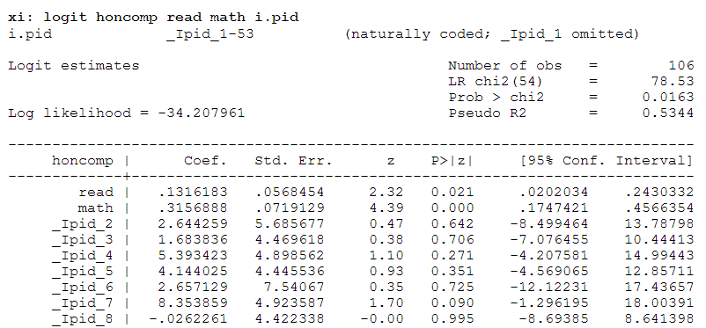
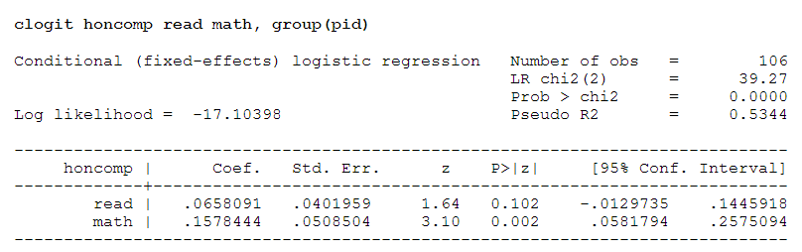
Notes:
Students in honors composition matched with non-honors student based on gender and program type.
Can try to model data by including pairs term as a predictor in the model. DF for chi-squared test is 54 – large if only 106 observations. Estimates of coefficients may be biased.
Comparison of goodness of fit measures shows conditional logistic regression is much better fit.
More efficient than unconditional logistic regression for matched data

Slide 24
Special case: Polytomous logistic regression
Sometimes called polychotomous logistic regression or multinomial logistic regression
Response variable: unordered outcome with J categories
Polytomous logistic regression model fits simultaneously J-1 logit models
P(Y=y₁ | X=x)
P(Y=y_{J} | X=x)
ln
= α₁ + β₁x
P(Y=y₂ | X=x)
P(Y=y_{J} | X=x)
ln
= α₂ + β₂x
. . .
P(Y=y_{J-1} | X=x)
P(Y=y_{J} | X=x)
ln
= α_{J-1} + β_{J-1}x

Slide 25
Special case: Polytomous logistic regression
Example from the HW: Examine the association between BMI categories and age and race.
Multinomial logistic regression Number of obs = 1005
LR chi2(6) = 34.54
Prob > chi2 = 0.0000
Log likelihood = -1063.7183 Pseudo R2 = 0.0160
------------------------------------------------------------------------------
bmicat | RRR Std. Err. z P>|z| [95% Conf. Interval]
-------------+----------------------------------------------------------------
1 |
age | .8716765 .0790564 -1.51 0.130 .7297194 1.041249
race | 1.24e+07 1.32e+10 0.02 0.988 0 .
_cons | .0000192 .0204384 -0.01 0.992 0 .
-------------+----------------------------------------------------------------
2 | (base outcome)
-------------+----------------------------------------------------------------
3 |
age | .9879199 .0091128 -1.32 0.188 .9702195 1.005943
race | .7952254 .1675817 -1.09 0.277 .5261534 1.201899
_cons | 3.94992 2.440605 2.22 0.026 1.176635 13.25974
-------------+----------------------------------------------------------------
4 |
age | .9671333 .0101013 -3.20 0.001 .9475364 .9871354
race | 1.71347 .3694795 2.50 0.013 1.122871 2.614707
_cons | 7.902542 5.459609 2.99 0.003 2.040326 30.60795
------------------------------------------------------------------------------

Slide 26
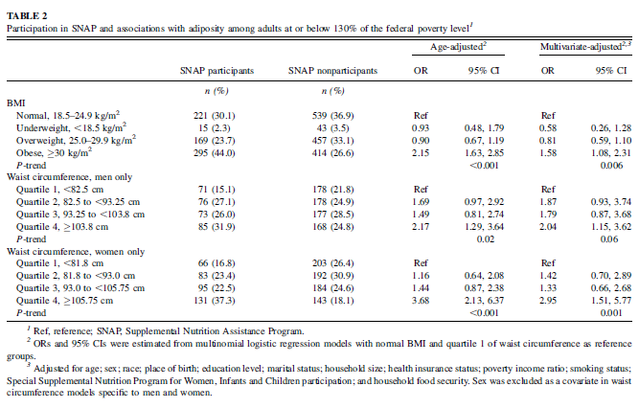
Leung CW. Low-income Supplemental Nutrition Assistance Program participation is related to adiposity and metabolic risk factors. AJCN 2011.

Slide 27
Special case: Ordinal logistic regression
Sometimes called ordered logistic regression or proportional odds model
Response variable: ordered outcome with J>2 categories
If Y is ordinal, models are simpler to interpret and possibly more precise (if correctly specified) than polytomous logistic regression
P(Y ≤ y₁)
P(Y >y₁| X=x)
ln
= α₁ + β₁x
. . .
P(Y ≤ y_{J-1})
P(Y >y_{J-1}| X=x)
ln
= α_{J-1} + β_{J-1}x

Slide 28
Special case: Ordinal logistic regression
Example from the HW: Examine the association between BMI categories and age and race.
. ologit bmicat age race, or
Ordered logistic regression Number of obs = 1005
LR chi2(2) = 15.05
Prob > chi2 = 0.0005
Log likelihood = -1073.4653 Pseudo R2 = 0.0070
------------------------------------------------------------------------------
bmicat | Odds Ratio Std. Err. z P>|z| [95% Conf. Interval]
-------------+----------------------------------------------------------------
age | .9785191 .0069192 -3.07 0.002 .9650513 .9921749
race | 1.471573 .2337674 2.43 0.015 1.077863 2.009092
-------------+----------------------------------------------------------------
/cut1 | -7.604452 .851401 -9.273168 -5.935737
/cut2 | -2.359849 .4746542 -3.290154 -1.429544
/cut3 | -.3419956 .4677894 -1.258846 .5748547
------------------------------------------------------------------------------
------------------------------------------------------------------------------

Slide 29

Poisson models
Response variable: a count (e.g. # of cases of disease in a given period of time) or rate
E(Y) = μ = λT
  Y = # events
  μ = average # events
  T = follow up time
  λ = incidence rate
Poisson distribution: Pr[Y=y] = (μ^{y}e^{-μ})/Y!
Consider a linear model for the log number of counts:
ln(μ_{i}) = β₀ + β₁X₁+ log (t_{i})
  β₁ is the log incidence rate for a one-unit change in X
  log (t_{i}) called an offset term, adjusts for the volume of observations
Notes:
Poisson regression relates expected counts or rates to a set of covariates.
Average # events depends on length of follow up and incidence rate
Distribution assumes within fine intervals, the event is rare and the total number of events depends on a constant incidence rate and length of follow-up. With Poisson, expected number of counts is equal to the variance of counts.
Applicable for prospective count, prospective PT and cross-sectional data.

Slide 30
Poisson models
Poisson regression Number of obs = 10
LR chi2(5) = 922.93
Prob > chi2 = 0.0000
Log likelihood = -33.600153 Pseudo R2 = 0.9321
------------------------------------------------------------------------------
deaths | IRR Std. Err. z P>|z| [95% Conf. Interval]
-------------+----------------------------------------------------------------
agecat |
2 | 4.410584 .8605197 7.61 0.000 3.009011 6.464997
3 | 13.8392 2.542638 14.30 0.000 9.654328 19.83809
4 | 28.51678 5.269878 18.13 0.000 19.85177 40.96395
5 | 40.45121 7.775511 19.25 0.000 27.75326 58.95885
|
smokes | 1.425519 .1530638 3.30 0.001 1.154984 1.759421
pyears | (exposure)

Slide 31
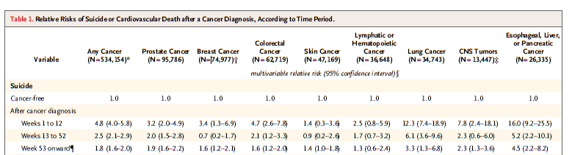
Fang F. Suicide and cardiovascular death after a cancer diagnosis. NEJM 2012.
Notes:
A study of 6 million Swedes to examine associations between cancer diagnosis and immediate risk of suicide or death from ca

Slide 32
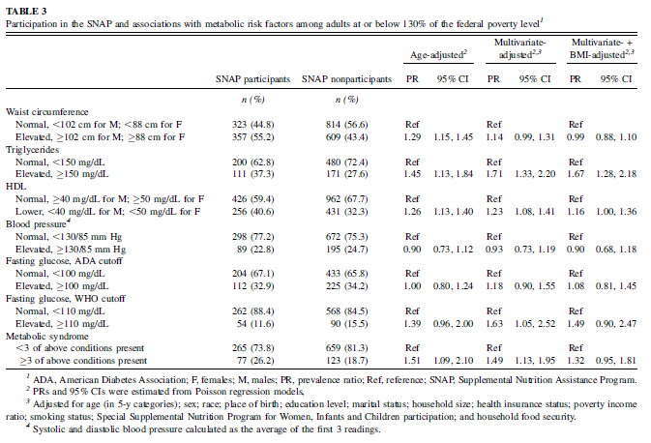
Prevalence ratios from Poisson models
Notes:
PR is more interpretable and easier to communicate to the public than the odds ratio.

Slide 33
Survival models
Response variable: Survival time (time from initial event until failure)
  Ex: time from birth until death; time from HIV infection until development of AIDS; time from start of treatment until remission of disease
Censoring: incomplete observation of time to failure
  Right censoring: when subject leaves study or study ends before event occurs
  Left censoring: event occurred before study enrollment
Truncation: eligibility or observation of subject for study depends on event
  Right truncation: entry into study depends on event of interest
  Left truncation: subjects already at risk of event before study began
Notes:
Right truncation: patients from cancer registry
Left truncation: life insurance policy holders where study starts on fixed date

Slide 34
Survival models
Estimate the probability that an individual will “survive” for a given length of time
Kaplan-Meier method (or product-limit method) – most commonly used to estimate survival curve
S(t): probability that an individual survives beyond time t or the proportion of subjects who have not yet failed
n_{i} – d_{i}
n_{i}
Ŝ(t) = Π
t_{i}<t
Notes:
Is this parametric or nonparametric?

Slide 35
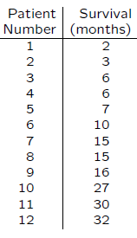
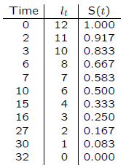
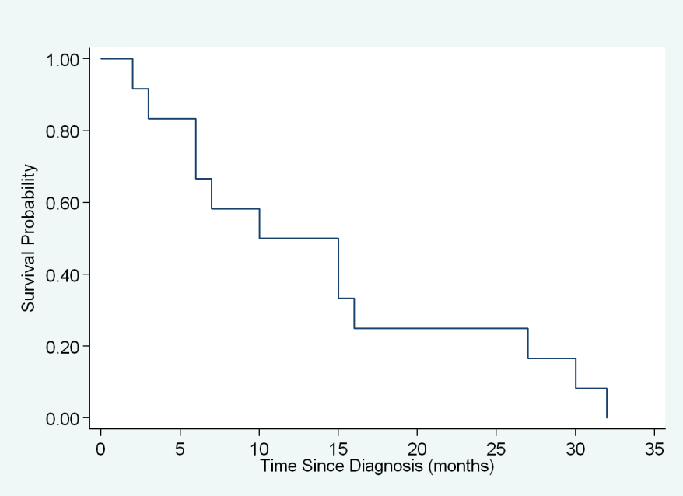
Survival models
Consider study of survival among 12 hemophiliacs diagnosed with AIDS and followed until death
Notes:
Begin by ordering survival times associated with each of the 12 patients
Estimate survival curve
If the observation is censored, S(t) does not change from the previous value.
However, the observation is not used to calculate probability of failure at a later time (removed from denominator)

Slide 36
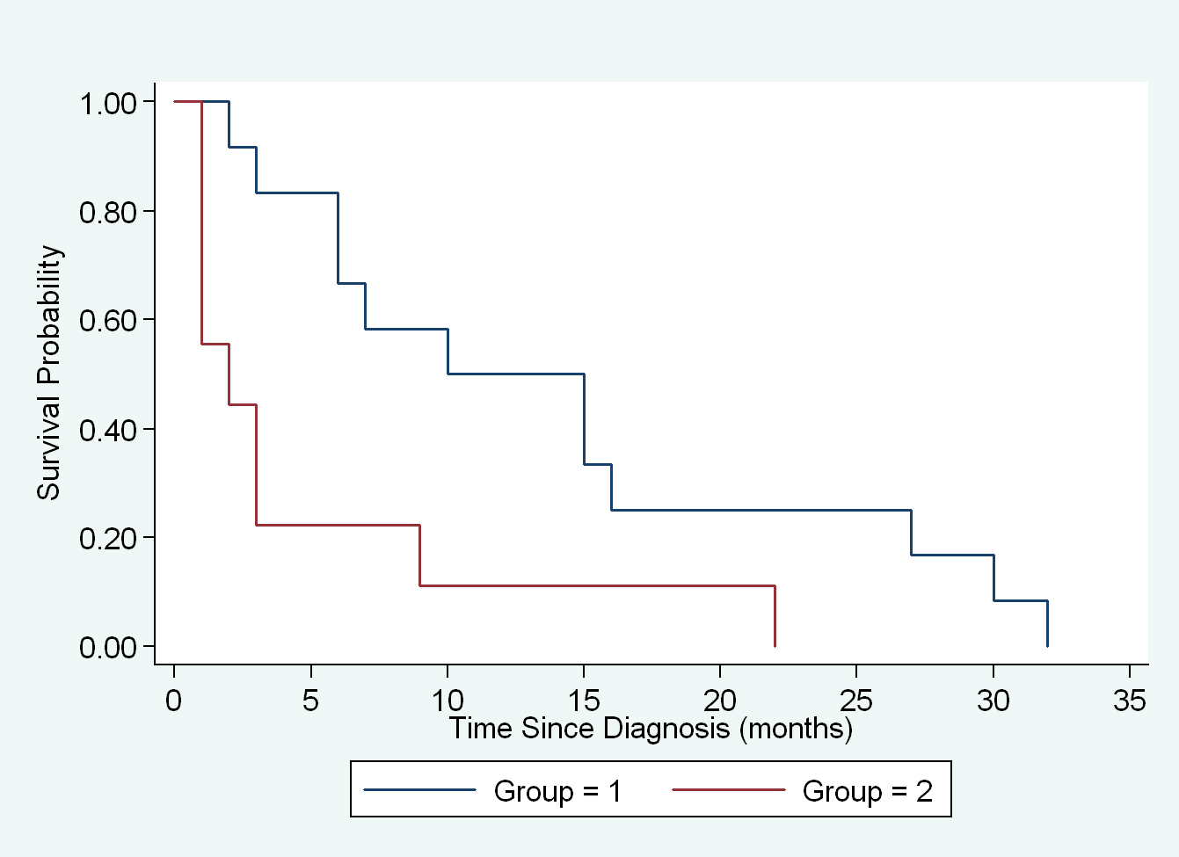
Survival models
Compare survival times among hemophiliacs by age at time of HIV seroconversion (≤40 years and >40 years)
Notes:
Individuals who are younger at the time of HIV seroconversion survive longer than those who are older at seroconversion
Difference between two curves represents difference in mortality.

Slide 37
Survival models
. sts test group, logrank
failure _d: censor
analysis time _t: survtime
Log-rank test for equality of survivor functions
| Events Events
group | observed expected
------+-------------------------
1 | 6 9.25
2 | 6 2.75
------+-------------------------
Total | 12 12.00
chi2(1) = 6.67
Pr>chi2 = 0.0098
H₀: The two distributions of survival times are identical.
Notes:
Tests the null hypothesis that the two distributions of survival times are identical. Log-rank test compares the observed number of failures at time t to the expected number of failures. Since p is <0.01, we reject H0 and conclude that the two distributions are not identical. Time to death is shorter for older patients.
Log-rank test can be used to compare survival times for 3+ groups but cannot be used if the risk factor is continuous or to evaluate simultaneously effects of more than one exposure… this requires Cox proportional hazards model

Slide 38
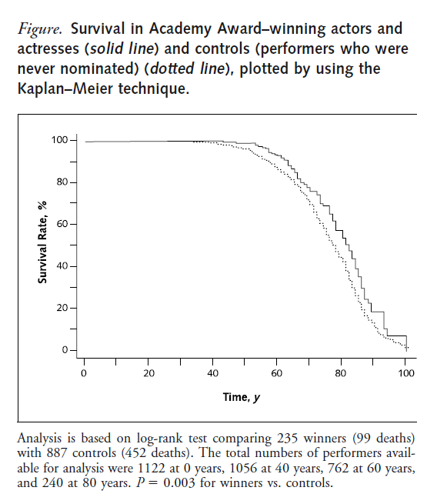
Redelmeier DA. Survival in Academy Award-Winning Actors and Actresses. Ann Intern Med 2001.
Notes:
Life expectancy was 3.9 years longer for AA winners than for other, less recognized performers, P=0.03. This difference was equal to a 28% relative reduction in death rates. Additional wins were associated with a 22% relative reduction in death rates, whereas additional films and nominations were not associated with a significant reduction in death rates.

Slide 39
Cox Proportional Hazard models
A semiparametric model
  Baseline hazard h₀(t) is nonparametrically modeled
  Parameters for the covariates in the model are parametrically modeled
h_{i}(t) = h₀(t)e^{(β1Xi1+ β2Xi2+ β3Xi3+… βpXip)}
  Predictors X₁-X_{p} are assumed to act additively on log h(t)
  h(t): hazard rate at time t for subjects with X_{p}=x_{p}
  h₀(t): baseline hazard rate at time t with X_{p}=0
  β₁: log hazard rate ratio for a one-unit change in X₁
Proportional hazards assumption
  Hazard for any individual is a fixed proportion of the hazard for any other individual
    h_{i}(t) = h₀(t)e^{(β1Xi1+ β2Xi2+ β3Xi3+… βpXip)}
    h_{j}(t) = h₀(t)e^{(β1Xj1+ β2Xj2+ β3Xj3+… βpXip)}
  Can be tested by adding product term between time and covariates
HR_{i,j}=
    = exp(β₁(X_{i1}-X_{j1})+…+β_{p}(X_{ip}-X_{jp}))
Notes:
For any individual I, the hazard is based on the baseline hazard (h₀(t)) and that individual’s set of covariates, X.
For any two individuals, the ratio of hazards does not depend on the time variable

Slide 40
. stcox age
failure _d: censor
analysis time _t: survtime
Iteration 0: log likelihood = -20.274897
Iteration 1: log likelihood = -15.892527
Iteration 2: log likelihood = -15.853709
Iteration 3: log likelihood = -15.853585
Refining estimates:
Iteration 0: log likelihood = -15.853585
Cox regression -- Breslow method for ties
No. of subjects = 12 Number of obs = 12
No. of failures = 12
Time at risk = 169
LR chi2(1) = 8.84
Log likelihood = -15.853585 Prob > chi2 = 0.0029
------------------------------------------------------------------------------
_t | Haz. Ratio Std. Err. z P>|z| [95% Conf. Interval]
-------------+----------------------------------------------------------------
age | 1.149709 .0630034 2.55 0.011 1.032625 1.280069
------------------------------------------------------------------------------

Slide 41
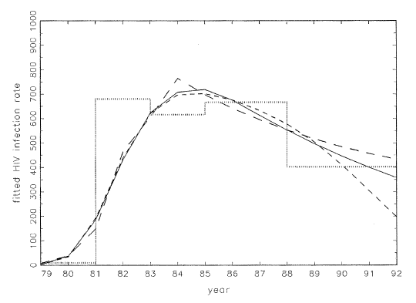
Modeling dose-response
B
A
C
D
Greenland S. Dose-Response and Trend Analysis in Epidemiology: Alternatives to Categorical Analysis. Epidemiology 1995.

Slide 42
Continuous Variable
Advantages:
  Most powerful if dose-response is truly linear
Disadvantages
  Sensitive to influential points often in the extremes of the distribution

Slide 43
Indicator/ Categorical Variable
Also known as reference coding, dummy coding, disjoint coding…
Key assumption: Categories should represent scientifically meaningful constructs within which risk is not expected to change dramatically
Take continuous variable, V
Define categorical variable X split into K cut-points where…
  X=1 if V in [0, cut-point 1]
  X=2 if V in [cut-point 1, cut-point 2]
  …
  X=k if V in [cut-point K, infinity]
E(Y) = β₀ + β₁I(X=2) + β₂I(X=3) + β₃I(X=4) + β_{k-1}I(k-1)
  K is reference group to which all other categories are compared
Notes:
Assumes dose response curve is a step function with abrupt changes in risk at the chosen threshold
Parameter beta describing relationship between V and Y is homogeneous within categories
How do you choose the best category? Largest sample size is most efficient/ powerful use of the data.

Slide 44
Indicator/ Categorical Variable
Advantages:
  Relatively insensitive to assumptions about shape of dose-response curve
  Insensitive to influential points
  More powerful than continuous if dose-response is not linear
Disadvantages:
  Loss of power if categories are incorrectly defined
  Loss of power due to risk estimation for many variables if dose-response is truly linear
  Assumes unrealistic jump in risk at category cut-points
  Residual confounding may result if categories are too wide

Slide 45
Score test
Exposure, V, can be replaced by ordinal score vector S assigned to different exposure levels
Some options:
  Ordinal score: 1, 2, 3, 4, 5
  Category midpoints
  Category means or medians
Linear trend test
  Advantages:
    More power and efficiency if the trend curve fits the linear function form
    Avoid unreasonable assumption of sudden change of risk between categories
  Disadvantages:
    Assumes trend curve is a linear function
    Not robust to a non-linear relationship
    May be sensitive to outliers
Notes:
Ordinal scores should be avoided because they can yield quantitatively meaningless dose-response curves
Category midpoints can be less distortive but are not defined for open-ended categories
Category means or medians can be even less distortive and are defined for open-ended categories

Slide 46
Fractional polynomials
What if linearity assumption is incorrect?
Examine dose-response without over-simplification of the dose-response relationship
Linear, quadratic terms, fractions and inverse powers of exposure, X, are added to the model
  Commonly selected: -2, -1, -0.5, 0, 0.5, 1, 2
Example: E[Y] = β₀ + β₁X^{1/2} + β₂X + β₃X^{-3/2} + β₄X²
In Stata, command mfp

Slide 47
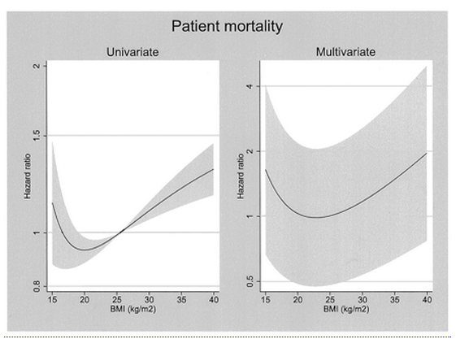
McDonald SP et al., Obesity is associated with worse peritoneal dialysis outcomes in Australia and New Zealand patient populations. JASN 2003
Notes:
J-shaped relationship between BMI and patient mortality rates and steady increase in patient mortality up to a BMI of 40. Mortality was lowest for BMI values around 20-25.

Slide 48
Fractional polynomials
Advantages:
  Simple qualitative analysis can be done by adding power terms
  A few different power terms can give model a wide range of shapes
  Allows change of slope and makes use of all information
  Increase power and precision to identify a non-linear relationship
  No assumption of step-risk function
  More parsimonious model than categorical or spline regression
Disadvantages:
  May be difficult to determine what terms to put in the model
  Many FP functions may fit equally well
  Outliers and influential points may affect model fitting
  Parameter interpretation is difficult
Notes:
May be difficult to determine what terms to put in the model
specify the shape of the curve before model fitting, otherwise fishing
Requires one to know power term’s effect on the shape of the curve to pre-specify the curve
Quadratic term increases the slope
Square-root term decreases the slope

Slide 49
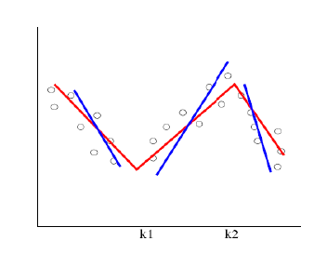
Splines
Sequence of joined segments that produce a piecewise pattern
  Knot: locations where segments are joined together
  Choose power of the spline
  Spline: resulting piecewise curve
Linear spline: E(Y_{ij}) = β₀ + β₁X + β₂(X-x*)
Quadratic spline: E(Y_{ij}) = β₀ + β₁X + β₂X² + β₃(X-x*)²
Cubic: E(Y_{ij}) = β₀ + β₁X + β₂X² + β₃X³ + β₄(X-x*)³
Notes:
First categorize regressor (define the knots)
Choose power of the spline according to flexibility one desires within categories.
Zero power indicates trend is flat within categories but may jump suddenly at knots
First power or linear spline – trend is modeled by series of connected line segments (line indicates trend, slope may change only at the knots)
Second power or quadratic spline – beta represents change in quadratic term from category to category
(spline has smoother appearance because same slope is shared on either side of the knots
- Third power or cubic splines has additional parameter

Slide 50
Splines
Advantages:
  Most flexible for capturing dose-response relationships of any shape
  Requires little a priori specification by analyst
  Can test for non-linearity
Disadvantages:
  Can be sensitive to influential points
  Effects depend on the number and value of knots
  Can be sensitive to choice of the smoothing parameter (ex: linear, quadratic)
  Difficult to summarize results with one or several relative risks
  Methods are computationally intensive and mathematically complex

Slide 51
Indicator method
Linear spline
Quadratic spline
Fractional polynomial
Greenland S. Dose-Response and Trend Analysis in Epidemiology: Alternatives to Categorical Analysis. Epidemiology 1995.
Notes:
Comparison of dose-response curves

Slide 52
Summary of dose-response methods
 | Categorical | Trend test | FP | Splines
Assumptions | Step-risk assumption | Linear assumption | Parametric assumption of power term function form | Semi-parametric assumption of knot and within-category functional form
Robust to non-linearity | Yes | No | Yes | Yes
Power and precision | Less | Good if linear relationship holds | Best power and precision | Between categorical and FP
Interpretability | High | High | Low | Low
Influence by outlier | Mild | Moderate | Strong | Strong
Ease of implementation | Easy | Easy | Moderate | Difficult

Slide 53

To sum it all up…
Study design and outcome can determine type of regression model to use
Select variables to include in a regression model
  How?
Decide how to model selected variables
  What modeling assumptions are you making?
  Are these likely to hold?
Evaluate model fit

Slide 54

Methods for causal inference

Slide 55
Assumptions necessary for causal inference
Exchangeability
Positivity
Well-defined intervention
No model misspecification

Slide 56
Conditional exchangeability
Remember exchangeability:
  The counterfactual risk in the treated equals the counterfactual risk in the untreated
  Subjects in group 1 would have had the same risk as those in group 2 had they received the treatment of those in group 2
  This is also called MARGINAL exchangeability
Conditional exchangeability:
  Randomization probabilities are dependent (conditional) on the value of L
    Randomly expose 75% of L=1 and 50% of L=0
  Exchangeability is guaranteed in each of the substudies
  The counterfactual risk is the same in the treated and the untreated with the same value of L
  This implies no confounding within levels of L

Slide 57
Standardization
Simulates what would have happened in the study population if:
  Everybody had received the treatment and
  The distribution of the covariates L were the same as its distribution in the standard population
E[Yª] = Σ E[Y|A=a, L=l] * Pr[L=l]
A weighted average of an outcome measure of a distribution
  Population 1: the study population
    Compute the risk in each stratum of a covariate L
  Population 2: the standard
    Compute the proportion of subjects in each stratum of L
  Standardized measure is
    Weighted average of stratum-specific measures of population 1
    Using the stratum-specific proportions of population 2
Results are marginal or population-averaged, NOT conditional on the covariates L

Slide 58
An example
Consider the following experiment:
Variables:
  A=1: heart transplant (exposure)
  Y=1: death (outcome)
  L = critical condition (prognostic factor)
Goal is to estimate the marginal effect of A on Y
 | L=0 |  | L=1
 | Y=1 | Y=0 | Y=1 | Y=0
A=1 | 1 | 3 | 6 | 3
A=0 | 1 | 3 | 2 | 1

Slide 59
An example
Step 1: compute the conditional risk if everyone had been exposed in each stratum of L
  Pr[Y^{a=1}=1|L=0] = Pr[Y=1|A=1, L=0]
  Pr[Y^{a=1}=1|L=1] = Pr[Y=1|A=1, L=1]
Step 2: compute the weighted average of the conditional risks
  Pr[Y^{a=1}=1] = Pr[Y=1|A=1, L=0] * Pr[L=0] +
  Pr[Y=1|A=1, L=1] * Pr[L=1]
Notes:
Marginal probability is weighted average of conditional probabilities

Slide 60
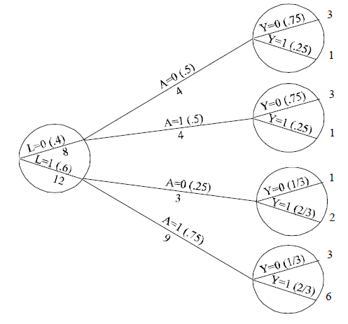
Pr[Y^{a=1}=1]
= Pr[Y=1|A=1, L=0]x Pr[L=0] + Pr[Y=1|A=1, L=0]x Pr[L=0]
= (1/4) x 0.4 + (2/3) x 0.6 = 0.5
Pr[Y^{a=0}=1]
= Pr[Y=1|A=0, L=0]x Pr[L=0] + Pr[Y=1|A=0, L=0]x Pr[L=0]
= (1/4) x 0.4 + (2/3) x 0.6 = 0.5
Pr[Y^{a=1}=1]/ Pr[Y^{a=0}=1] = 0.5/0.5 = 1.0

Slide 61
Which population to use as standard?
The EXPOSED (also called indirect standardization):
  Weighted average of the stratum-specific risk ratios using the distribution of exposed as the weights
  Estimates the standardized mortality ratio (SMR)
  SMR = Pr[Y=1|A=1]
  Σ Pr[Y=1|A=0, L=l] * Pr[L=l|A=1]
The UNEXPOSED (also called direct standardization):
  Estimates the standardized risk ratio (SRR)
  Weighted average of the stratum-specific risk ratios using the distribution of unexposed as the weights
  SRR = Σ Pr[Y=1|A=1, L=l] * Pr[L=l|A=0]
  Pr[Y=1|A=0]
Notes:
Observed number of cases in the exposed divided by the number of cases in the unexposed as if they had the covariate distribution of the exposed
Numerator simulates the number of cases had the unexposed been exposed divided by the observed number of cases in the unexposed

Slide 62
Standardization with models
Consider the linear model: E[Y|A,B] = β₀ + β₁A + β₂B
Interpretation of parameters
  E[Y|A=0, B=0] = β₀
  E[Y|A=0, B=1] = β₀ + β₂
  E[Y|A=1, B=0] = β₀ + β₁
  E[Y|A=1, B=1] = β₀ + β₁ + β₂
Use parameter estimates to calculate
  E[Y|A=0, B=0] = 130.22
  E[Y|A=0, B=1] = 125.51
  E[Y|A=1, B=0] = 133.82
  E[Y|A=1, B=1] = 129.11
Standardized mean in the exposed:
  E[Y|A=1, B=1] * Pr[B=1] + E[Y|A=1, B=0] * Pr[B=0]
  = 129.11 * 0.514 + 133.82 * 0.486 = 131.40
Standardized mean in the unexposed:
  E[Y|A=0, B=1] * Pr[B=1] + E[Y|A=0, B=0] * Pr[B=0]
  = 125.51 * 0.514 + 130.22 * 0.486 = 127.80
Effect Estimate = 131.40 – 127.80 = 3.6

Slide 63


Slide 64
Inverse probability weighing
W = 1_____
Pr[A=a|L=l]
Simulates what would have happened had all subjects in the study population been treated and untreated The treated and untreated are conditionally
Each individual in the population is weighted to create W individuals in the pseudo-population
The denominator of your W is the probability of having your observed treatment value given your L value (covariates)
  Sound familiar?

Slide 65
An example
Consider the following experiment:
Variables:
  A=1: heart transplant (exposure)
  Y=1: death (outcome)
  L = critical condition (prognostic factor)
Goal is to estimate the effect of A on Y
 | L=0 |  | L=1
 | Y=1 | Y=0 | Y=0 | Y=0
A=1 | 1 | 3 | 6 | 3
A=0 | 1 | 3 | 2 | 1

Slide 66
The original population

Slide 67
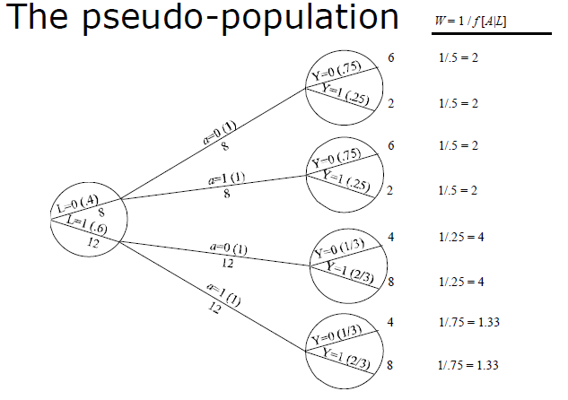
The pseudo-population
 | Yª=1 | Yª=0
a=1 | 10 | 10
a=0 | 10 | 10

Slide 68
Data analysis in the pseudo-population
 | Yª=1 | Yª=0
a=1 | 10 | 10
a=0 | 10 | 10
Pr[Y^{a=1}=1] = 10 / 20 = 0.5
Pr[Y^{a=0}=1] = 10 / 20 = 0.5
Risk ratio = 1.0

Slide 69
Pseudo-population
The pseudo-population created by IP weighting is a marginally randomized experiment
  Exposed and unexposed subjects are unconditionally exchangeable… because they are the same person!
  There is no confounding by L.

Slide 70
IPW with models
  #1 - Model for the weights
  Let’s assume we have an observational study with 1 dichotomous exposure and 3 covariates, L, M and N that are potential confounders
  Denominator for the treatment weights to create the PP:
    logit Pr[A=a|L, M, N] = β₀ + β₁L + β₂M + β₃N
  #2 - Marginal structural model: E[Yª] = β₀ + β₁A
  Interpretation of parameters:
    Mean Y if everybody was exposed: E[Y^{a=1}] = β₀ + β₁
    Mean Y if everybody was unexposed: E[Y^{a=0}] = β₀
    Difference = β_{1,} the causal effect of interest!
  MSMs are marginal because they allow for confounding control without including the confounders as covariates in the model
    The estimated effect is not CONDITIONAL on covariates

Slide 71
Modifications to IPW - weights
Unstabilized weights:
W = 1_____
Pr[A=a|L=l]
  Don’t work well if high weight given to subjects with low probability of receiving exposure
Stabilized weights:
SW = Pr[A=a]__
Pr[A=a|L=l]
  Increase efficiency, estimate effects in subsets of the population, etc.

Slide 72
Modifications to IPW - censoring
For censoring (also called IPCW)
CW = 1_____
Pr[C=0|A, L]
SCW = Pr[C=0|A]_
Pr[C=0|A, L]
Want to simulate what would have happened had everyone’s outcome been observed
Assumes censoring is random within levels of A and L (no unmeasured variables U affect censoring)
IP weights can be created that account for both confounding and censoring
Resulting estimate interpreted as: “had no one’s outcome been censored”
A
C=0
Y
L

