Slide 1
Basic Analysis Issues for Health Disparities Research
Anusha M. Vable, ScD, MPH
Assistant Professor
Department of Family and Community Medicine
University of California, San Francisco
anusha.vable@ucsf.edu
@AnushaVable
Notes:
Hello my name is Anusha Vable, and I’m a social epidemiologist here at UCSF. My research focuses on education and education policies as potential scalable, population-level solutions to racial and socio-economic health disparities

Slide 2
Topics covered
Confounding, mediation (Baron-Kenny) & model building
Effect modification
Intuition behind: Multi-level analysis
Notes:
Today we’ll discuss confounding, mediation, and model building.
Then, we’ll discuss effect modification.
And, finally we’ll touch on multi-level analysis. I took a whole semester-long course on multilevel, and we’re going to go over it in about 20 minutes.
So, my goal for today is provide you with some of the intuition behind these concepts, and we’ll do a few examples by hand. After this lecture, you should to be able to read the literature more critically, and know about different analysis techniques that are important for health disparities research.
So let me start with quickly defining these concepts, and then we’ll go through them in more depth.

Slide 3
Confounding
Confounding bias occurs when there is a common (shared) prior cause of both the exposure and the outcome.
Accounting for confounders is important for getting unbiased effect estimates
?
education
cognition
mother’s education

Slide 4
Mediation
Mediation analysis allows us to decompose the total effect (a) of the exposure on the outcome into the direct effect (a’) and the indirect (or mediated effect; b*c)
Helpful for identifying mechanisms
mother’s education
a
cognition
a'
mother’s education
education
cognition
b
c

Slide 5
Effect Modification
The relationship between an exposure and an outcome depends on the level of another variable, the effect modifier
Helpful for targeting of interventions.
Example: you may expect the effect of education on cognition to be different among Black women than among White men
Notes:
So for example, you might expect that the effect of education on cognition is different among Black women than among White men since Black women’s experience of the world every day differs from than of White men.

Slide 6
Multilevel Analysis
Empirically differentiating composition (characteristics of individuals) from context (differences due to place), both of which are important for health
Examining cross-level interactions (effect modification in a multi-level context)
Notes:
Multilevel Modeling is a totally different category of analysis, although it’s still regression based. And it’s particularly relevant for health disparities research.
Just like single level regression models, multilevel models can be used to account for confounding, evaluate mediation, and explore effect modification. What is different about multilevel models is that they help you empirically differentiate composition from context.
We’ll also touch on some of the cross-level interaction questions you can answer with multilevel models.

Slide 7
Confounding

Slide 8
Confounding
Confounding bias occurs when there is a common (shared) prior cause of both the exposure and the outcome.
Accounting for confounders is important for getting unbiased effect estimates
?
education
cognition
mother’s education
$$E\left[cognition\right]=β_{0}+β_{1}\left(mother^{′}s education\right)+β_{2}(education)$$
$$Cognition=β_{0}+β_{1}\left(mother^{′}s education\right)+β_{2}\left(education\right)+e$$
Notes:
Here I have the regression equations that you would write; there are two different ways you could write the regression equation. This top one is the expected value, so there’s no error term, and this bottom one is the actual outcome, so there is an error term.
Here we could say that mother's education confounds the effect of own education on cognition, but it would not be right to say that own education confounds the effect of mother's education because own education is a consequence - not a cause - of mother's education.

Slide 9
Activity: Confounding
Draw a DAG for a relationship of interest
Include only one confounder for simplicity
Follow convention that time moves from left to right, so there are no arrows that point from right to left (would imply moving backwards in time)
Optional: Write the equation to determine if the exposure has an effect on the outcome after controlling for confounding

Slide 10
Empirical example of confounding
Data generating rule:
cog = 4*momedu + 2*edu + error
?
education
cognition
mother’s education
?
education
cognition
mother’s education
Notes:
I simulated a little dataset to show you an example of confounding.
This is my data generating rule, so you can see the outcome, cognition, is based on both mother’s education (the confounder), and own education (the exposure). So, based on this data generating rule, what do we expect the coefficient for own education to be? Approximately 2.
First, I won’t adjust for confounding, which is depicted by no box around the confounder. Here you can see that the effect estimate is upwardly biased b/c there is another path way from education to cognition through mother’s education that isn’t blocked b/c we aren’t adjusting for mother’s education. This results in a biased, overestimation of the relationship between education and cognition.
In the second example, I do adjust for the confounder, depicted as a box around mother’s education, and I get the true, unconfounded effect of education on cognition, approximately 2.
Is this clear? So when I don’t adjust for the confounder, I get a biased effect estimate b/c there is another pathway from education to cognition through mother’s education. And, when I adjust for mother’s education, I block that pathway, and get the correct effect estimate.

Slide 11
Confounders in disparities research
education
occupation
income
health
race / ethnicity
Notes:
I want to clarify that confounders temporally precede the exposure of interest.
So, for example, I examine the effect of education and education policies on health. I think that education determines your skills, which determines your job, which determines your income, all of which effect health.
If this is the causal structure, do I control for income as a confounder?
Why not? b/c it’s a downstream consequence of the exposure. In this case, income is a mediator. We’re going to discuss mediator next.
Basically, things that come later in time do not confound things that come earlier in time -- for this reason, I like to follow the convention of no backwards arrows b/c it makes it easier to determine the temporal order.

Slide 12
Additional reading on confounding: Society for Epidemiologic Research (SER) Playlist

Slide 13
How to estimate mediation
Notes:
Mediation is another analytic technique that is especially important for disparities research. If want to determine how to reduce racial disparities, we can’t intervene on race, so we need to understand the pathways that link race to health, and you can figure out these pathways through mediation analysis.

Slide 14
Mediation analysis
Mediation analysis allows us to decompose the total effect (a) of the exposure on the outcome into the direct effect (a’) and the indirect (or mediated effect; b*c)
mother’s education
a
cognition
a'
mother’s education
education
cognition
b
c
Baron & Kenny, 1986

Slide 15
Baron-Kenny Decomposition
Evaluate if a variable is a mediator
Complete or partial mediation
mother’s education
a
cognition
a'
mother’s education
education
cognition
b
c
Baron & Kenny, 1986

Slide 16
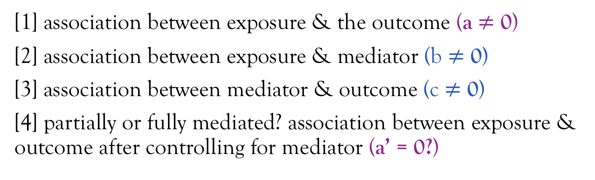
Baron-Kenny Decomposition (4 steps)
[1] association between exposure & the outcome (a $≠$ 0)
[2] association between exposure & mediator (b $≠$ 0)
[3] association between mediator & outcome (c $≠$ 0)
[4] partially or fully mediated? association between exposure & outcome after controlling for mediator (a’ = 0?)
mother’s education
a
cognition
a'
mother’s education
education
cognition
b
c
Baron & Kenny, 1986

Slide 17
Equations for the Baron-Kenny Decomposition
a
mother’s education
cognition
a'
mother’s education
b
c
education
cognition
[1] association between exposure & the outcome
[2] association between exposure & mediator
[3] association between mediator & outcome
[4] partially or fully mediated? association between exposure & outcome after controlling for mediator
$$E\left[cognition\right]=β_{0}+β_{1}\left(mother^{′}s education\right)$$
$$E\left[education\right]=β_{0}+β_{1}\left(mother^{′}s education\right)$$
$$E\left[cognition\right]=β_{0}+β_{1}\left(education\right)+ β_{2}(mother^{′}s education)$$
$$E\left[cognition\right]=β_{0}+β_{1}\left(education\right)+ β_{2}(mother^{′}s education)$$
Baron & Kenny, 1986
Notes:
Can you add the wrap up that you interpret beta 2 as the direct effect and contrast beta1 (from model 1) and beta 2 from model 4 to evaluate the indirect effect?
Block out equations so they are serially revealed

Slide 18
Empirical example of mediation
a'
mother’s education
a
cognition
mother’s education
education
cognition
b
c
Step 1:
Step 2:
Steps 3 & 4:
Notes:
Put a and a’ in previous example

Slide 19
Activity: Mediation
Suggest following the convention that time moves from left to right
Victora et al., 1997

Slide 20
family income
sanitation
malnutrition
diarrhea
Victora et al., 1997

Slide 21
List the confounders and the mediators for the following relationships:
family income
sanitation
malnutrition
diarrhea
 | Confounders | Mediators
Family income on diarrhea | none | sanitation malnutrition
Sanitation on diarrhea | family income | malnutrition
Malnutrition on diarrhea | family income sanitation | none
Victora et al., 1997

Slide 22
You want to determine if the relationship between sanitation and diarrhea is mediated by malnutrition. What are the equations to assess this relationship?
family income
sanitation
malnutrition
diarrhea
Step 1: association between exposure & the outcome?
Step 2: association between exposure & mediator?
Step 3: association between mediator & outcome?
Step 4: partially or fully mediated?
$$E\left[diarrhea\right]=β_{0}+β_{1}\left(sanitation\right)+β_{2}(family income)$$
$$E\left[malnutrition\right]=β_{0}+β_{1}\left(sanitation\right)+β_{2}(family income)$$
$$E\left[diarrhea\right]=β_{0}+β_{1}\left(malnutrition\right)+β_{2}\left(sanitation\right)+β_{3}(family income)$$
$$E\left[diarrhea\right]=β_{0}+β_{1}\left(malnutrition\right)+β_{2}\left(sanitation\right)+β_{3}(family income)$$
Notes:
We’ll go over this together – if you view in presentation mode the boxes will go away for the equations to be revealed

Slide 23
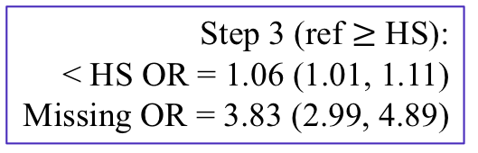
Pathways through which racial / ethnic disparities in US fetal deaths arise
Step 2:
< HS White = 11%
< HS Black = 22%
OR = 1.98 (1.81, 2.15)
Step 3 (ref $≥$ HS):
< HS OR = 1.06 (1.01, 1.11)
Missing OR = 3.83 (2.99, 4.89)
OR = 1.56 (1.42, 1.70)
OR = 1.04 (0.95, 1.14)
Step 1 (ref = Whites):
Black OR = 2.24 (2.08, 2.42)
Lorch et al., 2012
Notes:
In this study by Lorch, which was one of your assigned readings, they were interested in determining which of these factors, SES, preexisting comorbid conditions, fetal factors, etc., mediated the relationship between racial ethnic group and fetal death risk, and they implemented the BK decomposition understand these relationships.
This is a substantive and meaningful question b/c we can’t intervene on race, right? But, we may be able to intervene on these mediating factors, and therefore if we can determine which of these factors are important mediators, and if we can intervene on them, then maybe we can reduce disparities.
Lorch looked at a lot of different factors; I’m just going to walk you through Black / White disparities, and focus on education, but in their paper, they did formally examine all of these factors, including different ways of looking at SES, and looked at disparities among Hispanics and Asians compared to Whites.
In step 1, we want to see if there is a relationship between the exposure and the outcome, and we see that there is one – the Black / White differences in fetal death risk is 2.24, and the confidence interval doesn’t include the null value of 1.
In step 2, they tested to see if there was a relationship between the exposure, race / ethnicity, and race, and they found that there was one, such that 11% of White mother’s had less than a HS education, and 22% of Black mother’s had less than a HS education.
In step 3, they tested to see if there was a relationship between the mediator and the outcome, and they found there was one, such that having less than a high school education predicts higher risk of fetal death. Another thing I want to point out is those missing data on education – those with missing data on education have MUCH higher risk of fetal death; this is very typical in health disparities research – that is, it is very typically in health disparities research for those with missing data to the most socially vulnerable, and individuals with missing data are often excluded from analysis. For this reason, you often have to think very critically about how you handle those with missing data, because they are often the group that you are most interested in.
Ok let’s move on to step 4. These authors serially added each of these factors, and found from the total OR of 2.24 of fetal deaths for Blacks vs. Whites, adding SES factors reduced the OR to 1.98, adding antepartum complications reduced the OR to 1.56, and adding fetal factors reduced the OR to 1.04. They used this formula they describe in the text, and found socioeconomic factors explained 16% of the Black/White disparity, antepartum factors explained 30% of the Black/White disparity, and fetal factors explained 50% of the black white disparity, and then there was about 5% residual disparity.

Slide 24
Additional reading on mediation
Notes:
All subsequent mediation analyses are based on the framework proposed by BK. There have been some critiques of BK and advances in mediation analysis such as, there may be an interaction between the exposure and the mediator, there may be confounders of the mediator – outcome relationship, measurement error of the mediator, etc.
The BK approach is the foundation of all subsequent mediation approaches, so now you should have a solid foundation to build on if you want to study mediation.

Slide 25
Why is it important to differentiate between confounders & mediators in disparities research?
What to adjust for – don't adjust for mediator if want total effect
Want to control for mediators to understand the mechanisms
Interpretation of models
Notes:
Want to describe effect of race on quality of care in the hospital
Walk through an example related to race
If want to look at poverty / education then you do want to control for race

Slide 26
Why adjust for SES when examining racial disparities?
education
race / ethnicity
occupation
health
income
wealth
Notes:
If this is the causal structure, with SES variables as a downstream consequence of race, why do we typically adjust for SES when looking at racial disparities?
Typically, we’re interested in the direct effect of race not mediated by social factors, that is, we’re interested in the INJUSTICE due to race alone. If you’re looking at racial disparities, you want to know the effect that’s only due to “race” or racism. We’re also interested in this b/c we can intervene on SES, but we can’t intervene on race. So, if you did a mediation analysis, you may be able to determine how large the effect of race on health be if we could take away all the SES effects.
Incomplete adjustment for SES could also make racial / ethnic disparities seem wider than they actually are.

Slide 27
Measurement of racism reduces possibility disparities misinterpreted as genetic / biologic rather than social
racism
education
race / ethnicity
occupation
health
income
wealth
Notes:
If you don’t measure racism you could misinterpret the disparity as due to genetic / biologic reasons rather than social

Slide 28
Racism occurs on several levels
Structural
Institutional
🏥
Interpersonal
Internalized

Slide 30
“Structural racism refers to the totality of ways in which societies foster racial discrimination through mutually reinforcing systems of housing, education, employment, earnings, benefits, credit, media, health care, and criminal justice. These patterns and practices in turn reinforce discriminatory beliefs, values, and distribution of resources.”
Bailey et al., 2017

Slide 31
Structural racism
education
health care
(access & quality)
housing
criminal justice
employment
earnings
credit
benefits
Bailey et al., 2017
Notes:
mutually reinforcing systems of housing, education, employment, earnings, benefits, credit, media, health care, and criminal justice
So, let’s just follow one of these pathways, and see how it hits all the other things.
First, we know redlining meant that Black folks were not able to get credit to buy houses in certain areas.
In this country, we fund our schools through local property taxes and revenue, so quality varies widely based on where you live.
School to prison pipeline.
Criminal justice involvement effects ability to access the social safety net, vote, get a job, and the type of job you can get.
In this country, most people get their health care through their jobs; access to care and quality of care is also socially patterned.
Your employment impacts your ability to get credit.
And credit impacts housing.

Slide 32
Effect Modification

Slide 33
Effect modification is critical for health disparities research!!
Effect modification is important for reducing disparities, e.g. when the structurally marginalized group benefits more from the exposure than the advantaged group.
Effect modification is used interchangeably with other terms:
Heterogenous treatment effects
Interactions
Differential returns
Notes:
Differential exposure

Slide 34
Effect modification & health disparities
Notes:
Change these color so more obviously different?

Slide 35
Intersectionalities & Effect Modification
Intersectionality theory developed to address the non-additive effects of gender and race / ethnicity
Cannot sum the coefficients for “Black” and “male” to understand the experiences of Black men; must examine Black men independently
Bauer GR; Social Science and Medicine (2014)

Slide 36

Effect modification in linear models
The relationship between gender and systolic blood pressure does not vary by race:
The relationship between gender and systolic blood pressure does vary by race:
$$E\left[SBP\right]=β_{0}+β_{1}\left(male\right)+ β_{2}\left(Black\right)$$
$$E\left[SBP\right]=β_{0}+β_{1}\left(male\right)+ β_{2}\left(Black\right)+β_{3}\left(male\right)∗(Black)$$
Notes:
Check Maria’s slides in All documents for Maria’s review

Slide 37


Activity: Interpretation of coefficients assuming no effect modification
$$E\left[SBP\right]=β_{0}+β_{1}\left(male\right)+ β_{2}\left(Black\right)$$
$β_{0}$: mean SBP when all coefficients are zero
(that is, mean SBP for White women)
$β_{1}$: mean difference in SBP for men
$β_{2}$: mean difference in SBP for Black people
Mean SBP for Black men: $β_{0}+β_{1}+β_{2}$
Model assumes we can sum the regression coefficients for Black and male to understand the experience of Black men.
Notes:
Add boxes so serially revealed

Slide 38
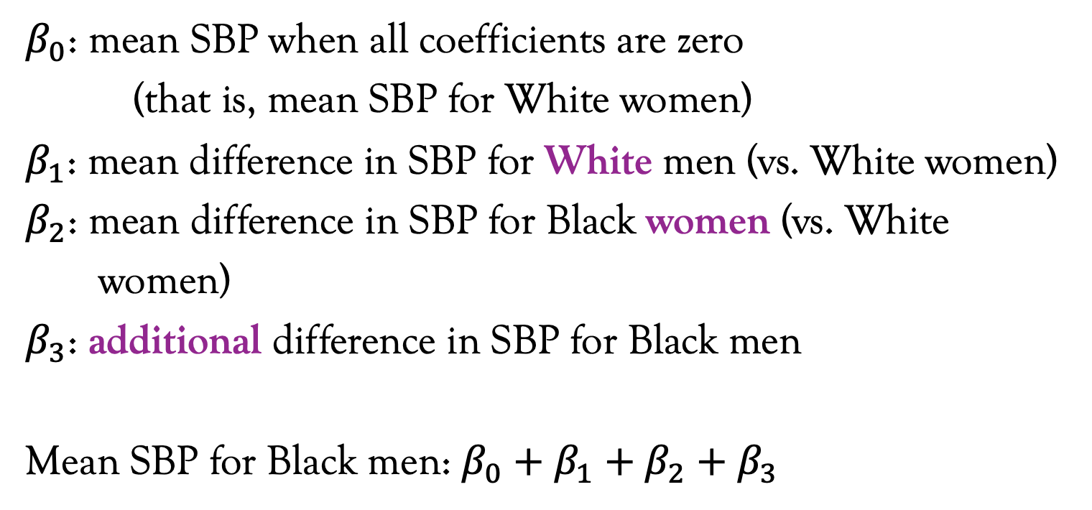
Interpretation of coefficients allowing for the possibility of effect modification
$$E\left[SBP\right]=β_{0}+β_{1}\left(male\right)+ β_{2}\left(Black\right)+β_{3}\left(male\right)∗(Black)$$
$β_{0}$: mean SBP when all coefficients are zero
(that is, mean SBP for White women)
$β_{1}$: mean difference in SBP for White men (vs. White women)
$β_{2}$: mean difference in SBP for Black women (vs. White
women)
$β_{3}$: additional difference in SBP for Black men
Mean SBP for Black men: $β_{0}+β_{1}+β_{2}+β_{3}$
Model assumes we cannot sum the regression coefficients for Black and male to understand the experience of Black men.
Notes:
After this slide- point out that you can do this with two binary variables or a binary and a continuous, or two continuous, and the ideas are the same it just gets slightly more complicated to interpret.
In this case, we looked at two binary variables – male and Black. You can extend this to look at the interactions between binary and continuous variables (which we’ll do now), or two continuous variables, but two continuous variables gets difficult to interpret.

Slide 39
Stretch!

Slide 40
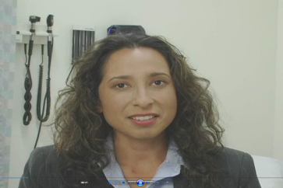
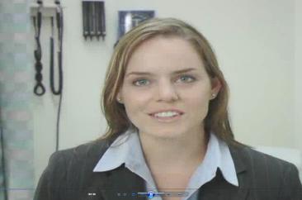

The “Patients”
Notes:
Examples of effect modification – Christine to explain

Slide 41
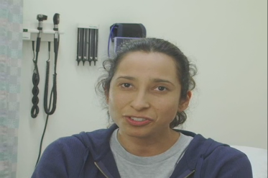
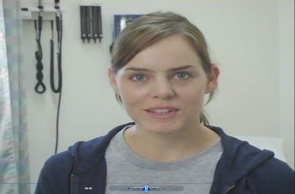

The “Patients”
Notes:
Examples of effect modification – Christine to explain

Slide 42
Differential returns to education
Because different sociodemographic groups have different experiences in the social world, we thought different sociodemographic groups may differentially benefit from each year of education, that is, there may be differential returns to education
Vable et al., 2018
Notes:
Quality of education Black students receive is lower than the quality of education White students receive
Blacks with higher educational attainment experience more inter-personal racism than Blacks with lower levels of education
There is also evidence that Blacks, and socially vulnerable groups more broadly, such as women, are structurally barred for receiving alternatives to education such as power, authority, earning, etc., making these groups more dependents on the resources they do have access to, such as education, potentially resulting in differential returns to education.

Slide 43
There are differential returns among race - sex subgroups in predicting mental health
 | Base Model |  |  | Race x Sex interactions
Constant | 54.0 | 53.5,54.5 | <0.0005 | 54.0 | 53.5,54.5 | <0.0005
Education (centered @ 12) | 0.7 | 0.4,1.0 | <0.0005 | 0.4 | 0.0,0.9 | 0.07
White women | -2.5 | -3.2,-1.9 | <0.0005 | -2.7 | -3.4,-2.0 | <0.0005
Black men | -0.1 | -0.9,0.7 | 0.7 | -0.1 | -1.0,0.6 | 0.7
Black women | -1.9 | -2.7,-1.1 | <0.0005 | -2.0 | -2.8,-1.2 | <0.0005
Latino men | 0.6 | -0.4,1.7 | 0.2 | 0.6 | -0.5,1.6 | 0.3
Latino women | -0.9 | -2.0,0.3 | 0.1 | -1.0 | -2.1,0.2 | 0.1
White Women*edu |  |  |  | 0.7 | 0.0,1.4 | 0.1
Black Men*edu |  |  |  | 0.2 | -0.6,1.1 | 0.6
Black Women*edu |  |  |  | 0.9 | 0.2,1.6 | 0.01
Latino Men*edu |  |  |  | 0.4 | -0.4,1.1 | 0.4
Latino Women*edu |  |  |  | -0.1 | -1.0,0.7 | -.8
Vable et al., 2018
Notes:
Base model:
Constant: average mental health component summary score for White men with 12 years of education
Education: average difference in mental health component summary score associated with a 1-year change education
Black women: average difference in the mental health component summary score for Black women vs. White men with 12 years of education
Race x sex interaction model:
Constant: average mental health component summary score for White men with 12 years of education
Education: average difference in mental health component summary score with each additional year of education FOR WHITE MEN
Black women: average difference in the mental health component summary score for Black women vs. White men with 12 years of education
BW*edu: additional average difference in the mental health component summary score for a 1-year change in education for Black women vs. White men

Slide 44
From Antiracist Baby by Dr. Ibram X. Kendi

Slide 45
Is there effect modification here?
Who benefits and who doesn’t?
Does this version of Paid Family Leave increase or decrease disparities?
Alternative: is this PFL policy racist or anti-racist?
Hamad R, Modrek S, White JS; AJPH, 2018
Notes:
Is there effect modification here?
Who benefits and who doesn’t?
Does this version of Paid Family Leave increase or decrease disparities?

Slide 46
College affirmative action bans and smoking and alcohol use among underrepresented minority adolescents in the United States: A difference-in-differences study
Venkataramani AS, et al.; PLOS Med, 2018
Notes:
Is there effect modification here?
Who benefits and who doesn’t?
Does this version of Paid Family Leave increase or decrease disparities?
Alternative: is this PFL policy racist or anti-racist?

Slide 47
Prop 47 (2014) reclassified drug possession in CA from a felony to a misdemeanor.
Mooney AC, et al.; AJPH, 2018
Notes:
Is there effect modification here?
Who benefits?
Is this policy racist or anti-racist?

Slide 48
Systematic Oppression of Black People by the State
Post Civil Rights: 8 years
(2%)
Enslavement: 246 years
(61.3%)
Reconstruction & Jim Crow: 100 years
(24.9%)
War on Drugs: 47(+) years
(11.7%)
1619
1865
1965
1973
2020
Resistance, e.g., underground railroad
Resistance, e.g., the Great Migration;
Civil Rights
Resistance, e.g.,
#BlackLivesMatter
Adapted from Dr. Shawnita Sealy-Jefferson & Dr. Sharon Washington
Notes:
And the status quo in this United State is the systematic oppression of Black people.
Enslaved Africans were first brought to the US in 1619, and enslavement lasted the next 246 years, or > 60% of time Black people have been in America.
Then the 13th amendment was passed, which abolished slavery, but there was still state-sanctioned oppression in the form of the Jim Crow laws, a collection of state and local statues that legalized segregation, and lasted 100 years.
Then Civil Rights passed, and there was brief period with less systematic state-sanctioned oppression.
But then the war on drugs started, and has been ongoing for the last 50 years.
It’s important to note that throughout this history, there has been resistance to this systematic oppression. For example, the
Underground railroad, which was a secrete system of safe routes for enslaved Americans to make their way to free states and Canada.
The Great Migration, whereby 6 million Black Americans moved out of the rural South and to the Northeast, Midwest, and West
The Civil Right Movement led by several people including Dr. Martin Luther King, Jr.
And today this is the Black Lives Matter movement, voter registration drive and more, which really builds on this rich history of resistance and protest movements

Slide 49
Structural racism
education
housing
health care
(access & quality)
criminal justice
employment
credit
earnings
benefits
Bailey et al., 2017
Notes:
This is just that quotation is just read to decipcted graphically to show the mutually reinforcing systems, and to highlight that, in this country, you can suffer from a felony for the rest of your life.
So, let’s just follow some of these arrows:
A felony conviction impacts the type of job you can get.
In this country, we tie our health care to our jobs, so the felony conviction will impact ability access to health care and the quality of health care you receive
Employment also impacts how much money you make, your ability to pay bills,
which will impact your credit
Your credit impacts where you can rent, and if you are able to buy a house
In this country, we tie funding of the public school system to property taxes, so where you live effects the quality of education your children can receive, so the criminal justice system has inter-generational effects
And the criminal justice system impacts your ability to access the safety net
And, not depicted in this graph, but especially important right now, a felony conviction effects your ability to vote

Slide 50
Relative vs. absolute disparities
Relative disparities depend on the rate in the reference group
Same relative effects, but different absolute effects
White | Black | Relative disparity | Absolute disparity
1 | 2 | 2 | 1
50 | 100 | 2 | 50

Slide 51
Impact of the Affordable Care Act on human papillomavirus vaccination initiation among lesbian, bisexual, and heterosexual U.S. women
AGÉNOR M, et al.; HRS, 2019

Slide 52
“I sometimes visualize the ongoing cycle of racism as a moving walkway at the airport. Active racist behavior is equivalent to walking fast on the conveyor belt … Passive racist behavior is equivalent to standing still on the walkway. No overt effort is being made, but the conveyor belt moves the bystanders along to the same destination as those who are actively walking. …
… unless they are walking actively in the opposite direction at a speed faster than the conveyor belt, unless they are actively antiracist, they will find themselves carried along with the others.”
Beverly Daniel Tatum;
Slide adapted from Dr. Zinzi Bailey

Slide 53
Homework question 1
Give an example of a research question for investigating racial/ethnic health disparities. In an analysis of this disparity, describe whether SES can act as
[1] a confounder;
[2] an effect modifier;
[3] a mediator,
and explain your answers.
Discuss the interpretations/implications of the different approaches for including SES in an analysis of racial/ethnic disparities.
Notes:
Answers: confounder, mediator, effect modifier, and multi-level

Slide 54
Homework question 2
Describe a potential effect modifier, mediator, or contextual variable (for definition of contextual variable, see Diez-Roux reading) for an association of interest to you and relevant to health disparities. For example, for investigating the association between education and hypertension, I might be interested in evaluating whether the association between years of education and hypertension is different for Black men than for White men. Describe how you would study whether this relationship exists.

Slide 55
Additional reading on effect modification

Slide 56
Multilevel Analysis
Notes:
Multilevel Modeling is a totally different category of analysis, although it’s still regression based. And it’s particularly relevant for health disparities research.
I’m just going to go over you some of the intuition behind it, and what kind of questions you can answer through multilevel models.

Slide 57
Multilevel analysis useful for
Empirically differentiating composition (characteristics of individuals) from context (differences due to place), both of which are important for health
Examining cross-level interactions (effect modification)
… among other things … !
Notes:
So, when might you be interested in separating composition from context?
Here’s an example: states in the south eastern US have much higher stroke rates -- in fact, this area is called as the “stroke belt”. The south eastern US also has a higher fraction of the population that is Black, and Blacks have higher stroke rates. So is the excess in the stroke belt about composition (due to the higher proportion of Blacks) or context (this region of the US)? Or due to both?
A multilevel model can help you answer this question.
You can use a multilevel model to assess cross-level interactions – we’ll touch on some examples of that.
You can also use a multilevel model to adjust for clustered standard errors, but we won’t discuss that b/c that’s not what’s most relevant for health disparities.

Slide 58
What is a multilevel model?
🏥
Level 3
. . . .
One can empirically differentiating composition from context, both of which are important for health
👩🏾‍⚕️
👨🏿‍⚕️
. . . .
Level 2
Level 1
👩🏾 🧟‍♀️👸🏽👩🏿‍💼👰🏼🤵🏾👨🏻‍🏫👵🏾🧕🏼👩🏻👨🏼‍💼👨🏾‍🔧👳🏾‍♀️
. . . .
Notes:
So, what is a multilevel model? As the name implies, there are multiple levels. I’m not sure if you can tell, this is supposed to be a hospital, and there are providers nested within hospitals, and patients nested within providers.
In this example individual patients are the lowest level, and they are level 1.
Providers are the second level, and the hospital is the 3rd level.
Safety net health centers provide care for the most socially vulnerable members of society. They also tend to have poorer health outcomes; so, a question would be, are the poorer health outcomes b/c they are getting lower quality care? Or b/c the patient population has so many unmet social needs? You can answer this type of question with a multi-level model.

Slide 59
Examples of when you might use multilevel models
🏫
. . .
🌆
. . .
👨🏽‍🏫
👩🏾‍🏫
. . .
🏘
🏘
. . .
👧🏿👦🏻👦🏼👧🏾👦🏽👦🏿👧🏽👧🏻👧🏼👦🏾
. . .
👨🏾‍🎨👩🏽‍✈️🤷🏻‍♀️💆🏽‍♂️🏃🏿‍♀️👶🏾🧕🏼💇🏾‍♂️
. . .
Notes:
Here are more examples of when you might want to use a multilevel model – you have students, nested within classrooms, nested within schools. You might wonder if the lower test scores in East Palo Alto vs. Palo Alto are due to the student population, or the quality of the of school, or both.
Similarly, here we have individuals nested within neighborhoods, nested within cities. You might wonder if differences in blood pressure are due to neighborhood factors such as access to parks and healthy foods, or individual factors, such as diet and exercise.

Slide 60
Questions you might answer with multilevel models
How much of health outcomes is due to quality of care vs. the composition of the patient population?
How much of test scores is due to the SES of the student population vs. the quality of the school?
Is the effect of neighborhood social capital on individual PTSD different for individuals who report high or low trust?

Slide 61
Multilevel models help you avoid the ecologic & atomistic fallacies
Ecologic fallacy: inferences about individuals are deduced from associations between groups
  Example: @ country level, higher GDP countries have lower mortality, therefore, increasing individual-level income will reduce mortality
Atomistic fallacy: inferences about groups are deduced from associations between individuals
  Example: @ individual level, higher income predicts lower mortality, therefore, increasing GDP will lower mortality
Diez Roux AJPH, 1998
Notes:
Both of these fallacies arise when you do an analysis at one level, and make inferences at a different level.
NY has highest literacy, most foreign born, therefore foreign born more literacy

Slide 62
Examples of cross-level interaction questions
Does the relationship between income and pellagra (vitamin B3 deficiency) vary based on village fresh fruit and vegetable availability?
Is the relationship between income and mortality different in countries with higher income inequality vs. lower income inequality?

Slide 63
Activity: multilevel
Research question | Number of levels
Is there an association between diet and BMI? | 1
Is there an association between neighborhood food availability, diet, and BMI? | 2
Is there an association between neighborhood food availability, diet, and changes in BMI over time? | 3
Is there an association between segregation within cities, neighborhood food availability, diet and BMI? | 3

Slide 64
Additional reading on multilevel

Slide 65
Additional reading on multilevel

Slide 66
Confounding
Confounding bias occurs when there is a common (shared) prior cause of both the exposure and the outcome.
Accounting for confounders is important for getting unbiased effect estimates
?
education
cognition
mother’s education
$$E\left[cognition\right]=β_{0}+β_{1}\left(mother^{′}s education\right)+β_{2}(education)$$
$$Cognition=β_{0}+β_{1}\left(mother^{′}s education\right)+β_{2}\left(education\right)+e_{i}$$

Slide 67
Mediation
Mediation analysis allows us to decompose the total effect (a) of the exposure on the outcome into the direct effect (a’) and the indirect (or mediated effect; b*c)
Helpful for identifying mechanisms
mother’s education
a
cognition
a'
mother’s education
education
cognition
b
c

Slide 68
Effect Modification
The relationship between an exposure and an outcome depends on the level of another variable, the effect modifier
Helpful for targeting of interventions.
Example: you may expect the effect of education on cognition to be different among Black women than among White men
Notes:
So for example, you might expect that the effect of education on cognition is different among Black women than among White men since Black women’s experience of the world every day differs from than of White men.

Slide 69
Multilevel Analysis
Empirically differentiating composition (characteristics of individuals) from context (differences due to place), both of which are important for health
Examining cross-level interactions (effect modification in a multi-level context)
Notes:
Multilevel Modeling is a totally different category of analysis, although it’s still regression based. And it’s particularly relevant for health disparities research.
Just like single level regression models, multilevel models can be used to account for confounding, evaluate mediation, and explore effect modification. What is different about multilevel models is that they help you empirically differentiate composition from context.
We’ll also touch on some of the cross-level interaction questions you can answer with multilevel models.

Slide 70
Resources for disparities / population health researchers
Society for Epidemiologic Research (SER)
#EpiTwitter (follow @epi_twit)
Population Health happy hour for Bay Area researchers; you can add yourself to the listserv here: https://bit.ly/2GlXpyX
@AnushaVable

Slide 71
Difference in Difference Analysis
Some intuition behind DID

Slide 72










Analytic models
For multilevel models, develop regression equation at each level of analysis, and the combine them
Level 1:
Level 2:
Combined:
$i$: each individual
$j$: each neighborhood
$$y_{ij}=β_{0j}+β_{1}x_{ij}+e_{0ij}$$
$β_{0j}$:mean of y for the jth neighborhood
$β_{1}$:mean differential in y for a change in x
$e_{0ij}$: individual level residual
$$β_{0j}=β_{0}+u_{0j}$$
$β_{0}$: mean across neighborhoods
$u_{0j}$: mean differential for each neighborhood
Partition the total variance into the variation in the individual level (level 1) and the neighborhood level (level 2); allows you to separate composition from context
$$y_{ij}=β_{0j}+β_{1}x_{1ij}+{(u_{0j}+e}_{0ij})$$
Kawachi & Subramanian, 2006
Notes:
In multilevel models, you create a regression equation at each level, and then you combine the regression equations.
At level 1, you have the individual level outcome, and an individual level residual. The individual level outcome partially depends on the mean outcome for the neighbhorhood, and individual characteristics. So, for example, an individual’s blood pressure, depends on the neighborhood mean, individual characteristics, and the individual level residual.
At level 2, you can take the neighborhood mean, and separate it into the mean across neighborhoods, and the differential contribution of each neighborhood. For blood pressure, this would be the mean across neighborhoods, and the mean differential for each neighborhood.
So, you see here, we have a residual at the neighborhood level and at the individual level.
Then, you combine the level 1 and level 2 models, and you have a fixed part of the model, and a random part of the model. And it’s this random part of the model, with residuals are more than one level, that distinguishes a multilevel model b/c it’s allows you to partition the total variance into the variance at the individual level, and the variance at the neighborhood level.

Slide 73
Does EITC impact food insecurity?
The difference in the difference is, essentially, subtracting the D1 – D2 to get the causal effect of the intervention, while taking into account secular changes.
Difference 1: change in outcome due to intervention
Difference 2: background / secular changes among those not impacted by the intervention
Notes:
The EITC, the earned income tax credit, is the largest poverty alleviation program in the United States. It provides an income supplement to qualifying individuals. People may be ineligible for the EITC either due to not working, or by making too much money to qualify.
The EITC is typically disbursed in Feb, March or April, so these are the intervention months.
The control months are May – January, that is those are the months when the EITC is not disbursed.
The y-axis is food insecurity, and higher numbers reflect more food insecurity.
The orange is people who are EITC eligible, and the Black is EITC ineligible. So, you can see here in the control months that the those who are EITC ineligible have better food security than those who are EITC eligible, and the trends are roughly parallel.
So, for the EITC to effect food security, we would expect the change in food security for those who are EITC eligible to be bigger than the change in food security for those who are EITC ineligible.

Slide 74
DID analysis in LEP paper
LD → LD: % glycemic control, 69% → 70%
LC → LD: % glycemic control, 69% → 72%
LC → LC: % glycemic control, 68% → 68%
LD → LC: % glycemic control, 63% → 74%
Control
Intervention
Notes:
Most groups had slight improvements after switching, regardless of change in language concordance

Slide 75
Code to generate toy dataset

Slide 76




Random slopes models
For multilevel models, develop regression equation at each level of analysis, and the combine them
Level 1:
Level 2:
Combined:
$i$: each individual
$j$: each neighborhood
$$y_{ij}=β_{0j}+β_{1j}x_{ij}+e_{0ij}$$
$β_{0j}$:mean of y for the jth neighborhood
$β_{1}$:mean differential in y for a change in x
$e_{0ij}$: individual level residual
$$β_{0j}=β_{0}+u_{0j}$$
$β_{0}$: mean across neighborhoods
$$β_{1j}= β_{1}+u_{1j}$$
$u_{0j}$: differential contribution of each neighborhood
$$y_{ij}=β_{0j}+β_{1j}x_{1ij}+{(u_{0j}+u_{1j}+e}_{0ij})$$
Kawachi & Subramanian, 2006

Slide 77
Extra slides

Slide 78
Structural racism
education
housing
health care
(access & quality)
criminal justice
employment
credit
earnings
benefits
Bailey et al., 2017
Notes:
This is just that quotation is just read to decipcted graphically to show the mutually reinforcing systems, and to highlight that, in this country, you can suffer from a felony for the rest of your life.
So, let’s just follow some of these arrows:
A felony conviction impacts the type of job you can get.
In this country, we tie our health care to our jobs, so the felony conviction will impact ability access to health care and the quality of health care you receive
Employment also impacts how much money you make, your ability to pay bills,
which will impact your credit
Your credit impacts where you can rent, and if you are able to buy a house
In this country, we tie funding of the public school system to property taxes, so where you live effects the quality of education your children can receive, so the criminal justice system has inter-generational effects
And the criminal justice system impacts your ability to access the safety net
And, not depicted in this graph, but especially important right now, a felony conviction effects your ability to vote

Slide 80
Confounding
Confounding bias occurs when there is a common (shared) prior cause of both the exposure and the outcome.
Accounting for confounders is important for getting unbiased effect estimates
?
education
cognition
mother’s education
$$E\left[cognition\right]=β_{0}+β_{1}\left(mother^{′}s education\right)+β_{2}(education)$$
$$Cognition=β_{0}+β_{1}\left(mother^{′}s education\right)+β_{2}\left(education\right)+e_{i}$$

Slide 81
Mediation
Mediation analysis allows us to decompose the total effect (a) of the exposure on the outcome into the direct effect (a’) and the indirect (or mediated effect; b*c)
Helpful for identifying mechanisms
mother’s education
a
cognition
a'
mother’s education
education
cognition
b
c

Slide 82
Effect Modification
The relationship between an exposure and an outcome depends on the level of another variable, the effect modifier
Helpful for targeting of interventions.
Example: you may expect the effect of education on cognition to be different among Black women than among White men
Notes:
So for example, you might expect that the effect of education on cognition is different among Black women than among White men since Black women’s experience of the world every day differs from than of White men.

Slide 83
Multilevel Analysis
Empirically differentiating composition (characteristics of individuals) from context (differences due to place), both of which are important for health
Examining cross-level interactions (effect modification)
Notes:
Multilevel Modeling is a totally different category of analysis, although it’s still regression based. And it’s particularly relevant for health disparities research.
Just like single level regression models, multilevel models can be used to account for confounding, evaluate mediation, and explore effect modification. What is different about multilevel models is that they help you empirically differentiate composition from context.
We’ll also touch on some of the cross-level interaction questions you can answer with multilevel models.

Slide 84
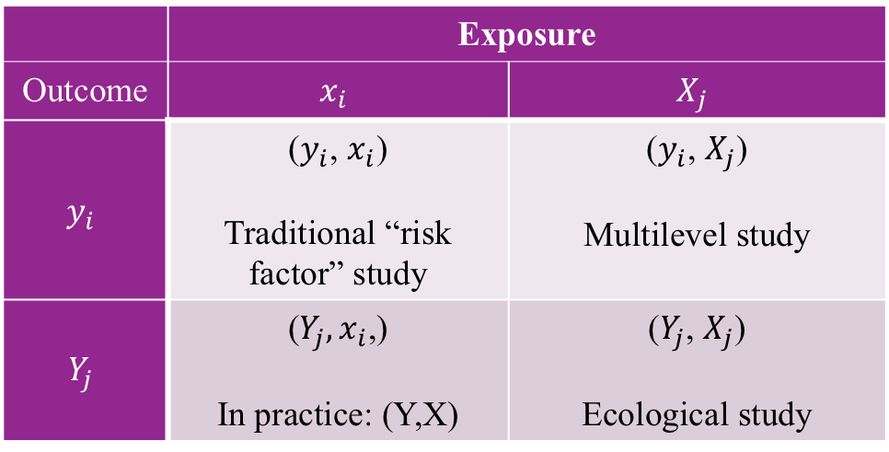


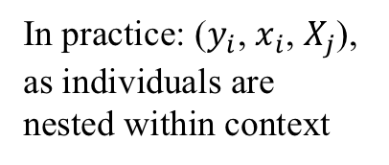
Types of studies
In practice: ($y_{i}$, $x_{i}$, $X_{j}$), as individuals are nested within context
 | Exposure
Outcome | $$x_{i}$$ | $$X_{j}$$
$$y_{i}$$ | ($y_{i}$, $x_{i}$) Traditional “risk factor” study | ($y_{i}$, $X_{j}$) Multilevel study
$$Y_{j}$$ | ($Y_{j},x_{i}\text{,}$) In practice: (Y,X) | ($Y_{j}$, $X_{j}$) Ecological study
$i$: individual-level
$j$: contextual-level
Adapted from Kawachi & Subramanian 2006
Notes:
I find tables just generally helpful for organizing information. So, here is one of different types of studies.
i is the individual level, and j is the contextual level.
Risk factor: how does diet impact blood pressure.
Ecological: how does grocery store access impact hypertension rate.
Multilevel: how does grocery store access and diet impact an individual’s blood pressure.

Slide 85
Level 2 variables
Variables that reflect the characteristic of groups can be:
Derived / aggregate variables (aggregate of individual-level variables)
Proportion living in poverty
Proportion minority
Integral / obligatory variables (characteristics of place; no individual-level analogue)
Density of health centers
Level of air pollution
Diez Roux AJPH, 1998

Slide 86
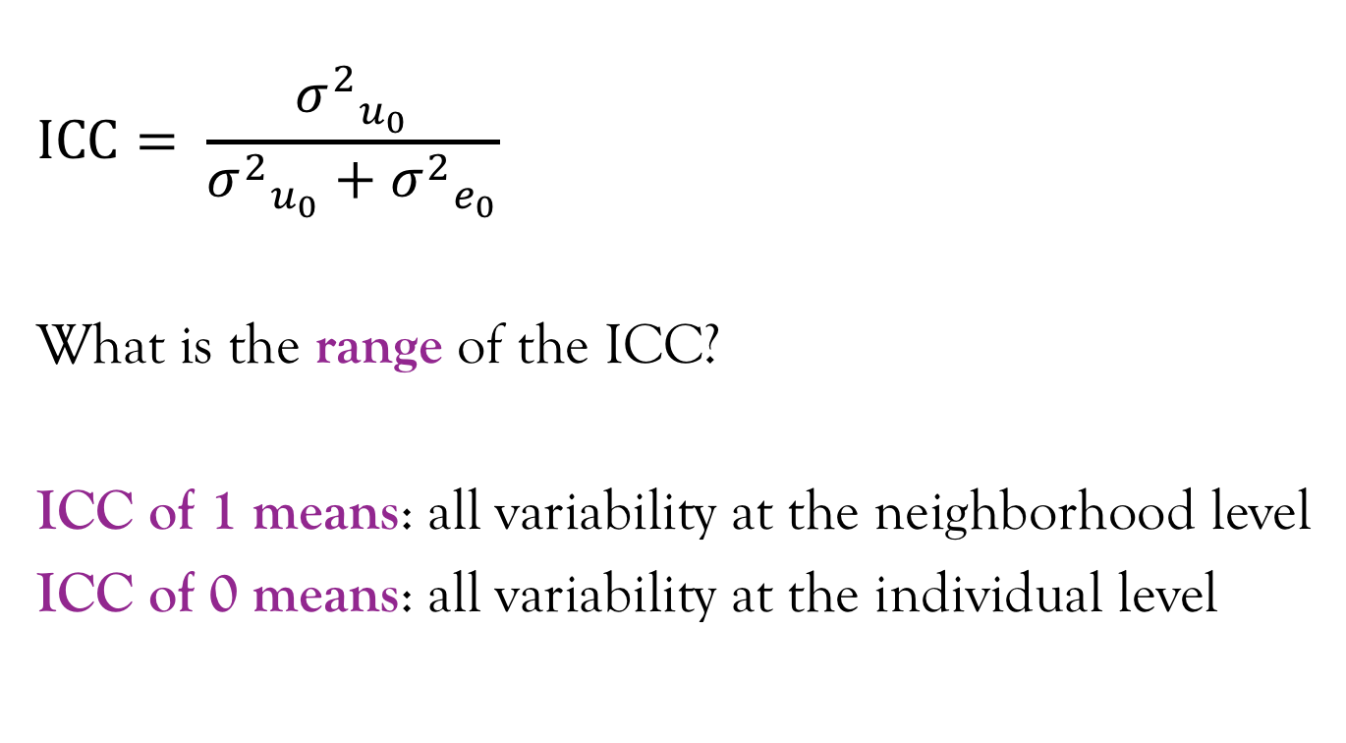
Interclass correlation separates the total variance into the individual-level and neighborhood level
$$ICC= \frac{{σ^{2}}_{u_{0}}}{{σ^{2}}_{u_{0}}+{σ^{2}}_{e_{0}}}$$
What is the range of the ICC?
ICC of 1 means: all variability at the neighborhood level
ICC of 0 means: all variability at the individual level
Kawachi & Subramanian, 2006; Merlo J, et al., 2005
Notes:
From the neighborhood level and individual level variation, you can calculate the ICC, which is the proportion of the total variance that is attributable to the neighborhood level.
In the Merlo article, the ICC = 0.08, so 8% of the variation is due to differences between neighborhoods, and 92% of the variation is due to differences between individuals, so age, BMI, etc.

Slide 87





Visual example of separating the variance
$$e_{0ij}$$
$${σ^{2}}_{e_{0j}}$$
$$u_{0j}$$
$$β_{0}$$
$${σ^{2}}_{u_{0}}$$
Merlo J, et al., 2005
Notes:
This figure is from the Merlo article, and I think it’s a nice visual depiction of how you can partition the total variance into the neighborhood variance and the individual variance.
Here, there is variability across neighborhoods, and there is variation within neighborhoods. And, we can see that the average level of blood pressure depends on which neighborhood you’re in.
So you have the B0, the mean across neighborhoods, and the u0j, which is the difference in mean between neighborhoods.

Slide 88





Random intercepts & slopes
$$β_{1}$$
$$β_{1}$$
$$u_{0j}$$
$$β_{0}$$
$$β_{0}$$
Notes:
Two things define a line, the intercept and the slope. In the equations I showed you, we looked at the level 2 intercept, but you could also look at the level 2 slope.
So, the U0j that we looked at earlier is the difference in intercepts across neighborhoods. There is also an extension to random slopes, where you can examine how the slopes change across neighborhoods -- that we’re not going to discuss that today, but I just wanted to let you know that it’s possible. If you’re interested in learning more about this, you should take Maria’s class where she discusses multilevel.

Slide 89
Differential returns to education
Because different sociodemographic groups have different experiences in the social world, we thought different sociodemographic groups may differentially benefit from each year of education, that is, there may be differential returns to education
Vable et al., 2018
Notes:
Quality of education Black students receive is lower than the quality of education White students receive
Blacks with higher educational attainment experience more inter-personal racism than Blacks with lower levels of education
There is also evidence that Blacks, and socially vulnerable groups more broadly, such as women, are structurally barred for receiving alternatives to education such as power, authority, earning, etc., making these groups more dependents on the resources they do have access to, such as education, potentially resulting in differential returns to education.

Slide 90
Differential returns among race - sex subgroups in predicting MCS?
Variables | Beta | (95% CI) | p-value
Constant (White men) | 54.01 | (53.51,54.50) | <0.0005
Education (yrs) | 0.44 | (-0.03,0.90) | 0.066
White women | -2.68 | (-3.35,-2.01) | <0.0005
Black men | -0.18 | (-0.96,0.61) | 0.658
Black women | -2.03 | (-2.84,-1.22) | <0.0005
Latino men | 0.58 | (-0.47,1.63) | 0.279
Latino women | -0.97 | (-2.10,0.17) | 0.095
White women * education | 0.65 | (-0.06,1.37) | 0.075
Black men * education | 0.22 | (-0.62,1.06) | 0.608
Black women * education | 0.91 | (0.19,1.64) | 0.014
Latino men * education | 0.36 | (-0.42,1.14) | 0.364
Latino women * education | -0.13 | (-0.99,0.74) | 0.775
Education is centered at 12 years
Vable et al., 2018
Notes:
So, here is one of our results tables. Here we are predicting mental health, and seeing if there are differential effects among race - sex subgroups.
The main effect of education reflects the effect for White men, and the point estimate is 0.44.
The differential effect for Black women is 0.91, so we would say that Black women benefit more than White men from each year of education. And this has important implications for health inequities – these results suggest that programs and polices to increase educational attainment may reduce racial disparities in mental health.
Black women benefit more than White men from each year of education in predicting MCS: 0.44 + 0.91 = 1.35
Black women MCS score if education = 12 years = 54.01 – 2.03 = 51.98
Black women at edu = 13 yrs = 51.98 + 1.35 = 53.33

Slide 91
GI Bill eligibility predicted smaller socioeconomic disparities in memory among veterans than non-veterans
0.04
0.07
0.08
Difference in disparities = 0.04 (0.01, 0.08); equivalent to aging 1 year
Vable AM, Eng CW, Mayeda ER, Basu S, Marden JR, Hamad R, Glymour MM; JECH 2018
Notes:
Here are some results that I think are cool. There’s a lot going on, so I’ll walk you through this slide. In this analysis we evaluated if the Korean War GI Bill, which provided a generous college education subsidy to qualifying veterans, differentially benefited veterans from lower socioeconomic back grounds in predicting memory, a measure of cognitive health. We hypothesized that veterans from high cSES backgrounds would benefit less b/c they could go to college without the college education subsidy, while low cSES veterans would benefit more b/c they couldn’t afford college without the subsidy, resulting in smaller socioeconomic disparities.
So, we thought there would be effect modification by SES so that the most socially vulnerable would benefit most.
I have standardized memory on the y-axis, low cSES men are light purple and high cSES men are dark purple. Here we see in the overall sample, the socioeconomic disparity is 0.07 standard deviations. Among non-veterans, who are unexposed to the GI Bill, the socioeconomic disparity is 0.08 standard deviations, while among veterans, who are exposed to the GI Bill, the socioeconomic disparities is 0.04 standard deviations, or about half as big. The difference in disparities is equivalent to aging about 1 year, which, can seem small on an individual level, but is actually huge on a population level.
Is there effect modification here?
Who benefits and who doesn’t?
Does this version of Paid Family Leave increase or decrease disparities?
These results are for memory, but I’ve found similar results for mental health and lung function. I’ve also found evidence of differential returns to education such that socially vulnerable groups benefit more from each year of education than socially advantaged groups.
Overall, my substantive work suggests programs and policies to increase educational attainment may be powerful mechanisms to reduce disparities.

