Slide 1
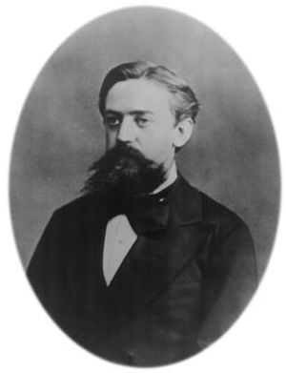
Markov Disease State Modeling
Training in Clinical Research
DCEA Lecture 5
UCSF Department of Epidemiology and Biostatistics
Elliot Marseille
February 11, 2021
Andrey Markov

Slide 2
Objectives:
• To understand the definition and uses of a Markov simulation.
• To understand steps in conducting a Markov simulation.
To orient to a Markov template for use with homework.

Slide 3
Background - 1
Until now - portrayed clinical outcomes with one time frame:
  short-term outcomes
  constant lifetime probabilities
However, many diseases progress through stages or states
Consider HIV, DM, chronic renal disease, etc.
  physiologic abnormality
  mild then moderate clinical disease
  complications
  end-stage

Slide 4
Background - 2
Thus, sometimes more appropriate to model disease as structured process:
  diseases transition through series of (usually increasing severity) states, over months or years, with characteristic health status and risks
This is -- Markov disease state simulation

Slide 5
Outline of lecture
1. What is in a Markov simulation?
2. When should I do a Markov simulation?
3. Steps in conducting a Markov simulation
4. Demonstration of Excel template

Slide 6
1. What is in a Markov simulation?
Portrays progression of a disease over time
Disease divided into discrete “states”
Initial distribution specified
Risks of progression per unit time
Utilities and costs assigned to each state/unit time and transition
Simulation with defined end-point
  E.g. number of years/cycles or life-time

Slide 7
2. When should I do a Markov simulation?
Probabilities/utilities change over time.
e.g., competing mortality risk increases with age.
Data availability.
Data on risk of disease progression/intervention effectiveness more readily available for short time periods
Face validity.
Conceptualized by readers as having discrete, progressive states. May tip the balance.
Multiple opportunities for intervention.
Portray effects of interventions occurring at multiple
stages in disease progression.
Cumulative effectiveness ≠ point effectiveness.
Recurring health events

Slide 8
Aneurysm CEA conducted with a Markov, for two reasons:
1. In older population all-cause mortality competes with the risk of SAH, and increases as the cohort ages.
2. SAH risk data are available for short time periods only, easily translated to annual risk and not as easily to lifetime risk.

Slide 9
Course of HIV, impact of increased early HAART
Conducted with Markov for 3 reasons:
Data: Studies on HIV progression and treatment effectiveness focus on disease state transitions.
Face validity: clinicians, epidemiologists, others think of HIV disease in stages: infection, worsening CD4 and viral load, pre-AIDS disease, AIDS, and death.
3. HAART can be used in different stages of disease – in fact, the effect of HAART timing is the issue being assessed.

Slide 10
Diseases for which Markov may add little
Key chance nodes have a short time frame
Quick resolution/stabilization of condition
Short term data not available, only lifetime
Examples:
  acute curable infections
  management of acute events (MIs, strokes)
  cancers (if prognosis captured with a few branches)
  immunizations for non-epidemic childhood infections (e.g., hemophilus influenza)

Slide 11
3. Steps in doing a Markov
Quick Overview
Similar to standard model building
A. Structure the simulation
  Portray disease states and transitions
  Determine end stages
B. Obtain data for the transition probabilities
C. Implement the model
  Build
  Calibrate
  Debug (quality control)
  Simulations

Slide 12
A. Structure
Portray disease states – principles
Include all important states of the disease:
-- stages of severity, e.g., renal disease in diabetes: severity of renal compromise (normal, micro-, macroalbuminuria, end-stage renal disease).
-- recurrent events e.g., exacerbations.
Also often health states induced by therapy (e.g., side-effects).
Portray transitions

Slide 13
Defining disease states- practical issues
Precisely what states?
Discrete shifts mark boundaries
changed health status, e.g., hypertension to stroke
lab defn’s, e.g., micro/macro albuminuria
Working definitions in the field
Data exist on progression
Balance simplicity and completeness
Interventions being studied
Usually need absorbing state (e.g., death)

Slide 14
Aneurysm example: long-term outcomes calculated by modeling movement among four states:
  Healthy
  Mild disability (due to surgery or SAH)
  Moderate-severe disability (ditto)
  Death

Slide 15
Example: renal disease in diabetes
  Healthy
  Microalbuminuria
  Macroalbuminuria
  End-stage renal disease
  Death

Slide 16
Portraying transitions
Possible transitions between states (up to n²)
Essential: single “forward” transitions (i.e., from state 1 to 2, 2 to 3, 3 to death) always.
Forward jumps (e.g., from 1 to 3, see HIV example).
Rarely: backward transitions (e.g., from 3 to 2) … more realistic to add state (e.g., 3 in remission); state achieved via a sicker state ≠ state achieved via a healthier state.
Death, in almost all Markov simulations, due to the disease or other causes.

Slide 17
Risk of progression (transition)
Risk per unit time (i.e., per Markov cycle) in “source” state
e.g., “For individuals with microalbuminuria,
there is 5% annual risk of progressing to macroalbuminuria.”
Time-period risk can evolve
e.g., annual risk of mortality increases as individuals age.

Slide 18
Effectiveness of interventions
Usually represented as reduction in the risk of progression
e.g., “ACE-inhibitors decrease the risk of progressing from micro- to macroalbuminuria by
70%.”
… or as relative risk, e.g., 0.30
Or as alternate set of transition probabilities, which is more flexible, can include backwards transitions (eg due to cure).

Slide 19
Disease state outcomes
Each disease state assigned utility (and cost) per cycle.
  Utility: If annual cycles, might be the portion of a QALY gained by being in that state for that year. Or DALY incurred.
  Costs: direct, total, etc.
    Keep track of utilities and costs accumulated in each state in each cycle → cumulative totals available at end.

Slide 20
Simulation structure
Portray individual or group (e.g., 1000)
Cycle duration short -- real patient would not have two state transitions in a cycle
End with specified duration, or when per cycle utilities below threshold (e.g., 0.001 QALY).
Track movement between states over time.
Consequences of intervention -- compare similar tree structures with different input values

Slide 21
Graphic techniques
Simple flow diagram effective for basic Markov states and transitions; limited transition probabilities possible without clutter.

Slide 22
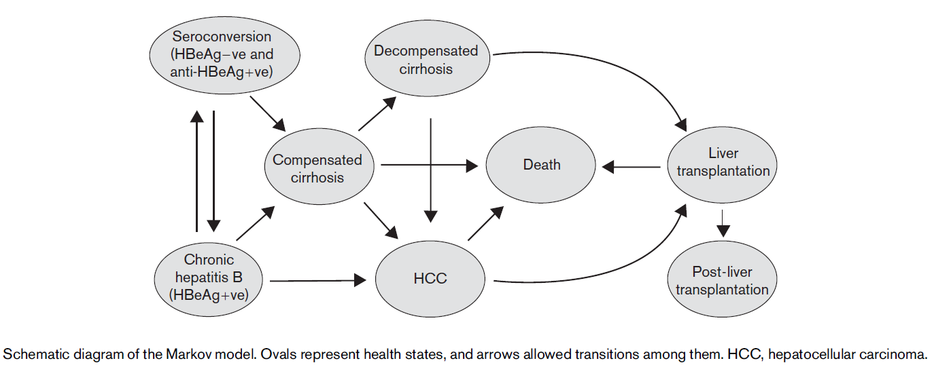
Chronic Hepatitis B Model
Veenstra DL, 2007

Slide 23
Multi-cycle bubble diagram
(Fig 1 Naimark)
Utilities = 1.0, 0.6 and 0 for well, sick and dead, respectively
Clear and more information -- evolving state distributions and cumulative outcomes
Not often used in published Markov analyses, probably because unwieldy with more than 3-4 states
Notes:
In this process, patients may exist in one of three states : _{WELL,} s1cK, and _{D} _{EAD} . Each row represents one cycle of the Markov process. Within each row, the states arc represented by ovals. Transitions between states are represented as arrows linking the ovals. The transition probabilities are vvritten beside the arrows for the first cycle (these probabilities remain constant for this particula r process). The fraction of the cohort in each state at the beginning of each cycle is shown in the box below the row. The incremental utilities for the _{WELL,} _{SICK,} and _{DEAD} states are 1.0, 0.6, and 0.0, respectively (not shown). The total incremental and cumulative utility for each cycle arc shown in
boxes to the right of the row . Total = total incremental utility,
Cumulative = cumulative utility (see text for definitions of total incremental and cumulative utility).

Slide 24
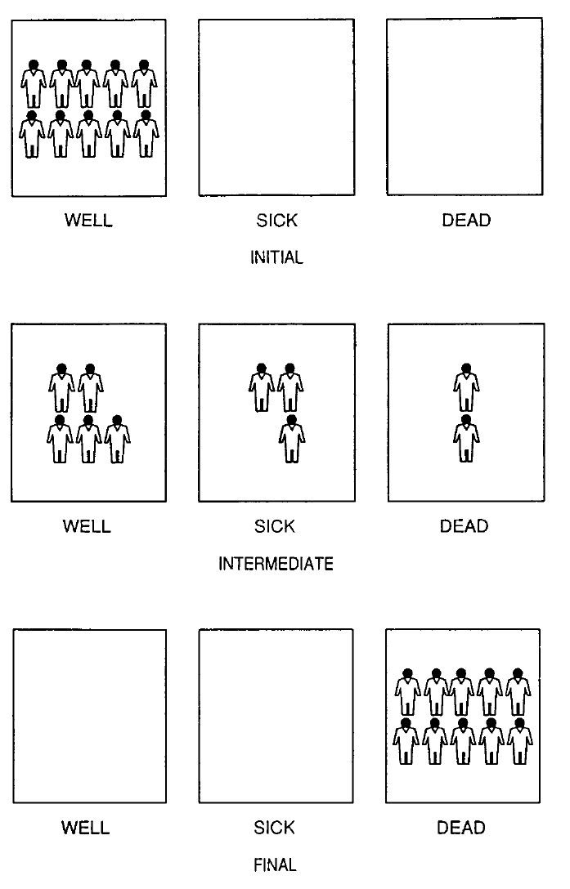
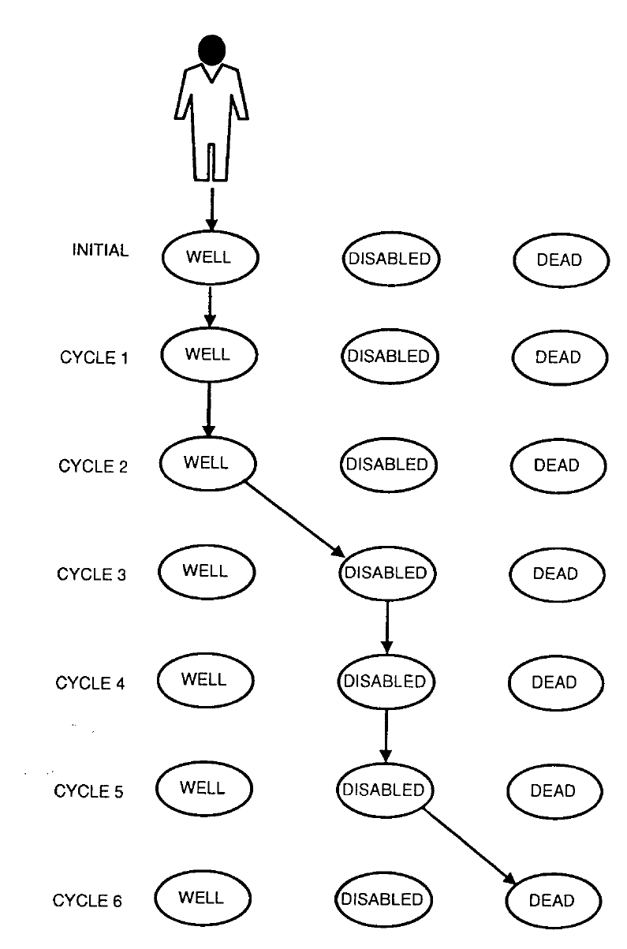
Cohort
Two simulation approaches
Individual
Sonnenberg FA., et al. Med Decis Making. 1993; 13: 322

Slide 25
“Markov subtree”
(Naimark Fig 2)
Markov with infinity symbol (∞) or (M) instead of chance node; states with branches; transitions with boxes at the end of each sub-branch.
If complex, as in example, multiple subtrees needed.
Excellent at documenting structure, but requires understanding trees and has no natural way to report transition probabilities.
Notes:
Main tree with Markov' subtrees. The main tree indicates three management options for patients with possible gi­ant cell arteritis (GCA): Rx NONE: give steroid to no patients ), Rx ALL (give steroid to every patient and BIOPSY (perform a temporal artery biopsy and treat those with a positive result). The subse­quent structure indicates the true underlying condition of pa­tients and the result of a temporal artery biopsy (if patients are tested). The result of this test is a function of the prevalence of GCA and its sensitivity and specificity. A common Markov sub­tree, "outcome," is attached to each branch of the main tree. Binding expressions located on the main tree indicate whether or not patients really have GCA and whether or not they receive steroid. Examples of these binding expressions are shaded. "pOthcr" is an indicator that is bound to the value: of 1 for patients who have an alternate diagnosis and O if they really have GCA. “onrx" is another indicator which is bound to the value 1 on branches where patients are treated elsewhere . These two indicators variables are used within "outcome" so that the same subtree structure can be attached to different places on the main tree (see text) Notice that for clarity, several binding expressions arc omitted from the diagram. No GCA = an alter­nate diagnosis; Bx pos and Bx neg = positive and negative biopsy , respectively; pGCA = probability of GCA sensitivity or temporal artery biopsy: spec = specificity of biopsy .

Slide 26
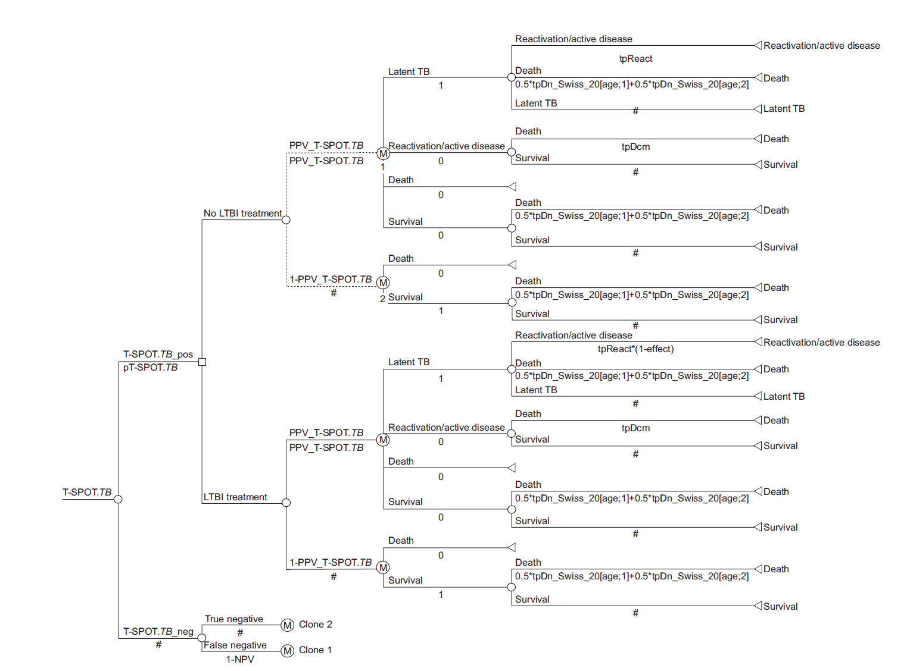
Diel R. et al. Eur Resir J 2007; 30: 321

Slide 27
Transition matrix
 | Target states
Source states | Normal | Micro albuminuria | Macro albuminuria | End-stage renal disease | Death
Normal | .96 | .03 | -- | -- | .01
Micro albuminuria | -- | .90 | .08 | -- | .02
Macro albuminuria | -- | -- | .94 | .01 | .03
End-stage renal disease | -- | -- | -- | .85 | .15
Efficiently summarizes states and transitions
Corresponds to structure used to analyze Markov (pre fast computers)

Slide 28
Multi-column table
Allows more information (e.g., effectiveness) with some loss in organizational efficiency.

Slide 29
HIV disease - states match CDC defns + clinical distinctions.
Source State | Target State | Transition Probability per Quarter | Reduction in Transition Rate with HAART
0. Uninfected | 1
1. Asymptomatic, CD4>500 | 2
 | 3
 | 4
 | 5
 | 6
2. Asymptomatic, CD4<500 | 3
 | 4
 | 5
 | 6
3. Symptomatic, pre-AIDS | 4
 | 5
 | 6
4. AIDS, 1993 definition | 5
 | 6
5. AIDS, 1987 definition | 6
6. Death | (absorbing)

Slide 30
B. Data for transition probabilities
Precise extraction and adaptation of published (or custom) data.
Plus usual data for CEA.

Slide 31
For the aneurysm Markov:
annual probability of aneurysm rupture (SAH) from a prospective cohort, assumed constant over time
one-time risks of death and disability from surgery / SAH from various studies.
annual age-adjusted risk of death all causes from life tables, studies of individuals with disabilities.

Slide 32
C. Implement the model - overview
Build the functional model
Calibrate if relevant
Maintain quality control
Run the simulations

Slide 33
Build the functional model
Standard protocols in decision analysis software
Spreadsheet: custom programmed in a set of tables (or … our template)
Successful model-building:
  careful planning of states and transitions
  programming from simple to complex, initially only a few transitions
  check results repeatedly to confirm that they make sense

Slide 34
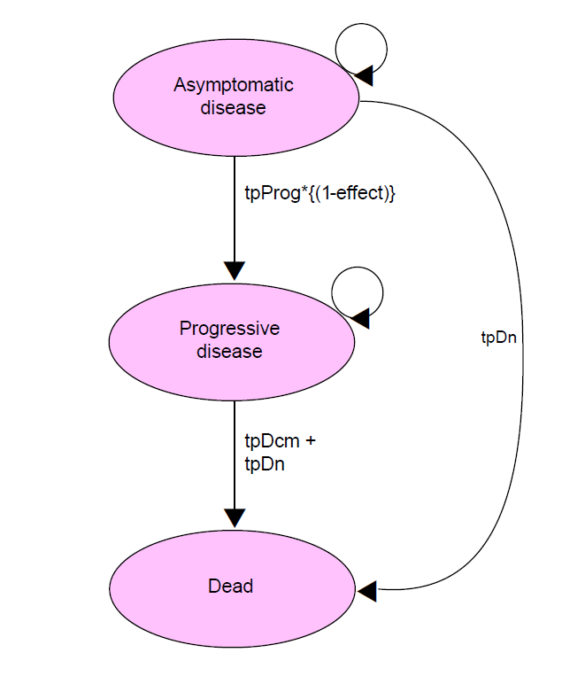
Simple example
Briggs A, Sculpher M. 1998

Slide 35
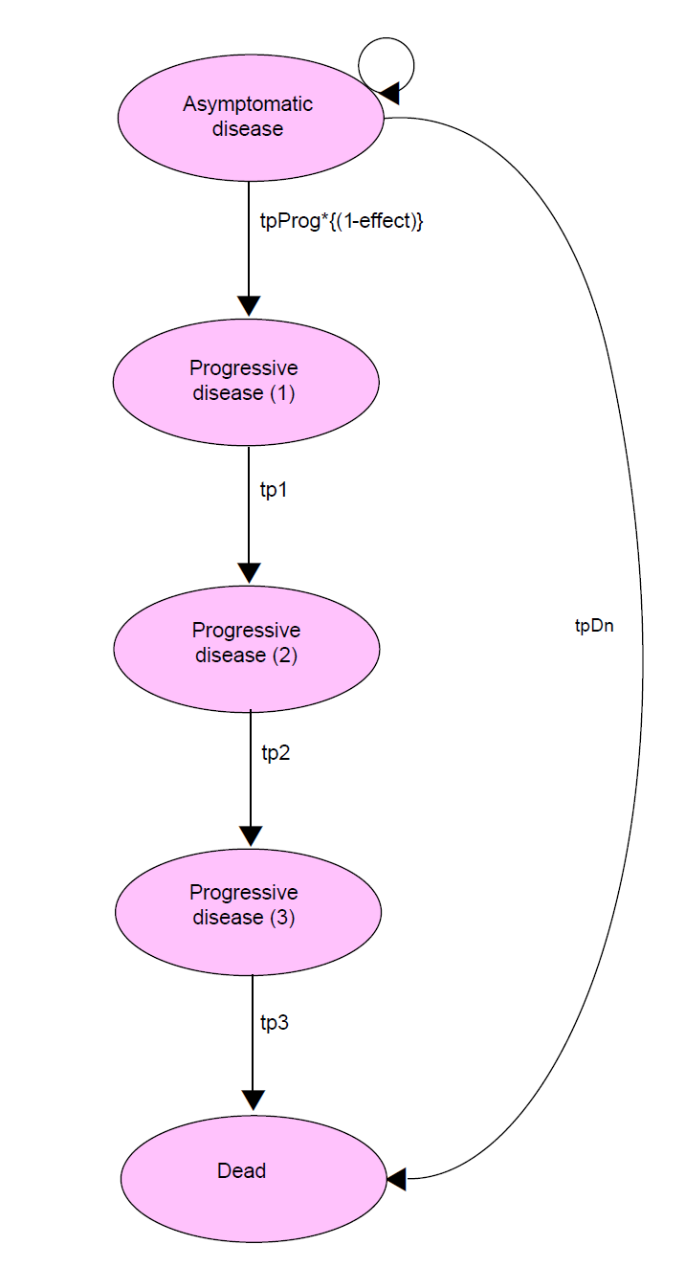
Getting around the Markovian randomness
Tunnel States
(3 progressive states)
Notes:
Markov assumption: “Memoryless” – once transition is made, population in a particular health state is considered homogeneous regardless of where they’ve come from (and when)…
Markov tunnels – useful when transition probabilities are a function of how long a person has been in the state

Slide 36
Portraying one-time events
Some pivotal events occur very quickly (vs. cycle length), with 100% transition to more typical recurring Markov states, eg
  heart attack (MI) → post-MI state
  traffic accident → chronic injured state
Two ways to model:
  Tunnel state – eg, non-fatal MI + recovery period, 100% move to post-MI state.
  State entry utility / cost – assign health (dis)utility and cost to the process of entering a state – eg non-fatal MI upon entry to post-MI state.

Slide 37
Calibration
If reliable transition probabilities and no real-world benchmarks of disease progression, no further adjustment.
If empirical benchmarks available, especially if more trustworthy than transition data -- calibration process:
  goal = transition probabilities that produce results consistent with real-world data.
  time-consuming … proceed backwards

Slide 38
Quality control/debugging
Markov models complex, rarely “transparent”
Essential to monitor the accuracy of model outputs.

Slide 39
Quality control:
Range checks: results plausible?
E.g., only 6.2 QALYs per person when mean survival = 12 years?

Slide 40
Quality control 1:
1-way SA: extreme values produce expected effects?
  E.g, zero effectiveness generate zero gain in QALYs?
  100% effectiveness freeze disease progression?
  Each unit change in effectiveness (e.g., from 10% to 20% and from 80% to 90%) generate equal magnitude changes in outcome?
  Use simplest outcome (e.g., QALYs expected rather than $/QALY).

Slide 41
Quality control 2:
Markov trace: Shows distribution by state for each cycle. Shows evolution of disease progression, can reveal if odd patterns.

Slide 42
Run simulations
Last step, culmination of process.
Some models calculate all desired outcomes (e.g., QALYs and costs for all arms, net differences, and CE ratios), others require repeating analysis with different inputs.

Slide 43
Reporting of results
Similar to that for any CEA – expected values for each arm and the
net differences between arms

Slide 44
Summary of Markov modeling
Some diseases/problems more clearly/definitively modeled with explicit representation of disease states
Markov simulations more complex than simple trees, but maybe only 50% more
Biggest challenges: credible cumulative disease progression, quality control/debugging
Notes:
44

Slide 45
Good models should…
Reflect the key clinical characteristics of the disease process and treatments under review
Use best-available estimates of data inputs – obtained from systematic reviews and critically appraised
Reflect uncertainty over data inputs and assumptions
Be as simple as possible, but no simpler
Be clearly described, so they can be replicated
Philips et al. Review of guidelines for good practice in decision-analytic modelling in health technology assessment.
Health Technol Assess 2004;8(36).
Notes:
Give credit to NICE for this slide

Slide 46
Demonstration of Excel Markov template

