Slide 1
Publishing & Presenting Clinical Research
EPI 212 – SPR 2021
Publishing and Presenting Research
Vinay Prasad MD MPH
Associate Prof. Department of Epi
Some included slides developed by Alison Huang

Slide 2
About me

Slide 3
About Alyson

Slide 4
What is your background?

Slide 5
The course
1. Why Does Publishing and Presenting Matter?
2. Introduction/ Methods
3. Visual Display of Data/ Results Discussion
4. Journal Submission/ Politics
5. The Media and Social Media

Slide 6
Why does publishing matter

Slide 7
Publishing is communicating
Communicating is the most transparent form of thinking

Slide 8
Do you want people to read your work?
How many?

Slide 9
Pros / Cons of 10^5 people reading it

Slide 10
Where you want to disseminate the result has impacts on everything
How to frame the question
How to design the question
What questions to pursue

Slide 11
Attention is the new commodity
Can you hold it?
Does a paper hold it?
Podcast?
Twitter?

Slide 12
Science

Slide 13
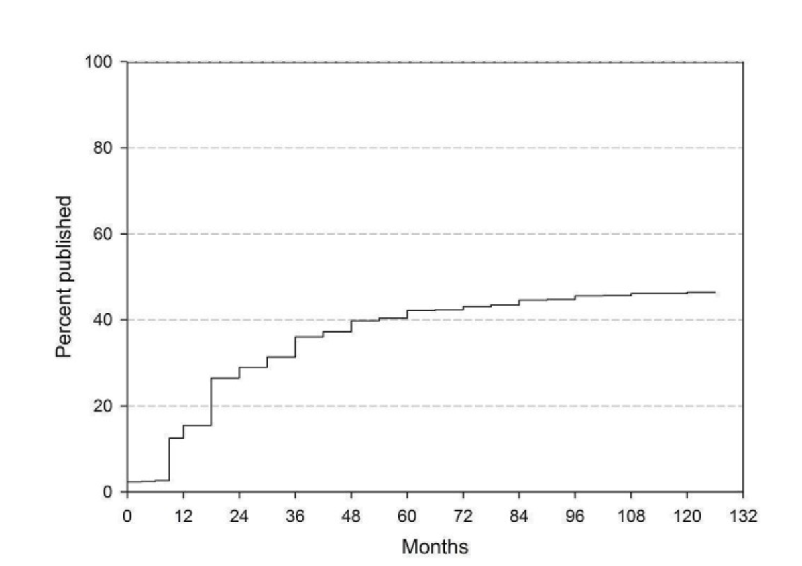
The abstract

Slide 14
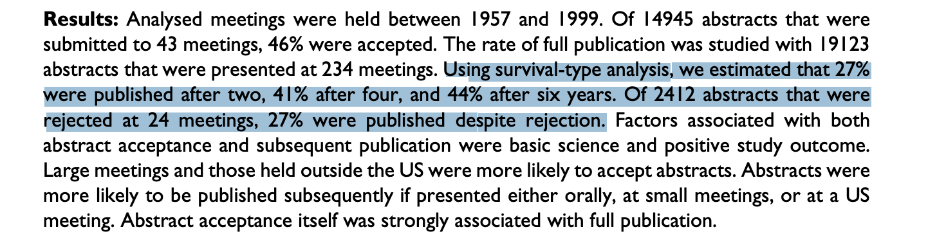

Slide 16
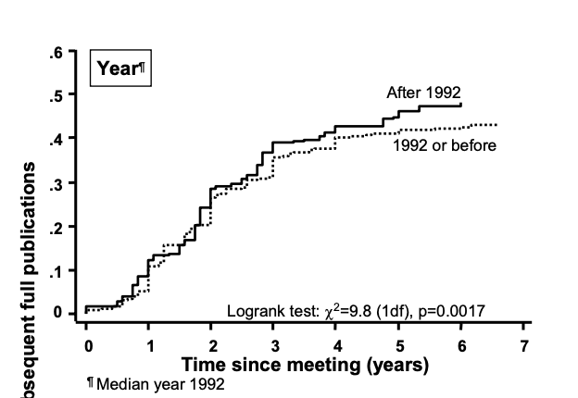

Slide 17
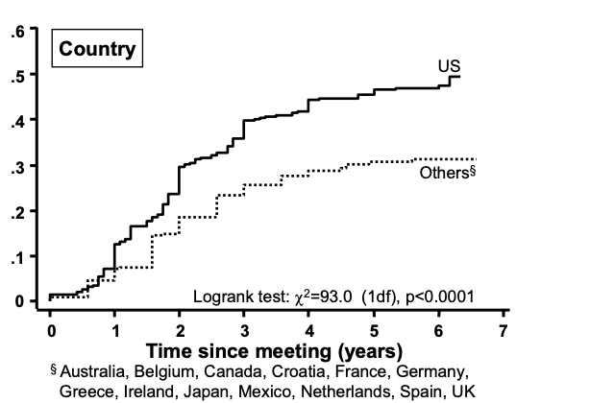

Slide 18
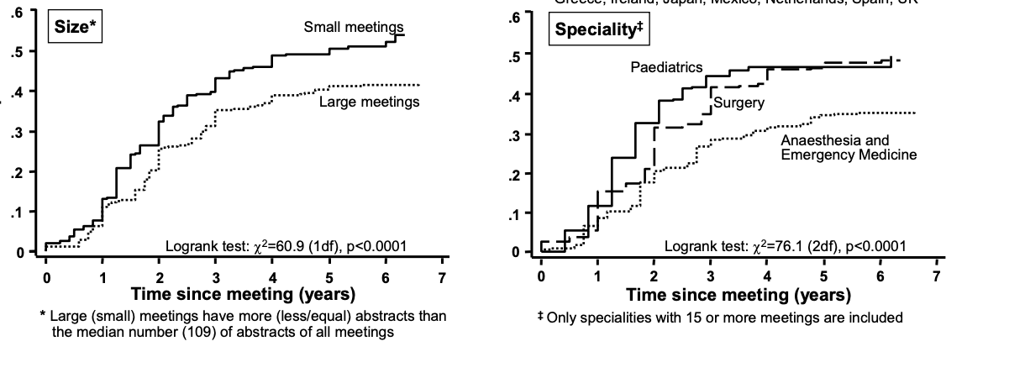

Slide 19
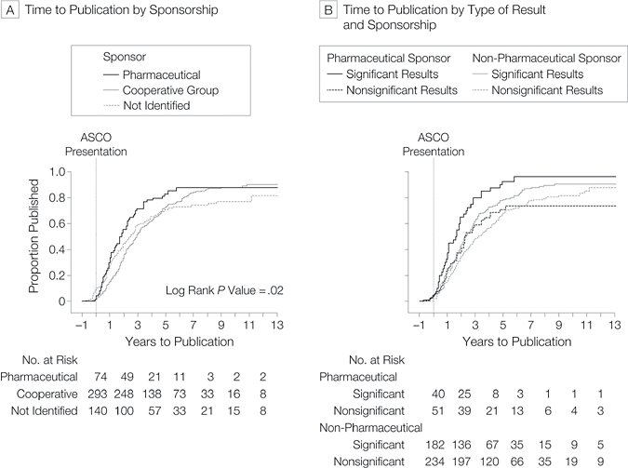
Large RCTs

Slide 20
The abstract is….
Slide developed by Alison Huang
The only part of a research paper published in the proceedings of a scientific conference
The only part of a paper that a potential reviewer sees when invited to act as a referee
The only part of a paper that a reader sees when searching electronic databases
The first (and often only) part of a paper that readers see when browsing through a journal copy
- Chittaranjan Andrade, ‘How to write a good abstract for a scientific paper,” 2011

Slide 21
An abstract must…
Slide developed by Alison Huang
Condense complex study information into a concise, clear summary
Uphold rigorous scientific reporting standards from consensus organizations
Persuade readers that the research described is worthy of greater scrutiny
Stay within tight word or space limits set by journals and conferences

Slide 22
Conference vs manuscript abstracts
Slide developed by Alison Huang
Abstracts submitted to conferences
    Stand alone without any additional content
    May have more generous word or space limits
    Sometimes include references, tables, or figures
Abstracts accompanying manuscripts
    Introduce but do not replace manuscript content
    Are retrievable through electronic search engines
    Must avoid discrepancy with the full-length paper

Slide 23
Why submit an abstract to a conference?
Slide developed by Alison Huang
To obtain feedback that will guide you in preparing a stronger manuscript
To demonstrate research productivity (in place of or prior to a manuscript)
To facilitate networking with potential collaborators, mentors, or employers
To compete for presentation awards or scholarships (especially for trainees)
To reflect internally upon the direction and progress of your research

Slide 24
Why not?
Time is a fixed commodity
Little academic credit
Poor quality findings

Slide 25
When should you submit an abstract?
Slide developed by Alison Huang
Research manuscript published
No results available
Preliminary analyses
Refined data available
First draft written
Revisions completed
Manuscript “in press”

Slide 26
Developing a timeline for abstract submission
Slide developed by Alison Huang
Prepare the initial abstract draft
Get feedback from primary mentor Request input from co-authors
Revise abstract based on feedback Submit to publications committee
Enter all information into website
SUBMISSION DEADLINE
(date and time)

Slide 27
Coauthors - ICMJE criteria for authorship
Slide developed by Alison Huang
Substantial contributions to the conception or design of the work; or the acquisition, analysis, or interpretation of data for the work; and
Drafting the work or revising it critically for important intellectual content; and
Final approval of the version of the work to be published; and
Agreement to be accountable for all aspects of the work in ensuring that questions related to accuracy or integrity are appropriately investigated and resolved

Slide 28
Slide developed by Alison Huang
Examples of activities that alone (without other contributions) do not qualify a contributor for authorship are:
  Acquisition of funding
  General supervision of a research group or general administrative support
  Writing assistance, technical editing, language editing, and proofreading

Slide 29
Coauthors
Too many slow you down

Slide 30
What happens after you submit an abstract?
Slide developed by Alison Huang
Abstract uploaded
Screening for violations
Panel peer review
Assignment to session
Acceptance letter sent

Slide 31
Common abstract presentation formats
Slide developed by Alison Huang
Plenary oral presentations
Non-plenary oral presentations
Traditional poster presentations
Other/new presentation types

Slide 32
Who reviews abstracts for conferences?
Slide developed by Alison Huang
Reviewers for scientific or professional conferences:
  Are members of the sponsoring society
  Review abstracts on a voluntary basis
  May be organized into review sections
  Do not always specific expertise in the study
  May read and rate many abstracts per hour

Slide 33
Reasons why abstracts are rejected
Slide developed by Alison Huang
(from Browner’s Publishing & Presenting Clinical Research)
Boring topic or no new findings
No context provided for the research
Small number of participants
No numbers, all talk
All numbers, no words
Sloppiness of presentation
Too different from other abstracts

Slide 34
Other factors influencing acceptance
Slide developed by Alison Huang
Total number of abstracts submitted to a content or methodologic category
Prioritization of abstracts from different institutions or geographic areas
Special presentation opportunities for abstracts related to a meeting’s theme
Other presentation opportunities for award winners or scholarship recipients

Slide 35
So what? Implications for abstract preparation
Slide developed by Alison Huang
The main purpose of an abstract is to provide a succinct and accurate summary of key study elements
BUT
For conference abstracts, another purpose is to guide reviewers in evaluating the research according to criteria
AND
An abstract plays a key role in persuading readers that the work is worthy of deeper engagement

Slide 36
Abstracts by section
Slide developed by Alison Huang
Title (and Authors)
Introduction
Methods
Results
Conclusions

Slide 37
50 million scientific articles

Slide 39
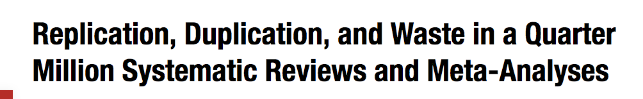

Slide 40
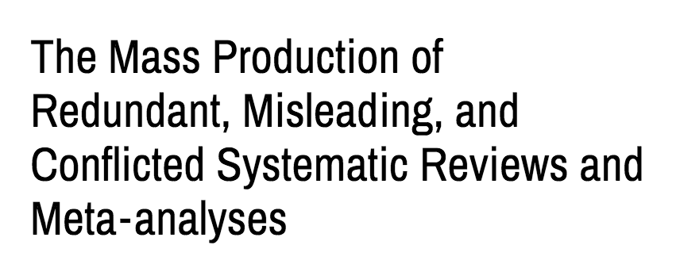

Slide 41
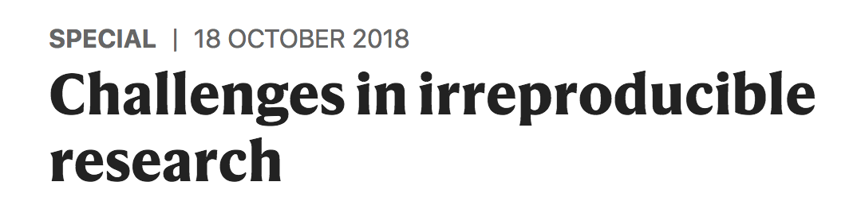

Slide 42
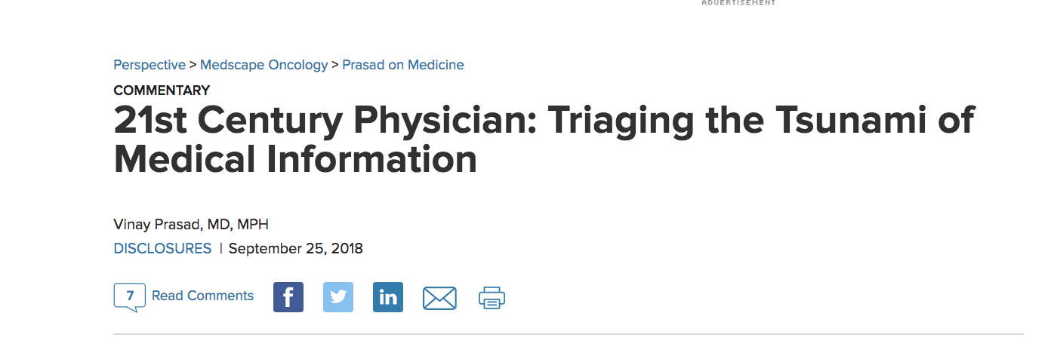

Slide 43
Timing is everything

Slide 44
Timing is everything
Jama internal medicine

Slide 45
Timing is everything
Jama internal medicine
JAMA

Slide 46
Timing is everything
Jama internal medicine
JAMA
NEJM

Slide 47
Timing is everything
Jama internal medicine
JAMA
JAMA Onc
NEJM
JCO

Slide 49
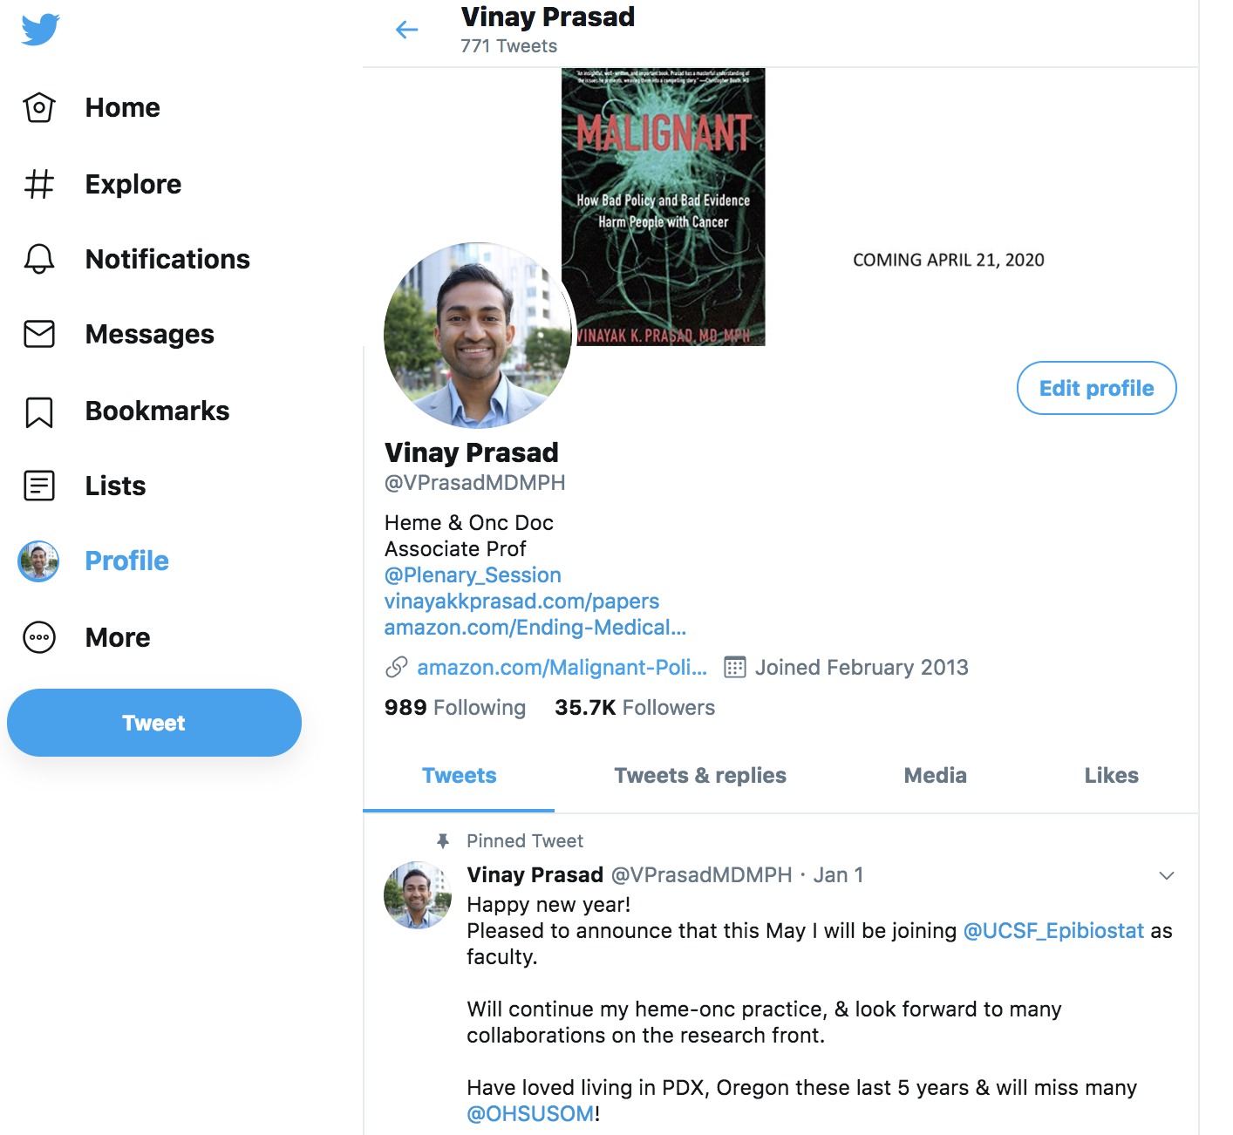

Slide 50
Triage
Pertain to my practice/ interest vs. No
Randomized vs. observational
Multicenter vs. single center
Large sample vs. small
Clinical endpoint vs. surrogate

Slide 51
Abstracts by section
Slide developed by Alison Huang
Title (and Authors)
Introduction
Methods
Results
Conclusions

Slide 52
The Title
Slide developed by Alison Huang
Goal: Orient readers to the study topic and context and engage their interest in the research
Length: Usually 8 to 18 words, depending on the specific meeting or journal requirements
Strategy: Use descriptive terms to indicate the predictor, outcome, intervention, or population, as well as point out strengths in design

Slide 53
Starting general
Slide developed by Alison Huang
Changes in Prenatal Aneuploidy Screening Policies
Survival and Morbidity of Extremely Preterm Infants Yoga Therapy for Urinary Incontinence in Older Women

Slide 54
Getting specific
Slide developed by Alison Huang
Long-Term Effects of Changes in Prenatal Aneuploidy Screening Policies in an Integrated Healthcare System
Survival and Major Morbidity of Extremely Preterm Infants: A Population-Based Study
Feasibility of Group-Based Yoga Therapy for Urinary Incontinence in Older Women: A Single Arm Trial

Slide 55
Strategies for abstract titles
Slide developed by Alison Huang
Consider question and statement titles
“Does exercise improve overactive bladder symptoms?”
Avoid promising what you can’t deliver
“A novel behavioral treatment approach to insomnia...”
Longer may be better than shorter

Slide 56
Titles using irony, puns, or catchphrases
Slide developed by Alison Huang
‘Being Old and Doing Time: Functional Impairment and Adverse Experiences of Geriatric Female Prisoners’
‘You Probably Think This Paper's About You: Narcissists' Perceptions of Their Personality and Reputation’
‘Carbon Monoxide: To Boldly Go Where NO Has Gone Before’

Slide 57
Reminder: Assignment #1 due by noon on Tuesday, April 20
Slide developed by Alison Huang
Option #1 is to submit a draft abstract from your own ongoing research project, formatted according to the guidelines of a scientific or professional meeting
Option #2 is to edit and improve a draft abstract from a sample manuscript based on a study of a smoking cessation intervention (posted on the course website)
Upload your assignment (as a Word document) onto the course syllabus website using the assignment upload link
Please use the template provided on the website and include your first and last name in the document title

Slide 58
The Introduction or Background Section
Slide developed by Alison Huang
Goal: Provide context for the study objective and indicate why the research is interesting, important, or innovative
Length: As little as one sentence or up to three sentences (depending on the abstract guidelines)
Strategy: Articulate the problem, establish the gap in knowledge, and ‘hook’ the reader’s interest (Problem- Gap-Hook device)

Slide 59
The Methods Section
Slide developed by Alison Huang
Goal: Describe the design and implementation of the research in a way that highlights its strengths
Length: Between a quarter and a third of the total abstract length (usually the second longest section)
Strategy: Briefly address each methods component - design, setting, participants, interventions (if any), measurements, analytic approach – in order

Slide 60
The Results Section
Slide developed by Alison Huang
Goal: Present essential data to answer the research question and guide the reader in evaluating significant findings
Length: Usually up to one half of the total abstract length (often the longest section of an abstract)
Strategy: Briefly characterize the study population or distribution of the major variables, then present findings that answer the research question

Slide 61
The Conclusions Section
Slide developed by Alison Huang
Goal: Summarize the take-away points from the key research finding(s) with regard to implications for future research, clinical care, or public health
Length: One to three sentences, depending on the abstract guidelines and length restrictions
Strategy: Summarize the most important finding(s), then articulate a take-home message about their potential impact

