Slide 1
Biostat 202: Opportunities and Challenges of “Big Data”
Aaron Wolfe Scheffler,
Division of Biostatistics,
Department of Epidemiology and Biostatistics
Biostat 202
Notes:
Introduction to course, course is being recorded.

Slide 2
Zoom lectures and labs
Zoom lectures and labs will be recorded and posted for those who cannot attend
Muted by default, please use chat to get my attention
Notes:
A fe

Slide 3
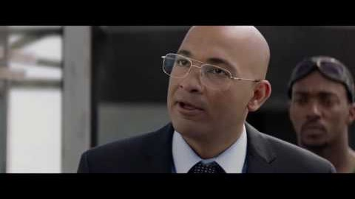
What is “Big Data” today?
Notes:
Big Data is everywhere even in today’s popular culture

Slide 4
Big Data
Jasper Sitwell: Zola's algorithm is a program...for choosing Insight's targets.
Steve Rogers: What targets?
Jasper Sitwell: You! The TV anchor in Cairo, the Undersecretary of Defense, a high school valedictorian in Iowa city. Bruce Banner, Stephen Strange, anyone who's a threat to HYDRA. Now, or in the future.
Steve Rogers The future? How can it know?
Jasper Sitwell: How could it not? The 21st century is a digital book. Zola taught HYDRA how to read it. Your bank records, medical histories, voting patterns, e-mails, phone calls, the damn SAT scores. Zola's algorithm evaluates peoples' past to predict their future.
Steve Rogers What then?
Jasper Sitwell: Then the Insight heli-carriers scratch people off the list.
Notes:
Describe scene. bviously science fiction.
Hyrda the villain will predict actions using the 21st century digital book.
But isn’t far from what is possible now. We can’t predict everyone’s exact future, but given that information we could predict a number of things.
Raises significant privacy issues.

Slide 5
“Big Data”
Big Data
All Data
Notes:
We discussed big data examples but we never really sat down and described big data.
No single definition, you can google Big data and get a very different definitions.
Here I have the 5 V’s of big data. You can find other charts with the 4 V’s. I happen to like this one.
Volume: size, digital exhaust
Variety: HER
Velocity: online learning with real time model training and prediction
Variability: present in all data, measures spread and randomness in all data – thereore also present in big data.
Veracity: the accuracy of the data, say a doctor recording a value down on a chart. Harder to confirm and check with big data (remember the baby weight example)
Image source: https://hac.nursing.umich.edu/2018/02/26/big-data-finding-its-mark/

Slide 6
“Big Data” – the 5 Vs
Volume: Google flu trends, billions of data points
Variety: electronic health records include diagnosis, imaging, genetics, etc…
Velocity: real time model training, e.g. hypoglycemia prediction
Variability: random variation, spurious correlations
Veracity: harder to ensure data quality in big data
Notes:
Some specifics for each of the 5 V’s
Image source: https://hac.nursing.umich.edu/2018/02/26/big-data-finding-its-mark/

Slide 7
Thoughts on Big Data
Data mining can be used for good and evil.
Big data isn’t the same as big information.
Having big data doesn’t help if it was selected in a biased way.
Compared to causality, prediction is easy since you only have to understand associations and correlation.
If you are interested in causation you can’t measure it all.
Modern machine learning methods are good at finding spurious correlations.
Randomization can be used with big data.
Notes:
I am going to briefly discuss the 7 thoughts on big data from the prerecorded content.
This course was developed over many years by some of the leading biostatistical faculty in the country and these thoughts reflect the cumulative experience of their careers
I really think they are valuable and worth revisiting at the beginning of our Big Data careers.

Slide 8
Thoughts on Big Data
Data mining can be used for good and evil.

Slide 9
Thoughts on Big Data
Big data isn’t the same as big information.
Baboon study:
13 baboons studied.
At least two electrical leads per animal.
Up to 67 days of observation.
Record electrical activity of uterine muscles 32 times per second
Data ? Information ? Knowledge
About 4.8 billion data points (~4.5 GB)

Slide 10
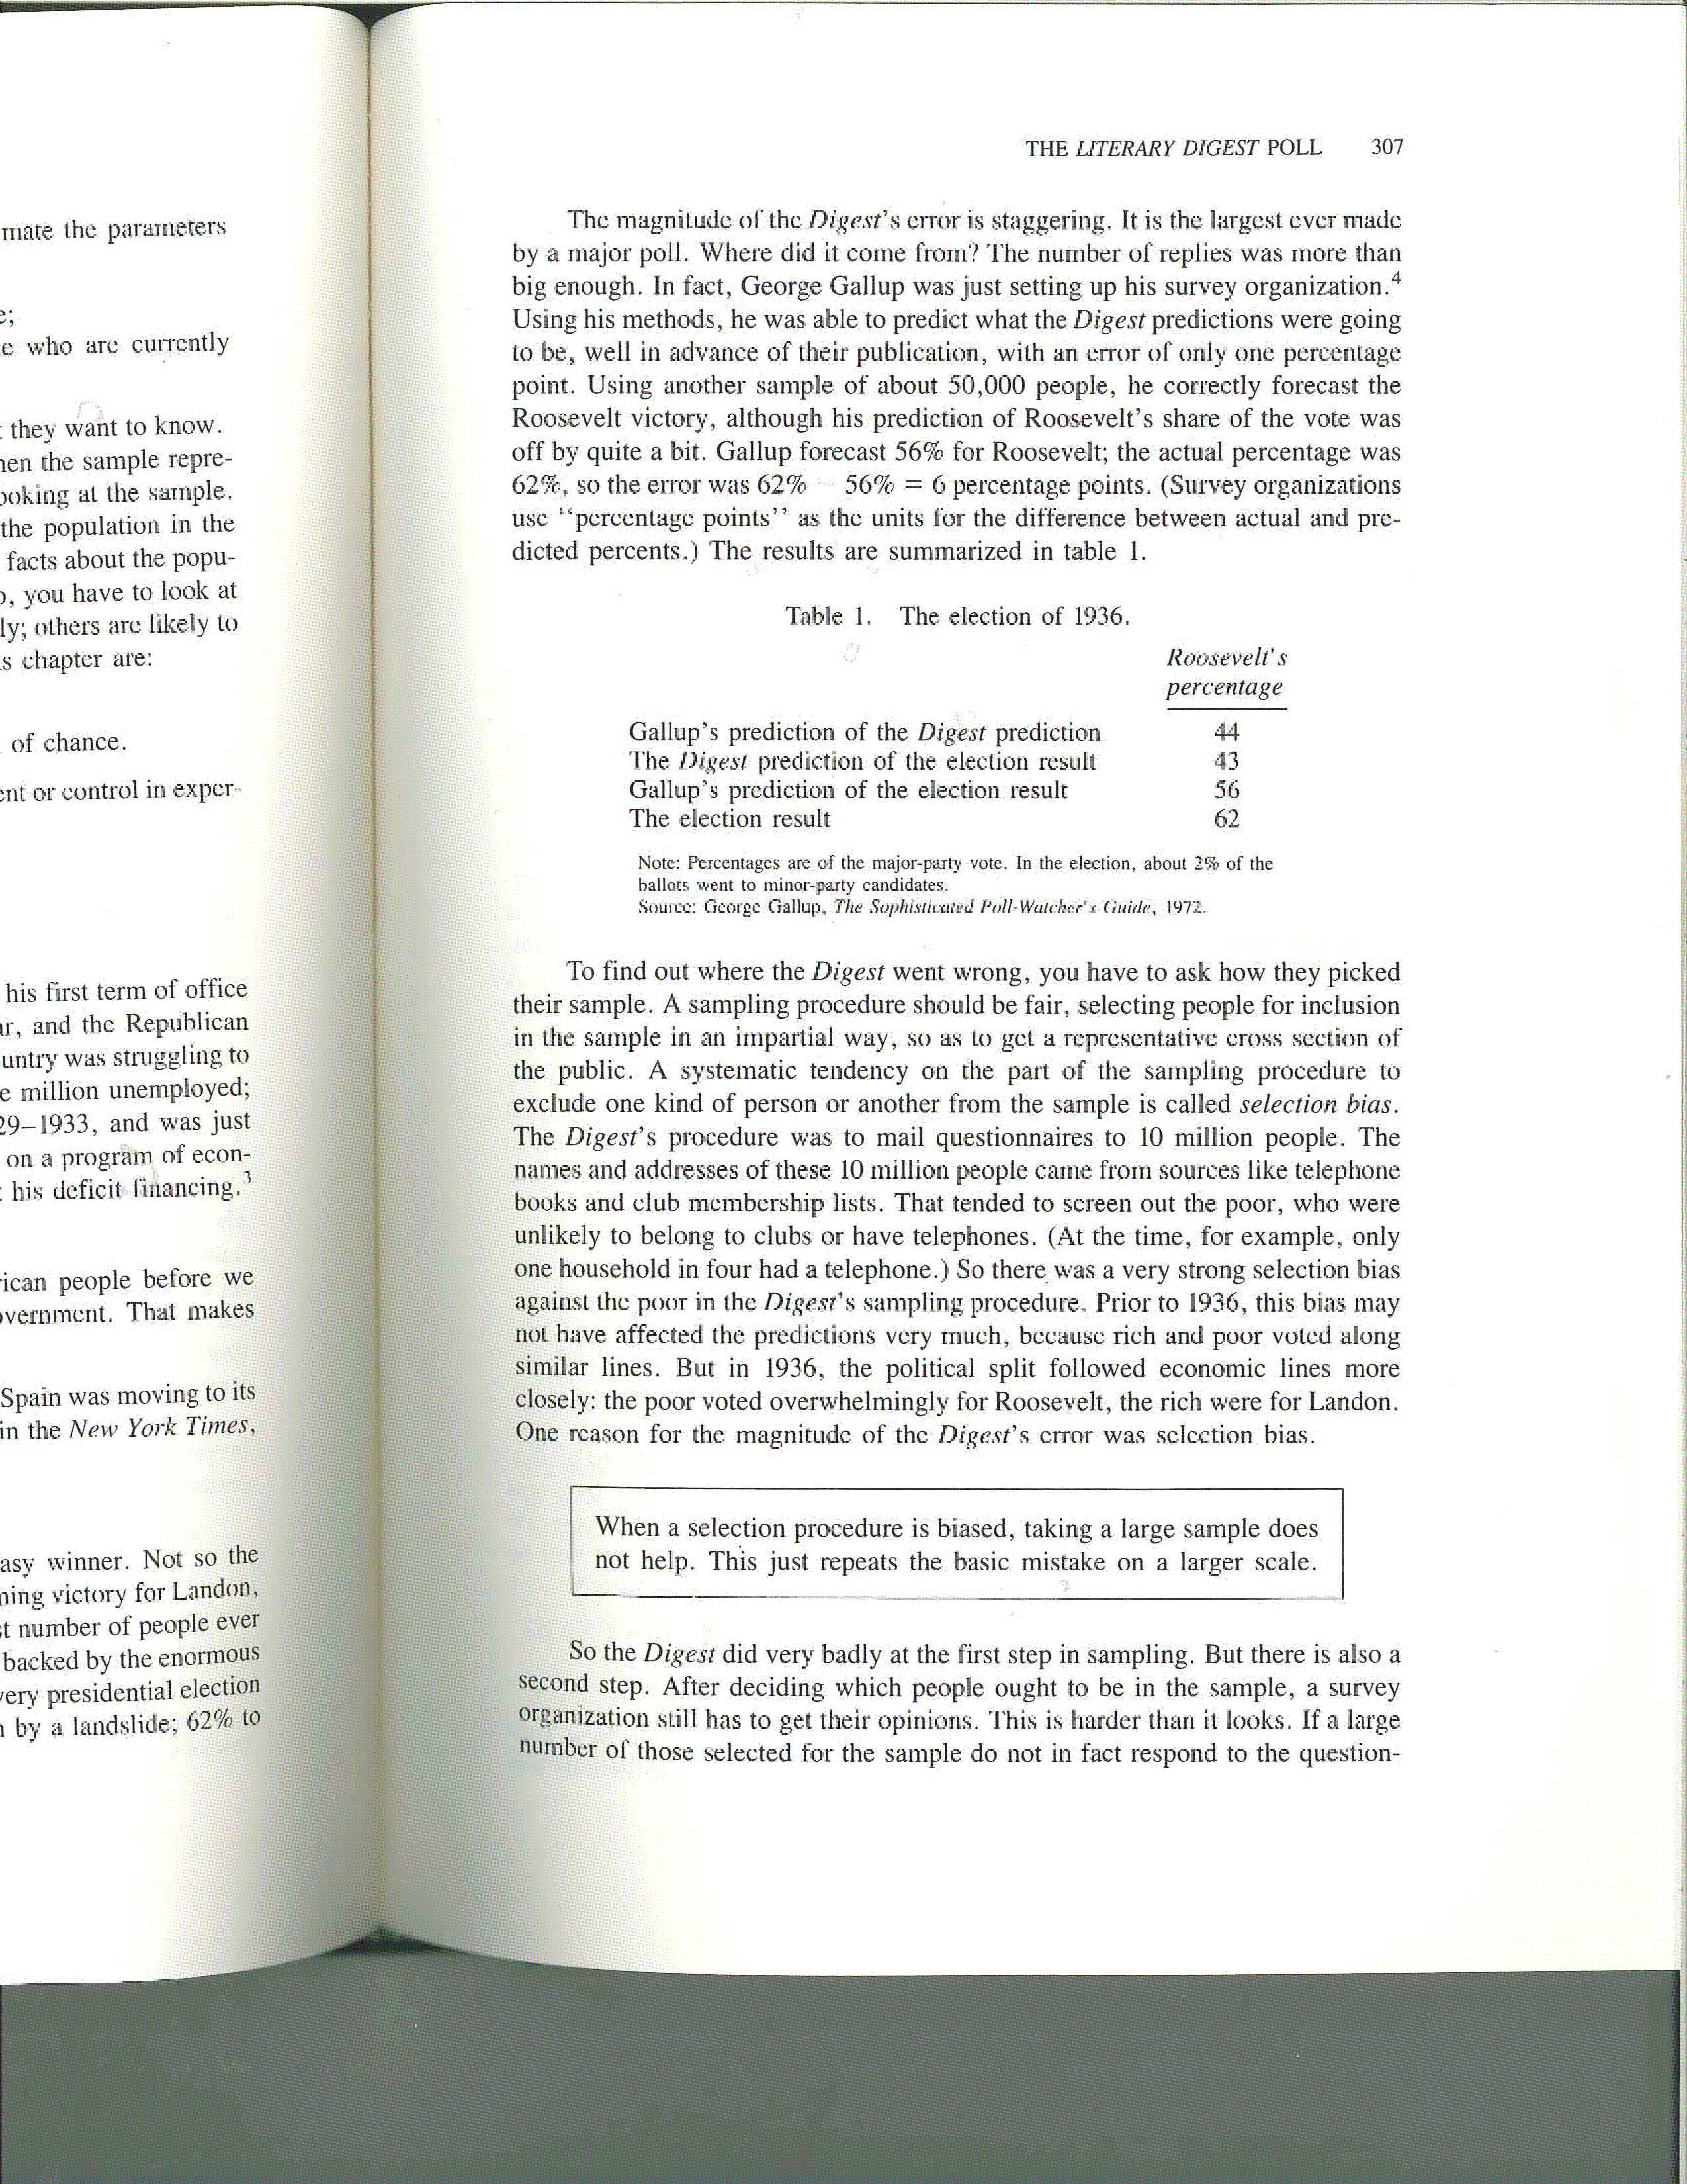
Thoughts on Big Data
Having big data doesn’t help if it was selected in a biased way.
Notes:
Demo class poll and discuss selection bias, we do not know the direction of the bias

Slide 11
Thoughts on Big Data
Compared to causality, prediction is easy since you only have to understand associations and correlation.
Notes:
Run through ice cream example.
Prediction does not require you to understand the causal mechanism under study.
Causal inference requires you to disentangle the mechanics of a system
Image source: https://miro.medium.com/max/700/1*8j7U89RK1SgopIGET0mSFA.png

Slide 12
Thoughts on Big Data
If you are interested in causation you can’t measure it all. You can at most, measure half of it.
Notes:
What does that mean? Well in causal inference you want to observe say the effect of a drug A and drug B. Ideally you observe both drugs in the same comparison and compare their effects
So in the world of Calvin and Hobbes, Calvin has a machine called the duplicator where he is able to make copies of himself. Causal inference is easy in this world!
In reality we tend to only observe one event and we need to construct what is called a counterfactual, or an estimate of what might have occurred in the world where someone received drug B instead of A
This is just meant to provide you some guidance on the limitations of observed data, even in highly controlled settings like drug trials
Image source: https://www.mutualart.com/Artwork/Calvin-and-Hobbes-Duplicator/A1D7C28ADF37DA90

Slide 13
Thoughts on Big Data
Modern machine learning methods are just as good or even better than the more usual statistical methods at finding spurious correlations. Solution? validation.
Notes:
Spurious correlation: a correlation that appears in your data due to chance and is interpreted as meaningful
Example: divorce and margarine
By chance in big data, you will find correlations
Algorithms are incredibly powerful, like a blood hound, and will sniff out any correlation so we need to have caution
Validation as a tool to combat
Image source: https://blogs.ams.org/blogonmathblogs/2017/04/10/divorce-and-margarine/

Slide 14
Thoughts on Big Data
Randomization can be used with big data.
Notes:
Positive note? We can combine clever study design with big data to produce very powerful clinical studies
Pragmatic clinical trial, leverage EHR data infrastructure to monitor a clinical trial within an existing health care setting
The contrast is a traditional trial which is heavily curated, more expensive, and less realistic
Hybrid designs show lots of promise
Very techy in spirit, like a real world experiment for advertising and click rates.
Image source: https://rethinkingclinicaltrials.org/chapters/pragmatic-clinical-trial/what-is-a-pragmatic-clinical-trial-2/

Slide 15
Questions related to content?
Use the chat to let me know, I will attend in that order.
Notes:
Help me help you understand content or concerns about the course

Slide 16
Course outline
Introduction
Getting data (large databases, electronic health records)
Managing data
Algorithms (predictive, clustering)
Predictor/variable selection
Causal inference and big data
Describing data with tables and figures
Case studies
Notes:
Getting data and managing data: the foundation of algorithms. Not the most exciting topic but without a discussion of databases and data quality, we are stranded.
Algorithms (five lectures): the core of the course
Predictor/variable selection
Causal inference with big data
Describing data with tables and figures
Case studies

Slide 17
Is this course for you?
High-level survey course
Fast, comprehensive, but not deep
No programming, graphical computer interface
Not statistics!
Goal: teach basic fluency in language and methods of machine learning/data mining in big data. Hold your own at a SF dinner party!

Slide 18
Course Delivery
As you may have noticed, we are remote!
Online format
  Lecture (2x/week): 1 hour recorded (watch before)
  Summary/QA (2/week): M/Th 1:00 – 1:45 PM (live Zoom)
  Lab: Th 2:00 – 4:00 PM (MH-1400)
  See CLE for links: https://courses.ucsf.edu/course/view.php?id=8594
  Attendance is not required but I urge you to log in!
  All class is pre-recorded or recorded via Zoom!

Slide 19
Course Grading
Assignments (55%)
Project (45%) – four data options
  3 “components” (0/1/2 grading – 15%)
  Final project write-up (30%)
Turn assignments in on time. We move fast.
To ease grading, copy and paste answers into a separate document – do not respond inline.

Slide 20
TICR Professional Conduct Statement
I will maintain the highest standards of academic honesty
I will neither give nor receive aid in examinations or assignments unless such cooperation is expressly permitted by the instructor (Our policy: mutual collaboration on labs and assignments is fine. The project should be your own work)
I will conduct research in an unbiased manner, report results truthfully, and credit ideas developed and work done by others
I will not use answer keys from prior years
I will write answers in my own words, and, when collaboration is permitted, acknowledge collaborators when answers are jointly formulated.

Slide 21
Course due dates
Assignments are due Thursdays starting 7/29.
Project components due on 8/8, 8/15 and 8/22.
Final project due Thursday 9/2.
All materials submitted via CLE.

Slide 22
Course software:
Orange Data Mining
A key aspect of the labs will be hands-on use of the software.
Allows access to many of the features of big data analytics without the need to learn programming.

Slide 23
Optional reading (posted on CLE):
An Introduction to Statistical Learning. eBook free via http://faculty.marshall.usc.edu/gareth-james/ISL/ISLR%20Seventh%20Printing.pdf Or within UCSF network from Springer directly.
Notes:
An introduction to statistical learning. Gareth James, Daniela Witten, Trevor Hastie, and Robert Tibshirani. New York: Springer, 2013 and is available for free via www-bcf.usc.edu/~gareth/ISL/. Largely a machine learning book. The book is technical in places, but strives to explain things in text. The book provides accompanying code in R to illustrate concepts, but the R material is restricted to lab sections at the end of each chapter; understanding R is not necessary for following the general concepts in the book.

Slide 24
Questions?
Class forum – let other people see your questions!
Or contact me: aaron.scheffler@ucsf.edu

Slide 25
Next up, lab
Take a 15 minute break and we will return and go through lab.

