Slide 1
Biostat 202: Accessing Data and Large Datasets
Aaron Wolfe Scheffler,
Division of Biostatistics,
Department of Epidemiology and Biostatistics
Biostat 202

Slide 2
Outline for today
File types
Variable types and roles
Data formats
Best practices in data
Availability of datasets
UCSF dataset help
UCSF EHR datasets

Slide 3
File types
Data are stored in many different file formats. You usually have to understand at least roughly how the data are stored to access them.
In Orange there are several widgets under the Data tab which can be used to import different file types.

Slide 4
Some file types
Excel spreadsheet
.csv file. Text file with a structured format – data elements separated by commas (delimiter).
Text file with other delimiters.
SAS or SPSS statistics data file.
Relational database
.xml file. Text file with mark-ups to designate fields and field names, text-based database.
Notes:
Xml = extendable markup file

Slide 5
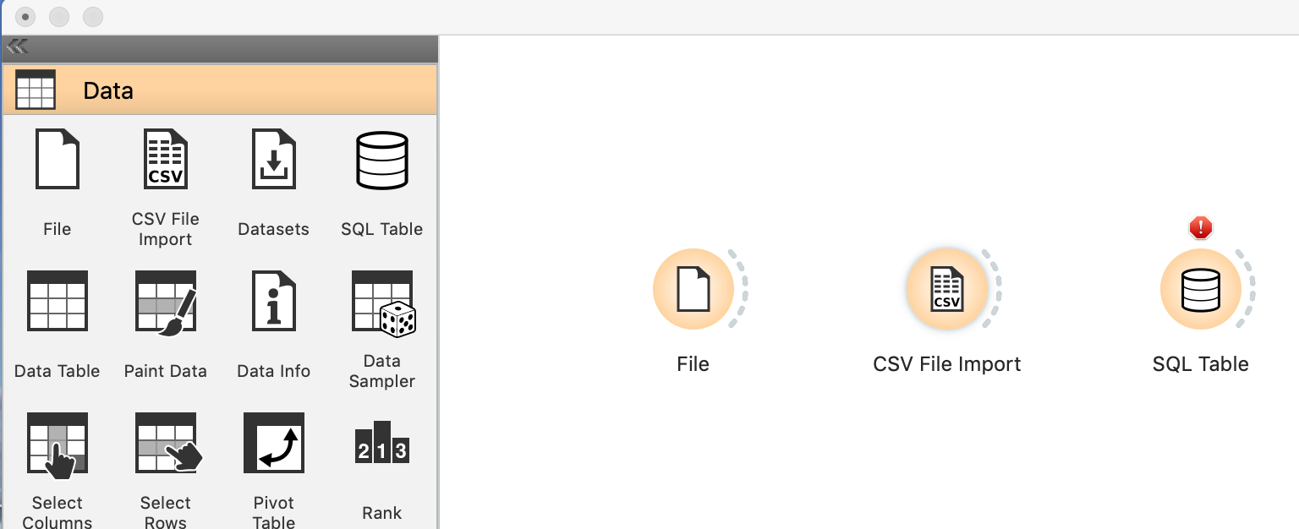
Orange file types

Slide 6
Files: What does a .csv file look like?
In homework we will use the data from the National Electronic Injury Surveillance System (NEISS).
Designed by the Consumer Product and Safety Commission to monitor consumer products that can cause injuries (think electric scooter).
Based on a national sample of U.S. hospitals. Records emergency department visits that involve injury related to a consumer product.
The data from 2018 alone consists of approximately 360,000 records.

Slide 7
Files: What does a .csv file look like?
Take a look at the NEISS dataset
CPSC Case #,trmt_date,psu,weight,stratum,age,sex,race,race_other,diag,diag_other,body_part,disposition,location,fmv,prod1,prod2,narr1,narr2¶
150324089,3/9/2015,21,15.0591,V,28,1,0,,57,,76,4,0,0,1894,,28YM EVADING BAIL BONDSMAN&JUMPED FROM 3RD STORY WINDOW LANDING ONTO FA,"CE, +LOC/SZ LIKE ACTIVITIES>>MULTI FACIAL BONE FXS” ¶
150734952,7/4/2015,57,15.7762,V,20,1,2,,59,,82,1,1,0,1894,,20 YOM DX HAND LACERATION - S/P PT PUNCHED A WINDOW., ¶
Notes:
What you would see if you opened the NEISS data as a text file. Paragraph marks mark the ends of the line in the text file (wrapping on screen here). Computers read the file starting at the beginning and move from left to right. So what does it need to do to make sense of the data?
It reads C then P then S then C then blank then C etc.

Slide 8
Files: What does a .csv file look like?
NEISS dataset from Homework
CPSC Case #,trmt_date,psu,weight,stratum,age,sex,race,race_other,diag,diag_other,body_part,disposition,location,fmv,prod1,prod2,narr1,narr2¶
150324089,3/9/2015,21,15.0591,V,28,1,0,,57,,76,4,0,0,1894,,28YM EVADING BAIL BONDSMAN&JUMPED FROM 3RD STORY WINDOW LANDING ONTO FA,"CE, +LOC/SZ LIKE ACTIVITIES>>MULTI FACIAL BONE FXS” ¶
Variable names
Notes:
How does it know that the first row contains variable names and not data?

Slide 9
Files: What does a .csv file look like?
NEISS dataset from Homework
CPSC Case #,trmt_date,psu,weight,stratum,age,sex,race,race_other,diag,diag_other,body_part,disposition,location,fmv,prod1,prod2,narr1,narr2¶
150324089,3/9/2015,21,15.0591,V,28,1,0,,57,,76,4,0,0,1894,,28YM EVADING BAIL BONDSMAN&JUMPED FROM 3RD STORY WINDOW LANDING ONTO FA,"CE, +LOC/SZ LIKE ACTIVITIES>>MULTI FACIAL BONE FXS” ¶
Data from an emergency room visit

Slide 10
Files: What does a .csv file look like?
NEISS dataset from Homework
CPSC Case #,trmt_date,psu,weight,stratum,age,sex,race,race_other,diag,diag_other,body_part,disposition,location,fmv,prod1,prod2,narr1,narr2¶
150324089,3/9/2015,21,15.0591,V,28,1,0,,57,,76,4,0,0,1894,,28YM EVADING BAIL BONDSMAN&JUMPED FROM 3RD STORY WINDOW LANDING ONTO FA,"CE, +LOC/SZ LIKE ACTIVITIES>>MULTI FACIAL BONE FXS” ¶
End of a record

Slide 11
Files: Data issues
NEISS dataset from Homework
CPSC Case #,trmt_date,psu,weight,stratum,age,sex,race,race_other,diag,diag_other,body_part,disposition,location,fmv,prod1,prod2,narr1,narr2¶
150324089,3/9/2015,21,15.0591,V,28,1,0,,57,,76,4,0,0,1894,,28YM EVADING BAIL BONDSMAN&JUMPED FROM 3RD STORY WINDOW LANDING ONTO FA,"CE, +LOC/SZ LIKE ACTIVITIES>>MULTI FACIAL BONE FXS” ¶
Issues?
Notes:
Issues: Narrative is split into two fields. Causes misspellings in each field. Quotes.

Slide 12
Files: Data issues
NEISS dataset from Homework
CPSC Case #,trmt_date,psu,weight,stratum,age,sex,race,race_other,diag,diag_other,body_part,disposition,location,fmv,prod1,prod2,narr1,narr2¶
150324089,3/9/2015,21,15.0591,V,28,1,0,,57,,76,4,0,0,1894,,28YM EVADING BAIL BONDSMAN&JUMPED FROM 3RD STORY WINDOW LANDING ONTO FA,"CE, +LOC/SZ LIKE ACTIVITIES>>MULTI FACIAL BONE FXS” ¶
,, Issue?

Slide 13
Files: Data issues
NEISS dataset from Homework
CPSC Case #,trmt_date,psu,weight,stratum,age,sex,race,race_other,diag,diag_other,body_part,disposition,location,fmv,prod1,prod2,narr1,narr2¶
150324089,3/9/2015,21,15.0591,V,28,1,0,,57,,76,4,0,0,1894,,28YM EVADING BAIL BONDSMAN&JUMPED FROM 3RD STORY WINDOW LANDING ONTO FA,"CE, +LOC/SZ LIKE ACTIVITIES>>MULTI FACIAL BONE FXS” ¶
Issue?

Slide 14
Data formats
Some data is structured, best expressed in tabular form
  Excel, csv, etc…
Some data is not easily packaged into tabular files, i.e. unstructured data
  Clinical notes, images, etc…
Notes:
Leads us to consider variable types.

Slide 15
Variable types
Numeric - It is not usually necessary to distinguish continuous versus not. “Numeric” in Orange
Categorical – also known as “nominal”. “Categorical” in Orange.
Ordinal – ordered categorical. Not available in Orange
Also: text, date, time

Slide 16
Variable types: Why is it important to distinguish?
Most software will try to adapt the analysis depending on the variable type and read it correctly.
Example: hospitalized on 12/7/2015, readmitted on 1/6/2016. Was that within 30 days? Many programs allow subtraction of dates.
Example: Knee pain is coded as 1, 2, 3 and 4. Does is make sense to split it as 1 and 2 versus 3 and 4?
Maybe if ordinal (1=no, 2=slight, 3=moderate, 4=severe pain). Probably not if nominal (1=no, 2=left knee only, 3=right knee only, 4=both).

Slide 17
Variable types - roles
It is also important to designate the role of a variable in the analysis. Main ones are:
Target. Also called outcome, response, dependent variable.
Feature. Also called predictor, covariate, independent variable.
Orange also has variable roles meta (information not used for modeling) and skip (ignore)
Notes:
Target and Feature are Orange names
Split is different from Partition. With Split the analyses are run separately for the values of the variable that is declared as Split. In Partition, the model is fit using the training and not refit with the test data. Also is done randomly.

Slide 18
Best practices in data
Most analysis programs want the data in “rectangles” with each row a record or observation and each column a field or variable. Exception: the first row usually contains variable names.
So a dataset with 10 variables and 300 people would have 10 columns and 301 rows (300 data rows and a variable names row).

Slide 19
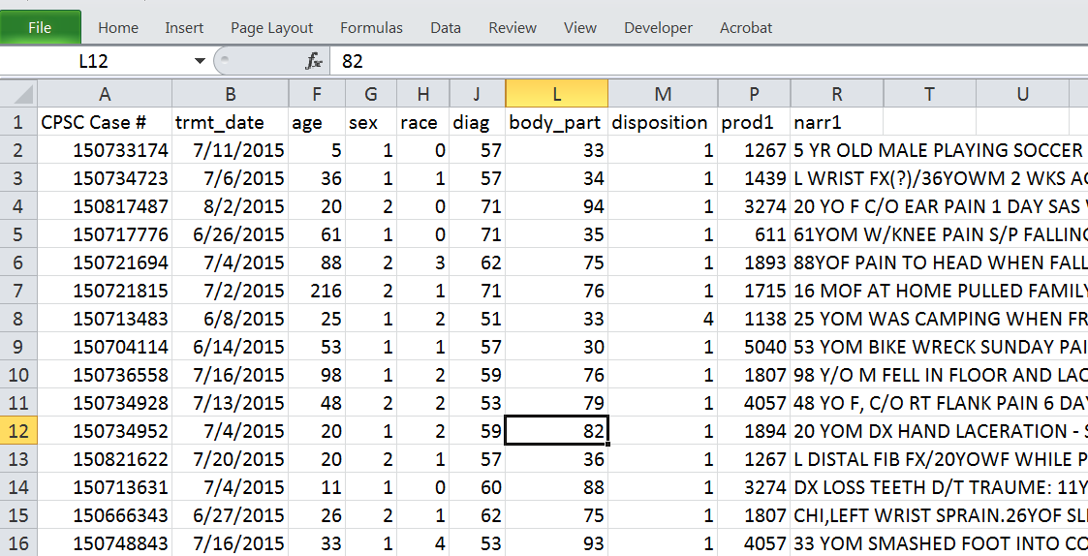
Best practices: rectangular data
Notes:
Here is what the NEISS data looks like in Excel.

Slide 20
Best practices in structured data
Each column should contain 1 variable, or one unique piece of information about the subject.
  E.g., don’t enter blood pressure in one column as “130/90”. That would be two variables -- one variable for systolic and one for diastolic.
Another thing I have seen is the patient id variable coded such as “Fresno1133”, “Parnassus0002” without a site variable elsewhere in the dataset.

Slide 21
Best data practices checklist part 1
One row per subject, one column per variable.
Variable names in first row only.
Avoid hyphens, or special characters in the variable names. Some programs don’t want variable names that start with numbers.
Some programs don’t distinguish lower and upper case in names.

Slide 22
Best data practices checklist part 2
Majority analysis programs leave missing data as blank
Sometimes on questionnaires or surveys, "Unknown" or "Don't know" is a valid answer.
Designate date by a type if possible. If not, format of mm/dd/yyyy (e.g., 07/04/2016) can be read by just about any analysis package.
Record time as military time (e.g., 14:00 instead of 2:00pm) and many programs can read a time if it is entered in the format of hh:mm (and seconds if necessary).

Slide 23
Best data practices checklist part 3
Do not intersperse blank rows or columns, lines of labels, or summary statistics in with the data. The dataset should be a solid rectangle.
It is hard for analysis programs to directly handle fields that contain comments or extended text. The usually need to be pre-processed using text analytics. For example, “natural language processing.”

Slide 24
Two common variations on the basic rectangular layout. 1. Longitudinal
It is quite common to collect data over time on the same “patient” (longitudinal data) across multiple “visits”.
There are two common ways to arrange the data: one row per patient (sometimes called “wide” format because the rectangle of data would have many columns and be wide) and one row per visit (sometimes called “long” format because the rectangle of data would have many rows and be long).

Slide 25
Data layouts for longitudinal data
“Wide format”
Notes:
Stata command: reshape

Slide 26
Data layouts for longitudinal data
For longitudinal analyses: “long format”
Not a very efficient data storage format
Notes:
Longitudinal analyses typically want data in the “long” format. One row per outcome.
Change analyses typically want data in the “wide” format. One row per subject.
“Long” is more flexible and missing data is then just a missing row.

Slide 27
Two common variations on the basic rectangular layout. 2. Relational
More efficient to store two files, one for patient level characteristics and one for visit level.

Slide 28
Healthcare datasets are rapidly becoming much more available
There are numerous datasets that are available for conducting research. The National Library of Medicine offers an entrée to many of them:
https://www.nlm.nih.gov/hsrinfo/datasites.html
I’ll briefly talk about two examples: NHANES and NIS.

Slide 29
Datasets: NHANES
National Health and Nutrition Examination Survey.
Description: NHANES is a set of studies for assessing the health and nutritional status of adults and children in the United States, comprising both interviews and physical examinations. It began in the early 1960s and, since 1999, has surveyed about 5,000 persons each year.
Location: http://www.cdc.gov/nchs/nhanes/
Datafile type(s): SAS transport files (.xpt)

Slide 30
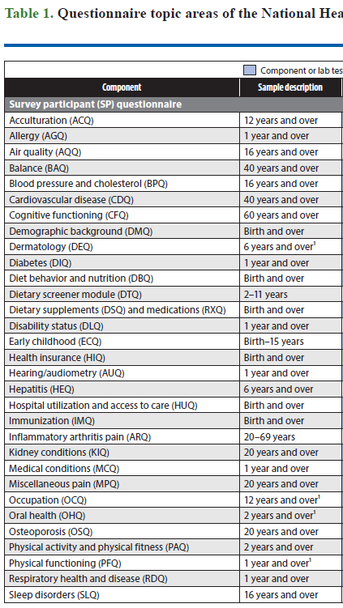
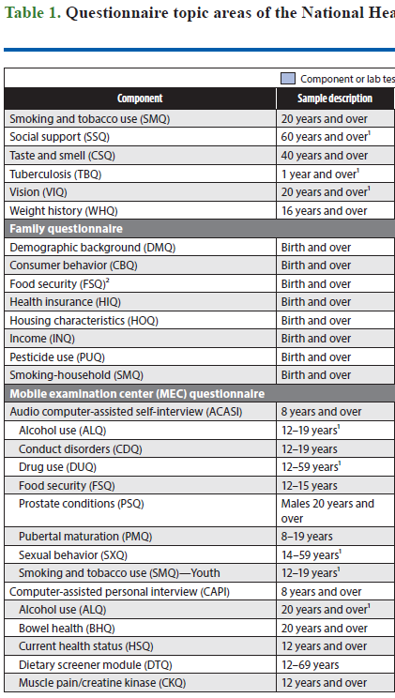
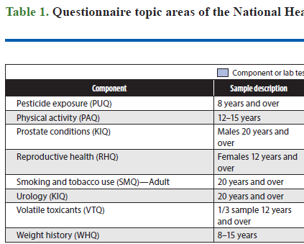
Datasets: NHANES

Slide 31
Datasets: NHANES
Interview questions
  Do you use products to control insects?
  Do you use products to control weeds?
Urine analysis
Blood analysis
Etc…

Slide 32
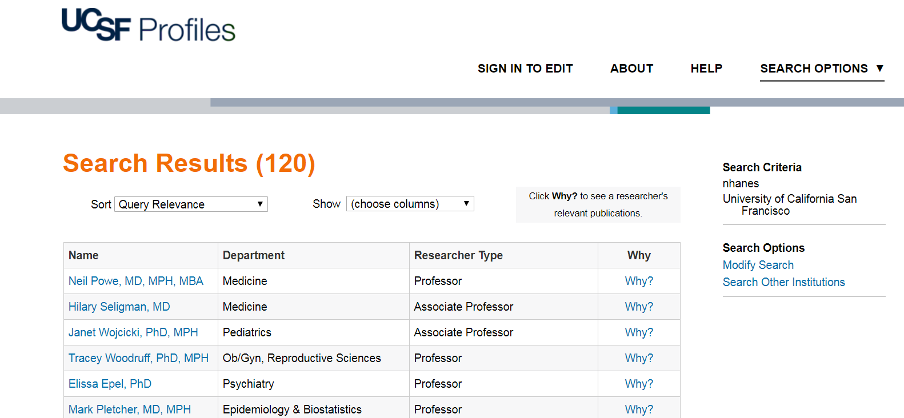
UCSF Profiles search on “NHANES”
120 entries, mostly faculty who have published using NHANES

Slide 33
Datasets: NHANES examples

Slide 34
Datasets: NIS
National Inpatient Sample (NIS).
Description: NIS is the largest publicly available all-payer inpatient health care database in the United States, yielding national estimates of hospital inpatient stays. It contains data from more than 7 million hospital stays each year.
Location: https://www.hcup-us.ahrq.gov/nisoverview.jsp
Datafile type(s): text, fixed file format (website includes code to read the files into SPSS, SAS and Stata).

Slide 35
Datasets: NIS
The NIS contains clinical, nonclinical, and resource-use information that is included in a typical discharge abstract, including:
Primary/secondary diagnoses and procedures,
Patient demographics,
Hospital characteristics,
Payment source and total charges,
Discharge status and length of stay, and
Severity and comorbidity measures.

Slide 36
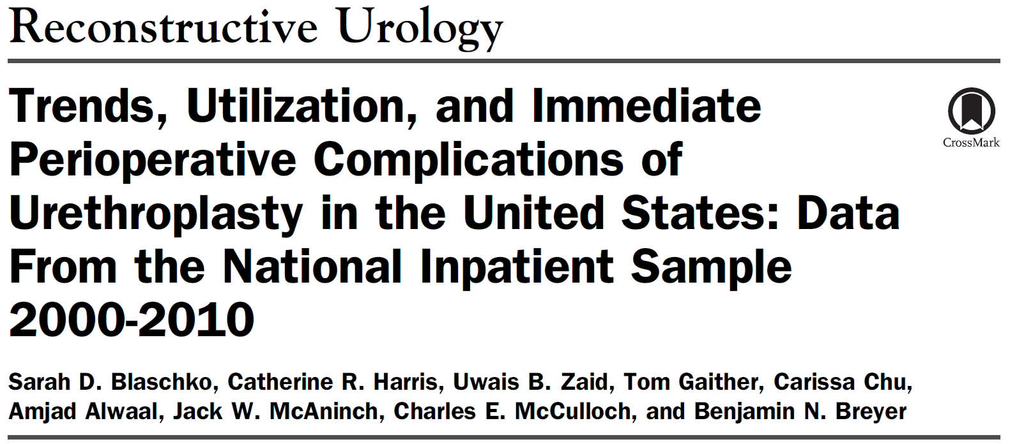
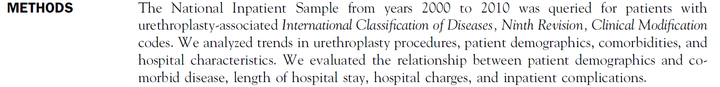
Datasets: NIS examples

Slide 37
Finding your way around population health datasets
The Clinical and Translational Sciences Institute (CTSI) has partnered with the Library (Data Science Initiative) and offer state, national and international datasets to conduct research on health and health care.
https://guides.ucsf.edu/pophealthdata/home

Slide 38
Population Health Data Repository
UCSF maintains a repository of select large, public datasets that are available to UCSF researchers, many at no cost.
These data sets include
  National samples of hospital discharges and ED visits
  Universes of hospital discharges and ED visits for select states
  Data on characteristics of hospitals
  County level data on demographic, socio-economic, and health system characteristics
Notes:
For example the NIS

Slide 39
How to Access Population Health Datasets
Obtain a Research Analysis Environment (RAE) account (FREE up 10 Gb storage) https://data.ucsf.edu/research/rae
Request data help through CTSI at
  https://consult.ucsf.edu/phhs

Slide 40
Using Electronic Health Records for Research
EHR at UCSF can be very confusing!
I want to give you some context for resources available, also provide a resource for future inspection
Important guiding questions include:
  Identified vs de-identified data? Permissions
  Type of data, e.g. clinical notes, images
  Interface, e.g. point-and-click, SQL query, mapped drive, etc…
Notes:
Image source: https://data.ucsf.edu/research/ucsf-data
Information Commons

Slide 41
Using Electronic Health Records for Research
Notes:
Image source: https://data.ucsf.edu/research/ucsf-data
Information Commons

Slide 42
Using Electronic Health Records for Research
The Academic Research Systems group makes a de-identified extract of the APeX files available.
Point and click interface: RDB
Details at: https://ars.ucsf.edu/research-data-browser-de-identified-export-and-flowsheet-files

Slide 43
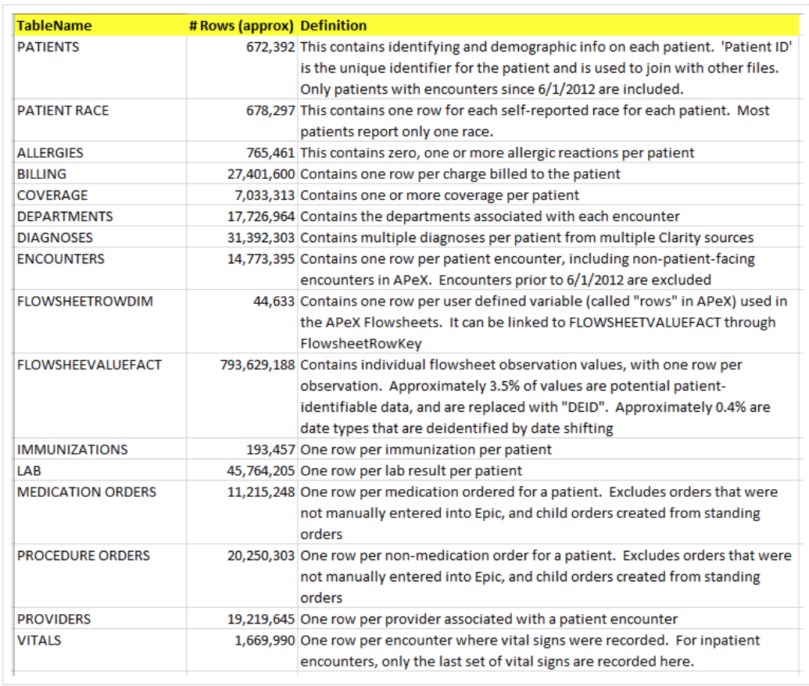
Using Electronic Health Records for Research

Slide 44
Using Electronic Health Records for Research
Before you can access the de-identified data you need to be granted access to the “Research Data Browser.”
Apply for access here: https://ars.ucsf.edu/research-data-browser-de-identified-export-and-flowsheet-files
More resources here: https://guides.ucsf.edu/c.php?g=101037&p=2704613

Slide 45
Using Electronic Health Records for Research
If you want access to data including identifiers, you can request an extract of APeX data at UCSF through Academic Research Systems.
First 8 hours of consultation are free.
Need IRB approved protocol.
Details available at:
https://data.ucsf.edu/research/ucsf-data
Notes:
Notes and lab fields contain PHI.

Slide 46
Using Electronic Health Records for Research
Navigating the process of specifying what you need from APeX to conduct research can be a daunting task.
CTSI’s Data Management Unit can help with both the specification and the data request to Academic Research Systems.
http://accelerate.ucsf.edu/research/data-consult
But note that these often require considerable work for which you would need to arrange funding.
Notes:
Notes and lab fields contain PHI.

Slide 47
Using Electronic Health Records for Research
Also
UCReX – University of California Research eXchange – a compendium of 14.5m data records from the five UC medical centers. Contact ARS for more info
https://ars.ucsf.edu/
Limited data.
Notes:
Notes and lab fields contain PHI.

Slide 48
Summary
It helps to know the format and layout of a dataset you want to analyze.
Paying attention to data formatting issues can save LOTS of time later.
Defining variable roles is important in Orange Data Mining.
Access to rich data is easy.
Finding your way around can be hard.
Look for tools (tutorials, browsers),
Or get professional help (Library, ARS and CTSI).

