Slide 1

Biostat 202: Data Management, Storage, & Preprocessing
or
The Many Lives of Research Data
Aaron Wolfe Scheffler
Assistant Professor, Biostatistics & Epidemiology
aaron.scheffler@ucsf.edu

Slide 2
Where do we spend time?
Notes:
When performing data science, in fact in most analyses, majority of time spent either collecting data or organizing and cleaning
Well worth our while to spend a few moments on this topic

Slide 3
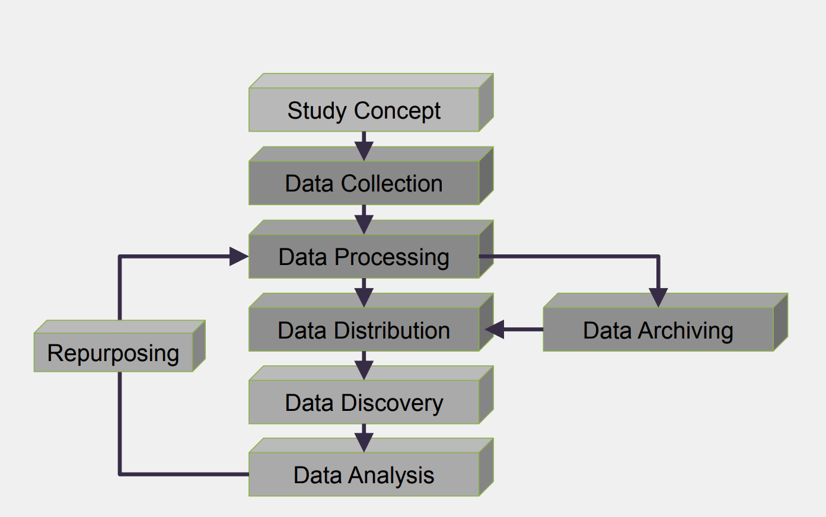
Research data life cycle – dynamic!
Notes:
The research data life cycle is dynamic and iterative
Preparation is key but expect something may not go as expected
Be prepared to iterate
Image source: https://ocw.mit.edu/resources/res-str-002-data-management-spring-2016/workshop-materials/MITRES_STR002S16_IntroDM.pdf

Slide 4
Why discuss data management and storage?
Save yourself time in the future
Ensure data integrity
Retention requirements
Promote and protect yourself!
Support open research
Protect and secure your data
Notes:
Further content: https://libraries.mit.edu/data-management/plan/why/

Slide 5
Why discuss data management and storage?
Save yourself time in the future
  Anticipate possible bottlenecks or roadblocks
Ensure data integrity
  How would someone else use your data?
Retention requirements
  Often contractual obligations about how long and where to store data
Promote and protect yourself!
  Protect yourself against questions of provenance
Support open research
  Increase your research profile, advance science
Protect and secure your data
  Don’t leave your data on the street!
Notes:
Save yourself time in the future
Poor data management and storage will lead to headaches
Ensure data integrity
Have confidence in your data – veracity!
Retention requirements
Funding sources will often require archiving
Promote and protect yourself
Ensure your research integrity is not questioned
Support open research
Allow others to benefit from that 80% effort towards data collection cleaning
Protect and secure your data
Don’t leave your money on the street
Further content: https://libraries.mit.edu/data-management/plan/why/

Slide 6
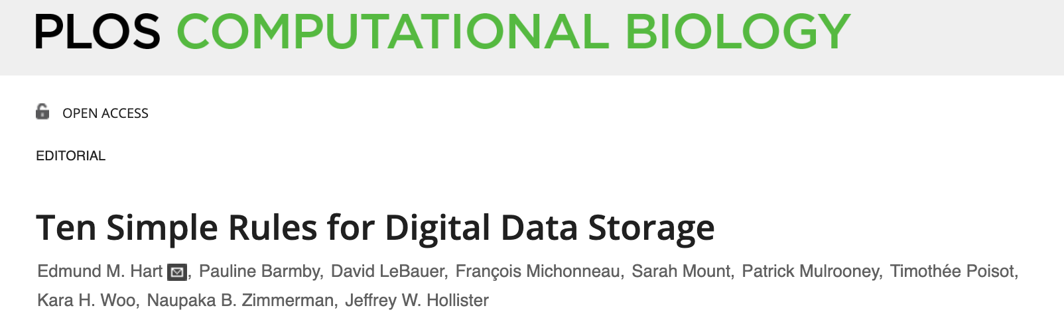
Anticipate how your data will be used
Know your use case
Keep Raw Data Raw
Store Data in Open Formats
Data should be structured for analysis
Data should be uniquely identifiable
Link Relevant Metadata
Adopt Proper Privacy Protocols
Have a systematic Backup Scheme
The location and method of storage depend quantity
Notes:
Article source: https://journals.plos.org/ploscompbiol/article?id=10.1371/journal.pcbi.1005097

Slide 7
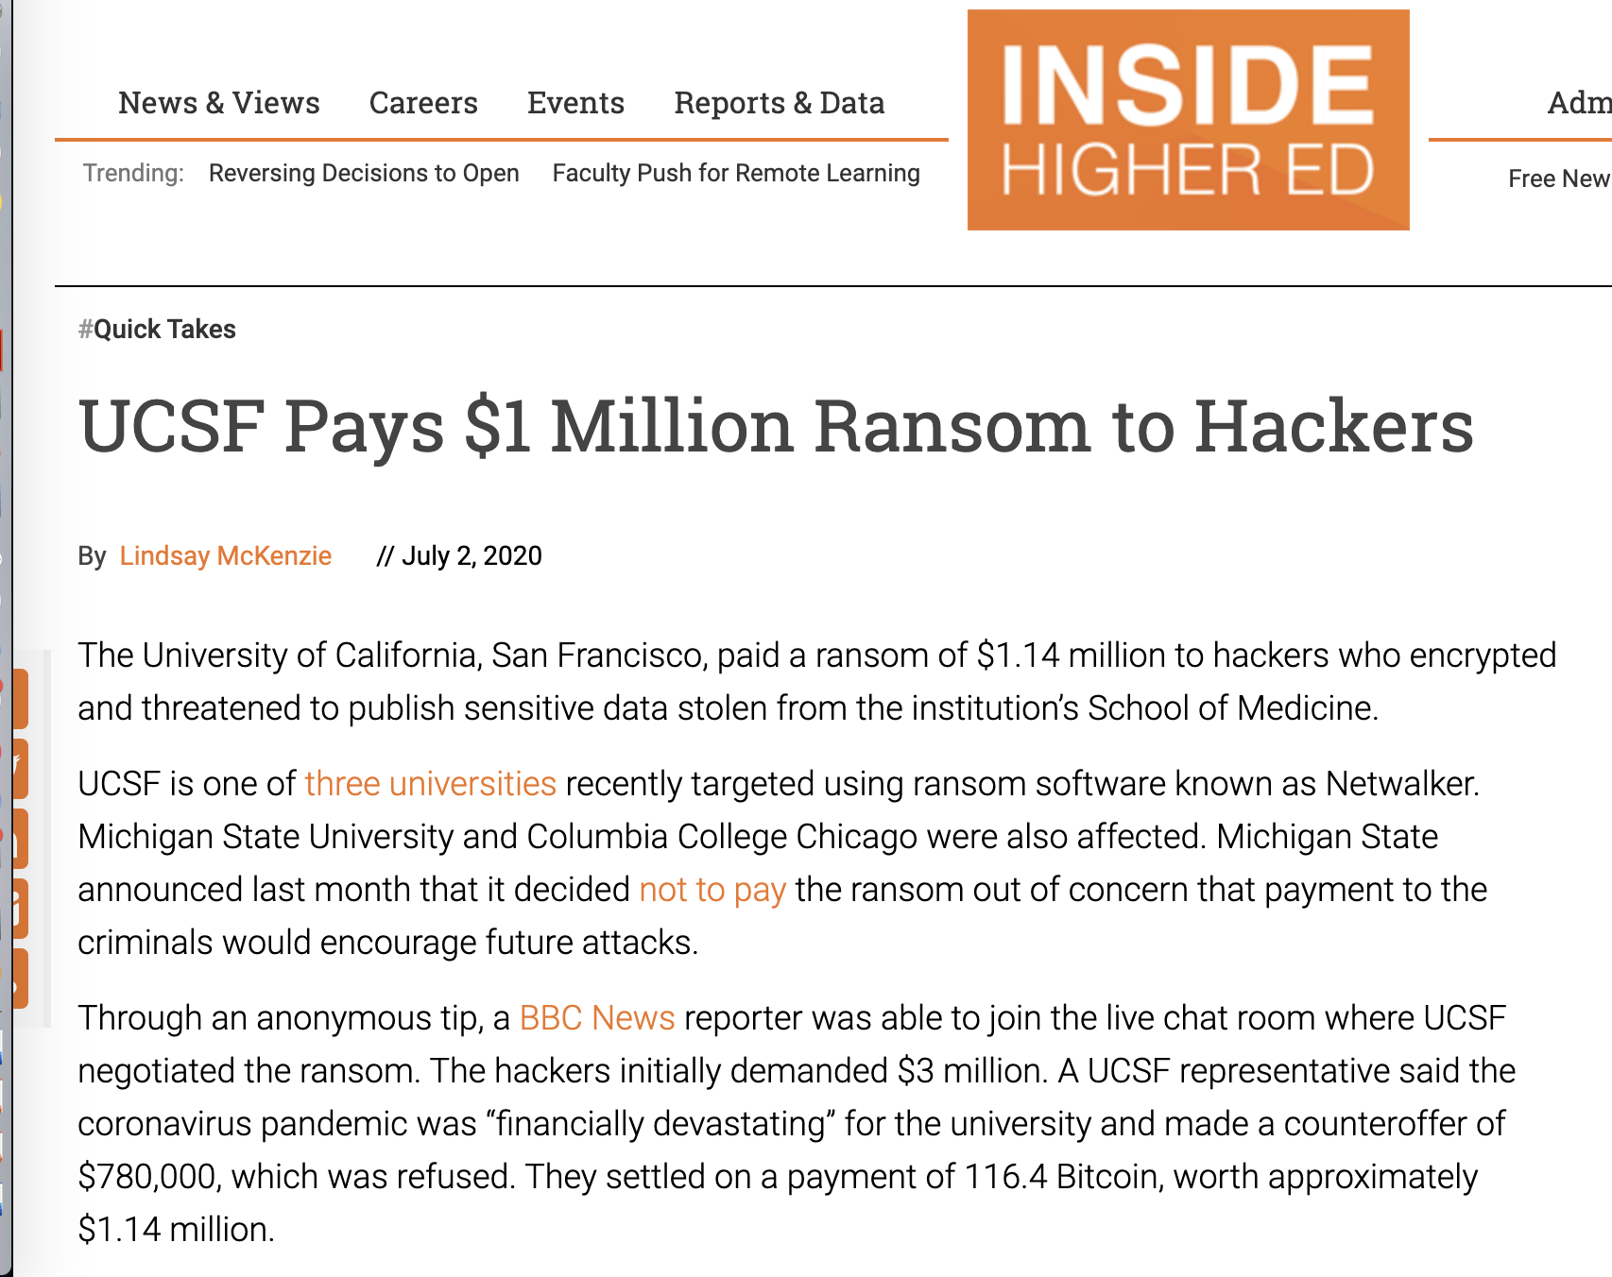
Notes:
Even careful institutions can fall victim – be aware of any phishing or intrusion attempts on your personal accounts. Also imagine your worst case data scenario and protect yourself!

Slide 8
Orange for data management and cleaning
Feature construction (lab)
Merging & concatenating (lab)
Impute missing data (class demo/lab)
Detect outliers (class demo)
Notes:
We can use data to demonstrate and learn about data management and cleaning
Here is the breakdown of where this content will be discussed

Slide 9
Outliers
Notes:
We can spot outliers with plots (discuss 1D vs 2D outliers)
Share example of epigenetics
But what if our data lies in a high dimensional space? Algorithms can help (next slide)
Image source: https://medium.com/@praveengovi.analytics/outliers-what-it-say-during-data-analysis-75d664dcce04

Slide 10
Orange – Local Outlier Factor
Notes:
Local outlier factors looks in a data points immediate neighborhood of a data point and determines how “likely” or ”unlikely” the value is”
Helpful when we have lots of data (both in terms of subjects and features)
Other options available in Orange, now we will demo the local outlier factor
Image source: https://scikit-learn.org/stable/auto_examples/neighbors/plot_lof_outlier_detection.html

Slide 11
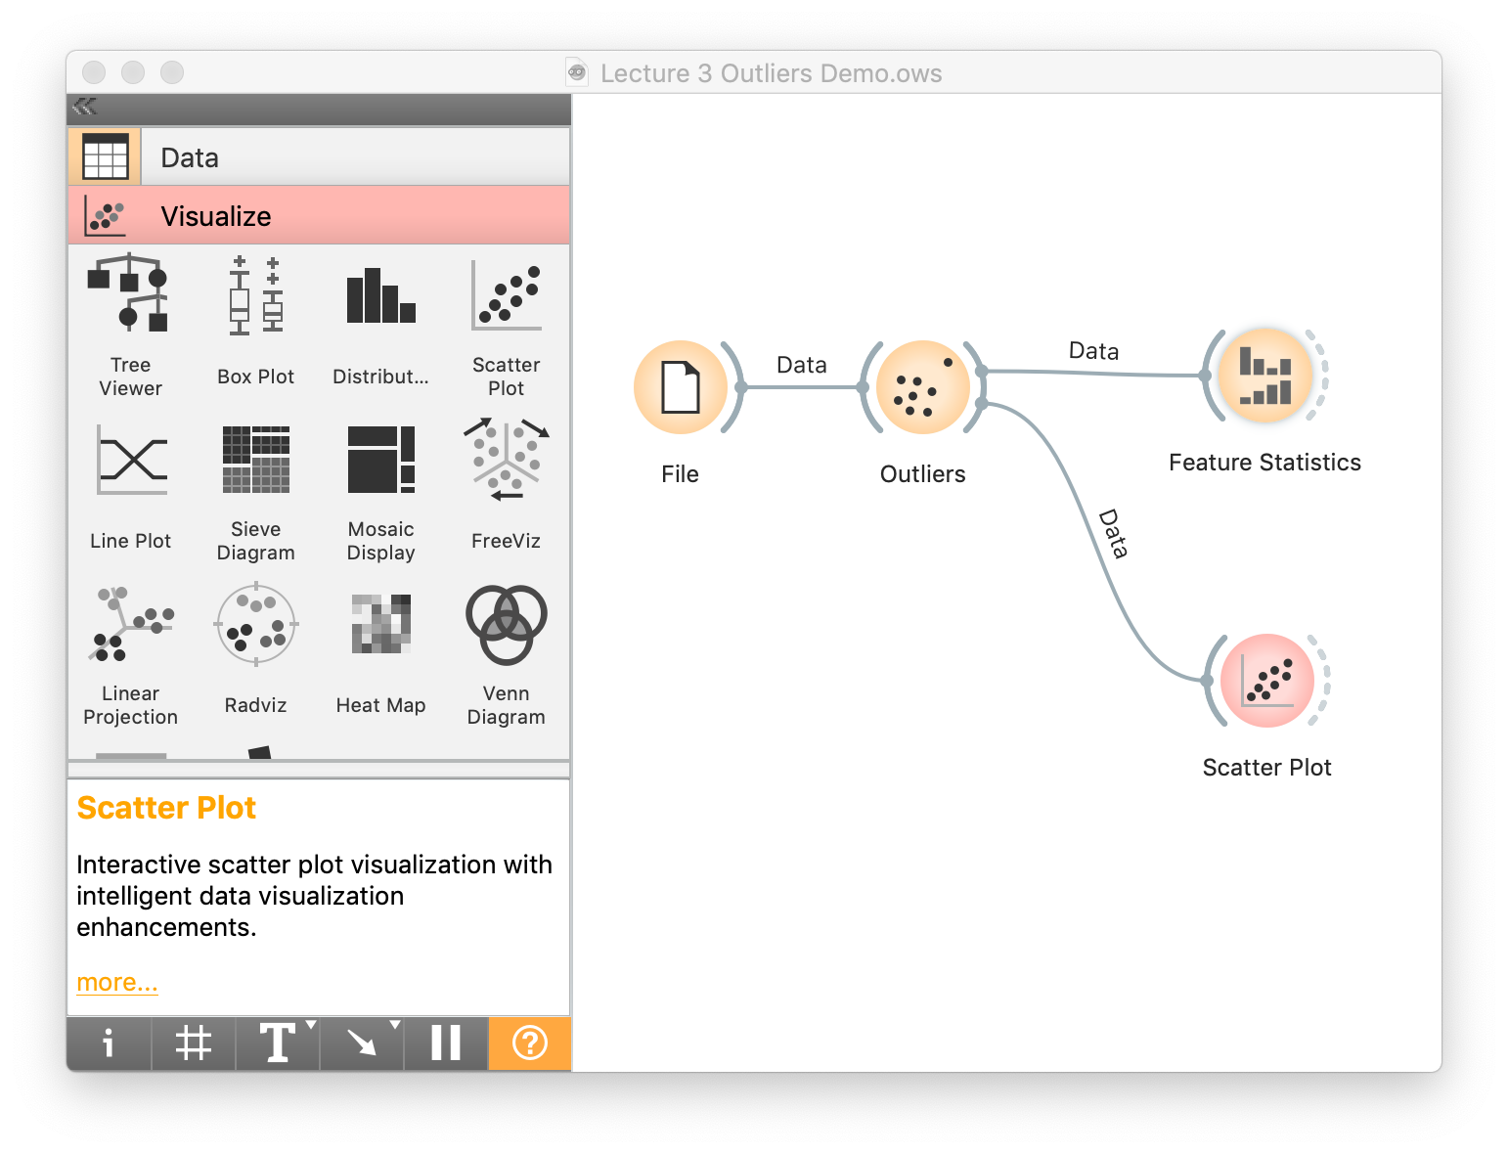
Orange – outlier detection
Notes:
Workflow on CLE
From Orange documentation:
One class SVM with non-linear kernel (RBF): classifies data as similar or different from the core class:
Nu is a parameter for the upper bound on the fraction of training errors and a lower bound of the fraction of support vectors
Kernel coefficient is a gamma parameter, which specifies how much influence a single data instance has
Covariance estimator: fits ellipsis to central points with Mahalanobis distance metric:
Contamination is the proportion of outliers in the dataset
Support fraction specifies the proportion of points included in the estimate
Local Outlier Factor: obtains local density from the k-nearest neighbors:
Contamination is the proportion of outliers in the dataset
Neighbors represents number of neighbors
Metric is the distance measure
Isolation Forest: isolates observations by randomly selecting a feature and then randomly selecting a split value between the maximum and minimum values of the selected feature:
Contamination is the proportion of outliers in the dataset
Replicabe training fixes random seed

Slide 12
Outlier detection – honest truth
There is no simple solution
Best practice is to evaluate multiple considerations
  Plausibility
  Visual inspection
  Automated algorithms to flag points
If uncertain, consider models that are robust to extreme values (more on this later)

Slide 13
Missing data
Notes:
Image source: https://towardsdatascience.com/missing-data-cfd9dbfd11b7

Slide 14
Missing data imputation
Use the mean to fill in the missing value (okay)
Use the mean for all samples belonging to the same class to fill in the missing value: (smart)
Use the most probable value to fill in the missing value: inference-based such as Bayesian formula or decision tree or regression (smarter)
Multiple imputation techniques examining sensitivity of estimates to imputation (smartest?)
What can Orange do for you? (In class!)

Slide 15
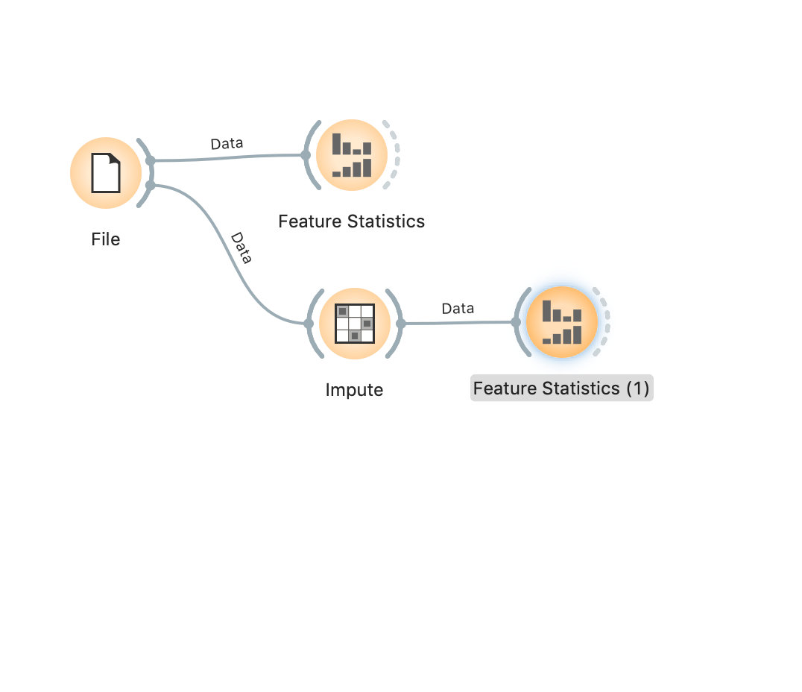
Orange – missing data imputation
Notes:
Workflow on CLE

Slide 16
Questions?
Use the chat to let me know, I will attend in that order.

Slide 17
Next up, lab
After a 15 minute break we will return for lab.
Please visit CLE to download Assignment 2 and the associated data sets.

