Slide 1
Biostat 202: Opportunities and Challenges of “Big Data”.
Machine Learning 3:
Supervised learning, contd. [classification]
Aaron Wolfe Scheffler
Division of Biostatistics
Department of Epidemiology and Biostatistics

Slide 2
Announcements
Assignment 3 due Thursday
Project Component 2 due 8/15 @ midnight
Notes:
Project component 2 due
I will read through component 1 – if you do not hear from me, all is good. Otherwise I will reach out
We discussed four new classifiers and contrasted them

Slide 3
Overview of this lecture
- more classification!
K-nearest neighbors
  Parameter tuning
  Training-validation-test
Classification trees (recursive partitioning)
Support vector machines
Artificial neural networks
Comparison of classifiers

Slide 4
Ongoing case study – Heart data
  Data:
    n = 303
    14 attributes
  Target:
    AHD: diagnosis of heart disease (1 = yes, 0 = no)
  Predictors:
    Age: age (years)
    Sex: gender
    ChestPain: chest pain type
    Chol: cholesterol
    Fbs: fasting blood sugar >120 mg/dL
    restecg: resting electrocardiographic results
    MaxHR: maximum heart rate achieved
    ExAng: exercise induced angina
    Oldpeak: ST depression induced by exercise
    Slope: slope of peak exercise ST segment
    Ca: # of major vessels colored by flouroscopy
    Thal: Thallium stress test
    SysBp: systolic blood pressure
Goal: Predict (probability) of heart disease using different classifiers.
Notes:
Run through case study
Use for exposition of the new techniques and widgets

Slide 5
K-nearest neighbors classification

Slide 6
K-nearest neighbors classification
k = 3 : red wins
height
weight
Notes:
K nearest neighbors classifies a point based on the majority class of its nearest neighbors
E.g. training data consists of height and weight for boys and girls (red and blue, respectively)
Then for any new data point, such as the green square, we assign a predicted gender based on the closest neighboring points.
Consider k = 3, 2/3 of neighboring points are male so red wins and we predict the green square is male
Operates based on the local neighborhood in the predictor or feature space, e.g. height and weight
Very flexible and does not have a “model” but you do have to always inspect the training data

Slide 7
Parameter tuning
Parameter tuning is the process of adjusting model parameters in order to find the “best” model
For example, we tune the K-nearest neighbors by adjusting the parameter k, the number of neighbors
Analogy: tuning the strings of a guitar to play the proper note is like parameter tuning to get the best prediction
Notes:
But now we need to chose the optimal number of neighbors to consider when performing classification, this is the paremeter we need to tune
What is our solution? Model selection via validation. What do I mean by this?
We fit several different KNN with different numbers of neighbors, e.g. k = 2, 3, 4 etc… then chose the KNN that has best performance in our testing data
A huge and important concept in ML – allows you to rigorously select the right number of neighbors, or any other parameter
And this act is called parameter tuning
Image source: https://www.guitarworld.com/lessons/how-to-tune-your-guitar-by-ear

Slide 8
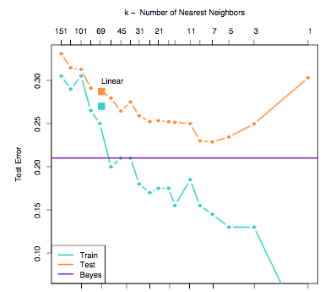
Choice of k
Best predictive
models (k = 7)
Fitting increased noise
Low to high complexity
Test error goes down then up again when overfitting
to training data
Training set error gets better with more complexity – fitting to noise helps
Notes:
Parameter tuning: find the value of K that minimizes the predictive error in our testing data
Describe U shape trend that relates model flexibility and overfitting for our test or validation data.
The sweet spot is the balance between a flexible model and overfitting
Performance on the training data will tend to get better as the model gets more complex (overfitting)

Slide 9

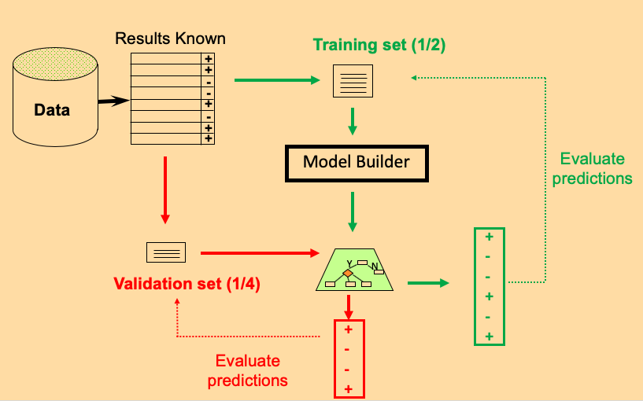

Train/Validate/Test
k = 3, 4, 5, 6
1. Train: repeatedly fit model to training data for multiple values of the procedures parameter(s), e.g. k = 3, 4, 5, 6 for K-nearest neighbors
2. Validate: each model based on training set has potentially been overfit… so utilize a validation set to determine best fitting model
3. Test: we are choosing from many models so we may have over-fit…utilize a test set to determine predictive performance of the best fitting model from the purple box
BEST
MODEL
+
-
-
+
-
+
Testing set (1/4)
Y
N
(k = 5)
Evaluate predictions
Notes:
To perform hyperparameter tuning, we need to employ train/validate/test.
What do we need an additional step? Because we are effectively fitting multiple models, each with a separate hyperparameter value (e.g. # of neighbors)
Our training data is used to fit our model, e.g. tell us what the local neighborhood looks like for KNN with a set number of neighbors e.g. k = 3, 4, 5, 6
We then evaluate these models on our validation data set and chose the one that does best according to some evaluation metric, for instance k = 5 in this example is the best in validation and we crown it the winner
Then in the testing data set, we evaluate our final model (k=5) to get an unbiased estimate of its performance.
Breaking it down, training data is used to fit our models, validation data is used to identify the best model based on our training data, and the test data confirms the performance of this best model.

Slide 10
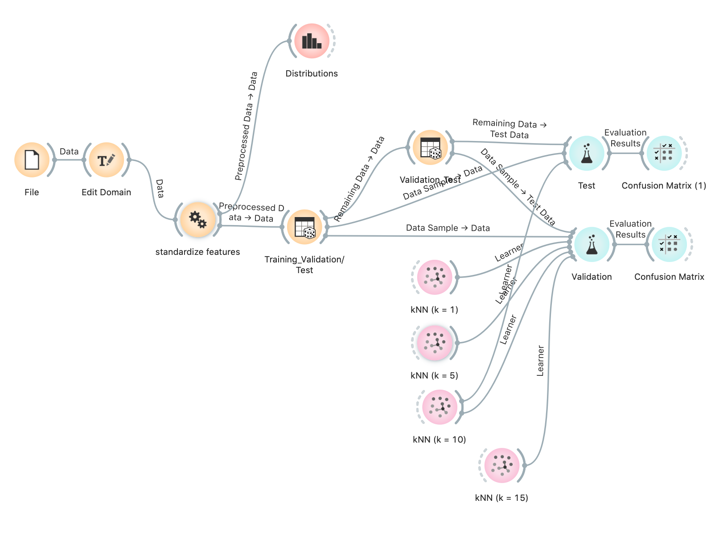
K-Nearest Neighbors workflow – available on CLE
Notes:
Go over data
Standardize variables via preprocessing widget (distance metric)
Orange hack for training-validation-testing
Setup data channels and describe flow
Introduce KNN widget, remind what neighbors mean for flexibility and why you chose this number
Conduct validation, select winner (note the U shape)
Conduct testing and compare to our validation performance

Slide 11
Decision Trees
(Recursive Partitioning)

Slide 12


At risk for heart disease? RISK vs NO RISK
Systolic BP < 140?
No Yes
Exercise < 2 times per week
LDL > 190?
Exercise < 3 times per week
Alcohol < 2 units/day?
RISK
NO RISK
RISK
NO RISK
RISK
NO RISK
Notes:
Tree splits one feature or predictor at a time to induce purity in subsequent ”nodes” or ”leaves”. Splits are determined based on this purity, e.g. SysBP split on 140 is the “optimal split”
Recursively partition our data into smaller and smaller groups, try to produce homogenous groups in each node after splitting
One we stop splitting, assign class based on the majority of other members
Very interpretable based on the tree structure, many in clinical research love them
Trees have downsides, very sensitive to the “root node” or first split – for instance noise in the data can determine the first split and the whole tree is affected by this

Slide 13
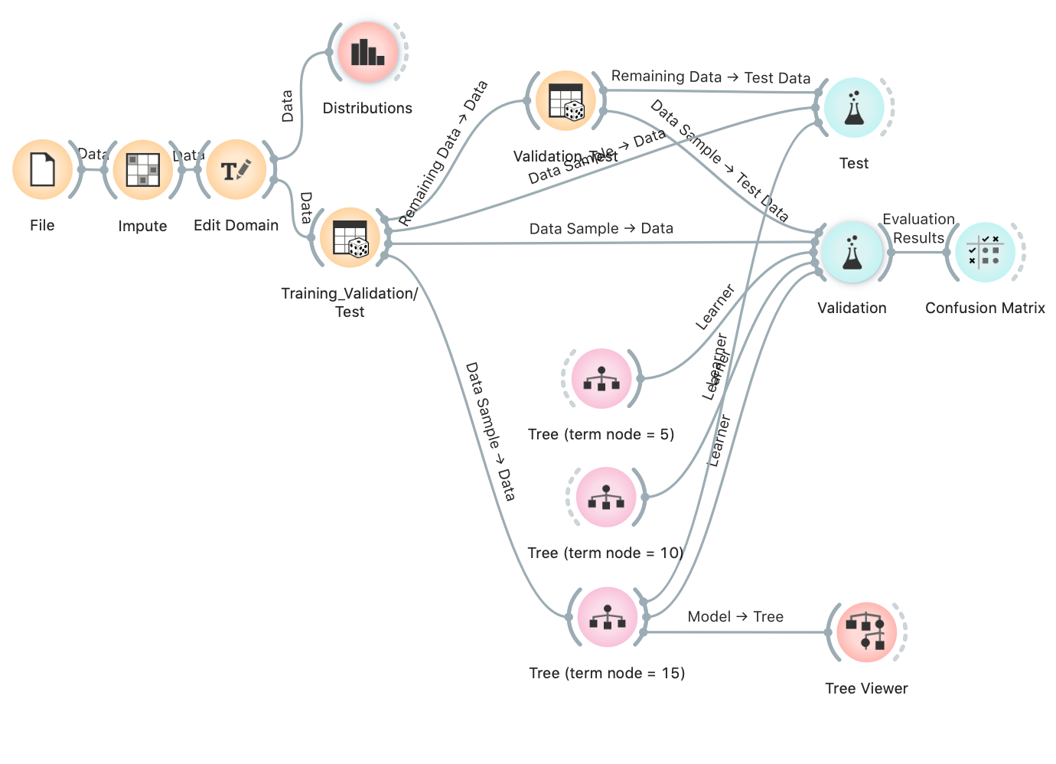
Tree workflow – available on CLE
Notes:
The decision tree in Orange is called “Tree”
Decision trees have a number of toggles, go through options and discuss impact on complexity
We will focus on tuning the number of instances (or subjects) in each terminal node
Discuss winning model
Discuss instability of performance metrics due to small sample size (solution next lecture using cross validation)
Discuss tree and splits

Slide 14
Support Vector Machines
(SVM)

Slide 15
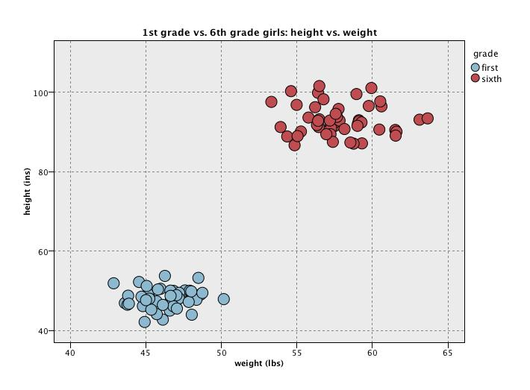
Maximizing margins
Classification Rule
Notes:
An important classifier in the history of machine learning
Introduce example
Essentially tries to find a classification rule or linear boundary between two classes in the feature space by maximizing the margins between two groups
The “margin” between these two classes is defined by the distance between the classification rule and the closest points to this rule in each class (these are called the supports, hence SVM), discuss example of first and sixth grader
In most cases, we cannot perfectly divide two groups by a line and instead we maximize the so called soft-margin

Slide 16
Linearity can be limited, may need
“non-linear” decision boundary
?
The trick of SVM is not to have non-linear models for the separation boundaries directly, but rather to warp the space that the data is in. That way, linear boundaries in the warped space become non-linear back in the original space.
Notes:
Often hard to find a line or plane to divide two groups, so we transform the data into a new mathematical space and find the linear in this new space, then transform this rule back to our original space to form classifications
Mathematically, very interesting and allows us to find non-linear decision boundaries in our data via this so called Kernel trick
Sounds fancy, isn’t that bad. I want you to know what they are saying when you read a paper

Slide 17
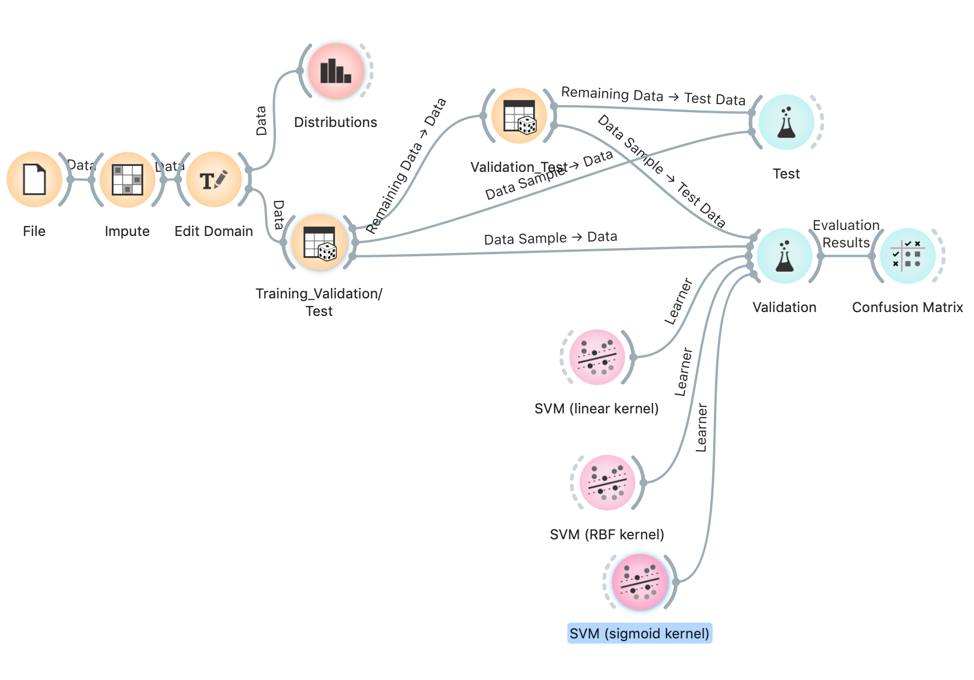
SVM stream – available on CLE
Notes:
Tuning parameters for SVM: choice of kernel to transform the data
Again, we may not know this kernel ahead of time and we can tune it, ie fit a SVM with each kernel and assess which fits best

Slide 18
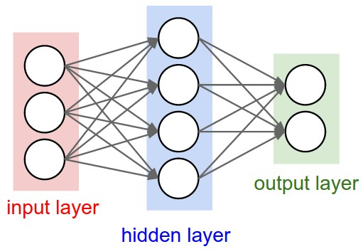
Artificial neural networks
Connections
Nodes
SysBP
HD
sex
NO HD
age
Underlying math is complex, but every node is a complex function of it’s inputs, and the parameters/weights (connections) of the function are learned from the training data. To expand model complexity, add more hidden layers.
Notes:
Complex algorithms that are like a crude understanding of the nervous system
Data goes in in the form of our features in a so called input layer, and is transformed via channels, after which it is further transformed until eventually a prediction is made to determine which class the corresponding subject belonds to
This flow of information and the highly interconnected nature these interconnected nodes is what drives the term neural networks
Essentially, data flows in and a prediction flows out.
Very good for unstructured data like images, noise, and text due to the complexity. But you need a lot of data to train them.

Slide 19
Artificial neural network - visualization
https://www.youtube.com/watch?v=3JQ3hYko51Y
Notes:
Billions of parameters!

Slide 20
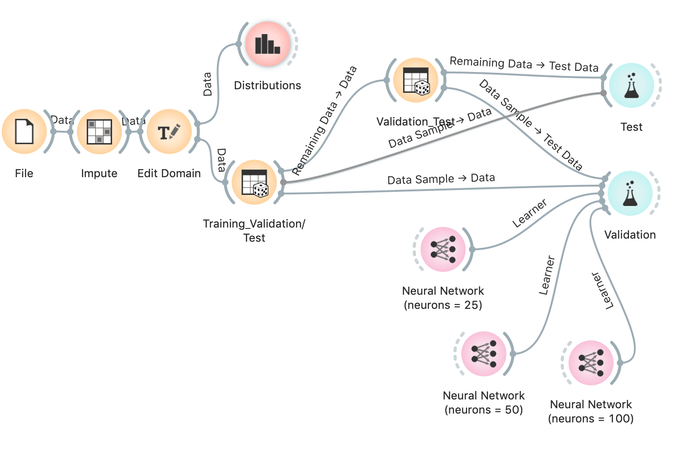
Artificial Neural Network stream – available on CLE
Notes:
Discuss tuning parameters (# of neurons)
In reality people often take so called pre trained networks and transfer them into new datasets, a whole cottage industry
Right now we know that artificial neural networks are really good at certain tasks, now just trying to determine what is the added value and can we rely on them?

Slide 21
Many of the models discussed today can be used for regression!
With some adaptation, the techniques we have discussed today can be applied to target continuous outcomes, i.e. regression problems
We will not discuss but Orange offers regression versions of the following algorithms:
  K-nearest neighbors
  Regression trees (recursive partitioning)
  Support vector machines
  Artificial neural networks

Slide 22
Next Thursday— supervised learning fin
Cross validation
Ensemble methods
  Bagging
  Boosting
  Stacking
Parameter tuning
Feature importance

