Slide 1
Biostat 202: Opportunities and Challenges of “Big Data”:
Machine Learning 4:
Cross-Validation, Ensembles, and Feature Importance
Aaron Wolfe Scheffler
Division of Biostatistics
Department of Epidemiology and Biostatistics

Slide 2
Announcements
Lab will be completely remote today, see CLE for ZOOM link (same link as class)
Stick around, this lab is MUCH easier when done with a group (and more fun)

Slide 3
Outline
Cross-validation
Ensemble methods
  Bagging: Random Forests
  Boosting: Adaboost
  Stacking
Feature importance

Slide 4
Cross-validation

Slide 5
Why cross-validation?
The purpose of cross validation is to get an unbiased assessment of model performance for the purpose of model selection or hyperparameter tuning in small data settings
Train/Validate/Test: 200 subjects, requires 100-50-50 split.
Can I somehow maintain more data for model training, while still validating properly?
Yes, cross-validation! Replaces the Train/Validate split but NOT the Test split

Slide 6
E.g. 5-fold cross-validation
1. Break up data into 5 “folds” of the same size
2. Set aside one fold for validation and use the rest to build model, repeat this process for each fold
Estimate the predictive performance of our model on the combined validation data (i.e. the validation_1-5 sets)
Fold 1 | Fold 2 | Fold 3 | Fold 4 | Fold 5
Iteration 1 | training_1 |  |  |  | validation_1
Iteration 2 | training_2 |  |  | validation_2 | training_2
Iteration 3 | training_3 |  | validation_3 | training_3
Iteration 4 | training_4 | validation_4 | training_4
Iteration 5 | validation_5 | training_5
Notes:
The idea of cross validation is to ”recycle the data” so that we can use more for training
E.g. five fold cross validation - not used for testing
At each iteration, model evaluation is conducted on data that is not used to train the model. Still principled.
At each iteration, training on a larger portion of data than we would achieve via training/validation/testing
More data for training is good because we get better signal
Cross-validation is often called “k-fold” cross validation to indicate the number of splits, e.g. 5 or 10 fold mean splitting data into 5 or 10 equal portions
N fold is leaving one subject out
We do not need to do this manually, computer will do for us

Slide 7
Validation comparison
Train/Test: to assess performance of a single model
Train/Validation/Test: to compare multiple models for model selection or hyperparameter tuning (more data)
Cross-validation/Test: to compare multiple models for model selection or hyperparameter tuning (less data)
We always assess our final model choice on TEST data!!!
Notes:
Let’s compare all the methods of validation we have learned and their purpose

Slide 8
Ensemble methods
Train a bunch of predictive models and pool them to form a final prediction.
Advantage:
  improvement in predictive accuracy
Disadvantages:
  more computation
  it is difficult to understand an ensemble of classifiers
Examples: bagging, boosting, and stacking
Notes:
We have spent three lectures discussing individual algorithms
The next step in this development is ensemble methods which combine individual machine learning algorithms to potentially improve prediction
Disadvantage: less interpretation and more computation
Ensemble methods represent the best models in predictive performance in recent years
Examples, bagging, boosting, and stacking

Slide 9
Bagging
Notes:
Bagging, first big ensemble hit
Bagging = bootstrap aggregating – it is in the name
Principle,
bootstrap sample the data: sample with replacement
Perform many times, come up with different iterations of our original data (introduces variation)
In parallel, train many classifiers on each bootstrapped data set
Average predictions across all models to obtain final prediction
The motivation, classifiers can be unstable and sensitive to noise, e.g. decision trees are sensitive to the first root node or split
This bagging procedure reduces this instability in our final prediction by averaging over many models
Most popular bagging algorithm is random forests, which is bagging of decision trees
Image source: https://upload.wikimedia.org/wikipedia/commons/thumb/c/c8/Ensemble_Bagging.svg/2560px-Ensemble_Bagging.svg.png

Slide 10
Boosting
Notes:
We try to improve our individual learner at each iteration, sequential model training
Test example, focus on the type of questions you got wrong to improve your score
If we get our model to focus on the points that are misclassified at each iteration when we retrain, we can improve predictions
This will be made clear in this diagram
We start by training our initial model and get some points correctly classified, others misclassified.
Then we retrain our model but upweight or give more importance to the subjects that we previously misclassified, thus making the model focus more on them and improving our chance of correcting our mistakes
We repeat this process and average our predictions across these sequentially trained classifiers, where in each step we have encouraged the model to focus extra hard on subjects it previously misclassified
A variant of this called XGBoost is the best out of the box predictive algorithm for structured tabular data (not unstructured data)
Image source: https://en.wikipedia.org/wiki/Boosting_(machine_learning)#/media/File:Ensemble_Boosting.svg

Slide 11
Boosting vs Bagging
Notes:
Bagging vs boosting, two B words. How do I keep them straight?
Single classifier is the building block of our ensembles
Bagging introduces variability to the data set and trains models in parallel
Boosting is done sequentially by reweighting the data to try and improve predictions that were incorrect in the previous iteration
Image source: https://www.datacamp.com/community/tutorials/adaboost-classifier-python

Slide 12
Stacking
Notes:
Stacking, train a bunch of separate models (any combination, not a single learner like in bagging or boosting)
From each model, you extract predictions for your target and feed them into a second layer of machine learning and the second machine learning algorithm makes a final prediction
While bagging and boosting did clever averaging of many models, stacking does machine learning on the output of other machine learning models. It can thus learn to correct bias and combine output from several machine learning algorithms. We do not really know how the first layer predictions are combined, its more sophisticated than an average.
Image source: https://towardsdatascience.com/ensemble-methods-bagging-boosting-and-stacking-c9214a10a205

Slide 13
Feature importance
Even though we fool ourselves into only being concerned with prediction, we often want to understand which features impact our prediction
Given a target variable, which variables are important for prediction?
The define this, you can develop measures of feature importance
Feature importance
  Pairwise: based directly on measures of association between target and individual features (e.g. correlation)
  Model based: based on machine learning algorithms (e.g. regression coefficients, classification tree splits)
  Permutation: shuffle the data among subjects, one feature at a time, and track changes in predictive performance. A big drop indicates the shuffled feature was important
Notes:
In supervised learning, sometimes we want to explain the importance of a feature in making a prediction
To do so, we need to define how to capture feature importance
Pairwise
Model based
Permutation

Slide 14
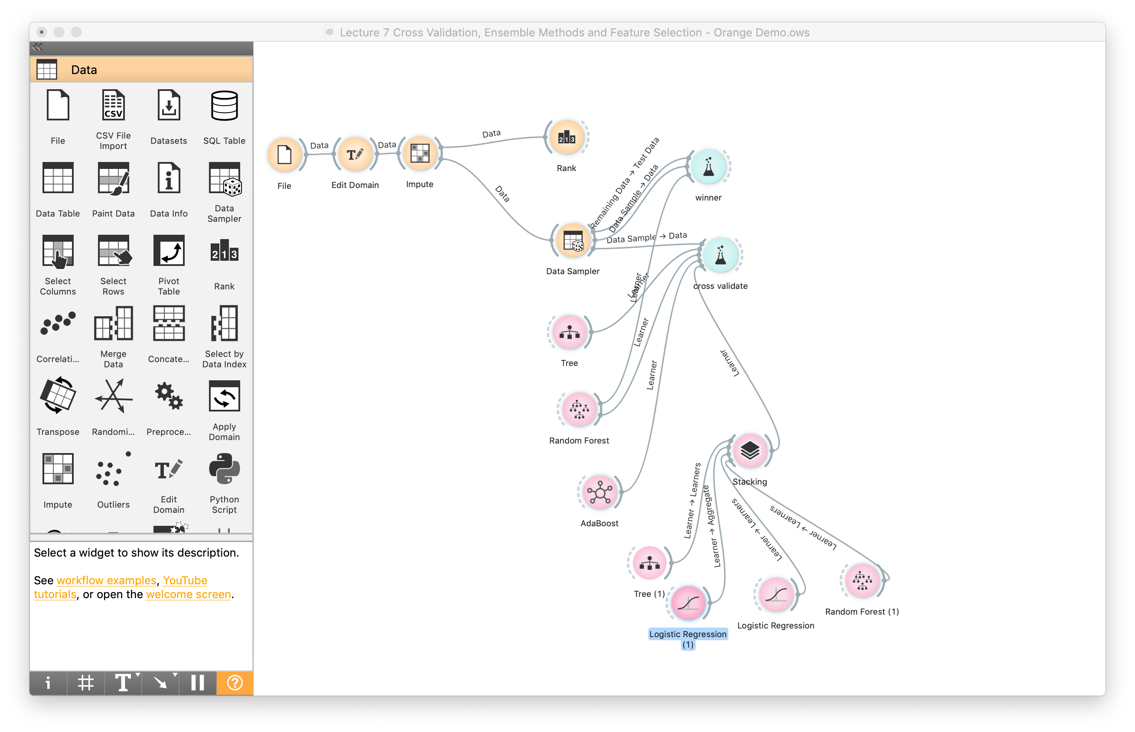
Orange Demo of Topics
Notes:
Discuss feature importance via pairwise measures (Rank) – pairwise and conditional associations – discuss data types (categorical vs continuous)
Discuss how to output data based on pairwise importance
Discuss data sampler
Discuss each algorithm and some of the options – including replicable training
Discuss how test and score performs cross validation

Slide 15
Next time
Clustering
  k-means clustering
  Hierarchical clustering
Data reduction
  Principal components analysis (PCA)
  t-Distributed Stochastic Neighbor Embedding (t-SNE)
Guidance for choosing machine learning algorithms

Slide 16
Lab- Prediction Competition
Predict time to readmission among diabetic patients
Prepare reproducible models
Collaborate as teams, submit work individually
You will have one hour (max) to perform this task
Notes:
Lab comments
Explain Kaggle competitions
Consider the new validation techniques and ensemble learners – this is your chance to play around
Hyper parameter tuning, do not get carried away, try a few options
Make sure to explore the variable definitions in the paper and setup your features accordingly
Show how to evaluate their final model on a testing data set
Go through results on word document

