Slide 1
Biostat 202: Opportunities and Challenges of “Big Data”:
Machine Learning 5:
Clustering and Data Reduction
Aaron Wolfe Scheffler
Division of Biostatistics
Department of Epidemiology and Biostatistics

Slide 2
Announcements
Extra office hours today following class
Notes:
Announcements:
Extra office hours today following class
Enter your name into chat and ill randomize the order, will attend in that fashion.

Slide 3
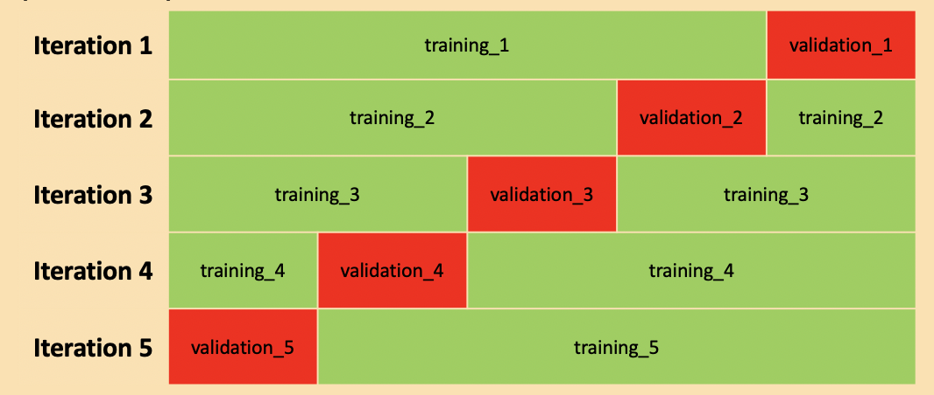
Review of last lecture
Boosting
Stacking
Feature Importance
Cross-validation
Bagging
Notes:
Last session we introduced cross validation as a way to replace training/validation split in small data settings
Wrapped up supervised learning (predictive modeling) with ensemble methods via bagging, boosting, and stacking
Then we introduced different forms of feature importance and different methods in Orange

Slide 4
Overview of this lecture
Clustering
  k-means clustering
  Hierarchical clustering
Data reduction
  Principal components analysis (PCA)
  t-Distributed Stochastic Neighbor Embedding (t-SNE)
Notes:
In this lectures prerecorded content we introduced unsupervised machine learning, which is the domain of machine learning concerned with clustering and dimension reduction.
We will review these concepts and perform some demos in Orange for each technique.

Slide 5
Supervised vs. unsupervised
Machine Learning
Supervised
Regression (continuous outcome)
Classification (categorical outcome)
Unsupervised
Clustering
(grouping observations)
Data Reduction (transforming variables)
Notes:
First four machine learning lectures were concerned with supervised learning on the left
We had a target we wished to predict and we discussed many methods of how to improve our predictive performance
And perform machine learning in a principled way via model validation to ensure against over fitting
Unsupervised machine learning will be covered this lecture and we primarily seek to cluster observations or reduce the dimension of the data, NOT to predict

Slide 6
Supervised vs unsupervised
Supervised Learning
Have data where you know outcome in order to train the model
Train the model to predict future outcomes from sets of predictors
Unsupervised Learning
No desired outcomes
Separate data points into groups with “similar” properties (clustering)
Or reduce data to fewer variables in some way that still captures important structure of the data
Prediction: Regression (continuous outcomes) and classification (categorical outcomes)
Clustering and data reduction
Notes:
This reiterates what I just said
If you are ever confused about what activity you are performing, ask yourself:
“Am I trying to predict a target or outcome? If so, I am doing supervised machine learning.
Otherwise I am likely doing unsupervised machine learning

Slide 7
Clustering
Notes:
Our first topic is clustering, or subgroup identification

Slide 8
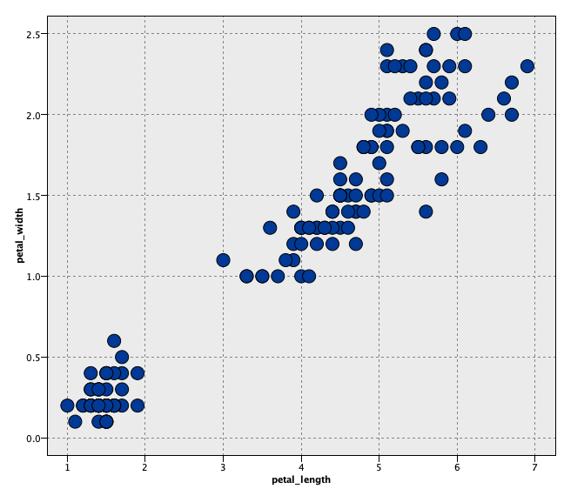
2D clustering: Iris example
When determining clusters
We want long green lines (large distance between cluster centers)
We want small ellipses (points within clusters grouped tightly together)
Goal: maximize similarity within clusters and minimize similarity between clusters
Notes:
Fundamental idea in clustering is we have some data and we think there may be subgroups in this data
For example, perhaps you have a bunch of tissue samples from various breast cancer tumors and you suspect different genetic mutations might be driving the occurrence of breast cancer. You might wish to identify the cancer subtypes that share common genetic markers.
So we try to identify clusters of patients where we maximize similarity within a cluster and maximize dissimilarity between clusters
Make tight red ellipses and long green distances – this is our goal
Once again, we do not know that these clusters exist, or what they look like. We merely hypothesize.

Slide 9

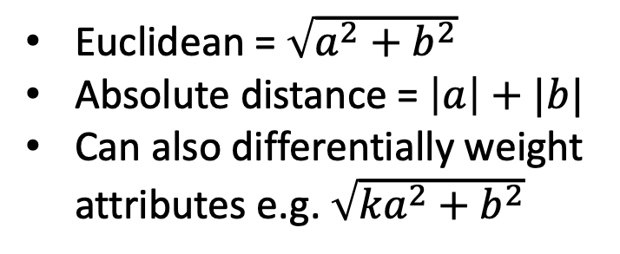
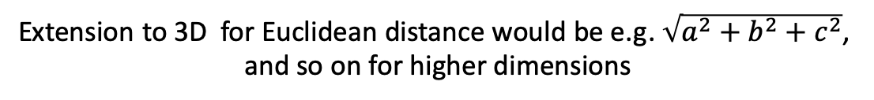
Measures of similarity/dissimilarity
Need to define similarity (or dissimilarity) and we need to be able to measure it
Consider 2 observations with only 2 variables x₁ and x₂ –dissimilarities could be
x₂
Euclidean = $\sqrt{a^{2}+b^{2}}$
Absolute distance = $\left|a\right|+|b|$
Can also differentially weight attributes e.g. $\sqrt{{ka}^{2}+b^{2}}$
(most common)
a
b
x₁
Extension to 3D for Euclidean distance would be e.g. $\sqrt{a^{2}+b^{2}+c^{2}}$,
and so on for higher dimensions
Notes:
To measure similarity within a cluster of patients, or dissimilarity between a cluster, we need to define an appropriate distance metric
In this way we can measure these quantities
The most common distance metric for clustering is Euclidean, or as the crow flies, but we we saw with KNN, which also operates based on distance metrics, there are numerous others, e.g. Manhattan distance

Slide 10
k-means clustering

Slide 11
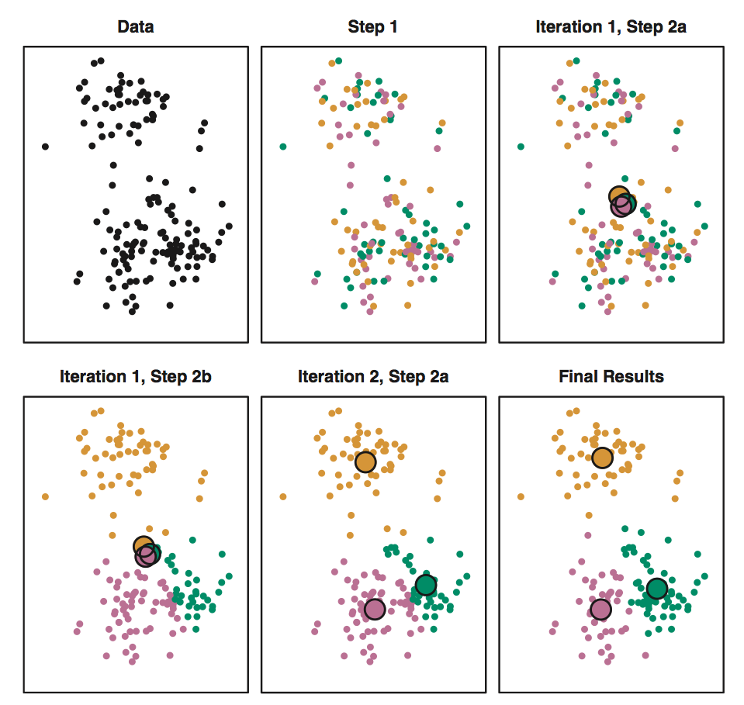
k-means algorithm (k = 3)
Data
Step 1a.
Step 1b.
Adapted from ISLR,
James et al., 2013
p. 389
…
Step 2a.
Step 2b.
Final clusters!
Notes:
K means is one of the most well known clustering algorithms
In our first step we take our data
Then we randomly assign each data point to one of k clusters (fixed)
Then we calculate the cluster mean (cluster center) for each cluster
Then reassign each subject to the closest centroid
Iteratively repeat until we reach convergence
In this way, we discover a cluster grouping
We may need to try a number of different K’s to find a sensible cluster structure
How do we determine K? We need a measure of cluster similarity/dissimilarity
Any questions about k means clustering?

Slide 12
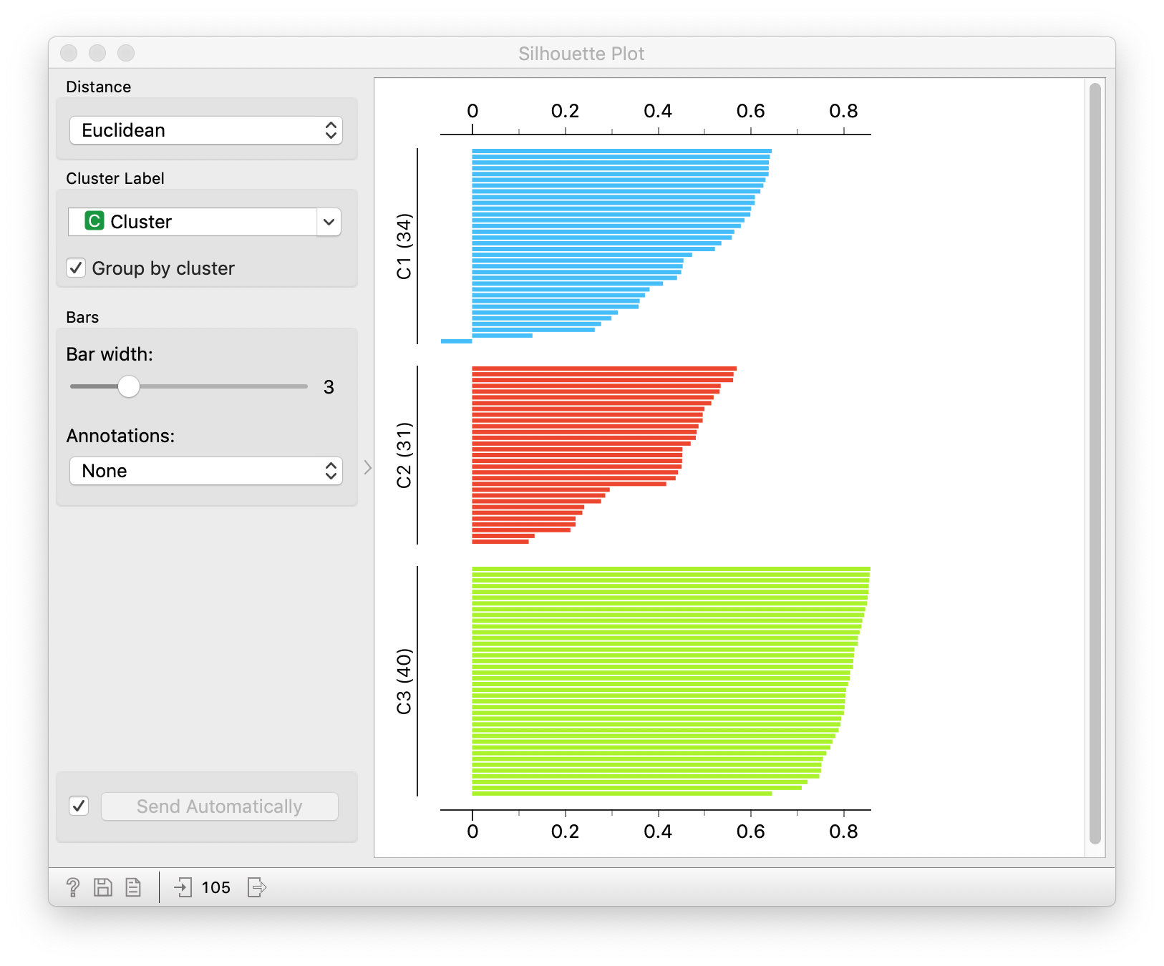
Silhouette Measure
Measures the degree of similarity (cohesion) of observations within a cluster compared to other clusters (separation)
[-1 (bad), 1 (good)]
An evaluation metric for cluster assignment
Goal: high average silhouette via clustering
Example silhouette measures for three clusters of individuals.
Notes:
Silhouette measures the degree of similarity (cohesion) of an observation within a cluster compared to other clusters (separation)
This is an evaluation metric for cluster assignment
Our goal is thus to maximize the silhouette score across all subjects, which tells us that we are maximizing cluster similarity and maximizing cluster dissimilarity
Walk through the figure as you discuss
We will work with this measure during our Orange demo

Slide 13
Orange demo - K means
Notes:
Remove flower labels
I am a botanist on a strange alien planet trying to identify and name new species of flowers

Slide 14
Clustering vs. classification
Cluster analysis is NOT classification!
Cluster analyses hypothesizes there is some latent characteristic which generates these clusters, something we might need to construct a label for after our cluster analysis (e.g. Netflix movie genres)
So we do not wish to predict a label but rather potentially reveal a label or grouping and interpret
Notes:
Cluster analysis is not classification
We do not have labels we are trying to predict, we are trying to learn a new label for the data

Slide 15
Other clustering algorithms

Slide 16
Hierarchical clustering method
  Joins (agglomerative) or divides (divisive) observations
  Hierarchically joins/divides similar/dissimilar subclusters together based on distance
Notes:
Hierarchical clustering takes all your data and either sequentially joins them together or divides them, known as agglomerative and divisive clustering, respectively
Again, this sequence operates on data points that are similar or dissimilar based on a distance metric
Walk through figure and describe how you would assign the cluster
Image source: https://www.researchgate.net/publication/321399805_Blind_Nonlinearity_Equalization_by_Machine_Learning_based_Clustering_for_Single-_and_Multi-Channel_Coherent_Optical_OFDM/figures?lo=1

Slide 17
Orange demo – Hierarchical clustering

Slide 18
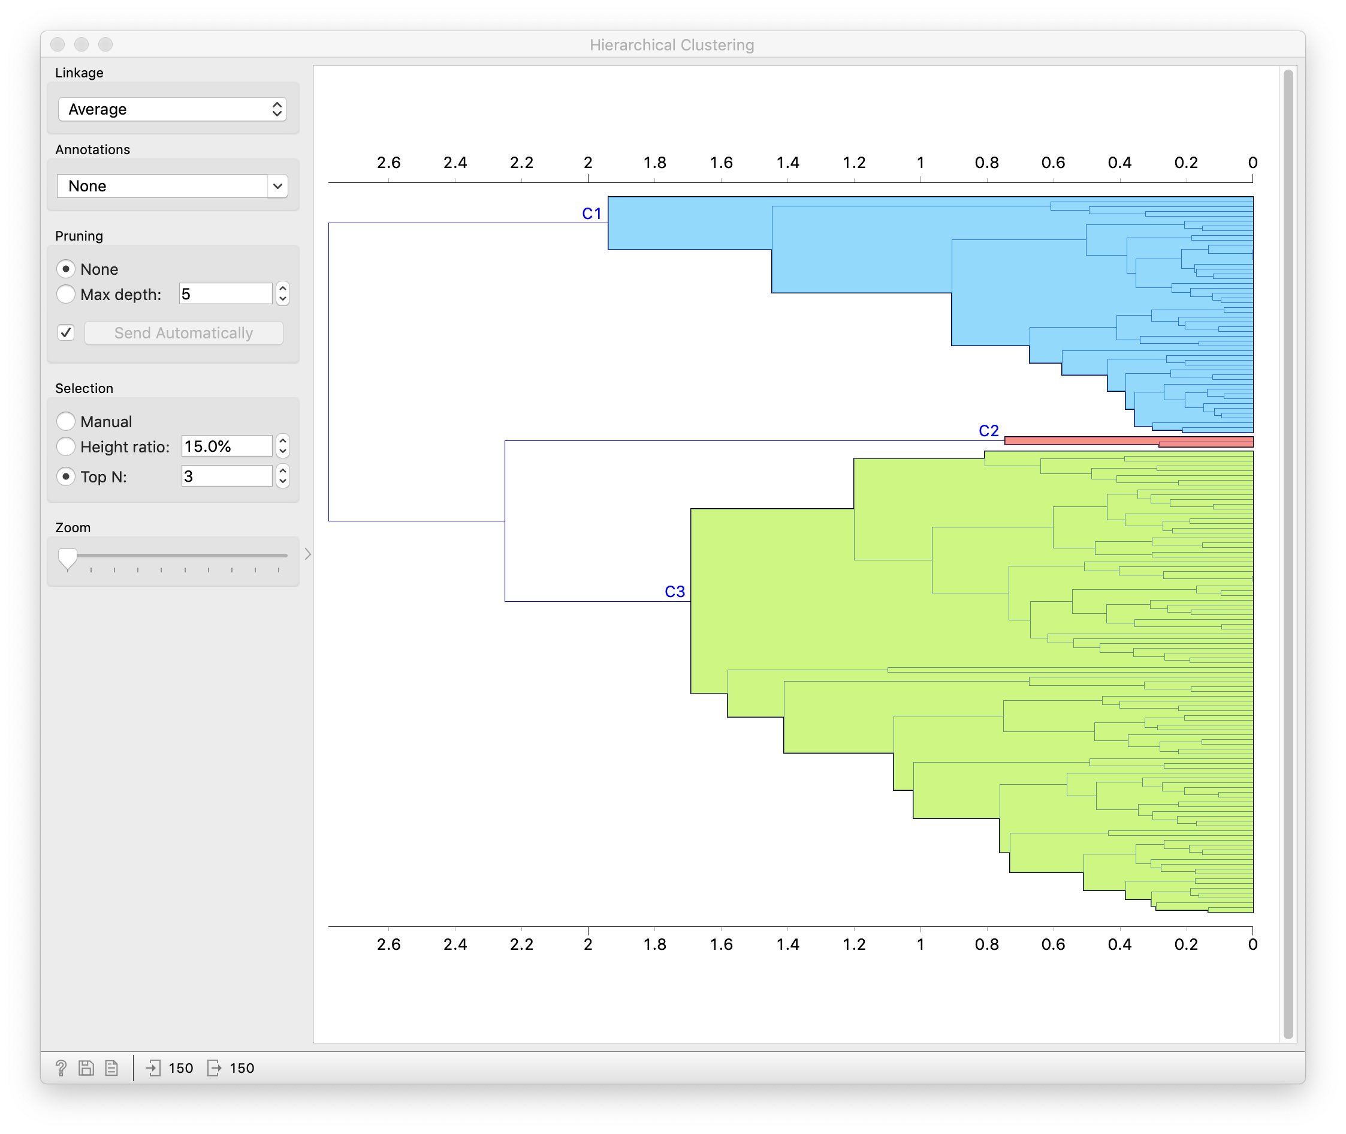
Iris example – agglomerative hierarchical clustering
Notes:
For hierarchical clustering, we either join or divide every subject until all subjects are grouped together or divided
Where we interupt this process determines the cluster structure.

Slide 19
Notes:
K means: Partition the data space such that we can assign an observation to a cluster based on where it falls. Clusters are defined simultaneously.
Hierarchical: generates a hierarchy among the subjects in terms of similarity via sequential agglomeration or division, does not find clusters simultaneously.
Image source: https://www.slideshare.net/mirjalil/large-scale-data-clustering-an-overview

Slide 20
Data Reduction Methods
Notes:
Questions about clustering?

Slide 21
Shadow Analogy
Notes:
We can almost always reduce the dimensionality of our data
Shadow analogy takes 3D humans to a 2D projection while preserving information
https://upload.wikimedia.org/wikipedia/commons/thumb/3/33/Looking_down_from_The_Eiffel_Tower%2C_Paris_8_April_2007.jpg/440px-Looking_down_from_The_Eiffel_Tower%2C_Paris_8_April_2007.jpg

Slide 22
Why data reduction?
Interpretation:
  Wish to visualize high dimensional data in a 2D/3D space
Memory/storage:
  Cannot store raw data, need to reduce to store/analyze
  E.g. summarize step counts by minute rather than second
Pre-processing:
  Reduce dimension of data to perform an analysis
  E.g. for k-nearest neighbors to avoid the “curse of dimensionality”
  Reducing dimension decreases chance of overfitting
Notes:
Walk through slide

Slide 23
Principal components analysis (PCA)

Slide 24
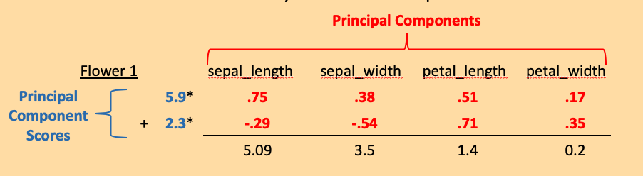
Principal components analysis
How does this new mathematical vocabulary fit into “recipe” framework?
Principal components identify the directions of “maximal spread (variation)”
.17
.51
Notes:
Come up with a way of representing our observations using fewer dimensions
PCA helps us identify different representations of our data that maintain as much “information” as possible
Run through ingredient example of flower
Interpret how ingredients identify directions of maximal variation, ie identifying geometric spread in the data

Slide 25
Orange demo – PCA

Slide 26
Other dimension reduction methods
Notes:
Lots of dimension reduction methods with different flavors.
There are fads and we see some new methods every year

Slide 27
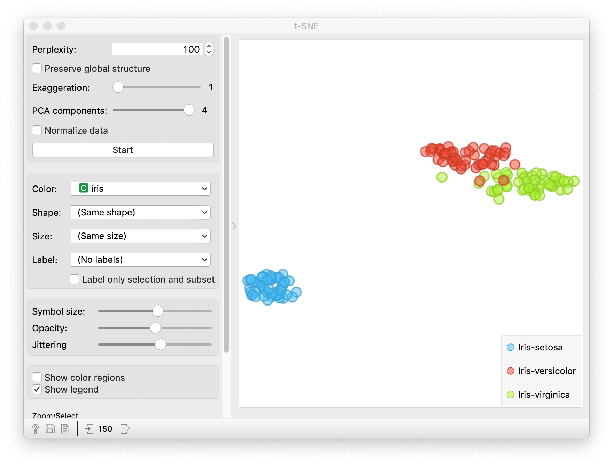
t-SNE for Iris Data
Notes:
T distributed stochastic neighborhood embedding is a popular technique
Tries to maintain closeness of observations in a higher dimensional space in the reduced space
E.g. if you had gene expression data for 20,000 genes then you would want subjects with similar gene expression levels in the full dimensional space (20,000 genes) to lie close together in your reduced tSNE space (2 or 3D)
Thus, you preserve the “neighborhood” around a observation

Slide 28
Orange demo - tSNE
Notes:
Very sensitive, unstable run to run

Slide 29
Clustering vs Dimension Reduction
Clustering
Discover latent classes or structure in data
Maximizes within cluster similarity
Minimize similarity between clusters
Cluster labels can be assigned
Dimension Reduction
Reduces feature dimension to lower dimension
Can capture leading directions of variation
Does not assign a label
Subsequent machine learning can be used on reduced dimension data
Notes:
Go through sldie

Slide 30
Choosing a Machine Learning Method
Notes:
We have now finished our instruction on the core algorithms of machine learning as defined in this course
Next several lectures will deal with important topics in big data like causal inference with machine learning and best practices for data visualization
So lets wrap up by discussing how to chose a machine learning method.

Slide 31
Choosing a Machine Learning Method
Common question: “Which machine learning algorithm should I use?”
Answer: It depends,
  Do you have supervised or unsupervised data?
  If supervised, do you have continuous, binary class, or multi-class outcome(s)?
  If unsupervised, are you interested in looking for latent groupings or data reduction?
  Do you have predictors that are continuous, categorical, ordinal, text-based, or some combination of the above?
  How large is your training set?
  Do you need a fast algorithm?
  Do you have time to explore multiple approaches?
  Do you need an interpretable model?
  For classification, do you need class probabilities, or will “hard” classes suffice?
Notes:
Let’s walk through nine different questions you can ask yourself to determine what type of machine learning is appropriate for your goals.
Details on the following slides.

Slide 32
Do you have supervised or unsupervised data?
  Supervised data → use classification or regression methods
  Unsupervised data → use clustering or data reduction algorithms
If supervised, do you have continuous, binary class, or multi-class outcomes?
  Continuous data → use regression methods (e.g. multiple linear regression)
  Class data → use classification methods (e.g. classification trees
If unsupervised, are you interested in looking for natural groupings, or data reduction/simplification?
  To group data into similar sets → clustering algorithms, e.g. k-means
  To reduce data → use data reduction algorithms (e.g. principal components analysis, t-SNE)

Slide 33
Do you have predictors that are continuous, categorical, ordinal, text-based, or some combination of the above?
  Some algorithms will not work with certain types of predictors, e.g. unstructured data
How large is your training set?
  Small data → “high bias/low variance” methods (e.g. linear regression, logistic regression, SVM)
  Large data → “low bias/high variance” methods (e.g. decision trees, KNN); lower level of assumptions – need a lot of data to train
Do you need a fast algorithm? (e.g. for real-time work)
  More complex algorithms can be relatively slow, especially if there are algorithm parameters to be optimized (e.g. neural nets)
Do you have time to explore multiple approaches?
  If so, you may as well try many and see which does “best” for your data (making sure you are dutifully evaluating on independent data) or use ensemble methods

Slide 34
Do you need an interpretable model?
  Consider whether you’ll need to understand the role your predictors play in prediction
For classification, do you need class probabilities, or will “hard” classes suffice?
  How will you use your predicted output?
There are also many “cheat sheets” for choosing machine learning algorithms on the internet, but you can see there is a lot of variability…

Slide 35
Notes:
Examples of how to organize your thought, I do not endorse any particular one

Slide 38
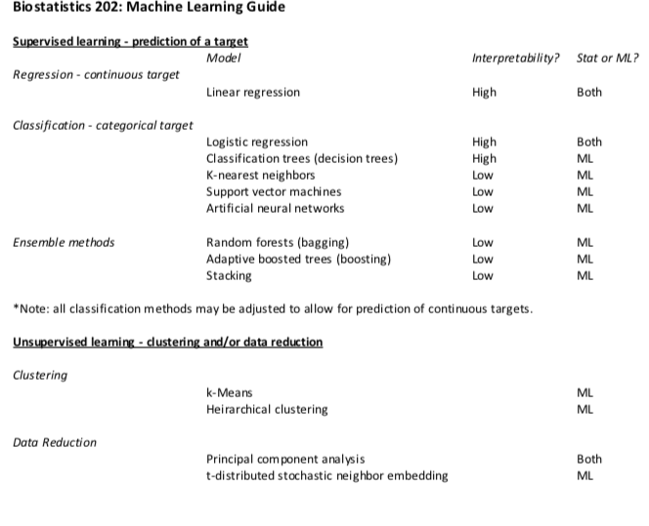

Slide 39
Machine Learning Computational Tools
We have focused on Orange but there are other tools/software/programming languages if you want to dig further. Here are some free ones
Weka -- http://www.cs.waikato.ac.nz/ml/weka/ - Java based machine learning platform - Data Mining: Practical Machine Learning Tools and Techniques 3rd edition, Witten, Frank and Hall, 2011
R -- https://www.r-project.org/ -- R has many machine learning libraries and tools. They have a machine learning and statistical learning “Task View” page which much of what is available in R (including an R interface to the Weka package) – packages mlr and caret are wrappers for calling multiple machine learning algorithms
Python -- https://www.python.org/ -- if you want to go even further down the programming line – many numerical and scientific libraries – see e.g. python resources to get started
Notes:
R courses in TICR

Slide 40
Review of this lecture
Clustering
  k-means clustering
  Hierarchical clustering
Data reduction
  Principal components analysis (PCA)
  t-Distributed Stochastic Neighbor Embedding (t-SNE)
Machine learning summary

