Slide 1
Biostat 202: Opportunities and Challenges of “Big Data”
- Causal Inference in ‘Big Data’
Aaron Wolfe Scheffler,
Division of Biostatistics,
Department of Epidemiology and Biostatistics
Notes:
We are trying to do a lot in this lecture! Do not worry if it seems overwhelming

Slide 2
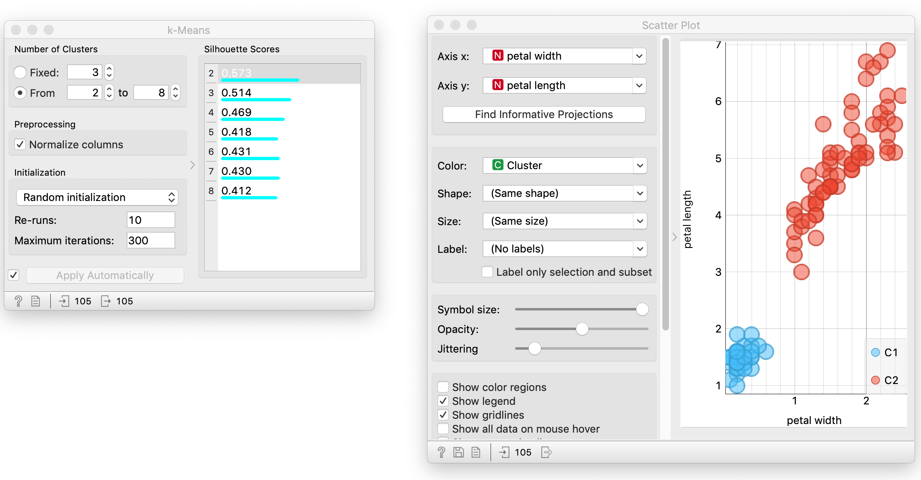
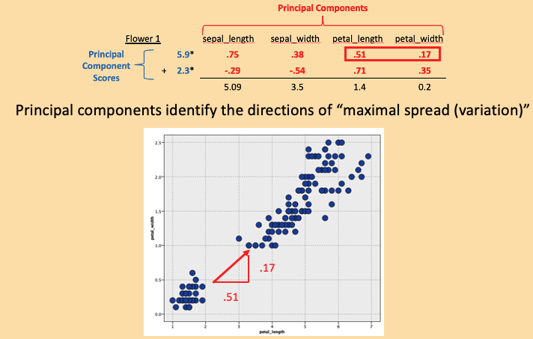
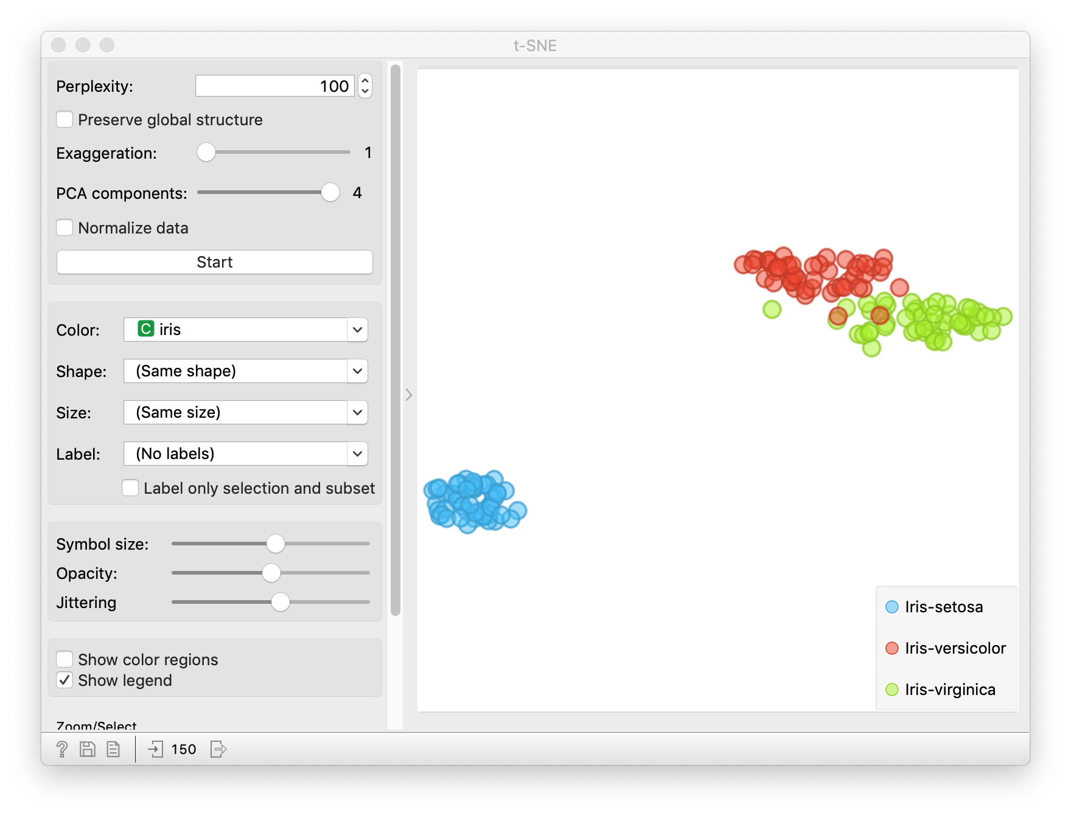
Review
Clustering
k-means
heirarchical
Dimension Reduction
PCA
t-SNE

Slide 3
Outline
Introduction: prediction versus causation
Causal methods in (very) brief
Some uses of big data and machine learning in causal inference
Summary
Notes:
Practice the examples for each bulletpoint

Slide 4
Prediction versus causality
Data-mining and machine learning algorithms are only based on associations.
Often interested in causation, i.e., understand the cause of illness or develop interventions that cause improvement.
Correlation does not imply causation
  https://www.tylervigen.com/spurious-correlations
Often senior researchers have lapses and over-interpret correlations causally
The (social) media frequently confuses causation and correlation
Notes:
With the right approaches and assumptions, we can sometimes use techniques from ML for causal inference – but be cautious

Slide 5
Causal inference – the 5¢ tour
CONFOUNDER
Down’s syndrome
MEDIATOR
Maximum Bilirubin
RISK FACTOR
OUTCOME
Phototherapy
Cancer
Adapted from Newman, et al Pediatrics, 2016
Biostat 215 covers these topics in detail
Notes:
Goal of causal inference to assess effect of changing the value of some risk factor on an outcome of interest
E.g. does phototherapy in infants cause cancer
But we also need to acknowledge there are other variables that make it difficult to accurately measures this effect, for instance mediators and confounders
Biostat 215 covers these topics in detail. I just want to give you an exposure so you can see how big data methods may or may not help.

Slide 6
Which of these are prediction versus causation questions?
Effect of Abaloparatide on fractures in postmenopausal women.
Estimating fetal risk of a disease using genetic screening.
Effect of cerebral protection device on brain lesions following aortic valve implantation.
Estimation of temporal trends in preterm birth rates and their association with obstetric interventions.
Survival for children with trisomy 13 and 18.
Notes:
Read through the questions in class and ask students to identify causal vs prediction and WHY?
Abaloparatide = treatment for osteoporosis. Trisomy 13 and 18 are genetic disorders that cause birth defects; babies with these defects often die by age 1.

Slide 7
Which of these are prediction versus causation questions?
Effect of Abaloparatide on fractures in postmenopausal women.
Estimating fetal risk of a disease using genetic screening
Effect of cerebral protection device on brain lesions following aortic valve implantation.
Estimation of temporal trends in preterm birth rates and their association with obstetric interventions .
Estimation of survival for children with trisomy 13 and 18.

Slide 8
Potential outcomes
Imagine a hypothetical experiment in which you get to observe each participant under both the treatment and control conditions holding all else the same, like a perfect cross-over experiment.
Y_{trt}, Y_{ctl}
Often, we only get to observe one of Y_{trt} or Y_{ctl}, depending on whether the participant is in the treatment or control condition.
Sometimes described as the “fundamental problem in causal inference.”
Notes:
Called potential outcomes or counterfactuals.
We really want to observe both conditions, but we cannot typically
This is the fundamental problem in causal inference.
And this is not a new idea: I learned this in 1978 ….
From a book written in 1959 ….
Quoting a result from a 1923 paper by Jerzy Neyman – a contemporary and hated rival of R.A. Fisher.

Slide 9
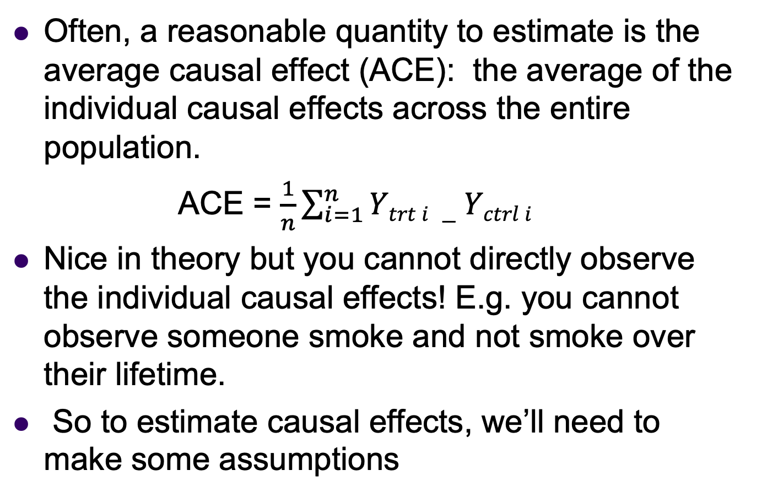
Potential Outcomes
– Average Causal Effect
Often, a reasonable quantity to estimate is the average causal effect (ACE): the average of the individual causal effects across the entire population.
ACE = $\frac{1}{n}\sum_{i=1}^{n}{Ytrt i −Yctrl i}$
Nice in theory but you cannot directly observe the individual causal effects! E.g. you cannot observe someone smoke and not smoke over their lifetime.
So to estimate causal effects, we’ll need to make some assumptions
Notes:
Of we did have data on both conditions, we could find the average causal effect
Even though we do not have it, we can try to estimate it using models to estimate potential outcomes or matching patients based on influential confounders (e.g. propensity score matching)

Slide 10
E.g. Propensity score matching
match subjects based on propensity scores strata
https://www.summitllc.us/propensity-score-matching
Notes:
Propensity scores are one way we can address issues that emerge in causal inference, such as confounding
Confounders are variables that have an association of our risk factor and outcome
High level summary statement: “[Propensity score] matching is the observational study analog of randomization in ideal experiments.
Propensity score matching tries to adjust for confounders in the analysis by stratifying our sample such that patients in the treatment and control arm are matched with respect to varying confounding characteristics.
This matching or stratification occurs by via the predicted probability of receiving treatment as a function of the suspected confounders.
The assumption is that subjects with similar probabilities of receiving the treatment will be matched on these suspected confounders.
Thus by modeling the effect of this propensity score or matching on this propensity score, we can adjust for all these suspected confounders simultaneously
1. Size of bubble represents the propensity for assignment to the treatment intervention. Estimated via logistic regression or some other ML algorithm .
2. Match subjects based on covariates within common strata of propensity scores
3. Perform analysis
Great review: https://www.ncbi.nlm.nih.gov/pmc/articles/PMC2943670/pdf/nihms200640.pdf

Slide 11
Propensity score estimation using Orange
Often divide propensity scores into quintiles in order to adjust.
For example, bin the propensity scores into five equal categories using a Bin Node (bin method = Tiles (equal count), quintiles ) and then use a logistic regression node (for a binary outcome) or a linear regression model node (for a numeric outcome).
The only predictors are the propensity score bins (as a nominal variable) and treatment.
Notes:
We used machine learning methods and propensity scores in the phototherapy and cancer paper to winnow down the >2,000 predictors to a single propensity score.
Once you have these propensity scores, you can use them several different ways
One is a quintile analysis, as described in the slide.

Slide 12
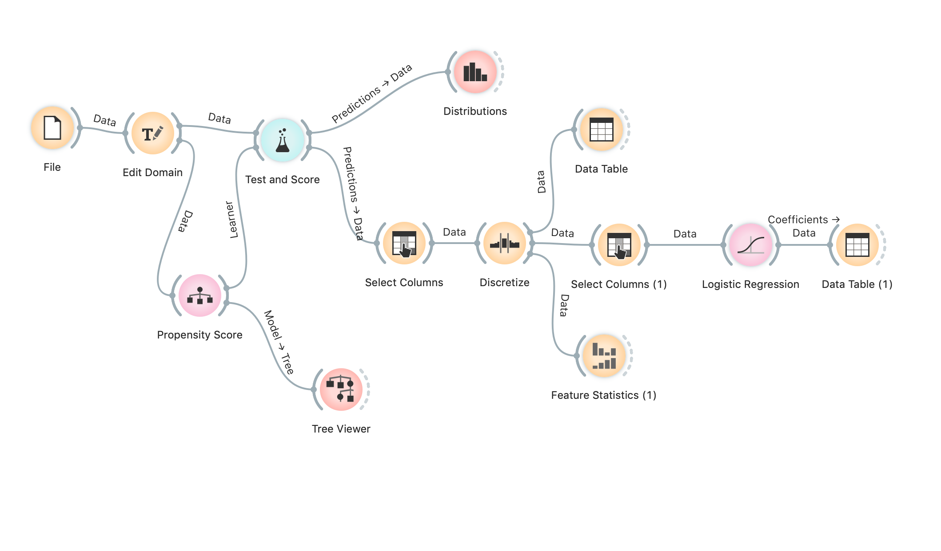
Propensity score example
I have posted an example Orange workflow example and dataset on the website.
Notes:
Remind audience of phototherapy example.
Babies with jaundice receive phototherapy as treatment. Does this cause cancer?
The problem is jaundice which initiates phototherapy treatment is associated with other cancer risk factors, e.g. congenital anomalies
Show variables. And describe.
First predict the probability of receiving our risk factor/treatment, phototherapy as a function of suspected confounders.
Emphasize strengths of machine learning here (variable selection, interactions). Prediction is all that matters.
Look at test and score to see how well we predict, look at histogram to discuss positivity assumption
Then discuss select columns to focus on propensity score, then discretize into quintiles
Check for success of quintile calculation
Then show how logistic regression is performed and where propensity scores fit in
Interpretation of coefficients suggests without signififance testing that phototherapy is associated with higher cancer rates after propensity score adjustment

Slide 13

Potential outcomes estimation
$$∆ BDI$$
Predicted causal effect for a ctl subject
Predicted causal effect for a trt subject
ACE estimated to be 1.2 (CI 0.4, 2.1)
Notes:
The filled circles represent the (model-based) predicted value for a participant in the treatment or control groups.
The open circles represent the (model-based) predicted potential outcome for the participants. So, for example, a participant in the treatment group has a predicted potential outcome in the control group. And vice versa.
Now have an estimate of the individual causal effect, which you can average to get ACE. Can either compare predicted potential outcome with predicted value or with the real value.
Idea of potential outcomes is we do not have the perfect world where we can observe our subjects both with and without a risk factor
So we try to estimate the potential outcome of being exposed or not being exposed to the outcome for each person.
We can then predict the average causal effect by differencing the predicted response for treatment and control for each subject to get the average causal effect.

Slide 14
Potential outcomes estimation using Orange
Create duplicate rows of data with the treatment assignment switched and missing outcome data:
Notes:
We can do potential outcomes estimation in Orange.
We take our observed data and copy it and stack the copy below our original data
In the copy, we switch the treatment or risk factor indicators and set the observed outcome to missing, e.g. it is not absent for model training.
We then fit a model to predict the outcome on our original data

Slide 15
Potential outcomes estimation using Orange
Want to end up with a predicted outcome under treatment and under control:
Notes:
And predict the outcome for each subject, once as if they were in the treatment group, and once as if they were in the control group.
Take he difference to get the average causal effect

Slide 16
Potential outcomes estimation using Orange
Read the data using a File widget
Read in a duplicate version of the data using another File widget. In this part of the stream, switch the coding of treatment and control and recode the outcome variable to missing.
Concatenate the duplicate data to the original data. So now the dataset is twice as large as the original and has a copy of every person under control and under treatment (though only one of them has the outcome – the other is missing).

Slide 17
Potential outcomes estimation using Orange
Separate the data into data for the treatment group and control groups.
Fit your favorite machine learning method to predict the outcome in the treatment group and do the same for the control group. This will give predictions for the data that were missing previously.
Merge the datasets together so everyone has a predicted outcome under the treatment and under the control conditions.

Slide 18
Potential outcomes estimation using Orange
Average all the differences between the under-treatment and under-control conditions to estimate the average causal effect (ACE).
Or the ACE in different subgroups.

Slide 19
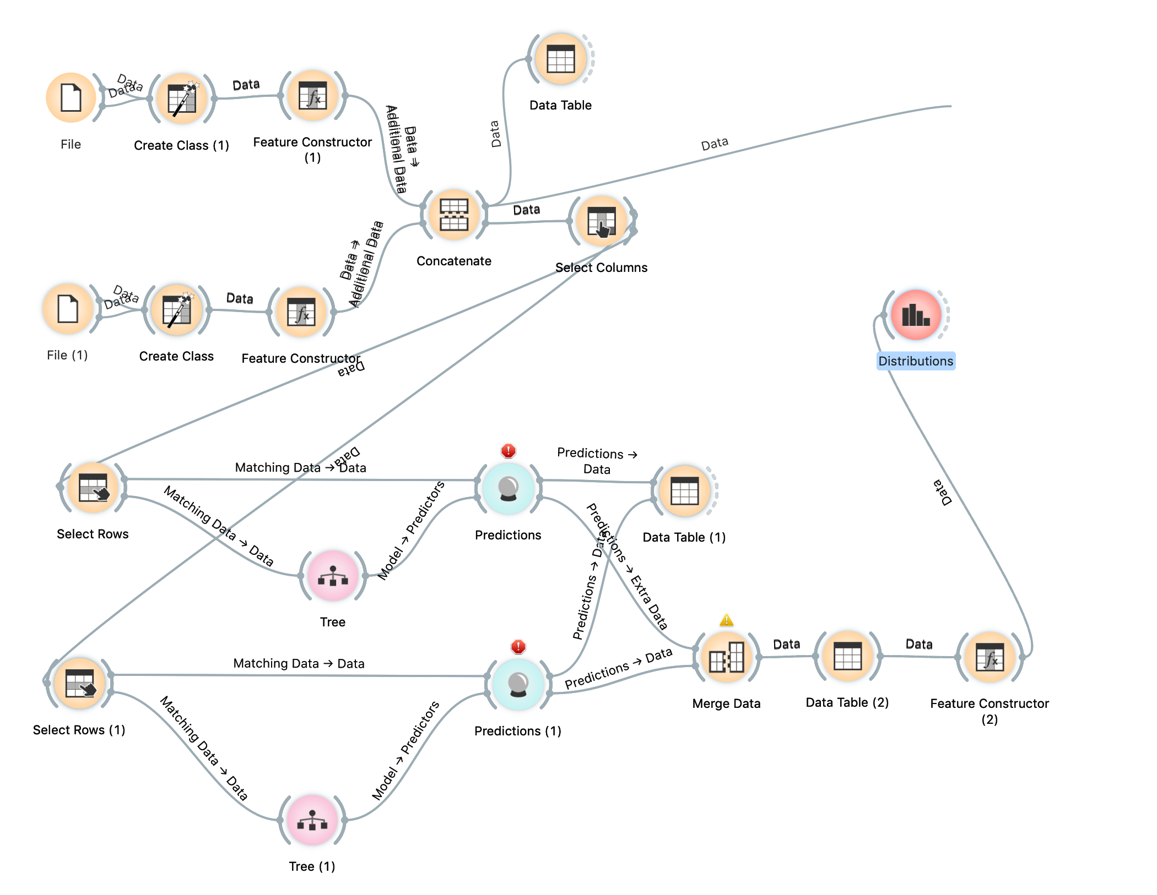
Potential outcomes estimation
I have posted an example Orange workflow and dataset on the website illustrating the idea for this and the next section (subgroup analysis).
Notes:
Made up data, walk through the predictors and outcome

Slide 20
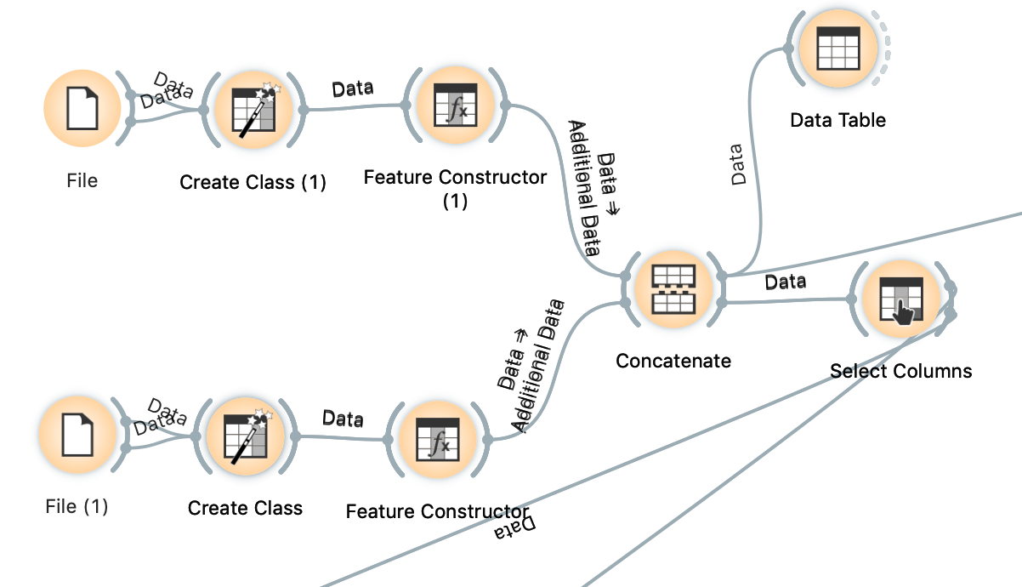
Potential outcomes estimation
Looks complicated, but let’s break it down.
1. Create duplicate records

Slide 21
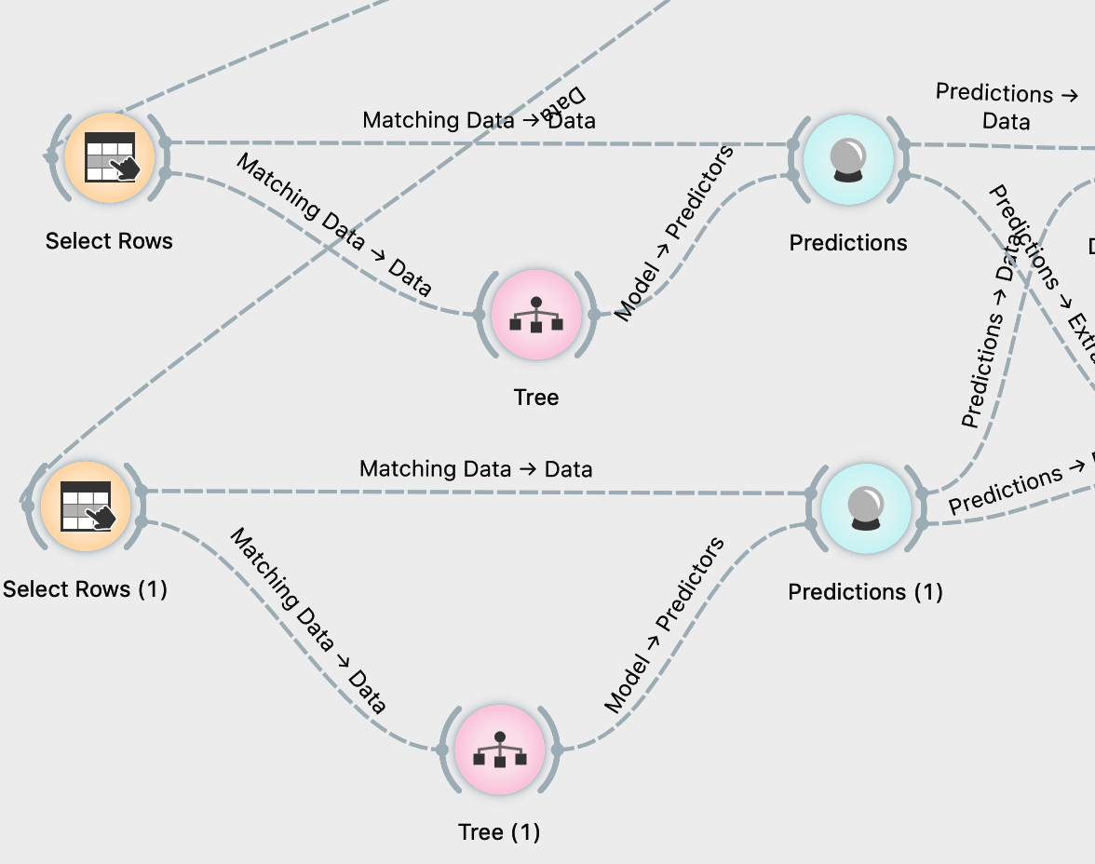
Potential outcomes estimation
Looks complicated, but let’s look at the steps.
2. Estimate effects in treatment and control
3. (Next) Use potential outcomes to get ACE

Slide 22
Potential outcomes estimation using Orange
Issues
(+) Can use flexible models in each condition to help avoid issues with incorrectly specifying the model.
(-) Requires large sample sizes in treatment and in control groups.
(0) Does not solve the problem of “unmeasured confounders”. Not surprisingly, you can only adjust for measured quantities.
Notes:
Complex models reduce our concern about model misspecification
How to overcome limitations of observational data, especially unmeasured confounders

Slide 23
Potential outcomes vs propensity score adjustment
Potential outcomes: try to estimate the potential outcome using supervised learning
Propensity score adjustment: try to construct balanced groups
Both rely on models!!! (not a silver bullet)
Can be used alone or in tandem (“doubly robust”)
Neither helps us extrapolate to samples that do not represent the training data
Notes:
Walk through bullet points

Slide 24
Subgroup analysis: decision tree
Systolic BP > 140?
No Yes
Exercise < 2 times per week
LDL > 190?
Alcohol > 2 units/day?
Large effect
Small effect
Large effect
Small effect
Small effect
Notes:
The idea behind precision medicine
Treatment effects are not expected to be uniform across individuals because we are each different
The one thing common among all humans is we are different
Here is one way you could use machine learning to identify sub group effects
Try to predict large or smell response to a treatment
Use a decision tree to group large and small effects in the terminal leaves or nodes.

Slide 25
Summary
Distinguish questions by whether they can be answered by prediction only or require more detailed analysis.
  effect, intervention = causal,
  estimate, association, correlation = prediction
Machine learning methods are not designed for drawing causal conclusions.
However, aspects of causal analyses may be prediction problems for which we can use the methods in the class
  Estimating propensity scores and predicting potential outcomes (e.g. regression estimation)
  Identifying subgroups on the basis of different estimated treatment effects
Notes:
Maying attention to language is important when writing and interpreting results
Machine learning can be incorporated into existing causal inference frameworks but it is not a silver bullet

