Slide 1
Introduction and Methods

Slide 2
Elements of Introduction (Browner)
Background of the research question
Previous research in the area
Problems with that research
What you did to fix those problems

Slide 3
Elements of Introduction (Mack)
What?
  What is the paper about
So what?
  Why should the reader care?
Introduction Checklist" from: How to Write a Good Scientific Paper. Chris A. Mack. SPIE. 2018

Slide 4
Elements of Introduction (Mack)
Establish a territory
  Field of work, why it is important, what has already been done
Establish a niche
  Indicate gap, raise a question, or challenge prior work
Occupy that niche
  Outline the purpose and announce the present research
Introduction Checklist" from: How to Write a Good Scientific Paper. Chris A. Mack. SPIE. 2018

Slide 5
Elements – background of introduction
Orient the reader to the specific topic
  Provide the “lay of the land”

Slide 6
Elements – previous research
What is already known on the topic
  Start broad and get more specific
Keep it current
  Seminal papers

Slide 7
Elements – problems with prior research
Too specific/too general population?
Weak study design?
Practice has changed?
Adverse events not fully reported/examined?
Length of follow-up inadequate?

Slide 8
Elements – what you did to fix the problem
Highlight ways you addressed the shortcomings of prior research
How is your study innovative?
End with your specific research question/hypothesis

Slide 9
Pitfalls
Too much information
Tangential/unrelated information
Exaggerating the importance of the work
Failing to make the research question clear
Boring!
  Approach it as if you were telling a story

Slide 10
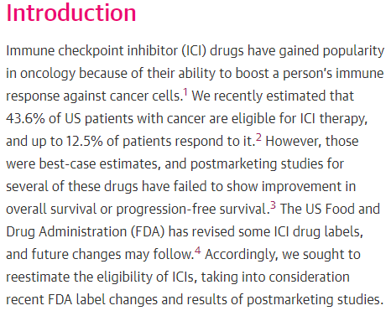
Estimation of the Percentage of US Patients With Cancer Who Are Eligible for Immune Checkpoint Inhibitor Drugs

Slide 11
Methods
Straightforward description of what you did
  Approach this as if you were writing a recipe
Probably not be the most compelling part of the research paper
  Important, nonetheless!
Details, details, details…
  Citation of previously used methods (if available)
Compatible with the results section
  For every result, there should be a description of its methods
  For every method, there should be a result

Slide 12
Methods – study design
Type of study used
  Randomized, cross-sectional, case-control, etc.

Slide 13
Methods – subjects and setting
Inclusion criteria
  Age, gender, health status, etc
Exclusion criteria
Where did population come from?
  Hospital-based, convenience sample, complete case ascertainment in a given setting, etc
Source of data
When did study occur?

Slide 14

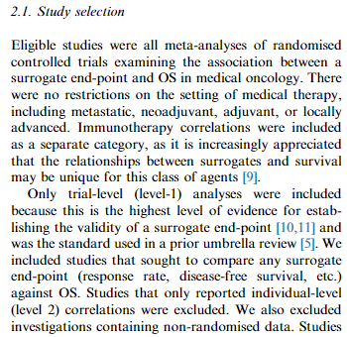


Slide 15
Methods - measurement
Explain all variables
  Dependent
  Independent
How outcomes/variables were assessed
Questionnaires used
Categorization rules
Variable transformations
Reliability/validity when relevant

Slide 16

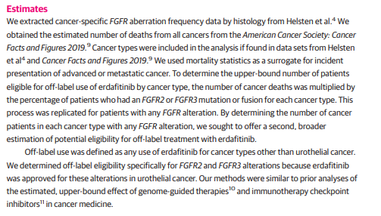

Slide 17
Methods - analysis
Statistical tests
  Frequencies, modeling, etc
  Browner discourages mentioning specific tests
    Encourages transformations, determination of effect size
  Checking of statistical assumptions
  Explanation of why the specific methods were used
    Model adjustments, interactions, etc
  Sensitivity analysis
Effect size
  Sample size calculator or power analysis

Slide 18

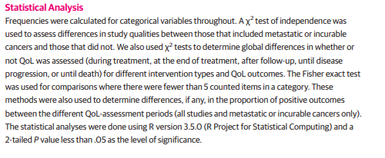

Slide 19
Assignment #2:
Option 1: Submit a draft ~3-paragraph introduction for a manuscript based on a research project you are currently conducting or have just completed - due by noon on May 4.
Option 2: Use "track changes" to edit and improve a draft introduction for any manuscript - due by noon on May 4.

