Slide 1
Results and Discussion

Slide 2
Results
Start broadly and then get more specific
  Begin with overview/general characteristics of study population
  Descriptive -> analytic
  Tell how many participants had outcome of interest
Think about how the data support the narrative you are presenting
Present results in same order as Methods
Present the data in a meaningful way
  E.g., presenting % overweight/obese rather than mean BMI if your study is comparing characteristics normal vs. overweight/obese
In cases of a high drop-out rate:
  Describe excluded vs. included

Slide 3
Results
Provide the denominator
  Study population for overall analysis
  number in each subgroup analysis
Use means and medians appropriately
  Medians for skewed distributions or heterogenous data
Provide actual p-values (not just “<“ or “>0.05”)
“Result” section should compliment Tables and Figures
  Mention all Tables and Figures in text
  Not necessarily a verbatim text of the actual results from the Tables/Figures

Slide 4
Results – what not to do
Focusing only on significant p-values
  Focus on the purpose of the study, not what is significant or how big the significance is
Using statistical jargon
  E.g., (Rosner) “We found a significant interaction among the variables (F3,111 = 5.1, P = 0.002).”
  Instead say: “We found that the effects of education on income varied by race, such that higher education had a greater effect in Hispanic Americans than in other ethnic and racial groups (P = 0.002).”
Over-precision in reporting data
  data should be described with the same level of precision that was used to make the measurement
Adding methods that were not included in the “Methods” section

Slide 5
Results – what not to do
Overwhelm the reader with lots of analytic tests
  Limit to the top 5-10 (or fewer) key results
Interpreting the results in the “Results” section
  This is good to save for the discussion

Slide 6
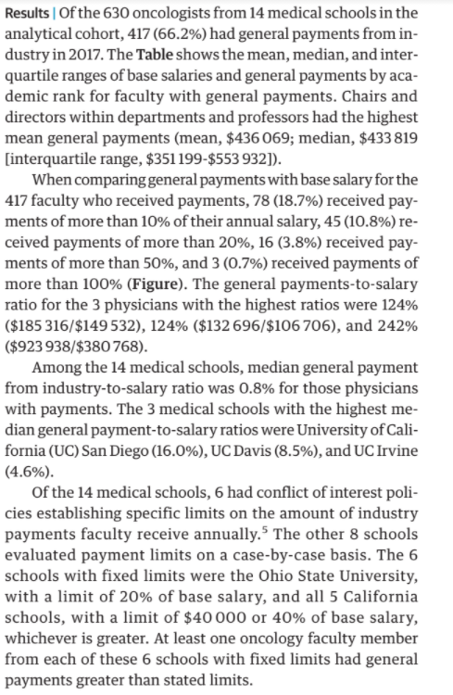
Gill J, Haslam A, Crain T, Perez D, Prasad V. Comparison of Industry Payments in 2017 With Annual Salary in a Cohort of Academic Oncologists. JAMA Internal Medicine. 2020

Slide 7
Tables
Two main purposes (Rosner)
  Present facts more compactly
  Provide the possibility of side-by-side comparisons of those facts
Stand on their own
  Reader should be able to know the context of the data (study population and years), any abbreviations/acronyms, and how variables are defined
Use footnotes to add detail
  Especially if there is lots of information that could be overwhelming in a table
Present comparisons side-by-side (not above/below)
  Groups being compared are in separate columns (not rows)

Slide 8
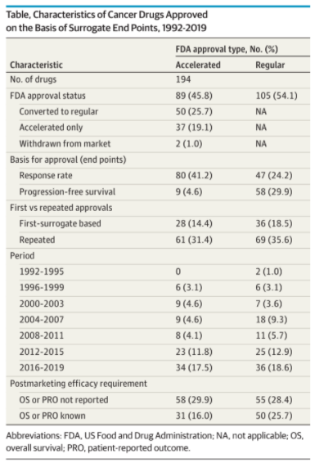
Chen E, Haslam A, Prasad V. FDA Acceptance of Surrogate Endpoints for Cancer Drug Approval: 1992-2019. Jama Internal Medicine. 2020.

Slide 9
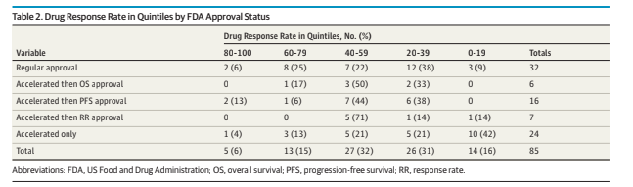
Chen EY, Raghunathan V, Prasad V. An Overview of Cancer Drugs Approved by the US Food and Drug Administration Based on the Surrogate End Point of Response Rate. JAMA Intern Med. 2019;179(7):915–921.

Slide 10
Figures
“one picture is worth a thousand words”
  If you can sum a figure in <20 words, you probably don’t need a figure
Great way to make a visual statement
Again, should stand on their own
Usually in the form of photographs, diagrams, and data presentations
Keep the figures clean and to the point
Most journals discourage pie charts
  Bar or line charts are better

Slide 11
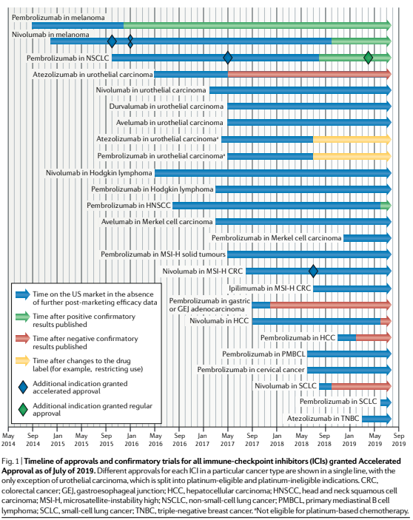
Gill J, Prasad V. A reality check of the accelerated approval of immune-checkpoint inhibitors. Nature reviews Clinical oncology. 2019;16(11):656-658.

Slide 12
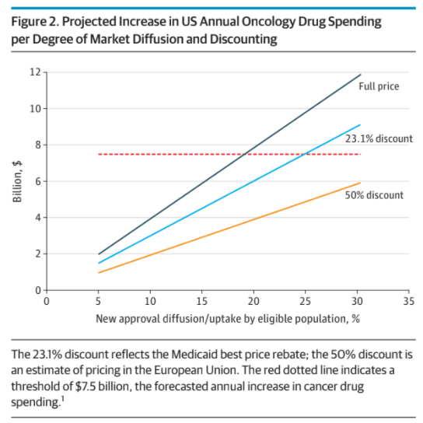
DeMartino P, Miljovic M, Prasad V. Potential Cost Implications for All US Food and Drug Administration Oncology Drug Approvals in 2018. Jama Internal Medicine. 2020

Slide 13
Discussion
Focus on the main findings
  Not a repeat of the results section
A continuation of the paper’s narrative
  Use words, not numbers
  Don’t get mired down in the statistics, numbers, and decimals
  If the results are null, it’s ok
    explain possible reasons for a lack of association
Focus on 4-6 main points

Slide 14
General outline (Rosner)
What you found
What you think your results mean
How your results compare with those of prior studies
Limitations
Concluding paragraph
  And implications
  Often with its own section header

Slide 15
Discussion components
Look back
  Answer whether the results make sense in terms of
    your expectation as expressed in the hypothesis?
    what you read before beginning (texts & research articles)?
    clinical practice?
    theoretical considerations?
  Do results agree with previous work? If not, explain
  Limitations
  Any unsettled points in results?
Look forward
  Implications for patient care or theory
  Suggestions for future research. Be specific.
Conclusion
  Beware of inappropriate conclusions (beyond the range of the data or design of the study)
https://healthprofessions.udmercy.edu/academics/na/agm/htresult.htm

Slide 16
Questions to consider (Rosner)
What did the study show?
What might that mean?
How else could the results be interpreted?
Have other studies had similar results, or is there disagreement in the field?
What are this study’s strengths and weaknesses?
What are the clinical or scientific implications of the results?
What, exactly, should happen next in this field of research?

Slide 17
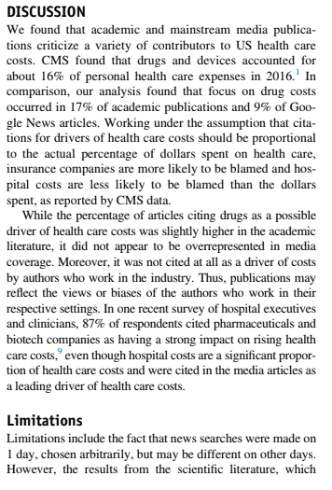
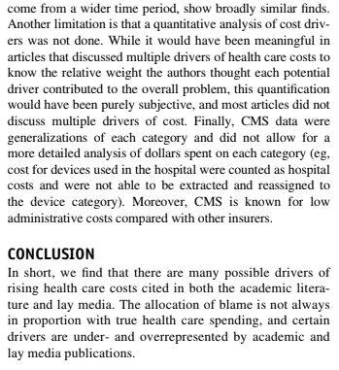
Haslam A, Crain T, Gill J, Herrera-Perez D, Prasad V. Where Does the Blame for High Health Care Costs Go? An Empirical Analysis of Newspaper and Journal Articles Criticizing Health Care Costs. The American journal of medicine. 2019;132(6):718-721.

Slide 18
Twitter and Social Media
~68% of Americans get their news from social media
47% of scientists use social media to follow new discoveries and discuss science (2015 survey of AAAS members)
13% of scientists reported being active tweeters and half use it to follow discussions on research-related issues (2014 Survey)
https://www.nature.com/articles/s41556-018-0253-6 (2018)

