Slide 1
Descriptive and Analytic Goals
Goal of research may be “descriptive” or “analytic”
Description
  How frequent/common are risk factors/exposures/conditions/diseases? How often does Y occur?
Causation
  The science of establishing causal relationships among biological, behavioral, environmental (etc.) factors among humans
  Does X cause Y?
Attribution
  What fraction of disease Y can be eliminated if a causal exposure X is eliminated?
Mediation
  Understanding the mechanisms of causation
  How does X cause Y?
Interaction
  When and for whom does X cause Y?
Prediction
  Do A, B, and C predict occurrence of Y? (e.g., diagnosis or prognosis)
Descriptive
Analytic
Everything in this course relates to designing studies that will accomplish a descriptive or analytic goal.
Notes:
Here is the framework we set forth in the Course Introductory Video and in the first lecture (Study Design) about the kinds of questions that epidemiology and clinical research can answer. We call these the “Big 6”. They represent six of the most common goals/objectives/purposes that clinical and epidemiologic research fulfills. Last week and this week, with our discussion of measures of disease occurrence, we are discussing aspects of description. Note, however, that prevalence and incidence are not the only forms of description. For example, estimating the mean height in a population is also a form of description. In the COVID-19 era, the reproductive number (R₀) or “R naught”, which is an estimate of how many persons get infected from an index case of SARS-CoV-2 infection, is also a descriptive parameter. Because it is a rather specialized descriptive estimand, we will not cover it in this course. Nonetheless, its ascension in lay vocabulary is an example of how important description can be. Most generally, description refers to a single variable or construct in isolation, or when these variables are reported according to time or various sub-groupings of the population but without attempt to causally relate one variable to another. When two or more variables are considered together in a deeper way, we call it analytic research.
Quickly being able to associate any given research question to one of these six areas (or to one of the nine areas in a broader classification scheme) will enable you to rapidly focus on the methods needed to address the question and the pitfalls that should be avoided to enhance validity.

Slide 2
Disease Occurrence II
Main Points to be Covered
Incidence rates (“person-time incidence”)
“Average” incidence rate
  Calculating
  Uses
Instantaneous incidence rate (aka “hazard”)
Cumulative incidence and incidence rate
  different but related
Assumptions: cumulative incidence & incidence rate
Accommodating competing events in incidence estimates
  Rates
  Aalen-Johansen cumulative incidence estimator
Notes:
Here is what we will cover in the second lecture on disease occurrence. The focus will be incidence rates. We will describe average incidence rates and instantaneous incidence rates. After we learn about incidence rates, we will contrast them thoroughly with cumulative incidence that we learned about last week. This will include the assumptions we need for both in order to give them a meaningful interpretation. Finally, we will circle back to how to manage competing events in incidence estimation. This will feature a discussion of the Aalen-Johansen cumulative incidence estimator.
We will go well beyond the concepts presented in the S+ N textbook. This is especially the case for the discussion of hazard and competing events. This is because these concepts are very commonly encountered basic entities in clinical and epidemiologic research, and no one can be practicing human subjects-based research at a high level without mastery of these basic concepts.

Slide 3
Disease occurrence
Prevalence
Point
Period
Incidence
Cumulative incidence
Incidence rate
Simple proportion
Kaplan-Meier
Life-table
Aalen-Johansen
Average incidence rate
Instantaneous (hazard) rate
Notes:
Here is a flowchart of the material covered in the lectures on Disease Occurrence, including topics that we will cover today (in red). The focus will be on incidence rates.

Slide 4
The Three Elements in Measures of Disease Incidence
E = an outcome event = a binary outcome
    (e.g., onset of disease)
N = number of at-risk persons in the population under study
T = time period during which the events are observed
Notes:
We introduced these three elements of incidence last week (E, N and T). They are the basis for any measure of the occurrence of a binary entity. The difference between cumulative incidence and incidence rates lies in how time is incorporated with the number of persons at risk.

Slide 5
Two Measures of Incidence
The proportion of individuals who experience the event in a defined duration of time (E/N during some time T)
  Probability of event in a given time period
  Formal term: cumulative incidence
  Short hand: risk
The number of events occurring per amount of person-time observed (E/”NT”)
  Events per unit person-time
  Formal term: incidence rate
  Short hand: rate or, in some cases, hazard
Notes:
To refresh your memories on the basic difference between cumulative incidence and an incidence rate, cumulative incidence is a proportion because it has the number of events (E) as the numerator and has as the denominator the number of persons (N) who start off at risk at the beginning of the period of observation. It can be interpreted as the fraction of people who started off without the event and who then developed the event in a given period of time. Because of censoring, however, we rarely can just plug an N into the denominator. Instead, via Kaplan-Meier or life table estimators (or the Aalen-Johansen approach, to be discussed later today), we derive an effective N by taking into account each person’s follow-up until it is censored (or until a competing event occurs). Regardless of how it is estimated, the proportion can be interpreted as the percentage of persons at the starting point of observation who subsequently develop the event in a given time period. Cumulative incidence is a fixed cohort phenomenon — it is exactly how you would think you would express incidence in a fixed cohort. The short hand for cumulative incidence is the term “risk”.
An incidence rate also has the number of events (E) as the numerator, but its denominator is different: person-time. Person-time refers to the amount of time, in aggregate, that some group of persons has been observed. For one person, person-time is simply the amount of time the person has been observed. For a group of persons, it is the sum of the individual amounts of time each person has been followed. The duration of time each person has been followed may be different or it may be the same. If the duration is the same, then person-time for a group of persons is simply the product of the number of persons x the number of time units they were observed (NT). Typically, however, the aggregate person-time is not a simple multiplication of N x T; it requires summing up person-time across all of the participants. The short hand for incidence rate is the term “rate” or “hazard”.
Both cumulative incidence and incidence rate account for time. Cumulative incidence accounts for time by specifying the time period for which the proportion applies. For example, 40% of participants experienced the outcome during 3 years of follow-up. Incidence rate also accounts for time by aggregating the amount of time observed in all persons under study and making it explicitly part of the denominator of the calculation.

Slide 6
Risk versus Rate
Last week: concept of cumulative incidence (risk)
  Most commonly calculated by Kaplan-Meier estimator.
  Can also use life table (with more assumptions) or Aalen-Johansen method [later today]; or simple proportion if complete and equal follow-up
Incidence rate of disease is less intuitive but is the more fundamental measure
Rates can be viewed as underlying velocity of incidence (the “speedometer”) while cumulative incidence is the effect of this velocity (the “odometer”).
Notes:
Understanding the difference between cumulative incidence and incidence rate is a central concept. Both are important measures in clinical and epidemiologic research and are widely used. Both are used in survival analysis.
Cumulative incidence is a proportion and hence very intuitive. It asks: of all persons starting off without the event of interest and who are at risk for the event, what fraction develop the event over time? It is familiar to most readers of biomedicine because of the frequent use of the Kaplan-Meier estimator in studies with individual-level follow-up data.
Rates are less familiar or intuitive at first but are staples (i.e., commonly used metrics) in many fields. Describing cancer incidence, for example, is typically done with rates. We will make the case that rates are actually more fundamental and granular than cumulative incidence, because rates can be viewed as the underlying velocity of incidence (the “speedometer”) and cumulative incidence is the effect of this velocity (the “odometer”). There are many useful applications of rates, including in comparing two or more populations where at least one population does not have individual-level data or where exposures are changing within people over time. We will show examples of these situations presently.

Slide 7
Incidence Rate
Our focus this week
The number of events per amount of person-time observed (E/NT) = incidence rate
Two flavors of incidence rates
  Average incidence rate (“incidence rate”)
  Instantaneous incidence rate (“hazard”)
Notes:
Incidence rates come in two types: average incidence rate (often just called an “incidence rate”), which we discuss first, and an instantaneous incidence rate (often just called a “hazard”), which we will discuss later.
Historical note: Sometimes it is believed that rates are a new discovery or calculation. They are not. Their use in health-related research goes back to at least the work of William Farr (mid 1800’s) and Joshua Milne (1837). Their theoretical conception by mathematicians go back even earlier than that. A humorous piece on how rates are continually rediscovered can be found in: Vandenbroucke J. On the rediscovery of a distinction. AJE 121: 627–628, 1985. Farr worked extensively with John Snow, who is sometimes credited as the “father of epidemiology”. Careful historians, however, note that Farr should be given just as much credit.

Slide 8
“Average” Incidence Rates
Numerator is the same as incidence based on proportion of persons = events (E)
Denominator is the sum of the follow-up times for all individuals under study = person-time (“NxT”)
Notes:
We will first discuss “average” incidence rates. The calculation for average incidence rates is simple. The numerator is the number of new outcomes/events/diagnoses of the condition under study amongst the population under study. This is the same as in the calculation of cumulative incidence. The denominator is the construct of “person-time”, which is the sum of all of the individual-level time that was observed in the population under study. The short hand we use for person-time is “NT”, in which N stands for person and T for time.

Slide 9
What is person-time?
The amount of time, in aggregate, any single person or group of persons has been observed.
For one person, person-time is simply the amount of time the person has been observed.
For a group of persons, it is the sum of the individual amounts of time each person has been observed.
For a group, a different kind of time than we are used to:
  Not a stretch of continuous time (e.g., 5 consecutive years)
  Instead, an aggregation (or collection) of individual blocks of time contributed by each person in the cohort
This sum can be expressed in any time unit: person-years, person-months, person-days, etc.
Notes:
An incidence rate uses number of incident events (E) as the numerator, as does cumulative incidence, but its denominator is different: person-time. Person-time refers to the amount of time, in aggregate, any single person or group of persons has been observed. For one person, person-time is simply the amount of time the person has been observed. For a group of persons, it is the sum of the individual amounts of time each person has been followed. Think of it as different people having different periods of observation and each then throws his/her observation (his/her person-time) into a hat and then all of the different durations of time are added together to yield a sum of person-time. The duration of time each person has been followed may be different or it may be the same. If the duration is the same, then person-time for a group of persons is simply the product of the number of persons x the number of time units they were observed (N*T). As we will see later, this N x T calculation is used a close approximation to person-time in large populations for which individual level measurement is not available.
Person-time is a different kind of time than we are used to in everyday life. Except when considering a single person, person-time is not a stretch of continuous calendar time (e.g., 5 consecutive years). Instead, it is an aggregation (or collection) of individual blocks of time contributed by each person in a cohort of interest which was observed for the event of interest. This sum of person-time can be expressed in any unit, such as person-years, person-months, person-days, etc. Even in a single individual, person-time may not be a continuous stretch of calendar time in any given study in that a single person may go in and out of being at risk and thus may contribute discontinuous stretches of person-time to his/her total person-time.

Slide 10
Calculating an Average Incidence Rate: Obtaining the Denominator of Total Person-Time
Method 1: Individual-level data available
  If have exact entry, censoring, and event times for each person, can sum person-time for each person to get denominator
Method 2: No individual-level data available
  Variety of approaches (based on “grouped data” or “group method”) to get aggregate person-time, with assumptions:
    Have: population size at one time
      Assume steady state or steady change in population over interval
    Have: no. at-risk at beginning and end of time interval
      Assume uniform entry/drop-out over time interval
Notes:
Calculating person-time makes it easier to understand. There are two basic approaches. The first should be used if you have individual-level data on everyone in your study population. If you do have this, you just simply sum up the person-time for each person. Person-time in a given individual refers to amount of time observed from the beginning of observation until either the event of interest has occurred, censoring (due to drop out or administrative), or a competing event.

Slide 11
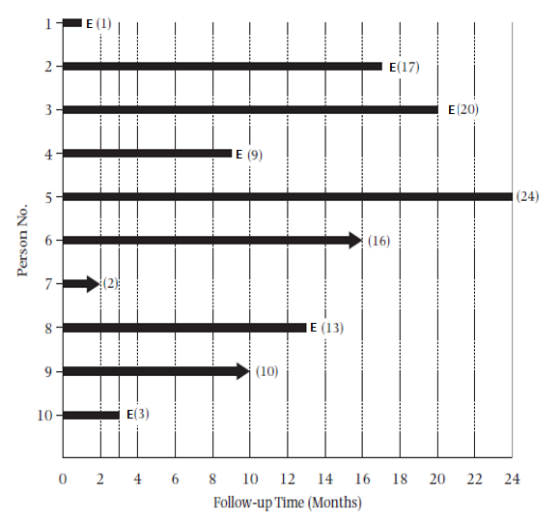
Fixed cohort study with individual-level data
= loss to follow-up
E = event
Notes:
This is the hypothetical example of a 10-person fixed cohort study given in the S & N textbook. The solid black horizontal bars represent the length of time each person was followed in the study. E denotes the event of interest. In this fixed cohort study, follow-up ended with either the event of interest, loss to follow-up (drop out), or administrative censoring.
11

Slide 12
Calculating an Average Incidence Rate:
Obtaining the Denominator
Incidence rate = E/”NT”
E= 6 deaths (events)
“NT” = 115 person-months
Person Number | Months of follow-up
1 | 1
2 | 17
3 | 20
4 | 9
5 | 24
6 | 16
7 | 2
8 | 13
9 | 10
10 | 3
Total | 115 person-months
6/115 person-months
6/9.583 person-years
= 0.626 per person-year
= 6.26 per 10 person-years
= 62.6 per 100 person-years
“Person-time” sometimes a source of confusion, but it need not be.
Why “person-time” instead of just “time”?
To distinguish it from more common meaning of time – a continuous duration, e.g., 115 months in a row
Notes:
Here are the calculations from the S+N text’s example using individual-level data to calculate a person-time incidence, in this case an “average” incidence rate. Note that the person-time in months is just the sum of the number of months from the previous graphic showing how long each person was observed in the study prior to getting the event of interest, drop-out, administrative censoring, or a competing event (although there are no competing events in this example). Because this example is depicted as a fixed cohort, all participants were “shifted to the left”, but this is not fundamentally necessary for the calculation of average incidence rates. Also, the S+N text calculates incidence rates separately for the first year of follow-up and then for the second year of follow-up, but this is not necessary unless there is specific interest in tracking the role of calendar time (e.g., rate in 2018, 2019, 2020, etc.).
The numerator is, as always, just the number of events; here, 6 deaths. We could express the incidence rate per unit person-month or as any person-time unit. What is conventional, however, in many fields is person-years. It is also conventional to present rates that have integers greater than 1 to the left of the decimal point. We achieve this in this example when we converted from per person-year to per 10 person-years. The decimal point is then moved for the fraction 6/9.583 to give the rate per 10 person-year or per 100 person-years (i.e., 0.626 cases per person-year equals 6.26 cases per 10 person-years).
The concept of person-time is sometimes a source of confusion but it need not be. Think of person-time as a collection of bits of observation time contributed by different people. Not all people contribute the same amount of time. In this example, we just add up time of observation from each participant to get our sum of 115 person-months. We have this construct person-time to distinguish it from the more common meaning of time, some continuous duration or stretch of time, for example here, 115 months in a row (as in calendar time). Person-time is also different than age (which is time from birth)). In our example, we cannot say that our rate has any meaning over 115 specific calendar months in a row in any single person or group of persons. Person-time is a collection of time as opposed to a string or run of time.

Slide 13
Dynamic Cohort Study
New Members
CE
CE
Observation begins
Observation ends
Time (calendar)
Notes:
How about in a dynamic cohort? Each horizontal line depicts the person-time observed in each individual participant in this study. You can add up all of this person-time across participants to get the denominator for an incidence rate. Again, each participant contributes person-time up until the occurrence of the event of interest, lost to follow-up, a competing event, or administrative closure.

Slide 14
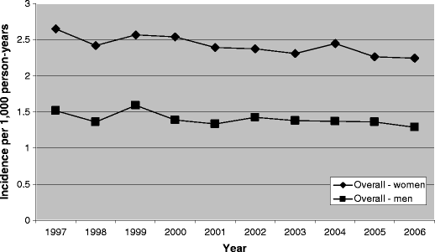
Example: Incidence Rate in a Dynamic Cohort
Individual-level follow-up data available
Person-years | 10,100,000
New hip fractures | 19,614
Average incidence rate (per 1,000 person-years) | 1.9
All data available from Kaiser’s computerized administrative and medical record databases
Adams et al. Osteoporos Int 2013
Notes:
To calculate an average incidence rate in a dynamic cohort, the approach depends on whether we have individual-level follow-up on the cohort members. In this example from Kaiser, individual-level data are available. The investigators know the dates of Kaiser membership, the occurrence and dates of the outcome (hip fracture in this study), and the occurrence and dates of any competing events, such as mortality. Kaiser and the U.S. Veteran’s Affairs healthcare system are two of the largest dynamic cohorts with individual-level data in the U.S. Kaiser, in particular, is an all-encompassing system with both outpatient and inpatient care documented in the same database.
In this study, an excerpt from the paper reads
“Hip fracture cases occurring each study year were identified from electronic medical records (inpatient, outpatient, emergency department) and claims information using International Classification of Diseases, Ninth Revision, Clinical Modification (ICD-9) diagnosis codes 820–820.9…
Using enrollment and electronic medical record data, we identified all KPSC members who were aged 45 years or older as of January 1 of each study year, 1997–2006. Gaps in enrollment up to 60 days were ignored and the subject was considered to be continuously enrolled. After the first year and at the beginning of each subsequent study year, existing members were added to the study as they achieved the minimum age. Newly enrolled members were also added each year if they met the age criteria. These subjects comprised the denominator and their person-time at risk for having an incident hip fracture each year was used in the rate calculation.”
During the period 1997–2006, 19,614 KPSC members aged 45 years or older sustained incident hip fractures. These fractures arose from a population with approximately 10.1 million person-years at risk for fracture over the entire study period.
Even though incidence rates are shown over time (and by gender), we would still refer to this study as primarily descriptive (#1 of the “Big 6”). There is no attempt to study causation by gender or calendar time.
Adams AL, Shi J, Takayanagi M, Dell RM, Funahashi TT, Jacobsen SJ. Ten-year hip fracture incidence rate trends in a large California population, 1997-2006. Osteoporos Int. 2013 24:373-6

Slide 15
Calculating an Average Incidence Rate: Obtaining the Denominator of Total Person-Time
Method 1: Individual-level data available
  If have exact entry, censoring, and event times for each person, can sum person-time for each person for denominator
Method 2: No individual-level data available
  Variety of approaches (based on “grouped data” or “group method”) to get aggregate person-time, with assumptions:
    Have: population size at one time
      Assume steady state or steady change in population over interval
    Have: no. at-risk at beginning and end of time interval
      Assume uniform entry/drop-out over time interval
Notes:
If you do not have individual-level data on everyone, be it in a fixed or dynamic cohort, then there are a variety of approaches to make your best estimate of the aggregate person-time in the population. Collectively, these are sometimes called “group”, “group-level”, “grouped data”, or “average population” methods. They all have some assumptions, some of them have more assumptions than others. Note that although the word group or group-level is used, this discussion has nothing to do with ecologic study design.
Let us say you just have the size of a population at one time. If you are willing to assume a steady state population size, you can multiply the duration the population was at steady state x population size to get aggregate person-time. This is one situation in which N x T is literally used to derive person-time. Or, if you have the number of persons at risk at the beginning of the period of observation and number at the end of the period, you can also, as we show in a few slides, estimate aggregate person-time. To do this, you will need to assume that losses and/or additions occur in some pattern throughout the period. (This is remindful of the assumption of what happens in an interval in the life table approach to cumulative incidence estimation.)

Slide 16
Method 2: Calculating Incidence Rate
Without Individual-level Follow-up:
Most often seen & exemplified in large dynamic cohorts
Research question: What is the incidence rate of diagnoses of pancreatic cancer in San Francisco (SF) County in 2010?
Numerator: All new pancreatic cancer diagnoses are reported to the SEER cancer registry
How to obtain a denominator for a rate?
Notes:
Not having individual-level data is seen most commonly in large dynamic cohorts that represent geographic areas; they are simply too large to enumerate everyone. And, it is in these contexts where most of the solutions have been derived.
For example, what if you wanted to estimate the incidence rate of pancreatic cancer diagnoses in San Francisco County in 2010? In the field of cancer, the SEER registry does an excellent job of capturing all of the new cancer diagnoses (E) for large swaths of the U.S. population. The SEER registry is a program of the National Cancer Institute, which is one of the institutes of the National Institutes of Health. It covers particular regions of the U.S.. Please see the SEER web page for detailed information on what areas are covered by SEER registries, what data are available, etc. In California, the SF Bay Area registry has been established the longest (since 1973). It is now housed at UCSF. There is also now a state-wide cancer registry (since 2001).
But, how will an investigator determine the person-time denominator to calculate the average incidence rate?

Slide 17
Large Population Incidence Rates
The study base for the pancreatic cancer cases is the population of SF County during the year(s) that cases were diagnosed (i.e., a dynamic cohort).
To get an incidence rate person-time denominator for a particular year by the “group method” requires only an estimate of the “average population” size during the year
  If assume steady state: need population size at any point
  If linear increase/decline: mid-point population provides the average but with some math, other points also work
  If non-linear, then more math is needed
  With small time intervals, steady state typically assumed
Average population size (N) x time (T) = person-time
Fortunately, SF population was determined in 2010 U.S. census.
Notes:
Clearly, no investigator has data on everyone who was living in San Francisco as of January, 1 2010, every new arrival who entered San Francisco in 2010, and when every departure or death took place. Thus, an individual-level aggregation of person-time is not possible at it was in the Kaiser example. Thus, the problem is how to obtain information that will allow calculation of a person-time denominator. The solution is to obtain an estimate of the average population size during the time period. The average population size (N) multiplied by the time period (T) gives the aggregate person-time denominator for the rate. This method of estimating incidence rate is sometimes called the “group method” or “average population method”.
There are several ways to get the average population size for an interval, in this case a year (2010). If you assume that the population is at steady state, then you can use the population as counted at any time during the year. If it is believed that the population is experiencing a linear increase or decline, then an estimate at the mid-point tells you the average population size. If change is felt to be non-linear, then average population size can be calculated with more sophisticated gyrations, which we will not get into in this course. Estimating population size is the purview of demography. Epidemiologic and clinical researchers need to borrow facts from demography but do not have to know in detail how population size in the community is estimated. In this class, we will deal with only the simplest examples of deriving person-time in dynamic cohorts which do not have individual-level enumeration.
Fortunately, in the U.S., the government-sponsored census provides what is believed to be very accurate population counts. The U.S. census occurs every 10 years, and the last one was 2010. The ability to support average incidence rate estimation — by determining the denominator — for various medical conditions is one of the underappreciated benefits of the massive census process. The incidence rates calculated with these populations are sometimes called “annual rates”, but this term should be avoided in that it is easily confused with a one-year cumulative incidence. Hence, just state the rate for 2010 was “xxx per 100,000 person-years”. Do not say the “annual rate in 2010 was xxx per 100,000 persons”.
A further advantage of using census data for forming rates in combination with case counts collected by registries is that rates can be formed for any of the grouping variables recorded in the census, such as age groups, gender, race, ethnicity, income, geographic sub-regions, and many others. This assumes such information is also collected on the cases.
Of note, the COVID-19 pandemic and perhaps other governmental dysfunction is wreaking havoc on the 2020 U.S. census. There are many anecdotes, including in San Francisco, of many persons not being counted. It remains to be seen if confidence is ultimately achieved in the 2020 census.

Slide 18
Pancreatic Cancer Rate – SF County 2010
Pancreatic cancer cases in SF 2010 = 123 (SEER)
Population in SF 2010 = 805,340 (U.S. census)
  Assume that population is steady state for 2010
  Thus, person-time for 2010 is 805,340 person-years.
Incidence rate for pancreatic cancer in SF in 2010:
  123 cases/805,340 person-years
  = 15.3 cases per 100,000 person-years
Notes:
Here is the calculation. The number of pancreatic cancer diagnoses in SF County in 2010 was obtained from SEER. The population of SF County in 2010 is available from census data. We assume that the size of the population is in a steady state for 2010. In other words, although we know people are leaving and entering SF County during the year, at any time point during the year these changes average out. We can therefore assume that the total person-time for the year is 805,340 people x 1 year = 805,340 person-years. The total number of people who contributed to this time is likely greater than 805,340 because some people contributed less than a year. That the total number of unique people was likely greater than 805,340 is expected and presents no problems for us in our incidence rate estimation.
Of course, the validity of these estimates are only as good as the raw data. The numerator is believed to be valid. The denominator is based on a one-time count of people (the census) and an assumption of steady state. It is recognized that this is not exact, as is the case when one has individual-level data. The census is not exact, the steady state assumption is not exactly correct, and we are also ignoring to modify the person-time for those persons who had prevalent pancreatic cancer at the beginning of 2010 (they should not be counted in the person-time denominator) as well as the person-time that occurred after case developed (it should not be included). Yet, in a denominator that is so much larger than the numerator, these areas of inexact person-time measurement are generally felt to be inconsequential. However, this will not always be the case with incidence rates in geographic dynamic cohorts, as we will show later.

Slide 19
Method 2:
Full individual-level data not available
Example in Fixed Cohort Study
Average population method also useful in a fixed cohort if individual information is, for some reason, not fully available.
To do this, just need to know:
  Number of events (E)
  Size of starting and ending population of fixed cohort
Rest of the math:
  Follows your intuition of doing the best you can with what you have to make a good guess at aggregate person-time.
Notes:
This second method of calculating incidence rate (the “group method”) is mainly needed with dynamic cohort studies, when it is not practical to enumerate everyone. The group method is not commonly used in fixed cohort studies because fixed cohorts typically are enumerated in terms of when all participants are under observation. However, in a pinch, if you had a fixed cohort without individual-level data, the “group method” could be used. With the starting N, the final N, the number of events (E), and a few assumptions, you can use the group-level method to estimate the incidence rate.

Slide 20
Example of Fixed Cohort Study
Notes:
Here again is the hypothetical example of a 10-person cohort study given in the S+N text book. Of course, if you had individual-level data on each participant, as is implied in this graphic, you would just add up the little bits of person-time to get the exact aggregate person-time.
20

Slide 21
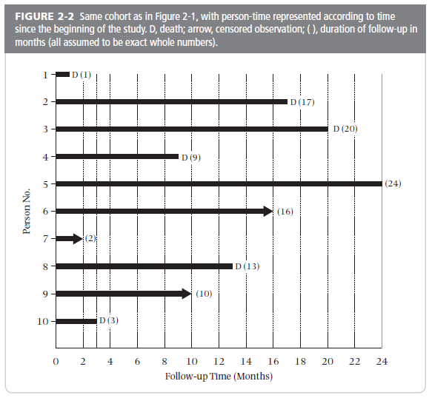
What if this is all you knew?
N_{begin} = 10
N_{end} = 1
E = 6
Notes:
What if this is all you knew? Imagine that you only know how many people entered the study (N=10) and how many were remaining at the end of the longest follow-up time (N=1). In addition, you know the number of events (E=6). What does your intuition tell you about how to estimate the person-time of this cohort of 10 persons?
21

Slide 22
Method 2: Example in Fixed Cohort
Numerator: 6 events (deaths)
Denominator: 10 persons at beginning; 1 person at end. 1 person contributes 2 pers-yrs. What about the other 9? As an estimate, they each contribute half of the total follow-up time: 9x2/2 = 9 pers-yrs. 2+9 = 11 person-yrs
Rate = 6 events /11 person-years = 0.545 per person-year
or 54.5 per 100 person-years
This method assumes uniform occurrence of events and of censoring during the interval
  like the life-table method
  if assumptions are wrong, the estimate is wrong (this is a common theme)
Notes:
The numerator is 6 events.
The average person-time for the denominator is calculated by our knowledge that there were 10 persons available at the beginning and 1 person at the end. We know that 1 person, available at the end of the study, contributed 2 person-years. What about the other 9? As an estimate, we assume they were followed for half of the total follow-up time. This is equivalent to assuming that the event of interest occurred at a uniform frequency over the interval and that censoring/competing events occurred uniformly over the interval. (9 participants x 1 year) = 9 person years. Adding together all of the person-years yields 2+9 = 11 person-years.
Another way to think about this is that there were 10 persons available at the beginning and 1 person at the end. This equals 5.5 persons (derived from: (10 + 1)/2) available, on average, at any point in time. If we have 5.5 persons at steady state, then we multiply 5.5 by two years equals 11 persons-years.
The rate calculation is therefore 6 events/11 person years, which is equal to 0.545 per person-year. Or, we can say the rate calculated this way is 54.5 per 100 person-years.
In this example with only 10 persons, the rate calculated by the average population method differs more from the rate calculated from individual data (62.6 per 100 person-years) than it often does in larger populations. As with the S+N textbook illustration of the life table method of calculating cumulative incidence, the text uses an example with very small numbers of persons in order to make showing the calculations simple. It has the effect, however, of magnifying the differences between the average population method and the individual-level method and making the average population size method appear inaccurate. In this example, the reason the two approaches differ is because the assumption of uniform censoring during the interval clearly does not hold. In larger data sets, such as from large geographical areas, the assumption often works better.
The bottom line is that accuracy of the estimate depends upon the accuracy of the assumption. If the assumption is wrong, the estimate will be wrong (invalid). The investigator, however, is typically not able to prove or disprove the assumption about population size.
One does not have to use an assumption of uniform occurrence of events and censoring over the study period. Other more complex distributions could be assumed if you could justify them on substantive grounds. Without actually knowing what happened to people on an individual level, it is hard to justify anything more elaborate than uniform occurrence of events and censoring. This is a common theme of epidemiology and biostatistics. We saw this in Kaplan-Meier estimation, for example, with the assumption of non-informative censoring. If you and your reviewers are willing to believe some assumption, then we can derive some useful metric. The assumptions, however, should not be taken blithely and should always be scrutinized. In some situations, the assumptions are not believable and hence the work should not proceed.

Slide 23
Average population (Group data) approach versus individual-level approach
If losses and events occur perfectly uniformly over interval
  Total person-time calculation for denominator (and thus the rate) will be the same whether based on average population size method or individual-level data
In this example, estimates slightly differ:
  62.6 per 100 person-yrs vs 54.5 per 100 person-yrs.
  Reason: losses & events did not occur perfectly uniformly over time
Notes:
In the S+N textbook example, calculating the rate using individual-level data and by an average population size approach results in slightly different rates (62.6 versus 54.5 per 100 person-years). This is because there was not uniform occurrence of events or censoring over the two-year period.

Slide 24
Note on terminology:
Average incidence rate based on group vs. individual data
Szklo and Nieto text use:
  incidence rate when calculating rate based on group data (average population at risk)
  incidence density when based on individual-level data
This terminology distinction not followed by most, and we don't favor this distinction.
  We call them both average incidence rate
Notes:
This distinction between an incidence rate and incidence density that is made by the S + N textbook is a refinement that we do not think is necessary, and it is not typically done in practice in the literature. It is sufficient to know the difference between an incidence rate (for which we consider incidence density an equivalent term) and a cumulative incidence and to know that the rate can be calculated using individual-level data or the average size of the population at risk during a time period.
Of note, the use of “incidence density” is the origin of the term “incidence density sampling” in case-control studies, introduced in our first lecture (Study Design).

Slide 25
“Average” Incidence Rates
The numerator is the same as incidence based on proportion of persons = events (E)
The denominator is the sum of the follow-up times for all individuals under study = person-time (NxT)
Resulting ratio of E/NT not a proportion; it may be > 1 or < 1
Value depends on unit of time used
  person-days vs person-months vs person-years vs 1000 person-years vs 100,000 person-years, etc.
Notes:
By now, it is clear that an average incidence rate is not a proportion. It is not bounded by 0 and 1. Instead, it may be greater than 1.
The numeric value of an average incidence rate depends upon the unit of person-time used. It will differ depending upon you characterize person-time as person-days, person-months, person-years, 100,000 person-years, etc. The smaller the unit of person-time, the smaller the value. We will show examples of this presently. Hence, the absolute magnitude of the average incidence rate is determined by the units used in the denominator.
We like to be precise and refer to this calculation as an “average” incidence rate. Why? This is because it is summarizing or averaging incidence over some period of time. By labeling it as “average” we remind ourselves that it is looking at an average over the sea of person-time and that the rate may not be constant over observation time. We like to use this reminder because trying to summarize the situation with just 1 number can sometime be treacherous and not very informative, as we show later. Our use of “average” contrasts with the form of incidence which is an instantaneous incidence rate. While you will commonly see the term instantaneous incidence rate (or hazard), you will not typically see “average” incidence rate. However, we encourage you to be precise in language and use “average” incidence rate.

Slide 26
Value of incidence rate depends on time unit
Incidence rate of 8 cases per 100 person-years:
Could report as cases per 100 person-months:
(8/100 person-yrs) * (1 yr/12 mos) =
0.67 cases per 100 person-months
Or as cases per 100 person-weeks:
(8/100 person-yrs) * (1 yr/52 weeks) =
0.15 cases per 100 person-weeks
All estimates identify the same incidence rate, but person-years most common
Usually presented with at least one non-zero integer to the left of the decimal point (e.g., 8 cases/100 p-yrs)
Notes:
A notable aspect of rates is that the value depends on the person-time units used. These data illustrate how the rate value changes when the time units are changed even though the data remain the same and the interpretation remains the same. Person-years are the most conventionally used person-time denominator and are likely to be sound familiar to readers, but other time units are possible. Rates are usually presented in units that leave at least one non-zero integer to the left of the decimal point. For example, 9 per 1,000 person-years would usually be preferred over 0.9 per 100 person-years. There are, however, conventions in some fields in which the same person-time unit is always used regardless of the value. Cancer, for example, is typically expressed per 100,000 person-years.
Cumulative incidence does not have units since it is always between 0 and 1. Therefore, it is not subject to this kind of alternative formulation that rates are. But, contrary to incidence rates, the time period of observation has to be specified to make cumulative incidence meaningful (e.g., 34% at two years of follow-up or 52% at five years). In other words, you need to be explicit over which time period the cumulative incidence is “cumulative”.

Slide 27
Average Incidence Rate - Examples
  Magnitude of incidence rates are not immediately (or perhaps ever) intuitive, but you can develop a feel for them in context
Condition | Incidence rate
Prostate cancer (men) (most common cancer in US) | 140 per 100,000 person-years
Breast cancer (women) (most common cancer in women) | 120 per 100,000 person-years
Heart attack (men) | 50 per 10,000 person-years
Heart attack (women) | 25 per 10,000 person-years
Low back pain (men) | 38 per 1000 person-years
Low back pain (women) | 58 per 1000 person-years
Acute respiratory infection (children) | 160 per 100 person-years
Notes:
The magnitude of these average incidence rate values are not immediately intuitive, like a percentage is, to most observers, but after you work with them for a while you can begin to develop a feeling for them. You can begin to get a feeling of the magnitude of incidence rates when looking at the values for diseases for which you already have a feeling for their relative frequency. For example, individual cancers are less common than heart disease which is less common than lower back pain which is less common than acute respiratory infections.
Cancers are a per “100,000 person-years” type of illness. However, because there are so many different forms of cancer, they begin to add up to have major public health importance. Heart disease, of which there are fewer forms, are a per “10,000 person-years” type of illness. Low back pain is a per 1000 person-years condition (Knox et al. The incidence of low back pain in active-duty United States military service members. Spine 36:1492 – 1500, 2011). Acute respiratory infection in children less than 5 years old is said have an incidence of 160 cases 100 person-years (Benson V, Marano MA. Current estimates from the National Health Interview Survey 1995. Vital Health Stat. 1998;10:1–428) although this may be an underestimate.
For many people, thinking about incidence rates in comparison to some of these landmark values in the table gives some context. For example, let us say you were told that some new disease had a rate of 25 per 100,000 person-years. This is less common than the most common cancers. It is the rate of a middle-level incidence cancer such as melanoma (~23 cases per 100,000 person-years in the U.S.). In general terms, melanoma is considered “uncommon” in its incidence at the general population level, and this new disease should be considered in the same way.
Qualitative perceptions of frequency are sometimes classified as “common, uncommon, rare, or reportable”. Cancer (other than some forms of common skin cancer) and heart attack are uncommon in the general population. Conditions less frequent than cancer would be considered rare, and disorders that are occur so infrequently that they merit description in the medical literature are called reportable. On the other end of the spectrum, both low back pain and respiratory infections in children are considered common.

Slide 28
Reporting Average Incidence Rate
Often erroneously described as “annual rate” or “annual rate per 100,000 persons” or “per 100,000 persons” (i.e., person-time denominator not explicit) – don’t do this!
Always include explicit “per person-time”; e.g.,
  50 per 100,000 person-years or 2.3 per 100 person-months
  17 (100 person-years⁻¹) (mathematically correct, but unfamiliar)
We like to explicitly call this “average” incidence rate but you will not see this commonly in practice
  Rationale: 1 number summarizing (averaging) incidence over some time and the incidence may not be the same over time
  When people say “incidence rate” they usually mean “average” but not always (sometimes mean instantaneous)
Good practice: Give substantive context…
Notes:
You will see the term “annual rate” commonly used in practice, but it is one to be avoided because it has a variable meaning. Sometime, authors and readers will imply that an “annual rate” applies over some calendar year. Yet, this is not always the case. Sometimes, rates are gathered over the course of a calendar year but often they are not. Also, the term “annual rate” might make naïve readers think that they are proportions as they are frequently described as per some number of persons without making explicit that it is really per some number of person-years.
In general, include the units “per person-time” (e.g., per 100,000 person-years). For readers who understand incidence rates, this will be unambiguous communication. For readers who do not understand incidence rates, at least you are not communicating any worse than some other ambiguous description. Sometimes you will see the units as person-years⁻¹; this signifies person-years in the denominator. It is correct mathematically but it will be unfamiliar to most readers.
We like to be precise and refer to this calculation as an “average” incidence rate. Why? This is because it is averaging incidence over some period of time. By labeling it as “average” we are reminding ourselves that it is looking at an average over the sea of person-time and that the rate may not be constant over time. We like to use this reminder because trying to summarize the situation with just 1 number can sometime be treacherous and not very informative, as we show later. Our use of “average” contrasts with the form of incidence called an instantaneous incidence rate. While you will see the term instantaneous incidence rate (or hazard) commonly, you will not typically see “average” incidence rate. However, we encourage you to be precise in language and use “average” incidence rate.

Slide 29
Reporting average incidence rates:
Provide context to help readers interpret them
If individual-level data are available
  Describe distribution of individual-level follow-up time used to calculate the average incidence rate
    e.g., “Among persons who were followed for median 3 years (interquartile range: 1 to 5 yrs; absolute range 0.2 yr to 7 yrs), the average incidence rate was 26 per 100,000 person-years”
If individual-level data NOT available (e.g., dynamic cohort in large population)
  Give the duration of time and calendar period observed when calculating the average incidence rate
    e.g., “Among residents of Tulsa who were observed for up to 4 years from 1996-1999, the average incidence rate was 20 per 10,000 person-years.”
Notes:
When reporting average incidence rates, give readers enough detail and context to help them understand where the data came from. Giving readers this detail helps them understand in what context they can apply the rates themselves. If rates were calculated over a short calendar period and short per-person observation period, it is harder to be sure that the rates will apply to longer calendar periods and persons followed for longer observation periods. If you have an average incidence rate calculated over 5 years in a fixed cohort, it means you really cannot say what happens to that rate when you go over 5 years of observation. Rates are only as good as the context (calendar time and duration of observation time) in which they were estimated.

Slide 30
Reporting Average Incidence Rate
Example: Incidence of pediatric cardiomyopathy in two regions of the United States (NEJM, 2003)
  Described as: “overall annual incidence of 1.13 per 100,000 children.”
  What was done: Numerator = 467 cases of cardiomyopathy in registry of 38 centers for 1996-1999
  Denominator (person-time) “population estimates…ages 1 – 18; 1990 census with an in- and out-migration algorithm”
What they should have done: Give substantive context, make person-time explicit, and identify as “average” rate:
  “Measured from 1996 to 1999, the average incidence rate among children was 1.13 per 100,000 person-years”
Notes:
Here is an example of a report describing an incidence rate (for pediatric cardiomyopathy) that does not include explicit person-time or context. Some readers may think this refers to a proportion, but it is really “per some number of person-years”. The use of “annual” here can be misleading. This rate was not measured just over one year. It was measured over 4 years from 1996 through 1999. There is nothing annual about this other than trying to give some interpretation to 1.13 per 100,000 person-years, which is if you followed 100,000 children for one you would expect to see 1.13 cases develop. However, you could have just as well described it in many other ways (follow a million children for a month, or 10 million for a week). More careful investigators are more linguistically precise and will specify rates as per person-years; they do not use the term “annual rate”. The problem when authors use non-standard terminology and do not provide sufficient explanation of what they have done is that readers cannot be sure that they know what the authors did. Readers lose confidence in the credibility of the work. With so much riding on the results of human subjects research, why wouldn’t everyone strive to be optimally clear in the description of their findings?
A better description makes person-time explicit. It is reported as “per 100,000 person-years”. This allows at least one integer to the left of the decimal point.
This preferred description also makes the context clear by providing the years of observation included in the study (1996-99).

Slide 31
Now That We Have Discussed Their Calculation, Why Use Average Incidence Rates?
To calculate incidence in a dynamic cohort in which you do not have individual-level data
      Cumulative incidence would be impossible to directly calculate unless you had individual-level data
      e.g., pancreatic cancer incidence rate in SF County
Notes:
Now that we have discussed how to calculate average incidence rates, why use them? What are they good for? There are a number of uses and advantages of rates. The first is that rates are essential to describe disease/event occurrence in a dynamic population in which there are not individual-level data. In this setting, because you do not have individual-level data, it is not possible to directly calculate the alternative measure of incidence, cumulative incidence (i.e., risk).
For example, there exist some disease registries that strive capture all the new occurrences of a particular disease in a defined geographic region. Good registries will capture all or nearly all the events. In the U.S., cancer registries are the most notable example. Indeed, one of the reasons these registries are created is to estimate new disease burden in DYNAMIC populations. Thus, the numerator (E) for incidence estimation in the population is readily available from disease registries. But how would those events be applied to the population covered by the registry? What about a cumulative incidence estimation? Individuals are entering and leaving the population throughout the year, but you have no ready way to record all that and link it with an outcome variable of diseased or censored, as you need to do for a Kaplan-Meier analysis. Thus, cumulative incidence would be impossible to calculate directly without individual-level data. We gave the earlier example of estimating the incidence of pancreatic cancer in San Francisco County. It is remarkable that we can get an idea of how frequently pancreatic cancer occurs and not have to keep track of everyone on an individual basis. We can do this by getting a count of cases for pancreatic cancer (with the use of a cancer registry) and then get a reasonable idea of the person-time that gave rise to cases, helped by the U.S. Census.

Slide 32
Potential Weakness of Census Data
Calculating rates from US census population data is very useful but caution is required as a full census is only done every 10 years
Interim estimates of population change are made by the census experts but over 10 years these estimates may become inaccurate
Other countries may conduct a census at different intervals, or may not have a reliable census
Notes:
Average incidence rates are very useful tools to measure incidence in large dynamic cohorts which would otherwise not be able to directly characterized with, say, cumulative incidence. This is not to say, however, that researchers and readers should not be careful when using average incidence rates. Both the accuracy of the numerator and the denominator must be scrutinized.
Regarding the denominator, census data are a major resource for population-based dynamic cohorts. Researchers using census data should be aware that the possibility of inaccuracy increases with time from the last census. Some countries, such as the U.S., have “intercensal” estimates (i.e., yearly estimates of the population size in years between the formal census). These do not, however, turn out to be always accurate. As mentioned earlier, there is suspicion that the 2020 census may be incomplete.
Other countries will differ from the U.S. in how often the census is conducted and in the accuracy.

Slide 33
Invasive Breast Cancer Incidence Rates for Marin County versus Other California Counties, 1995-2000
Year | Marin County | Other California*
1995 | 162.1 | 145.9
1996 | 187.8 | 145.4
1997 | 176.6 | 150.9
1998 | 176.6 | 155.9
1999 | 190.7 | 157.8
Estimated population in these years
2000 | 157.5 | 153.9
Census
White, non-Hispanic women. Rates per 100,000 person-years
*Excluding 5 Bay Area Counties
Notes:
A good example of how census data can affect inferences was seen in the rates of breast cancer in Marin County (a county within California) compared to the rest of California. Based on 1990 census data and intercensal extrapolations of the 1990 census, the rates steadily appeared to become substantially higher in Marin than the rest of California. This was a source of great alarm. Then, in 2000, when the next census occurred, the rate of breast cancer in Marin County went back down to that of the rest of California. What happened?
Remember that the U.S. census is done every 10 years at the beginning of each decades (e.g., 1990, 2000, 2010, 2020). In between the formal census years, the size of the population is estimated each year.
It now appears that the population grew faster in the 1990’s in Marin County than the Census estimated with its between-census extrapolations. Hence, the denominators used were too small and the estimated rates higher than they should have been. The rate for 2000 using the new census was not very different from the rest of California outside the Bay Area.
Advanced Note: Rates were age-adjusted to the 2000 census to account for any age differences in the underlying populations. We will discuss this technique later in the lecture.

Slide 34
Explanation for apparent surge in breast cancer incidence in Marin
The estimates of breast cancer incidence (number of new cancers per year) most recently reported for Marin and other areas of the country were based on 1990 census information. Data from Census 2000 have enabled researchers to recalculate rates for Marin. Preliminary results show that revised incidence rates for Marin County based on the 2000 census are substantially lower than the rates calculated using 1990 census information. The discrepancy between using the 1990 and 2000 census data is due to projected population growth differing considerably from actual population growth.
Clarke et al. Report from No. Calif. Cancer Center 2001
Notes:
The census office had underestimated the population size in Marin in the years between the formal census counts. The number of breast cancer cases were counted accurately but the population size (and hence person-time) was too low. This resulted in a spuriously high average incidence rate from 1995 to 1999. This was corrected when the 2000 formal census was done and the accurate population size in Marin became known.
This and previous slide are from a report published in 2001 by investigators at the Northern California Cancer Center.
Clarke C. et al. “Update on breast cancer incidence patterns in Marin County and the San Francisco Bay Area, California”, 2001.

Slide 35
Why Use Average Incidence Rates?
To calculate incidence in a dynamic cohort
To compare disease incidence in a fixed cohort (individual-level data) with rate from a dynamic cohort (e.g., the general population) in which you do have individual-level data
  OR
  to compare incidences between 2 or more dynamic populations (e.g., two countries)
    These comparisons are “analytic” objectives
    Rates are like a universal language or a handy jackknife. You can use them everywhere.
Notes:
Another common use of average incidence rates is to allow a comparison between incidence in a fixed cohort, in which you have individual-level data, and a dynamic cohort (such as the general population) in which you do not have individual-level data. Why do this? For example, this allows investigation of whether the events in the fixed cohort with a special exposure are more or less frequent than would be expected from a sample of the general population. We will go through an example of this presently.
Incidence rates can also be used to compare disease occurrence in two or more different populations where you do not have individual-level data. Say you want to compare mortality in two different countries. In this sense, rates are like a universal language or a handy jackknife; they are metrics which you can take with you everywhere for comparison with other rates.
Advanced note: if you were to compare two different countries for the incidence of a certain outcome, you would probably want to account for differences in age and perhaps, in some instances, sex distributions. A straight comparison of incidence rates could be misleading. The rates for each country can be age-adjusted to an external standard population distribution (such as the 2000 US census). These two rates can then be compared as a rate ratio. This is another example of an analytic objective. Accounting for age and sex in this context (comparisons between countries) would be examples of examining the direct effect of residing in country on a health outcome apart from country’s effect on age and sex. This will be discussed later in the course when we come to mediation.

Slide 36
(2a) Comparing a rate from a fixed cohort to the rate in the general (dynamic) population
Example
Cohort study of petroleum refinery workers followed the workers for up to 36 years and found 765 deaths.
Research question:
  Does working in petroleum refinery industry shorten lifespan? Was the mortality in these workers high, low, or just average?
  i.e., Is working in this industry dangerous?
  Answer: need a comparator group
How would you calculate the mortality incidence in the cohort?
Austin & Schnatter J Occup Med 1983
Notes:
In this example, the question is whether working in a petroleum company causes a shortened lifespan. The authors had followed a group of petroleum industry workers for up to 36 years and found 765 deaths. It is easy enough to calculate the cumulative incidence from the cohort data since you will have follow-up on each person, but the question of what to compare it to is difficult. Clearly, survival is also related to the original age distribution of the cohort. Is there some other cohort of individuals who are not petroleum workers but were the same age and followed just as long?

Slide 37
Example of Using Incidence Rates for Cohort Comparisons (Fixed vs Dynamic)
Cohort of petrochemical workers [fixed cohort study]
  6,588 employees of Texas plant
  Enrolled if employed anytime from 1941-50
  Mortality obtained from 1941-1977 from National Death Index
  137,745 person-years of follow-up time
  765 deaths
Overall death rate = 765 / 137,745 person-years =
5.6 per 1000 person-years
Question: Is this a high death rate?
Notes:
Here are more details on the petroleum worker cohort. It is a fixed cohort study as defined as being employed or starting employment anytime from 1941 to 1950; the goal is to understand the occurrence of death not just during employment but afterward as well. This is the essence of a fixed cohort. It is fairly easy, by searching the U.S. National Death Index, to find all of the deaths that have occurred as long as you have unique identifying information (names, date of birth, and perhaps social security numbers). Enrollment was limited to 1941 to 1950 and then follow-up occurred to 1977. With this individual-level data, we can determine the number of deaths (765) and all of the aggregate person-time contributed by the 6588 workers. The resultant death rate is 5.6 per 1000 person-years. The problem is how to interpret the findings. Is the observed death rate high or low? A comparison is needed. We would like to compare these workers to similar persons without exposure to the petrochemical industry.

Slide 38
Cohort of petrochemical workers
Could also calculate K-M estimate of cumulative incidence (for 36 years of follow-up), but for what comparison group could you derive a 36-year K-M estimate?
Solution: compare rate of death in this population to rate of death in a reference population (e.g., US population)
  Although could compare rates directly, you will first want to account for differences in age, sex, and race between groups
  Operationally: observed number of deaths in petro workers is compared to number of deaths that would be expected if rate from reference population (e.g., US population) is applied to the petro workers
Notes:
Before we answer the question about whether the rate is high, we should convince ourselves that an approach of calculating cumulative incidence in the cohort is not helpful because there is no clear comparison group that has cumulative incidence of death available through 36 years of follow-up.
Instead, the solution is to use the universal metric of rates to make the comparison. Specifically, you can compare the rate of death in the petrochemical worker population to the rate of death in the U.S. general population who lived through the time period that the petrochemical workers lived. Although you could compare the average incidence rates of death directly between the two groups, you will want to first account for some obvious differences between the two populations, such as age, sex, and race. For this research question, these factors are known as confounders, which we will define precisely later in the course. If we do not contend with these confounders, any apparent differences that might be observed between the two groups (say, if the petro workers had a higher death rate) may be because of differences in say, age, sex, or race.
Operationally, to conduct this comparison, age-sex-race-calendar period person-time mortality rates from U.S. population data can be applied to the amount of person-time follow-up by those groups in the petrochemical cohort cohort to produce an expected number of deaths as if the petro workers had experienced the rate of death in the general U.S. population. These expected number of deaths are then compared with the observed number of deaths in the petrochemical cohort. U.S. population data are available from the National Center for Health Statistics. This method of applying rates from a reference population to a study population is called indirect standardization, and the measure of association is the ratio of observed to expected outcomes, called the standardized mortality ratio (“SMR”) when the outcome is death. It is called the standardized incidence ratio (“SIR”) when the outcome is some incident condition other than death.
Indirect standardization should be contrasted with another form of standardization, called direct standardization, in which the stratum-specific rates are applied to some external standard population. It can be hard to remember what is “indirect” or “direct” but also not that important in that one just needs to pay attention to the details of the procedures.
Abstract: “A historical prospective cohort mortality study was conducted for a cohort of 6,588 white male employees of a Texas petrochemical plant because of a suspected increased incidence of malignant brain tumors. Mortality experience from 1941 to 1977 was determined and compared with that of the general U.S. white male population adjusting for age and time period.“

Slide 39
Standardized Mortality Ratio
The comparison can be done with an SMR.
  (This is a measure of association — to be covered in more detail in later lectures — but we skip ahead here to illustrate usefulness of incidence rates.)
If U.S. death rates for age-sex-race-calendar period groups applied to the cohort, 924 deaths were expected in the cohort versus the 765 observed.
Illustrated on next slide
Notes:
The standardized mortality ratio (SMR) is formed by the ratio of the observed number of events in the cohort and the number of events that would be expected applying age-sex-race-calendar period-specific rates from the U.S. population to the distribution of the cohort by those variables. Applying the U.S. general population rates gives an overall mortality that would be expected if the U.S. rates were operating in the petrochemical worker cohort.
This is metric is called a standardized incidence ratio (SIR), when it is applied to incident events other than death.
The SMR is a measure of association, and we will cover measures of association in much more detail in the next several weeks. We include SMR here to illustrate that incidence rates allow for certain measures of association to be estimated. At this point, our focus is not on the SMR per se, but rather on the use of rates as a flexible tool in which to make a comparison.

Slide 40
Obtaining an expected # deaths for comparison
Group (Race, sex, age, yrs) | Petro Workers pers-yrs in group | US death rate | Expected N deaths in Petro group | Observed N deaths in Petro Group
W, M, 40 - 44, 1941-45 | 1,234 | 0.11 / 100 pers.-yrs | 1.36 | 1
W, M, 45 - 49, 1941-45 | 2,312 | 0.15 / 100 pers.-yrs | 3.47 | 3
---etc. | --- | ---- | --- | ---
Total | 137,745 |  | 924 | 765
Notes:
The table illustrates how U.S. general population race/sex/age/calendar period-specific rates are used to produce a comparison to the petrochemical cohort workers. For simplicity, only 2 age-sex-race-calendar groups are shown and the person-years in the groups are hypothetical as that detail is not available in the paper. Since the cohort has a different age-sex-race composition from the U.S. population, one cannot just use the overall U.S. mortality rate for comparison. In addition, the U.S. mortality rate has changed over time, albeit very slowly, and thus calendar time also must be accounted for. For example, one cannot simply use U.S. death rates from today. By using U.S. mortality rates specific to groups defined by those variables and applying them to the person-years at risk in each comparable group in the petrochemical workers cohort, the expected number of deaths that would have been seen if the U.S. rates applied can be calculated. For example, the rate of 0.11 per 100 person-years applied to 1234 person-years in the petrochemical group yields an expected 1.36 deaths among the petrochemical workers. The actual number of deaths seen among petrochemical cohort individuals is what we call the observed number of deaths. Now, we are left with two rates: 924 in 137,745 person-years in the petrochemical workers if they are experiencing the mortality of the general population and 765 in 137,745 person-years in the actual observed cohort study. Since both have the same total person-time denominator, it cancels out in division and the ratio of the rates is just the ratio of the observed and the expected number of deaths. This is called a standardized mortality ratio (SMR), which is a measure of association relating petrochemical work to death.
This is an example of indirect standardization, also discussed in Additional Slides at the end of this lecture.

Slide 41
Standardized Mortality Ratio
Average incidence rate for observed deaths: 765 deaths/137,745 person-years
Rate of “expected” deaths in workers given US gen. pltn. experience: 924 deaths/137,745 person-years
Ratio of these two rates = 765 observed/924 expected deaths [Denominators cancel out] = 0.83 = standardized mortality ratio (SMR)
Conclusion: After taking account of age-sex-race-calendar period:
  lower mortality rate in petro cohort compared with general population
Notes:
The standardized mortality ratio (SMR) is a comparison between the observed rate and the expected rate. The observed rate is 765/137,724 person-years; the expected rate is 924/137,724 person-years. For the estimation of the SMR, the denominators cancel out, reducing to 765/924 = 0.83.
Thus, operationally the SMR is formed by the ratio of the observed number of events in the cohort and the number of events that would be expected applying age-sex-race-calendar period-specific rates from the U.S. population to the distribution of the cohort by those variables. Applying the U.S. rates gives an overall mortality that would be expected if the U.S. rates were operating in the cohort. Thus, the ratio is an observed number of deaths compared to an expected number of deaths.
Note: One problem with this analysis is what is known as “the healthy worker effect”. In this example, the observed rate in the cohort of petrochemical workers was actually lower than expected if the U.S. mortality rates had been present. This is a common outcome of studies of employed workers when they are compared to the general U.S. population because workers need to have a level of health in order to be working in the first place which makes them generally healthier than the entire U.S. population in the same age groups. This same level of health may cause them to live longer. This is a form of confounding. Managing this confounding presents a considerable challenge. As we will discuss later in the course, remembering the omnipresent nature of confounding is easier than remembering a laundry list of colorfully named effects and biases. Thus, if one understands confounding, one does not need to remember what the “health worker effect” is. There may be additional sources of confounding such as lifestyle and region of residence that are not being accounted for with the limited data available for indirect standardization using U.S. general population death rates. Finally, the general population group itself is not a pure comparator because it indeed contains some petrochemical workers. The fraction of the general population which is petrochemical workers, however, is very small. We will later in the course refer to this as misclassification of the exposure.

Slide 42
(2b) Comparing hip fracture incidence in different dynamic populations
WOMEN Age-specific incidence rates per 100,000 person-yrs
Age group (yr) | Beijing† | Budapest† | Hong Kong‡ | Reykjavik
20-29 | 1.0 | 3.4 | 2.5 | 6.0
30-39 | 3.1 | 5.7 | 3.8 | 0.0
40-49 | 7.6 | 24.5 | 9.0 | 24.1
50-54 | 17.9 | 38.7 | 27.9 | 36.1
55-59 | 32.4 | 46.1 | 49.2 | 186.0
60-64 | 56.2 | 84.4 | 75.0 | 199.1
65-69 | 91.2 | 193.0 | 194.0 | 402.5
70-74 | 164.1 | 288.1 | 438.8 | 838.0
75-79 | 141.0 | 564.8 | 823.6 | 1311.1
80-84 | 224.2 | 1100.5 | 1588.1 | 1945.3
85-89 | 219.2 | 1652.6 | 2572.9 | 3791.9
90-94 | 401.0 | 2217.3 |  | 3732.9
95+ |  |  |  | 5300.4
20 and older, age-adj¶ | 39.6 | 128.2 | 168.3 | 274.1
50 and older, age-adj¶ | 96.0 | 316.0 | 428.3 | 696.6
¶ Standardized to 1990 US non-Hispanic white population
Notes:
These are incidence rates among women for hip fracture for 5- or 10-year age groups in four different countries. For each row, hip fracture events over a specific time period (one or two years) in the designated age group were ascertained for the numerator; we assume that all events in the population were captured. The denominator was based on census data. The rates shown are age-specific incidence rates, calculated as the number of events in the specific age group divided by the number of person-years in the same age group.
The research question is whether living in one country causes more or less hip fractures than living in another country. (Note: when we say “cause” we refer to both causing the occurrence and preventing the occurrence of event. We thus use the term in a general sense, as anything that influences the occurrence of something else. Later, we will give more formal definitions of what a cause is, but it will still mean either creating or preventing occurrence of something else.) From each country, we have eight rates. How can we derive one number to compare across populations, such that we can assess the influence of country on hip fracture incidence? The answer is to estimate age-adjusted incidence rates for each country. These are shown at the bottom for age 20+ and age 50+. In both cases, fracture incidence in Reykjavik is higher than the other countries.
These age-adjusted incidence rates were calculated using direct standardization to a reference population (in this study, the US non-Hispanic white population in 1990). The age-adjusted rates are a weighted average of age-specific rates, where the weights came from an external reference population. See the Additional Slides for a description of direct and indirect standardization, and an explanation of how to perform direct standardization. One issue with this approach is that you can see how you might get slightly different answers depending upon the weight structure (i.e., the population structure) in the external reference population. Standardization is a technique you should be aware of as a means of contending with confounding and nuisance indirect effects, although we will not focus on the technique in this class.
Schwartz et al. Osteoporosis Intl 1999.

Slide 43
Comparing Two Dynamic Populations
WOMEN | Beijing | Budapest | Rate ratio
No. hip fx (1 yr) | 808 | 284
Total population | 2,650,400 | 180,904
Unadjusted rate* | 30 | 157 | 5.2
Age-adjusted rate* | 39.6 | 128.2 | 3.2
* per 100,000 person-years
Unadjusted rates do not take into account the different age structures of the populations in Beijing and Budapest.
Used “direct standardization” to calculate rate adjusted for age (see Extra Slides). Measure of association, comparing rates in Beijing and Budapest, falls from 5.2 (unadjusted) to 3.2 (age-adjusted).
Notes:
Our research question is whether residence in one country, compared to another, causes more or less hip fracture. Here, we show Beijing vs Budapest. We can calculate what we call “unadjusted” rates of hip fracture for these populations using the formulae we showed earlier. But, the unadjusted rates do not take into account the different age structures of the populations in Beijing and Budapest. If we want to compare these rates intelligently, we need to adjust for the age structure (and perhaps other things). We can adjust for age with direct standardization, described in the Additional Slides.
We can then compare the two country-specific rates by forming ratio between the two rates. We call this a ratio measure of association. The unadjusted rate ratio is 157/30= 5.2, which means that women residing in Beijing have 5.2 times the rate hip fracture as women residing in Budapest. After we account for differences in age, the adjusted rate ratio is = 3.2, which is a substantial change compared to the unadjusted measure of association. We could have also compared the country-specific rates by subtracting one from another to form an additive measure of association.

Slide 44
Why Use Average Incidence Rates?
To calculate incidence from a dynamic cohort
To compare disease incidence in a fixed cohort with a rate from a dynamic population OR to compare incidence in 2 or more dynamic populations
To estimate incidence of outcomes when exposures change over time in given individuals
Notes:
Let us move on to the third reason to use average incidence rates.

Slide 45
(3) To estimate incidence of outcomes when exposures are time-varying
Research question: Does use of non-steroidal anti-inflammatory drugs (NSAIDs) cause coronary artery disease (CAD)?
How would you study the relationship between NSAID use and CAD?
Notes:
This research question asks whether non-steroidal anti-inflammatory drug (NSAID) use is a cause of coronary artery disease. One thing to recognize immediately is that the exposure in question, NSAID use, can change over time in a given person. This is common in cohort studies that examine exposures which can change over time, such as smoking, changes in diet, exercise, medications, etc. To address this question, you will need a source of data that distinguish time periods when medications were being used and time periods when they were not used. Some persons will never use the medications and some will use it continuously, but there is a large group who may go on and off the medication multiple times.
What is immediately clear it that it is difficult to see how you would analyze such data using the cumulative incidence approach, for example how we did with the petrochemical workers.

Slide 46
Calculating stratified average incidence rates in cohorts
For persons followed in a cohort, some exposures may be fixed (time-invariant) but some are changing (aka time-variant, time-varying, time-dependent)
  Biologic sex is fixed
  Taking medications or getting regular exercise are behaviors (exposures) that can change over time
Adding up person-time in each exposure status category to get a denominator of time at risk accommodates exposures that change over time
Notes:
For any given individual, there are some exposures that are fixed (also called time-invariant) and other exposures whose status can change over time. These changing exposures are called time-variant, time-varying, or time-dependent. For exposures that are time-varying, incidence rates a good way to manage changing exposure and still express the frequency of incident events. We do this by adding up the total person-time of exposure and adding up total person-time of non-exposure to form two denominators. This is a very useful way of dealing with the problem of changing exposure status.
To complete the estimation of these incidence rates, the numerators for each denominator is the number of events that occurred among persons at times when they were exposed and similarly for the events among the unexposed. This approach assumes that the exposure’s effect on the event is predominately or solely during the time the exposure is occurring. It therefore is most relevant for exposures whose effects quickly disappear when the exposure is removed. This assumption would not work very well for exposures which have lasting effects long after the actual exposure is removed. For example, for an exposure like smoking with known long-term health risks (at least for some health outcomes), linking events to time periods when an individual was and was not currently smoking would not be that useful when approaching the study of some new outcome. This because the non-smoking person-time that occurred a period of smoking would be very contaminated by the long-term effects of smoking.
Of course, we sometimes do not know if the effect of an exposure on a given outcome is long lasting or ephemeral, and our interpretation needs to concede this.

Slide 47
Analysis of changing exposure and disease incidence
Tennessee Medicaid database, 1987-1998:
  Does use of NSAIDs cause CAD?
Same person could both use and not use NSAIDs at different times over the 11 years
  A cumulative incidence approach to the analysis does not seem appropriate
Ray Lancet 2002
Notes:
To address this question, investigators decided to use data from the Tennessee Medicaid system. Medicaid is an example of a publicly funded insurance system; in other words, the government pays for the expenses incurred in the medical care of the group members. In doing so, the government records of the payments in a central database. Although the database was created for administrative purposes (keeping track of the finances), researchers use these databases to study questions relevant to epidemiology and clinical research.
NSAIDS (e.g., ibuprofen or naproxen) are a type of medication whose use can vary over time. People cannot be permanently classified in the groups they are at time 0 of any analysis because exposure status may change over time. To place persons in baseline exposure groups in order to calculate and compare cumulative incidence, the changes in use that happen after baseline would have to be ignored, an obviously unsatisfactory approach for this research question.

Slide 48
A given person can contribute exposed and unexposed follow-up time
No NSAID use
NSAID use
Notes:
In contrast to a cumulative incidence approach, calculating incidence rates by putting times of NSAID use and non-use into the appropriate person-time bins account for person-time experienced in the time-varying exposure. This is the solution to manage changing exposure over time. There is an implied assumption, however, and it is that whatever effect NSAID use has on CAD risk will occur during NSAID usage but that this effect will “wash out” when use is stopped. If the “wash out” is not thought to be immediate, a time period that approximates whatever the wash out time is thought to occur can be added to avoid attributing time to non-exposure person-time before the exposure effect has gone away.
Shown is a graphical representation of how an individual person can contribute person-time as unexposed (no NSAID use), then exposed (using NSAIDs), and then (after a wash-out period) as unexposed again.

Slide 49
Analysis of changing exposure with average incidence rates
Person-time totaled for using (“exposed”) and not using (“unexposed”) NSAIDs
CAD outcomes tallied & assigned to ambient exposure group (user or non-user)
A person can contribute to the denominator both for use and non-use but, in this analysis, only after a 365 day “wash out” period between use and non-use
 | Person-yrs | No. CAD | Rate per 1000 pers-yrs
Users | 275,565 | 3,313 | 12.02
Non-users | 257,069 | 3,049 | 11.86
Ray Lancet 2002
Notes:
The study endpoint event was hospitalization for myocardial infarction or death from coronary artery disease (CAD). Collectively, these were termed incident CAD. Rates of incident CAD during NSAID use were compared with rates of CAD during non-NSAID use. A patient who stopped using NSAIDs was eligible to be in the non-using group later, but to avoid any carryover effect this could only be after 365 days of non-use had elapsed. In this study design, the choice of the washout period is a key substantive decision for which it is very difficult to know the right answer at the beginning of the study. A good approach to manage this is to vary the length of the washout period in what is called a “sensitivity analysis”. That is, different durations of the washout period should be evaluated to see if the final answer varies. This particular analysis, using a 365 washout period, does not show any appreciable difference in the rates in the NSAIDS user and non-user groups.
Subject matter note: Because this is is a question involving a modifiable exposure (a medication), it would ideally be resolved by a randomized trial. However, given the context, a clinical trial of this question will likely never be done. In the absence of a randomized trial, observational data is all we have to make a decision about the research question. A newly assembled cohort with dedicated measurements of all the potential confounders, in particular aspirin use, would be preferable, but to get the sample size and number of CAD events required would mean a very large cohort followed for a number of years. This is theoretically possible but very expensive; in reality, no one would fund it. Analyzing existing data, such as a Medicaid database, is less desirable in terms of measurement quality, but it does provide an opportunity to conduct a cohort analysis on a large number of persons over many years at minimal expense. A major question that remains in Tennessee example is whether the authors were able to get adequate control of confounding, a topic we will cover later in the course.

Slide 50
Calculating Average Incidence Rates in Stata
Declare data set survival data:
. stset timevar, fail(failvar)
. strate (gives person-time rate)
Example: Biliary cirrhosis time to death data
.use biliary_cirrhosis_data, clear
.stset time, fail(d)
.strate
D Y Rate Lower Upper
96 747.04 0.1285 0.1052 0.1570
Incidence rate = 0.128 deaths per person-year
= 12.8 deaths per 100 person-years
Person-time (not always years! Y represents whatever native units the data are in.)
No. of Events
Notes:
To calculate incidence in Stata, whether you are using Kaplan-Meier, life table, or average incidence rates, we always begin with the Stata command that declares data to be survival data (also known as “failure time data” or “time to an event data”). This is the stset command. This command tells Stata the name of the time variable and the name of the failure (=outcome/censoring) variable.
The command “strate” will calculate the average incidence rate and 95% confidence interval. Following use of the command “strate” with the name of the variable for an exposure variable that has categories, such as treated (“exposed”) vs. not-treated (“unexposed”), will give the rates within each category of the predictor.
To illustrate this, we go back to the biliary cirrhosis dataset that we worked with last week. The time element in these data is given in the variable “time”, and it is in units of years. Typing in the strate command produces the following output. The column header “D” is what Stata means for number of events (i.e., the number of patients in whom the failvar is equal to 1). The column header “Y” is what Stata uses for the total person-time in the calculation. The average incidence rate in the cohort is 0.1285 per person-year. By convention, we typically express rates such that they have a non-zero integer to the left of the decimal point. In this case, it would be 1.28 per 10 person-years or 12.8 cases per 100 person-years.

Slide 51

Immediate Commands in Stata
Stata has an option to use it like a calculator for
various computations without loading in a data set.
Termed “immediate” commands
Example: to calculate the person-time rate and confidence interval from aggregate number of events and follow-up time:
. cii means #person-time_units #events, poisson
e.g., 96 events occur in 747.04 person-years of follow-up:
    . cii means 747.04 96, poisson
Notes:
There are a suite of commands in Stata called “immediate” commands which do not use or require data from a loaded dataset. Instead, these immediate commands work on values/numbers that you directly type into Stata on the command line. Immediate commands allow you to use Stata like a calculator. They have no effect on anything you have stored in memory. All immediate commands end in “i”. Many of you have seen the immediate commands in our BIOSTAT 212 class.
The “cii” command is used to calculate confidence intervals around various parameters. In this example, we specify “, poisson”, referring to the Poisson distribution which is what is used for standard error generation of rates. By specifying “, poisson”, you tell Stata you have count data and that you want the point estimate and 95% confidence interval of a rate. You will need to accept without proof that the Poisson distribution is the correct one to use for generation of standard errors and hence confidence intervals for rates.
Using the data from the biliary cirrhosis dataset in the previous slide, we can use the cii command to have Stata calculate the incidence rate from the number of events and the person-time of follow-up. You can see that it is virtually identical to the point estimate and confidence interval we obtained when using the individual-level raw data. The difference is due to round off error in our input of person-years.
This cii immediate command is particularly useful to do quick calculations using data you see in various reports, preprints and published papers.

Slide 52
Average Incidence Rate:
Most Useful if Rate is Constant
So far, we have considered the “average” incidence rate
  calculated over a discrete period of time (be it calendar time or observation time)
  Has greatest relevance and interpretation if the rate is constant over that period of time
However, constant rate may not be present
Notes:
Average incidence rates have the clearest meaning and relevance if they represent a constant rate over the period in which they were derived.

Slide 53
Assumption for meaningful interpretation of average incidence rate i.e., what do we need for average incidence rate to be relevant?
Average incidence rate is an attempt to have 1 number represent the incidence rate over a period of time in which it was derived
Therefore, average incidence rates have the most relevance and utility if they represent rates that are constant over time in the interval in which they were derived
Whether or not rates are constant or not over time requires direct assessment of instantaneous rates (see later in slides)
  Can only be directly assessed when we have individual-level data
  If we just have “group” data, we cannot directly assess how rate changes over time. We can only speculate if it is constant.
    The longer the time period, less likely that the rate can be assumed to be constant.
Notes:
An average incidence rate is an attempt to have one number represent the incidence rate over whatever the interval of time the rate was derived. This interval is either calendar time if a dynamic cohort study is used or observation time if a fixed cohort study is used. One number is only a good representation of the incidence if there is only one number for the rate over the time interval being measured. One number for the rate is the same thing as saying there is a constant rate. What if the rate is not constant? One number that represents a rate that is changing over time is still the average rate ⎯ it is still mathematically correct ⎯ it is just that it is not as informative about the underlying situation.
How do you know whether the rate is constant over the time interval of interest? You can only directly assess this if you individual-level data, and we will demonstrate how to do this later when we examine instantaneous rates (also called hazards). If you just have group-level data (i.e., total number of events that occurred and total person-time in which the events occurred), you cannot directly assess moment-to-moment rates and hence whether rate is constant. You can only speculate and make assumptions, such as we have shown in the calculation of incidence rates with group-level data.
If you do not have individual-level data, it is safe to say that shorter time periods are less prone to changes in rates than longer time periods. This is because the longer the time period, the more of a chance there is for period effects and age effects. In fixed cohort studies, the loss of susceptibles may also result in rates changing over time. Of course, the ultimate short period of time is the instantaneous period, and we call an instantaneous rate a “hazard”.

Slide 54
What do we mean by “constant” rate and is it plausible?
New Members
SF residents
CE
CE
Pancreatic cancer. Average incidence rate for 2010 was 15.3 per 100,000 person-years.
Jan 1, 2010
Dec 31, 2010
Time (calendar)
Notes:
We use this schematic to illustrate what we mean by a rate that is “constant over time” in the time interval it was derived and as an example to speculate if it is plausible. Earlier we showed how to calculate the average incidence rate for pancreatic cancer in SF for the year 2010 using the group method. We knew the total number of cases for 2010, and we had the U.S. census for the total population. When we say that the rate is constant during the time interval it was derived, then we mean the rate at which pancreatic cancer diagnoses are being made is essentially the same at every time point during 2010.
Is it plausible that the rate of pancreatic cancer was constant over calendar time in this example? Yes. The period is sufficiently short such that we do not have to be greatly concerned about period effects or cohort effects (the composition of birth cohorts is not changing much over one calendar year) that could perturb the rates, and because it is a dynamic replenished population, we do not think there are age effects. The rate of 15.3 cases per 100,000 person-years likely represents the population well as a constant rate throughout the period in which it was derived.
Note: The abrupt occurrence of the COVID-19 pandemic in early 2020 will upset many of the convenient assumptions that we use to calculate population-level incidence of many diseases. Many diseases are being underdiagnosed as community residents avoid coming into contact with medical facilities for fear of acquiring SARS-CoV-2 infection.

Slide 55
What do we mean by “constant” rate and is it plausible?
New Members
SF residents
CE
CE
Pancreatic cancer. Average incidence rate for 1990-2010 was 15.3 per 100,000 person-years.
Jan 1, 1990
Dec 31, 2010
Time (calendar)
Notes:
On the other hand, if we imagine a time line on the x-axis of 20 years, say 1990 to 2010, then it becomes less plausible that the incidence rate has remained constant. The prevalence of environmental risk factors for pancreatic cancer may have changed during that time period due to changes in lifestyle (not that we know what the strong causal determinants are for pancreatic cancer); these are example of period effects. And/or, the population of SF may have changed, with the proportion who are more genetically susceptible to pancreatic cancer changing over this 20 year time period; these are cohort effects.
Advanced note: if an investigator took all of the individual observations from a dynamic cohort and “shifted them to the left”, then whether or not the rate is constant (as assessed over observation time) may be different than an assessment of the observations taken “as is” in the dynamic cohort, i.e. assessed over calendar time. Thus, readers of work where incidence rates are being derived from dynamic cohorts need to be cognizant of the context.

Slide 56
Example: Rate is not constant
Mortality in Children with End Stage Renal Disease
Calendar years | Incidence rate of death per 100 patient-yrs
1963-72 | 11.0
1973-82 | 4.4
1983-92 | 2.0
1993-2002 | 1.8
Would it be informative to use 1 number (the average from 1963 to 2002, which is ~5 per 100 patient-years) to represent the entire period?
McDonald et al. NEJM 2004
Notes:
These are average incidence rates for mortality among children with end-stage renal disease, taken from McDonald et al. (NEJM 2004). The incidence rates are quite different for the different calendar periods. We suspect that the rates are not constant even within each set of calendar years, especially the first two. For example, the rate likely went down substantially from 1963 to 1972. As is obvious from the quite different incidence rates of mortality over calendar time, a single average incidence rate for all of these children would be misleading because it would ignore how strong the temporal trends toward improved survival have been. The improved survival is because of improvement in medical interventions. These kind of secular trends should always be considered whenever treatment may have changed over time for the disease in question.
The point here is not especially profound. Using one number to represent a substantively changing number is not very informative or relevant.
Note: Rates are based on time from the start of renal-replacement therapy to death or the date on which the data were censored. Patients were included who were <20 y.o. at start of renal-replacement therapy and whose first treatment occurred before April 1, 2002. Patients were followed until March 31, 2002.

Slide 57
When to suspect that the rate is not constant over time?
In a dynamic cohort, when calendar period of observation is long
  How long is too long depends upon the condition being studied
Any time you are studying a fixed cohort
  Susceptible participants are depleted over time and not replenished
  Participants age and might be progressively at greater risk
  Like age, cumulative effects of other exposures build over time
    When there are important changes in the environment
      These are known as period effects
      e.g., natural disasters
Notes:
When should you suspect that the underlying rate in your study population is not constant over time? In a dynamic cohort, the longer the calendar period, the greater the chances that the rate is changing. You should also concerned about this any time you are studying a fixed cohort. This is because it is possible that the susceptible participants are limited in number and may then get depleted over time as they the get the disease in question. Recall that in a fixed cohort, they are not replenished. On the other hand, in a fixed cohort, participants will age and often this means there are at greater risk for the outcome. Increasing age is causally responsible for increased rate of disease in many health conditions. Similar to age, with time, the cumulative “dose” of other exposures may begin to build and these cumulative effects may confer greater risk.
In both fixed and dynamic cohorts, whenever there are important changes in the environment, one must be concerned about non-constant rates. Natural disasters are one obvious example. A pandemic is another example. Changes in the environment which cause change in rates are called period effects.
The above critique of a fixed cohort is not to say that dynamic cohorts are not prone to changes in rates. When the period of study is long, there is more opportunity for the incidence rate to vary. The most obvious threat is period effects (changes in the environment) but the nature of human host may change as well. It may age if it is not fully replenished in the dynamic (age effects) or different types of host backgrounds (with different event risk) may start to dominate the population (“cohort effects”). There are no general rules for how long observation must be for us to begin to worry about changes in rates, as this varies from condition to condition.

Slide 58
When is a constant rate more likely?
Shorter period of observation in a dynamic cohort
  Ultimate short period is what we measure with instantaneous rates
Larger dynamic populations
  Less likely, compared to small population, to be perturbed by small influxes of persons with different underlying rates of the event
Example: most large cities in a particular year (barring natural disasters) have constant rates of many diseases
But, without individual-level data, can never be certain
Notes:
This discussion about the need for the underlying rate to be constant for an average incidence rate to be interpretable should also be ringing a bell in our minds for what situations are most likely to have constant rates. First, shorter periods of observation are, by definition, less apt to be affected by the influences that can change rates. The ultimate short period is the instantaneous moment and this is what we measure when we determine the hazard.
Larger populations are also less likely, compared to small populations, to have non-constant rates because they are less likely to be perturbed by small influxes of persons with different underlying rates of the event under study. This is purely a mathematical argument. If a small number of non-immune persons from the U.S. moved to Africa, they are more likely to perturb the malaria rate of a small village then they would in a big city.
A nice scenario for a constant rate is one of a dynamic cohort that is large and in which the period of observation is not too long. In these situations, although we typically cannot look at the instantaneous rate directly because we do not have individual level data, we feel more confident that rate is constant. If the rate is constant, average incidence rate is an accurate expression of incidence. However, without individual level data, we can never be certain that the rate is indeed constant.
Most large cities in a particular year fit this description, barring natural disasters or other secular upheavals.

Slide 59
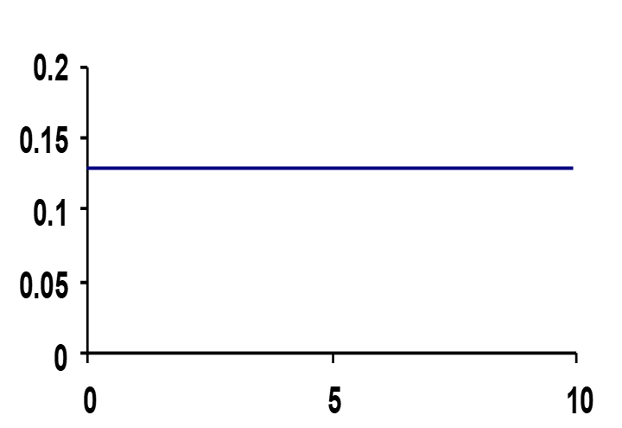
Constant Rate
Example: Mortality in biliary cirrhosis cohort
Average incidence rate, calculated previously, was 0.13 deaths per person-year. If this rate is strictly constant, this is what a plot would look like:
Deaths per person-year
Follow-up time, years
Notes:
This is a plot of the incidence rate, assuming that it is constant throughout the study, of mortality in the biliary cirrhosis fixed cohort study introduced last week.
Note: this is not a plot of the actual empiric data but instead is our plot of what a constant rate would look like.

Slide 60
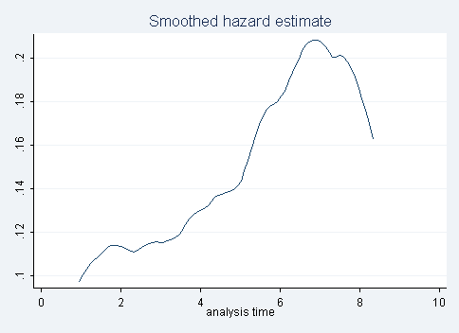
Constant Rate
Mortality in biliary cirrhosis cohort study
Deaths per person-year
Follow-up time, years
Follow-up time, years
Rate at each time-point: Reveals reality that incidence rate is not constant
Left hand graph is idealized if rate were constant
Right hand graph depicts the actual data
Notes:
In fact, the incidence rate of mortality during the follow-up period in the biliary cirrhosis cohort was not constant. On the right is the graph of the instantaneous incidence rate over time (which is called the “hazard”). This is what occurred in reality, estimated directly from the individual-level data. We will explain how to generate this plot in a moment. On the left is the plot which shows the rate if it were indeed constant.
It is clear that the incidence rate of mortality in this fixed cohort study was not constant throughout follow-up. Of note, it is rare that actual data will display a true straight line, like the plot on the left, and we do not need to see an absolutely straight line to call it a constant rate. In our example, however, the empiric rate over time is clearly non-constant; it is clearly changing substantially.

Slide 61
Assumption for meaningful interpretation of average incidence rate i.e., what do we need for average incidence rate to be relevant?
Average incidence rate is an attempt to have 1 number represent the incidence rate over a period of time in which it was derived
Therefore, average incidence rates have the most relevance and utility if they represent rates that are constant over time in the interval in which they were derived
Whether or not rates are constant or not over time requires direct assessment of instantaneous rates
  Can only be directly assessed when we have individual-level data
  If we just have “group” data, we cannot directly assess how rate changes over time. We can only speculate if it is constant.
    The longer the time period, less likely that the rate can be assumed to be constant.
Notes:
We are now in a better position to understand what we said earlier about average incidence rates. That is, average incidence rates attempt to have one number represent the incidence rate over a period of time. Such an average rate will be most relevant and meaningful if it is applicable over the entire time period, in other words, if the rate is constant over time. If the rate is not constant, then it is not the case that the average incidence rate is incorrect or invalid in most contexts; it is just less informative.

Slide 62
Instantaneous Incidence Rate
Prior plot had as the y axis the “incidence rate”, but more specifically this is “instantaneous incidence rate” aka “hazard”
Deaths per person-year
Follow-up time, years
  − Rate that occurs in an infinitely small period of time, the instantaneous rate, given that the individual has not had the event up to time t
Plot shows what is called: hazard function or h(t); expresses how hazard changes over time
Notes:
The plots in several of the prior slides and on this slide show incidence rate on the y axis and time on the x axis. This leads us to the other form of incidence rate, the instantaneous incidence rate. The incidence rate being plotted on the prior figures are instantaneous incidence rates. Estimation of this incidence rate requires individual-level data. The instantaneous incidence rate is more commonly known as the “hazard”. You may be aware of this term, hazard, from the regression technique called the “proportional hazards model”.
A hazard is defined as a group’s instantaneous probability of the event at time t, given that the persons were at risk at time t. Or, in other words, conditional on the person being still at risk at time t.
The hazard function, h(t), is the relationship of the hazard across/over time.

Slide 63
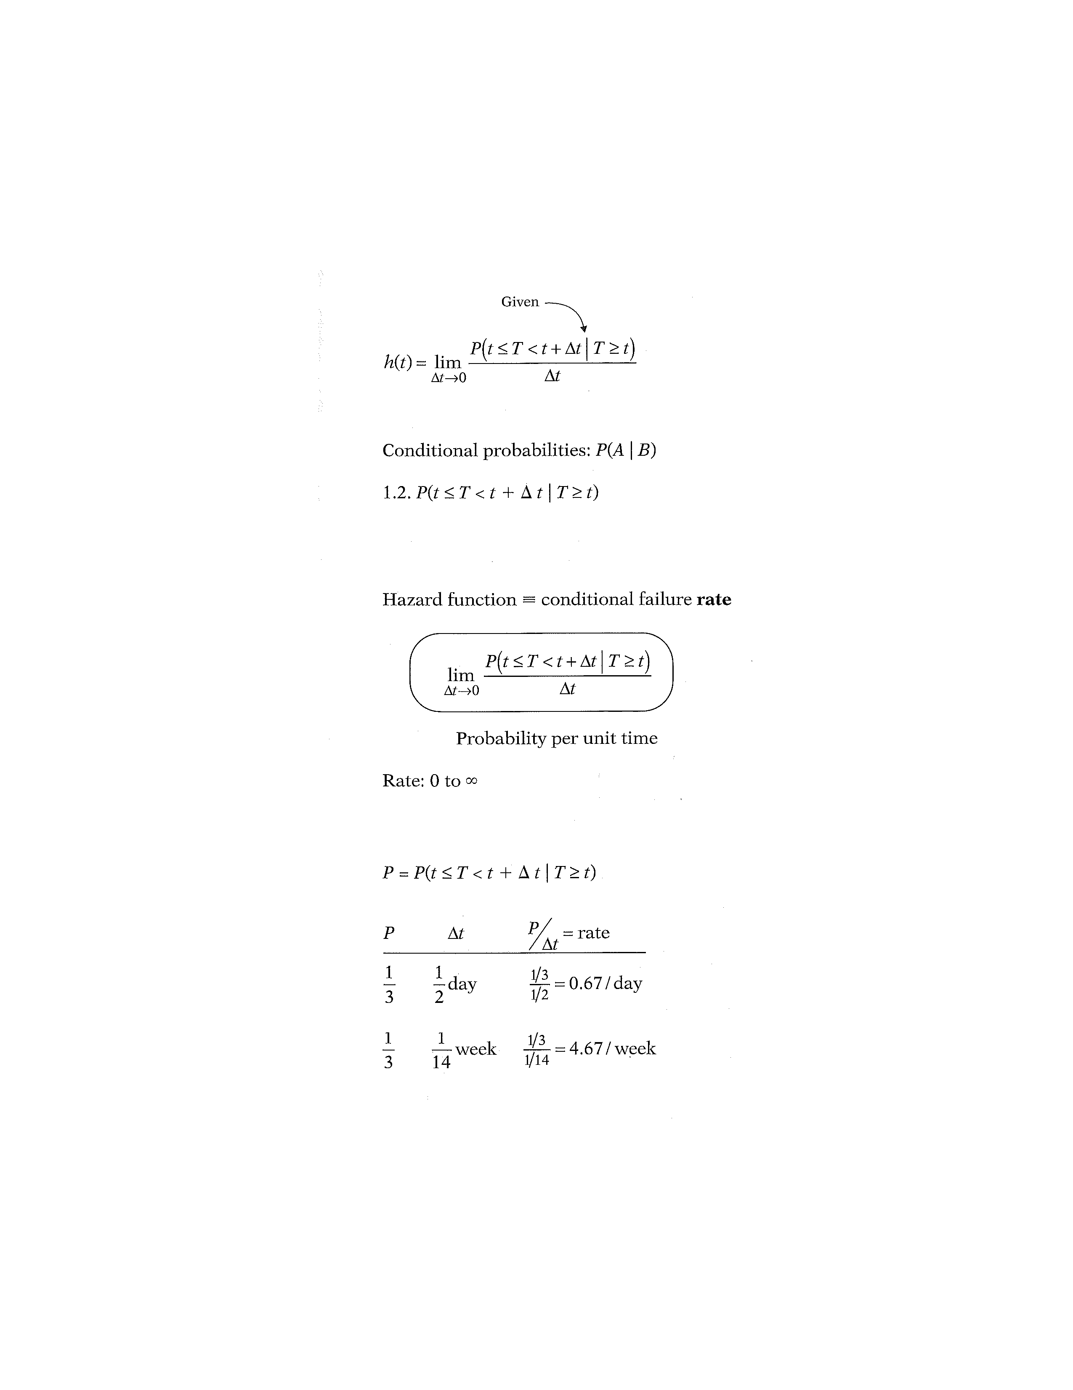
Hazard Function
(a type of Conditional Failure Rate)
Probability of the event (T) occurring in the interval between t and (t + Δt)
Numerator is a conditional probability, of the form:
Probability that the event will occur in the time interval between t and t + Δt, given that the survival time, T, is greater than or equal to t. Or, the probability that if you survive to t, you will succumb to the event in the next instant (Δt).
Notes:
Here is the mathematical formula for a hazard function. In mathematical terms, the “given” (which is meant by the word “conditional”) part of the formula for the hazard function is depicted by a long vertical line. This vertical line is found in the probability statement, the numerator to the right of the limit sign. This probability statement is called a conditional probability because it is of the form, P of A, given B, where the P denotes probability and where the long vertical line separating A from B denotes “given” or “conditional upon”.
In the hazard function formula, the conditional probability gives the probability that the event (T) will occur in the time interval between t and t + Δt, given that the survival time, T, is greater than or equal to t. In other words, the hazard is the probability of having the event in the next infinitely small interval, given that you have survived to the start of the interval. Because of the “given” sign here, the hazard function is sometimes called a conditional failure rate, meaning conditional on surviving without the event to time t. You have seen conditional probability before in our calculation of the Kaplan-Meier and life table estimates of cumulative incidence.
The numerator is then divided by the small Δt, which is time.

Slide 64
Denominator is time
Hazard function is a conditional failure rate.
Conditional probability per unit time
Notes:
We now explain why the hazard is a rate rather than a probability. Note that in the hazard function formula, the expression to the right of the limit sign gives the ratio of two quantities. The numerator is the conditional probability we just discussed. The denominator is Δt, which denotes a small time interval. By this division, we obtain a probability per unit time, which is no longer a probability but a rate. In particular, the scale for this ratio is not 0 to 1, as for a probability, but rather ranges between 0 and infinity, and the value depends on whether time is expressed in days, weeks, months, or years, etc. You might ask why does the value matter whether time is measured in days, weeks, months or years if the point is that time is very small. The answer is that the value is estimated in a very small period of time but then can be expressed in anyone of a variety of person-time units. Expressing in a variety of person-time units simply scales the value up or down. The value in person-months will be different than person-years than in 100 person-years.
Sometime observers think that because the time period is so small that the magnitude of the value should be small. This would be correct for a probability but it is the wrong interpretation of the meaning of a rate. Rates inherently capture the pace of new events in a population of people being observed. At every new moment in time there is a rate of disease incidence. Think of that pace like the velocity of a car. At any moment in time a car has a velocity, just like a population has a rate of occurrence of a particular disease. Rates can be expressed in different ways (cases per person-year or 100 person-year or 1000 person-year) but these all describe the same fundamental pace of occurrence. The expressions are just a way to make humans more able to understand them.

Slide 65
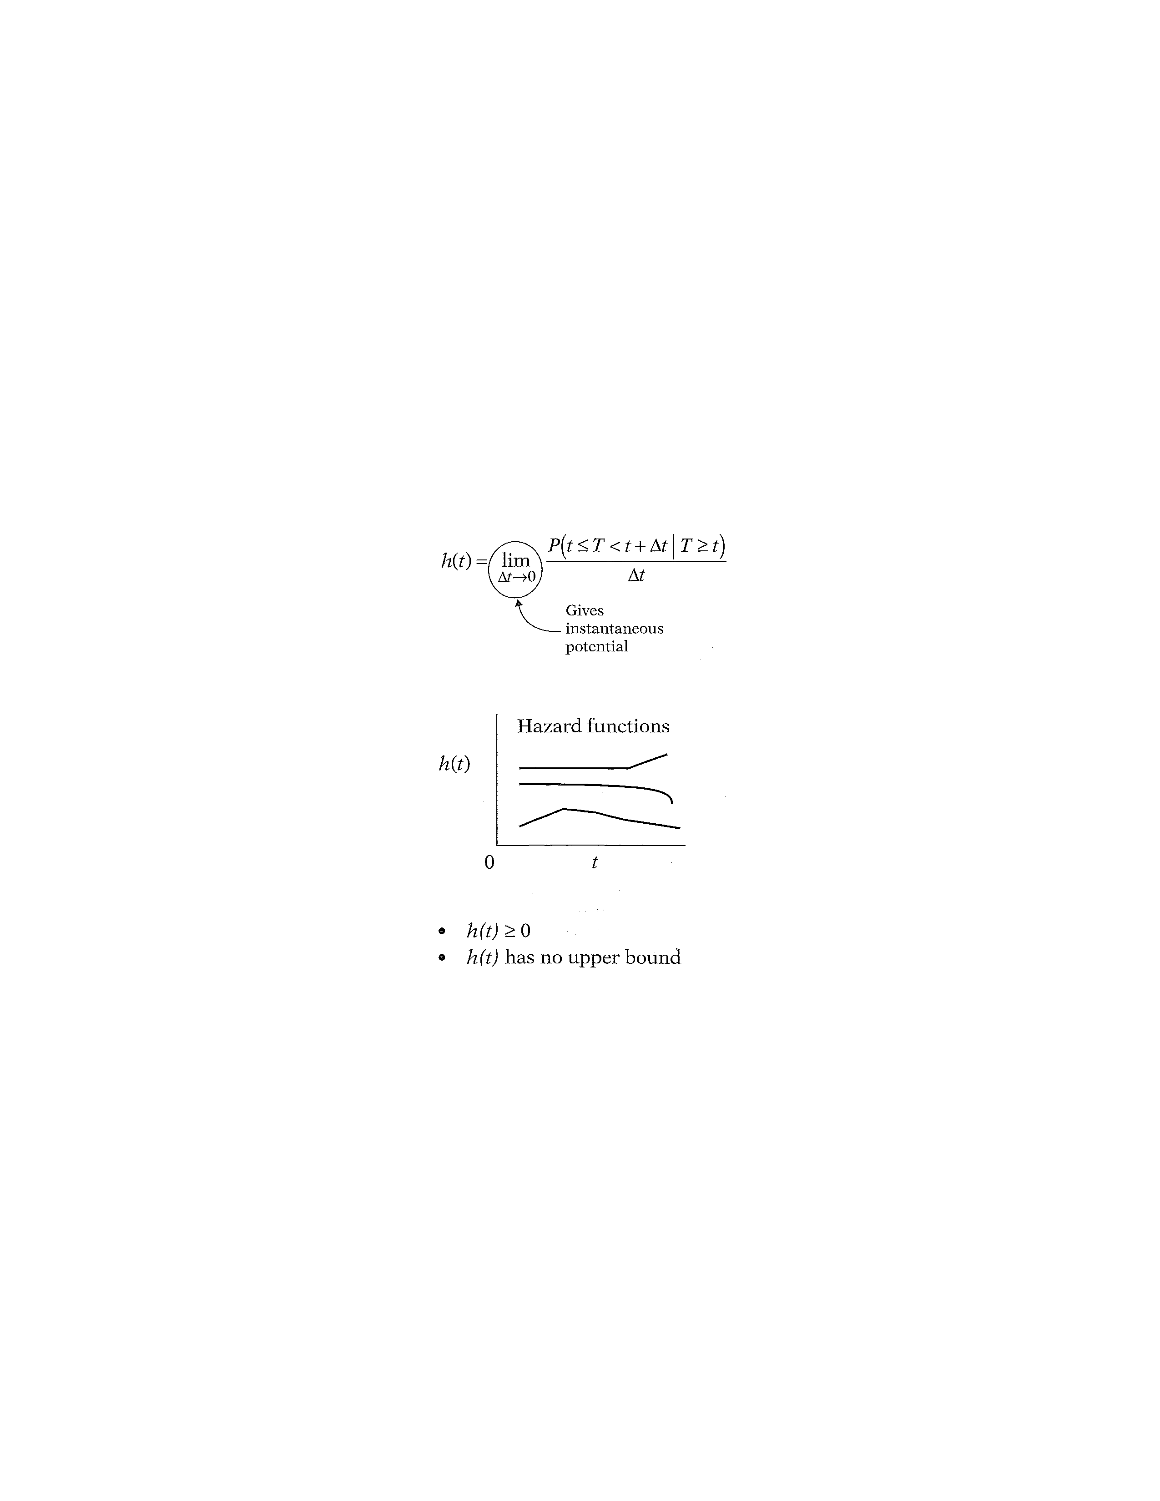
Hazard Function
(Instantaneous rate of some event)
Calculated as the duration of the time period approaches 0. This is what makes it “instantaneous”.
Average rates are macroscopic in that they are directly calculated over time durations that humans can understand with simple math
Instantaneous rates cannot be directly calculated with simple math; they can only be derived mathematically with techniques of calculus
Notes:
When we take the limit of the right-side expression as the time interval approaches zero, we are getting an expression for the instantaneous probability of failing at time t in a very small period of time. Another way of saying this is that the conditional failure rate or hazard function h(t) gives the instantaneous potential for failing at time t per unit time, given survival up to time t. As you can see from this formula, estimating the hazard rate at a given point in time requires calculus and cannot be hand calculated directly from the data with simple math — as we did for the average incidence rate. We will not, however, be doing any calculus ourselves in this course, Instead, we will use statistical software to do this for us.

Slide 66

Hazard function: Conditional probability of event in infinitely small time interval
CE
CE
∆ t
∆ t
∆ t
Initial Cohort
Cohort at the end
of Follow-Up
Time since enrollment
Notes:
If we think about how this would look in our schematic of a fixed cohort, we start here with time interval Δt. We could calculate the conditional probability of the event in each time period, i.e., the probability conditional on having survived without the event to the start of the interval. Then, imagine that we make the time interval smaller and smaller ⎯ as shown on the next slide.

Slide 67
Hazard function: Conditional probability of event in infinitely small time interval
CE
CE
∆ t
∆ t
∆ t
∆ t
∆ t
∆ t
∆ t
∆ t
Initial Cohort
Cohort at the end
of Follow-Up
Time since enrollment
Notes:
Now, we show even shorter intervals. As in the previous slide, we could calculate the conditional probability of the event in each time period. But, we imagine making the intervals even shorter. At this juncture, we need calculus to estimate the actual value, what we call the “hazard”.

Slide 68
When time interval goes to zero
Example: Mortality in biliary cirrhosis cohort study
Hazard (deaths per person-year)
Follow-up time, years
Each point on the line represents the hazard at that time. i.e. instantaneous probability of mortality at that moment in time, conditional on surviving to that time point.
Notes:
As we reduce our time interval towards zero, we end up with the hazard for our event. Here is the slide we showed earlier as an example of the hazard, in this case from the hazard of mortality in the biliary cirrhosis cohort study example that we showed last week. The curve was estimated using calculus and smoothing. Each point on the line represents the hazard at that time, which is the instantaneous probability of mortality at that moment in time, conditional on surviving to that time point. A hazard is a rate, and the units of the hazard here are deaths/person-year (more generally, the units for any rate are events per person-time).

Slide 69
Properties of Hazard Function
t can be calendar time (as in a dynamic cohort); observation time (as in a fixed cohort); or age
Notes:
The hazard function, h(t), is graphed as t ranges over some construct of time; t can be calendar time (as in a dynamic cohort) or time since enrollment in a fixed cohort, or even age. The graphs above illustrates two different hazards. In contrast to a survivor function, the graph of h(t) does not have to start at 1 and go down to zero, but rather can start anywhere and go up and down in any direction over time. In particular, for a specified value of t, the hazard h(t) has the following characteristics:
° it is always nonnegative, that is, equal to or greater than zero;
° it has no upper bound.
These two features follow from the ratio expression in the formula for h(t) in the prior slides. A hazard is non-negative because both the probability in the numerator and the Δt in the denominator are non-negative. It has no upper bound because Δt is a very small non-zero number.

Slide 70
Hazard function for mortality in general U.S. population
Compare information provided here versus depicting this with an average incidence rate. The average is not wrong; just less useful.
Notes:
It is useful to be able to see the shape of a hazard function. This graph illustrates a hazard function with a 'bathtub shape’, or, at least, the semblance of a bathtub. This graph is depicting the hazard function for death in the general U.S. population over the lifespan. Notice that here age is the time on x axis. Hazard is high shortly after birth but drops rapidly and remains at a relatively low level during youth and middle age. Hazard starts to rise later in life and increases steadily. This is a natural way for us to depict a construct that is changing over time.
Other metrics of interest, such as the survival function, can be derived from the hazard. Once we have obtained the hazard, we can easily obtain these other functions of interest. The hazard function is the basis for proportional hazards regression model.
Note how much more this plot tells you than can be understood from an average incidence rate when incidence is not constant. An average incidence rate gives you one number — by definition. Does one number adequately depict what is going on in this plot? No. This one number is not wrong; it is just that it is not very useful. This illustrates how when the underlying hazard function is not constant, the average incidence rate falls short of being fully informative.

Slide 71
Estimating hazard function in Stata
Example: Mortality in biliary cirrhosis cohort
Deaths per person-year
Follow-up time, years
Using a dataset identified to Stata as survival data, Stata command is
sts graph, hazard
Notes:
Here is the plot we showed earlier showing the instantaneous incidence rate (hazard) of mortality in the biliary cirrhosis cohort. How exactly do get this? The Stata command to generate this plot is “.sts graph, hazard”. The drop-down menu can also be used: Graphics, Survival analysis graphs, Smoothed hazard estimate.
Generating this plot requires calculus and smoothing. The plot can be easily derived in Stata, but it would be very hard to do by hand.

Slide 72
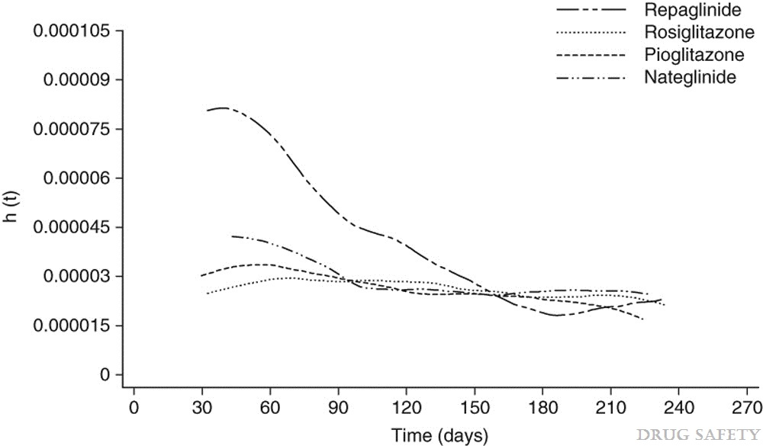
Example: Hypoglycemia with Antidiabetic Drugs
Methods: …Observation time for each patient and incidence rate (IR) per patient-years of treatment for hypoglycaemia was calculated for each drug cohort. Smoothed hazard estimates were plotted over time...
Hazard of hypoglycemia over time, by drug
h(t) = hazard at time t
(Would be better if units were provided on y axis)
Vlckova et al. Drug Safety 2009
Notes:
Here is an example of a published report that included a plot of the hazard. Use of these plots is growing in the literature now that software has caught up to the computationally heavy procedure required to perform the calculation and then the smoothing that is required to make it readable.
The aim of this study was to quantify the incidence of hypoglycemic events and to describe the pattern of these incident events during the first 9 months of treatment with four oral antidiabetic drugs, rosiglitazone, pioglitazone, nateglinide and repaglinide, prescribed in general practice in England.
The authors stated “The smoothed hazard plot depicted in figure 1 shows that the incidence of hypoglycaemia in patients treated with rosiglitazone was approximately constant over time. A slight decrease in hazard over time is observed in patients receiving pioglitazone. Patients treated with repaglinide experienced more hypoglycaemic episodes at the beginning of their treatment. Similarly, patients treated with nateglinide tended to have more hypoglycaemic episodes after starting the treatment but the difference was not as pronounced as it was for repaglinide.“
This plot could be improved by providing units on the y-axis that are more easily interpretable. For example, this could be “1.0, 2.0, 3.0 … per 100,000 person-years.” The very small values (e.g. 0.000015) are difficult for readers to follow. Most likely, the authors simply used the plot from the software package without paying attention to appropriate units for the axes. The journal editors were also similarly naïve.

Slide 73
Disease occurrence
Prevalence
Point
Period
Incidence
Cumulative incidence
Incidence rate
Simple proportion
Kaplan-Meier
Life-table
Aalen-Johansen
Average incidence rate
Instantaneous (hazard) rate
Notes:
Going back to the flowchart for our lectures on Measures of Disease Occurrence, we have covered how to estimate cumulative incidence and incidence rate. Next, we examine the relationship between cumulative incidence and incidence rate.

Slide 74
Cumulative incidence and
Incidence rate (average and hazard)
K-M cumulative incidence
Hazard
Deaths per person-year
Same underlying data, presented in 3 ways
Average incidence rate = 0.13 deaths per person-year
Notes:
We have now covered three ways of measuring incidence, illustrated on this slide using the example of mortality in the biliary cirrhosis cohort study. On the left is the Kaplan-Meier cumulative incidence curve that we saw last week. The plot on the right is the hazard function that we just finished explaining. We can also report the average incidence rate of death which we calculated earlier as 0.13 deaths per person-year.
How are these 3 measures — derived from same dataset — related?

Slide 75
Difference between Hazard and Cumulative Incidence
Hazard can be thought of as how likely an event is to happen at any moment in time (“force of morbidity”)
Cumulative incidence is the result of applying that hazard to a fixed cohort for a specified duration
Analogy:
  Velocity of a car ⎯ “speedometer” (hazard) vs
  Distance traveled in a certain time – “odometer” (cum. incidence)
Hazard can be constant or changing over time. Can vary from 0 to infinity
Cumulative incidence can only increase or stay steady
Notes:
It may help in understanding the difference between the hazard and cumulative incidence to think of the hazard as how likely an event, such as death or a disease diagnosis, is to occur at any given moment in time (the moment-to-moment instantaneous incidence) and to think of the cumulative incidence as the result of applying that instantaneous rate to a fixed number of persons for period of time. Thus, the rate can be thought of as the most fundamental measure of disease incidence, something captured rather metaphorically by older more colorful descriptions of a rate as the “force of morbidity” or the “force of mortality.”
The cumulative incidence can only be constant as long as no new event occurs, but every time an event occurs, the cumulative incidence has to increase. Remember, cumulative incidence applies to some fixed group of people who are followed for a specified time period. It is a fixed cohort phenomenon.
As an analogy, consider the difference between the velocity of a car, indicated on the speedometer (analogous to rate or hazard), and the distance traveled within a certain time period, indicated on the odometer (analogous to cumulative incidence).

Slide 76
Relationship between Constant Hazard and Cumulative Incidence
A constant hazard (rate) produces an “exponential” cumulative incidence (or survival) function
If know the constant incidence rate, can derive the cumulative incidence/survival function or vice-versa from the “exponential formula”
where S(t) = cumulative survival and
F(t) = cumulative incidence
e = 2.71828; λ = rate; t = time units
Assumes no competing events
Notes:
There is a mathematical relationship between rate and cumulative incidence. For the special situation of a constant rate, it is represented by this formula. If the rate is constant, applying that rate to a given number of persons for a given time period produces a cumulative incidence that follows an exponential distribution given by the formula above, where F(t) = the cumulative incidence, e = 2.71828, λ = the rate per the person-time units, and t = the number of time units. Remember that F(t) and S(t) are bounded by 0 and 1. This formula is called the “exponential formula.” The proof for this can be found elsewhere (such as advanced textbooks on survival analysis).
Please note that this assumes no competing events. This is symbolic of many of the classic mathematical formulae of survival analysis which were derived under ideal circumstances. Real-world human populations often do not act in ideal ways, however, and suffer from competing events. If there are competing events, the exponential formula will not yield valid results.

Slide 77
Constant Rate Results in Exponential Survival
Hazard
Cumulative incidence
Cumulative survival
Cumulative survival
Cumulative mortality
1 2 3 4 5 6 7 8 9 10
Notes:
These figures illustrate the relationship the between a CONSTANT incidence rate and cumulative survival. A constant incidence rate (top panel) produces a what is called an “exponential” survival curve (lower left panel) and exponential cumulative incidence curve (lower right panel) when applied to a fixed cohort. Note how the exponential survival and incidence curves are not straight lines, but, in fact, are curves.

Slide 78
Relationship between hazard function and survival function with a constant hazard
where h(t) = λ
Assumes no competing events. In the presence of competing events, this direct relationship between hazard and cumulative incidence no longer holds. More on this in later slides.
Notes:
Here is the relationship between the hazard function and survival function, shown again, when the hazard is constant. If the hazard function is constant, i.e., h(t) = λ, then it can be shown that the corresponding survival function is given by the following formula: S(t) equals e to the power minus λ times t.
Of note, this also assumes no competing events. If we think of this constant hazard rate being applied to a population to produce cumulative incidence, then those who experience a competing event are removed from the population and this rate is no longer being applied to everyone. In other words, if there are competing events, the relationship no longer holds because there is nowhere in the formula where these losses are being accounted for. If there are competing events arising in a fixed cohort study but this formula is nonetheless naively applied, then cumulative incidence is going to be overestimated in comparison to what really occurred in the population (i.e., the event of interest is not occurring in those with a competing event).
With this formula, you can take an average incidence rate from an article and turn it into a cumulative incidence (which is typically more understandable by most humans). Two examples follow.

Slide 79
From average incidence rate to cumulative survival/incidence
Previous example: Biliary cirrhosis time to death data
Average incidence rate = 0.1285 deaths per person-year
Use average incidence rate to determine 10 year cumulative survival
S(t) = ℮(-0.1285 deaths/person-yr * 10 yr)
= 0.277 = cumulative survival over 10 yrs
Cumulative survival (10 yrs) from K-M: 0.237
Values are close but not identical. Why?
Notes:
We can use the average incidence rate to determine cumulative incidence in a fixed cohort after any duration of observation. In the biliary cirrhosis dataset, we are interested in time-to-death. The average incidence rate of mortality = 0.1285 deaths per person-year. Let us say we are interested in a time interval of 10 years of observation. The estimated cumulative survival over 10 years with the exponential formula is 0.277, which is close to the value based on Kaplan-Meier estimation (0.237).
The reason that the result from the exponential formula does not exactly match the K-M estimate is because the hazard is not truly constant (as shown on an earlier slide in which we plotted hazard over time).

Slide 80
Survival and Hazard
cumulative hazard
Does not require constant hazard
Notes:
More generally, the relationship between S(t) and h(t) can be expressed in either of two formulae shown here. The first of these formulae describes how the survivor function S(t) can be written in terms of an integral involving the hazard function, which is sometimes called the “cumulative hazard”. The formula says that S(t) equals the exponential of the negative integral of the hazard function between integration limits of 0 and t. The exponential formula, shown in prior slides, is just a simplified version of this in which the hazard is constant and does not need to be integrated over time. When hazard is constant, the integral of the hazard function from 0 to t is simply the constant hazard time t (the area under the curve is simply the height times the length). This general formula no longer requires the hazard to be constant.
The second formula describes how the hazard function h(t) can be written in terms of a derivative involving the survivor function. This formula says that h(t) equals minus the derivative of S(t) with respect to t divided by S(t). We are not surprised to see a derivative here for the calculation of hazard. That is, we are looking for essentially how the survival function is changing in a very small time period when restricted to those who have survived up to that time.
In the first formula, the quantity in the integral is what is called the "cumulative hazard", an entity that is used in other survival analysis contexts. We will not discuss it more in our course other than to say …

Slide 81
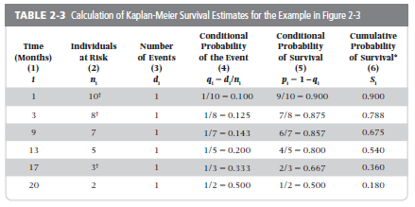
Sum these to get “cumulative hazard”
Notes:
We have actually seen how to get this quantity of the “cumulative hazard”. At any point in time, the cumulative hazard is just the sum of all the conditional probabilities of the event, which is the column circled in red. Unlike a single probability, this sum can be greater than 1. We mention the concept of cumulative hazard for completeness (i.e., you may it in some more advanced statistical handling of this topic), but it does not come up often in practical applications in clinical research or epidemiology.
81

Slide 82
Which depiction of incidence is best to show?
K-M cumulative incidence curve
Hazard
Deaths per person-year
10 year cum incidence = 0.76
Hazard at 7 years = 0.21 per person-year
Average incidence rate = 0.13 per person-year
Notes:
Let us refer back to the 3 ways that we can express incidence for our example of mortality in a cohort study of patients with biliary cirrhosis. The plot on the right is the hazard function. On the left is the K-M cumulative incidence curve for the same data. We could also report the average incidence rate of 0.13 deaths per person-year. These are 3 main forms of describing incidence that we have discussed. Each of the two plots can also be used to attempt to summarize cumulative incidence or hazard with one number. For example, we could say that the cumulative incidence of death is 76% at 10 years. Or, we could say that the hazard at 7 years is 0.21 per person-year. So, there are really 5 ways.
Which depiction is best to show? When earlier describing the K-M plot, we stated that a picture is worth a thousand words. Hence, the plot of cumulative incidence is far superior to a single estimate at a single point in time. The same things can be said about the hazard plot. Presenting a single point from the hazard function is very unsatisfying, unless there is a constant hazard. The K-M curve and plot of the hazard function are based on the same data but present the findings quite differently. For most of us, it is difficult to make the mental leap from this cumulative survival curve to the underlying hazard rate, or vice versa. In other words, the two plots give us different information. Finally, the average incidence is only informative if it is constant.
Which plot or metric to show your audience? This depends upon the context. If you are writing an abstract and can only write text and not show a figure, then the cumulative incidence at a few time points is likely the best way to go (e.g., cumulative incidence was 10% at 1, 15% at 3 years and 40% at 5 years). If you only have room for one plot, it is hard to say but the K-M plot is likely most informative in most contexts (although not all). If space allows, however, as it usually does in a manuscript, then showing both plots would be the best solution since they provide different information. If you are not familiar with the hazard plot, it is not surprising because it is not currently performed in the biomedical literature as often as it should be. This will undoubtedly be changing as more applied workers are educated about it.

Slide 83
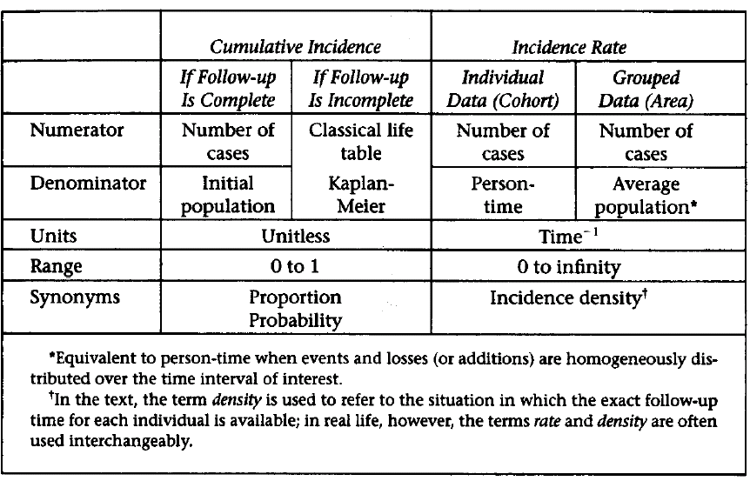
Cumulative Incidence vs Average Incidence Rate
Average Incidence Rate
Risk
Incidence proportion
Rate
Notes:
This is a useful table from the S+N text that summarizes the characteristics of cumulative incidence versus average incidence rate. We have added “risk” as a synonym for cumulative incidence and “rate” as a synonym for incidence rate. Note that 'incidence proportion' is also a fine synonym for cumulative incidence.
One clarification: For the calculation of average incidence rate for by grouped method, the “average population” needs be multiplied by the time interval of interest and which was used to count the cases (e.g., 1 year) to yield the person-time.

Slide 84
Rates: What to do about
Drop-out and Competing Events?
In the calculation of rates, people contribute person-time until they either have the event of interest (E) or:
  drop out (aka lost to follow-up)
  are administratively censored (i.e., study ends)
  have a competing event
Thus, without any special assumptions, rates have a specific interpretation:
  “Rate of the event E given that something else (drop-out; admin censoring, or competing event) has not happened first”
  i.e. “Rate of event E among those still at risk (i.e. without those who dropped out, are admin censored, or had CE)”
  This interpretation is inherently accommodating (i.e. specifically recognizing and allowing for) presence of drop-out; admin censoring; and competing events
Notes:
We spent a lot of time last week during the discussion of cumulative incidence about what to do about drop out (i.e., losses to follow-up) and administrative censoring. We also talked about what we needed regarding competing events in order to perform the Kaplan-Meier and life table estimations. What should we do about drop out, administrative censoring, and competing events in the context of rates?
If we step back for a moment, remember that in our calculation of rates thus far, persons contribute person-time until they either have the event of interest or they drop out, are administratively censored (i.e., the study ends) or they have a competing event. Thus, without making any special assumptions, rates have a specific interpretation. That is, the interpretation is: “Rate of the event (E) given that something else (drop-out; administrative censoring, or the competing event) has not happened first.”
We say that this interpretation is inherently accommodating for drop out, administrative censoring, and competing events. That is, this interpretation recognizes that these events occur and allows for them.

Slide 85
Is native interpretation of rate meaningful for descriptive objectives?
i.e., Do we want to accommodate (allow for) administrative censoring; competing events; and drop-out?
  Or, would we prefer if they never happened (i.e., were eliminated)?
Threat | Discussion | Conclusion
Administrative censoring a) those followed for entire period of study b) those with delayed entry; not followed for entire period | All studies must end, and study end is typically unrelated to substance of study itself (i.e., end is just an artifact) | Appropriate to accommodate
Competing events | A fact of life Difficult to envision a reality without such events | Appropriate to accommodate
Drop-out | Unfortunate manifestation of studying humans Concern about how often the event occurs after drop-out Have a sense that harder work could have prevented | Usually, prefer to eliminate (Exception: descriptive studies in certain dynamic cohorts)
Notes:
Is this native interpretation of rate meaningful for descriptive objectives? We emphasize for descriptive objectives because things are different when we use these measures in analytic work.
When we say “meaningful”, what we mean is how do we feel about accommodation, allowing for these things (administrative censoring; competing events; drop-out) to happen? Or, would we prefer if these things never happened, in other words, if they were eliminated? Note: by eliminate, we do not mean to eliminate the people from the analysis. In fact, you never want to eliminate people entirely from your analysis because of something that happens after time 0. We are just referring to eliminating the occurrence of the censoring or competing event.
Let us look at all 3 of them individually. First, administrative censoring. We recognize that all studies must end, and the end of a study really has typically nothing to do with the events of the disease process itself. It is just an artifactual end. Given this, it is appropriate to accommodate administrative censoring. This is especially true when the subject has been followed for the maximum duration of the study. For a person with delayed entry, it would have been nice if we had a chance to follow them for the entire duration, but, even in this case, we are typically fine with accommodating this situation. An exception to this latter situation is in a fixed cohort study if there are secular trends in the occurrence of the outcome. Recall the example regarding fracture incidence in Rochester, Minnesota studied over a 24 year period. With staggered entry and a single administrative ending in 1994, we are left with only those persons who entered at the beginning of calendar period contributing observation time at the latter observation period (the last 20 to 24 years, for example). To the extent they are different than the other participants, rates that are estimated between years 20 and 24 are not representative of all members of this cohort. We would have preferred if everyone without the event (or competing event) had the same length of follow-up.
Second, competing events. We recognize that competing events are a fact of life. It is difficult to envision a reality without such events. Thus, we are typically willing to and it is appropriate to accommodate competing events when the objective is descriptive. There may be certain situations, such as longevity of devices (that we discussed last week), in which we would like to eliminate competing events, but these are exceptions.
Finally, how about drop-out? Drop-out is an unfortunate manifestation of studying humans. We are always wary about how often the event of interest occurs after drop out. We also have a sense that harder work on our part could have prevented drop-out. Because of this, for most descriptive objectives, we wish we could eliminate drop-out and are not willing to blithely accommodate for it. The desire to eliminate drop-out is certainly the case for fixed cohort studies because if the rate of the event amongst the drop outs is different than the rate of those who remain (i.e. informative censoring), then using those who remain to represent the rate of the event for everyone who started at the beginning of the fixed cohort will result in the wrong answer.
The one exception to preferring elimination for drop outs (i.e., we will accommodate or except the drop outs) are dynamic cohorts in which we are only interested in the burden of the condition in that specific population amongst those in the dynamic cohort at the time and we are not trying to generalize to other similar populations. An example of this would be trying to plan for the burden of cancer care (say, for pancreatic cancer) in San Francisco. In this example, the dynamic cohort of San Francisco is defined as being “open to the right” with leaving the cohort (moving out of San Francisco) to be expected. Thus, we only care about estimating incidence of pancreatic cancer amongst those who remain. In this instance, drop-outs do not bother our descriptive estimates; we expect them. However, if you were using San Francisco to estimate the incidence of pancreatic cancer in the general population in the U.S., then you would have to be concerned about drop outs. For example, what if the symptoms of pancreatic cancer caused a person to lose his job and then have to move out of San Francisco. This would mean that the drop outs would be enriched for cases of pancreatic cancer and those who remained would not represent everyone; we would end up underestimating the rate of pancreatic cancer in the U.S. general population.
On the other hand, when analytic objectives are in play (relating exposures to outcomes), drop-outs may be a source of bias in all settings and we hope to eliminate them.
This discussion illustrates how it is critical to be specific about whether the objective is descriptive or analytic and what the specific research question is and exactly which underlying populations are we interested in making inferences about.

Slide 86
In a rate calculation, what does it mean to prefer elimination of drop-out?
Means that you are not satisfied with:
  “Rate of the event E given that drop-out has not happened first”
  Wise to be unsatisfied because we are wary about the drop-outs for many research objectives. It is hard to be sure that those who remain are representative of all who started observation.
You wish you could say:
  “Rate of the event E assuming drop-outs don’t occur/were eliminated”
But because drop-outs, in reality, often do occur, the only way we can be satisfied with the accommodation that is inherent in the definition and calculation of a rate is if:
  We assume that the rate of the event of interest in the lost is the same as those who remain (i.e., those who remain truly represent those lost)
  Same “non-informative censoring” assumption used in cumulative incidence
Notes:
Let us discuss elimination of drop-out a bit more. What does it mean in a rate calculation to hope for elimination of losses to follow-up (drop-outs)? It means that you are not satisfied with the native interpretation of a rate, which is that “Rate of the event E given that drop-out has not happened first”. If you are unsatisfied with this interpretation of rate, you should be because it is a messy statement for most research objectives. The statement “Rate of the event E given that drop-out has not happened first” means that you are comfortable with calculating incidence using just those who remain in the analysis. Aside from dynamic cohorts for which do not seek to generalize externally (see next slide), we are rarely comfortable with accommodating rates because we are worried about what is happening with the drop outs. Therefore, what you would prefer to be saying is that it is the rate of event assuming drop-outs don’t occur (an elimination approach).
Yet, in reality, drop-outs do occur. Thus, how can we move forward and be OK with the accommodation of drop out that is inherent in the definition of a rate? In other words, we are stuck with how rates are calculated mathematically. Rates add up events and divide by person-time; they are naturally accommodating for when a person moves out of the cohort. Yet, how can we be satisfied with this and get a meaningful answer from rates in the face of drop outs? The only way we can do this is to assume that we know what is happening to these losses and that we assume that the incidence in the lost is the same as those who remain. This is the same assumption of non-informative censoring that we learned for cumulative incidence calculated by Kaplan-Meier or life table estimation last week.

Slide 87
Sometimes we are happy to accommodate departures from a cohort and do not need to make any assumptions
New Members
SF residents
CE
CE
Pancreatic cancer. Average incidence rate for 2010 was 15.3 per 100,000 person-years.
Depends on goal. If only focused on SF, then accommodate; if wish to extrapolate from SF to broader US, then we would prefer to eliminate.
Jan 1, 2010
Dec 31, 2010
Time (calendar)
Notes:
The one exception to preferring elimination for drop outs (i.e., we will accommodate or except the drop outs) are dynamic cohorts in which we are only interested in the burden of the condition in that specific population amongst those in the dynamic cohort at the time and we are not trying to generalize to other similar populations. An example of this would be trying to plan for the burden of cancer care (say, for pancreatic cancer) in San Francisco. In this example, the dynamic cohort of San Francisco is defined as being “open to the right” with leaving the cohort (moving out of San Francisco) to be expected. It is also said to be “open to the left” with new residents entering San Francisco during the year. Thus, we only care about estimating incidence of pancreatic cancer amongst those who remain, i.e., those who are current residents. In this instance, drop-outs do not bother our descriptive estimates; we expect them. However, if you were using San Francisco to estimate the incidence of pancreatic cancer in the general population in the U.S., then you would have to be concerned about drop outs. For example, what if the symptoms of pancreatic cancer caused a person to lose his job and then have to move out of San Francisco. This would mean that the drop outs would be enriched for cases of pancreatic cancer and those who remained would not represent everyone; we would end up underestimating the rate of pancreatic cancer in the U.S. general population.
The current counting of new HIV infections in San Francisco is another example. Incidence of HIV infection is now published every Fall. This is known as the “Getting to Zero” campaign. The San Francisco Department of Public Health is only interested in HIV infections that occur on San Francisco grounds. That someone has lived in San Francisco and then leaves and then two months later acquires HIV infection is of no concern to the health department. It would be a concern to the U.S. CDC which has a national outlook.

Slide 88
In a rate calculation, what does it mean to accommodate competing events?
Means that you are satisfied with:
  “Rate of the event E given that a competing event has not happened first” e.g., accept that death due to MI will sometimes occur in study of cancer.
  This is a reasonable scenario for a descriptive objective.
Thus, without any effort (i.e., do our usual calculation), rates naturally account for competing events
  Include observation time until it ends with a competing event
  Don’t need to assume competing events do not occur
In contrast, recall that we had to assume no competing events (or independent ones) in a K-M estimation
Another reason to appreciate fundamental nature of rates
Notes:
Now, let us talk about competing events in a rate calculation. We said we were willing to accommodate competing events. What does it mean to accommodate competing events?
It means that you are satisfied with the native interpretation of a rate which is the rate of the event E given that a competing event has not happened first. Given that competing events are a fact of life, this is a reasonable scenario for a descriptive objective in a fixed or dynamic cohort study. It is simply describing reality. When there are competing events and we just end observation when the competing event occurs, we technically refer to this as a “cause-specific” rate (or hazard). Given that competing events basically take people out of risk for the event, it makes sense that such persons are no longer included in rate calculations after they develop their competing event. (Advanced note: there is another specialized way to handle competing events in a rate calculation, which is to leave these individuals in the denominator even though they cannot ever experience the event of interest. Such a rate is called a sub-distribution rate or hazard. This only arises in specialized contexts.)
Thus, the good news is that without any effort ⎯ i.e., just the usual rate calculation, rates naturally account for competing events. If a person develops a competing event, we just include observation time until it ends with a competing event. We do not have to live in a make-believe world where competing events do not occur.
Recall this is in contrast to what we discussed last week in the calculation of the K-M estimator, where we had to assume either no competing events or independent competing events, in order for the K-M estimation to be valid.
This more natural handling of rates is another reason to like rates and appreciate why they are so fundamental.

Slide 89
If we are willing to include all competing events in rate calculation, why not for Kaplan-Meier?
Last week: K-M valid only if no competing events or if competing events were independent of primary outcome of interest and there was a reality where they did not exist (in which case we censor)
  If competing events not independent, censoring will not give valid results
This is an approach of “elimination” rather than “accommodation.” We are assuming that we can eliminate competing events when we calculate K-M by censoring these events.
  Censoring would be as if life goes on after the competing event.
But, what if we wanted to accommodate CE and still calculate incidence?
Rates naturally accommodate CE in their standard calculation
Cumulative incidence estimated by K-M does not naturally accommodate CE
Notes:
Let us now return to Kaplan-Meier estimation. Last week, we said that Kaplan-Meier estimation was only valid if there were no competing events or when competing events were independent of the primary outcome of interest and we could envision a world in which they did not exist. In the latter situation, we could censor at the time of the competing event. Censoring at the time of a competing event is an approach of “elimination” rather than “accommodation”. This is because we pretending that the competing event did not exist (we are essentially eliminating it) and the person went on to live his/her life and still was able to experience the event of interest. He/she will simply be represented by those persons who remain in the analysis.
What if we wanted to instead accommodate the competing event and still calculate cumulative incidence? Rates naturally accommodated competing events in their calculation. Cumulative incidence by Kaplan-Meier estimation does not naturally accommodate competing events.

Slide 90
Why doesn’t K-M accommodate competing events?
For cumulative incidence, we refer to all at time 0 in fixed cohort:
People who leave fixed cohorts (via drop out or competing event) haunt us because they were present at time 0 and cannot be forgotten
  We want to know what happens to everyone who started at time 0
K-M is only valid for everyone who started if incidence of outcome of interest in those who leave is same as those who do not leave
  Because those who are censored become represented by those who remain
But, those who experience a competing event do not, by definition, experience the event of interest
  To the extent that anyone who remains in the analysis has event of interest, then they are NOT representative of those with a competing event. K-M fails.
Thus, K-M has limited usefulness in the face of competing events
  It can only “eliminate” competing events and even then, it does not work with non-independent competing events (yields biased results)
  Instead, other techniques (Aalen-Johansen), which accommodate competing events, are used to estimate cumulative incidence
Notes:
Let us examine more closely why Kaplan-Meier estimation does not accommodate competing events. To do this, we need to remember that in the estimation of cumulative incidence, we are determining the fraction of everyone who started in the fixed cohort who developed the binary outcome of interest at some time point after time 0. The key is that we are always making a statement about the entire cohort who started at time 0. Persons who later leave the cohort or stop contributing data, either via drop out or a competing event, cannot easily be forgotten about. Because they started in the cohort, we are still interested in making inferences about them. In the case of those who had a competing event, if we seek to accommodate this competing event, we will need to do something that recognizes it but still allows for an accurate estimate of the cumulative incidence of the main event of interest.
In the Kaplan-Meier approach to determining cumulative incidence, some persons may stop contributing data to the fixed cohort, either through drop out or a competing event. If they do stop contributing data, the only choice we have with conventional Kaplan-Meier estimation is to call them “censored” observations. Only those persons who remain in the cohort are contributing the data for the string of “conditional probabilities of the event” that occur after others stop contributing data. Thus, we can see that the Kaplan-Meier estimate is only valid if it is case that those who remain have the same incidence of the event of interest as those who no longer contribute.
Remember that those experiencing a competing event do not, by definition, experience the event of interest. Thus, to the extent that anyone who remains in the analysis experiences the event of interest, then they are NOT representative of those with a competing event. This is why attempting to use Kaplan-Meier estimation to accommodate competing events fails. By censoring at the time of the competing event, we use those who remain to represent the experience of those with a competing event. This is flawed, and thus the Kaplan-Meier approach cannot accommodate competing events. Kaplan-Meier can only attempt to eliminate competing events, and, even here, its utility is very limited. It is limited to situations in which there are independent competing events and a reality in which we can envision competing events being eliminated.
In order to accommodate the presence of competing events in the estimation of cumulative incidence, we need another technique, and this is called the Aalen-Johansen estimator.

Slide 91
Disease occurrence
Prevalence
Point
Period
Incidence
Cumulative incidence
Incidence rate
Simple proportion
Kaplan-Meier
Life-table
Aalen-Johansen
Average incidence rate
Instantaneous (hazard) rate
Notes:
This inability to appropriately deal with competing events in Kaplan-Meier analysis brings us to our last estimator for incidence, which is the last one on our list for cumulative incidence. This is one we said we would be getting to this week, and finally we have.

Slide 92
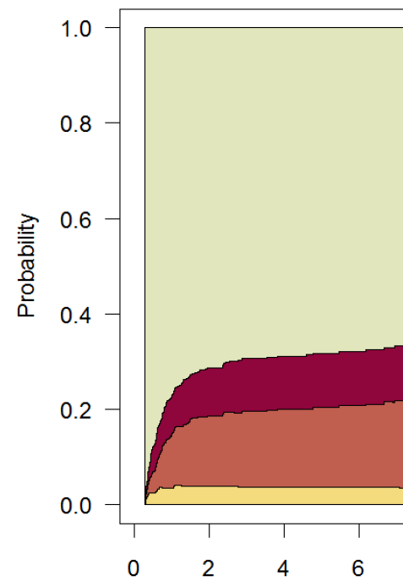
Solution for Competing Events in Cumulative Incidence Estimation
Instead of censoring at time of competing event, account for competing events explicitly as additional separate outcomes in the analysis
There is not just 1 outcome; there are two or more outcomes
e.g., Outcomes after sentencing to death penalty
In this example, there is equal follow-up on all persons; plot calculated with simple % at each time point
Alive
Death from suicide/trauma
Death from illness
Executed
Time since sentencing of death penalty
Notes:
The solution, instead of censoring at the time of a competing event, is to account for the competing risk events explicitly as additional separate outcomes in the analysis. There is not just one outcome under study as there is with K-M estimation; there are two or more. Here is an example using outcomes after being sentenced to the death penalty. The primary outcome (to our interest) is execution by the legal system, but there are also competing events: death from illness and death suicide or trauma. (Escape and decarceration are two other possibilities, but they did not occur in this population.) The way to depict this is with this multi-state probability plot. This is sometimes also called a stacked cumulative incidence plot. In this example, where we have equal follow-up on everyone, we can calculate the incidences (and then draw the plot) with just simple proportions. This example features multiple different types of competing events. It is the most general situation. Having just one competing event is a specific form of this more general situation.

Slide 93


Solution for Competing Events in Cumulative Incidence Estimation
Accounting for multiple outcomes is easy with simple %’s if there is equal follow-up on everyone (prior graph), but what if there is not?
  Typically, there will again be drop outs, staggered entry/admin censoring
Solution -- Technique known by many names, including “cumulative incidence estimate” or “cumulative incidence function”
Non-specific names have likely contributed to ignorance about it
We prefer: “Aalen-Johansen estimator”, after its originators
Odd Aalen
Soren Johansen
Notes:
Accommodating and reporting multiple event outcomes is easy if there is equal follow-up on all participants. We just form simple proportions corresponding to each event at each time point. However, as we recall, this is rarely the case because of drop outs and staggered entry/admin censoring. The death penalty example in the prior slide is an exception because of the (literal) captive nature of the study population; there was no drop out. Hence, the question is how to accommodate multiple events (a primary event and 1 or more competing events) in the face of unequal follow-up?
The solution is a technique known by many names. It is probably most often called the cumulative incidence estimate (or estimator) or cumulative incidence function (“CIF”), but it is increasingly being called the Aalen-Johansen estimator after the two statisticians who developed it in the 1970’s. (Interesting local note: Aalen did his Ph.D. work at UC, Berkeley in the early 1970’s). It is sometimes also called the cumulative incidence approach, cause-specific risk, the crude incidence curve, and the cause-specific failure probability. The term “cumulative incidence function” is a somewhat unfortunate generic-sounding name because it does not give you much to distinguish it from other estimators (as compared to the Kaplan-Meier or life table approaches, which are more distinctive and less generic). The non-specific names given to this have likely contributed to ignorance about it. For this reason, we are promoting the more memorable and distinctive name, Aalen-Johansen estimator, after the originators.
One of the original references for this technique is:
Aalen, O.O. and Johansen, S. (1978). An empirical transition matrix for non homogeneous Markov chains based on censored observations. Scandinavian Journal of Statistics 5, 141-150.
The main reason why the name Aalen-Johansen did not become more popular for this approach in biomedical research is that Aalen and Johansen were not working on the exact problem that we have been focusing on — one outcome with one competing event in the health sciences arena — at the time of their work. They were studying a much more general problem, one that featured multiple states. It was not until later that other researchers noted that their general solution was indeed what was needed to solve our narrower application. This is a different scenario than that of the Kaplan-Meier estimator where it was clear in the initial paper how the technique could be used broadly in health sciences research.

Slide 94
Solution for Competing Events in Cumulative Incidence Estimation
Key technical computation is simple. In successive time intervals:
  calculate joint probability of:
    a) experiencing none of the events (either event of interest or any of competing events) up through beginning of interval and
    b) experiencing event of interest during the time interval
  add up these joint probabilities within successive time intervals to get cumulative incidence of the event of interest
An argument could be made that this technique is all you need for cumulative incidence. It does everything that K-M can do & more.
Explained in detail in Satagopan et al. Brit. J. Cancer 2004
Notes:
Generally, the Aalen-Johansen technique involves calculating, in successive time intervals throughout the course of follow-up, the joint probability (as applied to all participants who started at time 0) of a) experiencing none of the events (either the event of interest or any of the competing events) up through the beginning of the time interval and b) experiencing the event of interest during the time interval. Then, one adds up these joint probabilities within the successive time intervals to get the cumulative incidence of the event of interest through the end of the a specific time period. This is explained in more detail in the Satagopan article, which is recommended reading for this week. We will now walk through one of the examples from the article.

Slide 95
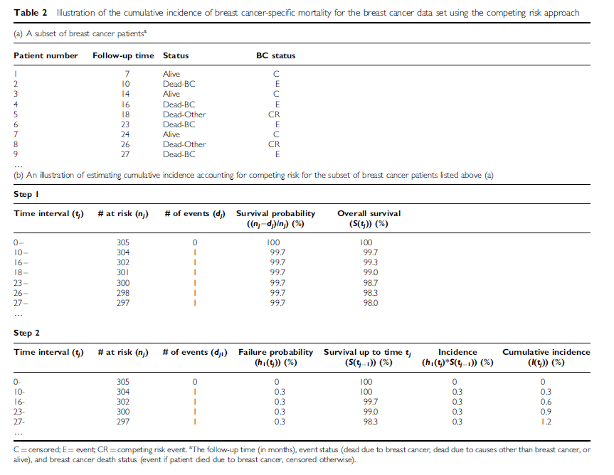
Cumulative incidence – Aalen-Johansen estimator
Satagopan et al. Brit J Cancer 2004
Notes:
Here is an example of calculating cumulative incidence taking into account competing events, taken from the Satagopan et al. article in your reading for this week. The goal of the Aalen-Johansen estimator is to obtain the probability for more than one event while also accounting for censoring (administrative and lost-to-follow-up).

Slide 96
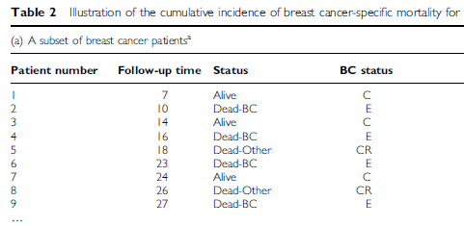
Final status of first 9 patients
Pt 1 alive at end of follow-up (C=censored);
Pt 2 had event of interest (BC death; E=event);
Pt 5 had competing event (Other death; CR = competing risk event)
Notes:
This provides the status at the end of follow-up for the first 9 participants, i.e. those with the shortest follow-up times. The first participant was followed for 7 months and was alive at that time. The participant is called a “C” for censored. The second participant was followed for 10 months until death from breast cancer, which is the event of interest in this study. The participant is classified as E for event. Patient 3 was censored at 14 months. Patient number 5 experienced a competing event ⎯ death due to a cause other than breast cancer ⎯ at 18 months. The notation is CR (for competing risk, which we said earlier is synonymous with a competing event). The status of the other 4 patients can be read off the table.

Slide 97
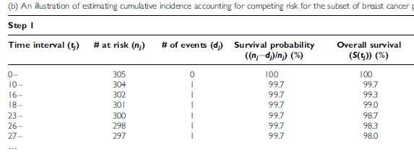
Survival without event or competing event
K-M way of thinking is used to calculate overall (cumulative) survival without event or competing event (i.e., without having anything happen). Events column includes all deaths.
Notes:
The first step in the Aalen-Johansen method is to calculate the cumulative survival (not having any event) up until the beginning of each time interval that an event or competing event occurs. The K-M way of thinking is used to calculate the cumulative survival, that is it is joint probability of not experiencing any of the events in all of the preceding time intervals.
For example, at time interval 10-, there was one event (BC death – Pt #2). The survival probability for that interval is 303/304 = 99.7%. At time interval 18- there is a competing event (Other death – Pt #5). For time interval 18- the overall (cumulative survival without developing any of the outcomes) is 1.00*0.997*0.997*0.997 = 99.0%
Hence, this table shows the calculation for the probability of having nothing happen to you through the end of the interval (or, synonymously, to the beginning of the next interval).

Slide 98
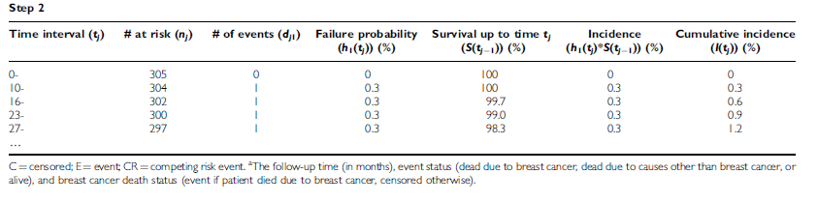
Cumulative incidence of primary event of interest
F
S
1. Failure (BC death) probability for “10-” is 1/304. Survival to 10 mos is taken from previous KM calculation (overall survival) = 100%.
Failure probability for “16-” is 1/302. Survival to 16 mos is 99.7%. Etc.
2. Incidence (of BC death) in interval: F * S
For “16-”, 0.003 * 0.997 = 0.3%
3. Cumulative incidence of BC death is sum of incidence in time intervals.
At “23-” cumulative incidence is 0+0.3+0.3+0.3 = 0.9%
Notes:
Failure probability is now calculated for each time interval when an event of interest (Breast cancer death) occurred. In our example, there were 4 BC deaths so failure probability is calculated for each of those intervals.
The probability of survival up to the beginning of each time interval is taken from the table on the previous slide (“Step 1”) in which we calculated cumulative survival without an event or a competing event.
Now we can calculate the incidence of the event of interest in each time interval as the product of the failure probability for that interval and the probability of survival to that time interval (i.e., F * S). This is the joint probability of experiencing the event of interest in the interval given survival without the event or any competing event(s) through all previous intervals up until the beginning of the interval of interest.
The cumulative incidence is just the sum of the incidence in each interval up to any given point in time.
In summary, this is a clever mathematical approach that borrows some of the logic from the K-M approach in determining the cumulative probability of still being eligible for an event in some interval of time by determining the conditional probability of no event in each of the prior time interval and then multiplying them together. It then multiplies this cumulative probability of no prior event by the conditional probability of the event of interest to get the probability of having the event in the time interval of interest from the perspective of everyone who was present at time 0. We then add together these probabilities to get the cumulative probability of experiencing the event of interest by the end of the interval of interest.

Slide 99
Aalen-Johansen Estimator and Loss to Follow-up
Aalen-Johansen estimators censors those who are:
  still in follow-up at the end of the study and have not had the event of interest or a competing event (administrative censoring)
  lost to follow-up (drop out)
To get valid estimates, we must make the same assumptions as in K-M that censoring is non-informative
  i.e. incidence of outcome(s) is the same in those censored as in those remaining in the study.
A-J does not solve our problem of possible bias with loss to follow-up
  Without actually knowing what happened to those who drop out, we are susceptible to bias just as we are in K-M
Notes:
While the A-J estimator is favorable in its flexibility of being able to manage multiple events as well as censoring due to drop out or administrative closure of the study, it still must assume non-informative censoring in order for the estimates to be unbiased. Hence, the A-J estimator is not magical and does not solve our problem of drop out. Without actually knowing what happened to those who have dropped out, we are just as susceptible to bias as we are with the Kaplan-Meier estimator.

Slide 100
Implementing Aalen-Johansen Estimator in Stata
Download user-written file “stcompet” from internet
  command: ssc install stcompet, replace
Within survival analysis dataset, instead of failure variable having only two values (0 = censor; 1=event), make sure there are additional values for each competing event type
  e.g., 0=censor; 1=event of interest; 2=competing event
stset data, with special attention towards telling Stata which is the event of interest (e.g., if “outcome” is failure variable)
  command: stset time, failure(outcome=1)
Declare the competing events & calculate cumulative incidence
  command: stcompet cif=ci, compet1(2)
Tease out event of interest-specific cumulative incidence
  command: gen cuminc1 = cif if outcome==1
Notes:
The Aalen-Johansen method of calculating cumulative incidence can be implemented in Stata, but it is inexplicably not included in the base software. One has to add the function by downloading a free file (called “stcompet”) that has been written by a Stata user. The command to do this is provided here. It is “ssc install stcompet”.
To work with this function, first be sure that the outcome variable is correctly specified. Earlier, when we established a dataset to work with the Kaplan-Meier command, we created an event variable with two values (0 or 1). We used 1 to depict someone who had the event of interest and 0 was used for those who were censored. In the presence of competing events, we need to specify this further by creating a 3rd value for the event variable. Unless this has already been done, assign a value of 2 for all those who experienced a competing event. Thus, the event variable will have value 0, 1, or 2.
Then, declare your dataset ready for survival analysis by using the usual “stset” command, but be sure to tell Stata what is the event of main interest by specifying it. To do this, use the command “stset time_variable, failure(outcome_variable=1)”, where time_variable is the name of your time variable and outcome_variable is the name of the event outcome/event variable.
Then, begin to use the stcompet command that you installed earlier. To calculate cumulative incidence with the Aalen-Johansen estimator, use the command “stcompet cif=ci, compet1(2)”. This tells Stata to create a new variable “cif” which holds the cumulative incidence estimate at the time of the time variable for each participant. It will list the cumulative incidence of the main event for those participants who experienced the main event, and it will list the cumulative incidence of the competing event for those who developed the competing event. This also reminds Stata that the competing event is depicted with a value of 2 in your event variable.
Because the new variable cif will contain cumulative incidence estimates for both the main event and the competing event, you need to tease out the cumulative incidence of the main event by creating a special variable for it. To do so, use the command
“gen cuminc1 = cif if outcome_variable==1”
At this point, list the data (i.e., look at the dataset) to see what Stata has done.

Slide 101
Implementing Aalen-Johansen Estimator in Stata
List the cumulative incidence for event of interest
  command: sort time
  list time cuminc1 if outcome==1
Graph the cumulative incidence for event of interest
  command: twoway line cuminc1 _t, connect(J) sort
  ytitle(Cumulative incidence) xtitle(Time)
For details
  command: help stcompet
Notes:
To view the cumulative incidence of the main event in isolation, first sort by time (“sort time”). Then, list the cumulative incidence variable limited to those who had the event of interest:
“list time cuminc1 if outcome_variable==1”
To graph the cumulative incidence function for the main event, use the command:
“twoway line cuminc1 _t, connect(J) sort ytitle(Cumulative incidence) xtitle(Time)”
An additional user-created file called “stcomlist” is a fast way to generate a listing of the cumulative incidence and its confidence intervals. Use “ssc install stcomlist” to install the file.
Then, use
“stcomlist, compet1(2)” to show a listing comparable to “sts list” command for Kaplan-Meier estimation.

Slide 102
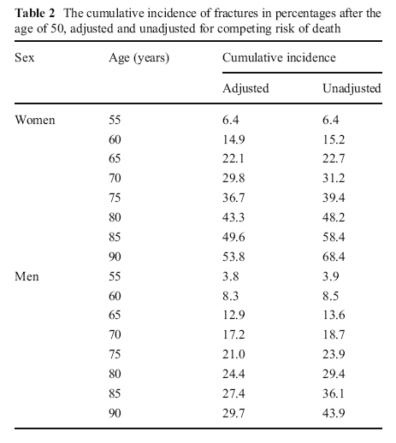
Example: Cumulative incidence of fracture in Iceland after age 50
Aalen-Johansen
K-M always overestimates incidence when there are competing events
Kaplan-Meier
Siggeirsdottir et al. 2013
Notes:
This is an example of a paper that reported cumulative incidence calculated with the Aalen-Johansen estimator with death as a competing event and with the Kaplan-Meier method. The first column (that the authors call “adjusted”) shows the Aalen-Johansen approach; it presents the cumulative incidence with death treated as a competing event. We do not like this term “adjusted” because it typically refers to management of confounding; we would rather say “accounting for (or accommodating for) the competing event of death”.
The last column provides the incidence based on the Kaplan-Meier method. We do not know why the authors also show the Kaplan-Meier estimate in that it has no valid interpretation. Perhaps they showed it to illustrate the need to account for competing events. We would not recommend including the K-M estimate in a situation like this one; it is not valid.
The follow-up period starts at age 50 and is then reported for intervals to age 55, to age 60, etc. This nicely illustrates the difference in the estimate using the Aalen-Johansen estimator versus the Kaplan-Meier approach when there are a substantial number of competing events. For example, at age 90 for women, the cumulative incidence estimates vary by almost 15 percentage points (53.8% versus 68.4%). Again, the so-called “adjusted” estimate, which is the Aalen-Johansen estimate, is the correct one.
This illustrates the general rule that the K-M calculation will overestimate cumulative incidence of the outcome of interest when there are competing events. This is because it applies the incidence of the event in those who remain in the analysis to those who experienced the competing event but for whom we know did not experience the main event. Thus, the Kaplan-Meier estimate is an overestimate of what actually occurred.

Slide 103
How commonly are the appropriate techniques being practiced in the literature?
Review of articles published between 2007-2010
  In 6 “high impact” clinical journals (NEJM, JAMA, BMJ, Lancet, Ann Int Med, and PLoS Medicine)
  Containing populations/questions likely to have competing events
  Choose 50 most recent articles
37 of 50 studies actually had competing events in the data
  24 of 37 (65%) used conventional K-M analysis to depict cumulative incidence (censoring upon the competing event)
  Only 2 of 37 used the Aalen-Johansen estimator
Koller et al. Statistics in Medicine 2012
Notes:
This example with fractures did manage to show the A-J estimator but, in general, how well are these techniques regarding competing events being practiced in the literature?
The answer is not very well. This paper reviewed all articles published between 2007 and 2010 in six prominent clinical journals. Of 50 articles reviewed of study populations which were likely to experience competing events, 37 had competing events present. Almost 2/3’s of these 37 articles incorrectly censored competing events and used K-M estimators, which we know is biased and which will produce an overestimate of the cumulative incidence. Only two studies correctly used the Aalen-Johansen estimator.
Incorrect practices are indeed the rule. The incorrect practices are so prevalent that those authors who do the correct analyses will often be seen as wrong by reviewers who are mostly unfamiliar with this topic. Authors may often need to argue with reviewers and editors in order to use the correct approach (the A-J estimator).

Slide 104
Competing Events in Incidence Estimation
Type of incidence estimate desired | Philosophy: Accommodate or eliminate competing event? | What estimator to use?
Cumulative incidence | Eliminate | If CE independent of primary event: Conventional K-M. Rarely credible If CE not independent: K-M with inverse probability of censoring weighting (or other advanced methods)
Cumulative incidence | Accommodate | Aalen-Johansen
Incidence rate/hazard | Accommodate | Usual rate/hazard calculation (in the face of competing events, it is called “cause-specific” rate/hazard)
Notes:
Here is a summary of how to handle competing events (CE) when calculating incidence, depending upon whether our goal is cumulative incidence estimation or rate estimation and our philosophy regarding accommodation or elimination. In regards to cumulative incidence, some of the best examples of wanting to eliminate competing events are studies of the longevity of heart valves, hip replacements, and other devices placed into human. The goal in these studies is to compare longevity between devices. The Grunkemeier et al. article in the Optional Reading section illustrates these situations. In these contexts, events like death in the human host are a nuisance that we would seek to eliminate. If our goal is cumulative incidence and we do indeed seek to eliminate competing events (i.e., pretend that competing events don’t occur), then we can use conventional Kaplan-Meier estimation if the CE is independent of the primary event under study. There are not too many examples of this, and hence performing K-M is rarely credible. Getting struck dead by lightening is one such example. If the CE is not independent (as is the case with most studies of devices, such as heart valves or joint), then conventional K-M will be biased. Instead, other techniques such as K-M with inverse probability of censoring weighting or other more advanced techniques are needed. We will not cover these advanced techniques in this class.
If we seek to accommodate for CE’s (accept their occurrence), we use the Aalen-Johansen estimator when we seek to estimate cumulative incidence. This is a different mathematical technique than K-M estimation, where natively we are calculating cumulative survival and take the complement to get cumulative incidence. In the A-J estimator, we work directly with calculation of incidence.
When the goal is to estimate incidence rate, there is actually nothing special to do from what we have already learned. This is because rates inherently accommodate competing events. We just perform our usual rate calculation. In the face of competing events, these rates are sometimes given the special name of “cause-specific” rates or hazards.
For completeness: what we do not show in this table is the scenario in which we are interested in rates and in eliminating competing events. This is not very common in descriptive work but it follows the same solution, in general, as for cumulative incidence. That is, if the competing events can be assumed to be independent, then the usual rate calculation will provide unbiased results. This is because those who remain in the rate calculation will have the same event rate as those who were removed by the competing event. If the competing event is not independent, then this will require more sophisticated methodologic approaches that reweight the remaining individuals in an attempt to create what the population would like if those with competing events were not removed. This is beyond the scope of this course.

Slide 105
Incidence in Clinical Research/Epidemiology
Making the measurements
Recruitment
Sensitive and specific detection of event onset
Retaining participants
Manipulating and summarizing the incidence data
Practical field work
Not covered in this course
Best learned by working with experienced researchers
At the same time, there are many decisions for measurements; best informed by understanding theoretical epi foundation
Notes:
This concludes our discussion of the calculation of incidence in clinical research/epidemiology. It is important to step back and remember that we have been discussing the manipulation and summarization of data pertaining to incidence. Yet, this is only half the story. The other half is actually making the measurements, i.e., collecting the data. In other words, where do the measurements come from?
Sometimes the data will already be available, having been obtained by others and sometimes for reasons other than research. This latter category is sometimes called “found” data. Understanding the context in which the found measurements were made (the “data generating mechanisms”) is crucial in understanding the pitfalls of the data and their attendant influences on study validity.
Other times the data need to be collected expressly for research. This means recruitment, sensitive and specific detection of event onset, and retaining participants such that they do not drop out and wreak havoc with our estimates. We note that we ARE NOT covering these activities in much detail in this course. This is the important discipline of practical field work. While enormously important, we do not especially think it can be taught in a course. In part, this is because it is very study-specific. Instead of getting this knowledge in courses, we suggest that this is best learned by working with experienced researchers. What is also true about data collection is that there are many decisions to be made about substance and logistics. These are best informed by understanding theoretical foundations of epidemiology, which we are learning in this course.
The importance of experience reminds us top-flight research requires the following 3-component recipe: 1 part (33%) subject matter knowledge; 1 part (33%) methodologic knowledge; and 1 part (33%) experience.

Slide 106
Summary
Incidence rate
  E/NT; a non-negative number with no upper bound
  Not a proportion; denominator is person-time
Average incidence rate can be calculated with individual-level or group-level average population data. Uses include:
  Incidence estimates in dynamic populations, especially those that are not fully enumerated at the individual level
  Comparison with other populations, both fixed and dynamic
  Contexts where exposure status in given persons changes over time
Average incidence rate most meaningful when constant
Instantaneous incidence (hazard) rate
  Hazard function – insight into changes in rate over time
  Mathematically related to cumulative survival via exponential formula
Just like K-M, all rates assume non-informative censoring
Competing Events
  Rates natively accommodate competing events
  For cumulative incidence when you seek to accommodate competing events, use the Aalen-Johansen estimator
Notes:
Here are the main points from today.

Slide 107
Measures of Disease Occurrence by Study Design
Study | Prevalence | Cumulative Incidence | Incidence Rate
Fixed Cohort | ✓ can be done at any slice of time; time 0 is very common | ✓ cumulative incidence is the quintessential fixed cohort concept | ✓ beware of depletion of susceptibles and how differs from a dynamic cohort
Dynamic Cohort | ✓ can be done at any slice of time | ✓ accomplished by turning dynamic cohort into fixed; done by “shifting” everyone “to the left” or via relationship between hazard and survival. | ✓ time-varying hazard most flexible way to describe incidence in a dynamic cohort
Cross-sectional | ✓ prevalence is synonymous with cross-sectional study | cannot be estimated | cannot be estimated
Case-control | ✓ limited to separate cross-sections of cases & non-cases | cannot be estimated | cannot be estimated
Notes:
The table contains a summary of the past two sessions on measures of disease occurrence showing the different measures of disease occurrence that can be derived by each of the study designs we have been discussing, fixed cohort studies, dynamic cohort studies, cross-sectional studies, and case-controls studies.
A few notes:
--Fixed cohorts naturally beg to be analyzed with cumulative incidence. In fact, cumulative incidence is a fixed cohort concept.
--If the interest in dynamic cohorts is to describe them over time, then this is naturally done with a depiction of rate over time. Dynamic cohorts can, however, by analyzed like fixed cohorts by shifting all persons to the left, at which time they can be described by cumulative incidence. Even without shifting everyone to the left, a cumulative incidence can still be estimated with data from a dynamic cohort by using the exponential formula.
--There are some measurement contexts that attempt to measure incidence with cross-sectional studies. Measurement of certain biomarkers that are only present in the early stages of diseases (such as IgM or antibody avidity) are used to denote recent incident infection. These studies, however, are not pure measures of incidence because we do not necessarily have all of the incident events; some may have died or become lost. Think about the underlying cohort for any cross-sectional study to better understand this. Thus, measuring incidence can sometime be different from measuring incident events per se.

Slide 108
Additional Slides

Slide 109
How to report incidence
Cumulative incidence: always include a time element.
  “The cumulative incidence of myocardial infarction among women was 5% (95% confidence interval: 2.3 to 8.6%) after ten years following smoking cessation.”
  “We found that 24% (95% CI: 20 to 28%) of children had suffered a bone fracture within two years after starting skateboarding.”
Incidence rate: always incorporate person-time
  “The incidence of HIV infection was 4.3 (95% CI: 2.8 to 6.2) per 100 person-years amongst men who have sex with men in San Francisco during 2005.”
  “There were 140 (95% CI: 118 to 163) new diagnoses of prostate cancer per 100,000 person-years amongst men in London in between 2010 and 2015.”
Notes:
Being able to clearly communicate findings from clinical/epidemiologic research to both scientific and non-scientific audiences is a major task for a researcher and a major objective of this course. Cumulative incidence will typically be better understood by lay audiences than incidence rates.

Slide 110
Proposing incidence objectives in a grant
Cumulative incidence: rarely wise to state 1 time point because, in fact, you will examine all time prior to it.
  “We will estimate the cumulative incidence of asthma, for up to 10 years, following occupational exposure to pesticides in Lake county.”
Incidence rate: be clear about the calendar period (if a dynamic cohort) or observation time (if a fixed cohort)
  “We will determine the rate of death by heroin overdose among commercial sex workers in Rome from 2010 to 2018”.
  “We will estimate the rate of T cell leukemia amongst participants during the first 10 years of the original Framingham cohort.”
Notes:
Researchers often need to communication incidence-related objectives in grant proposals. Descriptive objectives are often the initial specific aims (the lead off) in grant applications. Some people view descriptive objectives as unexciting and not really science. Do not let such beliefs persuade you. Accurate estimates on incidence in represent study samples take much strategic thinking and can form invaluable benchmarks for the clinical, public health, and research communities. The text shown are exemplars for how to express descriptive objectives.

Slide 111
Waiting Time Property of Incidence Rates
“Waiting time” to an event is reciprocal of the incidence rate (1/rate)
  e.g., if rate 20 per 100 person-years, reciprocal is 1
  (20/100 person-years) = 5.0 person-year
Average waiting time between events is 5.0 person-year. Or, on average, an individual will develop event every 5 years.
Average life expectancy is waiting time for outcome of all-causes mortality.
Notes:
The “waiting” time property of incidence rates is useful in quantifying the average time until a new occurrence of the outcome. It is another way to express the underlying pace of new occurrence, the underlying velocity or “force” we spoke of earlier. It follows from the assumption that the incidence rate is constant during the time interval under consideration. If there are 20 events per 100 person-years and the events are occurring at a constant rate, then a new event must occur, on average, depending on how exactly the constant rate assumption is met, every 5 years. Therefore, waiting time = 1/ person-time rate. This is a useful property to keep in mind. From the population perspective, a waiting time of 5 person-years means that with every passing of 5 person-years we expect to see one event. From the individual perspective, a waiting time of 5 years indicates that an individual, on average, will develop the event in 5 years. A notable example is the outcome of mortality (i.e., mortality rate). In this case, the average waiting time, which is the inverse of average mortality rate, is what is known as average life expectancy.

Slide 112
Direct and Indirect Standardization
Purpose is to make two or more populations comparable in terms of distribution of one or more factors (typically confounding factors or nuisance indirect effects)
  We wish to “standardize” (i.e., make uniform) the distribution of 1 or more of these factors across populations
  e.g., Age standardization is a very common goal
Direct standardization applies age stratum-specific incidence rates of the study population(s) of interest to the age structure of a reference external population.
  Akin to weighting age-specific incidences in study populations by age distribution in external population
  Useful for comparing more than 2 populations
Indirect standardization applies rate experience of reference population to age structure of study population
  Then compares observed to expected number of events
Notes:
Standardization is a technique used to make two or more populations comparable in terms of the distribution of one or more variables. It is used to manage confounding or to adjust for a nuisance indirect casual pathway (known as adjustment for a mediator). These objectives will become clearer later in the course. Standardization is often performed for age but can also by done for gender, race and calendar time.
These two approaches to standardization of incidence rates are discussed more fully in the S+N text. The terms direct and indirect are not exactly intuitive and not easy to commit to memory. Perhaps the best way to remember ‘direct’ is that we directly use the rates from the study population and standardize them by applying a weight. We do this to all study populations under investigation to make them comparable.
In today’s lecture we briefly covered an example of direct standardization, comparing hip fracture rates across countries. More detail on those calculations is provided in the next slide. We also covered an example of indirect standardization, comparing mortality in petroleum refinery workers with the general population, accounting for race, sex, age, and calendar period.

Slide 113
Direct Age Standardization
External “standard” population
55062/total US popn
Notes:
This illustrates how direct standardization calculations were made for previous example comparing hip fracture rates across countries.
Direct standardization will give an overall age-standardized (“age-adjusted”) rate for each population. We apply the age stratum-specific rates from the 5-year age groups in Beijing, Budapest, etc. to the age distribution of an external population, in this case the 1990 non-Hispanic white population in the US census. This gives the number of “expected” hip fractures if the Beijing rates had occurred in a population with age distribution like the US. The number of “expected” hip fractures is totaled and divided by the US population to give the age-adjusted incidence rate. This is done for each population. For Beijing, the expected number of hip fractures (in women) in one year was 55,062. Divide by the total population of the U.S. (138,908,682) to get the age-adjusted rate of 39.6 per 100,000 person-years. Follow the same procedures to calculate the age-adjusted rate for women in Budapest. Then, these age-adjusted rates can be compared as a rate ratio. A rate ratio of 1.0 would mean there was no difference in the hip fracture rates in two areas, once age differences are adjusted. In this example, the age-adjusted rates for Beijing and Budapest appear different and a rate ratio comparing these two age-adjusted incidence rates (Budapest/Beijing rates) is > 1.0, indicating that residence in Beijing confers a higher rate of fracture.
The actual value of the age-adjusted rate depends on the age structure reference population. The rate is not meaningful in isolation but is intended to allow comparisons across populations with different age structures.
The unadjusted rates that we calculated on the previous slide are also shown here. For Beijing, the unadjusted rate is lower than the age-adjusted rate. This is because the underlying age structure of the Beijing population is younger than the US population that was used as the “standard” population. For Budapest, the unadjusted rate is higher than the age-adjusted rate; this is because the age structure of Budapest is older than the US population.

Slide 114
High and low constant incidence rates and cumulative incidence
The relationship between constant incidence rate and cumulative incidence is exponential
When rates are low, the exponential formula converges to simple multiplication: cumulative incidence ~ rate x follow-up time.
However, when rates are higher, as illustrated in the 3rd row in the next slide, this falls apart.
Notes:
We know by the exponential formula that the relationship between a constant incidence rate (i.e., a constant force of incidence) and cumulative incidence is exponential. When rates are low, the exponential formula converges to simple multiplication: cumulative incidence ~ rate x follow-up time. However, when rates are higher, as illustrated in the 3rd row in the next slide, this falls apart.

Slide 115
Effect of high and low constant incidence rates on cumulative incidence
 | Cumulative Incidence at:
Inc. Rate (per pers-yr) | 1 year | 2 years | 5 years | 20 years
0.01 | 0.0100 | 0.0198 | 0.0488 | 0.1813
0.25 | 0.2212 | 0.3935 | 0.7135 | 0.9933
Notes:
Applying the exponential formula gives these values for cumulative incidence for a low and a high constant incidence rate over 4 time periods. Note that at one-year neither cumulative incidence differs that much from the rate (when the rate is expressed per 100 person-years) but that the high rate rapidly gives a quite different cumulative incidence while the low rate takes longer to diverge.
The reason for the mismatch in the high rate situation is that as the high rate is being applied to the fixed population, it is being depleted of people. As there are fewer and fewer at risk persons, applying the same high rate of event does not result in the same percentage of the original population having experienced the event. Hence, the issue is that the number of persons at risk is shrinking and becoming much different than the number of people in the original fixed cohort.

Slide 116
Competing Events
Definition: In a study of incidence of some event of interest, a “competing event” (aka “competing risk”, “competing risk event”):
  precludes the occurrence of the event of interest (e.g., death precludes all outcomes)
  or
  substantially impacts incidence of event of interest (e.g., prophylactic ovary removal in study of ovarian cancer)
Such an event is called “Competing” because it occurs prior to event of interest and precludes it from occurring
Two flavors:
  Independent: Occurs independent of event of interest (e.g., accidental deaths in study of brain cancer incidence)
  Non-independent: Related to event of interest (i.e., occurrence influenced by factors which influence event of interest; e.g., death from emphysema in study of lung cancer incidence)
Notes:
This slide reviews the definition of competing risks, also known as competing events or competing risk events. We introduced this concept in our first lecture on Study Design.
In a study of incidence of some primary event of interest, a competing event is one which either precludes the occurrence of the event of interest (and the best example of this is death, which precludes all non-fatal outcomes) or one which substantially impacts incidence of the event of interest. An example of this would be prophylactic ovary removal in the study of ovarian cancer (incidence is greatly diminished although does not go to zero).
We call these events “competing” because they occur prior to the event of interest that we are studying. They are competing with the occurrence of our event of interest and preclude or nearly preclude the occurrence of our main event of interest.
Competing events come in two flavors. One is a competing event that occurs independent of the event of interest. When studying brain cancer incidence, accidental deaths (say from getting struck by lightening) would be considered by most persons as occurring independently of the occurrence of brain cancer. The other type of competing event is actually related to the event of interest. In other words, its occurrence is influenced by factors which influence rate of event of interest. An example would be death from obstructive lung disease (e.g., emphysema) in a study where primary event of interest is lung cancer incidence.

