Slide 1
Epi 204, Lecture #1
Part 1: Course overview, the diagnostic process
Part 2: Measures of interobserver agreement
Michael Kohn
Updated 7/25/2021

Slide 2
Overview of lecture
Administrative stuff
Chapter 1: Introduction
  Diagnosis: Naming the illness vs. testing to guide decisions
  Simplifying assumptions
Chapter 2: Reliability for categorical variables
  Concordance vs. Kappa
  “Expected” agreement
  Balanced and unbalanced disagreement
  Weighted Kappa

Slide 3
Administrative stuff -1
Introductions
  Faculty (Interest)
    Michael Kohn MD/MPP (Epi/EM)
    Tom Newman, MD, MPH (Epi/Peds)
    Martina Steurer-Mueller, MD, MAS (Epi/Neonatology and Pediatric Critical Care)
    Alexis Beatty, MD, MAS (Epi/Cardiology)
    Miriam Laker MD, MAS (Epi/HIV Medicine)
  Section leaders
    Nicole Rodriguez, MSIV
    Vidya Eswaran, MD (Emergency Medicine)
    Anita Hargrave, MD (R3 Medicine)
    Nasim Sohani, MD (MFM)
    Adam Zakaria, MSIV

Slide 4
Administrative stuff -2
Basic structure of course
  Thursday 1:15-2:45 Small Group
    Problem set due at 1:15 pm (prior to start of small group)
    We will discuss the problem set that you just turned in
    1 remote evening small group
  Thursday Evening (by 9 pm) Next week’s video lecture and problem set posted
  Tuesday 8:45–10:15 am Zoom Large Group
    Discussion of material in assigned reading and video lecture (that was posted by 9 pm on the prior Thursday)
    Please view video lecture and do assigned reading prior to large group
  Other:
    We will post the final no later than
    Last large group meeting 12/?: review of take-home exam

Slide 5
Zoom Small Groups
Section assignments: See CLE
Faculty will rotate; Section leaders (TA’s) will be constant for the quarter
Small group attendance is highly recommended but not required

Slide 6
Homework: 9 Problem Sets and Problem-Writing Assignment
Required – key way of learning material
PSet due prior to next Thursday’s section, posted by 9 pm today.
Upload HW to CLE by 1:15 pm next Thursday
Not graded if late, but can still be turned in; answers on CLE
Will be graded by section leaders before small group on the following Thursday

Slide 7
Problem-writing Assignment
Write a homework or final exam problem
Ideally, based on a recent study (provide citation) from your field or of general interest
Problem should require understanding of material covered in this class
Due Tuesday, Nov ?? by 8:30 am. Upload to CLE.
May appear (probably altered) on final exam and/or in future homework sets!
Counts as one HW assignment
Details posted in a document at top of syllabus site.

Slide 8
Getting help
Classmates, then section leaders, then faculty
Post questions and answers on course Forum
Questions, ambiguous/confusing problems – post to the forum

Slide 9
“Evidence-Based Diagnosis, 2nd Edition” (EBD-2)
UCSF Library link: http://ucsfcat.library.ucsf.edu/record=b2792723
TBN’s royalties go to PSR. MAK’s royalties go to a cup of coffee at Starbuck’s. Martina doesn’t receive royalties.

Slide 10
Grading, honor code, etc.
Worst HW score dropped; all other HW count equally
Problem-writing assignment counts as one homework
Grade based on HW (60%) and take-home final (40%)
Write out answers to problems in your own words.
Acknowledge help from others.
Do NOT collaborate on the final exam
Honor code taken seriously

Slide 11
TICR Professional Conduct Statement
I will maintain the highest standards of academic honesty
I will neither give nor receive aid in examinations or assignments unless such cooperation is expressly permitted by the instructor (HW—Yes, with attribution, Exam – No!)
I will conduct research in an unbiased manner, reports results truthfully, and credit ideas developed and work done by others
I will not use answer keys from prior years
I will write answers in my own words, and, when collaboration is permitted, acknowledge collaborators when answers are jointly formulated (HW)

Slide 12
Clinical Epidemiology
“I hope that I may be excused for entering on these personal details, as I give them to show that I have not been hasty in coming to a decision.”
Charles Darwin, Introduction to “The Origin of Species” 1859
Notes:
TN created this course and started teaching it in 1989. I was an ED attending at SFGH when I took it in 1999. It was a revelation to someone frustrated with the lack of rigorous, quantitative thinking in clinical medicine.

Slide 13
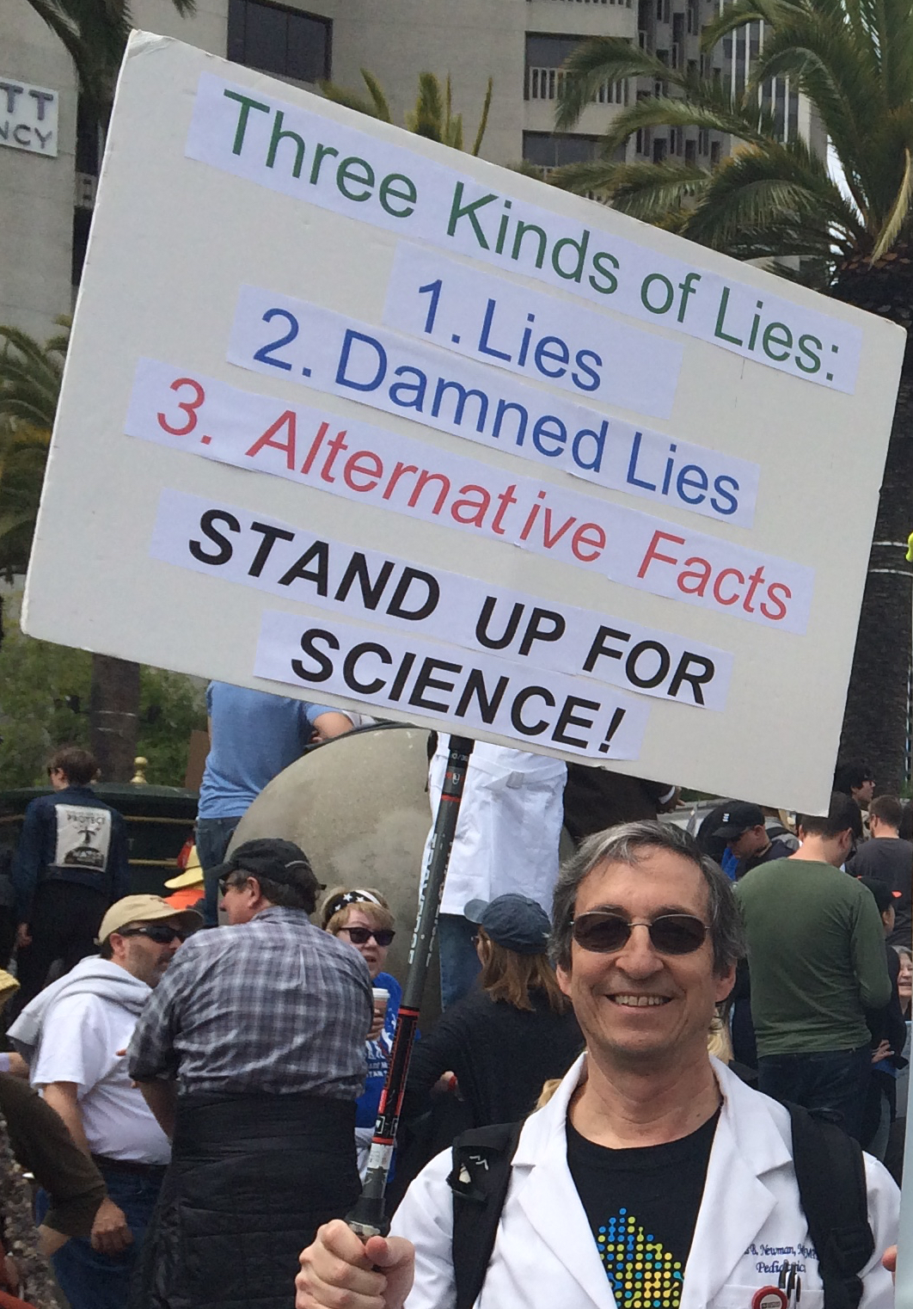
Notes:
TN created this course and started teaching it in 1989. I was an ED attending at SFGH when I took it in 1999. It was a revelation to someone frustrated with the lack of rigorous, quantitative thinking in clinical medicine.

Slide 14
Course: “Prediction 0”
Common speech
  Prediction: Using current information to estimate risk of future event.
Epidemiology
  Prediction: Using current information (e.g. test results) to estimate probability of a state that already exists*.
*but is too difficult or expensive to ascertain directly.
Notes:
In common speech, prediction involves using information that is available now to evaluate the likelihood of an uncertain event in the future. In epidemiology and biostatistics, “prediction” includes using available information not only to predict the future but also to estimate the probability of a state or condition that already exists but is difficult or expensive to measure by other means. In public health and clinical practice, diagnostic tests are used to estimate the probability of prevalent disease and risk prediction models (or “rules”) are used to evaluate the likelihood of some future event. In the first part of this course, we will cover how to interpret the metrics used to describe the performance of diagnostic tests and risk prediction models.

Slide 15
Course overview
Tests
  Theory (Using tests to guide decisions)
  Inter-rater reliability (Kappa)
  Dichotomous tests (Sensitivity, Specificity, PVs)
  Multilevel tests (ROC Curves, iLRs)
  Studies of tests (biases in test accuracy studies)
  Risk prediction (calibration, discrimination, NB)
  Combining tests (logistic regression, CART, …)
Treatments
  Randomized trials (ARR, NNT)
  Alternatives to randomized trials
Screening programs
P-values and confidence intervals
Cognitive process of diagnosis
Notes:
In common speech, prediction involves using information that is available now to evaluate the likelihood of an uncertain event in the future. In epidemiology and biostatistics, “prediction” includes using available information not only to predict the future but also to estimate the probability of a state or condition that already exists but is difficult or expensive to measure by other means. In public health and clinical practice, diagnostic tests are used to estimate the probability of prevalent disease and risk prediction models (or “rules”) are used to evaluate the likelihood of some future event. In the first part of this course, we will cover how to interpret the metrics used to describe the performance of diagnostic tests and risk prediction models.

Slide 16
Diagnosis
Identification of a disease by careful investigation of its symptoms and history.
The Oxford English Dictionary (2nd Edition 1989, accessed online)
Notes:
Diagnosis is naming a patient’s illness. We assign names to distinct illnesses, just as we name distinct animals, vegetables, minerals, cloud formations, personality types, …. So we can talk about them and maybe study them. Two distinct diseases can have the same treatment; other distinct diseases have no treatment; and yes, some distinct diseases have distinct treatments. But, assigning a disease name to a patient’s illness doesn’t necessarily imply a treatment decision.

Slide 17

Diagnosis: Complex cognitive process
Notes:
The cognitive process of diagnosis involves integrating information from history, observation, exam, and testing using an ill-defined combination of knowledge, experience, pattern recognition, and intuition to name a patient’s illness. We won’t be talking about this cognitive process and the errors to which it is prone until the last lecture.

Slide 18
Testing to refine probabilities and guide decisions (Ch 1 examples)
Rapid strep test to guide PCN treatment
WBC count and differential to determine NICU transfer and antibiotics
Screening mammography
Fetal 13-wk ultrasound to decide on chorionic villus sampling.
Notes:
Nothing special about clinical medicine. Need to make a decision, uncertainty about a current state or future outcome, can get additional information (at a cost) and refine probabilities. Should you test or just make the best decision you can without testing? Should an oil wildcatter pay for seismic soundings to help decide whether to drill before his option runs out? (Raiffa 1968)

Slide 19
Simplified Generic Decision Problem
Patient either has the disease or not
However, there is uncertainty, which we express as P(D+)
If D+, net benefit of treatment
If D−, better not to treat
  (“Treat” could just mean doing more tests)

Slide 20
Decision Analytic Framework
P(D+)
☺
Yes
D+ & Treated
No
Yes
D+?
😐
D- & Treated
No
Treat?
Yes
D+ & Untreated
☹
No
D+?
D- & Untreated
☺
Notes:
Next week, we will learn that the difference between 3 & 1 is “B”, and the difference between 2 & 4 is “C”.

Slide 21
Initial simplifying assumptions
1. Test results are dichotomous
2. Disease states are dichotomous
3. Test characteristics don’t depend on prior probability

Slide 22
Simplifying assumptions are often wrong because
Many tests have more than two possible results
Disease states are not really dichotomous
  Many diseases present along a spectrum of severity
  People who do not have the disease you are testing for may have one or more other diseases
History, physical findings, and laboratory data used to estimate the prior probability may also affect test characteristics

Slide 23
Nonetheless, these simplifying assumptions are often useful and can help clarify our thinking!
1. Test results are dichotomous
2. Disease states are dichotomous
3. Test characteristics don’t depend on prior probability

Slide 24
Questions about Chapter 1?

