Slide 1
Evaluating Risk Models
Michael A. Kohn, MD, MPP
10/22/2021

Slide 2
Risk Model
Can predict
  probability of a prevalent condition (diagnostic probability model*)
  risk of an incident outcome (risk prediction model**)
Divides population into groups and estimates the probability/risk in each group
Usually the grouping is based on multiple variables
* “diagnostic probability model” is my term created for this lecture
** “risk prediction model” usually covers both types of models, whether they estimate the risk of an incident outcome or the probability of prevalent condition

Slide 3
Assessing Risk Models
Assessed in an independent validation dataset
Calibration: accuracy of the risk predictions
  Calibration Plots (2 types)
  Bias, Mean Absolute Error, Brier Score (mean squared error)
  Brier Score = Calibration Error + Refinement Loss
Discrimination: how well does it order individuals from highest to lowest risk
  AUROC
Population Net Benefit calculation
Decision Curves

Slide 4
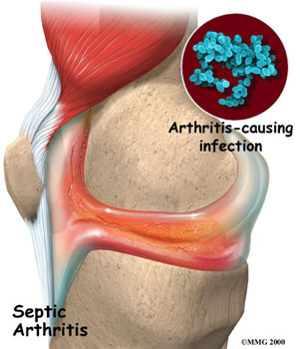
Segment 1: A Diagnostic Probability Model – Septic Arthritis Again

Slide 5
Our first risk model
Joint Fluid | Septic Arthritis
WBC (/uL) | Risk (r)*
>100 | 0.55
50 - 100 | 0.16
25 -50 | 0.03
0 - 25 | 0.01
*Pre-Test Prob= 0.04
Notes:
Divides population into groups. Predicts risk of uncertain condition – in this case a current, not future, condition. Notes: 1) Based on an assumed pre-test probability or prevalence of 0.04. Only one characteristic, the joint fluid WBC count. Risk models usually accommodate multiple characteristics. How do you evaluate this risk model?

Slide 6
Test in 1000 ED patients with warm, swollen, painful knee
Joint Fluid | Septic Arthritis | N with result | Actually D+
WBC (/uL) | Risk (r)* |  | N | p
>100 | 0.55 | 22 | 2 | 0.091
50 - 100 | 0.16 | 80 | 7 | 0.088
25 -50 | 0.03 | 188 | 16 | 0.085
0 - 25 | 0.01 | 710 | 62 | 0.087
 |  | 1000 | 87 | 0.087
Notes:
I concocted data that would show the model as performing poorly.
First note that the overall prevalence of septic arthritis is 8.7%, not 4%, as assumed when the model was developed.

Slide 7
Test in 1000 ED patients: Miscalibration
Joint Fluid | Septic Arthritis | N with result | Actually D+
WBC (/uL) | Risk (r)* |  | N | p
>100 | 0.55 | 22 | 2 | 0.09
50 - 100 | 0.16 | 80 | 7 | 0.09
25 -50 | 0.03 | 188 | 16 | 0.09
0 - 25 | 0.01 | 710 | 62 | 0.09
 |  | 1000 | 87 | 0.09
Notes:
Risk estimates (r) are way off. Too high by 0.46 or too low by 0.08.

Slide 8
Calibration Metrics: Bias, MAE, Brier Score -- Smaller is better; 0 is perfect.
r_{i} = predicted risk for individual i
o_{i} = outcome for individual i (1=yes; 0 = no)
Error_{i} = r_{i} - o_{i}
Absolute Error_{i} = AE_{i} = |r_{i} - o_{i}|
Squared Error_{i} = Error²_{i} = (r_{i} - o_{i})²
Sum over all individuals and divide by N
Mean Error = Bias = ∑ Error_{i} / N
Mean Absolute Error = MAE = ∑ AE_{i} / N
Brier Score = Mean Squared Error = MSE = ∑ Error²_{i} /N
Often report root mean squared error = RMSE = √Brier Score
Notes:
TN: A couple of examples might help make these parameters more concrete. We predict r= 50% risk in everyone. The actual risk is 0%. The error, absolute error and mean error are all 0.5, but the Brier score is 0.25. If the actual risk were 1, the error would be -0.5, but the other parameters would stay the same.
Now suppose that we predict 50% in everyone and the outcome occurs in 50%. So actually we are perfectly calibrated with zero discrimination. The errors will be 0.5 and -0.5 with equal frequency. The Mean Error = Bias will be zero. But the mean absolute error will be 0.5 and the Brier score will be 0.25. In fact, if our prediction is 50%, the MAE can be no worse than 0.5 and the Brier score can be no worse than 0.25.
Now suppose we predict r=0 in everyone and the event happens 50% of the time. The mean error will =1 when the event happens and 0 when it does not, so the mean error and MAE will be 0.5. The Brier score will be 0.5.
MAK: Good idea. The 50% risk in everyone, perfectly calibrated, no discrimination, gives rise to a calibration error = 0 and a refinement lost = 0.25. This is how decomposing the Brier Score into Calibration Error and Refinement Loss separates calibration from discrimination. But I would prefer to use the square root of all of these quantities. So then SQRT(Brier) = 0.5. SQRT(Calibration Error) = 0. SQRT(Refinement Loss) = 0.5

Slide 9
Calibration Metrics: Bias, MAE, Brier Score -- Based on risk groups
Divide population in risk groups
r_{k} = predicted risk in group k
p_{k} = proportion with outcome in group k
f_{k} = fraction of population in group k
Metrics are f_{k}-weighted averages; smaller is better; 0 is perfect.
Bias = ∑ f_{k} × [p_{k}(1 – r_{k}) + (1 – p_{k})(0 – r_{k)}] = ∑ f_{k}×(r_{k} – p_{k})
Absolute Error = ∑ f_{k} × [p_{k}|1 - r_{k}| + (1 – p_{k})|0 – r_{k}|]
Brier Score = ∑ f_{k} × [p_{k}(1 - r_{k} )² + (1 – p_{k}) (0 – r_{k})²]
(√Brier Score is frequently used.)

Slide 10
Calibration Metrics: Bias, MAE, Brier Score -- Example
r = 0.5
p = 0.5
Bias = ∑(r_{i} – o_{i})/N = (0.5 – 0) + (0.5 -1) + … = r – p = 0
Absolute Error = p|1 - r| + (1 – p)|0 – r|
= 0.5| 1 – 0.5| + (1 – 0.5)|0 – 0.5| = 0.5
Brier Score = p(1 - r )² + (1 – p) (0 – r)²
= 0.5(1 – 0.5 )² + (1 – 0.5) (0 – 0.5)² = 0.25
√Brier Score = 0.5

Slide 11
Test in 1000 ED patients: Weighted Mean
Joint Fluid | Septic Arthritis | N with result | Actually D+ |  | Error
WBC (/uL) | Risk (r)* |  | N | p | r - p
>100 | 0.55 | 22 | 2 | 0.091 | 0.456
50 - 100 | 0.16 | 80 | 7 | 0.088 | 0.077
25 -50 | 0.03 | 188 | 16 | 0.085 | -0.053
0 - 25 | 0.01 | 710 | 62 | 0.087 | -0.074
 |  | 1000 |  |  | -0.047
0.022*0.456 + 0.08*0.077 + 0.188*(-0.053) + 0.710*(-0.074) = -0.047 = Bias
Notes:
Now we have the proportion of the population in each risk group. Note that the proportions aren’t equal.

Slide 12
Test in 1000 ED patients: Bias, MAE, Brier Score
Joint Fluid | Septic Arthritis | N with result | Actually D+ |  | Error/ Bias | Absolute Error | Brier Score
WBC (/uL) | Risk (r)* |  | N | p | p(r-1) + (1-p)r | p|r-1| + (1-p)|r| | p(r-1)² + (1-p)r²
>100 | 0.55 | 22 | 2 | 0.091 | 0.456 | 0.539 | 0.291
50 - 100 | 0.16 | 80 | 7 | 0.088 | 0.077 | 0.223 | 0.086
25 -50 | 0.03 | 188 | 16 | 0.085 | -0.053 | 0.112 | 0.081
0 - 25 | 0.01 | 710 | 62 | 0.087 | -0.074 | 0.098 | 0.085
 |  | 1000 |  | 0.087 | -0.047 | 0.120 | 0.089
 |  |  |  |  |  | Square root: | 0.298
Notes:
Don’t forget that these are all weighted means. See circled column. In many calibration tables, the groups are of equal size, e.g., quartiles – but not always.
The error/bias understates things because underestimates balance overestimates.
A Brier Score of 0.089 is really bad. Taking the square root, makes it larger. Some authors (and MAK) prefer the square root.

Slide 13
Why divide the population into risk groups?
To create a calibration plot
Separate calibration from discrimination
Can evaluate discrimination without creating risk groups by generating a “walking man” ROC curve and calculating the area under it.
Can calculate a Brier score without creating risk groups, but this depends on both calibration and discrimination.

Slide 14
Calibration Plot 1
Joint Fluid | Septic Arthritis | N with result | Actually D+ |  | Error
WBC (/uL) | Risk (r)* |  | N | p | r - p
>100 | 0.55 | 22 | 2 | 0.091 | 0.456
50 - 100 | 0.16 | 80 | 7 | 0.088 | 0.077
25 -50 | 0.03 | 188 | 16 | 0.085 | -0.053
0 - 25 | 0.01 | 710 | 62 | 0.087 | -0.074
 |  | 1000 | 87 | 0.087 | -0.047
Notes:
Now have the proportion of the population in each risk group. Note that the proportions aren’t equal.

Slide 15
Calibration Plot 1
Notes:
Discrimination is the HORIZONTAL spread of points. There is none.

Slide 16
Calibration Plot 2
Joint Fluid | Septic Arthritis | N with result | Actually D+ |  | Error
WBC (/uL) | Risk (r)* |  | N | p | r - p
>100 | 0.55 | 22 | 2 | 0.091 | 0.456
50 - 100 | 0.16 | 80 | 7 | 0.088 | 0.077
25 -50 | 0.03 | 188 | 16 | 0.085 | -0.053
0 - 25 | 0.01 | 710 | 62 | 0.087 | -0.074
 |  | 1000 | 87 | 0.087 | -0.047
Notes:
Now have the proportion of the population in each risk group. Note that the proportions aren’t equal.

Slide 17
Calibration Plot 2
Notes:
Discrimination is the VERTICAL spread of points. There is none.

Slide 18
Brier Score = Calibration Error + Refinement Loss
r_{k} = predicted risk in group k
p_{k} = proportion with outcome in group k
f_{k} = fraction of population in group k
f_{k}-weighted averages:
Brier Score = ∑ f_{k} × [p_{k}(1 - r_{k} )² + (1 – p_{k}) (0 – r_{k})²]
Calibration Error = ∑ f_{k} × (r_{k} – p_{k})²
Refinement Loss = ∑ f_{k} × p_{k}(1-p_{k}) (metric of discrimination)
Brier Score = Calibration Error + Refinement Loss
Notes:
Refinement has nothing to do with calibration, only discrimination, and is related to the AUROC. Very roughly speaking, MAK Index = SQRT(1-REF/PQ). AUROC = (MAK Index +1)/2 = (SQRT(1-REF/PQ) +1)/2. (This is very rough!!!)

Slide 19
Brier Score = Calibration Error + Refinement Loss : Example
r = 0.5
p = 0.5
Calibration Error = (r – p)²= 0
Refinement Loss = p(1-p) = 0.25
Brier Score = p(1 - r )² + (1 – p) (0 – r)²
= 0.5(1 – 0.5 )² + (1 – 0.5) (0 – 0.5)² = 0.25
Note that all error is due to refinement loss – lack of discrimination.

Slide 20
Test in 1000 ED patients: Calibration Error, Refinement Loss
Joint Fluid | Septic Arthritis | N with result | Actually D+ |  | Error | Calibration Error | Refinement Loss | Brier Score
WBC (/uL) | Risk (r)* |  | N | p | r - p | (r - p)² | p(1-p)
>100 | 0.55 | 22 | 2 | 0.091 | 0.456 | 0.2082 | 0.0826 | 0.2908
50 - 100 | 0.16 | 80 | 7 | 0.088 | 0.077 | 0.0059 | 0.0798 | 0.0857
25 -50 | 0.03 | 188 | 16 | 0.085 | -0.053 | 0.0028 | 0.0779 | 0.0807
0 - 25 | 0.01 | 710 | 62 | 0.087 | -0.074 | 0.0055 | 0.0797 | 0.0852
 |  | 1000 |  |  | -0.047 | 0.0095 | 0.0794 | 0.0889
 |  |  |  |  | Square roots: | 0.0975 | 0.2818 | 0.2982
Notes:
You can calculate Bias, MAE, and Brier Score without breaking the population into risk groups, but you have to break it into risk groups to calculate Calibration Error and Refinement Loss.

Slide 21
Risk Model Error = Calibration Error + Discrimination Error
Risk Model Error
Discrimination Error
Calibration Error
Notes:
This is the key point. There are 2 separate components of risk model error: Calibration Error and Discrimination Error.

Slide 22
Brier Score = Calibration Error + Refinement Loss
√Brier Score
√Refinement Loss
√Calibration Error
Notes:
This is the key point. There are 2 separate components of risk model error: Calibration Error and Discrimination Error.

Slide 23
Brier Score = Calibration Error + Refinement Loss
Total error = √Brier Score
s = √Refinement Loss
Bias = √Calibration Error
Notes:
This is the key point. There are 2 separate components of risk model error: Calibration Error and Discrimination Error.

Slide 24
Discrimination
How well can the test separate subjects in the population from the mean probability to values closer to zero or 1?
In this example, risk model did not discriminate at all.
Proportion with outcome in each group is 0.09
AUROC = 0.5

Slide 26
Segment 2: Predicting an incident outcome
NLST Lung CancerMortality Prediction Model
Calibration
Discrimination
Net Benefit
Decision Curves
Notes:
Whether estimating the probability of a prevalent condition or the risk of an incident outcome, we can assess calibration assess discrimination, and we can calculate net benefit and draw decision curves. The NLST makes a better example to illustrate some of these points.

Slide 27
Risk Prediction vs. Diagnostic Probability
How is predicting incident outcomes different from diagnosing a prevalent condition?

Slide 28
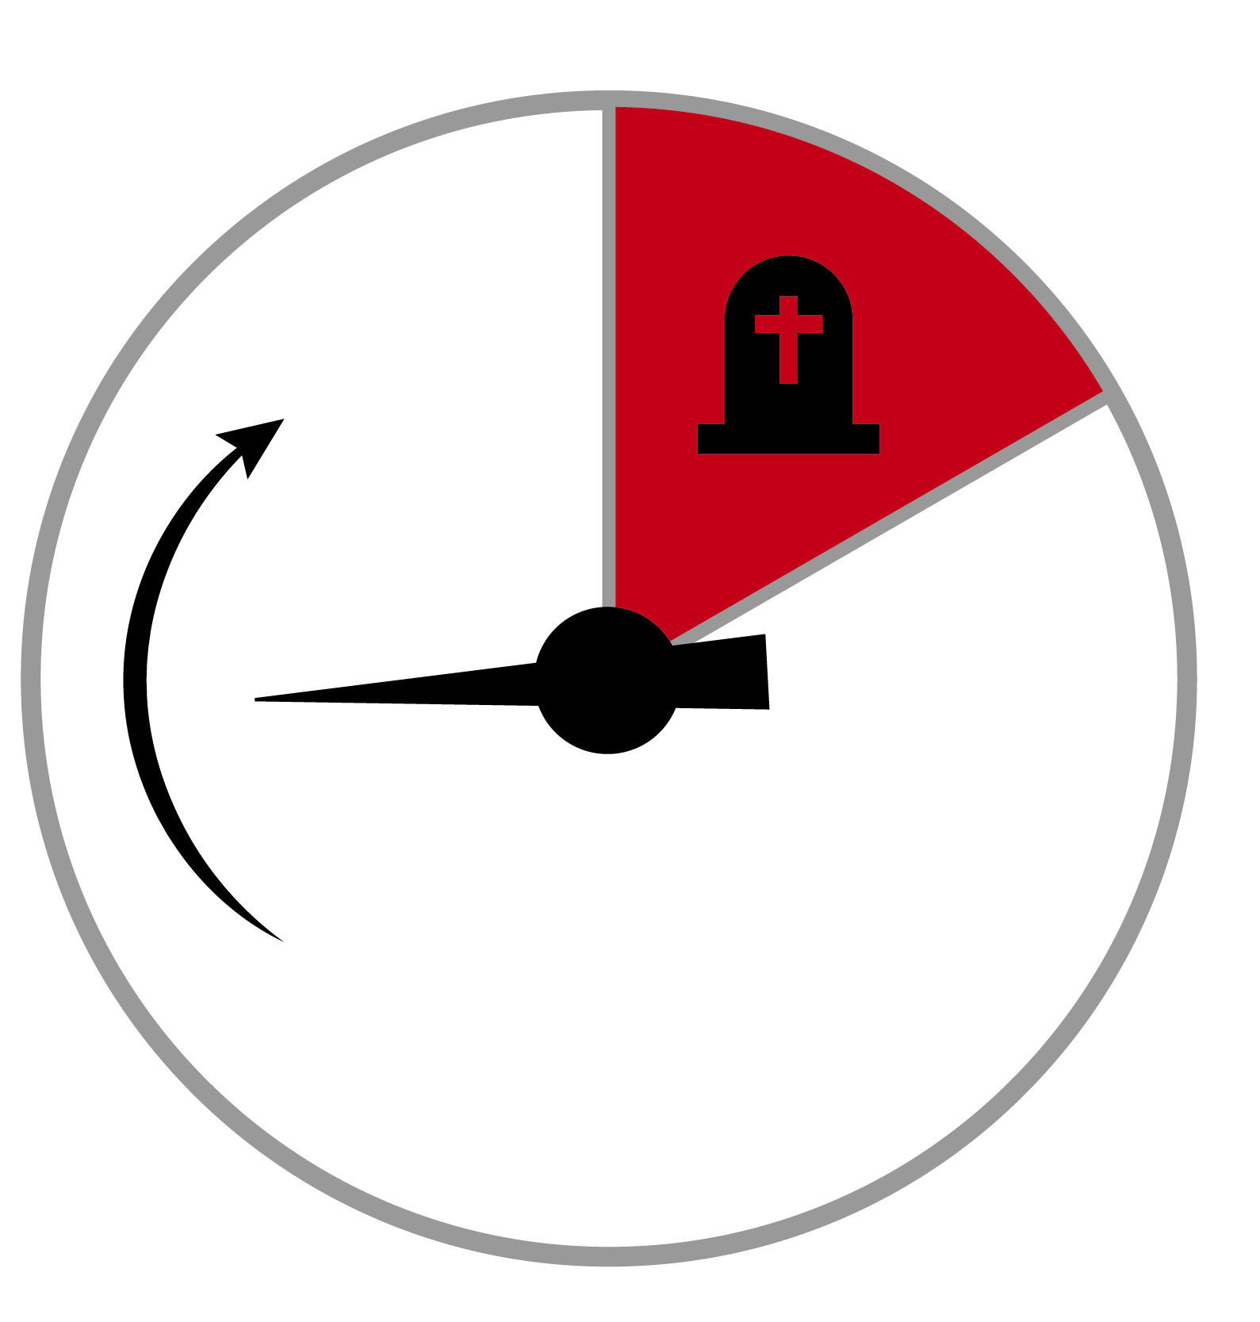
Chance determines whether you get the disease/outcome
Notes:
More on the distinction between a diagnostic probability model and a risk prediction model

Slide 29
Diagnostic Probability Model:
Chance event occurs to patient before estimation of P(D+|X)
Spin needle to see if you develop disease.
Given all information, model estimates the probability that you have it.
Gold standard can determine true disease state.
Time frame is cross-sectional.
Notes:
Diagnostic test results are commonly expressed in categories or units particular to the test (urine dip: -, +, ++, +++; V/Q: normal, low prob, intermediate prob, high prob). The conversion to risk of D+ uses LRs from the study and the patient’s pre-test probability. Measurement of the LRs is separate from assessment of pre-test probability.

Slide 30
Risk Prediction:
Chance event occurs to patient after estimation of P(D+|X)
Given all information, model estimates your risk of disease/outcome.
Spin needle to see if you develop disease/outcome.
“Gold standard” is follow-up.
Time frame is longitudinal (cohort).
Notes:
predictions are commonly expressed as a risk category (10%, 20%, etc), so they already include an assessment of the patient’s pre-test probability.

Slide 31
Diagnostic Probability Model versus Risk Prediction Model
 | Diagnostic Probability | Risk Prediction
Purpose
Chance Event Occurs to Patient
Time Frame
Test Result
Maximum Obtainable AUROC
Identify Prevalent Disease/Condition
Predict Incident Disease/Outcome
Prior to Test
After Test
Cross-Sectional
Longitudinal
+/-, ordinal, continuous → LR & P(D+) to get risk
Risk group (PV) Estimate risk directly
1 (gold standard)
<1 (not clairvoyant)
Notes:
Test result row: With diagnostic tests, we usually leave the results in the natural units of the test and use pre-test prob and LRs to convert to risk of having disease. Assumption: LR is independent of P(D+). With risk predictions, the results are usually reported as a risk of developing outcome and therefore already incorporate pre-test prob. Assumption: The patient is assumed to come from a population with the same overall prevalence of disease as the population used to develop the model.

Slide 32
Validation
A model developed in a derivation or “training” dataset must be assessed in an independent validation or “test” dataset.

Slide 33
Methods Used to Develop Risk Models
Logistic Regression
Classification Trees
Newer Predictive Analytic Techniques*
  Random Forests
  Artificial Neural Networks
*a.k.a Machine Learning
Notes:
Next week, we will talk about these methods. For now, it doesn’t matter how the risk model generates its estimated risks; focus on how good they are.

Slide 34
NLST Lung CA Mortality
Risk Prediction Model
Regression model converts the following variables* into a risk of lung cancer death within 5 years
Age
BMI
Family history of lung cancer
Pack-years of smoking
Years since smoking cessation
Emphysema diagnosis
*Sex and Race were not included in the model (?)
Notes:
“We developed an absolute risk-prediction model for lung-cancer mortality in the NLST's radiography group. The absolute risk of death from lung cancer accounted for a participant's specific risk characteristics and life expectancy by incorporating Cox proportional-hazards models of death from lung cancer and competing causes of death.¹⁸ We selected predictors for lung-cancer death among a set of previously identified demographic and clinical risk factors for lung cancer (including smoking history) using Lasso regression.¹⁹ The prediction model was externally validated²⁰ with outcome data from 15,114 NLST-eligible and 22,649 NLST-ineligible smokers between the ages of 55 and 74 years who were enrolled in the radiography group of the Prostate, Lung, Colorectal, and Ovarian (PLCO) Cancer Screening Trial.²¹”

Slide 35
NLST Lung CA Mortality
Validation
N = 15,114
Current and former smokers aged 55-74
Enrolled in X-ray group of the PLCO* Cancer Screening Trial
*Prostate, Lung, Colorectal, and Ovarian (PLCO)
Notes:
“We developed an absolute risk-prediction model for lung-cancer mortality in the NLST's radiography group. The absolute risk of death from lung cancer accounted for a participant's specific risk characteristics and life expectancy by incorporating Cox proportional-hazards models of death from lung cancer and competing causes of death.¹⁸ We selected predictors for lung-cancer death among a set of previously identified demographic and clinical risk factors for lung cancer (including smoking history) using Lasso regression.¹⁹ The prediction model was externally validated²⁰ with outcome data from 15,114 NLST-eligible and 22,649 NLST-ineligible smokers between the ages of 55 and 74 years who were enrolled in the radiography group of the Prostate, Lung, Colorectal, and Ovarian (PLCO) Cancer Screening Trial.²¹”

Slide 36
Calibration
Risk Group | Predicted (r) | Observed (p) | Bias
5 | 4.04% | 4.53% | -0.50%
4 | 1.71% | 1.95% | -0.24%
3 | 1.07% | 1.32% | -0.25%
2 | 0.64% | 0.46% | 0.18%
1 | 0.29% | 0.20% | 0.10%
 |  |  | -0.14%
*These were actually quintiles of risk, but for exposition, I will treat them as fixed risk categories. Groups are the same size. f_{k}= 0.2
Notes:
From Table S2. 15114 External validation. 15,114 NLST-eligible smokers between the ages of 55 and 74 years who were enrolled in the radiography group of the Prostate, Lung, Colorectal, and Ovarian (PLCO) Cancer Screening Trial.²¹
Don’t have to worry about weighted average because these were equal-sized groups.

Slide 37
Calibration Plot 1

Slide 38
Calibration Plot 2

Slide 39
Discrimination
Threshold | Sensitivity | 1-Specificity
≥ 5 | 53.5% | 19.4%
≥ 4 | 76.6% | 39.4%
≥ 3 | 92.2% | 59.4%
≥ 2 | 97.7% | 79.7%
≥ 1 | 100.0% | 100.0%
Notes:
If you know f_{k}, the fraction of the population in each risk group, you can convert a calibration table into an ROC table. We will show how this is done in the problem set.
3rd column: Of all patients who die of lung cancer within 5 years, 54% are in Risk Category 5; 77% are in Risk Categories 4 & 5; 92% are in categories 3, 4, & 5; and so on.

Slide 40
AUROC = 0.744
Notes:
There is an error in Table S2 of the paper. They said the AUROC was 0.72, But it’s exactly the same as the next table.
PMID: 23863051

Slide 41
ROC Curves and Calibration Plots
Notes:
Calibration points correspond to ROC segments. The highest risk point corresponds to the ROC segment on the lower left. For the above type of calibration plot, the VERTICAL spread of points corresponds to discrimination. If the calibration points correspond to quantiles, you can get the ROC curve from the calibration plot. Going the other way requires the proportion of the population with the outcome.

Slide 42
The ROC curve depends only on rankings, not calibration
Re-calibration does not affect the ROC curve (unless group ranks change)

Slide 43
Using Calibration Plots to Assess Discrimination
Greater “spread” usually means better discrimination
But need to know proportion in each risk group (not always equal!)
Notes:
You can’t use the ROC curve to assess calibration, but you can use the calibration plot to assess discrimination.

Slide 44
Binary Decision: CT Yes/No
Assume CT scanning one D+ individual (who will die of lung CA in the next 5 years) is worth CT scanning 100 D- (who will not die).
C/B = 1/100
C/(C+B)= P_{tt} = 0.99%
P_{tt}/(1- P_{tt}) = C/B = 1/100
Notes:
Keep in mind that the test we are evaluating is the risk model – not the CT scan. The decision we are guiding is whether to get a screening CT scan.

Slide 45
Net Benefit: NLST Risk Model
 |  |  | 10,000 per quintile
Risk Group | Predicted (r) | Observed (p) | D+ | D-
5 | 4.04% | 4.53% | 453 | 9547
4 | 1.71% | 1.95% | 195 | 9805
3 | 1.07% | 1.32% | 132 | 9868
2 | 0.64% | 0.46% | 46 | 9954
1 | 0.29% | 0.20% | 20 | 9980
 |  |  | 846 | 49154
453 + 195 + 132 = 780 D+ get CT ”True Positives”
9547 + 9805 + 9868 = 29220 D- get CT “False Positives”
C/B = 1/100
Notes:
From Table S2. 15114 External validation. 15,114 NLST-eligible smokers between the ages of 55 and 74 years who were enrolled in the radiography group of the Prostate, Lung, Colorectal, and Ovarian (PLCO) Cancer Screening Trial.²¹
Don’t have to worry about weighted average because these were equal-sized groups.

Slide 46
Net Benefit
NB = [TP - C/B(FP)]/N
= [(CTs in D+) – C/B×(CTs in D-)]/N
P_{tt}/(1- P_{tt}) = C/B

Slide 47
Net Benefit of Risk Model
C/B = 1/100 P_{TT}= 1/101 =0.99%
 | Total Scans | TP | FP | (1/100)×FP | TP – (1/100)×FP
CT None | 0 | 0 | 0 | 0 | 0
CT Risk Groups 3,4,5 | 30,000 | 780 | 29220 | 292 | 488
CT w/o risk stratification | 50,000 | 846 | 49154 | 492 | 354
In a hypothetical population of 50k, using the risk model results in 488 – 354 = 134 net true positive equivalents.
Notes:
In a hypothetical population of 50k, using the risk model results in 488 – 354 = 134 net true positive equivalents.

Slide 48
Population Net Benefit
Get r from model for each of N persons (r₁, r₂,…, r_{N})
Record your best decision on each person
  Treat for p_{i} > P_{TT} =C/(C+B)
Determine outcomes (D+/D-)
NB = [#Treated Appropriately –
  (C/B) (#Treated Unnecessarily) ] /N
Notes:
Assumes C/B is same for all patients.

Slide 49
Population Net Benefit
[#Treated Appropriately –
  (C/B) (#Treated Unnecessarily) ] /N
(TP – (C/B)×FP)/N
TP = number of D+ treated appropriately when strategy is treat for p_{i} > P_{TT}
FP = number of D- treated unnecessarily when strategy is treat for p_{i} > P_{TT}

Slide 50
Maximizing Net Benefit vs. Minimizing Expected Regret
Algebraically equivalent, i.e., lead to same treatment threshold P_{tt}
Expected Regret of Treat Relative to No Treat
  (1 –P)×C - P×B
  Higher is worse
Net Benefit of Treatment
  [P×B – (1-P)×C]/B
  P – C/B ×(1-P)×C
  Higher is better

Slide 51
“Treat All”
P – C/B×(1-P)
P – P_{tt}/(1- P_{tt})×(1-P)
Crosses vertical axis at NB = P
  When P_{tt} = 0, NB = P
Crosses horizontal axis at P_{tt} = P
  When P_{tt} = P, NB = 0

Slide 52
Decision Curves

Slide 53
Net Benefit of Risk Model
C/B = 1/100 P_{TT}= 1/101 =0.99%
 | Total Scans | TP | FP | (1/100)×FP | TP – (1/100)×FP
CT None | 0 | 0 | 0 | 0 | 0
CT Risk Groups 3,4,5 | 30,000 | 780 | 29220 | 292 | 488
CT w/o risk stratification | 50,000 | 846 | 49154 | 492 | 354
In a hypothetical population of 50k, using the risk model results in 488 – 354 = 134 net true positive equivalents.
Notes:
In a hypothetical population of 50k, using the risk model results in 488 – 354 = 134 net true positive equivalents.

Slide 54
Net Benefit of Risk Model
C/B = 1/50 P_{TT}= 1/51 =1.96%
 | Total Scans | TP | FP | (1/50)×FP | TP – (1/50)×FP
CT None | 0 | 0 | 0 | 0 | 0
CT Risk Group 5 | 10,000 | 453 | 9547 | 191 | 262
CT w/o risk stratification | 50,000 | 846 | 49154 | 983 | -137

Slide 55
Net Benefit for Range of P_{TT}
Ptt | C/B | Strategy | TP | FP | C/B*FP | TP - C/B(FP)) | Treat All
0.10% | 0.0010 | Treat All | 846 | 49154 | 49 | 797 | 797
0.28% | 0.0028 | Treat All | 846 | 49154 | 138 | 708 | 708
0.29% | 0.0029 | ≥Group 2 | 826 | 39174 | 114 | 712 | 703
0.63% | 0.0063 | ≥Group 2 | 826 | 39174 | 248 | 578 | 534
0.64% | 0.0064 | ≥Group 3 | 780 | 29220 | 188 | 592 | 529
0.99% | 0.010 | ≥Group 3 | 780 | 29220 | 292 | 488 | 354
1.06% | 0.0107 | ≥Group 3 | 780 | 29220 | 313 | 467 | 319
1.07% | 0.0108 | ≥Group 4 | 648 | 19352 | 209 | 439 | 314
1.69% | 0.0172 | ≥Group 4 | 648 | 19352 | 333 | 315 | 1
1.70% | 0.0173 | ≥Group 4 | 648 | 19352 | 335 | 313 | -4
1.71% | 0.0174 | ≥Group 5 | 453 | 9547 | 166 | 287 | -9
1.96% | 0.0200 | ≥Group 5 | 453 | 9547 | 191 | 262 | -137
4.03% | 0.0420 | ≥Group 5 | 453 | 9547 | 401 | 52 | -1218
4.04% | 0.0421 | Treat None | 0 | 0 | 0 | 0 | -1223
4.50% | 0.0471 | Treat None | 0 | 0 | 0 | 0 | -1470
5% | 0.0526 | Treat None | 0 | 0 | 0 | 0 | -1741

Slide 56
Decision Curves

Slide 57
Decision Curves and Miscalibration
Overestimating risk leads to treating when you shouldn’t. NB < 0.
Underestimating risk leads to failing to treat when you should. NB < “Treat All”
A properly calibrated model will always have 0 ≤ NB and NB ≥ “Treat All”

Slide 58
Decision Curves “Sawtooth”
Occurs when a large group is assigned the same risk estimate and…
the risk estimate for the next lower risk group is miscalibrated.
Vertical jump occurs at Ptt = risk estimate.
Common for risk models created using classification trees.
Notes:
You shouldn’t get sawtooth curves when each individual is assigned a unique risk estimate as occurs in a logistic regression with one or more continuous predictors or a risk model with lots of “features” that uses Random Forests.

Slide 59
Comparing Predictions
Identify cohort.
Obtain predictions (or information necessary for prediction) at inception.
Provide uniform treatment to cohort or at least treat independent of (blinded to) prediction.
Determine outcomes.
Scenario: What would have happened if treatment were based on predicted risk? Would net benefit have been higher with Risk Prediction 1 or Risk Prediction 2?

