Slide 1
Evaluating Predictions and Risk Models
Michael A. Kohn, MD, MPP
10/17/2019

Slide 2
Outline
Risk models: Predicting incident outcomes vs. diagnosing prevalent disease
Calibration and Discrimination
Population Net Benefit
Decision Curves
Extra: Using the result of a single diagnostic test to guide a binary decision
Extra: Logarithms
Extra: Minimizing Expected Regret = Maximizing Expected Net Benefit

Slide 3
“Prediction is difficult, especially about the future.”
-- Danish (probably) saying of unknown origin, but often attributed to Niels Bohr, Yogi Berra, Mark Twain, Casey Stengel, Sam Goldwyn, Dan Quayle, Will Rogers, Winston Churchill, Woody Allen, ….
Notes:
Niels Bohr used the saying, but in Denmark, it is commonly attributed to “Storm P” aka Storm Petersen, a Danish cartoonist and wit. Sort of a Danish James Thurber. But every Dane knows him the way we all know Rube Goldberg, and they attribute things like this to him the way we attribute them to Yogi Berra or Mark Twain. Storm P probably never said it and nobody knows who originated it.

Slide 4
In Epi/Biostats, prediction isn’t necessarily about the future
Use currently available data to estimate the
risk of a future outcome
probability of an existing condition (diagnosis)
Distinction is with causal inference.

Slide 5
Risk Model
Can predict
  probability of prevalent condition (diagnostic probability model*)
  risk of incident outcome (risk prediction model**)
Divides population into groups and estimates the probability/risk in each group
Usually the grouping is based on multiple variables
* “diagnostic probability model” is my term created for this lecture
** “risk prediction model” usually covers both types of models, whether they estimate the risk of an incident outcome or the probability of prevalent condition

Slide 6
Methods Used to Develop Risk Models
Logistic Regression
Classification Trees
Newer Predictive Analytic Techniques*
  Random Forests
  Artificial Neural Networks
*a.k.a Machine Learning
Notes:
Next week, we will talk about these methods. For now, it doesn’t matter how the risk model generates its estimated risks; focus on how good they are. Following E.T.Jaynes, I like assuming the risk predictions come from a robot.

Slide 7

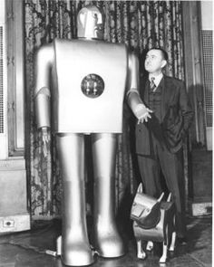

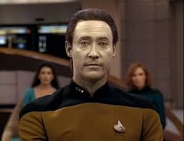
P(D+|available information)
Notes:
Following E.T.Jaynes, I like assuming the risk predictions come from a robot. What if a robot does all the probability updating according to rules and gives you P(D+|X)? How do you evaluate the risk predictions?

Slide 8
Risk Prediction vs. Diagnostic Probability
How is predicting incident outcomes different from diagnosing a prevalent condition?

Slide 9

Chance determines whether you get the disease/outcome
Notes:
More on the distinction between a diagnostic probability model and a risk prediction model

Slide 10
Diagnostic Probability Model:
Chance event occurs to patient before estimation of P(D+|X)
Spin needle to see if you develop disease.
Given all information, robot estimates the probability that you have it.
Gold standard can determine true disease state.
Time frame is cross-sectional.
Notes:
Diagnostic test results are commonly expressed in categories or units particular to the test (urine dip: -, +, ++, +++; V/Q: normal, low prob, intermediate prob, high prob). The conversion to risk of D+ uses LRs from the study and the patient’s pre-test probability. Measurement of the LRs is separate from assessment of pre-test probability.

Slide 11
Risk Prediction:
Chance event occurs to patient after estimation of P(D+|X)
Given all information, robot estimates your risk of disease/outcome.
Spin needle to see if you develop disease/outcome.
“Gold standard” is follow-up.
Time frame is longitudinal (cohort).
Notes:
predictions are commonly expressed as a risk category (10%, 20%, etc), so they already include an assessment of the patient’s pre-test probability.

Slide 12
Diagnostic Test versus Risk Prediction
 | Diagnostic Test | Risk Prediction
Purpose
Chance Event Occurs to Patient
Study Design
Test Result
Maximum Obtainable AUROC
Identify Prevalent Disease/Condition
Predict Incident Disease/Outcome
Prior to Test
After Test
Cross-Sectional
Cohort
+/-, ordinal, continuous → LR & P(D+) to get risk
Risk group (PV) Estimate risk directly
1 (gold standard)
<1 (not clairvoyant)
Notes:
Test result row: With diagnostic tests, we usually leave the results in the natural units of the test and use pre-test prob and LRs to convert to risk of having disease. Assumption: LR is independent of P(D+). With risk predictions, the results are usually reported as a risk of developing outcome and therefore already incorporate pre-test prob. Assumption: The patient is assumed to come from a population with the same overall prevalence of disease as the population used to develop the model.

Slide 13
Diagnostic Probability Model: Septic Arthritis
*Pre-test Probability = 0.38
Synovial WBC (/uL) Interval | Probability of Septic Arthritis*
>100,000 | 0.95
50,001-100,000 | 0.74
25,001-50,000 | 0.33
0 - 25,000 | 0.16
Notes:
Two weeks ago, we saw a simple diagnostic probability model for septic arthritis based only on synovial WBC count.

Slide 14
Validation
A model developed in a derivation or “training” dataset must be assessed in an independent validation or “test” dataset.

Slide 15
Fictional Example: Mastate Cancer
After mastatectomy, 3 robots (Bleakhaus, PolyANA, and AgnoSIA) separately assign each of N=300 individuals risk for recurrence over next 5 years.

Slide 16
How do you assess the validity of the predictions?
(N = 300)

Slide 17
N = 100
Bleakhaus assigns risk of 50%
PolyANA assigns risk of 25%
AgnoSIA assigns risk of 20%
Spin the needles.
33 get mastate cancer

Slide 18
100 like this
Bleakhaus assigns risk of 35%
PolyANA assigns risk of 10%
AgnoSIA assigns risk of 20%
Spin the needles.
17 get mastate cancer

Slide 19
100 like this
Bleakhaus assigns risk of 20%
PolyANA assigns risk of 5%
AgnoSIA assigns risk of 20%
Spin the needles.
11 get mastate cancer

Slide 20
Calibration
How accurate are the predicted probabilities?
  Break the population into groups*
  Compare actual and predicted probabilities for each group
* Maximum number of groups = number of different risk predictions.

Slide 21
Calibration Table
Bleakhaus’s Predicted Risk | Observed Proportion |  | Predicted - Observed
50% | 33/100 | 33% | 17%
35% | 17/100 | 17% | 18%
20% | 11/100 | 11% | 9%
 |  | Mean | 14.7%
PolyANA’s Predicted Risk | Observed Proportion |  | Predicted - Observed
25% | 33/100 | 33% | -8%
10% | 17/100 | 17% | -7%
5% | 11/100 | 11% | -6%
Mean |  |  | -7%
Notes:
Bleakhaus: Mean Bias = 14.67% SD Group Errors = 4% Calibration = SD^2 + Bias^2 = 0.023 SQRT(Calibration) = 0.152. Refinement = 0.153. Brier = Calibration + Refinement = 0.1765
Calibration tables show predicted risk and observed risk for each risk group, but they can’t be converted into LR tables without knowing the proportion in each risk group. (In this example, 1/3 in each risk group.)

Slide 22
Calibration Table
AgnoSIA’s Predicted Risk | Observed Proportion |  | Predicted - Observed
20% | 61/300 | 20.3% | -0.333%
Notes:
AgnoSIA: Mean Bias = 0.333% SD Group Errors = 0 Calibration = Bias^2 = 0.0000111111 SQRT(Calibratioin) = Same as Bias

Slide 23
Calibration Plot

Slide 24
Calibration Plot
Notes:
MSE = Brier Score = 0.1765 , RMSE=. Bias = 0.147, Variance of Individual Errors = 0.1765 – 0.147^2 = 0.155 SQRT(0.155) = 0.4 = SD of individual Errors.
SQRT(Calibration) = 0.152
TN: QUESTION for next time − are the error bars SD, SE or 95% CI
MAK: I checked. They are 95% Confidence Intervals. That appears to be the standard for calibration plots.

Slide 25
Calibration Metrics: Bias, MAE, Brier Score, Calibration*, Refinement
r_{i} = predicted risk in group i
p_{i} = proportion with outcome in group i
f_{i} = fraction of population in group i
Metrics are f_{i}-weighted averages; smaller is better; 0 is perfect.
Bias = r_{i} – p_{i}
Absolute Error = p_{i}| 1 - r_{i} | + (1 – p_{i})|0 – r_{i}|
Brier Score = p_{i}(1 - r_{i} )² + (1 – p_{i}) (0 – r_{i})²
Calibration* = (r_{i} – p_{i})² (*metric has same name as concept)
Refinement = p_{i}(1-p_{i}) (metric of discrimination)
Brier Score = Calibration + Refinement
Notes:
Will need to calculate mean bias, MAE, and Brier Score for the meteorologist problem.
Decomposition of Brier Score into calibration and refinement is not required material (yet).

Slide 26
Calibration Metrics: Bias, MAE, Brier Score, Calibration*, Refinement
 | Mean Bias | Mean Absolute Error | Brier Score | Calibration | Refinement
Bleakhaus | 0.147 | 0.389 | 0.177 | 0.023 | 0.153
PolyANA | -0.070 | 0.267 | 0.158 | 0.005 | 0.153
AgnoSIA | 0.003 | 0.322 | 0.162 | 0.000 | 0.162
Notes:
Remember, smaller is better, 0 is perfect.
AgnoSIA does best on mean bias and Calibration
PolyANA is best on MAE, and Brier Score
Like AUROC, refinement depends only on ranks, so it’s the same in Bleakhaus and PolyANA. It is maximal in AgnoSIA P(1-P) = 0.2*0.8 after rounding.
Very roughly, MAK Index = SQRT(1 – Refinement/PQ); AUC = (MAK Index + 1)/2. This is very rough.
In this case, AUROC = 0.65. MAK Index = 0.3. REF = 0.153. SQRT(1 – REF/PQ) = 0.238. AUC* = 1.236/2 = 0.62 not great when AUC = 0.65.

Slide 27
(Not for Discussion) Bleakhaus: Bias, MAE, Brier Score, Calibration, Refinement
Bleakhaus’s Predicted Risk (r) | Observed Proportion (p) |  | Predicted - Observed (r-p) | Absolute Error p(1-r)+(1-p)r | Brier p(1-r)^2 + (1-p)r^2 | Calibration (r-p)^2 | Refinement p(1-p)
50% | 33/100 | 33.0% | 17.0% | 50.0% | 0.250 | 0.029 | 0.221
35% | 17/100 | 17.0% | 18.0% | 40.1% | 0.174 | 0.032 | 0.141
20% | 11/100 | 11.0% | 9.0% | 26.6% | 0.106 | 0.008 | 0.098
 |  | Weighted Average | 14.7% | 38.9% | 0.177 | 0.023 | 0.153
Notes:
Not for discussion. Just giving the details of the calculations.
Bleakhause: Mean Bias = 14.67% SD Group Errors = 4% Calibration = SD^2 + Bias^2 = 0.023 SQRT(Calibration) = 0.152. Refinement = 0.153. Brier = Calibration + Refinement = 0.1765

Slide 28
(Not for Discussion) PolyANA: Bias, MAE, Brier Score, Calibration, Refinement
PolyANA’s Predicted Risk (r) | Observed Proportion (p) |  | Predicted - Observed (r-p) | Absolute Error p(1-r)+(1-p)r | Brier p(1-r)^2 +(1-p)r^2 | Calibration (r-p)^2 | Refinement p(1-p)
25% | 33/100 | 33% | -8.0% | 41.5% | 0.228 | 0.006 | 0.221
10% | 17/100 | 17% | -7.0% | 23.6% | 0.146 | 0.005 | 0.141
5% | 11/100 | 11% | -6.0% | 14.9% | 0.102 | 0.004 | 0.098
Weighted Average |  |  | -7.0% | 26.7% | 0.158 | 0.005 | 0.153
Notes:
Not for discussion. Just giving the details of the calculations.

Slide 29
(Not for Discussion) AgnoSIA: Bias, MAE, Brier Score, Calibration, Refinement
AgnoSIA’s Predicted Risk | Observed Proportion |  | Predicted - Observed (r-p) | Absolute Error p(1-r)+(1-p)r | Brier p(1-r)^2 +(1-p)r^2 | Calibration (r-p)^2 | Refinement p(1-p)
20% | 61/300 | 20.30% | -0.3% | 32.2% | 0.162 | 0.000 | 0.162
Notes:
Not for discussion. Just giving the details of the calculations.

Slide 30
Assessing/Quantifying Calibration*
Calibration Plots with Mean Bias, Mean Absolute Error, and Brier Score
*Overall calibration of a model is always good in the “derivation” dataset. For example, mean bias is always 0 for a logistic regression model in the dataset used to derive its coefficients.
Notes:
(SD of Group Errors)^2 + (Mean Bias)^2 = Mean-Squared Group Error = “Calibration”
“Calibration” + “Refinement” = Brier Score
These numbers are always < 1 and 0 is perfect. They are usually very small. I would rather look at the square roots. But nobody does it.

Slide 31
Discrimination
How well can the test separate subjects in the population from the mean probability to values closer to zero or 1?
May be more generalizable
Often measured with C-statistic (AUROC)

Slide 32
Start with Calibration Table
Bleakhaus’s Predicted Risk | Observed Proportion |  | Predicted - Observed
50% | 33/100 | 33% | 17%
35% | 17/100 | 17% | 18%
20% | 11/100 | 11% | 9%
Break into D+ and D- groups. Calculate column percentages, and …
Notes:
Calibration tables show predicted risk and observed risk for each risk group, but they can’t be converted into LR tables without knowing the proportion in each risk group. (In this example, 1/3 in each risk group.)

Slide 33
LR Table
Bleakhaus’s Predicted Risk | D+ |  | D- |  | Total
50% | 33 | 54% | 67 | 28% | 100
35% | 17 | 28% | 83 | 35% | 100
20% | 11 | 18% | 89 | 37% | 100
Total | 61 | 100% | 239 | 100% | 300
Notes:
33
LR Table shows P(risk group|D+) and P(risk group|D-) . Cannot convert to Calibration Table without P(D+) (overall probability in population)
Can obtain from calibration table if we know what P(r) for all r.

Slide 34
Discrimination (Bleakhaus)

Slide 35
Discrimination (Bleakhaus)
ROC Table
Bleakhaus | D+ | Sens | D- | 1-spec
Risk = 50% | 33 | 54% | 67 | 28%
Risk = 35% | 50 | 82% | 150 | 63%
Risk = 20% | 61 | 100% | 239 | 100%
Total | 61 | 100% | 239 | 100%

Slide 36
Discrimination (Bleakhaus)
AUROC = 0.65

Slide 37
Discrimination (AgnoSIA)
Notes:
TN: Why not have ROC curve with AUROC = .5?
MAK: It implies that you could choose a cutoff with 50% sensitivity and 50% specificity
37

Slide 38
True Risk
Commercial lab | High Tertile (N=100) | Middle Tertile (N=100) | Low Tertile (N=100)
Bleakhaus, Inc | Risk = 50% | Risk = 35% | Risk = 20%
AgnoSIA, Inc | Risk = 20%
PolyANA, Inc | Risk = 25% | Risk = 10% | Risk = 5%
 | Spin the Needles
Recurrences in 5-years | 33 | 17 | 11

Slide 39
True Risk – Re-Calibration of Bleakhaus
Predicted Risk | Observed Proportion |  | Predicted - Observed
50% | 33/100 | 33% | 17%
35% | 17/100 | 17% | 18%
20% | 11/100 | 11% | 9%

Slide 40
True Risk – Re-Calibration of Bleakhaus
New Predicted Risk | Observed Proportion |  | Predicted - Observed
50% 33% | 33/100 | 33% | 0%
35% 17% | 17/100 | 17% | 0%
20% 11% | 11/100 | 11% | 0%
Notes:
Note that Mean Squared Group Error = 0, “Perfect Calibration”
Remember, that to go from the Calibration Table to the LR Table (and then the ROC Table) you need the proportion in each risk group (Here, 1/3, 1/3, 1/3)

Slide 41
True Risk – Re-Calibration of Bleakhaus

Slide 42
True Risk Recalibration
LR Table
True Risk | D+ |  | D-
33% | 33 | 54% | 67 | 28%
17% | 17 | 28% | 83 | 35%
11% | 11 | 18% | 89 | 37%
Total | 61 | 100% | 239 | 100%
Notes:
The is the LR Table. Got here because I knew that Calibration table was tertiles. To get from here back to Calibration Table, you need overall risk in population.

Slide 43
True Risk -- Discrimination

Slide 44
True Risk -- Discrimination
AUROC = 0.65

Slide 45
The ROC curve depends only on rankings, not calibration
Re-calibration does not affect the ROC curve (unless group ranks change)

Slide 46
Using Calibration Plots to Assess Discrimination
Greater “spread” usually means better discrimination
But need to know proportion in each risk group (not always equal!)
Notes:
You can’t use the ROC curve to assess calibration, but you can use the calibration plot to assess discrimination.

Slide 47
Note that points are reversed in order between Calibration Plot and ROC Curve.
Notes:
The 0 risk group has 2/3 of the patients. (That’s why the marker is bigger.)
Points on the calibration plot correspond to segments on the ROC curve.
Note that points are reversed between Calibration Plot and ROC Curve segments.
There is a rough relationship between the length of the line segment and the proportion of the population in the corresponding risk group, but it’s not a direct proportion.
Fine point: As AUROC goes up Refinement goes down. If AUROC = 1, Refinement = 0 . If AUROC = 0.5, Refinement = P(1-P). If you know P, the proportion with the outcome, you can go from the ROC curve to the refinement. ROC Table → LR Table → Calibration Table → Refinement. If there is a formula directly relating AUROC to refinement (given P), I don’t know it. It would be something like 2*(1 –AUROC)*P*(1-P),

Slide 48
Population Net Benefit
Get P(D+|X) (e.g. from robot) for each of N patients (p₁, p₂,…, p_{N})
Record your best decision on each patient
  Treat for p_{i} > P_{TT} =C/(C+B)
Determine outcomes (D+/D-)
NB = [#Treated Appropriately –
  (C/B) (#Treated Unnecessarily) ] /N
Notes:
Assumes C/B is same for all patients.

Slide 49
Population Net Benefit
[#Treated Appropriately –
  (C/B) (#Treated Unnecessarily) ] /N
(TP – (C/B)×FP)/N
TP = number of D+ treated appropriately when strategy is treat for p_{i} > P_{TT}
FP = number of D- treated unnecessarily when strategy is treat for p_{i} > P_{TT}

Slide 50
Maximizing Net Benefit vs. Minimizing Expected Regret
Algebraically equivalent, i.e., lead to same treatment threshold P_{tt}
Expected Regret of Treat Relative to No Treat
  (1 –P)×C - P×B
  Higher is worse
Net Benefit of Treatment
  [P×B – (1-P)×C]/B
  P – C/B ×(1-P)×C
  Higher is better

Slide 51
Net Benefit
Chemotherapy has severe side effects but always prevents recurrence.*
It is 3 times worse to have a recurrence than to treat with chemotherapy unnecessarily.
B = 3C
C/B = 1/3
Should treat with chemo when
p_{i} > C/(C+B)
p_{i} > ¼ = 25%
* NNT = 1. We will learn how to quantify treatment effects in 2 weeks.
Notes:
In 2 weeks, will learn about CBOP and BBOP. CBOP = C*NNT and BBOP = Benefit per Bad Outcome Prevented.
Ptt = CBOP/BBOP
This is the same as C/(C+B) because
B = BBOP*ARR – C
B + C = BBOP*ARR
C/(B+C) = C*NNT/BBOP
C/(B+C) = CBOP/BBOP

Slide 52
Net Benefit
NB = [TP - C/B(FP)]/N
= [Recurrences Prevented
– C/B(Unnecessary ChemoTx)]/300

Slide 53
Value of Prognostic Information
300 patients (100 per risk group)
PolyANA: 25%
≥ 25%
ChemoTx
33 recurrences prevented; 67 out of 100 unnecessary
PolyANA: 10%
< 25%
NO ChemoTx
17 recur; no recurrences prevented; no unnecessary tx
PolyANA: 5%
< 25%
NO ChemoTx
11 recur; no recurrences prevented; no unnecessary tx

Slide 54
PolyANA Net Benefit (P_{tt}=0.25)
NB = (1/N)[TP - C/B(FP)]
= [Recurrences Prevented
– (C/B)(Unnecessary ChemoTx)]/300
= [33 – (1/3)(67)]/300 = 11/300

Slide 55
Value of Prognostic Information
Net Benefit (C/B = 1/3)
 | Chemo | Recur | Recur Prevented | Unnecessary Chemo | Net Benefit (x300)
No Treat | 0 | 61 | 0 | 0 | 0
PolyANA | 100 | 28 | 33 | 67 | 11
Treat All | 300 | 0 | 61 | 239 | -19

Slide 56
Value of Prognostic Information
300 patients (100 per risk group)
Bleakhaus: 50%
≥ 25%
ChemoTx
33 recurrences prevented; 67 treated unnecessarily
Bleakhaus : 33%
> 25%
ChemoTx
17 recurrences prevented; 83 treated unnecessarily
Bleakhaus : 20%
< 25%
NO ChemoTx
11 recur (no recurrences prevented), no unnecessary tx

Slide 57
Bleakhaus Net Benefit
NB = [TP - C/B(FP)]/N
= [Recurrences Prevented
– C/B(Unnecessary ChemoTx)]/300
= [50 - 1/3(150)]/300 = 0/300

Slide 58
Value of Prognostic Information
Net Benefit (C/B = 1/3)
 | Chemo | Recur | Recur Prevented | Unnecessary Chemo | Net Benefit (x300)
No Treat | 0 | 61 | 0 | 0 | 0
Bleakhaus | 200 | 11 | 50 | 150 | 0
Treat All | 300 | 0 | 61 | 239 | -19

Slide 59
Net Benefit (C/B = 1/3)
 | Treated | Unnecessary Treatment | Recurrences | Recur Prevented | Net Benefit (x 300) Recur Equivalents
No Treat | 0 | 0 | 61 | 0 | 0
PolyANA | 100 | 67 | 28 | 33 | 11
Bleakhaus | 200 | 150 | 11 | 50 | 0
Treat All | 300 | 239 | 0 | 61 | -19

Slide 60
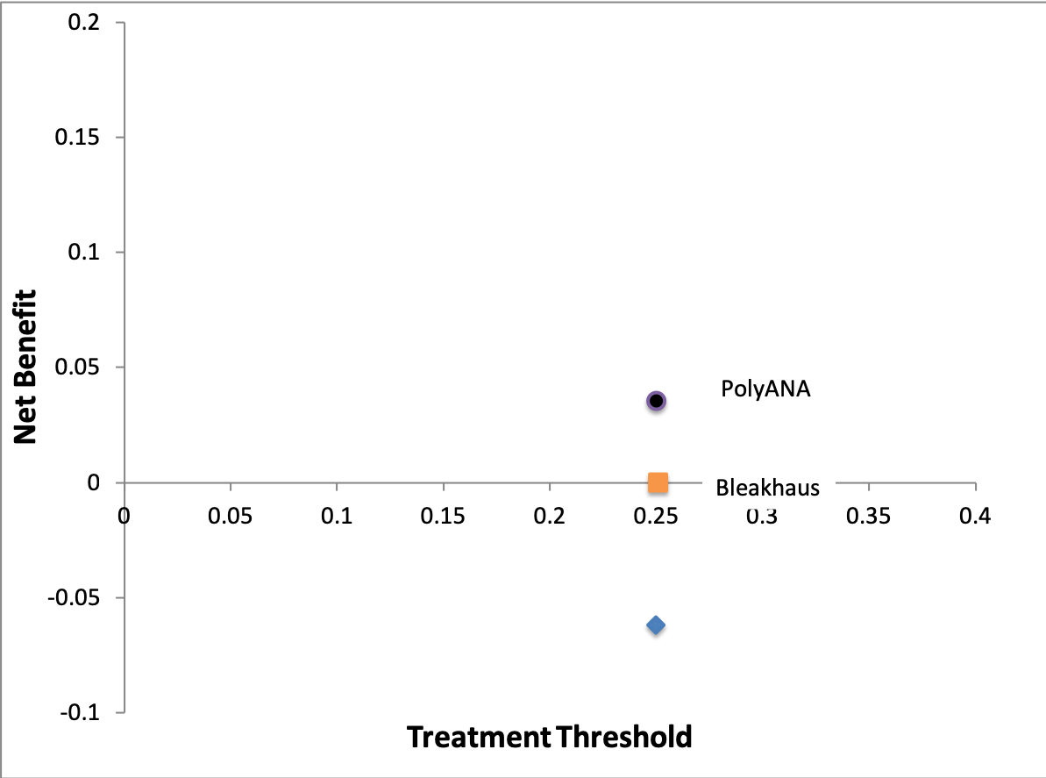
Treat All

Slide 61
Value of Prognostic Information
300 patients (100 per risk group)
True Risk: 33%
> 25%
Chemo
33 recurrences prevented; 67 treated unnecessarily
True Risk: 17%
< 25%
No Chemo
17 recur; no recurrences prevented; no unnecessary tx
True Risk: 11%
< 25%
No Chemo
11 recur; no recurrences prevented; no unnecessary tx

Slide 62
Decision Curve
Net Benefit
Ptt | C/B | Treat All | Bleakhaus | PolyANA | Recalibrated
0.01 | 1:99 | 0.195 | 0.195 | 0.195 | 0.195
0.05 | 1:19 | 0.161 | 0.161 | 0.161 | 0.161
0.07 | 1:17 | 0.146 | 0.146 | 0.131 | 0.146
0.10 | 1:9 | 0.115 | 0.115 | 0.111 | 0.115
0.17 | 1:5 | 0.040 | 0.040 | 0.064 | 0.064
0.20 | 1:4 | 0.004 | 0.004 | 0.054 | 0.054
0.25 | 1:3 | -0.062 | 0.000 | 0.036 | 0.036
0.33 | 1:2 | -0.189 | -0.080 | 0.000 | 0.000
0.50 | 1:1 | -0.593 | -0.113 | 0.000 | 0.000

Slide 63
“Treat All”
P – P_{tt}/(1- P_{tt})×(1-P)
Crosses vertical axis at NB = P
  When P_{tt} = 0, NB = P
Crosses horizontal axis at P_{tt} = P
  When P_{tt} = P, NB = 0

Slide 64
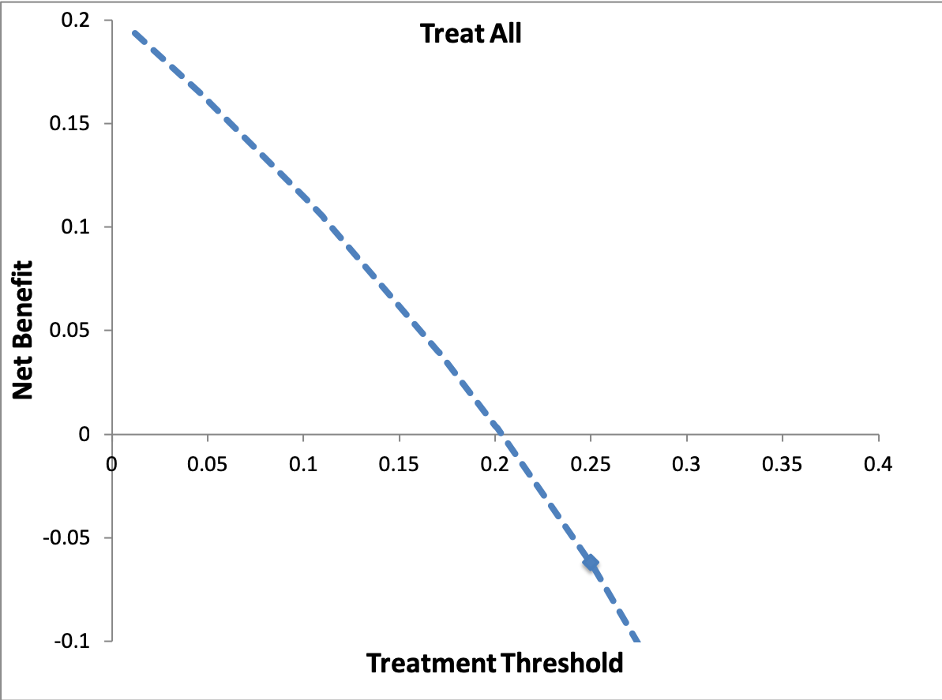
Notes:
Maximum NB is cumulative incidence (P) in the population. This has led to some people using NB/P as the standardized net benefit.
Treat All always crosses vertical axis at maximum NB = P and horizontal axis at treatment threshold Ptt = P.
The range of Ptt that is relevant is much narrower than shown here.

Slide 65
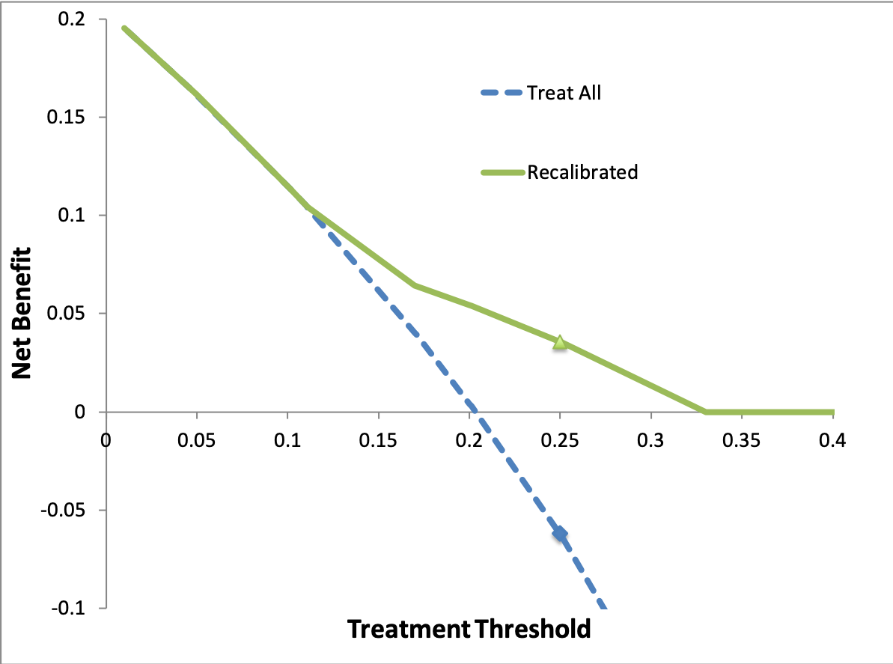
Notes:
A properly calibrated risk model never crosses the horizontal axis into the negative Net Benefit region.
A properly calibrated risk model ALSO never is below the “Treat All” curve.

Slide 66
Decision Curves and Miscalibration
Overstimating risk leads to treating when you shouldn’t. NB < 0.
Understimating risk leads to failing to treat when you should. NB < “Treat All”
A properly calibrated model will always have 0 ≤ NB ≤ “Treat All”

Slide 67
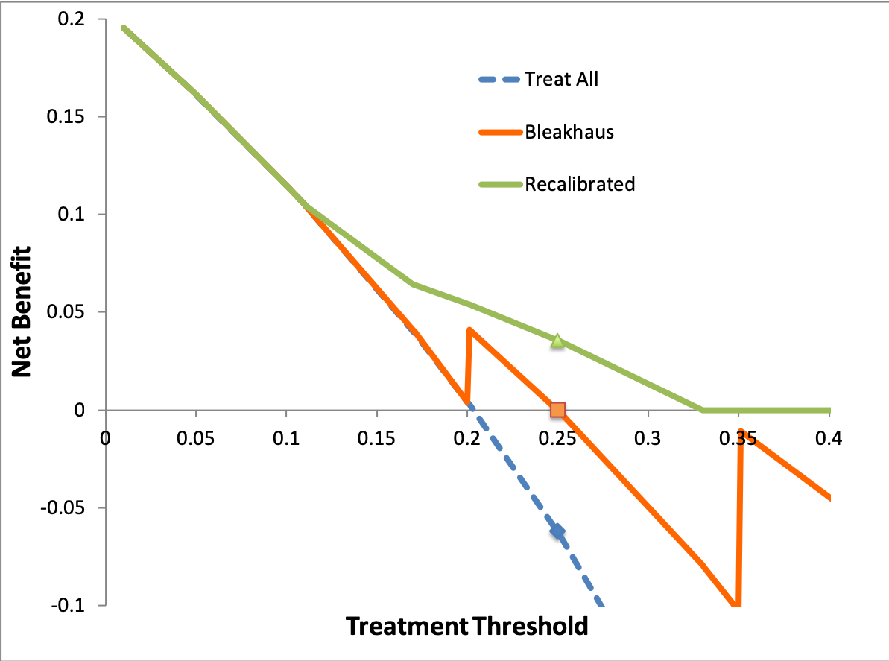
Notes:
Bleakhaus overestimates risk. This leads to overtreatment and can lead to negative net benefit (always relative to no treatment)
The sawtooth appearance occurs because of discrete risk groups in which many individuals are assigned the same risk. In this case, there are only 3 discrete risks. An abrupt vertical increase or decrease (sawtooth) occurs when Ptt = the discrete risk estimate and the previous group’s risk estimate was miscalibrated. A vertical increase occurs when the previous group’s risk estimate was too high leading to overtreatment. An vertical decrease occurs the previous group’s risk estimate was too low, leading to undertreatment.

Slide 68
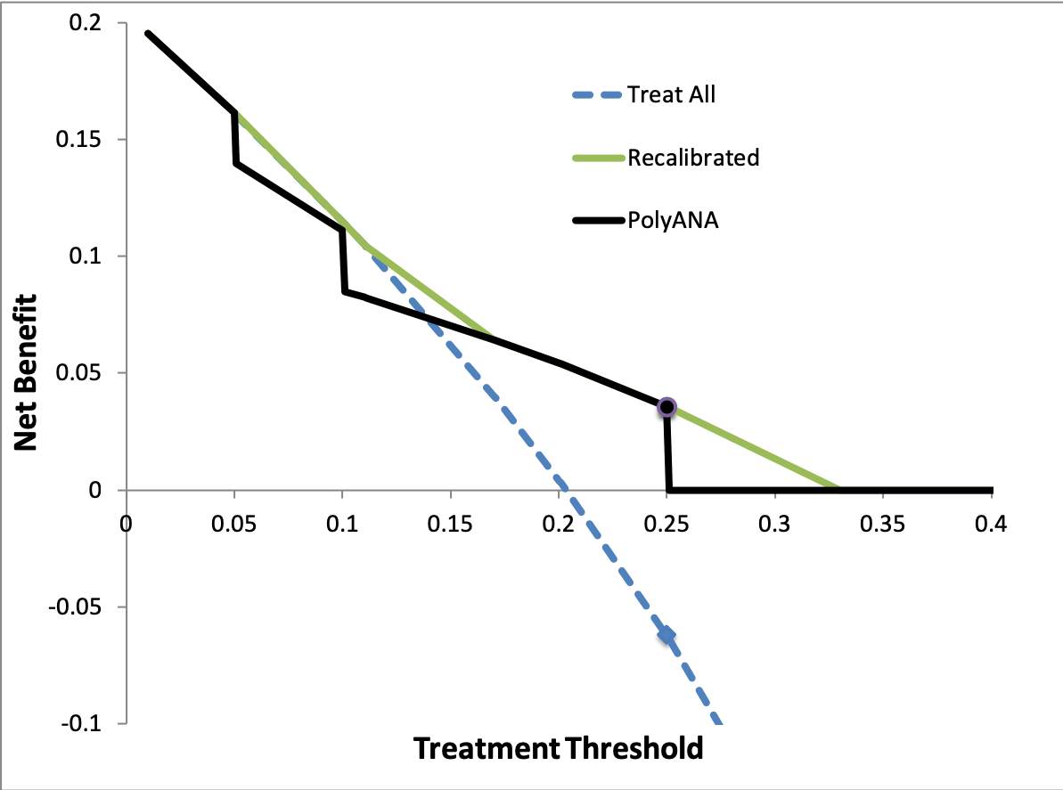
Notes:
PolyANA understimates risk. This leads to undertreatment and net benefit less that can be obtained via the Treat All strategy.

Slide 69
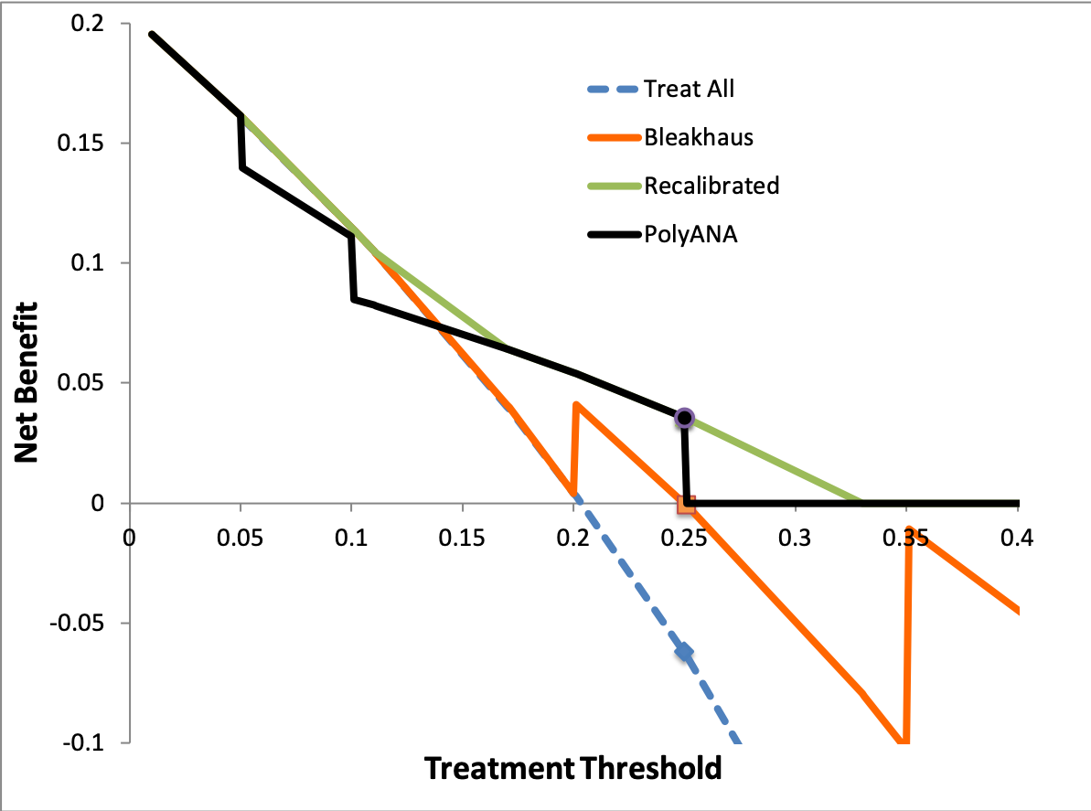

Slide 70
Decision Curves “Sawtooth”
Occurs when a large group is assigned the same risk estimate and…
the risk estimate for the next lower risk group is miscalibrated.
Vertical jump occurs at Ptt = risk estimate.
Common for risk models created using classification trees.
Notes:
You shouldn’t get sawtooth curves when each individual is assigned a unique risk estimate as occurs in a logistic regression with one or more continuous predictors or a risk model with lots of “features” that uses Random Forests.

Slide 71
Comparing Predictions
Identify cohort.
Obtain predictions (or information necessary for prediction) at inception.
Provide uniform treatment to cohort or at least treat independent of (blinded to) prediction.
Determine outcomes.
Scenario: What would have happened if treatment were based on predicted risk? Would net benefit have been higher with Risk Prediction 1 or Risk Prediction 2?

Slide 72
Clinical Treatment Based On Predicted Risk
Especially relevant if outcome is something like 7-day in-hospital survival
If treatment is effective and higher risk patients are treated more aggressively:
Discrimination is DECREASED
If highest risk patients are considered futile and support is withdrawn:
Discrimination is INCREASED
Notes:
7-7 (a)iii
72

Slide 73
NLST Lung CA Mortality
Risk Prediction Model
Regression model converts the following variables* into a risk of lung cancer death within 5 years
Age
BMI
Family history of lung cancer
Pack-years of smoking
Years since smoking cessation
Emphysema diagnosis
*Sex and Race were not included in the model (?)

Slide 74
Calibration
Risk Category* | Lung Cancer Deaths within 5 years/1000
 | Predicted | Validation | Difference
5 | 34.1 | 45.3 | -11.2
4 | 13.7 | 19.5 | -5.8
3 | 8.3 | 13.2 | 4.9
2 | 6.6 | 4.6 | 2.0
1 | 3.8 | 2.0 | 1.8
*These were actually quintiles or risk, but for exposition, I will treat them as fixed risk categories.

Slide 77
Discrimination
Risk Category | Lung Cancer Death within 5 years
 | Predicted | Sensitivity | 1- Specificity
5 | 34.1 | 54% | 19%
4 | 13.7 | 77% | 39%
3 | 8.3 | 92% | 59%
2 | 6.6 | 98% | 80%
1 | 3.8 | 100% | 100%
Notes:
3rd column: Of all patients who die of lung cancer within 5 years, 54% are in Risk Category 5; 77% are in Risk Categories 4 & 5; 92% are in categories 3, 4, & 5; and so on.

Slide 78
AUROC = 0.744

Slide 80
Binary Decision: CT Yes/No
Assume CT scanning one who will die of lung CA in the next 5 years is worth CT scanning 100 who will not die
Threshold mortality risk =1%

Slide 81
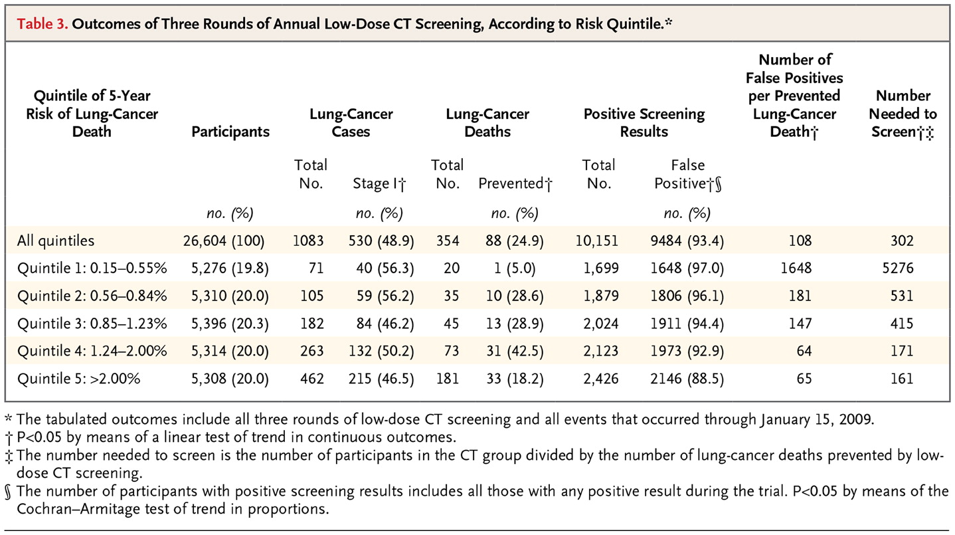

Kovalchik SA et al. N Engl J Med 2013;369:245-254.

Slide 82
Binary Decision: CT Yes/No
Assume CT scanning one who will die of lung CA in the next 5 years is worth CT scanning 100 who will not die
Threshold mortality risk =1%

Slide 83
Net Benefit of Risk Model
 | Total Scans | TP | FP | (TP - FP/100)/N
CT None | 0 | 0 | 0
CT Risk Groups 3,4,5 | 16018 | 376 | 15642 | 8.3/1000
CT w/o risk stratification | 26604 | 442 | 26162 | 6.8/1000

Slide 84
extra

Slide 85
Review: Using a single diagnostic test
Given
  Binary decision (e.g, treat/no treat)
  Consequences of errors, B and C
  Pre-Test Probability of Disease P(D+)
  Result r of a single diagnostic test
  P(r|D+) and P(r|D-)

Slide 86
Review: Using a single diagnostic test
Calculate post-test probability P(D+|r)
Make binary decision (Treat/No Treat)

Slide 87
Review: Steps
Convert P(D+) to Odds(D+)
  Odds = P/(1-P) (Pizza)
Determine LR(r)
  LR = P(r|D+)/P(r|D-) (WOWO)
Odds(D+|r) = Odds(D+)×LR(r)
  (Bayes’s Rule “Odds Form”)
Convert Odds(D+|r) to P(D+|r)
  P = Odds/(1+Odds) (Pizza)

Slide 88
Compare P(D+|r) to P_{tt}
P_{tt}=C/(C+B)
P(D+|r) ≥ P_{tt} → treat
P(D+|r) < P_{tt} → no treat

Slide 89
Logarithms
10^{b} = a; b = log(a)
10² = 100; 2 = log(100)
10⁽⁻¹⁾ = 0.1; -1 = log(0.1)
10^{0.3} = 2, 0.3 = log(2)

Slide 90
a | Log(a)
1 | 0
2 | 0.30
3 | 0.5*
4 | 0.60
5 | 0.70
6 | 0.8*
7 | 0.85
8 | 0.90
9 | 0.95
10 | 1.00
*approximate
Notes:
TN: Point out that these are approximate because this makes it look like 3 × 3 = 10.

Slide 91
log(xy) = log(x) + log(y)
log(1,000×10) = log(1000) + log(10)
log(10,000) = 3 + 1 = 4
log(10×2) = log(10) + Log(2)
log(20) = 1 + 0.3 = 1.3
Notes:
The logarithm of the product is the sum of the logarithms

Slide 92
log(x/y) = log(x) - log(y)
log(10,000/10) = log(10,000) - log(10)
log(1,000) = 4 - 1 = 3
log(10/2) = log(10) – log(2)
log(5) =1 – 0.3 = 0.7
Notes:
The logarithm of the quotient is the difference of the logarithms.

Slide 93
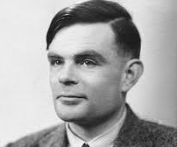

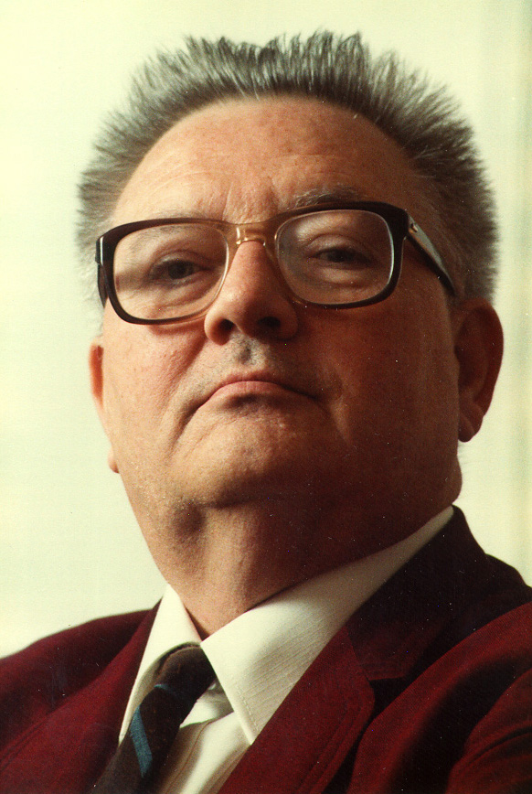
Odds(D+|r) = Odds(D+)LR(r)
log(Odds(D+|r) = log(Odds(D+)) + log(LR(r))
Notes:
Alan Turing, ET Jaynes, Tom Newman
Actually both Turing and Jaynes added a factor of 10: 10log(Odds(D+|r) = 10log(Odds(D+)) + 10log(LR(r)).
Jaynes refers to 10log(Odds) as the “evidence”. The units are decibans (Turing) or decibels (Jaynes).
If pretest probability is 1/6, then pretest odds are 1/5, log(1/5) = -0.7 or -7 decibels. If the LR is 20, log(20) = 1.3 or 13 decibels. Post-test “evidence” = -7 + 13 = 6 decibels. Post test odds =4:1, P = 4/5 = 0.8.

Slide 94


Slide 95
Minimize Expected Regret
E(Regret|No Treat) = P*×B
E(Regret|Treat) = (1-P*)×C
where P* = P(D+|available info)

Slide 96
Treat is better than No Treat
Treat is worse than No Treat

Slide 97
Minimize Expected Regret of Treat Relative to No Treat
E(Regret) = -P*×B + (1-P*)×C
Negative values (<0) are good.

Slide 98
Treat is worse than No Treat
Treat is better than No Treat

Slide 99
Maximize Expected Net Benefit of Treat Relative to No Treat
E(Net Benefit) = P*×B - (1-P*)×C
Positive values (>0) are good.

Slide 100
Treat is better than No Treat
Treat is worse than No Treat

Slide 101
Maximize Expected Net Benefit
E(Net Benefit) = P*- (1-P*)×C/B
C/B = Treatment Threshold Odds
= P_{TT}/(1 – P_{TT})

Slide 102
Notes:
This shows how the expected net benefit depends on a single patient’s probability of disease, P(D+|available info).

Slide 103
Expected Net Benefit of Treatment for a Patient
E(Net Benefit) = P*- (1-P*)×C/B
P* = P(D+|available information)
Note: this is net benefit of treatment relative to no treatment

Slide 104
Population Net Benefit
Get P(D+|X) (e.g. from robot) for each of N patients (p₁, p₂,…, p_{N})
Record your best decision (treat or no treat) on each patient
  Treat for p_{i} > P_{TT} =C/(C+B)
Determine outcomes (D+/D-)
NB = [#Treated Appropriately –
  (C/B) (#Treated Unnecessarily) ] /N
Notes:
P(D+|X) = P(D+| available info)
Assumes C/B is same for all patients. Population net benefit used for evaluating risk models
TN: Second bullet might be clearer as record your best estimate of Pi on each patient. MAK – I don’t think so. It’s record ”treat” or “no treat”

