Slide 1
Combining Tests, Multivariate Risk Prediction
Michael A. Kohn, MD, MPP
10/22/2020

Slide 2
Outline: Combining Tests
Independence Conditional on D+/D- (Hard!)
Classification Trees
Logistic Regression
  Digression: Natural Logarithms
Variable (Test) Selection
Validation separate from derivation

Slide 3
Combining Tests
Example
Prenatal sonographic Nuchal Translucency (NT) and Nasal Bone Exam as dichotomous tests for Trisomy 21*
*Cicero, S., G. Rembouskos, et al. (2004). "Likelihood ratio for trisomy 21 in fetuses with absent nasal bone at the 11-14-week scan." Ultrasound Obstet Gynecol 23(3): 218-23.

Slide 4
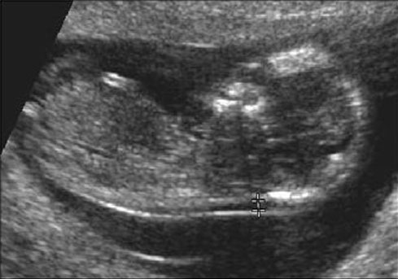
If NT ≥ 3.5 mm Positive for Trisomy 21*
*What’s wrong with this definition?

Slide 6
In general, don’t make multi-level tests like NT into dichotomous tests by choosing a fixed cutoff
I did it here to make the discussion of multiple tests easier
I arbitrarily chose to call ≥ 3.5 mm positive

Slide 7
One Dichotomous Test
(212/333)/(478/5223)
Trisomy 21
Nuchal D+ D- LR
Translucency
≥ 3.5 mm 212 478 7.0
< 3.5 mm 121 4745 0.4
Total 333 5223
Notes:
Many oversimplifications in this example. Made NT dichotomous and considered only trisomy 21. In fact, you do CVS to identify any chromosomal abnormality,, not just trisomy 21. Different chromosomal abnormalities do different things to NT.

Slide 8
NT Positive
Pre-test Prob = 0.06
LR(Result) = 7.0
Post-Test Prob = ?

Slide 9
Clinical Scenario – One Test
Pre-Test Probability of Down’s = 6%
NT Positive
Pre-test prob: 0.06
Pre-test odds: 0.06/0.94 = 0.064
LR(+) = 7.0
Post-Test Odds = Pre-Test Odds x LR(+)
= 0.064 x 7.0 = 0.44
Post-Test prob = 0.44/(0.44 + 1) = 0.31

Slide 10
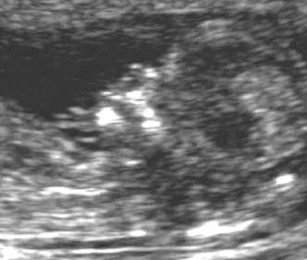
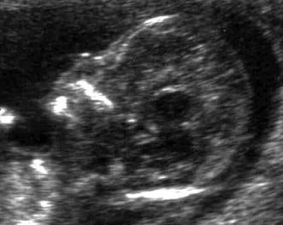
Nasal Bone Seen
NBA=“No”
Neg for Trisomy 21
Nasal Bone Absent
NBA=“Yes”
Pos for Trisomy 21

Slide 11
Second Dichotomous Test
Nasal Bone Tri21+ Tri21- LR
Absent
Yes 229 129 27.8
No 104 5094 0.32
Total 333 5223
(229/333)/(129/5223)

Slide 12
Pre-Test Probability of Trisomy 21 = 6%
NT Positive for Trisomy 21 (≥ 3.5 mm)
Post-NT Probability of Trisomy 21 = 31%
Nasal Bone Absent
LR(NBA) = 27.8
Post-NBA Probability of Trisomy 21 = ?
Clinical Scenario –Two Tests
Using Probabilities

Slide 13
Clinical Scenario – Two Tests
Using Odds
Pre-Test Odds of Tri21 = 0.064
NT Positive (LR = 7.0)
Post-Test Odds of Tri21 = 0.44
Nasal Bone Absent (LR = 27.8?)
Post-Test Odds of Tri21 = .44 x 27.8
= 12.4?
(P = 12.4/(1+12.4) = 92.5%?)

Slide 14
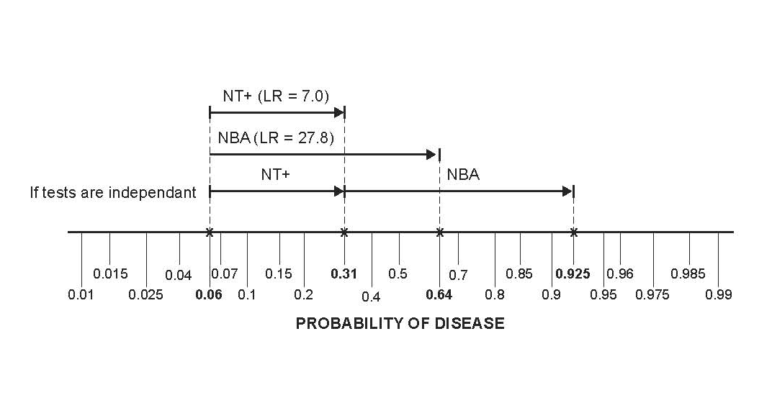
Clinical Scenario – Two Tests
Pre-Test Probability of Trisomy 21 = 6%
NT ≥ 3.5 mm AND Nasal Bone Absent

Slide 15
Question
NT “positive” and Nasal Bone Absent. What is probability of Trisomy 21?
< 92.5%
= 92.5%
> 92.5%
Cannot say

Slide 16
Answer
NT | NBA | Tri21+ | Tri21- |  | Post Test Prob*
Pos | Pos | 158 | 36 | 158/(158+36) | 81%
Pos | Neg | 54 | 442 | 54/(54+442) | 11%
Neg | Pos | 71 | 93 | 71/(71+93) | 43%
Neg | Neg | 50 | 4652 | 50/(50+4652) | 1%
Total | Total | 333 | 5223 | 333/(333+5223) | 6%
*Assumes pre-test prob = 6%

Slide 17
Question
Can we use the post-test odds after a positive Nuchal Translucency as the pre-test odds for the positive Nasal Bone Examination?
i.e., can we combine the positive results by multiplying their LRs?
LR(NT+, NBA +) = LR(NT +) x LR(NBA +) ?
= 7.0 x 27.8 ?
= 194 ?

Slide 18
Answer = No
NT | NBA | Trisomy 21 + | % | Trisomy 21 - | % | LR
Pos | Pos | 158 | 47% | 36 | 0.7% | 69
Pos | Neg | 54 | 16% | 442 | 8.5% | 1.9
Neg | Pos | 71 | 21% | 93 | 1.8% | 12
Neg | Neg | 50 | 15% | 4652 | 89% | 0.2
Total | Total | 333 | 100% | 5223 | 100%
Not 194
158/(158 + 36) = 81%, not 92.5%

Slide 19
Non-Independence
Absence of the nasal bone does not tell you as much if you already know that the nuchal translucency is ≥ 3.5 mm.

Slide 20
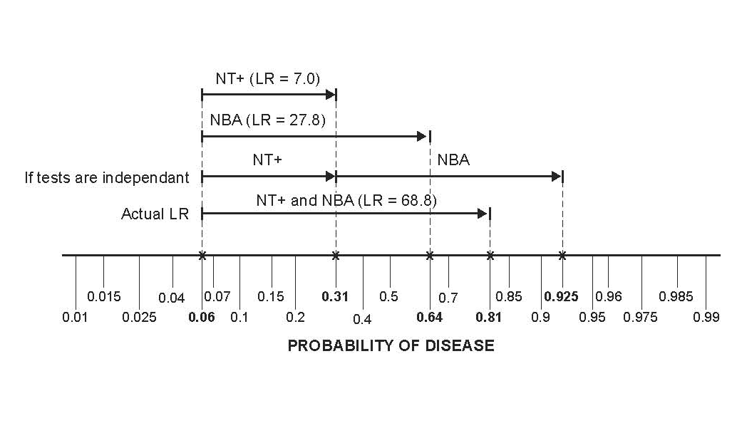
Non-Independence

Slide 21
Non-Independence of NT and NBA
In chromosomally normal (D-) fetuses, a false positive on the NT makes a false positive on the NBA more likely.
Some (but not all) of this may have to do with ethnicity. In this London study, chromosomally normal fetuses of “Afro-Caribbean” ethnicity had both larger NTs and more frequent absence of the nasal bone.
In Trisomy 21 (D+) fetuses, normal NT was associated with the presence of the nasal bone, so a false negative on the NT was associated with a false negative on the NBA.
Notes:
8-8 (d)

Slide 22
Non-Independence of NT and NBA
Of normal (D-) fetuses with NT ≥ 3.5 mm, 7.5% had nasal bone absent. Of normal (D-) fetuses with NT < 3.5 mm only 2.0% had nasal bone absent.
P(NBA+|NT+ & D-) = 0.075
P(NBA+|NT- & D-) = 0.020
Notes:
Among D- fetuses, NBA+ increases the odds of NT+ by a factor of 0.075/0.02 = 3.25.
Odds(NT+|NBA+&D-) = Odds(NT+|D-) * 3.25
They are not independent.

Slide 23
Non-Independence of NT and NBA
If independent,
P(NBA+|NT+&D-) = P(NBA+|NT-&D-) = P(NBA+|D-)
But,
P(NBA+|NT+ & D-) = 0.075
P(NBA+|NT- & D-) = 0.020
Notes:
If conditional independence, Odds(NT+|NBA+&D-) = Odds(NT+|D-), but Odds(NT+|NBA+&D-) = Odds(NT+|D-)*3.25

Slide 24
Non-Independence
Instead of looking for the nasal bone, what if the second test were just a repeat measurement of the nuchal translucency?
A second positive NT would do little to increase your certainty of Trisomy 21. If it was false positive the first time around, it is likely to be false positive the second time.

Slide 25
Reasons for Non-Independence
Tests measure the same aspect of disease.
One aspect of Down’s syndrome is slower fetal development; the NT decreases more slowly and the nasal bone ossifies later. Chromosomally NORMAL fetuses that develop slowly will tend to have false positives on BOTH the NT Exam and NBA.

Slide 26
Reasons for Non-Independence
Heterogeneity of Disease (e.g. spectrum of severity)*.
Heterogeneity of Non-Disease.
(See EBD-2 Chapter 7 first 3 pages)
*In this example, Down’s syndrome is the only chromosomal abnormality considered, so disease is fairly homogeneous. But this is actually quite unrealistic.
Notes:
Many oversimplifications in this example. Made NT dichotomous and considered only trisomy 21. In fact, you do CVS to identify any chromosomal abnormality,, not just trisomy 21. Different chromosomal abnormalities do different things to NT and NBA.

Slide 27
Unless tests are independent (conditional on D+/D-), we can’t combine results by multiplying LRs.
Notes:
“Naïve Bayes” is assuming that tests are conditionally independent, so that you can multiply LRs.

Slide 28
Independence Conditional On Disease Status
In D+ patients,
a false negative on Test 1 does not affect the probability of a false negative on Test 2.
In D- patients,
a false positive on Test 1 does not affect the probability of a false positive on Test 2.

Slide 29
Ways to Combine Multiple Tests
On a group of patients (derivation set), perform the multiple tests and (independently*) determine true disease status (apply the gold standard)
Measure LR or PV for each possible combination of results
Classification Trees
Logistic Regression
*Beware of incorporation bias

Slide 30
Determine LR for Each Result Combination
NT | NBA | Tri21+ | % | Tri21- | % | LR | Post Test Prob*
Pos | Pos | 158 | 47% | 36 | 0.7% | 69 | 81%
Pos | Neg | 54 | 16% | 442 | 8.5% | 1.9 | 11%
Neg | Pos | 71 | 21% | 93 | 1.8% | 12 | 43%
Neg | Neg | 50 | 15% | 4652 | 89.1% | 0.2 | 1%
Total | Total | 333 | 100% | 5223 | 100%
*Assumes pre-test prob = 6%

Slide 31
Sort by LR (Descending)
NT | NBA | Tri21+ | % | Tri21- | % | LR
Pos | Pos | 158 | 47% | 36 | 0.70% | 69
Neg | Pos | 71 | 21% | 93 | 1.80% | 12
Pos | Neg | 54 | 16% | 442 | 8.50% | 1.9
Neg | Neg | 50 | 15% | 4652 | 89.10% | 0.2
Notes:
8-7 (a)

Slide 32
Apply Chapter 4 – Multilevel Tests
Now you have a multilevel test (In this case, 4 levels.)
Have LR for each test result
Can create ROC curve and calculate AUROC
Given pre-test probability and treatment threshold probability (C/(B+C)), can find optimal cutoff.

