Slide 1
Classification Trees and Logistic Regression: simplified introduction
Michael A. Kohn, MD, MPP
10/22/2020

Slide 2
Combining Tests
Example
Prenatal sonographic Nuchal Translucency (NT) and Nasal Bone Exam as dichotomous tests for Trisomy 21*
*Cicero, S., G. Rembouskos, et al. (2004). "Likelihood ratio for trisomy 21 in fetuses with absent nasal bone at the 11-14-week scan." Ultrasound Obstet Gynecol 23(3): 218-23.

Slide 3
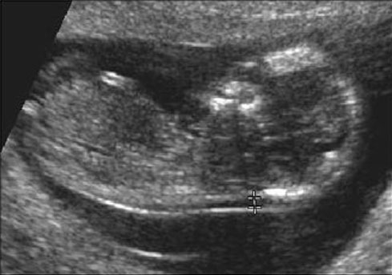
If NT ≥ 3.5 mm Positive for Trisomy 21*
*What’s wrong with this definition?

Slide 4
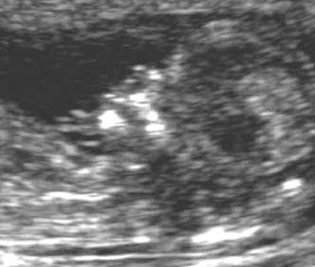
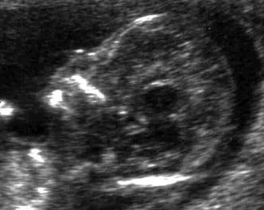
Nasal Bone Seen
NBA=“No”
Neg for Trisomy 21
Nasal Bone Absent
NBA=“Yes”
Pos for Trisomy 21

Slide 5
Assumption
Decision = Chorionic Villus Sampling (CVS) = “Treatment”
Willing to do CVS on 20 normals to identify one abnormal
C/B = 1/20 = 0.050 = 1:20
P_{TT} = 1/21 = 0.048 = 4.8%
(This threshold is much higher than used in practice.)

Slide 6
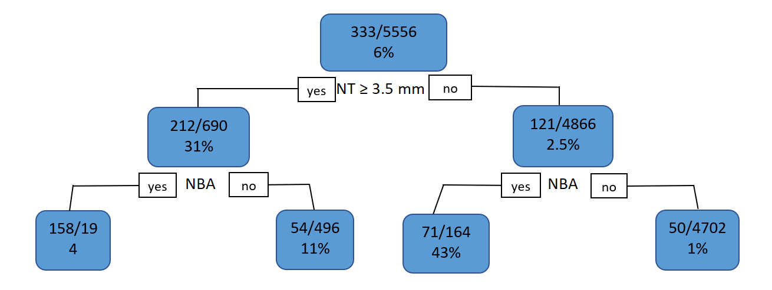
Treat/No Treat?
6% > P_{TT} = 4.8%. Decision = Treat
NB* = 333 – (1/20)×5223 = 72
NB*(Treat All) = 72
Note: NB = NB*/N = NB*/5556
Notes:
Recall Net Benefit is always (TP – (C/B)*FP.)/N . NBA has both more TP (229 vs 212) and fewer FP (129 vs 478), so it is always preferred to NBA.
If treatment threshold is 20% C/B = ¼, then you would not treat initially. NT+ → Treat. NT- → No treat. NB = [212 - ¼(478)5556 = 0.0167 (For NBA was 0.035.)
If treatment threshold is 4.8% C/B = 1/20, then you would treat initially. NT+ → Treat. NT- → No treat. NB(Treat all) = [333 - (1/20)(5233) ]/ 5556 = 0.013. NB = [212 - 1/20(478)]/5556 = 0.034 (for NBA was 0.040). Diff = 0.021 (with NBA was 0.027)
At both treatment thresholds NBA is better than NT. This will be the case at any treatment threshold where NBA and changes the default decision.

Slide 7
Can NT help?
Moves 4866 below P_{TT}
NB*(NT) = 212 – (1/20)×478 = 188
NB*(Treat All) = 72
NB*(NT) > NB*(Treat All)
Note: NB = NB*/N = NB*/5556
Notes:
Recall Net Benefit is always (TP – (C/B)*FP.)/N . NBA has both more TP (229 vs 212) and fewer FP (129 vs 478), so it is always preferred to NBA.
If treatment threshold is 20% C/B = ¼, then you would not treat initially. NT+ → Treat. NT- → No treat. NB = [212 - ¼(478)5556 = 0.0167 (For NBA was 0.035.)
If treatment threshold is 4.8% C/B = 1/20, then you would treat initially. NT+ → Treat. NT- → No treat. NB(Treat all) = [333 - (1/20)(5233) ]/ 5556 = 0.013. NB = [212 - 1/20(478)]/5556 = 0.034 (for NBA was 0.040). Diff = 0.021 (with NBA was 0.027)
At both treatment thresholds NBA is better than NT. This will be the case at any treatment threshold where NBA and changes the default decision.

Slide 8
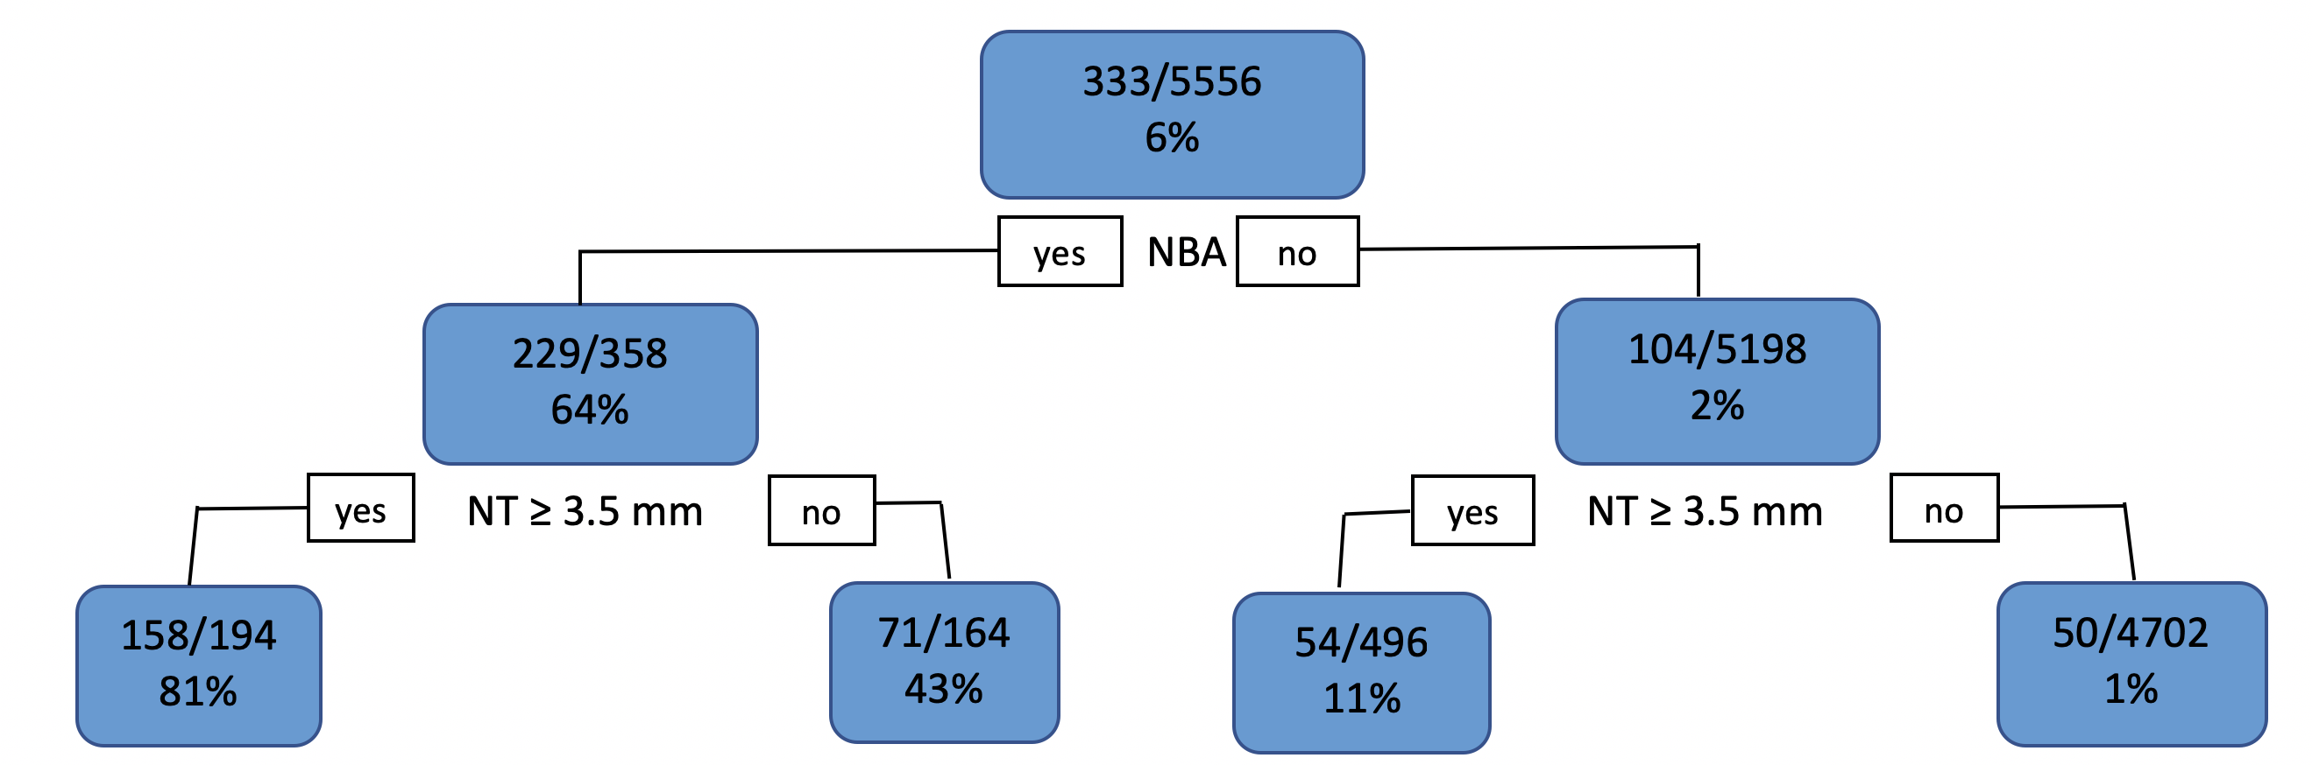
Can NBA help?
Moves 5198 below P_{TT}
NB*(NBA) = 229 – (1/20) ×129 = 223
NB*(NT) = 212 – (1/20)×478 = 188
NB*(Treat All) = 72
NB*(NBA) > NB*(NT) > NB*(Treat All)
Note: NB = NB*/N = NB*/5556
Notes:
Recall Net Benefit is always TP – (C/B)*FP. NBA has both more TP (229 vs 212) and fewer FP (129 vs 478), so it is always preferred to NBA.
Note that the probabilities at the nodes are P(D+|node), not the proportion of the population that the node represents This will help with at least one of the homework problems. 7.10 (a)
If treatment threshold is 20% C/B = ¼, then you would not treat initially. NBA+ → Treat. NBA- → No treat. NB = [229 - ¼(129)]/5556 = 0.035 (with NT is 0.017)
If treatment threshold is 4.8% C/B = 1/20, then you would treat initially. NBA+ → Treat. NBA- → No treat. NB(Treat all) = [333 - (1/20)(5233) ]/ 5556 = 0.013. NB = [229 - 1/20(129)]/5556 = 0.04 (with NT is 0.034). Diff =0.027 (with NT is 0.021).
At both treatment thresholds NBA is better than NT. This will be the case at any treatment threshold where NBA changes the default decision.

Slide 9
Split on NBA first
NBA+ (TP = 229, FP = 129)
NT+ (TP = 212, FP = 478)
Net Benefit = TP - (C/B)×FP (all divided by N)
Net Benefit of NBA+ always > NT+
But might be < NB(Treat All) or < 0 = NB(Treat None)
Notes:
NB(Treat All) = N⁺ - (C/B) × N⁻ (all divided by N)

Slide 10
Notes:
The question being addressed: Can only do one, NBA or NT. Which one?
Ptt < 0.02. (P(D+) in NBA- group). Don’t split. Treat everybody
Ptt > 0.02. (Up to 0.81). Do NBA, not NT.

Slide 11
Split on NBA first
Can NT help? P_{TT} = 4.8%
Not Here
But Here
Notes:
Recall Net Benefit is always TP – (C/B)*FP. NBA has both more TP (229 vs 212) and fewer FP (129 vs 478), so it is always preferred to NBA.
Note that the probabilities at the nodes are P(D+|node), not the proportion of the population that the node represents This will help with at least one of the homework problems. 7.10 (a)
If treatment threshold is 20% C/B = ¼, then you would not treat initially. NBA+ → Treat. NBA- → No treat. NB = [229 - ¼(129)]/5556 = 0.035 (with NT is 0.017)
If treatment threshold is 4.8% C/B = 1/20, then you would treat initially. NBA+ → Treat. NBA- → No treat. NB(Treat all) = [333 - (1/20)(5233) ]/ 5556 = 0.013. NB = [229 - 1/20(129)]/5556 = 0.04 (with NT is 0.034). Diff =0.027 (with NT is 0.021).
At both treatment thresholds NBA is better than NT. This will be the case at any treatment threshold where NBA changes the default decision.

Slide 12
Split on NBA first
Can NT help? P_{TT} = 4.8%
Notes:
Recall Net Benefit is always TP – (C/B)*FP. NBA has both more TP (229 vs 212) and fewer FP (129 vs 478), so it is always preferred to NBA.
Note that the probabilities at the nodes are P(D+|node), not the proportion of the population that the node represents This will help with at least one of the homework problems. 7.10 (a)
If treatment threshold is 20% C/B = ¼, then you would not treat initially. NBA+ → Treat. NBA- → No treat. NB = [229 - ¼(129)]/5556 = 0.035 (with NT is 0.017)
If treatment threshold is 4.8% C/B = 1/20, then you would treat initially. NBA+ → Treat. NBA- → No treat. NB(Treat all) = [333 - (1/20)(5233) ]/ 5556 = 0.013. NB = [229 - 1/20(129)]/5556 = 0.04 (with NT is 0.034). Diff =0.027 (with NT is 0.021).
At both treatment thresholds NBA is better than NT. This will be the case at any treatment threshold where NBA changes the default decision.

Slide 13
Split on NBA first
Can NT help? P_{TT} = 4.8%
NB*(Tree) = 283 – (1/20) 571= 254
NB*(NBA) = 229– (1/20) ×129 = 223
Note: NB = NB*/N = NB*/5556
Notes:
Recall Net Benefit is always TP – (C/B)*FP. NBA has both more TP (229 vs 212) and fewer FP (129 vs 478), so it is always preferred to NBA.
Note that the probabilities at the nodes are P(D+|node), not the proportion of the population that the node represents This will help with at least one of the homework problems. 7.10 (a)
If treatment threshold is 20% C/B = ¼, then you would not treat initially. NBA+ → Treat. NBA- → No treat. NB = [229 - ¼(129)]/5556 = 0.035 (with NT is 0.017)
If treatment threshold is 4.8% C/B = 1/20, then you would treat initially. NBA+ → Treat. NBA- → No treat. NB(Treat all) = [333 - (1/20)(5233) ]/ 5556 = 0.013. NB = [229 - 1/20(129)]/5556 = 0.04 (with NT is 0.034). Diff =0.027 (with NT is 0.021).
At both treatment thresholds NBA is better than NT. This will be the case at any treatment threshold where NBA changes the default decision.

Slide 14
Classification Trees
May not deal well with continuous test results*
Results in rules or algorithms, i.e. trees, not scores or formulas
Evaluation with calibration plots, ROC curves, net benefit calculations, and decision curves more difficult
*when there is a monotonic relationship between the test result and the probability of disease
*that have a monotonic relationship with the risk of the outcome.
Notes:
Ch07.57 a(ii)

Slide 15
Random Forests
Create of 1000s of classification trees and average the results
Bootstrap resampling of records
Random selection of candidate splitting variables
Black Box: Risk estimate with no explanation what went into it
Surprisingly accurate risk predictions
*when there is a monotonic relationship between the test result and the probability of disease

Slide 16
Logistic Regression
ln(Odds(D+)) =
a + b_{NT}NT+ b_{NBA}NBA + b_{interact}(NT)(NBA)
“+” = 1
“-” = 0

Slide 17
ln(a) = 2.3×log(a)
a | Log(a) | Ln(a)
1 | 0 | 0
2 | 0.30 | 0.69
3 | 0.48* | 1.10
4 | 0.60 | 1.38
5 | 0.70 | 1.61
6 | 0.78* | 1.79
7 | 0.85 | 1.96
8 | 0.90 | 2.07
9 | 0.95 | 2.19
10 | 1.00 | 2.3

Slide 18
ln(xy) = ln(x) + ln(y) ln(x/y) = ln(x) – ln(y)
Notes:
The logarithm of the product is the sum of the logarithms

Slide 19
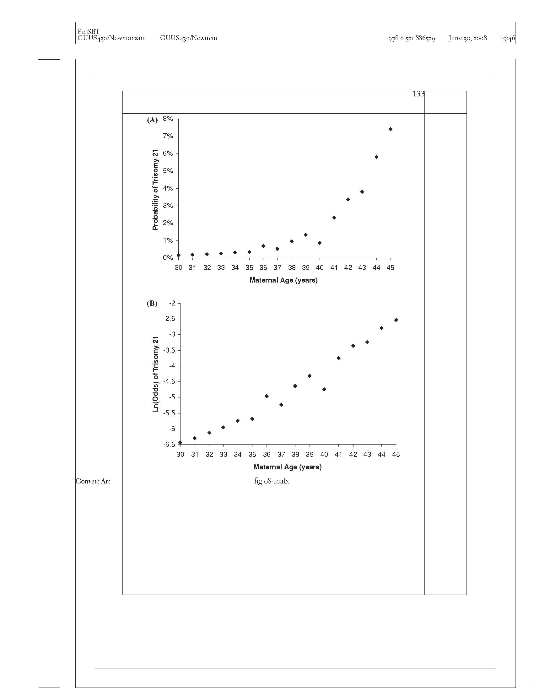
Probability of Trisomy 21 vs. Maternal Age
Data from Snijders et al. Ultrasound Obstet Gynecol. 1999;13(3):167-70. Tables 1 and 2, GA = 16)
Notes:
This is data for gestational age = 16 weeks from the Snijders reference given.
Tables 1 and 2 give the information for Maternal ages 35-45. They didn’t report actual risks for 30-34, so I fudged and used predicted risk. Even though the study had 57,614 women, after limiting it to gestation age = 16, it was only 19968, and only 1147 with both GA=16 and Maternal Age = 40, There were only 10 with trisomy 21. 10/1147 = 0.87%.
So, the smoothness from 30-34 is artificial. The authors didn’t report actual data, so I used predicted (already smoothed). The variability 35-45 is consistent with random error. Sample size was small because I only looked at GA = 16.
There were only 25 women aged 45 (and GA = 16), and 2 of them had trisomy 21 fetuses. 2/25 = 7.4%
But isn’t this the point? That if you take log odds, you get a linear trend in data that you can fit to account for random error.

Slide 20
Ln(Odds) of Trisomy 21 vs. Maternal Age

Slide 21
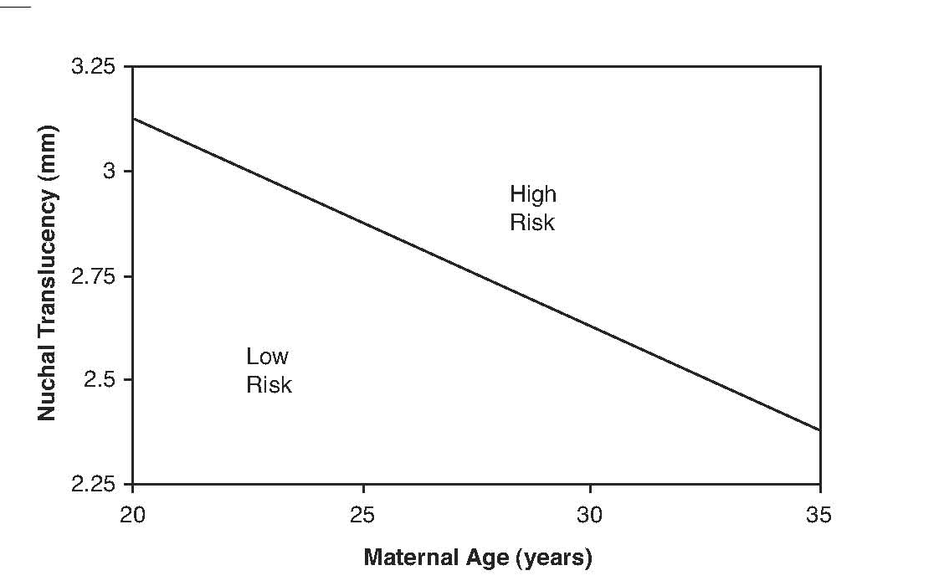
Combining 2 Continuous Tests
> 1% Probability of Trisomy 21
< 1% Probability of Trisomy 21
Notes:
Note, you couldn’t represent this with a tree.

Slide 22
Logistic Regression
ln(Odds(D+)) =
a + b_{NT}NT+ b_{NBA}NBA + b_{interact}(NT)(NBA)
Used to create risk scores, formulas,or nomograms, not trees.
Evaluation with calibration plots, ROC curves, net benefit calculations, and decision curves is natural

Slide 23
Logistic Regression Coefficients
The logistic regression coefficient for a dichotomous predictor is the ln of the multivariate odds ratio.
Notes:
Bottom line: the logistic regression coefficient for a dichotomous predictor is the ln of the multivariate odds ratio

Slide 24
Logistic Regression Coefficients
ln(Odds(D+)) = a + b_{NT}×NT + b_{NBA}×NBA
NBA+ (NBA = 1); NBA− (NBA = 0)
ln[Odds(D+|NBA+)] = a + b_{NT}×NT + b×1
ln[Odds(D+|NBA−)] = a + b_{NT}×NT + b×0
Subtract…
ln[Odds(D+|NBA+)] – Ln[Odds(D+|NBA-)] = b
ln[Odds(D+|NBA+)/Odds(D+|NBA-)] = b
Odds(D+|NBA+) / Odds(D+|NBA-) = OR_{NBA}
ln(OR_{NBA}) = b
OR_{NBA} = e^{b}
Notes:
Bottom line: the logistic regression coefficient for a dichotomous predictor is the ln of the multivariate odds ratio

Slide 25
ORs vs. LRs
Odds of disease given a positive test or exposure
Odds(D+|+) = Odds(D+) × LR(+)
Odds of disease given a negative test or no exposure = Odds(D+|−) = Odds(D+) × LR(−)
OR = Odds(D+|+)/Odds(D+|−)
= [Odds(D+)× LR(+)] / [Odds(D+) × LR(−)]
= LR(+)/LR(−)

Slide 26
ORs vs. LRs
Use LRs for test results, symptoms, or findings (caused by the disease)
Use ORs for risk factors that cause the disease
  The prevalence of the risk factor will affect the prevalence (pre-test probability) of the disease
  Risk factor rare, prevalence low, and LR(+) high
  Risk factor common, prevalence high, and LR(+) low.

Slide 27
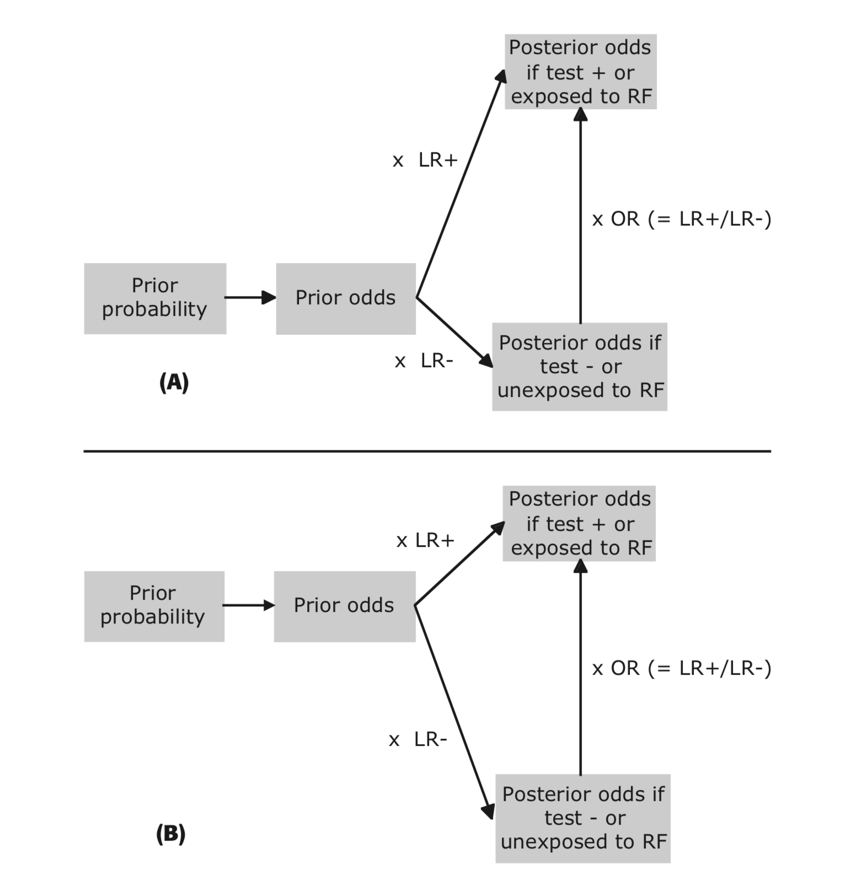
Notes:
For risk factors the causal arrow points from the risk factor to the disease. P(D+|r) tends to remain constant and P(D+) depends on P(r).
For symptoms, signs, and test results, the causal arrow points from the disease to the test result. P(r|D+) tends to remain constant and P(r) depends on P(D+).

Slide 28
Bigger Issue
Risk factors
  causal arrow points from the risk factor R to D+
  P(D+|R) tends to remain constant
  P(D+) depends on P(R)
Symptoms, signs, and test results
  causal arrow points from D+ to test result r
  P(r|D+) tends to remain constant
  P(r) depends on P(D+).
Notes:
We may to spend more time on this.

Slide 29
Choosing Which Tests to Include in the Risk Model
“Use well-established theory, past research, clinical observations, preliminary statistical analysis, or some sensible combination of these ….”
Stoltzfus, J. C. (2011). "Logistic regression: a brief primer." Acad Emerg Med 18(10): 1099-1104.
Notes:
Machine learning algorithms tend to use the whole dataset (all variables). In random forests, variable selection is done randomly and then all the rules are combined in an ensemble. The records are also selected randomly, which is called bootstrap aggregation. Bootstrap aggregation is different from cross-validation, because it is random sampling of records with replacement.

Slide 30
Need for Validation
Develop risk model by choosing a few tests and findings from a large number of candidates, based on which work the best.
Takes advantage of chance variations in the data.
Predictive ability of model will probably decrease or even disappear when you try to validate on a new dataset.
Can be referred to as “overfitting.”

Slide 31
Need to Test the Model in a Separate Dataset
Derivation → Validation
Training → Test
Beware of Tweaking the Model

Slide 32
Validation Dataset
Measure all the variables needed for the model.
Determine disease/outcome status (D+ or D-) on all subjects.

