Slide 1
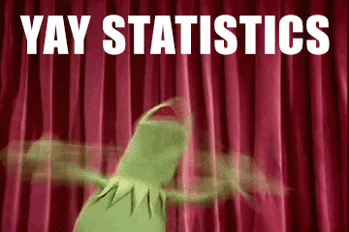
Biostat 200
Introduction to Biostatistics
Overview of the course

Slide 2
Course instructors
Course director
Isabel Elaine Allen, PhD
  Professor of Biostatistics & Epidemiology
  Isabel.allen@ucsf.edu @datacooker
Teaching Assistants
Moses Badio
Lara Crystal-Ornelas
Hannah Lambing
Michelle-Linh Nguyen
Carlos Valiente Moreira
This is an online class so you can reach out with questions by email anytime. If you are ahead of the weekly modules and have questions, we are here to answer them. You will have an assigned TA for labs and HW but we are all here for questions.

Slide 3
Classes & Labs
Office hours & interactive class sessions: Tuesdays 10:30-12:00 (except first class Thursday, September 23 & no classes 11/22)
Interactive Labs & HW question sessions: Thursdays 10:30-12 & no session 11/24
Course credits: 3
All course materials will be posted by mid-September to allow you to work at your own pace

Slide 4
Assignments & Exams
7 HW assignments – 6 counted for your grade (10 points each) and one extra assignment for extra credit if you want to hand it in
Assignments are posted on the CLE one week before the due date; due weekly on Thursdays by 10:30 AM and returned, graded by the TA’s, within one week but feel free to hand in early
Assignment 5 is the MIDTERM and is 15% of your grade
The FINAL is 25% of your grade and will be distributed on 12/10
You may work with others on the Assignments but the Midterm & Final must be your own work (but you can ask me or the TAs questions)
Assignments will consist of:
  Data analysis and interpretation
  Reading and interpretation of scientific research publications

Slide 5
Labs
Labs are for practicing the concepts from the videos/classes
Interactive Labs & HW help will be every Thursday 10:30 -12
  You will be in small groups with your TA for labs
No lab 11/26
Lab content
  Labs 1-2: Learning Stata, exploratory data analysis, nuts & bolts
  Labs 3-9: Tied to the video lecture material
  Labs are not turned in or graded but come to Lab with questions to help with the HW. Answers will be posted.

Slide 6
Forum
The forum is used for sending the class information and communications
And please post your questions here – usually if you have a question, others in the class also have the same question

Slide 7
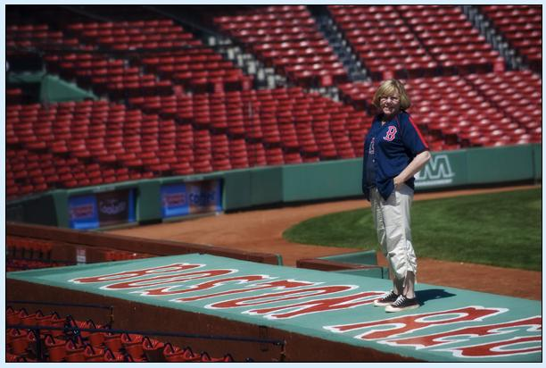
Who am I?
PhD in statistics & MS in math from Cornell
UCSF since 2012
Pre-UCSF in Boston @ Harvard & Babson & starting Biotech companies
Part of SOM, DEB, GBHI, MAC, ICHS, QB3/MBC, CTSI & Catalyst @ UCSF
Red Sox fan forever
Before the quarantine I would knit socks on Bart
I run in the East Bay Hills as often as I can to stay sane

Slide 8
Course goals
Knowledge of basic biostatistics terms and notation
Understanding of concepts underlying most statistical analyses, as a foundation for more advanced methods
Ability to summarize data and conduct basic statistical analyses using STATA or R
Ability to present and visualize data
Ability to understand basic statistical analyses in published journals
Questions? Comments? Come join us!
                Isabel.allen@ucsf.edu

