Slide 1
Demography and Demographic Methods for Public Health
Nadia Diamond-Smith, PhD, MSc
Assistant Professor
Department of Epidemiology and Biostatistics
Institute for Global Health Sciences
UCSF

Slide 2
Introductions
A little about you (some demographics)
Area of research focus, program
Area of interest within demography

Slide 3
Outline of Today’s Lecture
  Course information
  What is demography?
    Why is understanding demographic methods useful for epidemiologists/public health experts?
  Demographic theory and population growth
  Population pyramids!

Slide 4
Welcome: Class info
Sept 15-Dec 1
Wednesday 8:45am-10:15 (aim to end at 10am)
No pre-requisites, assumed basic math skills, use of excel, knowledge of fundamentals of public health
Letter grade or pass/fail
Canice Christian-TA

Slide 5
General format
Short presentations from you about labs/HW from the week before (~15 mins)
Lecture on topic of the week (me or guest lecturer) (~45 mins)

Slide 6
Readings and discussion
Instead of weekly in-class reading discussion, we will move this online
~2-3 readings are listed in the syllabus to be read before each class.
  Sometimes there are optional readings too
Everyone should post comments or questions and/or respond to questions from classmates about the reading on the CLE discussion board by 5pm the night before class (at least 3 comments or questions per week)
  Recommend doing it not at the last minute so that it can be more of a discussion
  Show me that you have read the readings

Slide 7
Labs
5 labs
Everyone choose 2 countries that you will use for the 5 labs
Data on website
Labs are due by 5pm the night before class on the website, and slides should be posted on the google slides link in lab document.
Each class will start with everyone briefly sharing their lab graphs
  Point out 1-2 interesting findings or comparisons between your countries
  To facilitate this, please post a few (2-4) of your graphs on the google slides website that I will send you
  Something that you can discuss in 3 minutes easily

Slide 8
COVID-19 and demography
On Nov 17, we will have flash presentations on COVID-19 and a demographic topic of your choice
Based on what you have learned about that demographic topic make a 3 slide presentation
  Why is thinking about this demographic process important for understanding the impact of COVID?
  How do you think that COVID will impact this demographic process going further
  Is there any evidence/literature out there yet on this topic and COVID?
Everyone will choose a topic by filling out a request and I will assign
  Covid and mortality
  Covid and fertility
  Covid and age structure
  Covid and Race/ethnicity
  Covid and migration
  Covid and marriage/cohabitation
  Covid and living arrangements and residential patterns

Slide 9
Final Project/extended abstract
Apply one of the methods learned in class to an existing data set to explore a question of interest to you
Potential types of projects:
Use life tables to look at people’s probability of migrating from Mexico to the US by age group, and expected number of years someone of each age group will spend living in Mexico or the US
Explore changes over time in total fertility rate and cohort childlessness by age group in a country of choice using Human Fertility Database Data
Project changes in population size of sub-groups in a population (for example, ethnic groups or women with asthma in the US) under different assumptions about future changes in fertility, mortality and migration
Use Demographic and Health Survey Data to explore if there is an urban penalty or advantage for child health outcomes in a country of choice

Slide 10
Final projects (Extended abstract)
Due: Friday Dec 4 via email to Nadia (midnight)
4 pages, mostly focus on methods, data analysis and findings
  Short background/intro, at least 5 references
  Single spaced, not including references
  As many tables/figures as needed, not included in page limit
Dec 1: 8 min powerpoint presentations of final project (limit 5 slides, 5 min presentation and 3 min for questions/discussion)
Nov 3: Send Nadia a 1/3-1/2 page description of your project and the data you will use
  Have gotten access to that data source

Slide 11
Grading
Completion of each lab/homework (5% each x 5=25%)
Reading questions and COVID presentation (25%)
A final paper (4 pages) (35%)
Presentation of the findings from labs and final project (15%)

Slide 12
Class expectations
Be on video unless absolutely not able to be
  Please email me if something arises
Participate in zoom
  I know its hard, but what makes this class fun is the discussion and questions that people ask, so please make an effort to participate in each class
  Can use chat or raise hand
Communicate with me if there are problems/concerns
Feel free to email me at any time with questions, concerns, thoughts, advice, etc

Slide 13
Office hours
I will plan to stay until 10:30/45 everyday on zoom to answer any questions about labs or readings or anything
Canice available to meet by zoom– just send her an email
I am always available to set up separate zoom meetings to talk about anything

Slide 14
Topics covered in the course
Intro to demography and theory, Population Growth (today)
Lexis Diagrams and measurement, data quality
Fertility, the impact of contraception and abortion on Population: (Diana Greene Foster, UCSF/ANSIRH)
Mortality
Gender and demography(sex ratios), Family Demography
Life tables; disability and work (Amal Harrati, Mathmatica)
Residential Segregation: (Joan Casey, Columbia U)
Migration and Urbanization (Emily Trelevean, U Michigan)
Aging and health systems (Canice)
COVID-19 and demography
Final class is presentations

Slide 15
Outline of Today’s Lecture
  Course information
  What is demography?
    Why is understanding demographic methods useful for epidemiologists/public health experts?
  Demographic theory and population growth
  Population pyramids!

Slide 16
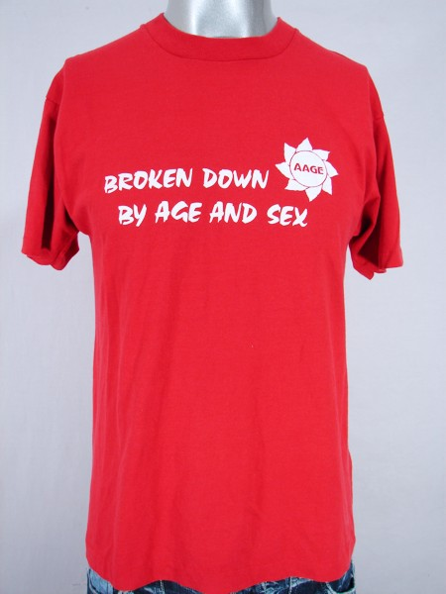
What is Demography?
  “Demography is the scientific study of human populations, primarily with respect to their size, their structure and their development”
  Demography =
  demos = people
  +
  graphos = writing or recording something

Slide 17
“Principle in the study of mortality, then and now (Caldwell, 2001)”: applied to all of demography
Based on hard data:
  “The work depended on data having come into existence at the whim of others, usually governments, often for other purposes, […] less true today”
Attention to data quality:
  “Much of the labor was spent, not on making immediate deductions from the numbers, but on suspiciously testing the data and trying to improve them”
Awareness of potential biases:
  “Demographers were deeply sensitive to the fact that crude numbers of measures may be misleading […] and they were given to devising measures that overcame the distortions to allow valid comparisons”

Slide 18
Principle in the study of mortality, then a now (Caldwell, 2001): applied to all of demography (continued)
Concentration on large populations:
  “There was a concept of a population, a large body of people constituting some kind of definable unit to which the measurements pertain”
Searching for patterns:
  “Demographers look for regularities in populations or subpopulations and for contrasts between subpopulations: Graunt showed urban-rural differentials in mortality, as well as male-female differentials in both numbers born and subsequent mortality”
Early interest in causation:
  “From the beginning there was an interest in causation (Graunt examined the causes of death), but there was, at the same time, a suspicion that measures of causes were more likely to be in error than measures of population or death.”

Slide 19
Principle in the study of mortality, then a now (Caldwell, 2001): applied to all of demography (continued)
A mostly empirical discipline:
  “Most demographers have been happy to carry out analysis within a minimalist theoretical framework and have been deeply suspicious of disciplines that built theoretical structures upon unproven, theoretical bases. They have preferred intermediate or short-range theory to grand theory”
  Less true now, and not true of Malthus

Slide 20
Why is demography important for health?
“The everyday activities of all human being, communities, and countries are interrelated with population change, patterns and levels of use of natural resources, the state of the environment, and the pace and quality of economic and social development”
  -Program of Action of the UN International Conference on Population and Development, Cairo, 1994
  Demographic situation Health care supply and demand

Slide 21
Differences between Demography and Epidemiology (Wallace, 2001)
Epidemiology
Demography
Historically more clinical: medicine, basic science, pathology
Somewhat less global and comprehensive
More appropriate for clinical, individual and programmatic decision making
Uses randomized experiments, tests interventions
Common Areas: Sociology, Economics, psychology
More global and comprehensive, but topically narrower
More appropriate for population policy
Relies on natural experiments, large datasets (censuses, etc.)

Slide 22
Commonalities between demography and epidemiology
Quantitative
Appreciation of role of human behavior and social institutions
  Both often consider differences in health or health related factors based on wealth, SES, urban/rural, race/ethnicity, gender, vulnerable sub-groups, etc.
Look at relationship between vital events and health and disease
Concerned with prediction

Slide 23
How Demography is used in Public Health
Comparing the health of one population with that of another
Monitoring changes in the health of a given population
Identifying and quantifying the health inequalities within populations (e.g. across social groups and geography)
Provide projections that inform priorities for health service delivery and planning
Inform debates on priorities for research and development
Analyzing the benefits of health interventions for use in cost-effectiveness analyses

Slide 24
Outline of Today’s Lecture
  Course information
  What is demography?
    Why is understanding demographic methods useful for epidemiologists/public health experts?
  Demographic theory and population growth
  Population pyramids!

Slide 25
Origins of modern demography
First death records in renaissance Italy
Establishment of parish registers in the 16th c. that became common in the 17th c. in Western countries
  Motivated early work on mortality
British Royal Society founded in 1660 with two fathers of demography
  John Graunt
  William Petty

Slide 26

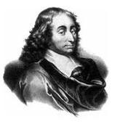
John Graunt (1620-1674)
  Natural and Political Observations Made upon the Bills of Mortality (1662)
  Laid the foundation for human statistical and census methods
  Developed first life tables
  Also a father of epidemiology

Slide 27
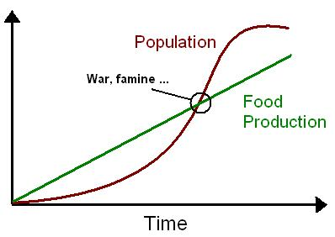
Demographic Theory
Thomas Robert Malthus
An Essay on the Principle of Population (1798)
  Population will grow geometrically
  Food production will grow arithmetically
  Famine and starvation
  UNLESS births are controlled!
    Delayed marriage

Slide 28
Malthus was very influential
Malthus’ work was well known in his time and later
Played a major role in Darwin’s development of the theory of evolution
Influenced David Ricardo in his Law of Diminishing Return
At the basis of the international family planning efforts of the 1960s, 1970s, and 1980s

Slide 29
Demographic Transition Theory
First proposed by Warren Thompson 1929
Formal theory proposed by Frank Notestein in 1940s and 50s
5 stages
  1. High births and death (Pre-industrial)
  2. Mortality drop, births high (some developing countries today)
  3. Fertility falls
  4. Low births and low deaths
  5. Below replacement level fertility

Slide 30
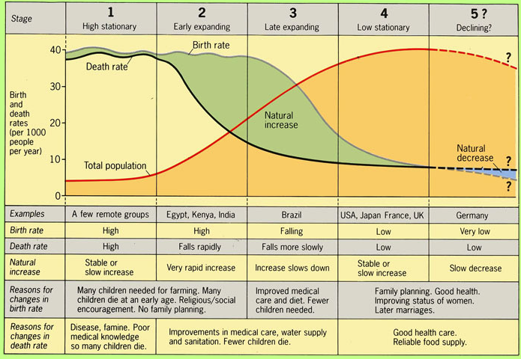
Demographic Transition Theory

Slide 31
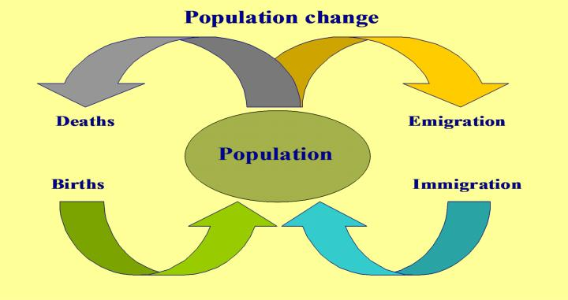
Population Growth: balancing equation
Demographic Balancing Equation
P(t+1)=P(t) + (births-deaths) + (In migration- out migration)
P=population
t=time

Slide 32
Exponential population growth
r=rate of growth
t=time
P= population at each time period, P(0) is your starting population, and p(t) is your population at t years later

Slide 33
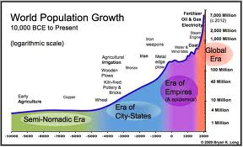
Historical Population Growth
Until about 1000 B=D
Then food supply, trade, etc. increased and B>D, slowly at first, then rapidly

Slide 34
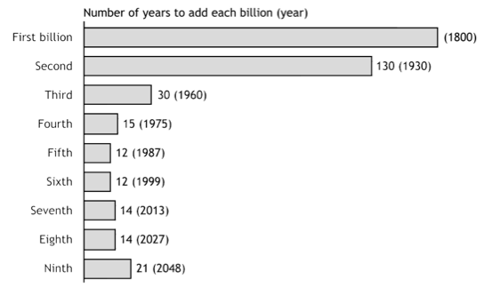
Number of years to add each billion
First and second billion: Population Reference Bureau; Third through ninth billion: United Nations.
(2005). World population prospects: the 2004 revision (medium scenario).

Slide 35
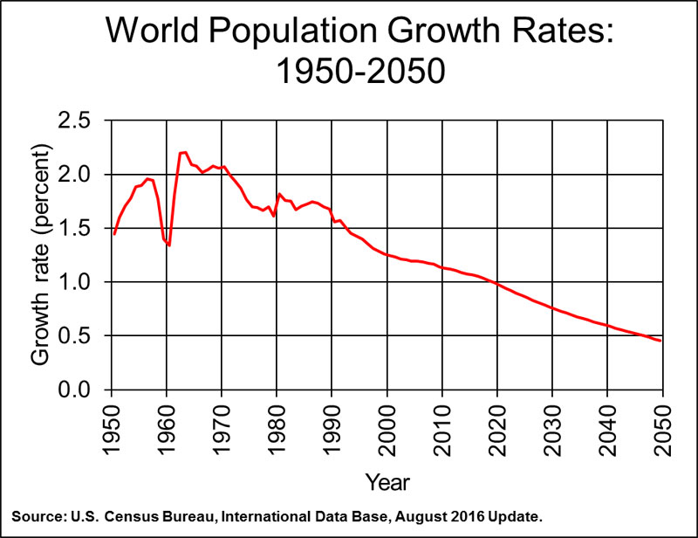

Slide 36
Outline of Today’s Lecture
  Course information
  What is demography?
    Why is understanding demographic methods useful for epidemiologists/public health experts?
  Demographic theory and population growth
  Population pyramids!

Slide 37
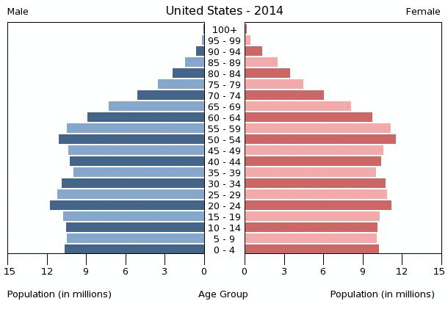
Population Pyramid: USA

Slide 38
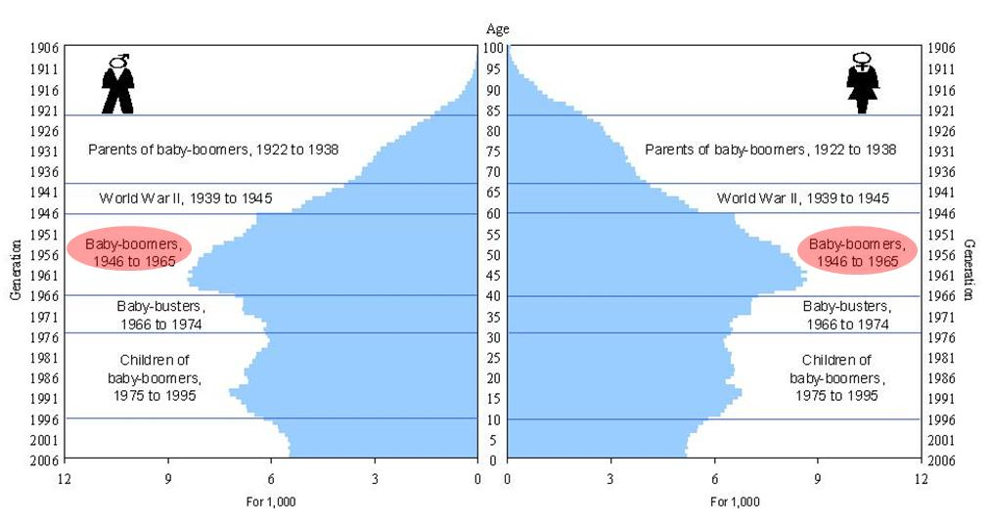
History in Pop Pyramids: US

Slide 39
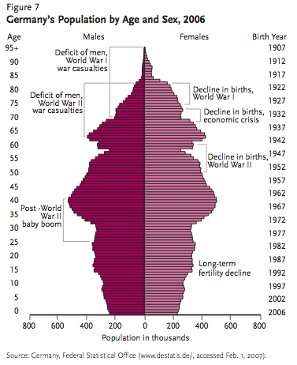
Notes:
Famine: 1866-68
15 months between two wars (1939-40 was the first one) between finland and soviet union.

Slide 40
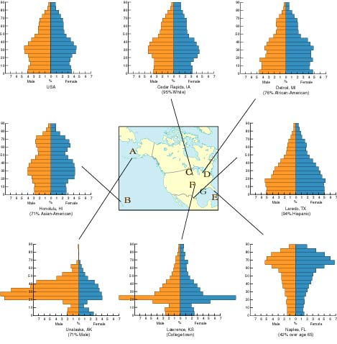
Guess the state
Alaska
Florida
Notes:
Lower right: florida
Middle bottom: kansas
Lower left: alaska
Middle right: texas
Top middle: iown
Left middle: hawaii

Slide 41
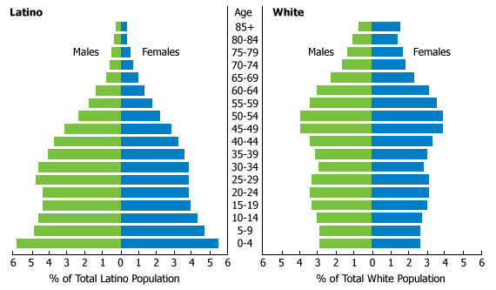
Difference by ethnic group: US

Slide 42
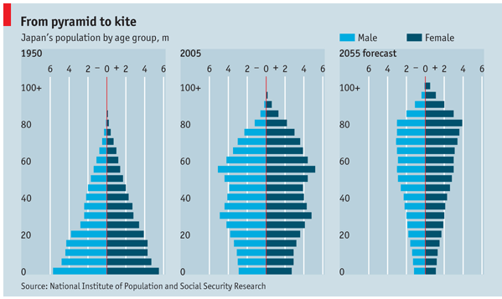
Change over time: Japan

Slide 43
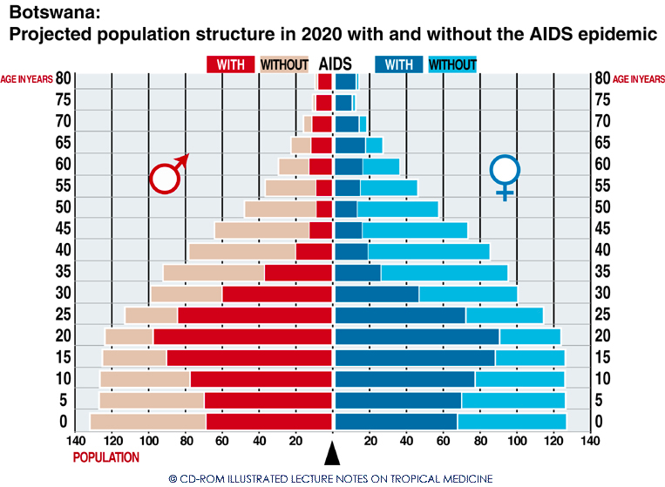
Botswana

Slide 44
Choose some countries!
For many lab assignments throughout the term, we will use data from 2 of the same countries to look at different demographic trends
Please choose two countries, on different continents, to use for the remainder of the course

Slide 45
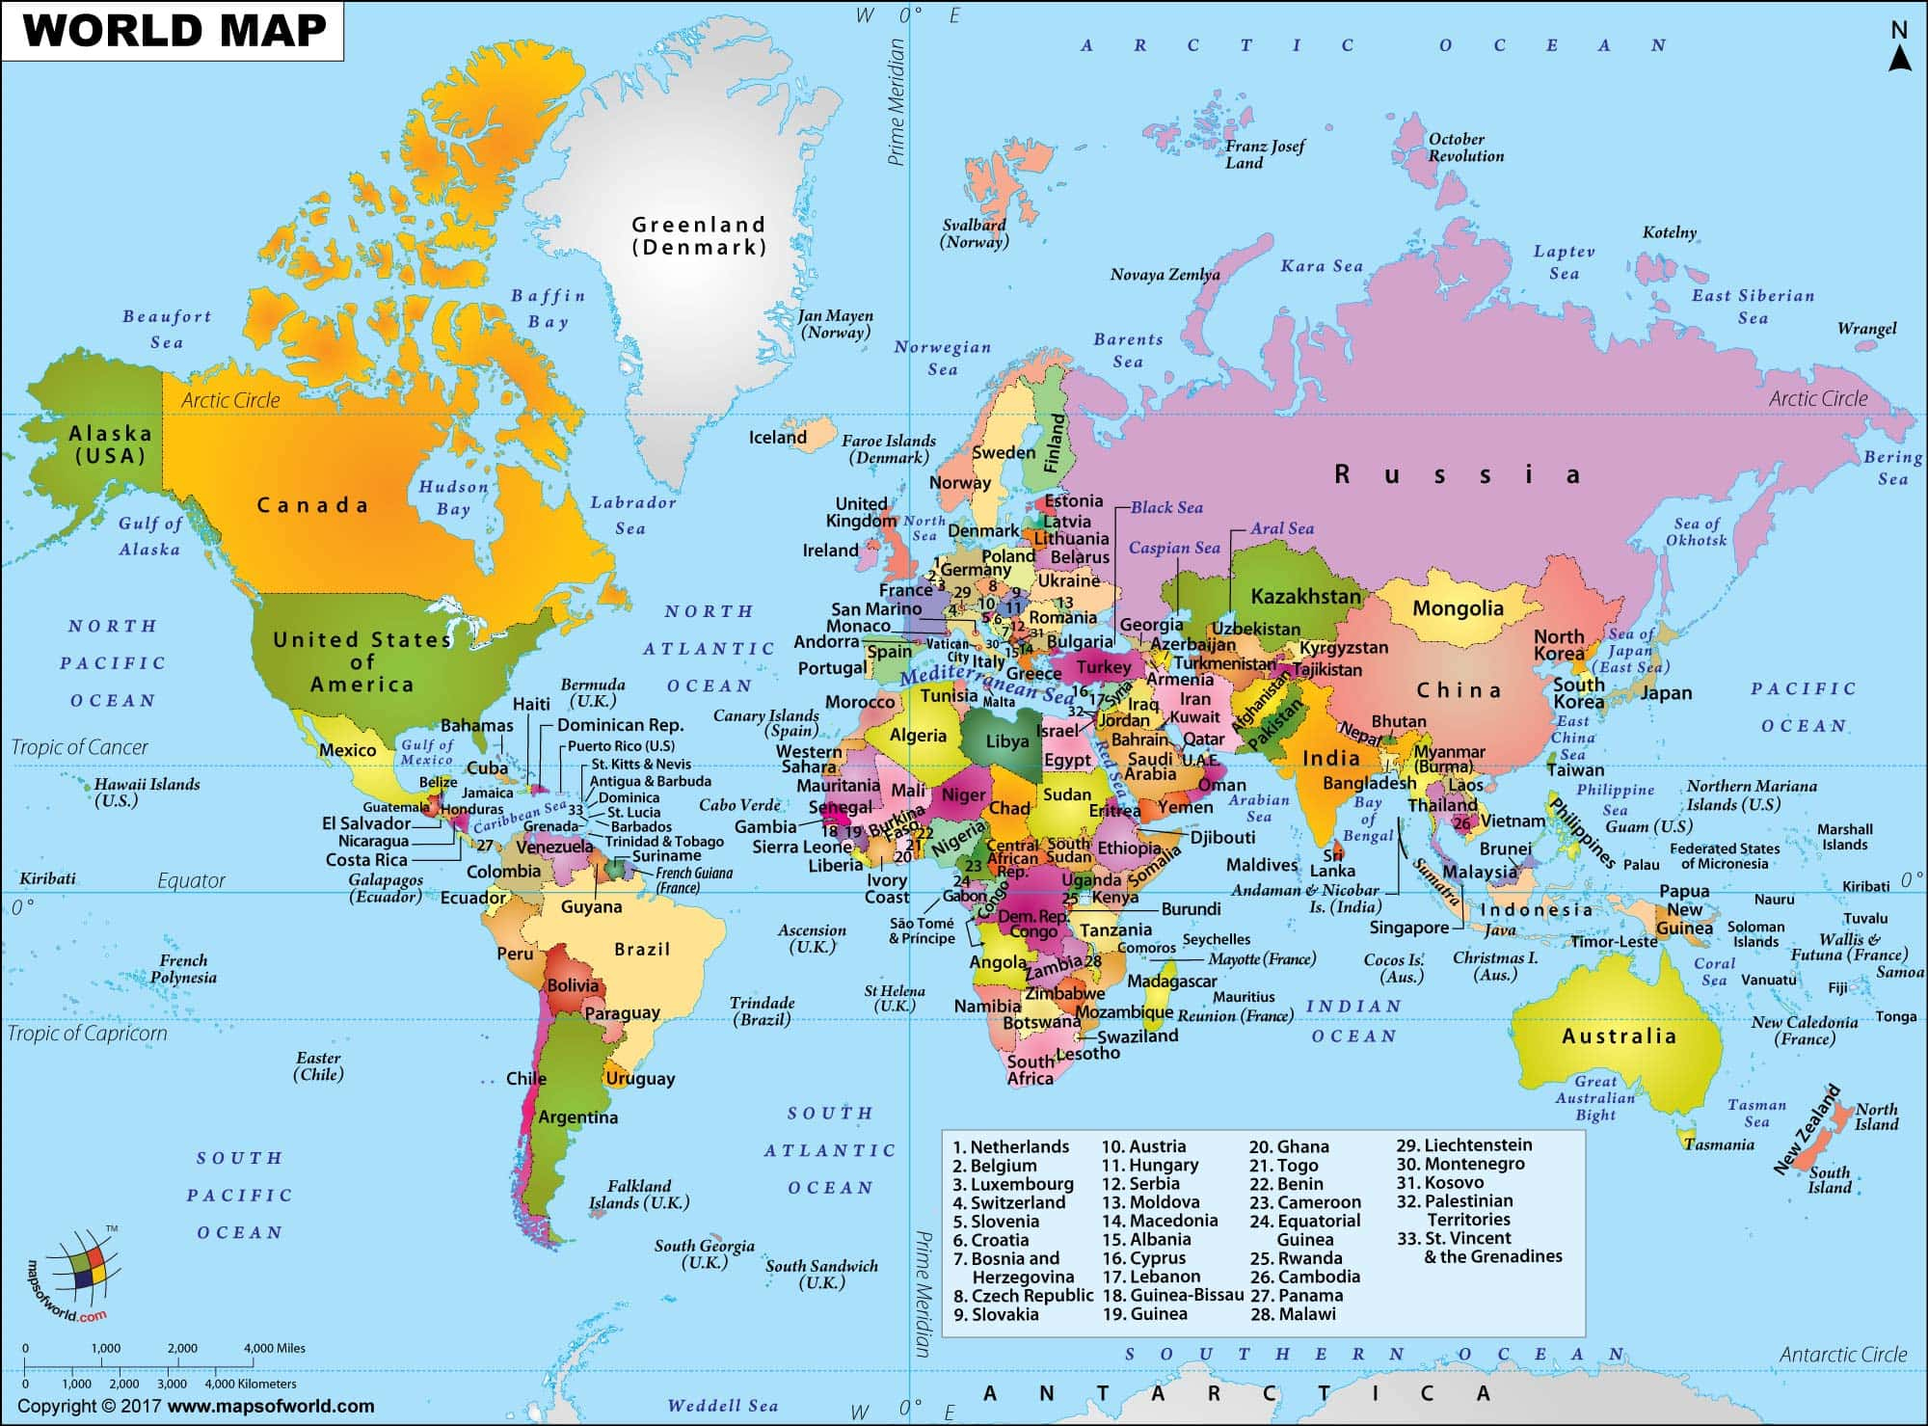

Slide 46
Countries
Kate: Russia, Argentina
Carolyn: Zimbabwe, Iran
Charles: Bostwana, Italy
Leah: Malaysia, US
Priz: Mexico, Netherlands
Sirena: England, Costa Rica
Richard: New Zealand, France
Jingxuan: Iceland, Uganda
Carlos: Brazil, Cuba
Lufan: China, Canada
Dan: Sierra Leone, Haiti

Slide 47
Tips on graphs: I will grade on this!
Always label your axes
  Units, what it is
Always have a title that makes it clear without reading anything else what you are showing
If comparing two graphs, make sure the axes have the same scale
Have a key
Think carefully about when a line graph vs bar graph might be useful
Use excel to do your graphs, always turn in the excel sheet. Can either paste the graphs into word and answer the questions there, or answer in excel.

Slide 48
What’s wrong with this graph?

Slide 49
What’s wrong with this graph?

Slide 50
Thank you!
Questions?
Notes:
Final boiler plate language: 2 versions
Through its singular focus on health, UCSF is leading revolutions in health.
UCSF is driven by the idea that great breakthroughs are achieved when the best research, the best education and the best patient care converge.

