Slide 1
Turn off VPN
Start recording

Slide 2
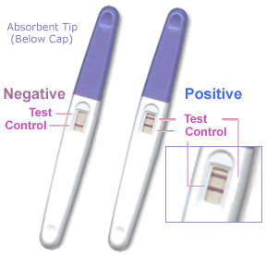
Dichotomous Tests
(EBD-2, Chapter 2)
Tom Newman, MD, MPH
September 24, 2020
Notes:
16x9 would be nice if possible.

Slide 3
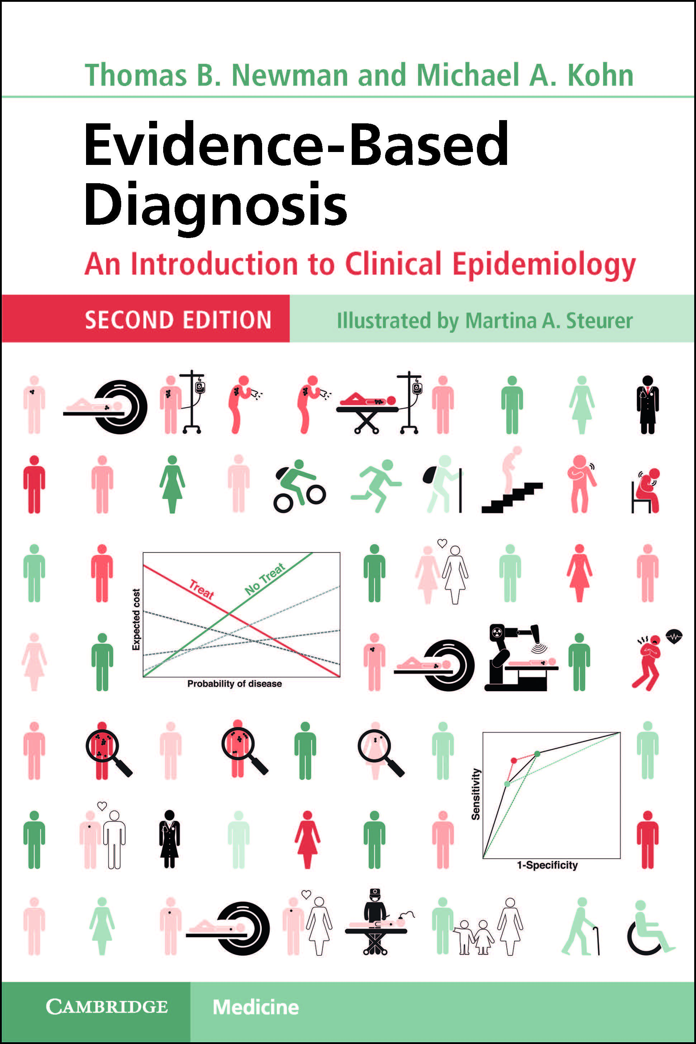
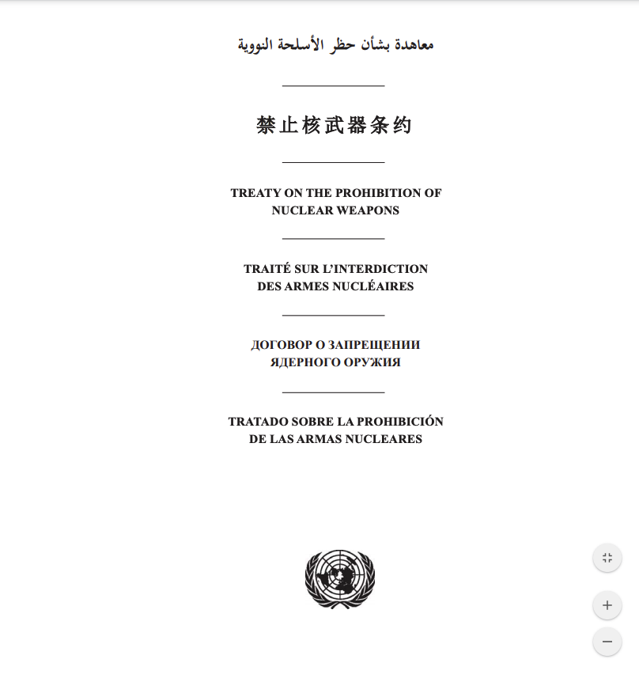


Slide 4
Overview
Definitions: sensitivity, specificity, prior and posterior probability, predictive value, accuracy
2 x 2 table method
Likelihood ratios - WOWO
Probability and odds
False-negative and false-positive confusion
Treatment and testing thresholds and regret graphs (web demonstration)
Likelihood ratios in action: the $10,000 case of conjunctivitis

Slide 5
Definitions

Slide 6
Definitions: Sensitivity and Specificity
 |  | Disease status
 |  | Has disease | No disease | Total
Test Result | Positive | A | B | A + B
 | Negative | C | D | C + D
 | Total | A + C | B + D | A + B + C + D
Sensitivity =
A/ (A+C)
Specificity =
D/ (B+D)
P.I.D. = Positive in Disease
N.I.H.= Negative in Health
Notes:
In the 2020 recorded lecture I misspoke; the test result goes on the left side, not the bottom. Also, the NIH is indeed specific about how they want grant proposals, but the problem is margins that are too narrow, not too wide.

Slide 7
Definitions: Pretest (prior) and post-test (posterior) probability
 |  | Disease status
 |  | Has disease | No disease | Total
Test Result | Positive | A | B | A + B
 | Negative | C | D | C + D
 | Total | A + C | B + D | A + B + C + D
Pretest probability =
(A+C)/(A+B+C+D)
Posttest probability =
A/(A+B) or C/(C+D)
ONLY IF SAMPLING IS “CROSS-SECTIONAL”!

Slide 8
“Cross-sectional” sampling
 |  | Disease status
 |  | Has disease | No disease | Total
Test Result | Positive | A | B | A + B
 | Negative | C | D | C + D
 | Total | A + C | B + D | A + B + C + D
Subjects are sampled randomly or consecutively, so that the proportion with disease (pretest probability, prevalence) is clinically meaningful

Slide 9
Definitions: Positive and Negative Predictive value, Accuracy
 |  | Disease status
 |  | Has disease | No disease | Total
Test Result | Positive | A | B | A + B
 | Negative | C | D | C + D
 | Total | A + C | B + D | A + B + C + D
PPV=A/(A+B)
NPV=D/(C+D)
Accuracy = (A + D)/(A + B + C + D)
= (A+D)/N
Demonstration: screening for brain tumors with >99.9% accuracy

Slide 10
“Case-control” sampling
 |  | Disease status
 |  | Has disease | No disease | Total
Test Result | Positive | A | B | A + B
 | Negative | C | D | C + D
 | Total | A + C | B + D | A + B + C + D
Pretest probability =
(A+C)/(A+B+C+D)
PPV=A/(A+B)
NPV=D/(C+D)
Subjects with and without disease are sampled separately
Proportion with disease is determined by investigator

Slide 11
Prevalence vs. Pretest probability
Prevalence= proportion with the disease at one point in time
  Typically measured in populations
Pretest probability is the more general term
  For screening tests, pretest probability = prevalence
  For diagnostic tests, pretest probability incorporates history and physical exam items

Slide 12
Post-test probability vs. Predictive value
Post-test probability after a + test is the same as positive predictive value
Post-test probability after a − test is
1− negative predictive value

Slide 13
2x2 Table method for obtaining posterior probability

Slide 14
2×2 table method: screening mammography for 45-year-old woman. 1. Draw a table
 |  | Disease status
 |  | Breast Cancer | No Breast cancer | Total
Mammography | Positive
 | Negative
 | Total
Pretest probability 2.8/1000
Sensitivity 75%,
Specificity 93%

Slide 15
Virtual Audience Participation
Given these parameters, if her mammogram is “positive,” what is the (“post-test”) probability that she has invasive breast cancer?
  Pretest probability 2.8/1000
  Sensitivity 75%
  Specificity 93%
          < 5%
          5 to <20%
          20 to <50%
          50 to <80%
          ≥ 80%.

Slide 16
2x2 table method: screening mammography for 45-year-old woman. 2. Put a big number in the corner
 |  | Disease status
 |  | Breast Cancer | No Breast cancer | Total
Mammography | Positive
 | Negative
 | Total |  |  | 10,000
Pretest probability 2.8/1000
Sensitivity 75%
Specificity 93%

Slide 17
2x2 table method: screening mammography for 45-year-old woman. 3. Get the total N with disease
 |  | Disease status
 |  | Breast Cancer | No Breast cancer | Total
Mammography | Positive
 | Negative
 | Total | 28 |  | 10,000
Pretest probability 2.8/1000
Sensitivity 75%
Specificity 93%

Slide 18
2x2 table method: screening mammography for 45-year-old woman. 4. Use sensitivity to get true +
 |  | Disease status
 |  | Breast Cancer | No Breast cancer | Total
Mammography | Positive | 21
 | Negative
 | Total | 28 |  | 10,000
Pretest probability 2.8/1000
Sensitivity 75%
Specificity 93%

Slide 19
2x2 table method: screening mammography for 45-year-old woman. 5. Subtract to get false −
 |  | Disease status
 |  | Breast Cancer | No Breast cancer | Total
Mammography | Positive | 21
 | Negative | 7
 | Total | 28 |  | 10,000
Pretest probability 2.8/1000
Sensitivity 75%
Specificity 93%

Slide 20
2x2 table method: screening mammography for 45 year old woman. 6. Get N without disease
 |  | Disease status
 |  | Breast Cancer | No Breast cancer | Total
Mammography | Positive | 21
 | Negative | 7
 | Total | 28 | 9,972 | 10,000
Pretest probability 2.8/1000
Sensitivity 75%
Specificity 93%

Slide 21
2x2 table method: screening mammography for 45-year-old woman. 7. Use (1-specificity) for false +
 |  | Disease status
 |  | Breast Cancer | No Breast cancer | Total
Mammography | Positive | 21 | 698
 | Negative | 7
 | Total | 28 | 9,972 | 10,000
Pretest probability 2.8/1000
Sensitivity 75%
Specificity 93%

Slide 22
2x2 table method: screening mammography for 45-year-old woman. 8. Subtract for true −
 |  | Disease status
 |  | Breast Cancer | No Breast cancer | Total
Mammography | Positive | 21 | 698
 | Negative | 7 | 9,274
 | Total | 28 | 9,972 | 10,000
Pretest probability 2.8/1000
Sensitivity 75%
Specificity 93%

Slide 23
2x2 table method: screening mammography for 45-year-old woman. 9. Get row totals
 |  | Disease status
 |  | Breast Cancer | No Breast cancer | Total
Mammography | Positive | 21 | 698 | 719
 | Negative | 7 | 9,274 | 9,281
 | Total | 28 | 9,972 | 10,000
Pretest probability 2.8/1000
Post-test probability if mammo + = (PPV+) = ?
Post-test probability if mammo – = (1−NPV) = ?

Slide 24
2x2 table method: screening mammography for 45 year old woman. 10. Calculate post-test probabilities
 |  | Disease status
 |  | Breast Cancer | No Breast cancer | Total
Mammography | Positive | 21 | 698 | 719
 | Negative | 7 | 9,274 | 9,281
 | Total | 28 | 9,972 | 10,000
Post-test probability if mammo + = (PPV+)= 21/719 = 2.9%
Post-test probability if mammo – = (1−NPV) = 7/9281= 0.75 per 1000

Slide 25
Likelihood Ratios

Slide 26
Likelihood ratios
A ratio of likelihoods:
P(Result|Disease)
P(Result|No Disease)
WOWO = With Over WithOut
  Think "Do You Want to Know a Secret?"
Pretest odds × LR = Posttest odds
(Alternate terminology:
Prior odds × LR = Posterior odds)

Slide 27
What Tests Do
Their results change our estimate of the probability of disease
HIV−
HIV+
0%
Negative test
Positive test
100%
Reasurance
Order a Test
Treatment
A good test changes estimates a lot.

Slide 28
Post-test Probability of Disease Depends on 2 Things
Where you started from (low, medium, high risk)
Result of the test, visualized as length and direction of the result arrow
Basic paradigm:
  What we thought before + test result = What we think now

Slide 29
Likelihood ratio Effect of test result
LR very low (0.01) Greatly decreases P(disease)
LR < 1 (eg, 0.5) Decreases P(disease)
LR = 1 No effect on P(disease)
LR >1 (eg, 2) Increases P(disease)
LR Very high (100) Greatly increases P(disease)

Slide 30
Likelihood Ratios
Advantages
  Simplify calculation of post-test probability (especially when disease is rare)
  Capture information for multi-level and continuous tests (next week)
Disadvantages
  If either pretest or posttest probability is high > ~10%) you need to use odds (or a slide rule or calculator)

Slide 31
Probability and Odds

Slide 32
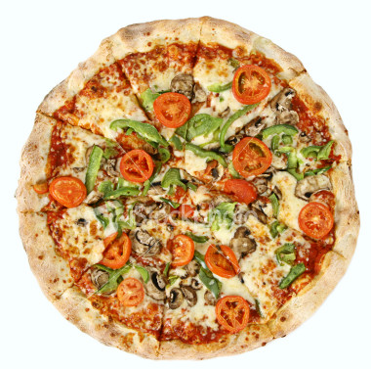
Understanding odds with pizzas
Michael and I share a small pizza while we grade exams.
My share is 3 times as big as his (ratio 3:1).
What PROPORTION of the pizza do I get?
3/4 (75%)
Tom’s share
Notes:
http://www.istockphoto.com/stock-photo-1513646-vegetarian-pizza-whole-3.php

Slide 33
Digression: understanding odds with pizzas -2
Tom’s share
I only eat 1/5 (20%) of the pizza.
What is the RATIO of the size of what I eat to what I don’t eat?
1:4
Odds = P/(1−P)
P=odds/(1+odds)
If odds are a/b, probability = a/(a+b)
Remember for slide 46
Notes:
http://www.istockphoto.com/stock-photo-1513646-vegetarian-pizza-whole-3.php

Slide 34
LR for mammography
LR = P(Result|Disease) (WOWO)
P(Result|No Disease)
LR+ = P(+ Mammogram|Breast Cancer)
P(+ Mammogram|No Breast Cancer)
LR+ = Sensitivity
1-Specificity
LR+ = 75% = 10.7
7%
Pretest odds × LR = Posttest odds
Can ignore odds step when P’s are low
2.8/1000 × 10.7 = 30/1000 = 3%

Slide 35
Go to EBD-2.net website slide rule demonstration

Slide 36
False-negative confusion

Slide 37
False-negative confusion
Sensitivity of rapid strep test is 85%
Therefore, the false negative "rate"* is 15%
A 15% probability of missing strep is too high, so I should always culture if the rapid strep is negative
*Of course it's really a false negative proportion, but that's the less egregious error here.

Slide 38
What's wrong?
Strep
No Strep
Total
Rapid Test +
TP
FP
TP+FP
Rapid Test −
FN
TN
TN+FN
TP+FN
FP+TN
2 definitions of “false negative rate”
Vertical: 1− sensitivity = FN/(TP+FN). This one is easier because it’s (assumed to be) constant.
Horizontal: 1 − negative predictive value = FN/(FN+TN). This one is harder because it depends on prior probability, but it is the one that should determine clinical decisions.

Slide 39
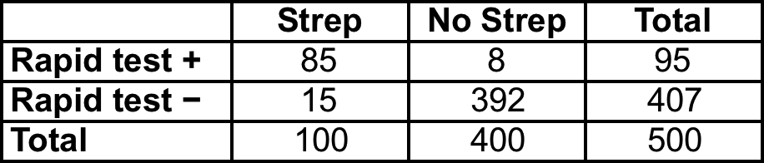
If prior probability of strep = 20% and specificity is 98%
False negative "rate" (def #2) = 15/407 = 3.7%
NNC (number needed to culture) = 1/.037 = 27 to identify 1 false-negative rapid test (if pre-test probability = 20%).
At some prior probability of strep, culture after negative rapid test is not indicated.
Notes:
Ask: what is sens? What is spec?

Slide 40
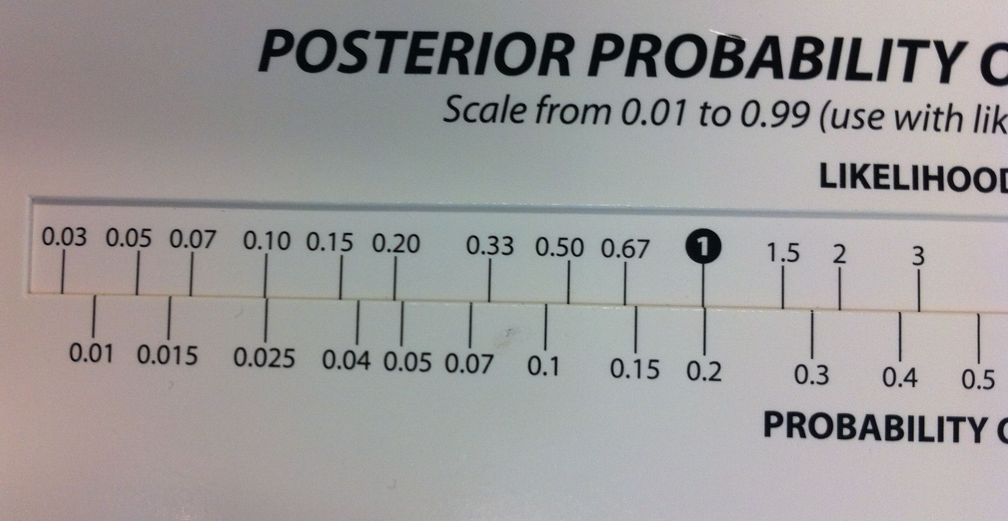
Try it with slide rule!
Sensitivity 85%
Specificity 98%
Prior probability = 20%
Rapid test is NEGATIVE. What is LR?
LR = (1-sens)/spec = .15/.98 = 0.15
3.7%
Notes:
In the 2020 lecture recording I misspoke: the chance that the test will be negative in someone WITH the disease is 1-sensitivity; I said 1-specificity. (It's clear I meant 1-sensitivity because I said 1-85% =15%.)

Slide 41
Similar examples:
Sensitivity of urinalysis (UA) for urinary tract infection is only 85%, therefore always culture after a negative UA
Sensitivity of CT scan for subarachnoid hemorrhage is only 90%, therefore always do a lumbar puncture after a negative CT
False positive confusion is similar: 1−specificity ≠ 1−positive predictive value
  More on this in Chapter 11

Slide 42
Treatment Thresholds

Slide 43
Treatment Thresholds
No treat
Treat
P_{TT}
Suppose we've estimated the prior probability of strep and have likelihood ratios for positive and negative rapid strep tests
The rapid strep test will help us estimate the probability of infection, but we still need a Treatment Threshold to decide what to do.

Slide 44
Treatment threshold
Lowest probability of disease at which the expected benefits of an empiric treatment exceed its expected risks and costs
Depends on relative badness* of 2 types of errors
  How bad it is to treat someone who does not have the disease? (=C)
  How bad it is not to treat someone who does have the disease? (=B)
  To simplify, all costs are the costs compared with making the right decision
*Sometimes abbreviated as "cost," but it includes everything bad, not just financial cost

Slide 45
Decision Analytic Framework
P(D)
☺
Yes
Treated strep
No
Yes
Strep?
😐 = C
Treated, no strep
No
Start penicillin?
Yes
Untreated strep
☹ = B
No
Strep?
Untreated, no strep
☺

Slide 46
X-Graph: Concept of expected cost (utility)
Expected "cost"
B
Treat: C(1−P)
C
No Treat: BP
0
Probability of Disease
1

Slide 47
Treatment threshold = P where the lines cross:
C(1−P) = BP, so C/B=P/(1−P)
If odds are a/b, probability = a/(a+b)
So if treatment threshold ODDS = C/B, the treatment threshold probability = C/(C+B)
Treatment threshold odds
B
Expected cost
Treat: C(1−P)
C
No Treat: BP
0
0.5
1
47
Probability of Disease

Slide 48
Test/Treat Thresholds
No treat
Treat
P_{TT}
If we know the treatment threshold (P_{TT}), we can use LRs to get testing thresholds
48

Slide 49
Test/Treat Thresholds
LR+
LR−
No treat
Test
Treat
P_{TT}
Use LR+ to find P below which, even if the test is +, you won’t exceed P_{TT}
Use LR− to find P above which, even if the test is −, you won’t go lower than P_{TT}
This defines the testing zone (for a costless test)
49

Slide 50
Test/Treat Thresholds
LR+
LR−
No treat
Test
Treat
P_{TT}
Algebra is very simple
  No treat/test threshold odds = Treatment threshold odds/LR+
  Test/Treat threshold odds = Treatment threshold odds /LR−
Things get only a little more complicated when you factor in the cost of the test
50

Slide 51
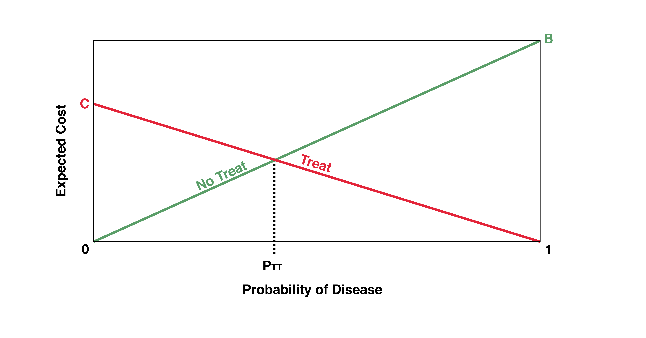
Details in Chapter 2 of EBD-2
Figure 2.2 Expected costs of not treating and treating by probability of disease. For probabilities from 0 to P_{TT}, “No Treat” has the lower expected cost. For probabilities from P_{TT} to 1, “Treat” has the lower expected cost.

Slide 52
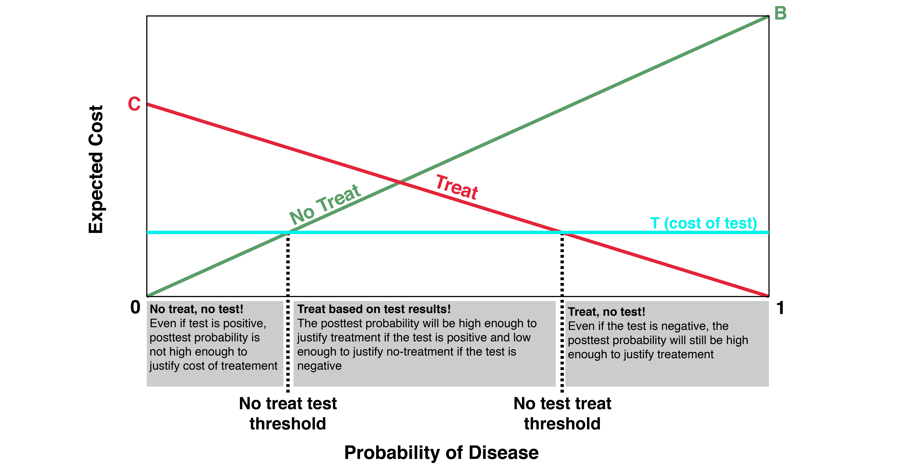
Perfect but costly test
T
T
Figure 2.6 “No Treat–Test” and “Test–Treat” thresholds for a perfect but costly test.

Slide 53
Excel spreadsheet demonstration from EBD-2.net

Slide 54
Likelihood Ratios in Action: Real Case – Switch to Gonzales LTE
Vaccine Type and Dose | Asymptomatic COVID-19 Risk¹ | Vaccine 1st Dose Efficacy² | Likelihood Ratio |  | PVFS COVID-19 Risk
 |  |  | P(PVFS|COVID) | P(PVFS|No COVID)
Pfizer, 1st dose | 0.006 | 0 | 4% | 4% | 0.006
Moderna 1st dose | 0.006 | 0 | 4% | 0.9% | 0.03
Pfizer 2nd dose | 0.006 | 0.80 | 4% | 16% | 0.0003
Moderna 2nd dose | 0.006 | 0.82 | 4% | 17.4% | 0.0002

Slide 55
Likelihood Ratios in Action: Real Case
6-week-old previously well baby seen the day before for conjunctivitis and fussiness (no fever)
Blood culture drawn at that time is now positive for “Staph species.”
  Staph epi: common contaminant, ~3% of blood cultures.
  Staph aureus: nasty bug, but uncommon cause of bacteremia at 6 wks, especially if no skin findings (<3% of true bacteremias)
Meanwhile, baby is no longer fussy, now feeding and acting well.

Slide 56
Likelihood Ratios in Action: Management options
Observation by mother at home; return to clinic if he acts sick
Bring child to ED for some combination of
  Repeat blood culture
  Lumbar puncture to rule out meningitis
  Admission to the hospital
  IV antibiotics
Quote from pediatric resident “How can you not?”

Slide 57
Likelihood Ratios in Action: Quantifying new information
The blood culture is a test for pathogenic bacteremia (bad bacteria in the blood; D+)
The result is “staph species.”
P(result|D+) < 3% 6% (Lecture and slide were wrong because having pathogenic staph in your BC does not prevent contamination, so <3% +3%.)
P(result|D-) ~ 3%
LR = <36%/~3%, <1 2! (See speaker notes)
Similar process for test “Did he get better without systemic antibiotics?” (LR < 0.2?)
Conclude: his probability of serious infection is now LOWER than the day before when he was sent home.
Notes:
Note added 9/21/21: After using this example and slide for many years, I caught an error. The probability of a BC positive for "staph species" in someone with pathogenic bacteria might well be the probability of S aureus + the probability of S epi, so I should have estimated <6%, not <3%. Still, given that he had recovered his probability of having had S. aureus the day before is still lower than it was on the day he was seen, and the probability that he is STILL bacteremic is lower still.

Slide 58
Likelihood Ratios in Action: What happened?
ED staff had parents bring child to ED for
  Repeat blood culture, IV
  Lumbar puncture to rule out meningitis
Ward full, TN asked to admit baby to NICU at 3:30 AM
TN unable to persuade ED attending to send child home
Mother had a cold, would not have been allowed to see baby in NICU
Baby stayed in ED until organism identified as S. epi 6 hours later
Case presented at joint ED/Pediatrics conference
  All involved ED attendings were out of town

Slide 59
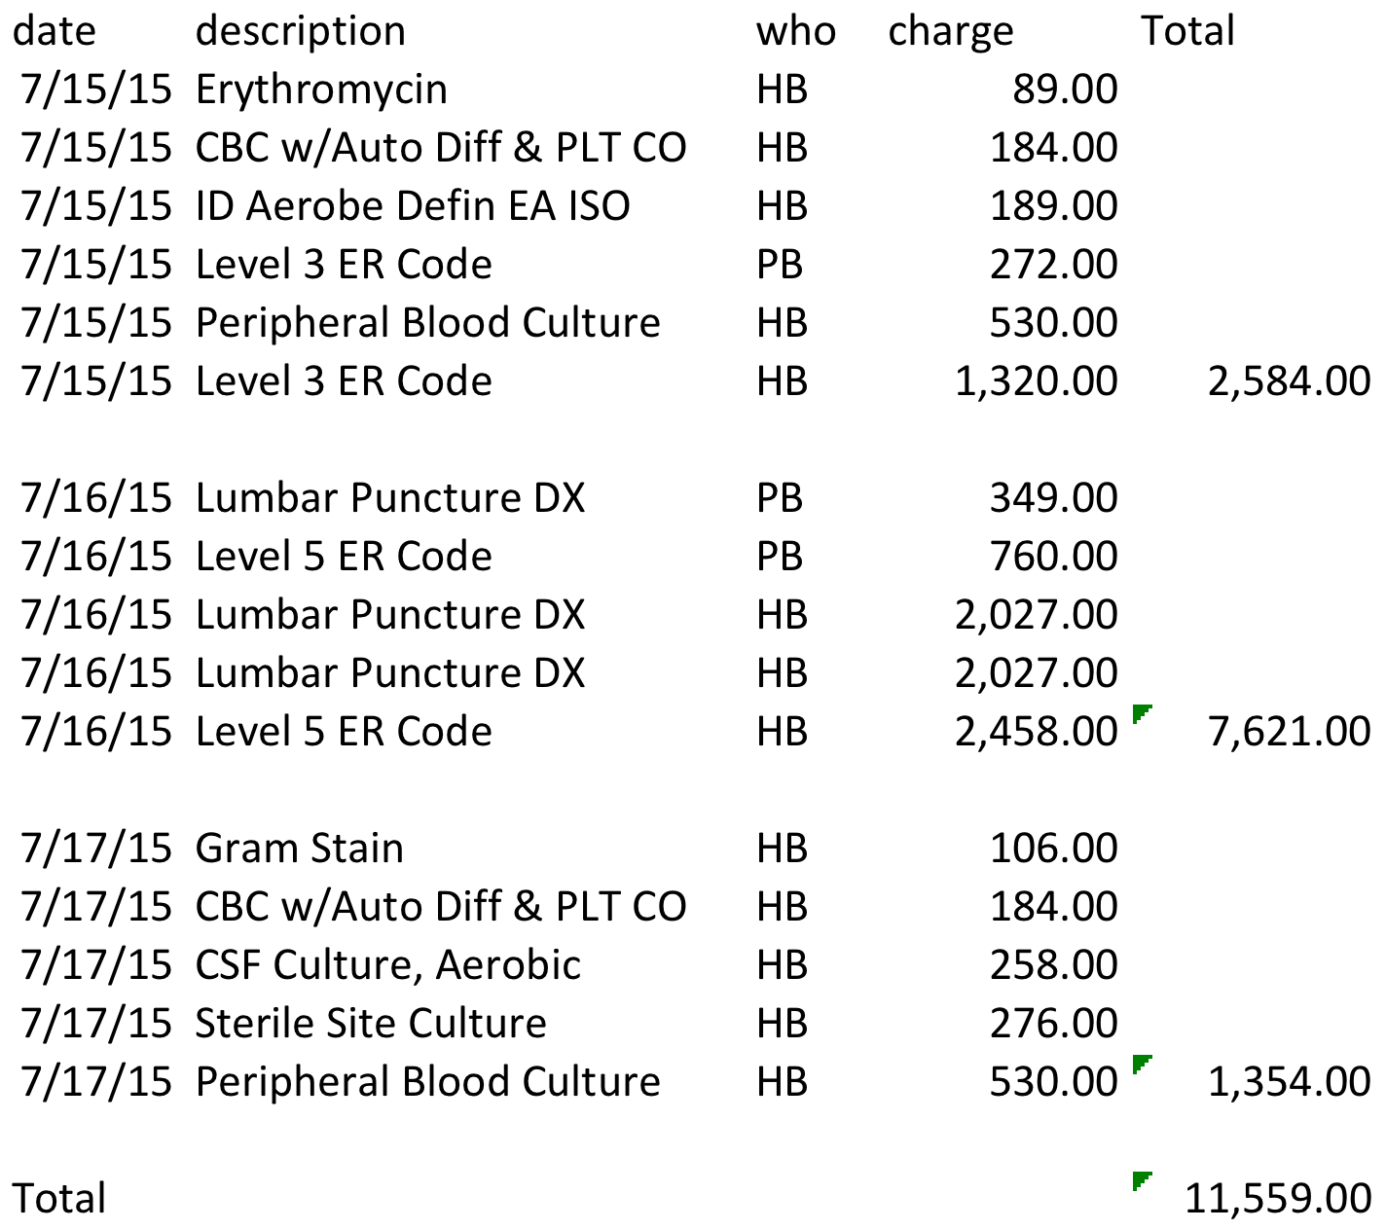
Total UCSF BCH charges
Notes:
PB= professional billing
HB= Hospital billing

Slide 60
Overview
Definitions: sensitivity, specificity, prior and posterior probability, predictive value, accuracy
2 x 2 table method
Likelihood ratios - WOWO
Probability and odds
False-negative and false-positive confusion
Treatment and testing thresholds and regret graphs (web demonstration)
Likelihood ratios in action: the $10,000 case of conjunctivitis

Slide 61

Notes:
Yyy

Slide 62
What is wrong with this logic?
“The positive predictive value of the sepsis screen in neonates is poor (<30%); however, the negative predictive accuracy has been high (>99%)”
“Diagnostic tests for early-onset sepsis (other than blood or CSF cultures) are useful for identifying infants with a low probability of sepsis but not at identifying infants likely to be infected.”
Polin R A , the COMMITTEE ON FETUS AND NEWBORN
Notes:
Does not account for low prior probability!

