Slide 1
Lexus Diagrams

Slide 2
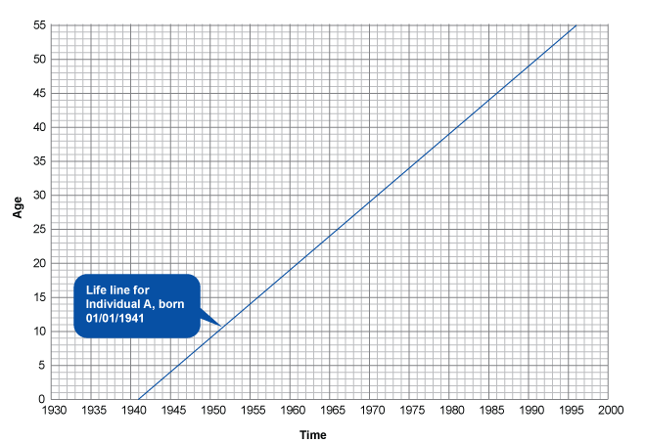
Lexis Diagrams: An individual

Slide 3
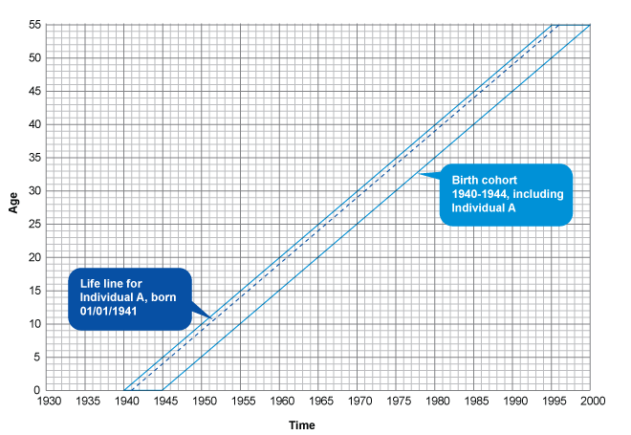
Cohort

Slide 4
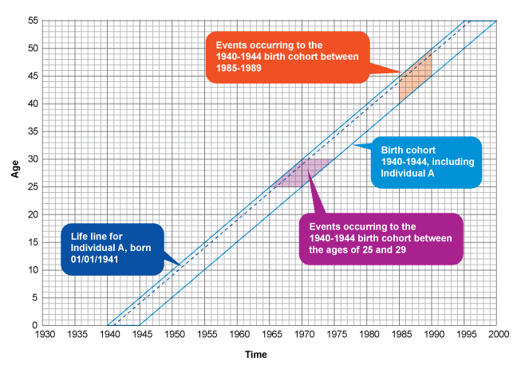
Cohort experiences

Slide 5
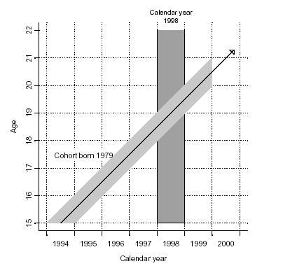
Lexis Diagram: Period vs Cohort

Slide 6
Measures of mortality

Slide 7
Measuring Mortality
Crude Death Rate=
  Number of deaths in year X, in country Y
  ___________________________________________________________________________________ X 1000
  Mid-year population in year X, country Y
Age specific death rate=
  Number of deaths at age Z, in country Y
  ________________________________________________________________________________________ X 1000
  Number of people age Z, in country Y

Slide 8
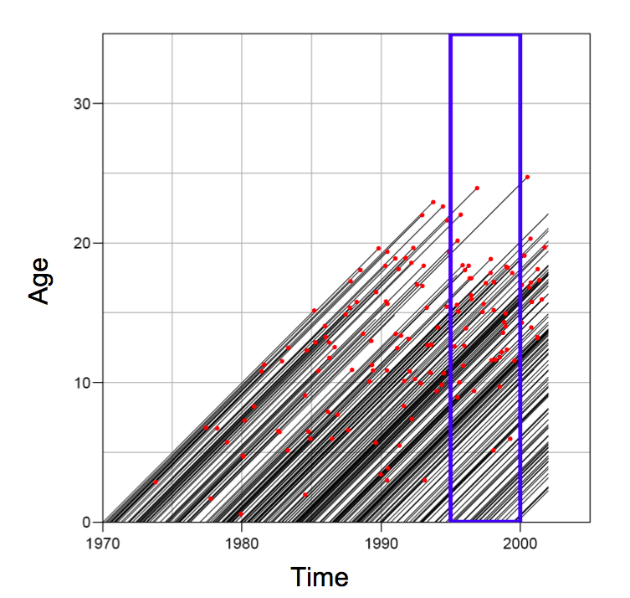
Crude death rate: why is it problematic?
Think about lexis diagrams

Slide 9
Rate vs probability
Rate:
  Measure of the frequency with which an event occurs in a defined population during a given length of time
  Numerator: Count of events that occur during a period
  Denominator: Midpoint population, or person-years, or other person-time units of exposure for the same period as the numerator
Probability:
  In demography, indicates the likelihood that some event will (or will not) occur to some group of exposed persons during the course of some period of time
  Similar to rates except that they consider the number of people exposed to risk at the start of a time interval

Slide 10
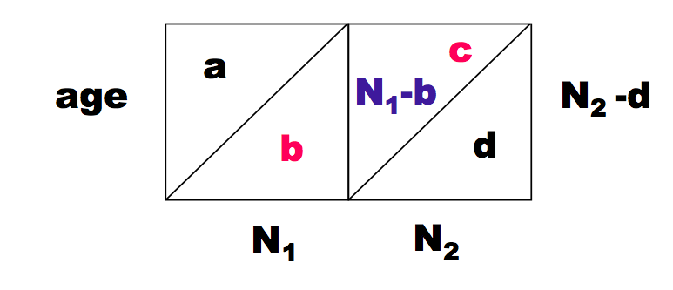
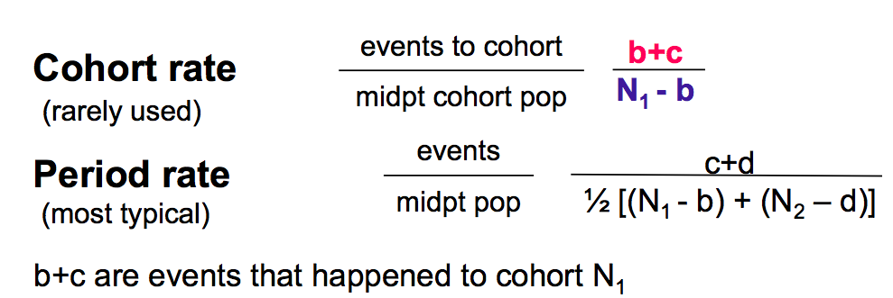
Cohort vs period rates

Slide 11
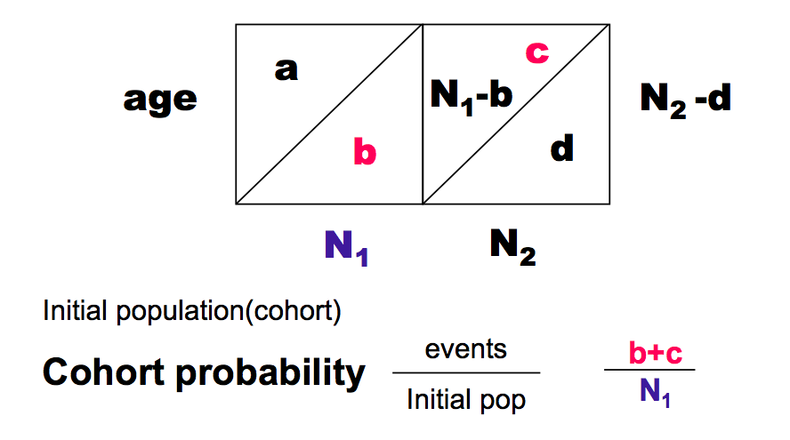
Rates vs probabilities
We often think in terms of probabilities in demography (the probability of dying)
  Life tables

Slide 12
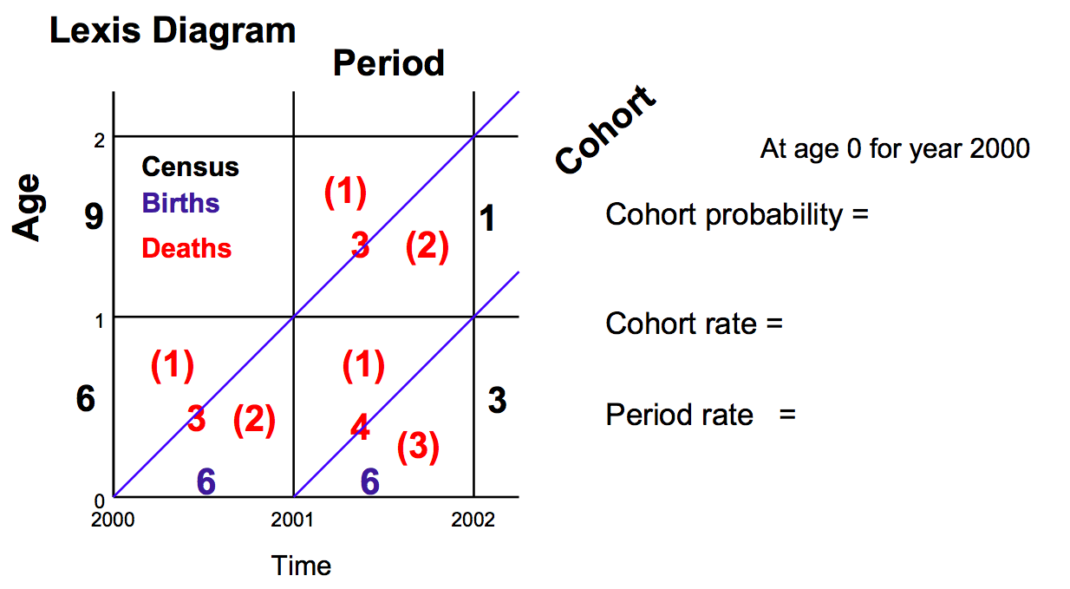
Try to calculate!

Slide 13
Try to calculate!

Slide 14
Try to calculate!
3/6
3/4
3/5

Slide 15
Problem with crude death rates
Populations differ in terms of age distribution
  Cannot really compare
Need to remove the effects of the population distribution on crude death rates to compare

Slide 16
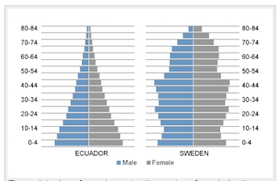
Ecuador vs Sweden
Crude death rate
Ecuador: 5.6/1000
Sweden 10.5/1000
Why?
Age Structure:
More old people in Sweden

Slide 17
How to address: Standardization
Direct
Apply age specific death rates of both countries to a standard population age distribution
Problem: what population to choose?
  Can get very different results depending on the population
  Some options
    Middle between the two populations
    Region specific fake populations (Africa, European, etc.)
    WHO in 2001 made a “world” population

Slide 18
Standardization: Direct continued
Usually calculate the Comparative Mortality Figure (CMR), which is the ratio of the age adjusted rate to the rate of the other country

Slide 19
How to address: Standardization
Indirect
Calculate the expected number of deaths if each country had real age structure, but apply a standard set of death rates
Usually calculate a Standardized Mortality Ratio (SMR)
Can use one countries death rates and apply to the other country
Only need to know # deaths, and age structure, not rates, so sometimes more feasible to calculate
Preferable when small numbers in some cells

Slide 20
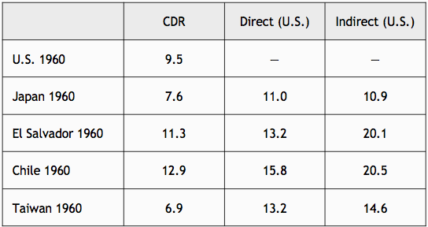
Comparison

Slide 21
Data sources and quality

Slide 22
Common Sources of Demographic Data
Vital Registration/Statistics
Population Registers (provides info about life events and population at risk)
Census
Sample Surveys
Record linkage
Other sources of demographic data
  Administrative Data: Medical claims, Hospital
  Qualitative sources
  Geographic Information Systems (GIS)
  Historical sources

Slide 23
Vital Registration Systems
Data:
  Mortality
  Fertility
  Nuptuality (marriage/divorce)
  Migration
US Vital registration/statistics:
  Death registration since 1900s (not for black population until 1968)
  Births since 1915
  1933: National Vital Statistics System started
Problems:
  Changes in cause of death classification over time
  Missing Populations
  Incomplete in many countries

Slide 24
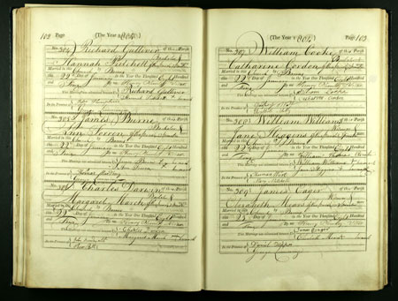
British Vital Registration:
Originally collected in church/parishes in Europe, then governments took over

Slide 25
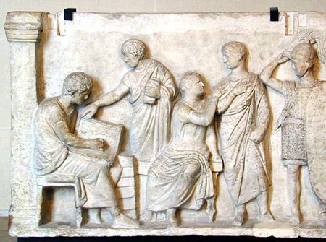
Censuses
Full count of a population at a certain point in time
  Age
  Sex
  Geographic locator
  Some have data on recent mortality
Pros: full country, most countries have them
  >90% of world population covered by census
  Cons: Only available at intervals, often 10 years

Slide 26
  Censuses: Types of errors
Sampling
Non-sampling
  Coverage
    Under enumeration; prone to missing data
      Recent births, migrants, homeless, hard to reach, minorities
      Ways to estimate using inter-censual projections
    Over enumeration: Kashmir and Jammu
  Content error:
    Prone to age-heaping
      Can use indirect estimation techniques to adjust for these
    Income notoriously hard to collet data on

Slide 27
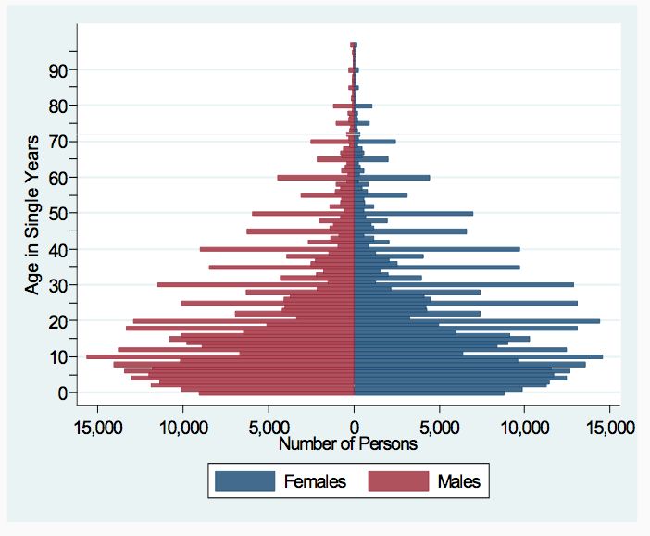
Ethiopia Census: 2007
Age attraction
Under reporting of children?

Slide 28
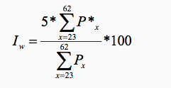

Detection and quantification of age attraction
Whipple’s Index (I_{w}):
Where Px is the population aged x, and P*x is the population of an age x ending in “0” or “5”

Slide 29

Other methods
Compare age ratios
  Ages in one 5 year group should be fairly similar (or smoothly related to) the ones before and after
Compare sex ratios
  Only works for some countries
UN: Age-sex accuracy index
Intercensal cohort comparisons

Slide 30
Sample Surveys
Used to validate vital statistics or Censuses, or provide information in inter-censual periods
Most focused on fertility and health
  Demographic and Health Surveys (International)
  Also general household surveys, labor force surveys, etc.
Pros
  Can be more in depth, ask different types of questions
  Can occur more frequently but still not continuous (compared to vital statistics)
Suffers from errors as well
  Sampling errors and biases: DHS and questionnaire length

Slide 31
Thank you!
Questions?
Notes:
Final boiler plate language: 2 versions
Through its singular focus on health, UCSF is leading revolutions in health.
UCSF is driven by the idea that great breakthroughs are achieved when the best research, the best education and the best patient care converge.

