Slide 1
A note on homeworks

Slide 2
Rate
Percent change of something (population) within a specific time period
r= (Population time 2- population time 1)/Population at time 1
Example:
Population Time 1: 200
Population Time 2: 175
r= (175-200)/200= -0.125
What if time 1 was 1950 and time 2 was 1990, what is the annual growth rate?
-0.125/40=-0.003125

Slide 3
Data
Make sure to look at your data closely and make sure you understand it
  How many years of data are provided may differ between sources. Be careful, double check your data and think about if your output makes sense.

Slide 4
Mortality

Slide 5
Crude death rates (WHO 2000-2005), rates per 1000 people

Slide 6
Adult mortality only: by sex

Slide 7
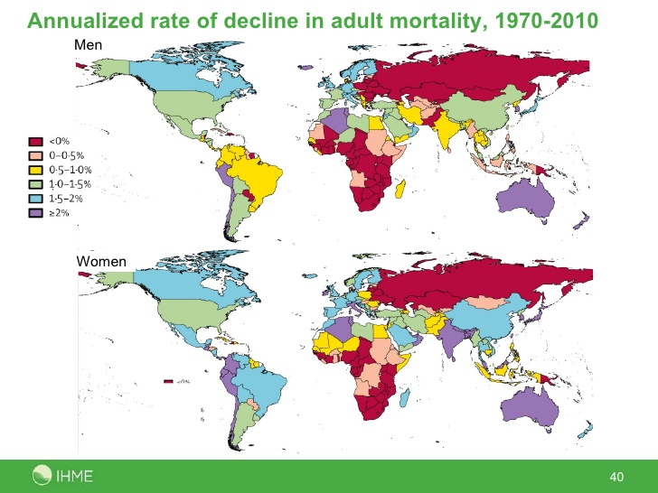
Adult Mortality Decline

Slide 9
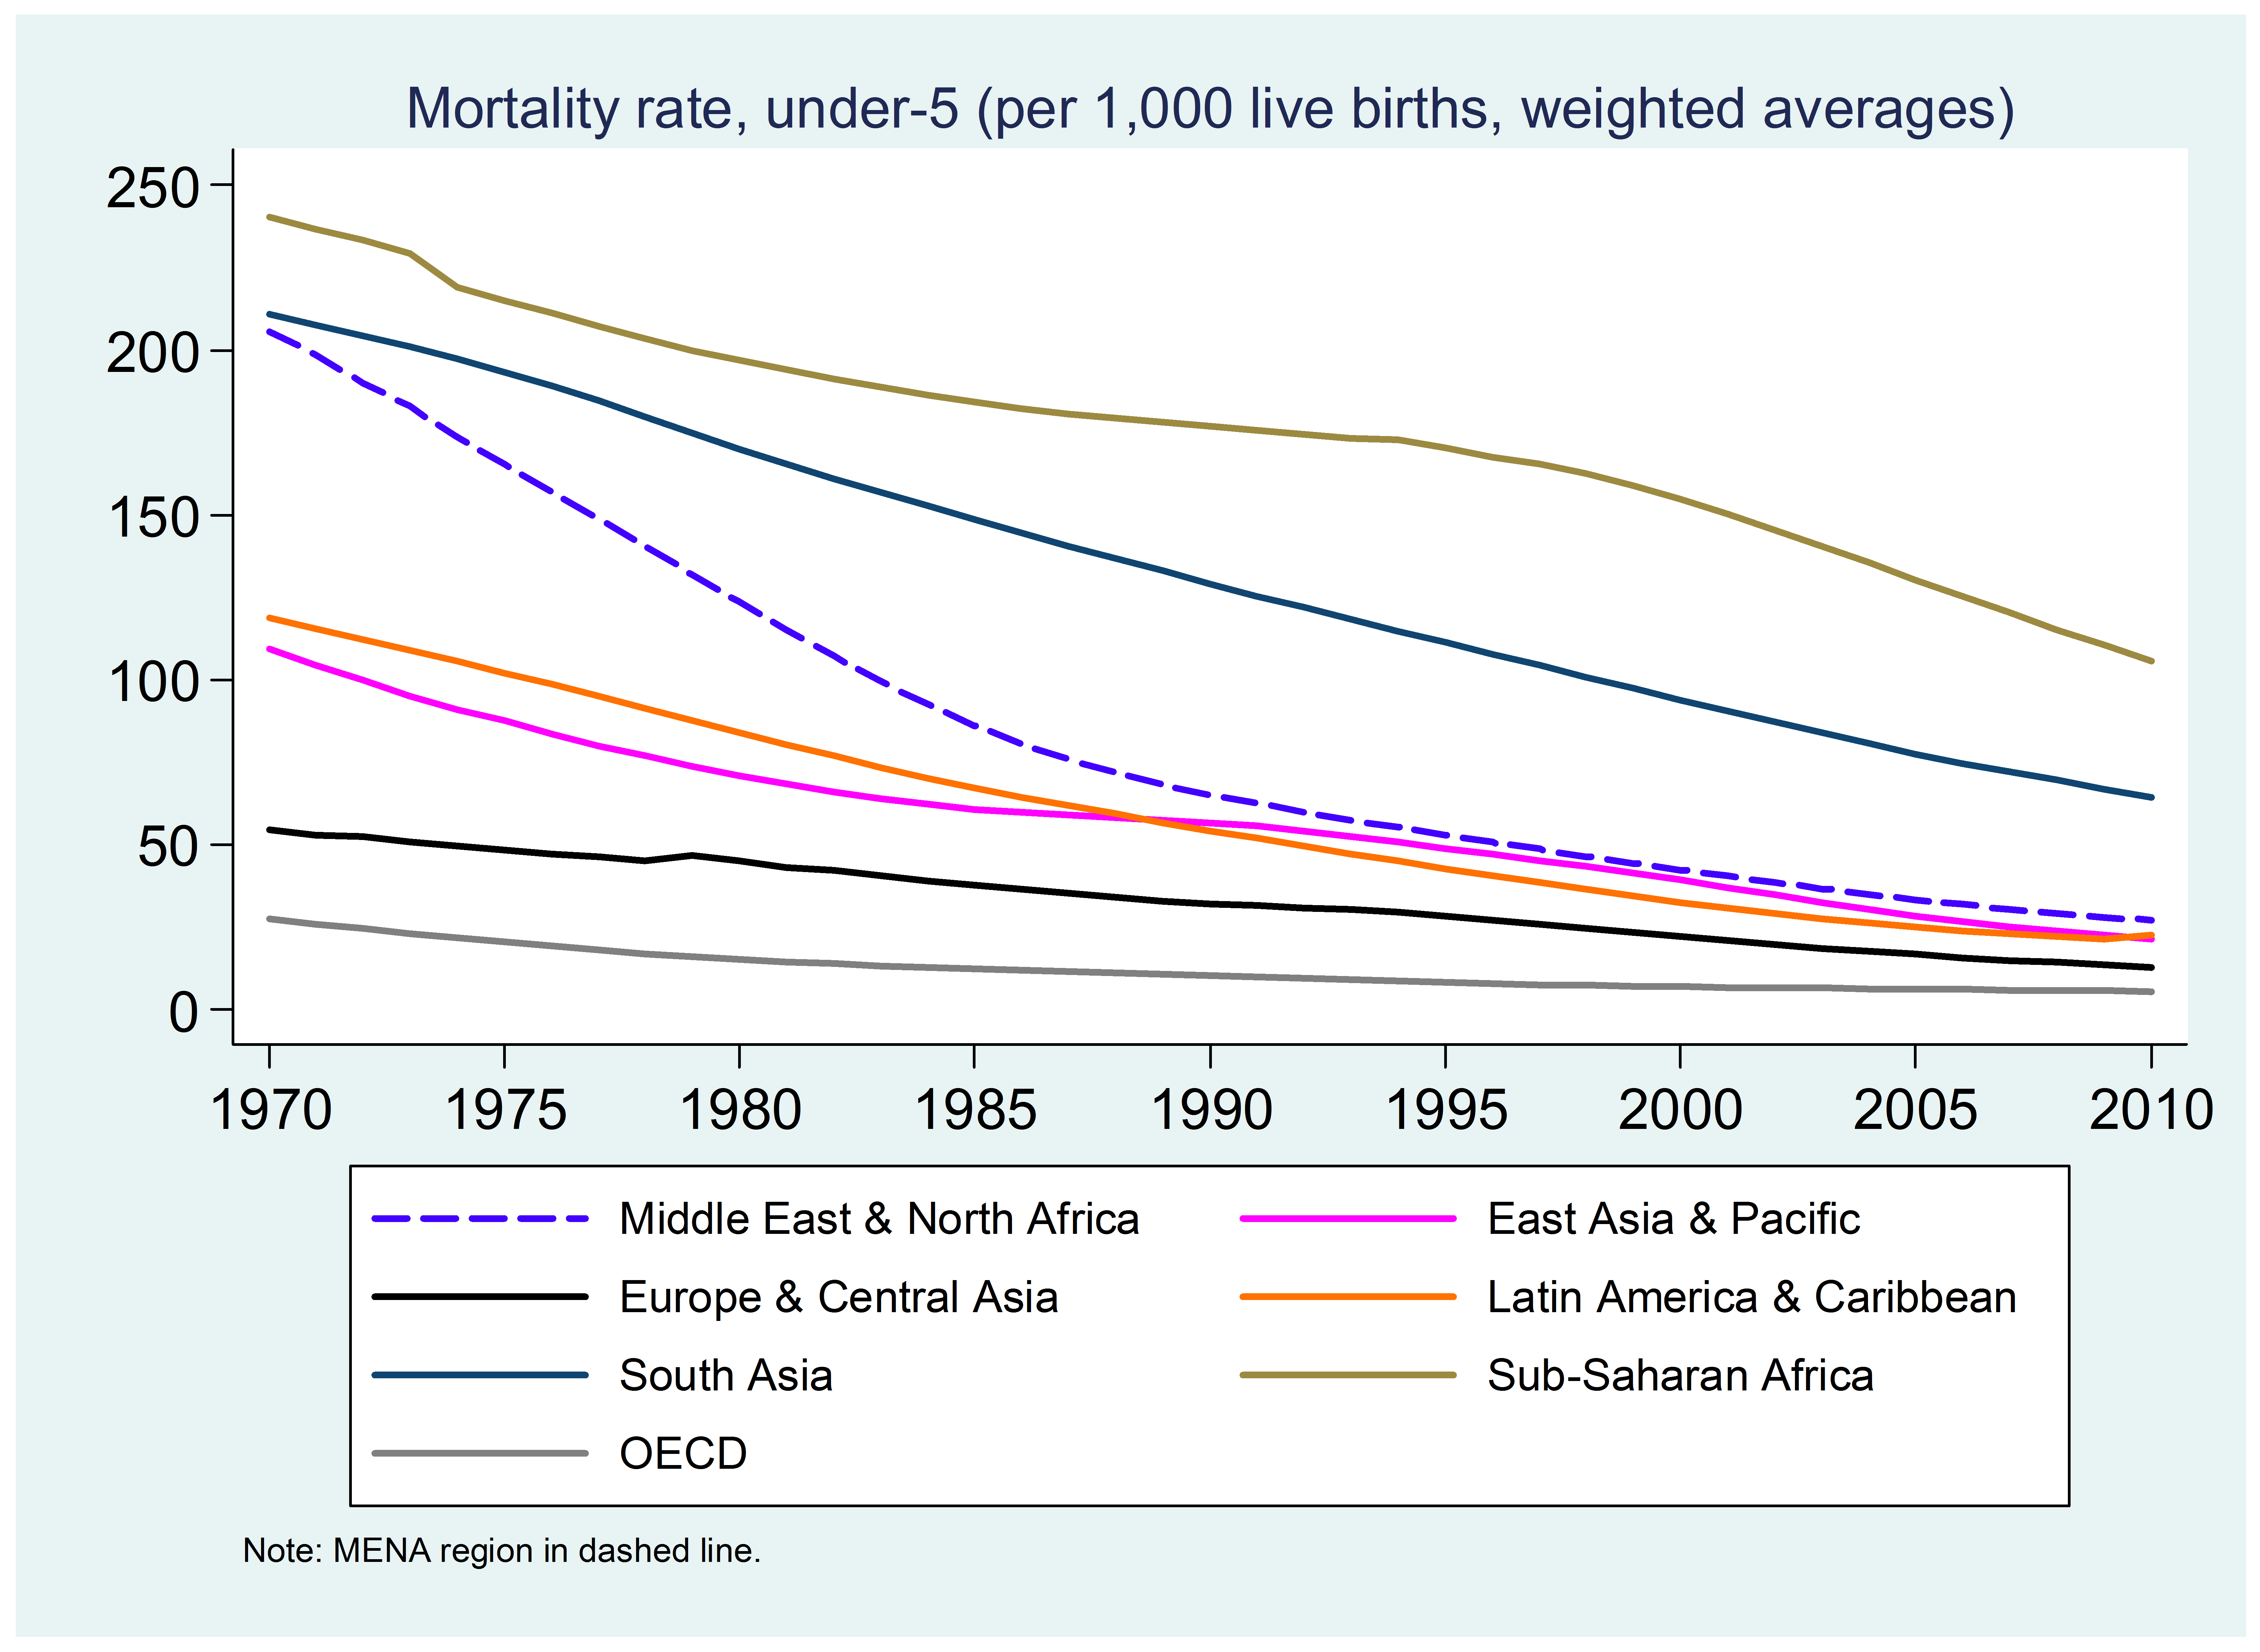
Under 5 mortality rate

Slide 11
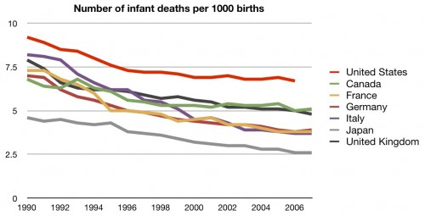
Infant mortality

Slide 14
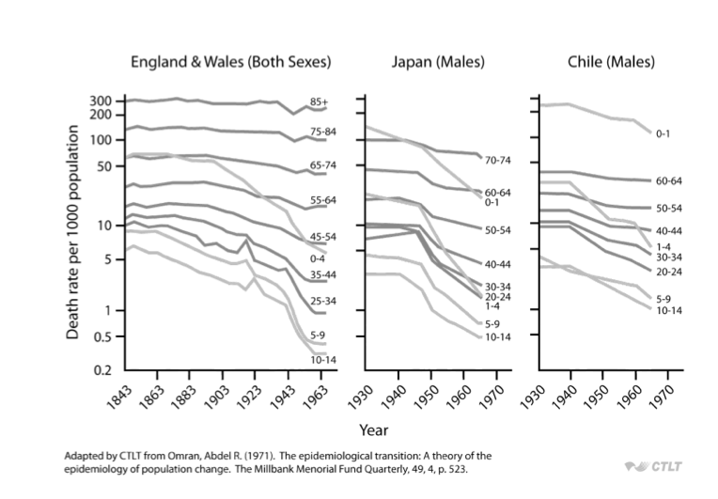
How does mortality differ by age group over time?

Slide 15
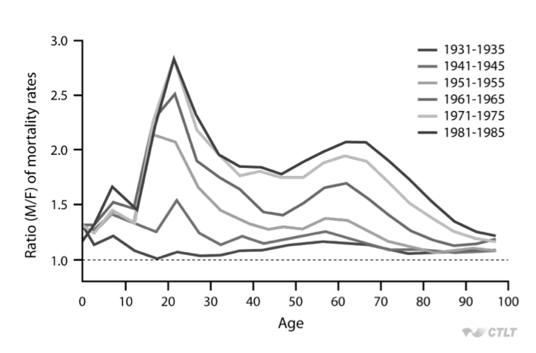
How does mortality differ by sex and age over time? (Sweden)

Slide 16
Theories of mortality decline
(Acknowledgement to Dr. Magali Barbieri for some of these slides)

Slide 17
Theories of mortality change
Malthus
The demographic transition theory
The epidemiologic transition theory
The health transition theory
  Initial formulation
  The 4th stage of the health transition
  Convergence/divergence cycles
Drivers of mortality change

Slide 18
Basic concepts of [mortality] transition theories
”A transition is not just any change but change that follows an identifiable pattern and which occurs over a relatively long time” (Frenk)

Slide 19
Epidemiologic Transition
What is the epidemiological transition?
Shift from communicable to non-communicable diseases
Changing risk factors, changing causes of death
Intricately linked with the demographic transition, but how?

Slide 21
What is the epidemiologic transition theory?
Abdel Omran’s seminal article published in The Milbank Memorial Fund Quarterly in 1971
Describes and explains the profound shift in mortality that has taken place around the world
Change in mortality pattern
  By age
  By cause of death

Slide 22
Three stages
High and fluctuating mortality => until the mid-18th century for the most advanced countries = The Age of Pestilence and Famine
Mortality declines =
The Age of Receding Pandemics
Mortality reaches its lowest level (implicit concept of a biological limit to life) =
The Age of Degenerative and Man-Made diseases

Slide 23
The Age of Pestilence and Famine
Mortality patterns of pre-modern societies characterized by frequent and violent fluctuations
The average length of life oscillated between 20 and 40 years
  18 in ancient Greece
  22 in Rome
  17-35 in medieval Britain
  22, 26, and 34 in 16th , 17th , 18th c. Geneva
Predominance of infectious diseases
No sustained population growth
Notes:
Two components of mortality : “normal” and “epidemics” (often related to natural catastrophes or wars)
Death rates fluctuate at very high levels between peaks and troughs in response to epidemics that periodically ravage the population
Major killers = influenza, pneumonia, diarrhea, smallpox, tuberculosis and the plague
Main victims of “normal” mortality = infants and children as well as women of reproductive ages => unusually high risks related to complications of pregnancy and delivery
Women probably had a lower expectation of life at birth than men in many pre-transitional societies (especially where they were severely discriminated – e.g. East and South Asia) but not the case any longer
Hence median age at death skewed toward younger ages

Slide 24
The Age of Receding Pandemics
Transitional phase
Mortality declines progressively
First, mortality crises recede
Then, “normal” mortality falls
Population growth is sustained and begins its exponential growth (as the birth rates remain high)

Slide 25
The Age of Degenerative and Man-Made Diseases
Mortality has fallen to a low level
Infectious diseases have been replaced by non-communicable diseases (cardiovascular diseases and cancer) as the leading causes of death
  Spectacular change in the epidemiologic profile of modern populations
The age structure of mortality has shifted from children to older adults
  Change in epidemiologic pattern associated to changes in age pattern of mortality
Notes:
Described basically as a plateau phase in our epidemiologic history where we reach again a level of equilibrium in mortality but lower than during the pre-transitional stage
In this stage, the pace of the declines in mortality rates slows as the theoretical limits to mortality declines are approached
Improvements in survivorship that occurred with the recession of pandemics were especially beneficial to children (1-4 years old) of both sexes and to women in the reproductive age period
Shift in the structure of mortality by cause is a major characteristic of the transition => the epidemiologic transition
Two main components of the epidemiologic transition = shifts in the cause-of-death pattern and change in the age structure of mortality

Slide 26
The three types of transition
The Classical (Western) model
  Gradual, progressive transition
  Mainly determined by socioeconomic factors
  Slow population growth (=> fertility decline)
The Accelerated model
  Rapid modernization lead to rapid mortality drop in the 20th century
  Epidemiologic transition driven by a combination of sanitary and medical advances as well as by general social improvements (also bringing a decline in fertility)
The Contemporary model
  Relatively recent transition of most developing countries
  Rapid and substantial declines in death rates after WWII
  Public health and primary health care measures determinants
  Explosive population growth as fertility remained high for a long time

Slide 27
Limits to the epidemiologic transition theory
Concept of a biological limit to life
Linear process
Overlapping patterns (“double burden of diseases”)
Determinants of change
Revisions to the initial theory
  The fourth stage of the epidemiologic transition
  The health transition theory
  The concept of convergence/divergence cycles
Notes:
In the 1960s and early 1970s, scientific consensus on 3 propositions :
The century long decline in mortality rates in industrialized countries over the period from 1850 to 1950 was unique and could not be repeated because virtually all of the gains made through the limination of death from contagious diseases below age 60 had been made.
Deaths, now concentrated at older ages, were due to degenerative diseases that were unrelated to the contagious diseases they superseded. The degenerative diseases were caused by accelerated organ losses that were part of the natural process of aging.
There was an upper limit to life expectancy that was genetaically determined. One influential paper put that limit at 85, plus or minus 7 (Fries 1980, 1989).

Slide 28
The fourth stage of the epidemiologic transition
Proposed by Olshansky and Ault (1986)
Context of renewed mortality decline (c.1970)
  Due to medical advances
  And improved access to health care (Medicare and Medicaid in the 1960s)
  [Change in individual behavior = smoking]
Timing and magnitude significant and distinct from the first 3 stages
  qualifies as a 4th stage
Notes:
Cardiovascular revolution of the 1970s and 1980s: US mortality from heart diseases, the leading cause of death at the time, declined by 25% between 1968 and 1978

Slide 29
Characteristics of the 4th stage
Rapidly declining death rates concentrated in advanced ages
Occurred for both men and women
Cause-of-death structure relatively similar to 3rd stage BUT
Age distribution of deaths from degenerative causes shifting to older ages
Notes:
Olshansky believes in a biological limit to life (to about 85 years at the time) => consequence of this new stage of the mortality transition = rectangularization of the survival curve

Slide 30
The health transition theory
Concept developed by Frenk and al. to describe the transition from a high to a low level of mortality
Built on the epidemiologic transition theory, itself an offspring of the demographic transition theory
Not a dispute of the main characteristic of the epidemiologic transition theory but more encompassing
  The health conditions in a population
  The response to those conditions
Strong focus on the determinants of mortality change
Notes:
Frenk’s main critic to Omran = not only should the theory describe the characteristics/process of mortality change but it should also aim at understanding its determinants and consequences

Slide 31
Theoretical framework
Four element model driven by
The population
  Size
  Growth rate
  Age structure
  Geographic distribution
The environment
  Altitude
  Climate
  Natural resources
  Type of pathogens (parasites, vectors…)
Linked by two “bridges”
Social organization
The genome
Notes:
Organized into a very complex framework presented in the paper
Multiple attempts to provide a valid and functional theoretical framework to analyze mortality factors but not highly successful so far
Starting point in the determinants of health = population and the environment, which interactions are determined by social organization and the population genome
Social organization = a society’s structures and process to transform nature
The genome = transforms the deepest constitution of human populations in response to changes in the environment (evolution)

Slide 32
Social organization
Economic structure (production system)
Political institutions
Science and technology
Culture and ideology
Total level of wealth
Distribution of wealth within the population
  Occupational structure
  Redistribution mechanisms
Notes:
Four major dimensions on the social determinants
Redistribution mechanisms = used by the community or the government to spread wealth within the population, notably through taxes and subsidies
Social organization determines in turn the proximate determinants of health

Slide 33
Proximate determinants
Occupational hazards
Living conditions
Lifestyles
The health care system
  Health policy
  Health care (prevention and treatment)
Notes:
Living conditions include market-based elements (food, housing..), education and assistance programs (social security), public health (water and sanitation systems) => objective material situation in which the different social groups live
Lifestyles = the manner in which social groups translate their objective material situation into patterns of behavior (determined in turn by living conditions, culture and ideology, laws and regulations, taxes and subsidies, and the pressures of commercial enterprises)

Slide 34
Divergence-convergence cycles theory
Developed by France Meslé and Jacques Vallin (INED, Paris) (2004 Demographic Research)
To explain the lack of convergence postulated by the health transition theory (Eastern Europe, sub-Saharan Africa…)
Notes:
Seek to explain the wide diversity of mortality situations throughout the world and within MDCs
The idea that the social response to epidemiologic patterns is as important as the pattern itself (e.g. predominance of infectious vs. chronic diseases), that is emphasized by the health transition concept – by contrast with the epidemiologic transition theory – is also emphasized by others scholars and has led to other developments of the theory

Slide 35
Basic theory
Each new stage of the health transition is associated with major changes in health technologies and/or strategies
Some societies/populations are better prepared than others to take advantage of the advances => divergence
Progress diffuses from population to population => convergence
Hence the successive cycles of divergence/convergence as life expectancy increases

Slide 36
Why did mortality decline?

Slide 37
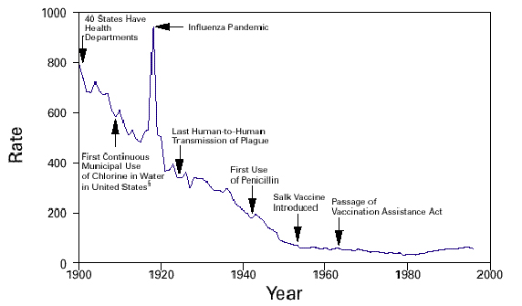
Mortality decline in the US

Slide 38
Why did mortality decline?
Improved therapeutic medical interventions
Improved water and sanitation (Preston and van de Walle, 1978)
Improved preventive medical interventions (Razzell)
Increased living standards, nutrition, hygiene (McKeown, 1976)
Spread of knowledge to public concerning disease prevention (Preston and Haines, 1991)
  Evidence in differences in child mortality by mother’s education level, etc.

Slide 39
Thomas McKeown’s thesis
4 seminal articles published in Population Studies between 1955 and 1975
2 popular books published in 1976
  The Modern Rise of Population
  The Role of Medicine: Dream, Mirage, or Nemesis?
His work generated considerable controversies and continues to stimulate support, criticism, and commentary
Idea: The growth in population in the industrialized world from the late 1700s to the present was due not to life-saving advancements in the field of medicine or public health, but instead to improvements in overall standards of living, especially diet and nutritional status, resulting from better economic conditions

Slide 40
McKeown’s Rebuttal of other theories
Medical treatment:
  Ruled out (except for smallpox) because became effective long after a downward mortality trend had begun
Public health advances
  Small role at best because influenced water-borne illnesses such as cholera, which were responsible for just a small portion of the mortality decline
  Did not influence airborne diseases, such as tuberculosis, which made up a large share of mortality
Notes:
McKeown acknowledges that experience of the pre-registration period in terms of TB mortality is uncertain but he claims that « there is no serious doubt that mortality from tuberculosis was very high during the previous three centuries » = one of the critics of his opponents is that TB seems in fact to have increased with urbanization in the first third of the 19th century

Slide 41
Influential thesis
Despite flawed data, analysis, interpretation and conclusions (as showed in the 1980s)
Major influence on demography, public health research and policy
Asked fundamental questions that remain relevant (especially in a context of scarce resources and rising health care costs) =
What are the most important determinants of a society's patterns of morbidity and mortality? and How should public health practitioners most effectively focus their efforts?
Also because of the demographic context as the mortality decline of the previous period had stalled (1960s) despite large expenditures on sophisticated medical techniques
  Optimism and faith in medicine had characterized the 1940s and 1950s

Slide 42
Conclusions: Determinants of mortality decline—debate still open
Ecological => complex balance between
  disease agents
  The level of hostility in the environment
  The resistance of the host
Socio-economic, political and cultural determinants
  Standards of living (nutrition)
  Health habits (hygiene)
Medical and public health determinants
  Improved public sanitation (sewage and water systems)
  Immunization (smallpox)
  Therapies (surgery and treatment)
Notes:
Much debate over the respective impact of these various factors on mortality change, especially as regards historical Europe
Variations in the role of these different determinants over time and across space (e.g. Western countries = role of social factors most important ⬄ role of medical technology predominates in LDCs) => determine different models of the epidemiologic transition

Slide 43
Fertility: additional measures

Slide 44
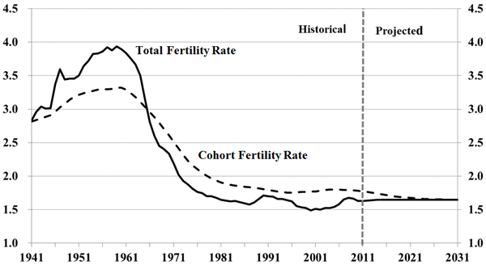
Cohort vs. Period fertility: Canada

Slide 45
Cohort vs. Period fertility: Why?
Timing of childbirth
  Postponement/delay
  Mean age at childbirth
What might make this difference?

Slide 46
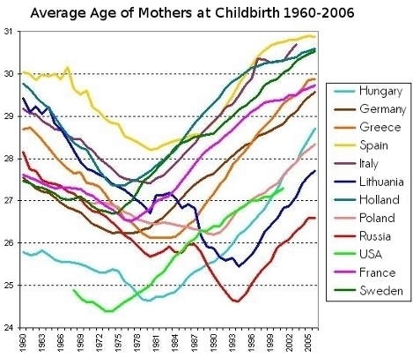
Average age of mothers over time

Slide 47
Tempo effects
A tempo effect is defined as an inflation or deflation of the period incidence of a demographic event (e.g., births, marriages, deaths) resulting from a rise or fall in the mean age at which the event occurs (Bongaarts and Feeney)

Slide 48
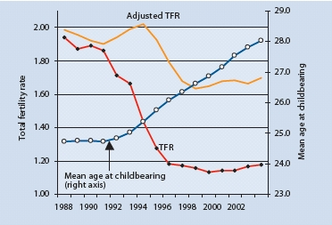
Tempo effect: Czech Republic

Slide 49
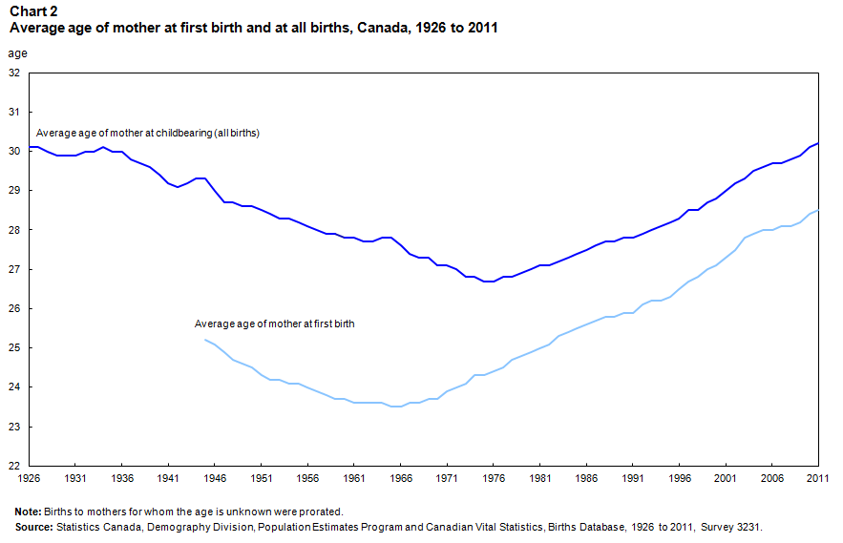
Mean age at childbirth: need to look at parity

Slide 50
Parity Progression Ratios
An approach for estimating/projecting fertility rates based on patterns of when women stop childbearing
  Cohort measure, free of tempo effects
Definition: Proportion of women with n children who go on to have n+1 children

Slide 51
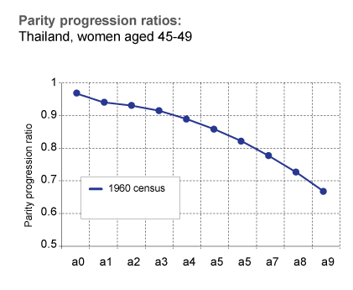
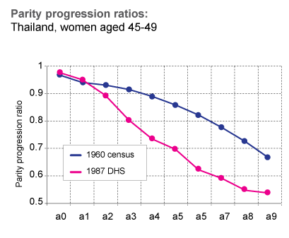
Parity Progression ratios
a0 = proportion of women with 0 children who go on to have 1
a1 = proportion of women with 1 child who go on to have 2
a2 = proportion of women with 2 children who go on to have 3
Etc….
(UNFPA)

Slide 52
Thank you!
Questions?
Notes:
Final boiler plate language: 2 versions
Through its singular focus on health, UCSF is leading revolutions in health.
UCSF is driven by the idea that great breakthroughs are achieved when the best research, the best education and the best patient care converge.

