Slide 1
Family Demography and Sex Ratios

Slide 2
Marco family processes
Family and kinship processes
  Co-residence
  Marriage and divorce (timing, driver, patterns)
  Parenthood (timing), spacing of children
Why important for health researchers?
  Use family structure as predictors of health outcomes
    Do children from single-parent families have poorer health?
  Use health to predict family structure
    Are healthy people more likely to marry?

Slide 3
Examples of outcomes and predictors
Type of marriage
  Polygamous, monogamous
Type of family
  1 vs 2 parents
Intergenerational exchange
  Co-residence
  Extended vs nuclear households

Slide 4
Assumption
The group being studied has a culturally and historically specific set of kinship rules, which may be formal (written into the law) or informal, or a mixture, and which could be accurately described by any legitimate and competent group member under the right kind of questioning
There is a (very complex) relationship between a particular set of kinship rules and a particular schedule of fertility, mortality, marriage rates, and migration levels
Demographic rates affect kinship structure − Kinship structure affects demographic rates

Slide 5
Family Structure, trends over time

Slide 6
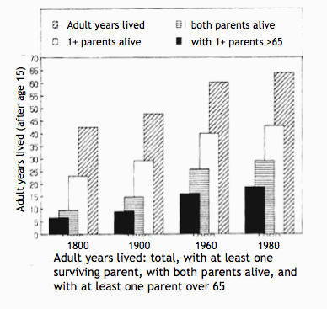
Years lived with parents over 65+
Obligations (on both sides) go on much longer
Benefits (on both sides) go on much longer
Happened simultaneously with a decline in fertility, so obligations on parent side reduced and on child side increased

Slide 7
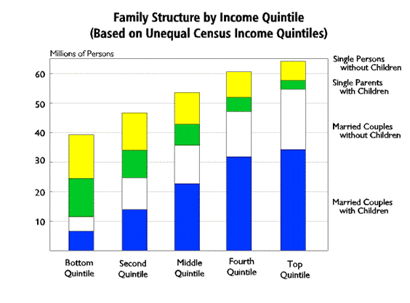
Wealth differentials

Slide 8
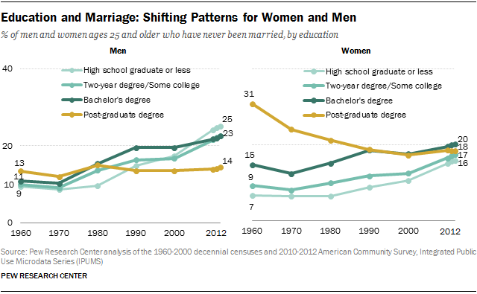
Educational differentials

Slide 9
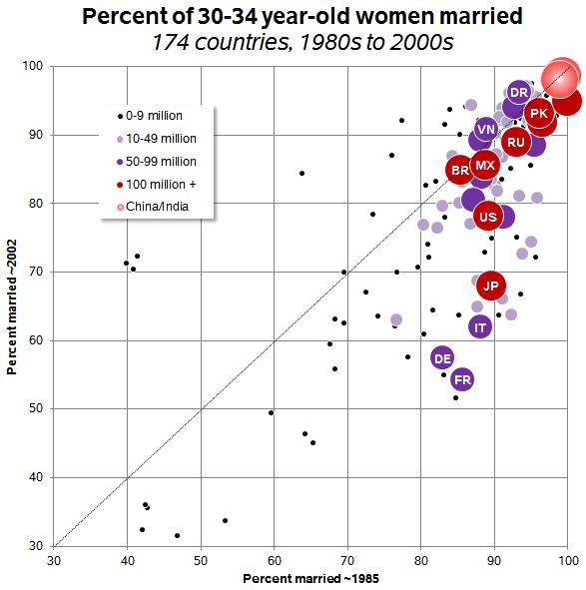
Marriage on the decline globally
Remarriage also on the decline

Slide 10
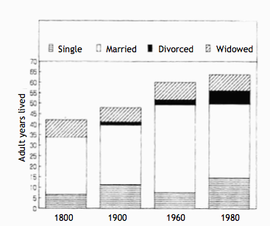
Adult years spent in each state

Slide 11
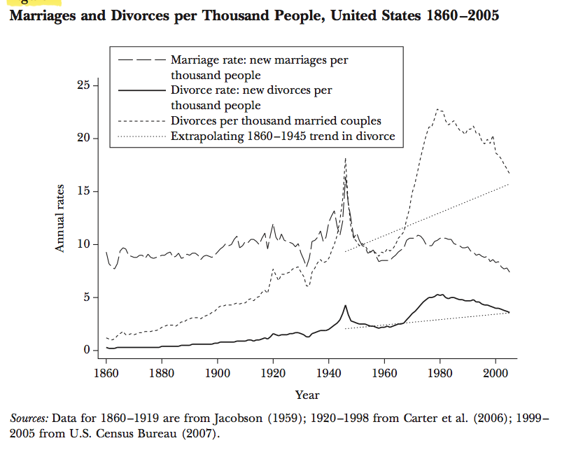

Slide 12
Global divorce rates

Slide 13
Marriage, divorce, life expectancies: a hypothesis
Number of years married rose from 27 to 42 and then declined to 35
  Rising age at marriage and increase in divorce totally overcome by declining death rates
Puts enormous strains on married couples
  In 1800, a certain number of “bad” marriages ended by death before they could consider divorce

Slide 14
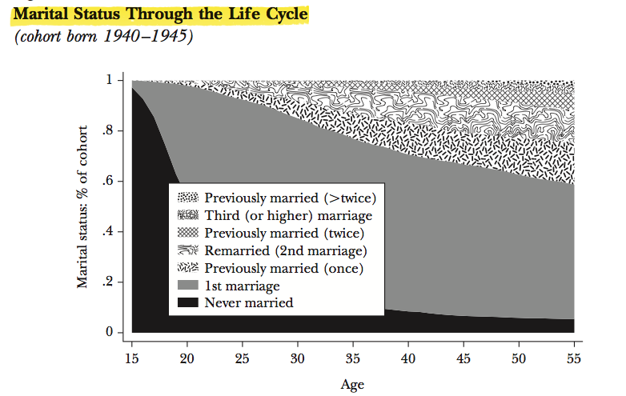

Slide 15
Measures of marriage and divorce
Crude marriage rate=
General marriage rate=
(can do for men
or women)
Age specific marriage rate=

Slide 16
More measures of marriage and divorce
Order specific marriage rate=
Can do age and order
Total marriage rate
TMR = Total number of marriages a person will have at the end of his/her marriageable age if he/she follows the given schedule of marriage

Slide 17
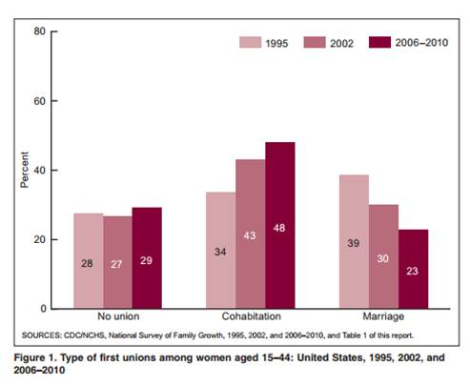
Increases in cohabitation

Slide 18
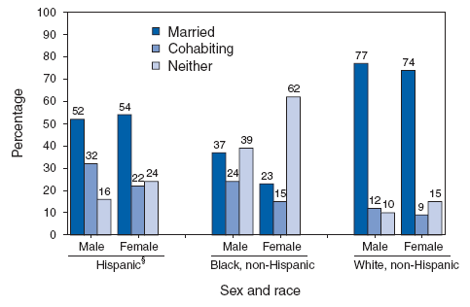
Differences in cohabitation

Slide 19
Cohabitation
Short lived
  Half-life of cohabitation is 2 years, either marry or break up
People who marry less likely to divorce within 5 years than people who cohabit– now no longer true!
Trend towards less of a transition into marriage– big differences by education, SES
Cohabitation and mortality
  Married>cohabitating>divorced, single, widowed
Cohabiting and childbearing– decoupling. Increase in non-marital births is due to increase in cohabiting

Slide 20
Same-gender partnerships
Increasing over time, much more likely to be white, rich, well educated, both partners earning
  Gender dispartity
Less likely to be raising children– 19% married, 13% unmarried compared to 39% in different gender
  Again more in female same gender households
  This is declining over time
More dissolution, but no data by married/not

Slide 21
Global differences: trends
East Asia:
  Later age at marriage, increase in never married and childless, low levels of non-marital childbearing, cohabitation remains low but appears to be growing (short duration), low divorce rates
South Asia
  Trend towards later age at marriage and childbearing, older persons supported by/cohabit with younger, low divorce and non-marital childbearing
Africa
  Age at marriage increased, decline in marriage, Rise in non-marital childbearing, some rise in cohabitation (~10%), decline of polygamy, decline of child fostering,
Latin America
  Increase in cohabitation, wide range (20 Chile-70 DR%), more births in these unions, no change in age at marriage and birth among those that do marry

Slide 22
Second demographic transition
Delay in marriage
Delay in childbearing
Increase in cohabitation
Increase in divorce
Increase in women working
Outcome:
  Big changes in children’s living arrangements
    Poor for child outcomes? Socioeconomic status

Slide 23
How does kinship affect demographic processes? Examples
Polygamy decreases fertility
  Mixed evidence, mostly support this
  Why? Think about proximate determinants of fertility
    Age, fecundability (male)
    Coital frequency
    Fewer men marry
    Conflict between co-wives
Late marriage in Europe caused low natural fertility

Slide 24
Sex Ratios

Slide 25
India: Age contribution to the sex gap in mortality (M/F)

Slide 26
India: Cause contribution to sex gap in mortality (M/F)

Slide 27
Sex Ratio
Most of the world (including China), over 1 or over 100 favors boys
India: under 1000 favors boys

Slide 28
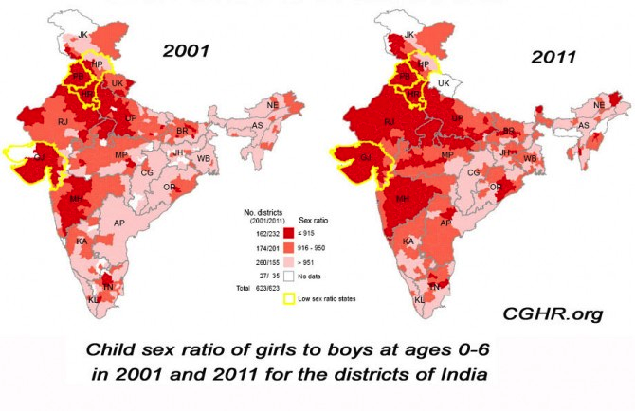
Child sex ratios in India have become increasingly imbalanced
Child sex ratios (girls per boys 5 and under)
  945/1000 in 1991
  927/1000 in 2001
  914/1000 in 2011
Geographic heterogeneity in the extent of imbalance in the child sex ratio
Notes:
SW: LARGER FONT. WOULD MAKE HEADING AND BODY FONT SAME. CONSIDER SOME NICE FORMATTING TO MAKE IT MORE INTERESTING

Slide 29
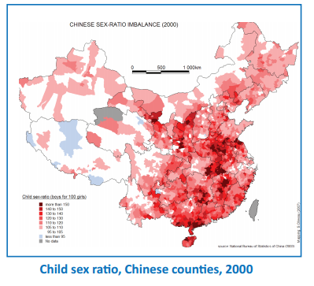
Uneven sex ratios elsewhere
China: 118 boys: 100 girls
  25% of women with no sons
  resort to sex selective abortion
Vietnam 111; Pakistan 110; Azerbaijan 116, Armenia 115, Georgia 114, Albania 112
Study in the UK (2011 Census) found sex ratios as high as 110-120 for second children born to families where the mother was born in India, Nepal, Pakistan, Afghanistan, or Bangladesh
  Similar findings in US and other western countries among immigrants

Slide 30
Why should we care about uneven child sex ratios in India?
Human rights
Marriage patterns: 40 million men remaining single (Guilmoto, 2012)
  Can increase use of prostitution and spread of STDs and HIV (China, Tucker et al., 2006)
Relationship found between sex ratios, violence and homicide rates and the perception of women being harassed more (Hudson et al., 2002; South et al., 2014)
  6 Asian countries, data from men: uneven sex ratios associated with more intimate partner violence, rape of a woman, use of a weapon. Not associated with rape of a man (Diamond-Smith and Rudolph 2018)
Increased sex trafficking (Hesketh et al., 2006)
Possible increase in men joining terrorist / paramilitary/ criminal groups and subsequent increase in regional violence (Hesketh et al., 2006)
Notes:
SW: LARGER FONT. WOULD MAKE HEADING AND BODY FONT SAME. CONSIDER SOME NICE FORMATTING TO MAKE IT MORE INTERESTING

Slide 31
How does the child sex ratio become imbalanced? Two components
1. Pre-birth events
  Measured by the sex ratio at birth (Natural sex ratio at birth is about 105 males for every 100 females)
  Sex-selective abortion
  Anomalies in imbalanced conception and fetal survival
2. Excess mortality for girls compared to boys
  Child mortality for girls exceeds child mortality for boys in India; in other countries males have higher mortality (especially in neonatal/infancy)
  Breastfed for shorter duration, provided less food, fewer vaccinations, taken to health facility less frequently or not as quickly, etc.
  Infanticide
Notes:
SW: LARGER FONT. WOULD MAKE HEADING AND BODY FONT SAME. CONSIDER SOME NICE FORMATTING TO MAKE IT MORE INTERESTING

Slide 32
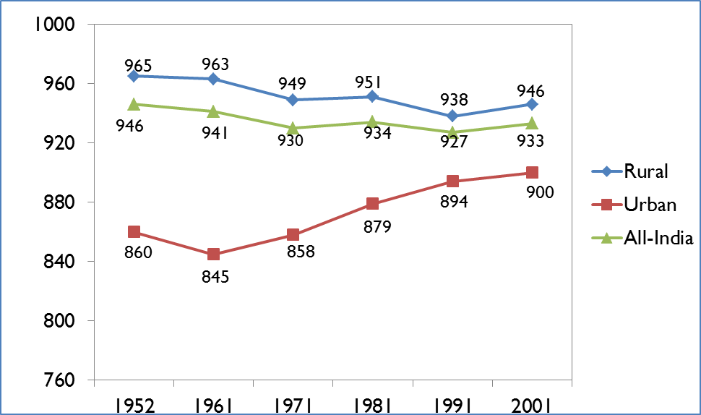
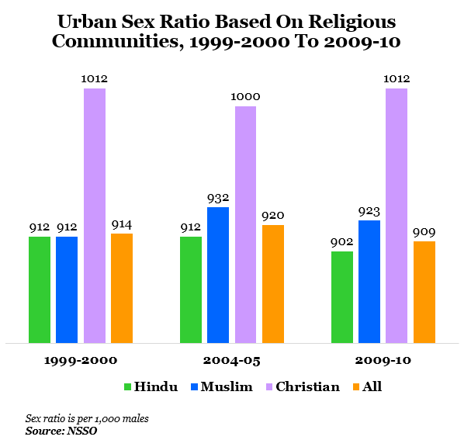
Why has the child sex ratio in India declined so dramatically recently?
Son preference
Fertility decline
Access to sex selective technology
and abortion
Sex ratios are more imbalanced among: urban, rich, highly educated, higher caste
  Doctors in India have extremely skewed child sex ratios (Patel, 2013)
Notes:
STOPPED HERE

Slide 33
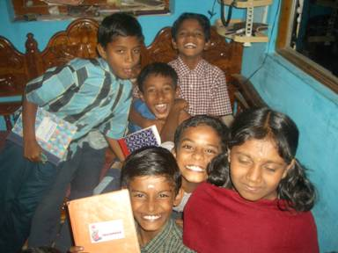
1. Why is there son preference in India?
Benefits of boys
  Patrilineal and Agrarian society
  Religious and cultural
Costs of girls
  Dowry
“500 rupees today to save 50,000 rupees tomorrow”
(Advertisement on ultrasound clinic)
  Investing in a daughter who will be married and live in another household
“Bringing up a daughter is like watering a neighbor’s plant” (Old Indian expression)
Notes:
SW: LARGER FONT. WOULD MAKE HEADING AND BODY FONT SAME. CONSIDER SOME NICE FORMATTING TO MAKE IT MORE INTERESTING

Slide 34
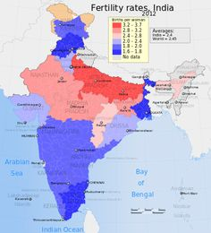
2. Fertility Decline in India

Slide 35
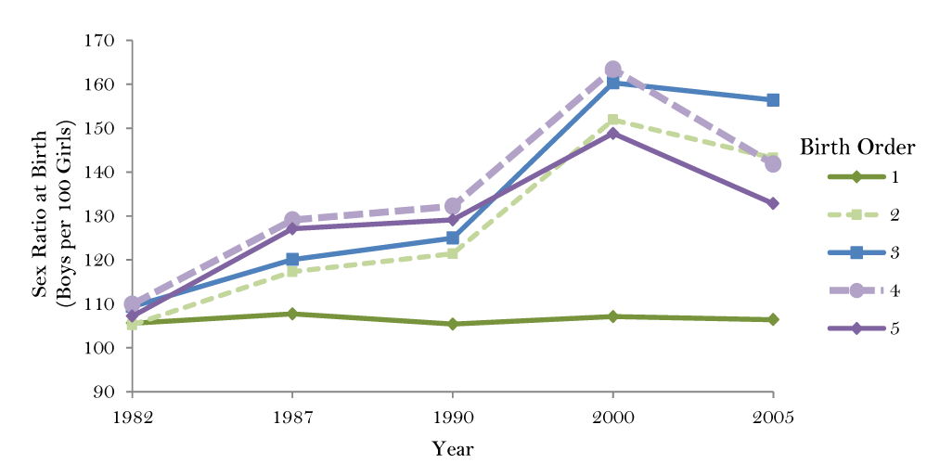
Sex Ratios differ by birth order

Slide 36
3. Abortion and sex selective abortion in India
Abortion is legal in cases of health (physical or mental) of mother, contraceptive failure or rape, or if fetus is physically or mentally disabled (since 1972)
  Prenatal sex determination is illegal (since 1994)
Very hard to enforce the law to not discriminate against female fetuses
  Place where determination of sex and actual abortion can be separated
Ban on sex selection should not lead to bans on abortion itself, but these have at times been conflated
  Some evidence that women think that abortion is illegal
Evidence that providers are afraid of providing abortions because might be accused of providing sex selective abortion
  Claim that clients pressure them

Slide 37
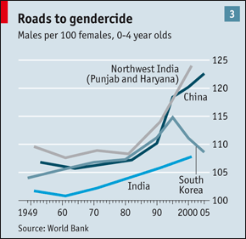
But, sex ratios have become more normal in some countries over time
South Korea: Why?
Not well understood

Slide 38


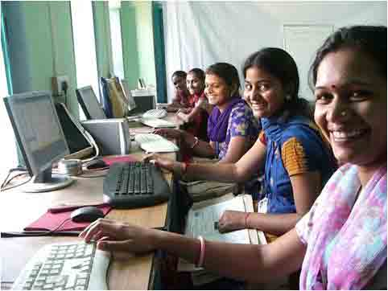
What might change the demand for girls compared to boys?
  Shortage of women in the marriage market
  Shortage of women to fill women-dominated jobs, leading to increased wages
  Changing role of woman: westernization, policies/programs, media
Notes:
SW: LARGER FONT. WOULD MAKE HEADING AND BODY FONT SAME. CONSIDER SOME NICE FORMATTING TO MAKE IT MORE INTERESTING

Slide 39

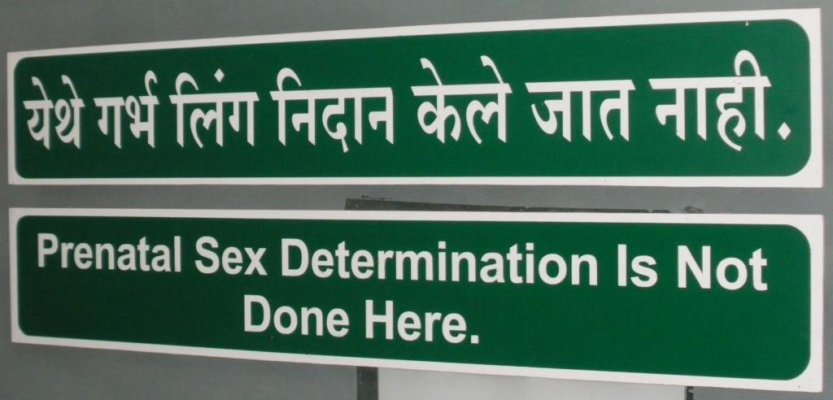
What might change the supply of girls or boys?
Improved health care access
Reduced access to sex-selective technology
  Laws and policies
Notes:
SW: LARGER FONT. WOULD MAKE HEADING AND BODY FONT SAME. CONSIDER SOME NICE FORMATTING TO MAKE IT MORE INTERESTING

Slide 40
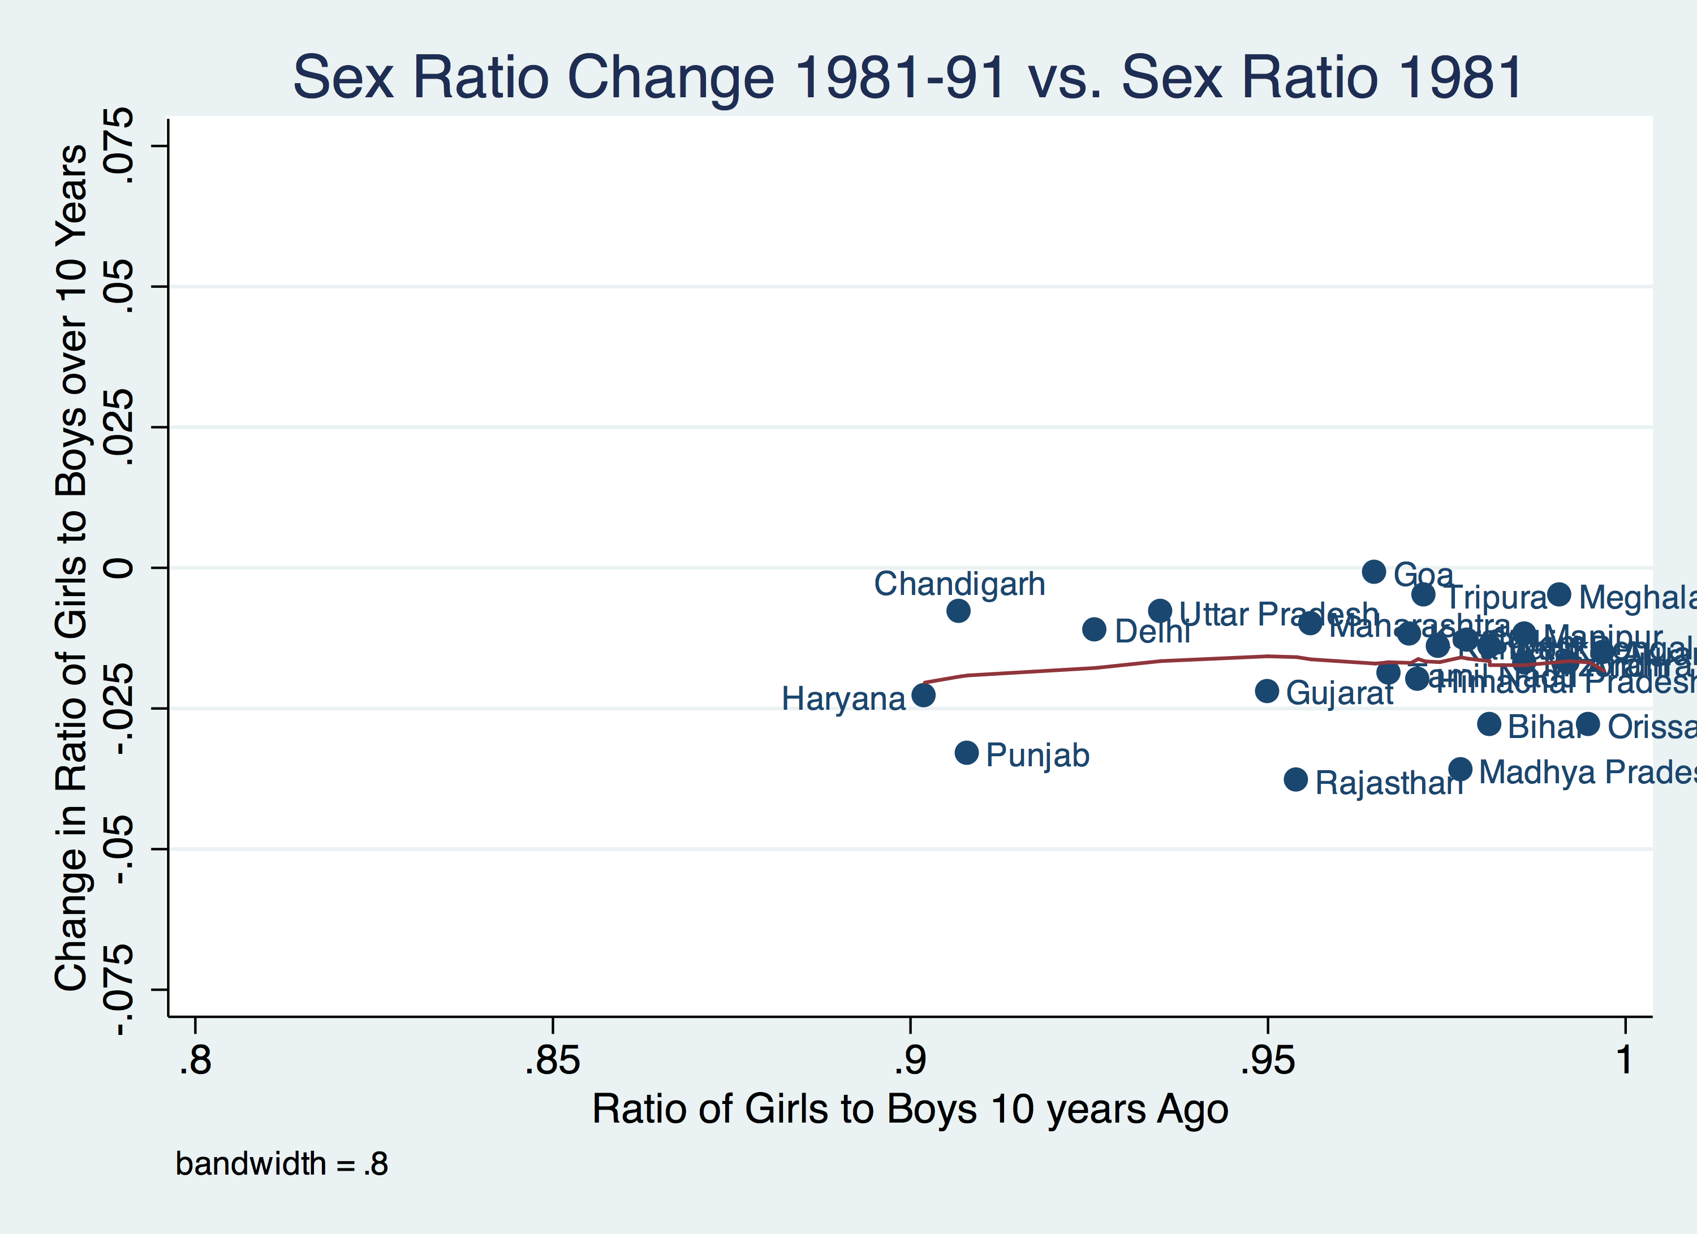
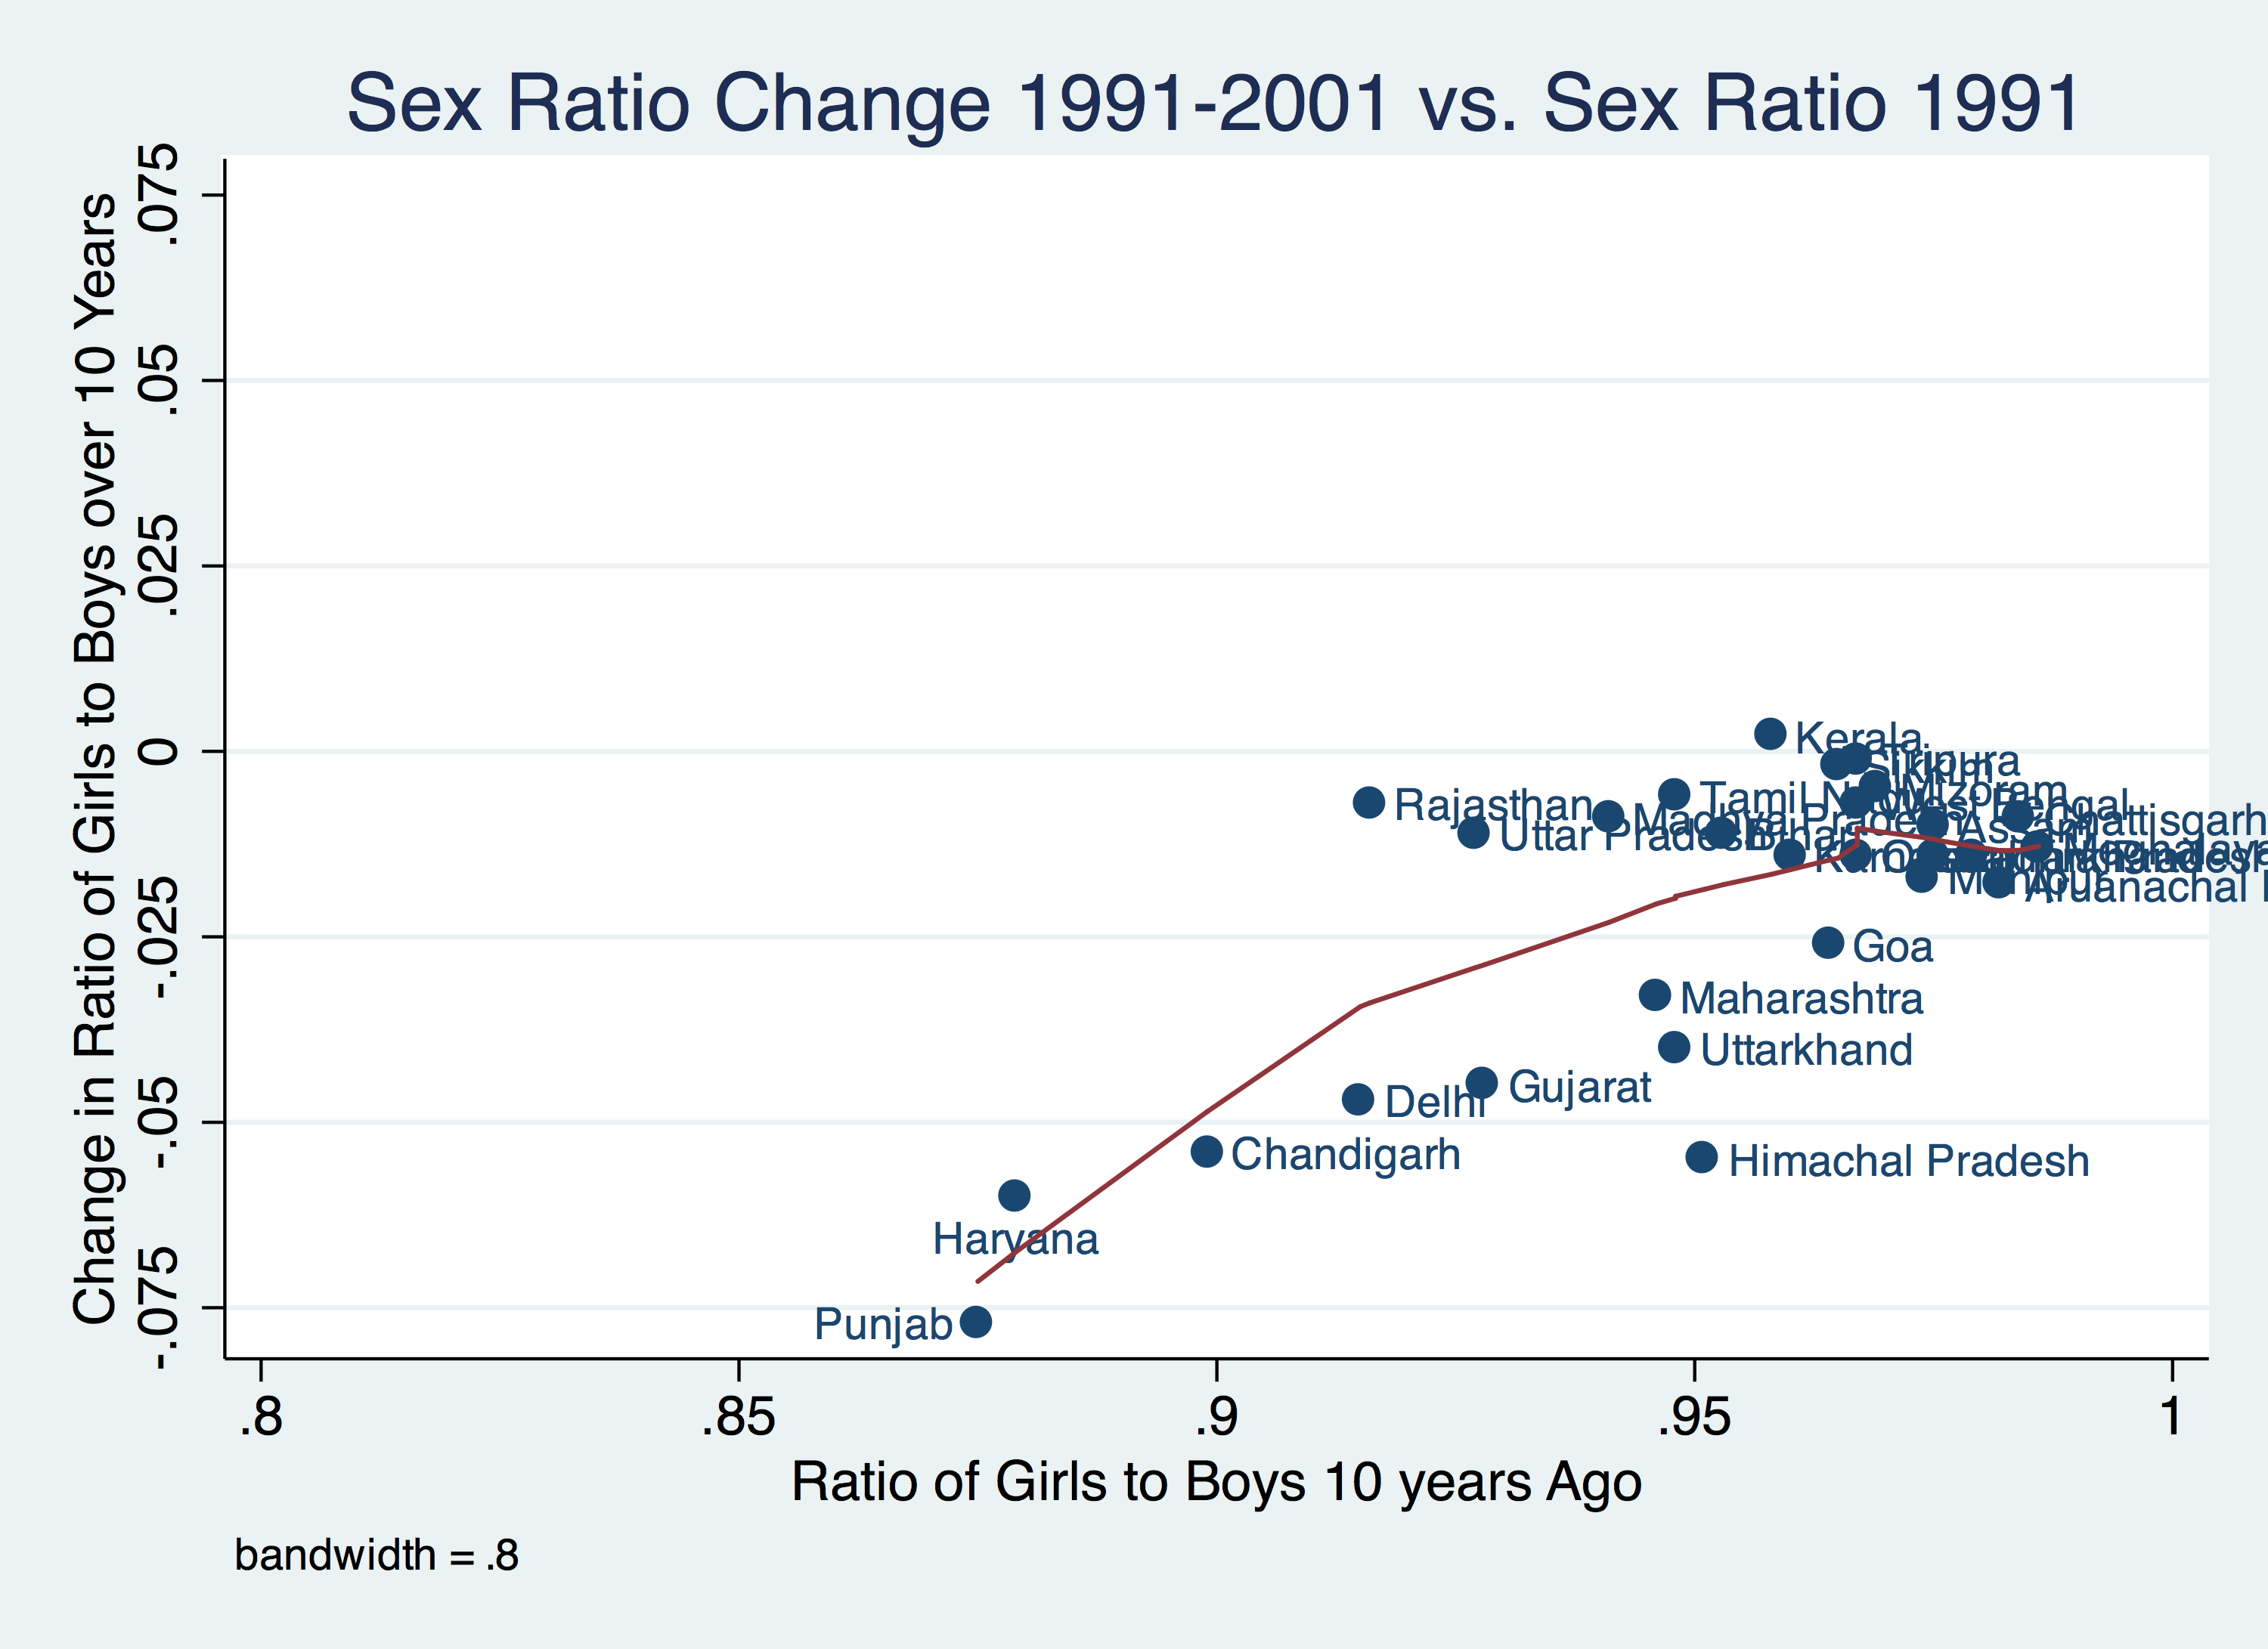
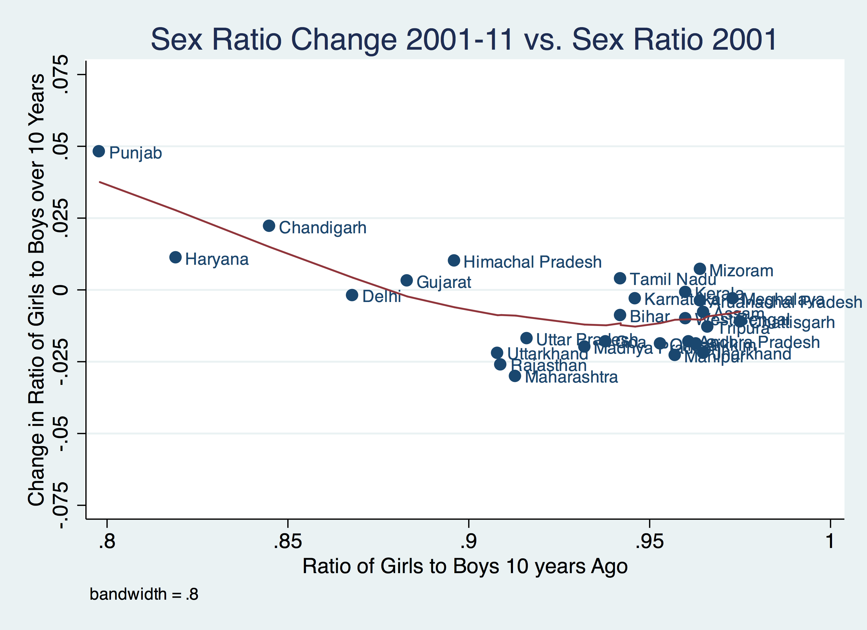
Is this happening in India?

Slide 41
Exploring the slowdown and improvement in imbalanced sex ratios in detail:
1. Is equalization occurring at a district-level?
2. Decompose the equalization into:
    Equalization due to less sex-selective abortion vs. improved girl child mortality compared to boy child mortality
    Look at geographic and urban/rural differences
3. What are the drivers of equalization?
    Marriage and labor market, norms, access to sex-selective technology

Slide 42
Is equalization occurring at a district level?
Test if the child sex ratio at the district level is associated with a change in child sex ratio 10 years later
  Ordinary Least Squares Regression
  Fixed effects models
  Control for other district-level factors such as fertility rate, literacy rates, urban/rural, infant mortality rate, scheduled caste and tribe
Indian census data, collected every 10 years
  1981-2011
Sample Registration System (SRS) 2010
  Some data not yet available for 2011 Census, so use data from 2010 SRS

Slide 43
Methods: OLS and fixed effects
Ordinary Least Squared regression of each 10 year period separately
Fixed Effects model:
SexRatioChange_{jt} = C + μ_{t} + (SR_{jt-10})β₁ +(D_{jt}) β₂ + α_{j} + ε_{jt}
Where:
SexRatioChange_{jt} = Change in sex ratio (boys over girls) between current year and 10 years before, in children under 6 in district j, for time t.
SR_{jt-10} = Sex ratio lagged 10 years
D_{jt} = Vector of community- level characteristics (literacy, caste, urban/rural, fertility, infant mortality)
α_{j} = Unobserved characteristics for district j
ε _{jt} = Measurement error for district j at time t
μ_{t} = Time dummy
C = Constant
Notes:
Alpha is the combined effects on SRchange of all unobserved characteristics that do not change over time
E is purly random variation at each point in time

Slide 44
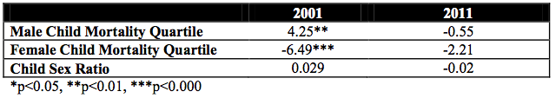
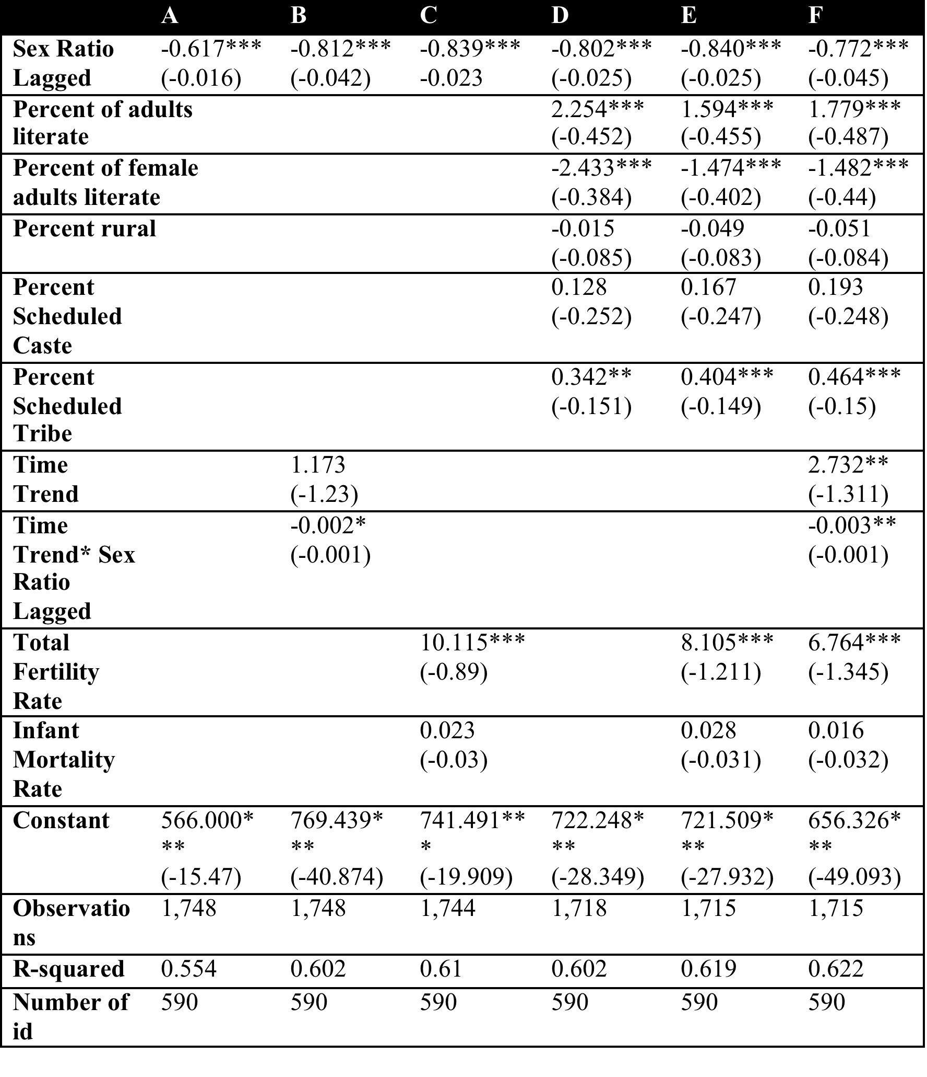
Results: Fixed effects models
Lagged sex ratio always significantly associated with equalized sex ratio in next 10 years
% of literate adults, % Scheduled tribe, Total fertility rate associated with increasingly imbalanced sex ratio
% literate females associated with equalizing sex ratio
Infant mortality rate not associated
Notes:
HAUSMAN
IMR from heterogenetiy: when people modern, they don’t kill girls and IMR is low when there are lots of health services and people have easy access to killing girls

Slide 45
Findings
Despite overall increasingly imbalanced sex ratios, the districts that have been the most imbalanced are starting to become less imbalanced
% of literate adults, % Scheduled tribe, Total fertility rate associated with increasingly imbalanced sex ratio
% literate females associated with equalizing sex ratio
Provides hope that sex ratios will not continue to become imbalanced forever
  But, if all districts had to become very imbalanced before they equalized this would mean many decades of discrimination against girls
Do not know if trend of improvement will be sustained

Slide 46
Less sex selective abortion or improved mortality for girls compared to boys?
Decompose the improving child sex ratio into 2 components:
  Missing girls due to excess girl child mortality
  Missing girls due to sex-selective abortion
Do this for all districts that showed improvement between 2001 and 2011
  Rural and urban populations within districts
Explore geographic patterns in the improving child sex ratio
Test if there is a trade-off between declines in post birth female mortality and increases in pre-birth female mortality (sex-selective abortion)

Slide 47
Decomposition: Child Sex Ratio Each Year
Goal: Decompose the child sex ratio into sex ratio at birth (SRB) and child mortality sex ratio (CMSR)
CSR= SRB * CMSR.
Assuming B_{f}, SR_{f} and P_{f(0-4)} are the number of births, their survival ratio, and population below age 5, we estimate number of births
B_{f} = 1/SR_{f} * P_{f(0-4)}
Where the survival ratio is calculated in the standard way (Preston et al, 2001)
SR_{f}= ₅L_{0f}/(5×l_{0f})
Male and female births are substituted in, and Eq 1 can be re-written:
CSR= (B_{f}/B_{m}) * (SR_{f} /SR_{m})
Where: SRB= B_{f}/B_{m}and CMSR= SR_{f} /SR_{m}

Slide 48
Decomposition: Changes in Child Sex Ratio
Using Kitagawa’s technique (Kitagawa, 1955):
∆CSR = ∆SRB + ∆CMSR
Where:
∆SRB =[SRB₍₂₀₁₁₎-SRB₍₂₀₀₁₎]*([CMSR₍₂₀₁₁₎+CMSR₍₂₀₀₁₎]/2 )
And
∆CMSR =[CMSR₍₂₀₁₁₎-CMSR₍₂₀₀₁₎]*([SRB₍₂₀₁₁₎+SRB₍₂₀₀₁₎]/2 )
48

Slide 49
Results: Abortion component larger than mortality component
Notes:
SW: LARGER FONT. WOULD MAKE HEADING AND BODY FONT SAME. CONSIDER SOME NICE FORMATTING TO MAKE IT MORE INTERESTING

Slide 50
Results: Worsening condition for female child mortality in urban areas
Notes:
SW: LARGER FONT. WOULD MAKE HEADING AND BODY FONT SAME. CONSIDER SOME NICE FORMATTING TO MAKE IT MORE INTERESTING

Slide 51
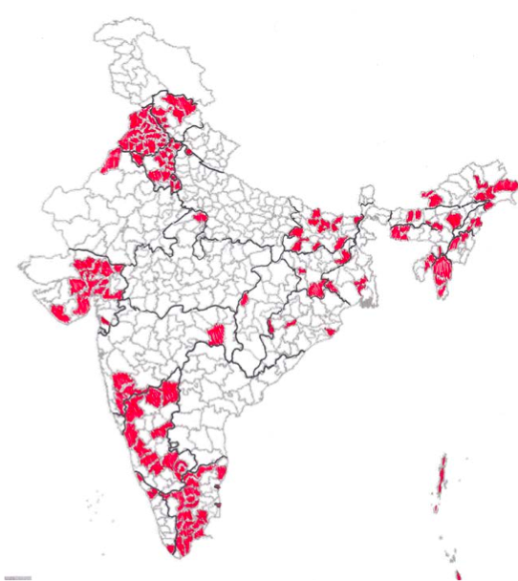
Results: Geographic distribution of increased equalization
Geographic Clusters:
North: Very imbalanced child sex ratios, dense pocket of change, include major urban centers
West: Gujarat: Very imbalanced child sex ratios, include the capital and 3rd largest city in Gujarat
South: Not as imbalanced sex ratios, stretch along the western Ghats from Tamil Nadu up through Karnataka
North eastern region: Scattered, not as imbalanced sex ratios, areas of social unrest, some matrilineal societies
Notes:
SW: LARGER FONT. WOULD MAKE HEADING AND BODY FONT SAME. CONSIDER SOME NICE FORMATTING TO MAKE IT MORE INTERESTING

Slide 52
Does access to abortion improve the situation for those girls that are born?
Some authors have argued that access to pre-natal sex determination and abortion should allow those girls that are born to be more “wanted”
  Therefore excess girl-child mortality would decrease with increasing sex-selective abortion.
Evidence of this effect has been found by Sudha and Rajan, 2003
Others have argued that sex-selective abortion and girl-child neglect are additive, or even re-enforce and strengthen each other, and that additivity has lead to further imbalanced sex ratios in parts of Asia in recent years (Goodkind, 1996).

Slide 53
Results: Is there a trade-off?
Quartiles of child mortality rates for males and females were regressed on % of the imbalance due to pre-birth events, controlling for child sex ratio
2001:
  Higher male child mortality associated with greater % of imbalance from sex-selective abortion
  Higher female child mortality associated with lower % of imbalance from sex-selective abortion
2011:
  No relationship
Notes:
Why regress mortality on % imbalance
Absolute levels of post birth mortality on pre birth absence indicators, put in year dummy

Slide 54
Decomposition: Conclusions
Most of the cause of imbalanced child sex ratios is from sex-selective abortion
  Most of the improvement is from less sex-selective abortion
In those districts that are equalizing, it is happening in both rural and urban areas
  Slightly more in urban areas
Evidence that female children in urban areas are doing worse, compared to males, in 2011 compared to 2001
Distinct clusters of equalization: north, west, south
  Seems that equalization is grouped around urban centers
  Perhaps evidence of social contagion?

Slide 55
Why are sex ratios beginning to even out in India?
A test of supply- and demand-side factors influencing son preference

Slide 56
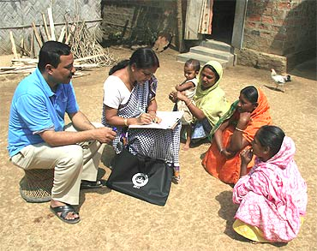
Data
National Family Health Survey 2005-06 data
  Household survey, individual-level data
Variables:
  Dependent:
    Probability of having a boy (Model 1, individual level)
    Community level child sex ratio (Model 2, community level)
  Independent (at both individual and community level):
    Marriage: marriage age gap
    Labor: % of women in the labor force and in professional occupations
    Social norms: % watch TV frequently, acceptability of wife beating
    Access to sex-selective technology: access to a doctor/nurse at delivery or antenatal care
    Demographic (age, education, religion, etc.)

Slide 57
An individual woman’s odds of having a boy
Increased the odds of having a boy:
A more even sex ratio in children under 10, 2003* (OR=1.33)
Higher percent of women in the community who saw a doctor or nurse for delivery*** (2.77)
Decreased the odds of having a boy:
Higher percent of women in the community who saw a doctor or nurse for ANC*** (0.49)
Higher percent of women in the community in advanced labor force occupations*** (0.23)
Controlling for women’s education, any labor market participation (individual and community %), advanced labor market participation (individual and community %), wealth index, Hindu/other (individual and community %), State dummy, age gap between husband and wife (individual and community %, watches TV frequently (individual and community %), wife beating score (individual and community %), mean ideal number of boys/girls, percent watch TV frequently, (individual and community %), percent delivery with doctor/nurse (individual and community %), percent see doctor/nurse for ANC (individual and community %)

Slide 58
Factors associated with the stratum-level sex ratio in children under 10 in 2006
Increased the stratum-level child sex ratio
Higher percent of women in the community in advanced labor force occupations*** (0.92)
Controlling for community-level: age gap between husbands and wives, wealth index, wife beating score, mean ideal number of boys/girls, percent watch TV frequently, percent delivery with doctor/nurse, percent see doctor/nurse for ANC

Slide 59
Conclusions
Some weak evidence that lagged community-level child sex ratio is associated with an individual’s probability of having a boy
Women’s labor force opportunities in high level professions seems to be associated with both an individual’s probability of having a boy (reduces the odds) and community level child sex ratio
Community level access to providers seems to be important, not sure of direction
  Other ways of measuring marriage, labor, norms and access to technology should also be explored

Slide 60

Further research
Don’t know yet if the equalizing districts will continue to equalize in the future
Other potential drivers could be associated with changes in son preference
Should not interpret findings to suggest that imbalanced child sex ratios will “fix themselves”

Slide 61
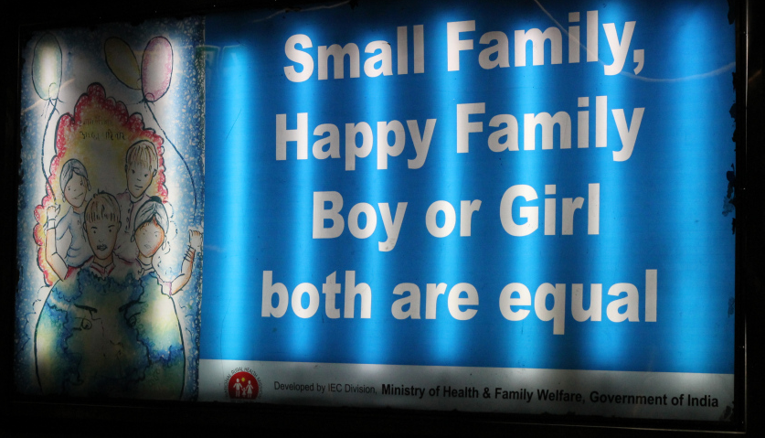
Programs and Policies
Many programs, interventions,
social media campaigns, and policies have been implemented in India but need evidence base
EXAMPLES:
The government will put money in a bank account for families who have a girl, which she gets to pay for her marriage (dowry)
Other schemes give an incentive at various stages of life: birth registration of a girl, completion of vaccinations, completion of various levels of education, marriage post age 18 or 21
Supreme Court of India ordered Google and Yahoo to stop advertising for sex determination technologies on their websites

Slide 62
Thank you!
Questions?
Notes:
Final boiler plate language: 2 versions
Through its singular focus on health, UCSF is leading revolutions in health.
UCSF is driven by the idea that great breakthroughs are achieved when the best research, the best education and the best patient care converge.

Slide 63
COVID quick presentations
-Covid and mortality
-Covid and fertility preference
-Covid and age structure
-Covid and Race/ethnicity
-Covid and migration
-Covid and marriage/cohabitation
-Covid and living arrangements and residential patterns

