Slide 1
Life tables
Nadia Diamond-Smith, PhD, MSc

Slide 2
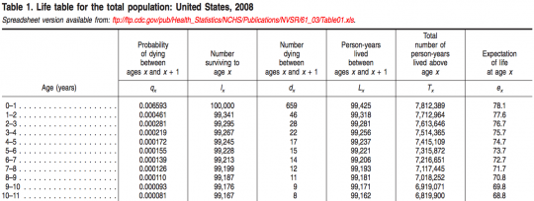
Life table: US mortality

Slide 3
Life Tables
The life table conceptually traces a cohort of newborn babies through their entire life under the assumption that they are subject to the current observed schedule of age- specific mortality rates
The life table records the passage of a cohort from birth to extinction, or when the last member has died, according to a set of fixed age specific probabilities of death/failure
As age increases, the number of survivors of the original group declines
Life Tables looks at the likelihood of an event occurring in the next time period (day, week, year) given survival to the beginning of the time period

Slide 4
Why do we use life tables?
Any question that concerns the probability of an event
To analyze any measurable process that involves a time pattern of exit from or entry into a particular state (e.g., births and deaths)
Estimate age/time specific risks
Examine changes in rates
Population growth and change (generate projections of the size and characteristics of future populations based on some initial base population.)
Compare health levels across two populations or one population over time

Slide 5
Not just life and death!
Mortality/Survival (people, cars, appliances)
Recidivism
Disability (Active Life Expectancy)
Marriage/cohabitation
Working Life (retirement, unemployment)
Contraceptive Use (effectiveness, discontinuation, switching)
Fertility (1st and higher order births, spacing, time to first sex)
Breastfeeding
Cancer survival

Slide 6
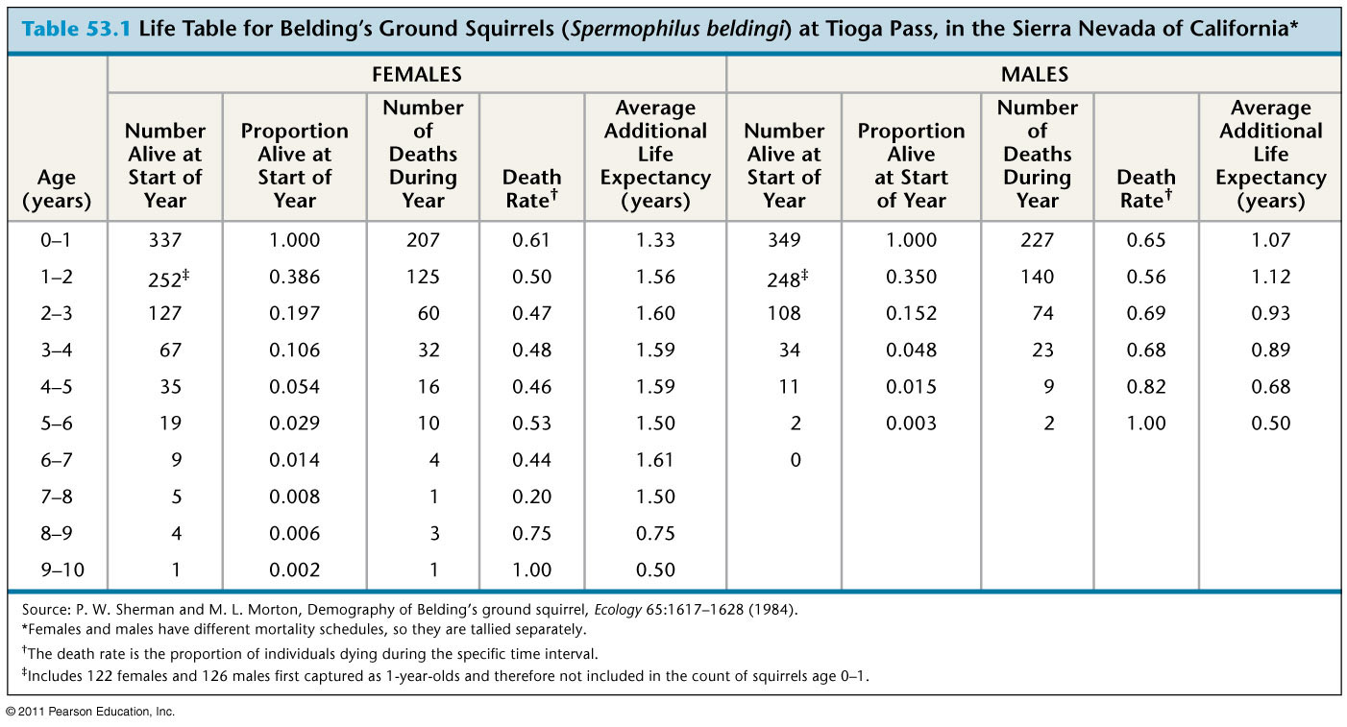
Squirrels!

Slide 7
Simplest form
Single decrement= people only go one way
Closed population
  Population growth constant
  No migration in or out

Slide 8
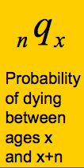
Life table notation:
The subscript before a symbol defines the width of the interval
The subscript after the symbol defines the starting point of the interval
lx, Tx and ex never have a left subscript as they refer to exact age x

Slide 9
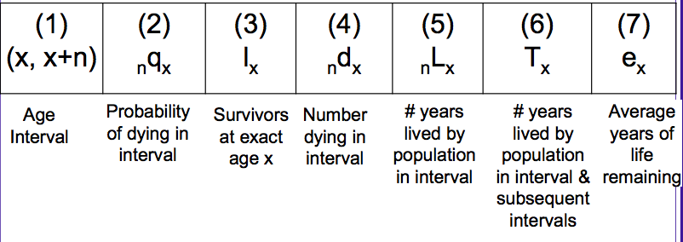
Life table

Slide 10
Practice notation
probability of dying between age 0 and 1
  ₁q₀
Number of deaths between age 40 and 45
  ₅d₄₀

Slide 11
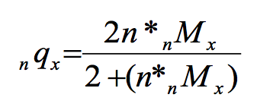
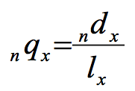
Usually start with age specific death rates (_{n}M_{x})
Can convert _{n}M_{x} to _{n}q_{x}
1)
Where n is the length of the interval (usually 5 years)
2)

Slide 12
lx= Survivors
l₀ =who are the survivors to age 0?
  Everyone born!
  The radix population, could choose anything, usually start with 100,000
l₁ = Survivors at the start of year 1?
l₁ = l₀- (l₀* ₀q₁)
Say ₀q₁ = 0.0582, how many people die in the first year?
5820
How many people are alive at the start of the next period?
100,000-5820= 94,180 = l₁
5820 is _{n}d_{x} =deaths between age n and n+x

Slide 13
0-1 | 0.0582 | 100,000 | 5820
1-2 |  | 94,180

Slide 14
L_{x}
L_{x} = The total number of person-years lived in each interval, or # in age group of stationary population
It is the sum of:
Persons who survived the interval, equivalent to the number alive at the beginning of the next interval or l_{x}+1
  They each contribute the number of years in the interval.
b. Persons who died during the interval (d_{x}) who contribute a part of the interval, depending on when they died. For most purposes, we simply assume they contributed 1⁄2 a year.

Slide 15
Lx calculations
Generally we assume linearity:
  unabridged: Lx = 0.5*(lx + lx+n)
    Every year from birth to death
  abridged: Lx = (n*0.5)*(lx + lx+n)
    Can have age groups

Slide 16
Infant/early childhood and oldest age
Because infant and early childhood deaths are closer to birth, we use:
  L₀ = 0.3*l₀ + 0.7*l₁
For the terminal category, we do not have length of interval, so we use :
∞L_{x} =l_{x}/ ∞m_{x}
for example
L₁₀₀₊ = l₁₀₀₊ / M₁₀₀₊
where ∞M_{x} substitutes for ∞m_{x} in abridged tables

Slide 17
  L₀ = 0.3*l₀ + 0.7*l₁
What is L₀ ?
0.3*100,000 + 0.7*94,180
L₀=95926
Age group | _{n}q_{x} | l_{x} | _{n}d_{x} | L_{x} | T_{x} | e_{x}
0-1 | 0.0582 | 100,000 | 5820
1-2 |  | 94,180

Slide 18
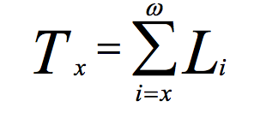
T_{x}
T_{x} is the total number of years of life lived by all members of the cohort. It is obtained by summing up all values of Lx from that age forward

Slide 19
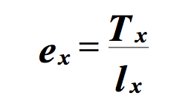
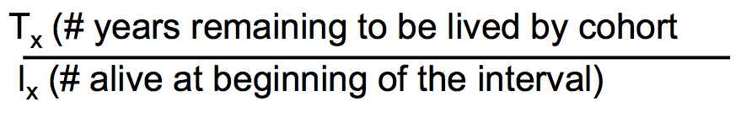
Life expectancy e_{x}
Whereas Tx provides the number of years remaining to be lived by the entire cohort, ex represents the number of years lived on average by any individual in the cohort.
Remember:

Slide 20
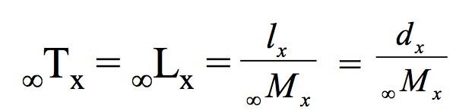
Terminal age category
Life expectancy at birth (e₀) is the number of years that a baby born now will live if that baby experiences all the age-specific mortality rates currently operating in the population
Terminal Age Category= Because the final age category in the life table is an open ended interval, and all individuals in our cohort must die, we have variations on the usual formulas for this interval
where ∞M_{x} is the observed ASDR for the terminal age group, assumed to be equivalent to ∞m_{x}
Because everybody dies: ∞qx = 1.0

Slide 21
Single vs. Multi – state life tables
2 states: Alive and Dead
1 “absorbing” state: Death
Alive
Dead

Slide 22
More advanced forms: multistate
Multiple states
Still need one “absorbing” state: Death
Called Multiple Decrement Table
Lets try to model marriage

Slide 23
Married
Single
Divorced
Death
Widowed

Slide 24
Single vs. Multi – state life tables
Single
Married
Divorced
Widowed
Dead

Slide 25
Complexities of a Multi-State life table
Censoring:
  Right-censoring: have we observed them at the beginning of their “lives”?
  Left-censoring: do we observe them until “death?”
Calculating transition probabilities
  Logit models with predicted probabilities
  Markov simulations
  SPACE (Hayward et al., 2009), etc

Slide 26
Questions one can ask with MSLT (contraception example)
Probabilities of Moving States: What is the probability that a cohort of women who began with a specific method (at Month 1) will be using other methods (or no methods) at the end of 6, 12, or 24 months, or that they will be pregnant unintentionally at these time points?
Duration in State: What is the expected length of time that women who began with a specific method will use it versus each of the other methods (or non-use), or be in the state of unintended pregnancy, during the first 24 months?
Movement of State Switching: What is the expected number of switches that women who began with a specific method will make to other contraceptive methods (or nonuse) or to unintended pregnancy during the first 24 months?

Slide 27
Thank you!
Questions?
Notes:
Final boiler plate language: 2 versions
Through its singular focus on health, UCSF is leading revolutions in health.
UCSF is driven by the idea that great breakthroughs are achieved when the best research, the best education and the best patient care converge.

