Slide 1
Introduction to Cost-Effectiveness
Elliot Marseille
Global Initiative Psychedelic Science Economics (UCB / UCSF)
Health Strategies International
Super Models for Global Health (Jim Kahn)
DCEA – Epi 213 - 28 January 2022

Slide 2
Goals
Understand key theoretical concepts underlying all CEAs
Understand the essential components of CEA.
Inquire abut when CEAs are useful and appropriate, “What are they good for?”

Slide 3
Opportunity Costs
KEY theoretical concept underlying CEA.
Notes:
A central concern of economics is how best to use available resources in a world where desires, if not needs, always exceed the capacity to fulfill them. The key concept informing consideration of this issue is “opportunity cost”. Opportunity cost refers to the simple truth that use of resources one place precludes their use elsewhere. It is concerned with real resources consumption, rather than with mere financial effects. Thus, the real cost of a particular expenditure is the best alternative use of those funds, now foreclosed. These statements may seem trivial because they devolve to the truism that money spent here can’t be spent there. But, like the prospect of being hanged in the morning ‘opportunity cost’ focuses the mind wonderfully, and therein lies its utility. It can counteract the bureaucratic tendency to unthinkingly continue this year what worked last year. Thinking about opportunity cost can thus stimulates creativity about the best use of resources given current needs and alternatives.
The opportunity cost concept suggests that it is not enough to do something useful with the resources available. Action with a net positive effect is still wasteful if the foregone alternative would have had higher value. It prompts the question, “Because money is limited (budgets are constrained), what is its best use at the margin (the next available dollars)”? But budgets are always constrained and the margin is our permanent residence, so opportunity cost and the challenge to allocate resources rationally are always present. Opportunity costs and rigorous thinking about resource allocation inoculate decision makers against the kind of thinking that prompts statements such as, “We are concerned with saving children’s lives. Money cannot be a determining factor.” What such statements overlook is that “money” is not “mere money” to be subordinated to the saving of lives. Cost is another name for an unrealized benefit somewhere else. That benefit might result in the saving of more children’s lives than the use being defended.
The problem of resource allocation then becomes, “Where can the greatest benefit be obtained for a given expenditure?” Cost-effectiveness analysis provides a conceptual framework and practical tools to assist with that determination. It is purely instrumental. As with economics generally, cost- effectiveness analysis is value-neutral regarding goal selection. One must look elsewhere to decide what is worth having. Once a goal is determined (e.g., reduced HIV incidence), the role of cost- effectiveness analysis is to help reach it with as small an expenditure (opportunity cost) as possible. It is concerned, in other words, with efficiency.

Slide 4
Opportunity Costs: Definition
Use of resources for one purpose precludes their use for another purpose.
Concerned with real resource consumption.
Resources are usually reflected in dollars (but not always).
Profound and trivial at the same time.
Notes:
Opportunity cost refers to the simple truth that use of resources one place precludes their use elsewhere. It is concerned with real resources consumption, rather than with mere financial effects. Thus, the real cost of a particular expenditure is the best alternative use of those funds, now foreclosed.

Slide 5
The Value of Considering Opportunity Costs
Counteracts the tendency to unthinkingly continue this year what worked last year.
Stimulates creativity about the best use of resources given current needs and alternatives.
Notes:
These statements may seem trivial because they devolve to the truism that money spent here can’t be spent there. But, like the prospect of being hanged in the morning ‘opportunity cost’ focuses the mind wonderfully, and therein lies its utility. It can counteract the bureaucratic tendency to unthinkingly continue this year what worked last year. Thinking about opportunity cost can thus stimulates creativity about the best use of resources given current needs and alternatives.

Slide 6
The Reality of Resource Allocation
The problem: Resources are always limited.
The challenge: To allocate resources to achieve a maximum benefit.
The focus: The best use of the next dollar.
Notes:
The opportunity cost concept suggests that it is not enough to do something useful with the resources available. Action with a net positive effect is still wasteful if the foregone alternative would have had higher value. It prompts the question, “Because money is limited (budgets are constrained), what is its best use at the margin (the next available dollars)”? But budgets are always constrained and the margin is our permanent residence, so opportunity cost and the challenge to allocate resources rationally are always present.

Slide 7
Methods of Resource Allocation
Where can the greatest benefit be obtained for a given expenditure?
  Cost-Effectiveness Analysis (CEA) can help answer this question.
Notes:
The problem of resource allocation then becomes, “Where can the greatest benefit be obtained for a given expenditure?” Cost-effectiveness analysis provides a conceptual framework and practical tools to assist with that determination. It is purely instrumental.

Slide 8
Cost-Effectiveness Analysis: When to use it?
When selecting among 2+ courses of action with different effects and/or costs.
  HIV Prevention:
    Intervention vs. no intervention?
    One intervention vs. another?
    Universal vs. targeted interventions?
    Group counseling vs. individual counseling?
Notes:
Use CEA when comparing two or more interventions for HIV and a single outcome, HIV infection.
For example, one can compare an intervention vs no intervention or two interventions such as nevirapine vs other antiretroviral regimens
In addition, one can compare the ce of nevirapine regimen for all pregnant women to giving it only to those who are HIV+

Slide 9
Ask: “Why is this question important?”
(What is the existential problem?)
Good definition: “People are dying of AIDS, a preventable disease”
Bad definition: “People are engaging in unprotected sex”
Significant public health question.
Something is at stake - A trade-off is implied.
Alternatives are feasible
Otherwise, why bother?

Slide 10
“Speaking Truth to Power”
CEA can Support Clear Decision-Making
“Our priority is saving children’s lives. Money is a subordinate issue.”
-vs.-
Cost is another name for an unrealized benefit somewhere else.
Notes:
Opportunity costs and rigorous thinking about resource allocation inoculate decision makers against the kind of thinking that prompts statements such as, “We are concerned with saving children’s lives. Money cannot be a determining factor.” What such statements overlook is that “money” is not “mere money” to be subordinated to the saving of lives. Cost is another name for an unrealized benefit somewhere else. That benefit might result in the saving of more children’s lives than the use being defended.

Slide 11

Role of CEA = Measure trade-off between cost and effectiveness
It doesn’t decide the goals (value neutral)
CEA helps to reach goal with smallest expenditure possible (most efficient)
Notes:
As with economics generally, cost- effectiveness analysis is value-neutral regarding goal selection. One must look elsewhere to decide what is worth having. Once a goal is determined (e.g., reduced HIV incidence), the role of cost- effectiveness analysis is to help reach it with as small an expenditure (opportunity cost) as possible. It is concerned, in other words, with efficiency.
Question to the audience: with limited funds and many different programs, how do you think about resource allocation for HIV programs? Give examples of trade-offs.

Slide 12
Trading off cost and effectiveness for an intervention vs. status quo
 | Lower Cost | Higher Cost
Lower Effectiveness | A | B
Higher Effectiveness | C | D
Notes:
It’s useful to think in terms of a two-by-two table. A new intervention can be lower or higher cost than an existing approach, and lower or higher effectiveness. Which cells are interesting for CEA?

Slide 13
CEA is a method for systematically quantifying the trade-off, when there is a trade-off
 | Lower Cost | Higher Cost
Lower Effectiveness |  | Dominated
Higher Effectiveness | Dominant
Notes:
Here we see that two cells are starred. These are the ones that are interesting for CEA. The bottom right is the most common for a new intervention – costs more, and works better. More money, more benefit. Is it worth it? There’s a trade-off we can quantify. Upper left is the same story, from the opposite perspective.
The two other cells are also important – for interventions that are higher cost and less effective, which we call “dominated”. And for interventions that are lower cost and more effective, which we call “dominant”. These situations do happen, as we’ll see, and they’re really important, to identify strong losers and winners. But they’re not amenable to CEA trade-off calculations.

Slide 14
Trading off cost and effectiveness
Costs
Effectiveness

Slide 15
Trading off cost and effectiveness
Costs
CE ratio relevant
CE ratio irrelevant and not interesting
Effectiveness
CE ratio relevant
CE ratio irrelevant and interesting

Slide 16
Structure of a CEA
Inputs
Outcomes
Analytic Approach
Notes:
Now let’s turn to how a CEA is set up. There are three legs to this stool. What information goes in, the results we want to generate, and the analytic approach.

Slide 17
Three broad inputs into CEA
Costs of intervention
Health effects of disease & intervention
Costs of health care
Notes:
We’ll start with inputs. Again, 3 parts: costs of intervening, health effects of disease and intervening, and costs of health care for that disease.

Slide 18
Input: Intervention costs
Standard cost-accounting categories
for input resources
Personnel: doctors, nurses, counselors, lab techs, drivers, guards, etc.
Supplies (aka commodities, consumables) eg drugs
Services (e.g., IT or cleaning)
Capital goods (e.g., vehicle, lab machine)
Training (esp. specific to the program)
Physical space (i.e., rent)
Notes:
Intervention costs may be unfamiliar to you, but is pretty easy to understand once you get the lay of the land. We quantify “resources” that are required and their costs. We use some standard categories. Let’s start with personnel, or staff, or “human resources”. This is usually the biggest category of costs. It includes health care workers and others. We measure quantity in hours or days or months. Costs are wages or salary or total compensation. [Review remainder of list]

Slide 19
Input: Health effects
Consequences of the disease being portrayed (eg mortality and morbidity risks)
Intended effect of interventions (e.g., reduced risk of mortality)
Side effects of interventions (e.g., adverse events, including long-term sequalae)
Notes:
The anticipated health effects of disease and treatment are inputs to the model. Of course it’s critical to portray how the disease will affect health. For example, how many will die over 3 years? That’s the outcome we’re trying to change. It’s equally critical to quantify how the intervention will alter that disease course, such as by reducing mortality. And, to have a proper full portrayal, we need to consider side effects, or adverse events, caused by intervening.

Slide 20
Input: Cost of health care
For the disease being modeled,
and due to treatment side effects
Outpatient (visits)
Hospitalizations (days)
Diagnostics (e.g., lab, x-ray)
Therapeutic procedures
Pharmaceuticals
Notes:
Finally, we need to portray the cost of health care for the disease being modeled. This is essential, because the overall costs of intervening may be affected by how the intervention affects health care use. If the intervention averts disease, it will lower health care costs. If it identifies disease it may increase use of medical care and thus costs.
We divide health care costs into standard categories. The big ones are listed here. The costing approach is similar to what we do for the intervention – count resources, and apply costs.

Slide 21
CEA Outcomes
Health:
  intermediate effects (eg physiological)
  morbidities, mortality
DALYs or QALYs: Inclusive standard metric
Net costs, i.e., intervention cost adjusted for offsetting savings or added induced costs
Incremental CE ratio (ICER!)
Notes:
Now the second big element of a CEA: Outcomes. This is what we’re trying to estimate.
Health outcomes may include intermediate effects, like changes in blood pressure or HgA1c, or CD4 count for HIV. They also always include clinical events, including both morbidity (like heart attacks and infections, or pain or physical or mental disability) and mortality (premature deaths, of course). Readers intuitively understand these clinical events.
However, it’s hard to sum up or compare diverse clinical events. What is a heart attack plus back pain? Or death at age 60 vs. five years of depression? In order to bring some order to this mix of events, we use one of two standard metrics that sum up the effects of premature death (a change in years of life) and of morbidity, taking into account severity and duration. This is done with DALYs or QALYs. More on these metrics in just a moment.
Before we move on, there are two more outcomes. One is “net costs” – the intervention costs adjusted for offsetting medical care savings or induced costs as a result of the intervention.
Finally, if there is a trade-off to assess – more health for more money – we calculate an “incremental cost-effectiveness ratio”, or ICER.

Slide 22
QALYs & DALYs - Review
QALY – Quality-Adjusted Life Year
  Measure of health – longevity and health status
  More is better
  Health status measured in “health state utility” (1 = perfect health, 0 = death)
  Years of life adjusted for for imperfect health
  Dominant metric in US and Europe CEAs
DALY – Disability-Adjusted Life Year
  Measure of disease burden – lost years of life and compromised health
  Less is better.
  Health status measured in “disability weight” (0 = perfect health, 1 = death)
  Years of life lost (YLL) plus disability adjustment (DA) when alive.
  Dominant metric in global disease policy and for CEAs in LMIC
Opposite & equal
  For any intervention, QALY gained = DALY averted. Really.
  Health state utility = 1 minus disability weight, and vice-versa.
  Theoretical difference but not in practice (as measured).
Notes:
Now we’ll take a look at the magic metrics that combined mortality and morbidity into a single measure. As mentioned, there are two types. The QALY is the quality-adjusted life year. It’s a measure of health – longevity and health status. More is better. Health status is measured with “health state utility”, on a 0-1 scale, with 1 being perfect health. Years of life are adjusted, as necessary, for imperfect health. This is the metric used in the US and Europe most of the time.
The DALY is the disability adjust life year. It’s a bit younger than the QALY. It’s a measure of disease burden – so less is better. Health status is measure in ”disability weight”, also on a 0-1 scale, but perfect health is represented by 0 – no disability. Thus the DALY is sum of years of life lost plus disability when alive. It’s the dominant metric in global disease policy and for CEAs in low and middle income countries.
A bit confusing, right? Different metrics, with different components. Actually, luckily, it’s a bit easier than that. It turns out that in practice – as actually implemented – QALYs and DALYs are opposite and equal. A QALY gained equals a DALY averted. Health state utility is the complement of disability. While disability was intended to measure something different than health state utility, in practice the measurement is a lot like for utility. This means if you can’t find the disability weight for an analysis, you can use one minus the health state utility.

Slide 23
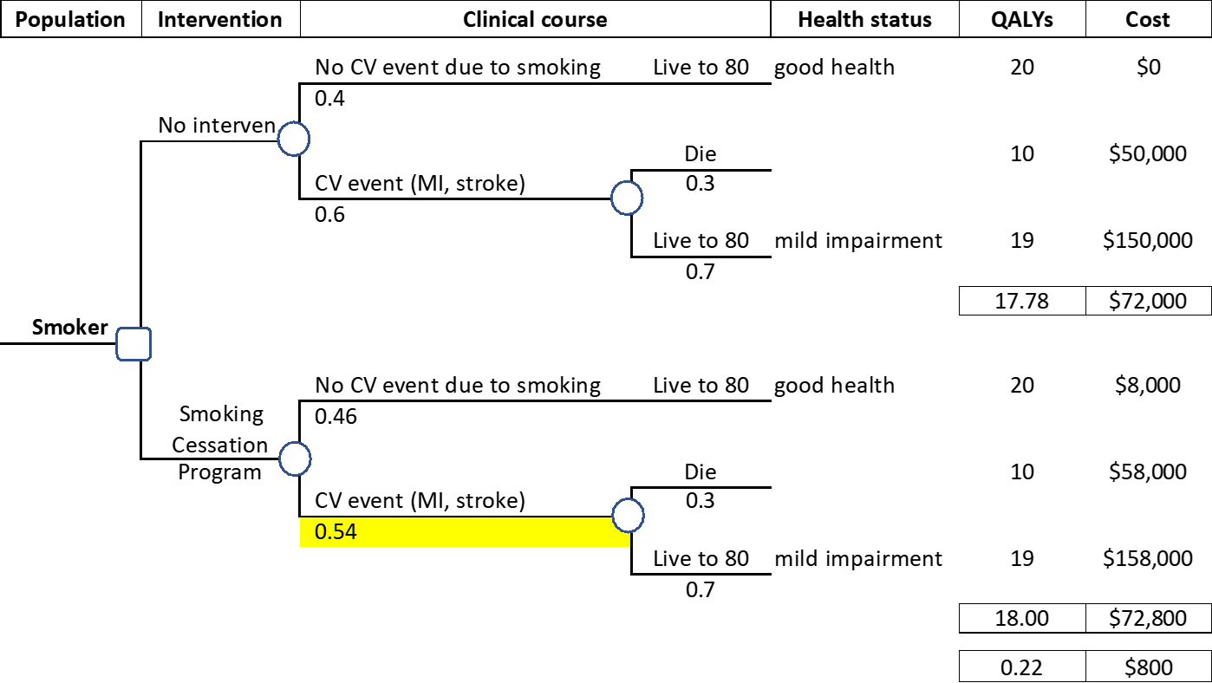
A Very Simple Decision Tree
Notes:
Now onto analysis. Here’s a very simple example of a decision tree. Trees in real analyses are a lot more elaborate. But this has the key elements.
There is a population with a health issue, for whom you’re contemplating intervention. In this instance, smokers. The decision (represented by the square) is whether or not to do a smoking cessation program. These are fairly expensive, and for long-time smokers not all that effective. The tree portrays expected clinical outcomes. Again, keeping it simple, is there a CV event related to smoking or not? Circles show the “chance nodes”. At the top, this event has a 60% chance of occurring. If it happens there’s a 30% chance of immediate death, and a 70% chance of long-term survival with mild impairment. The QALYs for no CV event are 20, and the cost is $0. With early death, the QALYs are 10 (because of healthy years before the fatal CV event), and cost is $50,000. Surviving a CV event costs more but results in more QALYs. The expected QALYs are 17.78, and the expected cost is $72,000.
With the program, the risk of a CV event drops by 10% (see yellow highlighting). All the other probabilities are the same. And the costs are the same too, except for $7000 for the program. The expected QALYs are 18, and expected cost is $72,800.
Thus, in this hypothetical example, the intervention increases QALYs by 0.22 and increases costs by $800. Of course for individuals who benefit, the QALY gain is huge. But only a few people benefit.

Slide 24
Δ Net Cost
Δ QALYs
$800
0.22
= $3,604 / QALY
Notes:
Back to our simple smoking cessation decision tree. Here’s the ICER. $800 divided by 0.22 is $3,600 per QALY gained

Slide 25

Why the “I” in ICER is important
The “I” is “Incremental” When considering multiple plausible interventions, must examine incrementally.
 | No Rx | Drug A (generic) | Drug B (brand) | Drug C (biologic)
Drug cost | $0 | $1,000 | $10,000 | $75,000
Care cost | $10,000 | $7,000 | $5,000 | $3,000
Net Cost | $10,000 | $8,000 | $15,000 | $78,000
QALYs | 10 | 12 | 12.5 | 13
Incremental
△ Net cost | - | ($2,000) | $7,000 | $63,000
△ QALYs | - | 2 | 0.5 | 0.5
ICER | Dominated | Dominant | $14,000 | $126,000
Not Incremental
△ Net cost | - | ($2,000) | $5,000 | $68,000
△ QALYs | - | 2 | 2.5 | 3
CE Ratio | Dominated | Dominant | $2,000 | $22,667
“Non-incremental” is not “another perspective” on the CEA.
It is . . . Wrong.
Pretends that “Drug A” doesn’t exist.
$$🚫$$
Notes:
It turns out the “I” in ICER is really important. That is, “incremental” has a special meaning, and applying it properly is essential to correct CEAs. It means, when there are 3 or more plausible intervention approaches, you must examine them step-by-step, one increment at a time.
Here’s an example. You’ve got 4 treatment strategies: No treatment; Drug A, which is generic and fairly cheap; Drug B which is brand name and more expensive; and Drug C which is a new and wildly expensive biologic.
No treatment has zero cost for drugs, and $10,000 for the disease. Drug A costs $!000, and lowers disease costs to $7000, so with a total cost of $8000. Drug B costs $10,000, plus $5,000 in other disease costs, is $15,000. And Drug C costs $75,000, lowers disease costs to $3,000, for a total of $78,000.
Under “Incremental” we can see that Drug A is cheaper and better than no treatment, so “dominant”. Drug B adds 0.5 QALYs to Drug A at an incremental net cost of $7,000, so the ICER is $14,000 per QALY gained. Drug C is $126,000 per QALY gained vs. Drug B. Which may be too costly. These are the step-by-step increments we should use.
Now look at “Not Incremental”. If we compare each drug directly to no treatment, it distorts the results. It unfairly makes Drug B and Drug C look very attractive, with much lower cost-effectiveness ratios -- $2,000 and 22,000 per QALY gained. But it’s wrong to skip the intermediate options (click, and hold a second).

Slide 26
CEA examples
Example 1: New antivirals for HCV, U.S.
(Chahal et al JAMA IM 2015)
Treating all fibrosis stages vs stages F3/F4
adds 0.73 QALYs and $28 899
ICER of $39 475 per QALY gained.
Example 2: Adult Male Circumcision in S. Africa
(Kahn, Marseille, Auvert PLoS Medicine 2006)
$181 per HIV infection averted (unadjusted for HIV care)
Adjusted: $2.4 million saved for 1,000 MCs
Dominant! Cheaper + Better. No ICER needed
Notes:
Now onto to some real CEA results from my work.
The first example is about antivirals for HCV in the U.S. These are new and highly effective, and very costly drugs. We compared treating all people with HCV to just those with stages F3 and F4, advanced disease based on histology. We found that advancing treatment to everyone adds 0.73 QALYs and $29,000, for an ICER of $39,500 per QALY gained. I’ll show detailed results in a moment.
Example 2 is about adult male circumcision (AMC) in South Africa to prevent HIB infection. We found a cost of $181 per HIV infection averted, unadjusted for changes in HIV care costs. With that adjustment, we found a net savings of $2.4 million for 1000 circumcisions. That means that AMC is “dominant” – cheaper and better. Thus no ICER is needed, or appropriate, because there’s no trade-off. Just report the savings and health benefits.

Slide 27
Cost and cost-effectiveness results for HCV antivirals by treatment initiation timing
Chahal HS, Marseille E, Tice JA, Pearson SD, Ollendorf DA, Fox R, Kahn JG. Cost-effectiveness of Early Treatment of Hepatitis C Virus Genotype 1 by Stage of Liver Fibrosis in a US Treatment-Naive Population. JAMA Intern Med, 2015.
Notes:
Here we see more detailed results for our HCV study.
At the top you can see the comparison I presented on the last slide. This divides the HCV population into two large groups. It costs $39,500 per QALY gained to treat everyone instead of stage F32 or greater. In the US this is generally considered a favorable cost-effectiveness ratio.
But then we decided to get more precise. We divided the HCV population into individual fibrosis stages. And what we found is that expanding the treatment population to each earlier stage has a pretty good ICER, until we compared Stage F1 and later versus Treat All. Then the ICER jumped to $187,000 per QALY gained. So, we found that with any evidence of liver damage, it makes economic sense to treat. But perhaps not for people who are infected but without liver damage.

Slide 28
The CE Ratio (ICER)
  Difference in costs between two courses of action
  divided by
  Difference in health outcomes
Notes:
Ah, now the coup de grace – the ICER. This is the analytic approach. (Well, actually, it’s the ultimate outcome measure of CEA, but the details of how we combine the various inputs to arrive at this are more than we can address today. If you’re interested, let me know and I’ll refer you to a video [”The ICER Man Cometh” on YouTube] and readings. Or take Epi 213 to really learn and start to use CEA methods.)
Back to the ICER. It’s a simple ratio – the difference in costs between two courses of action, divided by the difference in health outcomes …

Slide 29
The ICER, deeper dive:
  Net cost with intervention – Net cost with no intervention
  QALYs with intervention - QALYs with no intervention
Δ Net Cost
Δ QALYs
Formulation must be incremental: from no intervention to intervention, or from lower cost to higher cost intervention.
Notes:
… which looks like this, if you’re using QALYs (as is pretty standard, and recommended). It’s the difference in net costs with and without an intervention, or between two interventions, divided by the difference in QALYs. Delta net cost divided by delta QALYs.

Slide 30
Cost
Numerator of the CE Ratio
Computed as an inventory of all resources and unit costs necessary to run the intervention.
Costs = Net costs: Adjusted for changes in medical costs due to the intervention.

Slide 31
Effectiveness
Denominator of the CE Ratio
Cases delayed or averted
Deaths delayed or averted
Standardized metrics—Quality Adjusted Life Years (QALYs) & Disability Adjusted Life Years (DALYs).
Based on empirical data or on
models of risk reduction

Slide 32
Outcomes
Finally, the incremental cost-effectiveness ratio (ICER): Cost per Unit of Health Benefit
Example 1: Adult Male Circumcision in S. Africa
(Kahn, Marseille, Auvert PLoS Medicine 2006)
$181 per HIV infection averted (unadjusted)
$2.4 million saved for 1,000 MCs (adjusted)
Example 2: pMTCT – HIVNET-012 in Uganda
(Marseille et al Lancet, 1999
  $5.25 per DALY averted
Notes:
Lancet study on nevirapine results at 30% prevalence: $138/case averted and $5.25 per DALY

Slide 33
Other CE outcomes
Cost-utility analysis (CUA): dollars per QALY gained. Often used interchangeably with “CEA”.
Cost per DALY averted – adopted in global health. Approx. the negative version of cost per QALY gained.
Cost-benefit analysis (CBA): Health outcomes translated into financial values (e.g., willingness to pay). Difference (rather than ratio) used: dollars spent on the intervention minus dollars saved in benefits.

Slide 34
Analytic Approach – a few issues
Time Frame – Over how many years are you measuring costs and outcomes?
  Trade off between accuracy and relevance
Empirical data versus modelled
Economic perspective
  Medical system? Patient? Society?
  Payer(s) eg insurers
Notes:
Here are a few issues to consider in an analysis.
What time frame captures the important outcomes of the situation you’re analyzing? This requires balancing precision (easier for short time frames) with inclusiveness.
Do you have empirical evidence on outcomes? Or need to model disease progression and intervention effects? Or, as is common, a mix of the two.
Whose perspective are you considering – all of society? Payers (insurers)? Patients?

Slide 35
Analytic Perspective, Cost-Effectiveness and Policy Implication
 |  | S O C I E T A L
 |  | Cost-effective | Not cost-effective
P A Y E R | Cost-effective | “No brainer” (Yes) | Problematic (Should be “No”)
 | Not cost-effective | Subsidy (Should be “Yes”) | “Non-starter” (No)
Notes:
Results heavily dependent on perspective. Define boundaries and make perspective explicit. Ideally would want to do analysis from societal perspective, but the decision maker often doesn’t have the luxury of taking the societal perspective into account. Has to work for her or his budget. This is OK if societal and payer perspective is the same. If CE from societal but not from payer, this s a very useful finding because argues for subsidies.
Solution is to make the boundaries explicit. Who’s perspective are you taking into account?
Some governments may be reluctant because they believe they are in “problematic”. Fairly rare, but there is a fear that orphans may be an example.

Slide 36
Uncertainties
A “base case” analysis incorporates best estimates for input values.
Use sensitivity analyses to explore how results change with uncertainty in input values.
  1-way – each input value alone (summarize in Tornado)
  2-way – eg drug price & efficacy
  Scenarios – eg most or least favorable circumstances
  Multi-variate (probabilistic) – all variables at once
Notes:
A good cost-effectiveness analysis presents the results of a “base case” analysis that incorporates the best estimates for each input.
These findings are then supplemented by extensive use of sensitivity analyses, which explore how variations in the value of key inputs affect the results. The sensitivity analyses define the range of circumstances in which a given intervention remains or becomes cost-effective. The SAs can address one input at a time, or two, or sets of inputs, or all inputs doing a probabilistic exploration.
Sensitivity analyses are essential for many reasons – model validation and debugging, assessing the objective robustness of findings, reassuring the reader who may wonder about uncertainty, and identifying inputs that may be modifiable by policy makers, such as target population or drug prices.

Slide 37
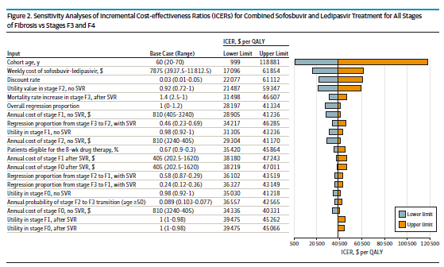
Sensitivity Analysis – an example
One-way, tornado
Notes:
This is a ”tornado graph” – because it looks a little like a tornado. It’s for the HCV CEA. It shows sensitivity of the ICER to a long list of individual input values. The most influential input is the age cohort being modeled, because older populations have less aggregate future risk of getting sick from HCV, all else being equal. The second most influential input is price. And so on.

Slide 38
Critiquing Published CEAs
Six “tires to kick” before buying:
  What is the comparison of options? Is it appropriate & complete?
  Perspective: Whose costs and benefits?
  Analytic approach explicit and reasonable?
  Appropriate use of data on health outcomes, intervention effects, costs? Any gaps or bias?
  Comparison increments appropriate?
  Uncertainties: Fully explored?
Notes:
Most of you will never do a CEA. But you’ll read them. So we want you to be educated consumers. Here are some key issues to assess:
Are relevant options (e.g., treatments) included? Are any important ones omitted?
Note the perspective. Is societal included? Are key decision-makers portrayed?
Is the analytic approach described and appropriate?
Credible use of data – complete and unbiased use of the evidence?
Are the increments right? No skipping of viable options!
Confront the uncertainties – are sensitivity analysis satisfactory?

Slide 39
Potential uses of CEAs
Policy – More $$ on screening for diabetes prevention?
Programs – Does screening for gestational diabetes make sense?
Clinical – Which screening test is best?

Slide 40
Consider Possible Implications
Who will read the analysis? (Factor in journal choice)
How might the CEA change policy?
Notes:
Who will read the analysis? How relevant will they deem it. How might it change policy, e.g., influencing resource allocation

Slide 41
Overview of Specific Steps

Slide 42
Steps in Conducting a CEA
1. Define the analysis.
2. Determine input values.
3. Conduct the analysis.
4. Publish the results.
Notes:
There are multiple descriptions on how to do a CEA. These four steps are an introduction to CEA.

Slide 43
Step 1: Define the Analysis
What is the intervention?
  Activity
  Target population
What is the comparator?
  Status quo (no intervention)
  Same intervention but different target group?
  Same intervention but more (less) intensive?
  From targeted to universal
Formulation must be incremental:
Isolate the additional activity, its costs and consequences
Notes:
the importance of problem definition. Beware of definitions that have a solution already implied. The limit the range of options that can be considered.
Good definition: “People are dying of AIDS, a preventable disease”
Bad definition: “People are engaging in unprotected sex”
It is important to frame the analysis before undertaking an economic evaluation such as a CEA. The first step in defining the analysis is o specify the policy situation. In Indonesia, we are addressing a situation where the government and civil society are addressing HIV.
We can start out by asking the question we want to analyze: what are the most cost-effective prevention interventions for mitigating HIV in Indonesia?
Specifying the study question also helps to define other parts of the analysis such as the options, perspective and outcome measures.

Slide 44
Define the Analytic Comparisons
Possible CEA Comparisons:
  SW peer education vs. no intervention.
  Annual screening versus biannual screening
  STD treatment vs. VCT.
  Itinerant market women vs. college students
Notes:
Once the study question has been determined, it is important that the comparisons for the analysis be defined. In many cases, an HIV intervention will be compared to no intervention. Alternatives include comparisons between two interventions or between two or more target populations.

Slide 45
Define the Analysis—Perspective
Possible CEA Perspectives:
  Society
  Public sector health care payer
  Provider
  Individual
In general broader analysis is better, but sometimes useful to look at effect on narrower groups too
Notes:
The perspective of the analysis relates to the question “who is responsible for the costs and consequences of the programs being evaluated”. For example, analysts may be interested in examining the perspective of the donor(such as USAID or the national government) who pays for the intervention. Other perspectives that might be examined include the entire society and the individual
The choice of perspective helps determine the types of costs that are captured. For example, a donor may incur the costs of the intervention, but not the costs of treating opportunistic infections resulting from HIV.
Source: HIV/AIDS Prevention and Care in Resource Constrained Settings. Family Health International.

Slide 46
Step 2: Determine Input Values
Health values:
  Chance node probabilities
  Utilities
Costs:
  For programs
  For medical care
Notes:
Sophisticated input data make CEA meaningful. There are two kinds of inputs: health values (chance node probabilities, utilities), and costs (for programs and medical care). Obtaining them requires broad searches, systematic review and synthesis, and sometimes new data collection.

Slide 47
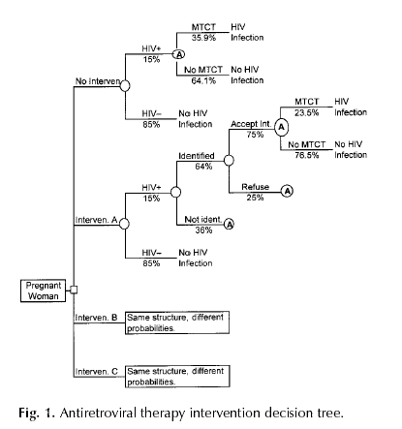
Notes:
A decision tree involves translating the defined analysis into operational tools. The major task is creating the decision tree that portrays the consequences of each option.

Slide 48
Step 3: Conduct the Analysis
How are calculations done?
  By hand
  Spreadsheets
  Decision analysis packages
Notes:
This is using decision tree software and inputs to determine the health outcomes for each option, and also the cost outcomes: cost and cost effectiveness measures. Doing the base case analysis is the first step. Extensive sensitivity analyses help debug the software and show how uncertainty in inputs affects results.
The more practical approach involves relying on one of two types of computer programs such as spreadsheets like Excel or which is very flexible or decision analysis packages such as SMLTREE or DATA which are designed to perform most common decision analytic tasks, but they are less flexible.

Slide 49
Step 4: Publish the Results
Problem:
  People can use CEAs to argue anything.
Solution:
  Make methods and underlying inputs and parameters explicit.
Notes:
Reading and Using Cost-Effectiveness Analyses
The results of CEAs are driven mainly by the assumptions that underlie them, such as intervention effectiveness or baseline HIV incidence. A jaundiced extension of this truism is that one can therefore use CEAs to argue anything. The best protection against the manipulation of CEAs is complete and clear presentation.

Slide 50
Why do cost-effectiveness analysis?
  Resource allocation is a reality:
  among social goods, within health care
  $ for one intervention decreases $ for another – via budgets
  We don’t like to spend huge $ on health care that hardly works
  Use health care $ to do most good: CEA is a measure of efficiency
  efficient allocation saves lives, improves health

Slide 51
How can CEAs make a positive difference?
  Huge concerns with rising health care costs in U.S.
  Renewed attention to international health, e.g., AIDS, TB, malaria
  Funding decisions: which programs should get funded?
  Cost-effectiveness = one consideration

Slide 52
How can CEAs make a positive difference?
~ $3.5 Trillion
2017 data: Petersen KFF https://www.healthsystemtracker.org/dashboard/#spending

Slide 53
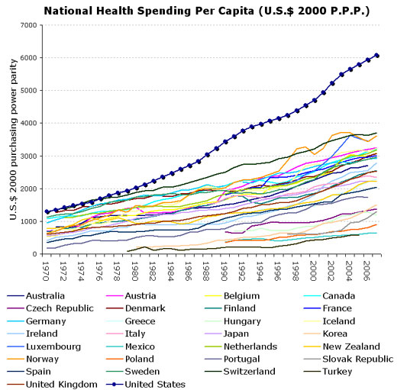

Slide 54
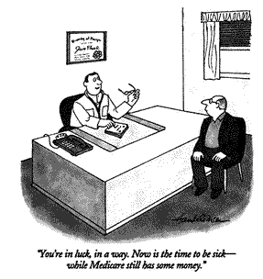

Slide 55
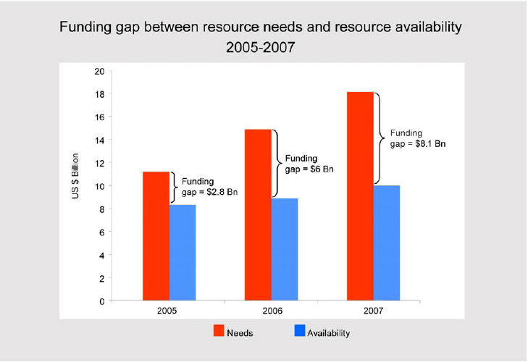

Financing HIV care in developing countries

Slide 56
Medical interventions need to be judged by the value they provide

Slide 57



Slide 58
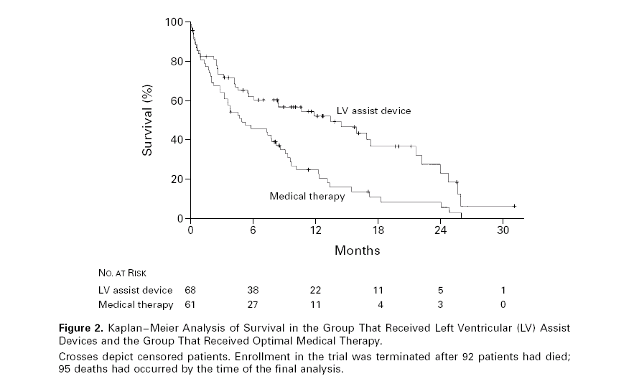

Slide 60
Selected CEA results from the literature
Intervention Cost / yr of life saved
Lovastatin for high cholesterol,
men with CHD 50 y.o. (savings)*
Varicella vaccination (societal perspective) (savings)
Needle exchange, IDUs $ 300
HIV counseling and testing, IDUs,
U.S. northeast $ 1,000
Brief quit smoking counseling $ 2,000
Varicella vaccination (payer perspective) $ 2,500
Beta blockers for MI $ 2,700
F/u visit for quit smoking $ 5,000

Slide 61
Selected CEA results from the literature (cont’d)
Intervention Cost / yr of life saved
Neonatal intensive care (1,000 – 1,499 gm) $ 5,500
Nicotine gum $ 4,100
Drug treatment of HTN (moderate disease) $ 6,250
Drug treatment of HTN (mild disease) $ 13,500
Neonatal intensive care (500 – 999 gm) $ 38,800
t-PA (versus Streptokinase) for AMI, overall $ 32,700
Cholestyramine for cholesterol >265, men 48 y.o.$160,000
t-PA (versus Streptokinase) for inferior
wall AMI, ≤40 y.o. $ 203,100
Lovastatin for high cholesterol,
low-risk men 30 y.o. $ 1 million

Slide 62
Cost-effective medicine vs evidence-based medicine
EBM only tells you whether something works, not whether we should pay for it.
  LVAD example
  Many other similar examples
Evidence of effectiveness ≠ Evidence of value

Slide 63
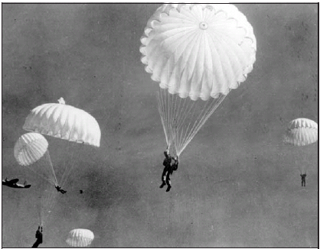
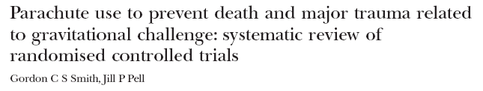

Cost-effective medicine vs evidence-based medicine
Evidence barrier in EBM can be unrealistically high.
Objectives To determine whether parachutes are effective in preventing major trauma related to gravitational challenge.
Design Systematic review of randomised controlled trials.
Data sources: Medline,Web of Science, Embase, and the Cochrane Library databases; appropriate internet sites and citation lists.
Study selection: Studies showing the effects of using a parachute during free fall.
Main outcome measure Death or major trauma, defined as an injury severity score > 15.
Results We were unable to identify any randomised controlled trials of parachute intervention.
Conclusions As with many interventions intended to prevent ill health, the effectiveness of parachutes has not been subjected to rigorous evaluation by using randomised controlled trials. Advocates of evidence based medicine have criticised the adoption of interventions evaluated by using only observational data. We think that everyone might benefit if the most radical protagonists of evidence based medicine organised and participated in a double blind, randomised, placebo controlled, crossover trial of the parachute.

Slide 64
Potential Uses of CEAs
Improve resource allocation
Improve resource allocation
Improve resource allocation

Slide 65
CEA abuse …
  Defend policies deemed unacceptable for other reasons (depriving of rights, unfair, cruel, etc)
  Methods correct but interpretation skewed
  Methods incorrect or strategies not considered

Slide 66
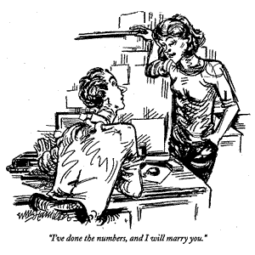
CEA can seem an odd input …

