Slide 1
Is MDMA-assisted therapy for severe, chronic PTSD, cost-effective?
If so, what is the incremental cost effectiveness of the 3-session phase three regimen versus the 2-session phase two regimen?

Slide 2
Intensive therapeutic regimen.
Three 90- minute orientation sessions
Three 8-hour active MDMA sessions
Nine 90-monurte integration sessions, 3 after each MDMA session
All sessions with two highly-trained therapists

Slide 3
What’s the difference between
“Cost-saving” and “Cost-effective”?
Cost-saving = For relevant payers, reduced future medical costs exceed intervention cost.
Cost-effective = Good value for $$$ relative to other feasible options.
If it’s cost-saving, it’s cost-effective.
Not everything that’s cost-effective is cost-saving.

Slide 4
Returning to the first question:
Is MDMA-assisted therapy for severe, chronic PTSD, cost-effective?

Slide 5
With that as background, the answer to our first question is . . .
“YES”
MDMA-assisted therapy (MDMA-AT) provided to the types of patients served in the pooled analysis of 6 MAPS P2 and first P3 trial appears to be cost-saving – thus, highly cost-effective.
Third-party payers are likely to save $ by including MDMA-AT as a benefit.
These conclusions hold across a wide range of plausible assumptions.
The next section describes the analysis that
supports this conclusion

Slide 6
Previous phase 2 cost-effectiveness study.
Now updated with results from phase 3 trial.

Slide 7
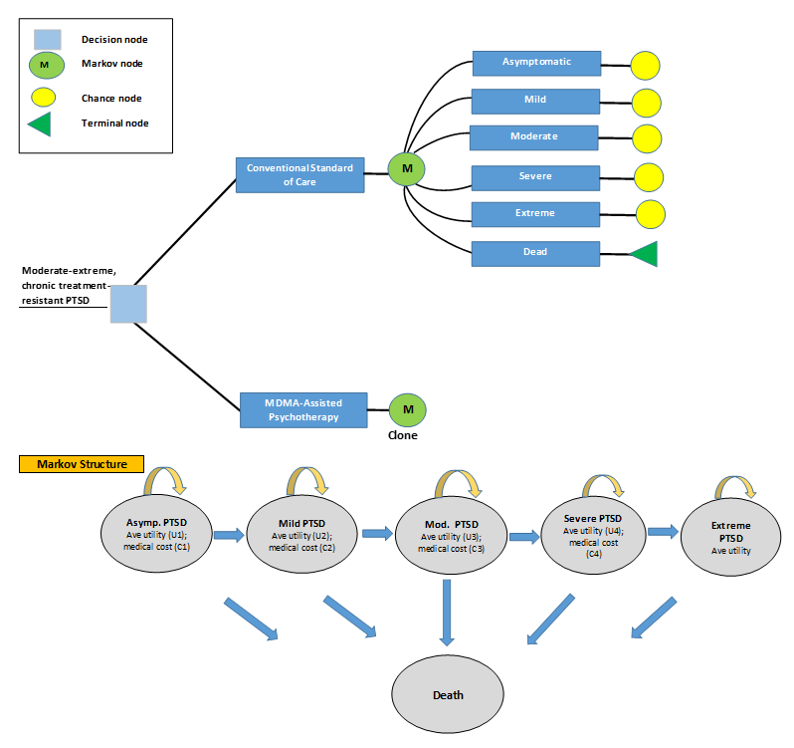
Notes:
Markov disease-state transition model.
Patients partitioned into 5 standard severity categories by CAPS score.
Costs and health states accounted for as pts progress to more severe disease states.
No further remission after trial.
Cohort of 1000 patients.
Mortality = Background age-specific mortality x RR of death associated with each PTSD severity level.
Savings in medical care costs phased in over 5 years.
Allows for variation in analytic horizon.
Implemented in Excel and @RISK software for sensitivity analysis.

Slide 8
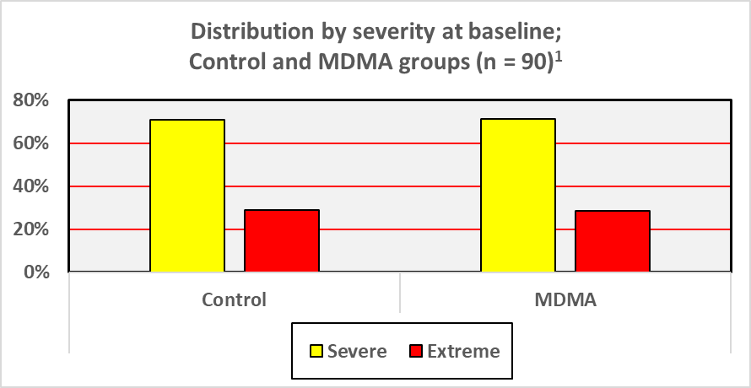
Patient characteristics
PTSD diagnosis for ~14 years.
Failed 2+ conventional therapies.
Severe or extreme PTSD.
Females: 59%.
Mean age: 41 years.
Largely white and well-educated.
1. Underlying data , Mitchell et al, 2021.
Notes:
DROP?

Slide 9
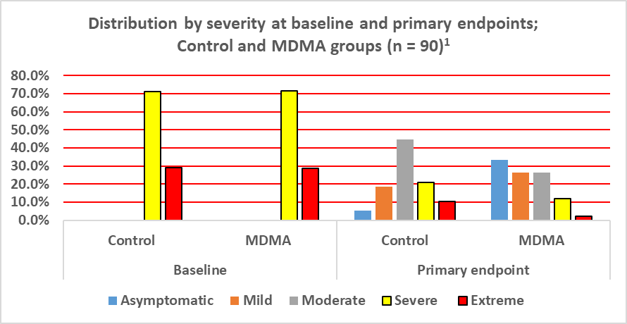
Portraying MDMA-AT effectiveness
1. Underlying data, Mitchell et al, 2021.
Notes:
DROP?

Slide 10
Key Inputs
Do traditional health economic measures under-estimate the benefits of psychedelic therapies?
85.2% of this is personnel costs

Slide 11
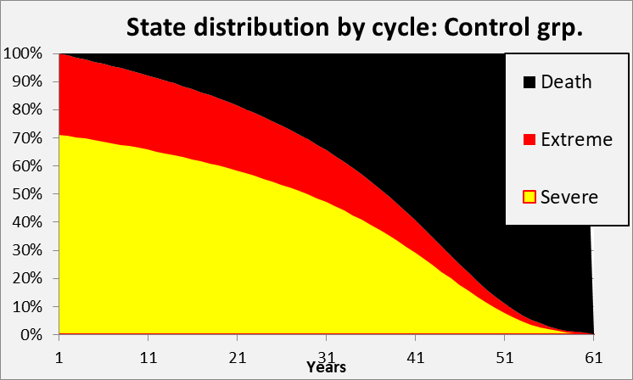
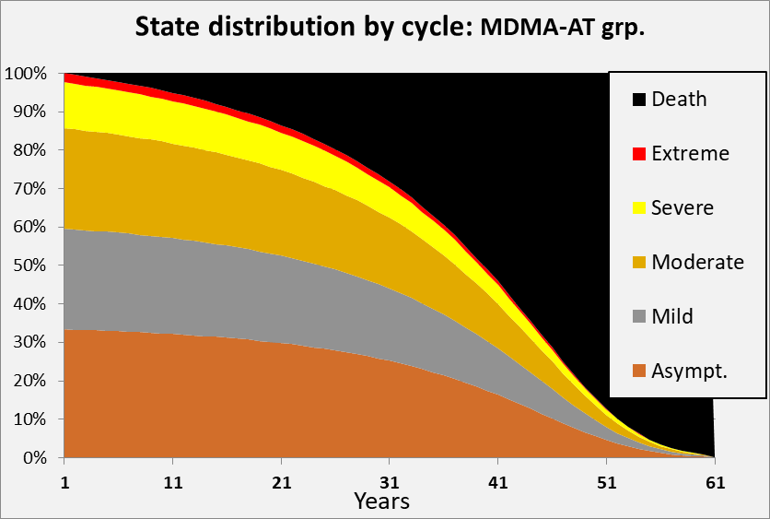
Life-time health-state trajectory:
Control vs MDMA-AT groups
Notes:
Portrays severity levels over time given initial distribution shown in earlier slide.

Slide 12
Cost and cost-effectiveness outcomes (1000 pts)
‘Break-even’ is at ~ 3.8 years.
At that point net cost = 0, while delivering about ~900 QALYs* and averting 10.8 deaths.
* Widely-used, synthetic measure of health benefit; combines
morbidity and mortality effects
Rough threshold for cost-effectiveness in USA = $100K - $150K per QALY

Slide 13
Is the extra cost of the additional MDMA session of the phase 3 regimen justified by the increased efficacy?

Slide 14
Sensitivity analysis – one-ways
Net discounted cost per 1,000 patients projected over 30 years

Slide 15
Sensitivity analysis – Multi-way, (Monte Carlo)
Net discounted cost per 1,000 patients projected over 30 years

Slide 16
Favorable economic findings are “robust”
Cost-effective or cost saving even if:
No savings in medical care costs:
ICER = $2,376 / QALY
Short duration of benefit
At 12 months ICER = $47,554 / QALY
MDMA patients but not control group progress to more severe PTSD
Net savings of $69.8 million
5X higher MDMA-AT costs
Net savings of $86.8 million

Slide 17
Putting these findings in context
From payers’ perspective: MDMA-AT is cost- saving for patients with clinical profiles like those in the MAPS trials.
From a societal perspective: Even more favorable, since many benefits are excluded from current analysis.
These results help make the case:
Accelerated access to MDMA-AT makes sense –
in both human and economic terms.

Slide 18


