Slide 1

Decision and cost-effectiveness analysis
Understanding sensitivity analysis
Epi - 213
Elliot Marseille, DrPH., MPP
  February 17, 2022

Slide 2
Objectives
To understand the purpose of sensitivity analyses.
To become familiar with several types of sensitivity analyses
  Strengths and weaknesses of each.
  Examples of appropriate application of each.

Slide 3
Why do Sensitivity Analyses?
    All CEAs have substantial uncertainty.
    Sensitivity analyses deal with uncertainty systematically.
    Convince audience that results are robust.
    Bonus: Good for de-bugging your model
Notes:
Uncertainty is a major consideration in cost-effectiveness (and decision) analyses. Data input values are rarely all known with high precision and certainty. Yet different input values can lead to substantially different results. Thus, the CEA is far more compelling if it includes thorough and thoughtful sensitivity analyses – documentation of how results vary according to the input values. Sensitivity analyses demonstrate that the analyst is aware of the uncertainties and their implications. Substantively, they show how results hinge on the value of certain inputs – or how key uncertainties, however disquieting initially, actually do not affect the findings in important ways. Sensitivity analysis, because of its importance in decision-assessing tools, is mandatory in a CEA. As a bonus, sensitivity analyses are an excellent quality control tool for model debugging.
In this lecture, we explore sensitivity analyses in detail, with the following topics:
1. Types of uncertainty
2. Deterministic sensitivity analyses (one-way, multi-way, scenario)
3. Probabilistic sensitivity analysis (Monte Carlo)
4. Uses of sensitivity analysis

Slide 4
Four Topics
Types of uncertainty.
Deterministic sensitivity analyses.
  One-way, multi-way, scenario.
Probabilistic sensitivity analyses.
  Monte Carlo simulations.
Uses of sensitivity analyses.
Notes:
In this lecture, we explore sensitivity analyses in detail, with the following topics:
1. Types of uncertainty
2. Deterministic sensitivity analyses (one-way, multi-way, scenario)
3. Probabilistic sensitivity analysis (Monte Carlo)
4. Uses of sensitivity analysis

Slide 5
Types of Uncertainty
Truth uncertainty:
  What are the correct input values?
Trait uncertainty:
  What if population characteristics or other circumstances change?
Methodological uncertainty:
  What if the analysis were done differently?
Notes:
Truth uncertainty – Easiest to understand. data not perfect. Measurement errors.
Trait uncertainty – Is it valid to generalize study findings to pts in an earlier stage of the disease, to Caucasians; to men?
Methodological uncertainty– What if you use a Markov model instead of a static decision tree? PPP-adjusted dollars instead of market exchange rates? Age-weighted DALYs? Different method for estimating health-state utilities?

Slide 6
Deterministic Sensitivity Analyses
One-way (univariate): Vary one input at a time.
Multi-way (multivariate): Vary 2+ inputs at a time.
Scenario analysis: Tests set of relevant conditions.
Threshold analysis (one-way or multi-way): Input values beyond which cost-effectiveness is achieved (or lost).
Notes:
Scenario: Country (Prevalence and wealth); Expanding versus steady-state epidemic. Larger vs smaller scale implementation.

Slide 7
One-way Sensitivity Analysis
Base case est. of annual rupture risk = 0.0005

Slide 8
Univariate Sensitivity Analyses: Base case and range of outcomes, 1,000 FC users (Marseille et al, 2001)

Slide 9
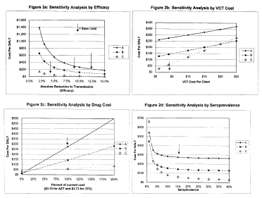
CE of ARVs for prevention of mother-to-child HIV transmission: PETRA Trials in Tanzania, Uganda, S. Africa
(Marseille et al, AIDS, 1998)
Notes:
The three antiviral regimens assessed here by UNAIDS-sponsored clinical trials in sub-Saharan Africa: Arm A consists of prepartum therapy starting during week 36 of gestation (an average of twenty days before delivery); intrapartum treatment; and one week of maternal and infant postpartum treatment. Arm B is the same as Arm A but omitting the prepartum regimen. Arm C consists of the intrapartum treatment only.

Slide 10
  Automating one-way SAs - Spider Graph:
  Male circumcision for HIV prevention in South Africa
  (Kahn at al, PlosMedicine 2006)

Slide 11
  Automating one-way SAs - Tornado Graph:
  Gestational Diabetes Screening – India
  (Marseille at al, J Matern Fetal Neonatal Med, 2013)

Slide 12
Two-way Sensitivity Analysis
Kahn, JAIDS, 2001
Notes:
Intervention with young gay men: steady HIV prevalence versus rising prevalence.

Slide 13
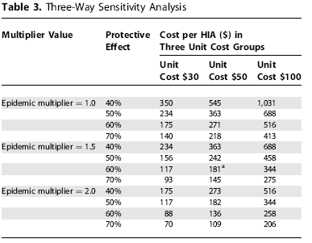
Three-way Sensitivity Analysis Adult male circumcision
(Kahn at al, PlosMedicine 2006)

Slide 14
HIVNET 012 Trial - Threshold Analysis: NVP for Prevention of Vertical Transmission of HIV in Uganda
Input values needed for $50/DALY
(Marseille et al Lancet, 1999)
 | 15% HIV prevalence | 30% HIV prevalence
Regimen efficacy (47%) | 18.0% | 10.6%
VCT cost ($7.30) | $18.50 | $36.00
HIV transmission (25.1%) | 9.6% | 5.6%
HIV prevalence for $50/DALY | 4.5%
Notes:
Threshold analysis: Explain what it is.
Rhetorical Strategy

Slide 15
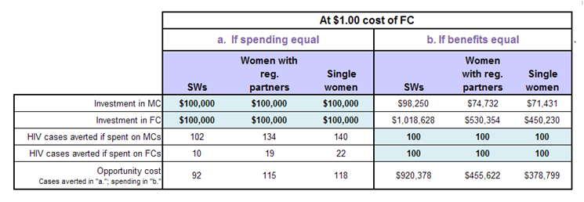
Using scenario analysis to quantify effect of unknown parameter
(Marseille, at al BMGF White Paper, 2009)

Slide 16
Strengths of each type of deterministic SA
1 ways: Simplicity; draws attention to key parameters
2 and 3-ways: Information dense; portrays many possibilities.
Scenario analysis: Ensures that real-world combinations are considered.
Break-even: Provides insight even when definitive data are unavailable.

Slide 17
Probabilistic Sensitivity Analysis
What is it?
What is it good for?
Notes:
That completes overview of deterministic SAs.
We turn now to probabilistic SA.
My goal in the next few minutes is to give you a good understanding of what it is; and to convince you that it can be useful in some circumstances

Slide 18
The Problem with Deterministic SAs
No estimate of the probability of achieving
a particular outcome.
Probabilistic SAs are the remedy.
Notes:
Problem with deterministic SA: While you can create any possible combination of inputs and corresponding outputs, it doesn’t tell you how probable it is that this outcome will actually occur

Slide 19
Probabilistic Sensitivity Analysis
Operational definition:
  Outputs are calculated based on random assignment of values to inputs drawn from user-selected probability distribution.
Examples:
  Monte Carlo, Latin Hypercube
  Software: @Risk®; Crystal Ball® TreeAge ®

Slide 20
Probabilistic Sensitivity Analyses
Value:
  Return the likelihood of attaining a particular outcome or outcome range.
  Everything known about each input is expressed at once.
  Particularly valuable when many inputs are important.
Drawbacks:
  Need to be able to make decent estimates of the underlying probability distribution.
  “Black box”

Slide 21
Running the GDModel:
– general inputs (Marseille, Kahn et al 2012)

Slide 22
Running the GDModel:
– country specific inputs

Slide 23
Running the GDModel:
– site specific inputs

Slide 24
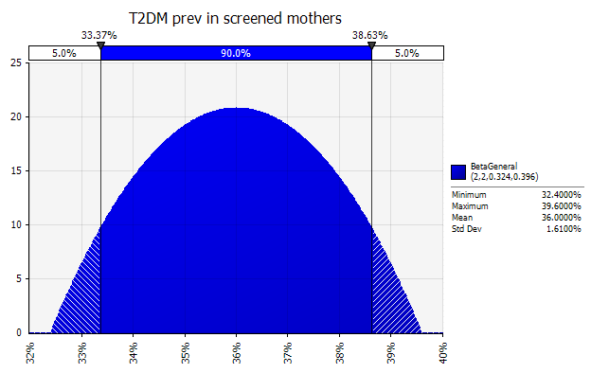
Assigning distributions - Beta

Slide 25
Assigning distributions - Lognormal

Slide 26
Assigning distributions - Uniform

Slide 27
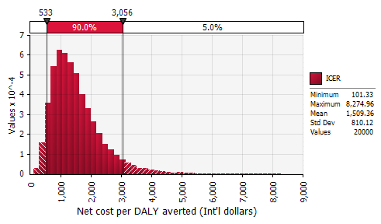
CE of screening and treatment of gestational diabetes, India
(Marseille, Kahn et al 2012)

Slide 28
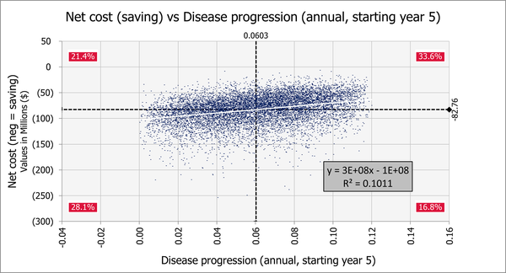
Fig 4. One-way sensitivity analysis of disease progression on net cost (savings) for 10,000 iterations of a Monte Carlo simulation.
Marseille E, Kahn JG, Yazar-Klosinski B, Doblin R (2020) The cost-effectiveness of MDMA-assisted psychotherapy for the treatment of chronic, treatment-resistant PTSD. PLOS ONE 15(10): e0239997. https://doi.org/10.1371/journal.pone.0239997
https://journals.plos.org/plosone/article?id=10.1371/journal.pone.0239997

Slide 29
Other Uses of SA:
(The Inner Teachings)
Planning the analysis.
Debugging the model.
Documenting relationships between inputs and outputs.
Identifying thresholds.
Influencing policy.
Notes:
Managing uncertainty is most widely understood use of SAs – yet there are other purposes that don’t directly have to do with managing uncertainty which are just as important.

Slide 30
Planning the Analysis
Cost-effective allocation of your limited analytic resources:
Identify candidates for more data
collection early.

Slide 31
Debugging the Model
Tricks of the Trade
One-ways are best: simple and intuitive.
Plug in extreme values.
Separate diagnosis of numerator from denominator.
Break outputs down further if necessary
(intervention versus control arms).
Notes:
Identify errors in the formulas that link inputs to outcomes.

Slide 32
Documenting Relationships Between Inputs and Outputs
Distinguish between ‘bugs’ and insights.
Examples of insights:
Slowing disease progression can increase costs.
Benefits decrease with age of patients.
Higher disease prevalence can mean lower benefits.
Notes:
SHOW NEXT SLIDE AS EXAMPLE OF EFFECT OF INCREASED PREVALENCE.

Slide 33
  Unexpected Dynamic
  Uncovered by SA
Notes:
In HIV prevention research it is intuitively obvious that the higher the population prevalence the greater the benefit that will be conferred by behavioral intervention.
But our model behaved strangely. As we entered extreme values for prevalence we noticed that there a point beyond which, not only did we encounter decreasing marginal benefits, but an absolute decline as well
This one-way SA examines the change in HIV infections averted when varying the HIV prevalence in CSWs (base case 50%). The ratio of client: SW HIV prevalence is maintained at 0.67. The graph shows a relatively unusual concave downward shape. The effectiveness is highest at 60%. Low HIV prevalence leads to lower effectiveness because CSWs and their clients have little HIV to transmit. High HIV prevalence, perhaps surprisingly, also leads to lower effectiveness. This is because with few HIV-negative “susceptibles”; most sex is between HIV+ individuals, where of course condoms confer no protection against new infection.
.

Slide 34
Identify Thresholds –
Influence Policy
Hard-to-quantify potential benefits of FC
Preventing HIV vertical transmission in
sub-Saharan Africa
  Cost of ARVs to prevent vertical transmission.
  Universal versus targeted provision of NVP.
Notes:
Hope we’ve answered the what is it and the why bother questions.
Yet other uses of SAs

Slide 35
NVP regimen as function of HIV seroprevalence and type of counseling/testing regimen
(Marseille et al, Lancet, 1999)

Slide 36
Summary
SA is a set of techniques for the explicit management of uncertainty.
Essential part of establishing key findings.
Indispensable for convincing an audience that results are technically sound and policy-relevant.

