Slide 1

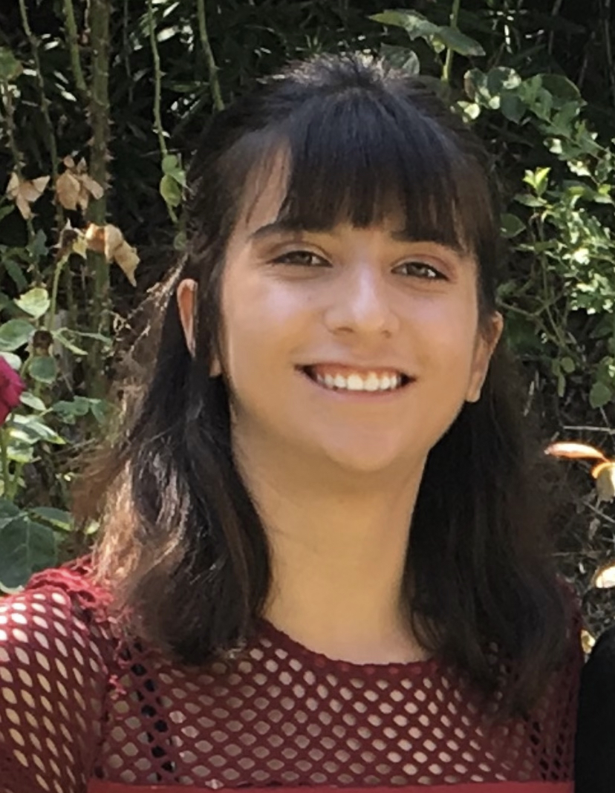
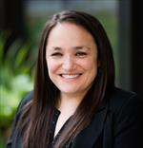
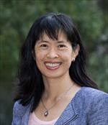
Welcome to EPI 207!
While we wait for class to start….
Go here: https://PollEv.com/jmlchan510
Answer 2 brief questions as ice breaker
  Your name will not be shown
Teaching Assistants
Carolyn Smith Hughes, MS, PhD candidate
Sarah Goldberg, BA, MAS candidate
Course Directors
June Chan, ScD, Prof. & Vice Chair (Education), Epid/Biostat & Urology
Rebecca Graff, ScD, Asst. Prof., Epid/Biostat

Slide 2
Epidemiology 207 - Epidemiology Methods II
June M. Chan, ScD
Professor & Vice Chair, Epidemiology & Biostatistics
Steven & Christine Burd-Safeway Distinguished Professor & Assoc. Chair, Clinical Research, Urology
Rebecca Graff, ScD
Assistant Professor, Epidemiology & Biostatistics
This work is licensed under a Creative Commons Attribution-NonCommercial-NoDerivatives 4.0 International License.

Slide 3
DISCLOSURES
June M. Chan
  Individual: Research collaborations with GenomeDx/Veracyte
  Urology Dept: Research collaborations with Genomic Health Inc., Genome Dx, & Myriad Genetics
  Husband: full time employee for Adela, Inc.
Rebecca Graff
  None

Slide 4
Expectations & Ground Rules

Slide 5
Zoom Etiquette – Brief Reminders
Make sure your name in the participant list is identifiable
Video sharing is encouraged
Turn off alerts and minimize other distractions
Mute yourself when you aren’t speaking
Use the reactions and chat functions freely

Slide 6
The classroom is a safe space for learning… and making mistakes… so engage!
Notes:
Be respectful of each other
Don’t be afraid to ask questions
Team work is important – how are we a “team” here?...
this is a classroom, not a competition
For all of us, when you come to this classroom, please consider this a “safe environment”, to learn, to listen to others, and be supportive, fine to disagree, learn to do it respectfully – teamwork is important.
The Course – 5th year teaching this class. There have been a lot of revisions over time. I'm a believer in "life long learning" - I’m a learner too… I may make mistakes… and when I do, my job is to learn from these mistakes. In that spirit, Dr. Graff and I welcome constructive feedback on the course.
If you have any concerns during the course, please come talk to Dr. Graff or myself.

Slide 7
Expectations Summary
Team Learning & Professionalism
Safe Space
Watch the “Welcome and Overview to EPI 207 2022” video/slides on the CLE - course logistics, grading, etc
  Assessments
    7 HW assignments (70% of grade)
      Due Thursday by 1:00 PM starting 1/20/22 through 3/10/22
      CLE will NOT accept late assignments
      Drop lowest score
    Take-home final assigned 3/10, due 3/18 (30% of grade)
  Code of Conduct
If you have any questions, please ask or post on the CLE.
Notes:
Please be sure to watch the short video or at least review the slides that were posted before the winter break on the CLE. If you have any questions, please ask now or post on the CLE.

Slide 8
Framing Objectives of EPI 207 W22

Slide 9
Ideal Randomized Experiments
+ standardization or IPW (using a pseudo-population)
Can compute average causal effects
This is what we’d like to be able to do

Slide 10
Observational Studies
Case-Control
Cohort
Ideal Randomized Experiments
+ standardization or IPW (using a pseudo-population)
Can compute average causal effects
But we can’t always do an ideal randomized experiment… often what we have are:

Slide 11
Ideal Randomized Experiments
+ standardization or IPW (using a pseudo-population)
Conceptualize Target Trial
Observational Studies
Case-Control
Cohort
Can compute average causal effects
Minimize or eliminate Bias
Fulfill Identifiability Criteria

Slide 12
Ideal Randomized Experiments
+ standardization or IPW (using a pseudo-population)
Conceptualize Target Trial
Observational Studies
Case-Control
Cohort
Can compute average causal effects
Minimize or eliminate Bias
Fulfill Identifiability Criteria
Case-Control – Matching, stratified analyses
Cohort – Stratified analyses, alignment of T₀, E, A
Interaction / Effect Modification
Quantitative Bias Analysis - how bad is the bias?
DAGs - to identify bias

Slide 13
Closing & Reminders
We are excited for your participation in this class
Organization:
  Course is front-loaded – First homework assignment is due Jan 20.
  Please watch lecture videos assigned before class; the in-person lecture will pick up where those leave off, & often incorporate interactive examples/applications for practice
  We plan to swap the order of HW review and Lec 1/20-2/27 (Lec FIRST 1:10-2:10; HW review 2:10-3; CLE updated)
Reminder – To introduce yourselves, please go to the CLE and share brief info about yourself – name, program, research interests, 1 fun fact
Course Delivery – Remote on Jan 13.
  Please check CLE for updates; we would like to return to in-person when possible
Notes:
We’ve tried to spread out the pacing a bit more from last year to make it more manageable.

Slide 14
Thank you for your attention.
Questions?
https://PollEv.com/jmlchan510 - If you didn’t do this before class, please go to the poll everywhere site and answer the 2 short anonymous questions. We will share responses during the break.
What are you most interested in learning about in Epi 207 this year?
What are 2 words to describe how you are feeling today?

