Slide 1

Conceptual Frameworks for Causal Inference – Part I
Epidemiology 207 - Epidemiology Methods II
Rebecca E. Graff, ScD
Assistant Professor, Epidemiology & Biostatistics

Slide 2
Learning Objectives (Weeks 1 & 2)
What is Causal Inference?
Causal Models and Heuristics
  Bradford Hill Criteria
  Sufficient and Component Cause Model
  Counterfactual Model
In Depth on Counterfactuals
Ideal Randomized Experiments
Conditional Randomization

Slide 3
What is Causal Inference?

Slide 4
The “Big 6”
Description
Causation (“Causal Inference”)
Attribution
Mediation
Interaction
Prediction

Slide 5
Causal Inference
The science of establishing causal relationships among biological, behavioral, environmental, etc. factors.
  Does A cause (or prevent) Y?
  Will intervening upon A change occurrence of Y?
Goal of these lectures: how do we establish what is a true cause?

Slide 6
Causal Models and Heuristics

Slide 7
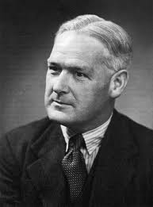
Bradford Hill Criteria
Strength
Consistency
Specificity
Temporality
Biological gradient
Plausibility
Coherence
Experiment
Analogy
For more on the Bradford Hill Criteria, see the optional lecture on the course website
Bradford Hill
(1897 – 1991)
Notes:
Strength: magnitude of the association size, wherein the criterion suggests that larger associations make causality more likely.
Consistency: consistent findings observed by different persons from different places with different samples strengthens the likelihood of an effect.
Different from the identifiability criterion
Specificity: causation is likely if a particular factor gives rise to only one outcome.
Temporality: indicates that exposure must precede disease
Biological gradient: greater exposure generally leads to greater incidence of the effect, i.e., presence of a dose-response relationship
Plausibility: a plausible mechanism between exposure and outcome
Coherence: a cause and effect interpretation for an association does not conflict with what is known of the natural history and biology of disease
Experiment: cessation of exposure should result in cessation of the outcome
Analogy: similar exposures should be associated with similar outcomes

Slide 8
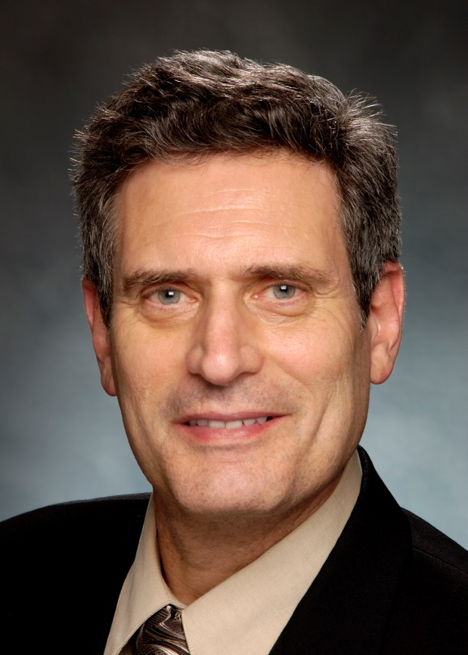
Sufficient & Component Cause Model
Sufficient cause
Component cause
  Strong component cause
Necessary cause
For more on the Sufficient & Component Cause Model, see the optional lecture on the course website
U
T
A
B
X
B
Kenneth Rothman
Notes:
A sufficient cause is a set of minimal conditions or events that inevitably result in disease
Each individual instance of disease occurs through a single sufficient cause
Each chunk of a sufficient cause is called a component cause
A component cause is any one of a set of conditions that is necessary for the completion of a sufficient cause
A strong component cause is one that plays a role in disease in a high proportion of a population
A component cause that plays a role in every instance of disease in a population, in this case B, is called a necessary component cause
It’s one that is a member of every sufficient cause
The sufficient and component cause model accepts that an effect can have more than one cause – in this case it has two – and that component causes interact to form a sufficient cause over time
So, A, B, and U can interact to result in the disease, or T, X, and B can interact to result in the disease

Slide 9
Counterfactuals
Potential outcomes occurring based on exposure received
  More than one of which is counter-to-the fact for any given individual
  Example: ever exposure to asbestos and mesothelioma
More on counterfactual theory in class!
Notes:
Ever vs. never exposure to asbestos and mesothelioma
There is an individual exposed to asbestos who developed mesothelioma. That’s one of her counterfactual outcomes (the one observed in reality)
Her other counterfactual outcome is what would have happened - whether or not she would have developed mesothelioma - if she hadn’t been exposed to asbestos.

