Slide 1

Conceptual Frameworks for Causal Inference – Part III
Epidemiology 207 - Epidemiology Methods II
Rebecca E. Graff, ScD
Assistant Professor, Epidemiology & Biostatistics

Slide 2
Learning Objectives (Weeks 1 & 2)
What is Causal Inference?
Causal Models and Heuristics
  Bradford Hill Criteria
  Sufficient and Component Cause Model
  Counterfactual Model
In Depth on Counterfactuals
Ideal Randomized Experiments
Conditional Randomization

Slide 3
Conditional Randomization

Slide 4
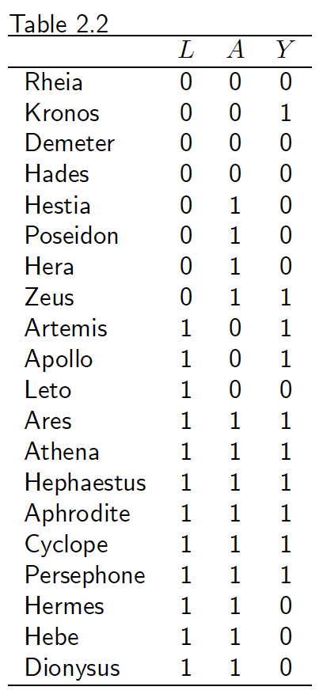
The Data
L = 1 ➔ critical condition (e.g., hospitalization in ICU)
Goal: Estimate the effect of A on Y
Two Options:
  Marginally randomized experiment exposing 65% of participants
  Conditionally randomized experiment exposing 50% of non-critical participants and 75% of critical participants
    Randomization probabilities are conditional on the value of L
Notes:
We know that these data can’t be from a marginally randomized experiment since exchangeability doesn’t hold
We showed that the risk of death had everyone been untreated wasn’t the same among the treated and untreated
In addition, we can now see that 9/13 of the exposed vs. 3/7 of the unexposed were in critical condition
This imbalance indicates that the risk of death in the treated, had they been untreated, would have been higher than the risk of death in the untreated
The data are consistent with conditional randomization, which is essentially two marginally randomized experiments, one in L = 1 and one in L = 0
Exchangeability is then conditional on L

Slide 5

Conditional Exchangeability
Alternative Identifiability Condition #2
Within levels of L, exposed subjects would have had the same risk as unexposed subjects had they been unexposed, and vice versa
Counterfactual risk is the same in the exposed and the unexposed with the same value of L
Pr(Yª = 1 | A = 1, L = l) = Pr(Yª = 1 | A = 0, L = l)
or, equivalently:
A Yª | L = l
Notes:
Same definition as marginal exchangeability, except that we only have the exchangeability within levels of L
Conditional exchangeability is expected if randomization takes place within levels of L
Generally implies no confounding within levels of L
When we think about whether an observational study mimics an ideal randomized experiment, we’re much more likely to consider conditional exchangeability than marginal exchangeability as one of our three identifiability criteria; we would ask ourselves the question whether exchangeability hold within levels of covariables for which we can adjust
Very rarely would we expect for there to be no confounding variables at all
But even if conditional rather than marginal exchangeability holds in addition to the other identifiability criteria, then we still can estimate causal effects from our observational data

Slide 6
Computing the Average Causal Effect
E.g., Pr(Y^{a=1} = 1)
  Compute the conditional risk in each stratum
    Pr(Y^{a=1} = 1 | L = 0) = Pr(Y = 1 | A = 1, L = 0)
    Pr(Y^{a=1} = 1 | L = 1) = Pr(Y = 1 | A = 1, L = 1)
  Compute the weighted average of the conditional risks
    Pr(Y^{a=1} = 1) = Pr(Y = 1 | A = 1, L = 0)*Pr(L = 0) +
    Pr(Y = 1 | A = 1, L = 1)*Pr(L = 1)
Standardization!
Notes:
Standardization reviewed:
Compute a frequency measure in each stratum of L in the study population
Compute the proportion of subjects in each stratum of L in the standard population
The standardized measure the weighted average of the stratum-specific measures of population 1 using the stratum-specific proportions of population 2
It’s the equivalent of simulating what would happen in the study population if everybody had received certain exposure level a and the distribution of the covariate L were the same as its distribution in the standard population

Slide 7
In Our Data
Risk in each level of L:
  Pr(Y = 1 | A = 1, L = 1) = 6/9
  Pr(Y = 1 | A = 1, L = 0) = 1/4
Proportion of subjects in each level of L:
  Pr(L = 1) = 12/20
  Pr(L = 0) = 8/20
Standardized risk in the exposed using the study population as the standard:
  Pr(Y = 1 | A = 1, L = 1)*Pr(L = 1)
  Pr(Y = 1 | A = 1, L = 0)*Pr(L = 0) +
  (6/9)*(12/20) + (1/4)*(8/20) = 0.5

