Slide 1

Directed Acyclic Graphs – Part I
Epidemiology 207 - Epidemiology Methods II
Rebecca E. Graff, ScD
Assistant Professor, Department of Epidemiology & Biostatistics
Based on Slides from Maria Glymour and Miguel Hernán

Slide 2
Learning Objectives (Weeks 2 & 3)
Overview of DAGs
Research Design Interlude
DAGs for Common Problems in Epidemiology
  Confounding
  Bias in RCTs
  Selection Bias
  Measurement Bias
Limitations of DAGs
2

Slide 3
Overview of DAGs

Slide 4
Why Causal Diagrams?
Conceptualize research questions
Show your assumptions about relationships among variables
Identify and classify sources of bias
Identify issues in study design and analysis
4
Notes:
DAGs help to conceptualize research questions. They offer a framework for summarizing your knowledge and assumptions about the problem you’re trying to solve
Because causal inference generally requires expert knowledge and untestable assumptions about relationships among exposure, outcome, and other variables, DAGs are important for making choices explicit.
They also help to identify and classify sources of bias that could affect your ability to validly answer your research question.
When you represent your study design and analysis in a DAG, you might see issues that you hadn’t otherwise identified

Slide 5
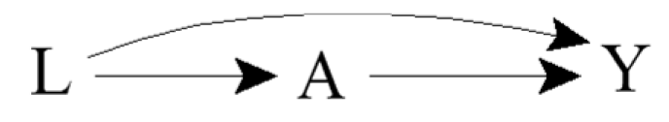
Terminology
Directed: Edges imply a direction
Acyclic: No cycles; a variable cannot cause itself
Edge: Arrow
Node: Random variable
Causal DAG: Common causes of any pair of variables are also in the graph
5
Notes:
Directed refers to the edges, or arrows, having an implied direction
For example, the arrow from L is into A, meaning that L may cause A, but not the other way around
Acyclic refers to the lack of cycles. A variable cannot cause itself
The arrows are referred to as edges
The random variables in a DAG are referred to as nodes
A DAG is considered to be causal when the common causes of any pair of variables in the graph are also in the graph
Causal DAGs need not include variables that are not of interest for the analysis and that are not common causes of other variables in the DAG

Slide 6

Ideal Randomized Experiments
What does the DAG look like for a marginally randomized experiment?
What does the DAG look like for a conditionally randomized experiment?
6
Notes:
E.g., effect of aspirin on the risk of stroke?
An ideal randomized experiment is not affected by any sources of bias, so the only relevant variables are aspirin and stroke.
E.g., effect of aspirin on the risk of stroke conditional on a history of heart disease?
In a conditionally randomized ideal experiment, a history of heart disease affects the probability of randomization to aspirin as well as the probability of stroke → edges from L into A and Y

Slide 7
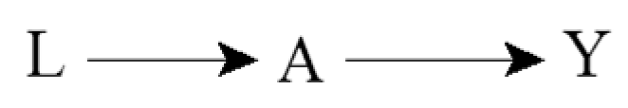
Incorporating Expert Knowledge
Complete DAGs do not exclude any possible causal effect
Incomplete DAGs encode expert knowledge in the form of missing arrows
7
Notes:
When incorporating expert knowledge into DAGs, the information is in the missing arrows.
What is termed a complete DAG does not exclude any possible causal effect
E.g., conditionally randomized experiment that randomized aspirin according to a history of heart disease
What is termed an incomplete DAG, which is to say a DAG that doesn’t have all possible arrows, encodes expert knowledge in the form of missing arrows.
This second DAG, for example, encodes the knowledge that the variable L does not affect the variable Y
E.g., conditionally randomized experiment that randomized according to day of the week? Then day of the week would affect exposure, but we would encode our expert knowledge that day of the week doesn’t affect stroke risk by omitting an arrow from L to Y

Slide 8
Causal Effects and Association
For example:
  A: Cigarette smoking
  Y: Lung cancer
  Pr(Y^{a=1} = 1) ≠ Pr(Y^{a=0} = 1)
  Pr(Y = 1 | A = 1) ≠ Pr(Y = 1 | A = 0)
8
Notes:
DAG that represents a true causal effect.
E.g., smoking has a harmful causal effect on the risk of lung cancer
What should the graph look like that represents an experiment in which cigarette smoking is randomly, and unconditionally, assigned?
Essentially back to our marginally randomized ideal experiment.
In general, when one knows that A has a causal effect on Y, then one should also generally expect A and Y to be associated
Consistent with the fact that in an ideal randomized experiment with unconditional exchangeability, causation implies association and vice versa

Slide 9
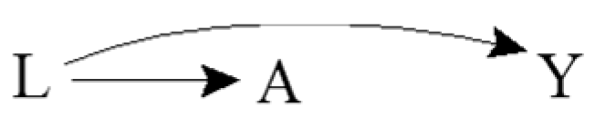
Common Causes and Association
For example:
  A: Yellow fingers
  Y: Lung cancer
  L: Cigarette smoking
  Pr(Y^{a=1} = 1) = Pr(Y^{a=0} = 1)
  Pr(Y = 1 | A = 1) ≠ Pr(Y = 1 | A = 0)
Confounding!
Results in lack of unconditional exchangeability
9
Notes:
DAG showing a common cause of two other variables.
Outcome remains lung cancer, exposure of interest is yellow fingers.
Yellow fingers has no causal effect on lung cancer, as reflected by the lacking arrow between A and Y
There is no causal effect of A and Y
Cigarette smoking, as represented by L, has a causal effect on both having yellow fingers and the risk of lung cancer. It is a common cause of A and Y.
In the observational setting
An investigator asks to see the fingers of a large number of people and records if they are diagnosed with lung cancer during the next five years.
Someone who has yellow fingers is more likely to be a smoker, and therefore is more likely to develop lung cancer.
A and Y are thus expected to be associated because the cancer risk in those with yellow fingers is different from the cancer risk in those without yellow fingers.
Having information about A improves our ability to predict Y, even though A does not cause Y
Are individuals with A = 1 exchangeable with the individuals for whom A = 0? No. There is a lack of exchangeability, and thus confounding of relationship between A and Y by L
That’s reflected in the DAG by a pathway from A to L to Y

Slide 10
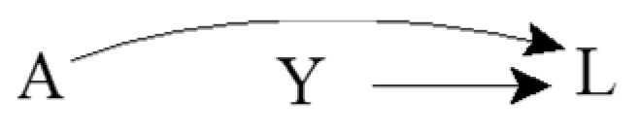
Common Effects
For example:
  A: Genetic factor
  Y: Environmental factor
  L: Lung cancer
  Pr(Y^{a=1} = 1) = Pr(Y^{a=0} = 1)
  Pr(Y = 1 | A = 1) = Pr(Y = 1 | A = 0)
Collider
10
Notes:
Common effects represented by DAGs
Assume that a genetic and environmental risk factor for lung cancer have no bearing on each other.
There is no causal effect of A on Y
The common effect L is referred to as a collider on the path A → L ← Y because the two arrowheads collide on this node
What about the associational relationship?
An investigator decides to study the effect of the genetic risk factor on the risk of the environmental risk factor. She determines whether or not each individual has the genetic risk factor and records whether the same individual has the environmental risk factor. For a person without the genetic risk factor, is the environmental risk factor more or less likely to be present than for any other individual? Learning about the genetic risk factor not improve our ability to predict the outcome Y because the risk of the environmental factor in persons with or without the genetic risk factor is the same. In other words, we would intuitively conclude that A and Y are not associated. The knowledge that both A and Y cause lung cancer is irrelevant when considering the association between A and Y.
Causal graph theory again confirms our intuition because it says that colliders, unlike other variables, block the flow of association along the path on which they lie.
Thus A and Y are independent because the only path between them is blocked by the L.

Slide 11
Conditioning on Mediators
For example:
  A: Cigarette smoking
  Y: Lung cancer
  B: DNA damage to lung cells
  Pr(Y^{a=1} = 1) ≠ Pr(Y^{a=0} = 1)
  Pr(Y = 1 | A = 1) ≠ Pr(Y = 1 | A = 0)
  Pr(Y = 1 | A = 1, B = b) = Pr(Y = 1 | A = 0, B = b)
A
B
Y
11
Notes:
Suppose the only mechanism through which smoking affects lung cancer risk is DNA damage to lung cells
The effect of A on Y runs through B
Is there a causal effect of A on Y?
All of the arrows on the path from A to Y are pointing in the same direction, so A still causes Y.
Association, unlike causation, is a symmetric relationship between two variables; thus, when present, association flows between two variables regardless of the direction of the causal arrows. In this DAG, one could equivalently say that the association flows from A to Y or from Y to A. For causation, however, the arrows must all flow in the same direction. Both A and B cause Y according to this DAG, but Y does not cause either.
Are A and Y unconditionally associated?
We know that A has an effect on Y, so that should indicate to use that there is an association between A and Y
But what if we only look at individuals who do (or do not) have DNA damage?
Represented by a box around B. We’ve conditioned on the variable B.
Is there an association between A and Y within levels of B or conditional on B? When we already have information on B, does information on A improve our ability to predict Y?
Suppose we restrict the analysis to the subset of individuals with no DNA damage (B=0), as indicated by the box placed around B.
Individuals with no DNA damage (B = 0) have a lower than average risk of lung cancer. Regardless of whether an individual with no DNA damage was treated (A = 1) or untreated (A = 0), we already know that he has a lower than average risk because he doesn’t have DNA damage.
Because smoking affects lung cancer risk only through DNA damage, learning smoking status doesn’t contribute any additional information about lung cancer risk
In the subset of individuals with low DNA damage, smoking and lung cancer are not associated, and it’s the same argument for those DNA damage.
Graphically, we say that a box placed around variable B blocks the flow of association through the path A → B → Y .

Slide 12
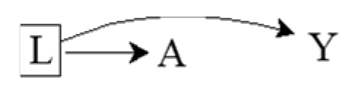
Conditioning on Common Causes
For example:
  A: Yellow fingers
  Y: Lung cancer
  L: Cigarette smoking
  Pr(Y^{a=1} = 1) = Pr(Y^{a=0} = 1)
  Pr(Y = 1 | A = 1) ≠ Pr(Y = 1 | A = 0)
  Pr(Y = 1 | A = 1, L = l) = Pr(Y = 1 | A = 0, L = l)
12
Notes:
Is A associated with Y conditional on L?
Represented by the box around L.
Suppose the investigator restricts the study to nonsmokers (L = 0).
Learning that an individual has yellow fingers (A = 1) does not help predict his risk of lung cancer (Y = 1) because the entire argument for better prediction relied on the fact that people with yellow fingers are more likely to be smokers.
This argument is irrelevant when the study is restricted to nonsmokers or, more generally, to people who smoke with a particular intensity.
Even though A and Y are marginally associated, A and Y are conditionally independent given L because the risk of lung cancer is the same in the treated and the untreated within levels of L
The flow between A and Y is interrupted because the path A ← L → Y is blocked by the box around L.

Slide 13
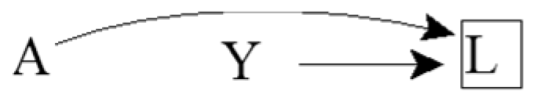
Conditioning on Common Effects
For example:
  A: Genetic risk factor
  Y: Environmental risk factor
  L: Lung cancer
  Pr(Y^{a=1} = 1) = Pr(Y^{a=0} = 1)
  Pr(Y = 1 | A = 1) = Pr(Y = 1 | A = 0)
  Pr(Y = 1 | A = 1, L = l) ≠ Pr(Y = 1 | A = 0, L = l)
Selection Bias!
Results in lack of conditional exchangeability
13
Notes:
What happens to the relationship between A and Y if we condition on their common effect L?
Suppose that the investigators, who are interested in estimating the effect of genetics on environment, restricted the study population to individuals with lung cancer (L = 1).
The square around L indicates that they are conditioning on a particular value of L.
Knowing that an individual with lung cancer does not have the genetic risk factor provides some information about the environmental risk factor because, in the absence of the genetic risk factor, it is more likely that another cause of lung cancer is present.
Among individuals with lung cancer, the proportion of individuals with the environmental risk factor is increased among individuals without the genetic risk factor.
Therefore, A and Y are inversely associated conditional on L = 1.
The investigator will make a mistake if he concludes that A has a causal effect on Y just because A and Y are associated within levels of L.
In the extreme, if the genetic and environmental factors were the only causes of lung cancer, then among individuals with lung cancer, the absence of one risk factor would perfectly predict the presence of the other.
Causal graphs theory shows that indeed conditioning on a collider like L opens the path A → L ← Y, which was blocked when the collider was not conditioned on.
Intuitively, whether two variables (the causes) are associated cannot be influenced by an event in the future (their effect), but two causes of a given effect generally become associated once we stratify on the common effect.
Premise of selection bias under the null.

Slide 14
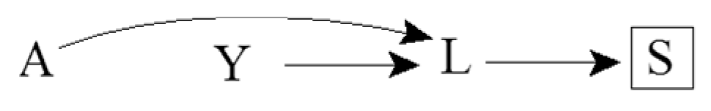
Consequences of Colliders
For example:
  A: Genetic risk factor
  Y: Environmental risk factor
  L: Lung cancer
  S: Death from lung cancer
  Pr(Y = 1 | A = 1, S = s) ≠ Pr(Y = 1 | A = 0, S = s)
14
Notes:
This causal diagram adds a consequence of the lung cancer, namely death from lung cancer.
A and Y are also associated within levels of S because S is a common effect of A and Y.
Causal graphs theory shows that conditioning on a variable S affected by a collider L also opens the path A → L ← Y
This path is blocked in the absence of conditioning on either the collider L or its consequence S.

Slide 15
Sources of Association
Statistical association between two variables A and Y may be due to:
Random fluctuation
A causing Y
Y causing A
A and Y sharing a common cause
Conditioning on a common effect of A and Y
15
Notes:
Two variables may be associated by chance, but that’s not a structural source of association
Increase the sample size and chance associations disappear, whereas structural associations will remain
We don’t address chance since we’re focusing our discussion on bias. We’re essentially assuming a very large population.

Slide 16
How we can use this
Eliminating four of these explanations is usually the goal of an analysis
Knowing these five sources of statistical association helps identify the (set of) causal structure(s) that could have generated the observed statistical associations
16

Slide 17
D-separation
Set of graphical rules to decide whether two variables are
  D-separated: independent
  D-connected: associated (in general)
If two variables are d-separated
  Without conditioning on any other variables in the DAG, then they are marginally independent
  After conditioning on a set of other variables, then they are conditionally independent
17

Slide 18
More Terminology
Ancestors / Descendants
  Parents / Children
Path: a route that connects two variables by following a sequence of edges such that the route visits no variable more than once
  A causal path consists entirely of edges with their arrows pointing in the same direction
Paths can be either blocked or open according to the following graphical rules
18
Notes:
V2 is a descendant of V1 (and V1 is an ancestor of V2) if there is a sequence of nodes connected by edges between V1 and V2 such that following the direction indicated by the arrows, one can reach V2 by starting at V1.
Parents: the set of nodes with direct arrow into the variable of interest

Slide 19
Rule 1
If there are no variables being conditioned on, a path is blocked if and only if two arrowheads on the path collide at some variable on the path
Open path
Blocked path
19

Slide 20

Rule 2
Any path that contains a noncollider that has been conditioned on is blocked
We use a box around a variable to indicate that we are conditioning on it
Blocked path
20

Slide 21

Rule 3
A collider that has been conditioned on does not block a path
Open path
21

Slide 22
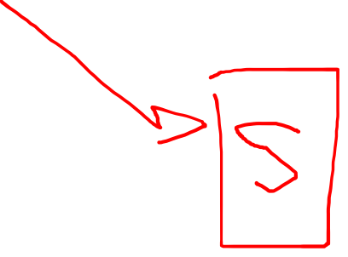
Rule 4
A collider that has a descendant (e.g., child) that has been conditioned on does not block a path
Open path
22

