Slide 1

Directed Acyclic Graphs – Part II
Epidemiology 207 - Epidemiology Methods II
Rebecca E. Graff, ScD
Assistant Professor, Department of Epidemiology & Biostatistics
Based on Slides from Maria Glymour and Miguel Hernán

Slide 2
Learning Objectives (Weeks 2 & 3)
Overview of DAGs
Research Design Interlude
DAGs for Common Problems in Epidemiology
  Confounding
  Bias in RCTs
  Selection Bias
  Measurement Bias
Limitations of DAGs
2

Slide 3
Review of DAG Intuition

Slide 4
Review of D-separation
Notes:
Note that “d” connotes “directional”

Slide 5
Questions from the Recorded Lecture?

Slide 6
Exercises

Slide 7
Causation
What causal statement represents the relationship between A and Y?
L
A
B
Y
C

Slide 8
Association I
What marginal associational statement represents the relationship between A and Y?
L
A
B
Y
C

Slide 9
Association II
What marginal associational statement represents the relationship between L and C?
L
A
B
Y
C

Slide 10
Association III
What associational statement represents the relationship between L and Y, conditional on A?
L
A
B
Y
C

Slide 11
Association IV
What associational statement represents the relationship between L and B, conditional on A?
L
A
B
Y
C

Slide 12
Research Design Interlude

Slide 13
Research Design
You are interested in estimating the effect of A on Y
Imagine the most plausible the ways the world might work
If the world worked like this or like that, would your analysis plan successfully identify the effect of A on Y?
What assumptions do you have to make to interpret your statistical association as a causal effect?
13

Slide 14
Quizlet: Can you test which DAG is correct if you have data on these variables?
X₁
X₁
X₂
X₃
X₂
X₃
X₄
X₄
X₅
X₅
If you know that one of these two causal structures generated the data, and you have perfect measures of all 5 variables, can you tell which one is correct?
14

Slide 15
Quizlet: Can you test which DAG is correct if you have data on these variables?
X₁
X₁
X₁
X₁
X₂
X₃
X₂
X₃
X₂
X₃
X₄
X₄
U
X₄
X₅
X₅
X₅
If you know that one of these three causal structures generated the data, and you have perfect measures of all 5 variables, can you tell which one is correct?
15

Slide 16
DAGs for Common Problems in Epidemiology
Confounding

Slide 17
Confounding is When…
Exposure and outcome have common causes
The exposed are not exchangeable with the unexposed
Association is not causation
All equivalent characterizations!
17

Slide 18
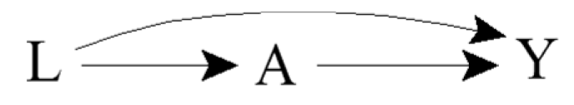
Identifiability of Causal Effects
Two components of an unconditional association between exposure and outcome:
  Effect of exposure on outcome
  Result of common causes
Can we identify the former component?
18
Notes:
A causal effect can be identified when there are no common causes or there are common causes but we have enough information to block what all are called backdoor paths
Here, the path A ← L → Y is an example of a backdoor path
A backdoor path is a path between A and Y that includes an arrow into A
To identify the former component we need expert knowledge
Statistical criteria are insufficient

Slide 19
The Backdoor Criterion
A set of variables L satisfies the backdoor criterion relative to A and Y in a DAG if:
  No variable in L is a descendant of A
  All backdoor paths between A and Y are blocked by conditioning on L
If a set of variables L satisfies the backdoor criterion, then the causal effect of A on Y is identifiable
19
Notes:
Conditional exchangeability on L holds if and only if L satisfies the backdoor criterion

Slide 20
Healthy Worker Bias
For example:
  A: Working as a firefighter
  Y: Death
  L: Physical fitness
20
Notes:
The effect of working as a firefighter A on the risk of death Y will be confounded if “being physically fit” L is a cause of both being an active firefighter and having a lower mortality risk.
Does L satisfy the backdoor criterion?
Yes

Slide 21
Exercise
How might you draw a DAG representing confounding by indication?
  A: Aspirin
  Y: Stroke
  L: Heart disease
  U: Atherosclerosis
21

Slide 22
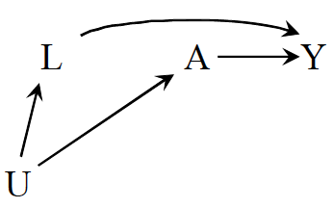
Confounding by Lifestyle
For example:
  A: Exercise
  Y: Death
  L: Cigarette smoking
  U: Personality or social factors
22
Notes:
The effect of behavior exercise on the risk of death will be confounded if the behavior is associated with another factor like cigarette smoking that has a causal effect on Y and tends to co-occur with exercise.
Does L satisfy the backdoor criterion?
Yes

Slide 23
Confounding by Early Life Factors
L₂
1
For example:
  A: Depression
  Y: Death
  L₁: Education
  L₂: Income
23
Notes:
Does education satisfy the backdoor criterion?
Yes
Does income satisfy the backdoor criterion?
Yes
One can adjust for either education or income to identify the effect of depression on mortality

Slide 24
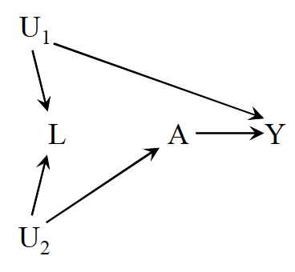
Be Careful with Adjustment!
For example:
  A: Physical activity
  Y: Cervical cancer
  L: Pap smear
  U₁: Pre-cancer lesion
  U₂: Health-conscious personality
24
Notes:
Do A and Y have any common causes in this scenario?
No!
L does not confound the effect of A on Y!
In fact, adjusting for it would open up a non-causal path between A and Y
Does L satisfy the backdoor criterion?
No!
This is our first example of a scenario in which unconditional exchangeability holds, but conditional exchangeability does not
Some people would call this selection bias since one is conditioning on a collider and others would still call it confounding since the bias results from an open backdoor path from A to Y
The definition is just a matter of preference
The conclusions are the same regarding identifiability of the causal effect

Slide 25
Is L a “confounder”?
Is L associated with A?
Is L associated with Y conditional on A?
Is L on the causal pathway from A to Y?
Yes
Yes
No
25
Notes:
L fulfills the traditional definition of a confounder, but adjusting for it would introduce bias in this case

Slide 26
Is L a “confounder”?
Is the conditional (within levels of L) association between A and Y different from the unconditional association measure?
  E.g., the adjusted odds ratio changes by >10% compared to the unadjusted odds ratio
Differences between conditional and unconditional association measures may exist in the absence of common causes when
  Using non-collapsible measures
  Conditioning on common effects
26

Slide 27
Is L a “confounder”?
Be careful with the “standard” definitions!
We need expert knowledge to determine if we should adjust for a variable
*But* if our expert knowledge reduces the number of possible causal structures, then consider the methods on the prior two slides to decide whether a variable is a confounder (Ahem, HW Q9!)
27

Slide 28
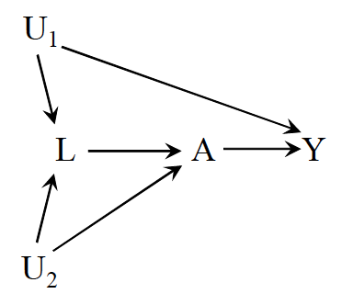
Intractable Confounding
Open backdoor path A ← L ← U₁ → Y
But what happens if we adjust for L?
  Open the path A ← U₂ → L ← U₁ → Y
28
Notes:
Does L satisfy the backdoor criterion?
No!
To deal with the bias, we’d have to find a way to measure a variable between U1 and A or Y or a variable between U2 and either A or L

Slide 29
Until Next Time…
Finish Homework #1
Get Started on Homework #2
Read Chapters 8.1-8.3 and 9.1-9.3 in Hernán & Robins
Watch “Directed Acyclic Graphs – Part III”
Office Hours: Tuesday @ 1:10pm on Zoom
Class 1/20 will be virtual

